Slide 2
Preparing for the System Center 2012 Private Cloud Certification Exams 70-246 and 70-247
Ryan Sokolowski
Sr. Program Manager
Microsoft

Slide 3
Session Objectives And Takeaways
Session Objectives
Help you successfully prepare for the System Center 2012 exams
70-246 and 70-247
Provide insight into new exam questions and formats
Key Takeaway 1
Certification exam information
Key Takeaway 2
System Center 2012 and 2012 R2 exam topics and sample questions
“Mile wide, inch high” ???

Slide 4
Microsoft Certification

Slide 5
For You
Increased confidence in your abilities at work
Enhanced product knowledge
Learn about certification to educate your coworkers and bosses

Slide 6
For Your Career
Makes a great commitment
Shows drive and initiative
Tangible way to demonstrate mastery of a product
Sets you apart from your peers at review time
Recognition inside and outside of Microsoft
Completely achievable at TechEd

Slide 7
Changes to Certifications and Exams
Relevance
Broader Skill Set
Rigor
Certification Requirement
Recertification
Deeper Skill Set

Slide 8
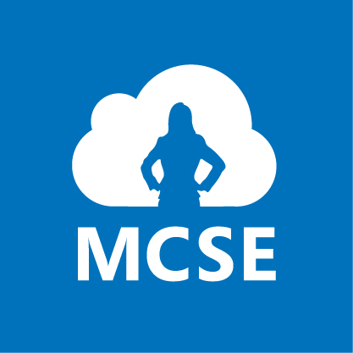
MCSE and MCSD Certifications
Private Cloud
Server Infrastructure
Desktop Infrastructure
Business Intelligence
Data Platform
Web Applications
Windows Store Apps

Slide 9
Increased Rigor
Reflection of the real world
Learn more, validate more
Solutions are more complex, questions must reflect that
Best way to measure candidates know what they know
New item types
Fewer multiple choice
Case studies
Scenario based
See big picture and make decisions
Innovative item types

Slide 10
Exam Tips

Slide 11
Exam Basics
40-60 questions
1-4 hours to complete exam
Can review questions
Cannot move between case studies
700 is passing
700 is not 70%

Slide 12
Exam Scoring
Each exam has a "cut score"
Each question is worth one point
No partial credit
No points deducted for wrong answers

Slide 13
How to interpret questions
Business Problem
All questions have a consistent anatomy
Goal Statement
One or Multiple Correct Answers
Questions are not intended to trick you
Multiple Distracters

Slide 14
Exam Content – 70-246

Slide 15
Monitoring and Operating a Private Cloud with System Center 2012
Exam Objectives
http://www.microsoft.com/learning/en/us/exam.aspx?ID=70-246
Configuring Data Center Process Automation (17 percent)
Deploy Resource Monitoring (20 percent)
Monitor Resources (23 percent)
Configure and Maintain Service Management (18 percent)
Manage Configuration and Protection (22 percent)

Slide 16
Monitoring and Operating a Private Cloud with System Center 2012
Exam Objectives
http://www.microsoft.com/learning/en/us/exam.aspx?ID=70-246
Configuring Data Center Process Automation (17 percent)
Deploy Resource Monitoring (20 percent)
Monitor Resources (23 percent)
Configure and Maintain Service Management (18 percent)
Manage Configuration and Protection (22 percent)

Slide 17
Exam Content Configuring Data Center Process Automation (17 percent)
Implement Workflows
Orchestrator Runbooks
Service Manager Incidents
Implement Service Offerings

Slide 18
Configuring Data Center Process Automation
You are currently planning your private cloud deployment. You wish to include SQL Server VMs in the library for deployment. What must you do to the SQL server VMs in order to create a SQL Server profile?
Install SQL Server 2008 SP2
Remove all non-system tables from databases
Create a sysprep version of SQL 2008 R2
Create the VMM table in the Master database on the SQL Server

Slide 19
Configuring Data Center Process Automation
You are currently planning your private cloud deployment. You wish to include SQL Server VMs in the library for deployment. What must you do to the SQL server VMs in order to create a SQL Server profile?
Install SQL Server 2008 SP2
Remove all non-system tables from databases
Create a sysprep version of SQL 2008 R2
Create the VMM table in the Master database on the SQL Server
Takeaways
You must know how to deploy the various types of VMs that will be required in the automated environment.

Slide 20
Monitoring and Operating a Private Cloud with System Center 2012
Exam Objectives
http://www.microsoft.com/learning/en/us/exam.aspx?ID=70-246
Configuring Data Center Process Automation (17 percent)
Deploy Resource Monitoring (20 percent)
Monitor Resources (23 percent)
Configure and Maintain Service Management (18 percent)
Manage Configuration and Protection (22 percent)

Slide 21
Exam Content Deploy Resource Monitoring (20 percent)
Deploy end-to-end monitoring
Discover devices and Deploy agents
Import Management Packs
Configure end-to-end monitoring
Configure overrides, performance monitoring (APM)
Create monitoring reports and dashboards
SLT, reports, dashboards

Slide 22
Deploy Resource Monitoring
You are deploying the Operations Manager 2012 agents on your private Cloud resources. You are planning on doing manual agent deployments on your systems in the perimeter network. What must you do to ensure these agents will install and be available in the Operations Manager console? (Choose all that apply)
Open port 443 in the firewall
Open port 5723 in the firewall
Grant all users administrator privileges
Use “Review new manual agent installations” in pending management view
Create a user role in Operations Manager to allow the installation of the agent
Pre-stage the system in the Operations Manager console in the Administration pane

Slide 23
Deploy Resource Monitoring
You are deploying the Operations Manager 2012 agents on your private cloud resources. You are planning on doing manual agent deployments on your systems in the perimeter network. What must you do to ensure these agents will install and be available in the Operations Manager console? (Choose all that apply)
Open port 443 in the firewall
Open port 5723 in the firewall
Grant all users administrator privileges
Use “Review new manual agent installations” in pending management view
Create a user role in Operations Manager to allow the installation of the agent
Pre-stage the system in the Operations Manager console in the Administration pane
Takeaways
Port number questions will appear on the exam, so make sure you know them.

Slide 24
Monitoring and Operating a Private Cloud with System Center 2012
Exam Objectives
http://www.microsoft.com/learning/en/us/exam.aspx?ID=70-246
Configuring Data Center Process Automation (17 percent)
Deploy Resource Monitoring (20 percent)
Monitor Resources (23 percent)
Configure and Maintain Service Management (18 percent)
Manage Configuration and Protection (22 percent)

Slide 25
Exam Content Monitor Resources (23 percent)
Monitor network devices
Monitor servers
Monitor the virtualization layer
Monitor application health

Slide 26
Monitor Resources
You are the private cloud administrator. Management has asked you to monitor certain network devices in your organization. The monitoring requests must use the most secure options available. Which method should you choose?
Configure a TCP port monitor
Configure a Process monitor
Configure an ICMP discover rule
Configure a SNMP v3 discover rule

Slide 27
Monitor Resources
You are the private cloud administrator. Management has asked you to monitor certain network devices in your organization. The monitoring requests must use the most secure options available. Which method should you choose?
Configure a TCP port monitor
Configure a Process monitor
Configure an ICMP discover rule
Configure a SNMP v3 discover rule
Takeaways
You must know the different options that are available for discovering resources to monitor and the methods you can you to monitor them.

Slide 28
Monitoring and Operating a Private Cloud with System Center 2012
Exam Objectives
http://www.microsoft.com/learning/en/us/exam.aspx?ID=70-246
Configuring Data Center Process Automation (17 percent)
Deploy Resource Monitoring (20 percent)
Monitor Resources (23 percent)
Configure and Maintain Service Management (18 percent)
Manage Configuration and Protection (22 percent)

Slide 29
Exam Content Configure and Maintain Service Management (18 percent)
Implement service level management
Define SLO
Define and implement SLA
Manage problems and incidents
Manage cloud resources
Deploy applications and services
Manage templates, applications, self service

Slide 30
Configure and Maintain Service Management
You are responsible for automating service management in your private cloud. You want to create a way to have different department help desk teams to be able to respond to incidents for their department only. What should you create in Service Manager to make this happen for the help desk teams. (Choose two)
Create a User role in Service Manager
Create a Service Offering in Service Manager
Create a Request Offering in Service Manager
Create a Queue in Service Manager
Create a Run As Account in Service Manager
Create an Operations Manager Alert connector in Service Manager

Slide 31
Configure and Maintain Service Management
You are responsible for automating service management in your private cloud. You want to create a way to have different department help desk teams to be able to respond to incidents for their department only. What should you create in Service Manager to make this happen for the help desk teams. (Choose two)
Create a User role in Service Manager
Create a Service Offering in Service Manager
Create a Request Offering in Service Manager
Create a Queue in Service Manager
Create a Run As Account in Service Manager
Create an Operations Manager Alert connector in Service Manager
Takeaways
You must know how to implement Service Manager components.

Slide 32
Configure and Maintain Service Management
Resources:
Using the Service Catalog in System Center 2012 - Service Manager
http://technet.microsoft.com/en-us/library/hh495624.aspx
Add User to Group Automated Request Offering Walkthrough
http://blogs.technet.com/b/servicemanager/archive/2012/06/25/add-user-to-group-automated-request-offering-walkthrough.aspx

Slide 33
Monitoring and Operating a Private Cloud with System Center 2012
Exam Objectives
http://www.microsoft.com/learning/en/us/exam.aspx?ID=70-246
Configuring Data Center Process Automation (17 percent)
Deploy Resource Monitoring (20 percent)
Monitor Resources (23 percent)
Configure and Maintain Service Management (18 percent)
Manage Configuration and Protection (22 percent)

Slide 34
Exam Content Manage Configuration and Protection (22 percent)
Manage compliance and configuration
ITGRC, System Center Advisor, Configuration Compliance
Manage Updates
Implement backup and recovery

Slide 35
Manage Configuration and Protection
You are the private cloud administrator. You have been asked to provide data recovery protection for a web server in the DMZ. What must you do to provide the requested recovery protection? (Choose all that apply)
Add the Windows Backup feature to the web server
Install the DPM Server on the web server
Run the DpmAgentInstaller on the Web Server
Open ports 80/443 in the firewall
Open ports 161/162 in the firewall
Open ports 5718/5719 in the firewall

Slide 36
Manage Configuration and Protection
You are the private cloud administrator. You have been asked to provide data recovery protection for a web server in the DMZ. What must you do to provide the requested recovery protection? (Choose all that apply)
Add the Windows Backup feature to the web server
Install the DPM Server on the web server
Run the DpmAgentInstaller on the Web Server
Open ports 80/443 in the firewall
Open ports 161/162 in the firewall
Open ports 5718/5719 in the firewall
Takeaways
You must know how to deploy and implement DPM protections for your cloud resources

Slide 37
Exam Content – 70-247

Slide 38
Configuring and Deploying a Private Cloud with System Center 2012
Exam Objectives
http://www.microsoft.com/learning/en/us/exam.aspx?ID=70-247
Design and Deploy System Center (19 percent)
Configure System Center Infrastructure (21 percent)
Configure the Fabric (27 percent)
Configure System Center Integration (16 percent)
Configure and Deploy Virtual Machines and Services (17 percent)

Slide 39
Configuring and Deploying a Private Cloud with System Center 2012
Exam Objectives
http://www.microsoft.com/learning/en/us/exam.aspx?ID=70-247
Design and Deploy System Center (19 percent)
Configure System Center Infrastructure (21 percent)
Configure the Fabric (27 percent)
Configure System Center Integration (16 percent)
Configure and Deploy Virtual Machines and Services (17 percent)

Slide 40
Exam Content Design and Deploy System Center (19 percent)
Design a scalable System Center architecture
Planning for capacity, high availability, scalability, continuity
Identify appropriate System Center components for cloud implementation
Install the System Center infrastructure
Upgrade System Center components
In-place upgrade
Side-by-side migration

Slide 41
Design and Deploy: Upgrades
You are currently running System Center Operations Manager 2007. You would like to upgrade to System Center Operations Manager 2012. Which of the following changes might you need to make in your System Center hosting environment? Choose all that apply.
Replace a SQL Server 2008 x86 server with a SQL Server 2008 R2 x86 server.
Replace a SQL Server 2008 x86 server with a SQL Server 2008 x64 server.
Replace a Windows Server 2003 server with a Windows Server 2008 R2 SP1 server.
Replace a Windows Server 2008 server with a Windows Server 2008 R2 SP1 server.
Enable WinRM on the management server.
Enable DHCP on the management server.

Slide 42
Design and Deploy: Upgrades
You are currently running System Center Operations Manager 2007. You would like to upgrade to System Center Operations Manager 2012. Which of the following changes might you need to make in your System Center hosting environment? Choose all that apply.
Replace a SQL Server 2008 x86 server with a SQL Server 2008 R2 x86 server.
Replace a SQL Server 2008 x86 server with a SQL Server 2008 x64 server.
Replace a Windows Server 2003 server with a Windows Server 2008 R2 SP1 server.
Replace a Windows Server 2008 server with a Windows Server 2008 R2 SP1 server.
Enable WinRM on the management server.
Enable DHCP on the management server.
Takeaways
SQL Server must be x64 and a minimum of SQL 2008 SP1; x86 is not supported for hosting SC 2012 databases.
Windows Server 2008 R2 SP1 is the minimum supported release for hosting SC 2012 services.
WinRM is required for SC 2012 management servers.
cf. http://technet.microsoft.com/en-us/library/hh205990

Slide 43
Configuring and Deploying a Private Cloud with System Center 2012
Exam Objectives
http://www.microsoft.com/learning/en/us/exam.aspx?ID=70-247
Design and Deploy System Center (19 percent)
Configure System Center Infrastructure (21 percent)
Configure the Fabric (27 percent)
Configure System Center Integration (16 percent)
Configure and Deploy Virtual Machines and Services (17 percent)

Slide 44
Exam Content Configure System Center Infrastructure (21 percent)
Configure System Center components
DPM – storage pools, site-to-site replication
Operation Manager – agents, management groups, Run-as accounts,
Configure portals and dashboards

Slide 45
Configure Infrastructure: SCOM
You have a server in a DMZ that would you like to manage using SCOM. What port(s) do you need to open? Choose all that apply.
UDP 5723 from managed server to management server
TCP 5723 from managed server to management server
UDP 5723 from management server to managed server
TCP 5723 from management server to managed server

Slide 46
Configure Infrastructure: SCOM
You have a server in a DMZ that would you like to manage using SCOM. What port(s) do you need to open? Choose all that apply.
UDP 5723 from managed server to management server
TCP 5723 from managed server to management server
UDP 5723 from management server to managed server
TCP 5723 from management server to managed server
Takeaways
Port numbers are easily found trivia, yes, but you will be asked about them.

Slide 47
Configuring and Deploying a Private Cloud with System Center 2012
Exam Objectives
http://www.microsoft.com/learning/en/us/exam.aspx?ID=70-247
Design and Deploy System Center (19 percent)
Configure System Center Infrastructure (21 percent)
Configure the Fabric (27 percent)
Configure System Center Integration (16 percent)
Configure and Deploy Virtual Machines and Services (17 percent)

Slide 48
Exam Content Configure the Fabric (27 percent)
Configure the storage fabric
Configure the network fabric
Configure the deployment of update servers
Configure clouds and virtualization hosts

Slide 49
Configure the Fabric: Update Servers
You have an existing WSUS infrastructure and are now adding System Center 2012 to your environment. What should you do to control host updates in your private cloud? Choose all that apply and order them.
Add the WSUS infrastructure to VMM.
Configure the hosts to use Automatic Updates.
Remediate the hosts using VMM.
Configure the hosts to reference the WSUS server through Group Policy.
Scan for baseline compliance using VMM.
Create an update baseline for the hosts using VMM.
Configure update sets in WSUS to apply to the hosts.

Slide 50
Configure the Fabric: Update Servers
You have an existing WSUS infrastructure and are now adding System Center 2012 to your environment. What should you do to control host updates in your private cloud? Choose all that apply and order them.
Add the WSUS infrastructure to VMM. (FIRST)
Configure the hosts to use Automatic Updates.
Remediate the hosts using VMM. (FOURTH)
Configure the hosts to reference the WSUS server through Group Policy.
Scan for baseline compliance using VMM. (THIRD)
Create an update baseline for the hosts using VMM. (SECOND)
Configure update sets in WSUS to apply to the hosts.
Takeaways
WSUS integration is a feature of VMM. Know how that integration works and why.

Slide 51
Configuring and Deploying a Private Cloud with System Center 2012
Exam Objectives
http://www.microsoft.com/learning/en/us/exam.aspx?ID=70-247
Design and Deploy System Center (19 percent)
Configure System Center Infrastructure (21 percent)
Configure the Fabric (27 percent)
Configure System Center Integration (16 percent)
Configure and Deploy Virtual Machines and Services (17 percent)

Slide 52
Exam Content Configure System Center Integration (16 percent)
Configure private cloud integration
Operations Manager connections, Orchestrator integration packs, Service Manager connections, SharePoint integration
Configure integration of private and public clouds
Profiles configuration – Host, Guest OS, Hardware, SQL Server, Application

Slide 53
Configure Integration: OM MPs
You have a custom line-of-business application running in your private cloud. It uses a business service running in WCF, an Oracle database on Solaris, and a web front-end written in ASP.NET. What should you do to monitor the application?
Use the Master Operations Manager to model monitoring of the application.
Use the Distributed Application Designer to model monitoring of the application.
Create three management packs (one for each application layer). Use all three to monitor the application.
Replace the Oracle database with a SQL Server database. Use the standard three-tier management pack to monitor the application.

Slide 54
Configure Integration: OM MPs
You have a custom line-of-business application running in your private cloud. It uses a business service running in WCF, an Oracle database on Solaris, and a web front-end written in ASP.NET. What should you do to monitor the application?
Use the Master Operations Manager to model monitoring of the application.
Use the Distributed Application Designer to model monitoring of the application.
Create three management packs (one for each application layer). Use all three to monitor the application.
Replace the Oracle database with a SQL Server database. Use the standard three-tier management pack to monitor the application.
Takeaways
System Center 2012 includes support for multi-layer applications.
Know what’s involved in monitoring line-of-business applications.

Slide 55
Configuring and Deploying a Private Cloud with System Center 2012
Exam Objectives
http://www.microsoft.com/learning/en/us/exam.aspx?ID=70-247
Design and Deploy System Center (19 percent)
Configure System Center Infrastructure (21 percent)
Configure the Fabric (27 percent)
Configure System Center Integration (16 percent)
Configure and Deploy Virtual Machines and Services (17 percent)

Slide 56
Exam Content Configure and Deploy Virtual Machines and Services (17 percent)
Configure profiles
Create and configure server App-V packages
Configure and deploy a service
Template import/export, VM templates, service templates, DAC packages, WebDeploy
Update a service

Slide 57
Configure & Deploy VMs & Services: App-V
Which of the following on-installation components are supported by Server App-V? Choose all that apply.
Windows Services
COM+ Applications
WMI Providers
Domain Users and Groups
Local Users and Groups
SQL Server Reporting Services
iSCSI SAN Connections

Slide 58
Configure & Deploy VMs & Services: App-V
Which of the following on-installation components are supported by Server App-V? Choose all that apply.
Windows Services
COM+ Applications
WMI Providers
Domain Users and Groups
Local Users and Groups
SQL Server Reporting Services
iSCSI SAN Connections
Takeaways
Server App-V supports many but not all possible installation results for server applications. Microsoft expects you to use it for many application scenarios however so you should know when it is possible to use it.

Slide 59
In Review: Session Objectives and Takeaways
Session Objectives
Help you successfully prepare for the System Center 2012 exams 70-246 and 70-247
Provide insight into new exam questions and formats
Takeaways
Certification exam information
System Center 2012 and 2012 R2 exam topics and sample questions
“Mile wide, yards deep” ☺

Slide 60
Related content
Breakout Sessions (session codes and titles)
Many, but focus on Labs perhaps?
Labs (session codes and titles)
DCIM-IL301-R Constructing Your Private Cloud with Windows Server and Microsoft System Center, Part 1
DCIM-H308 Microsoft System Center 2012 R2 Lab 1: Infrastructure Provisioning
DCIM-H304 Constructing Your Private Cloud with Windows Server and Microsoft System Center, Part 1
DCIM-H305 Constructing Your Private Cloud with Windows Server and Microsoft System Center, Part 2
Related Certification Exams
70-246 + 70-247

Slide 61
Related Content
Free Exam Study Guides
• Exam 70-246 Study Guide – http://aka.ms/sg70246
• Exam 70-247 Study Guide – http://aka.ms/sg70247

Slide 62
Resources
Learning
Sessions on Demand
Microsoft Certification & Training Resources
http://channel9.msdn.com/Events/TechEd
www.microsoft.com/learning
TechNet
msdn
Resources for IT Professionals
Resources for Developers
http://microsoft.com/technet
http://microsoft.com/msdn

Slide 63
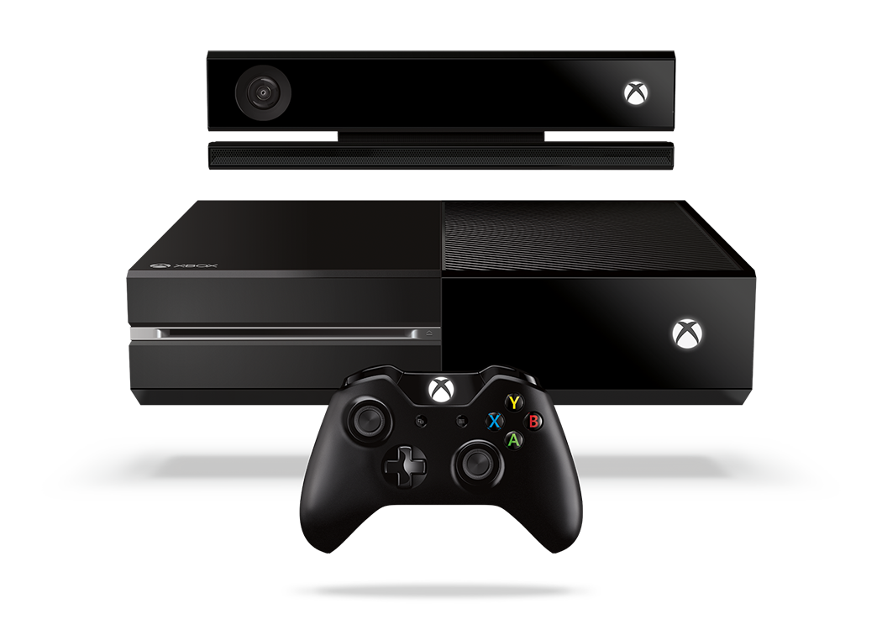
Complete an evaluation and enter to win!

Slide 64
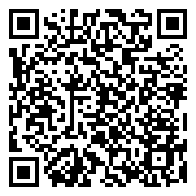
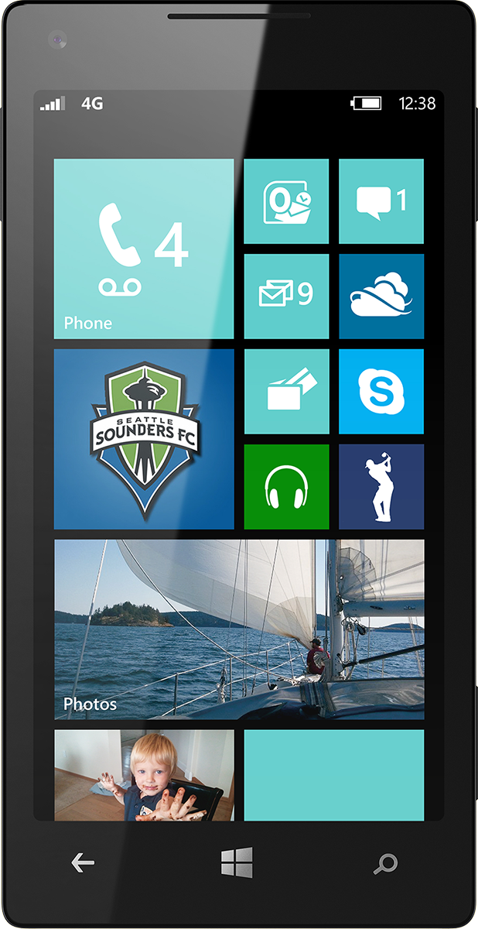
Evaluate this session
Scan this QR code to evaluate this session.

Slide 65
© 2014 Microsoft Corporation. All rights reserved. Microsoft, Windows, and other product names are or may be registered trademarks and/or trademarks in the U.S. and/or other countries.
The information herein is for informational purposes only and represents the current view of Microsoft Corporation as of the date of this presentation. Because Microsoft must respond to changing market conditions, it should not be interpreted to be a commitment on the part of Microsoft, and Microsoft cannot guarantee the accuracy of any information provided after the date of this presentation. MICROSOFT MAKES NO WARRANTIES, EXPRESS, IMPLIED OR STATUTORY, AS TO THE INFORMATION IN THIS PRESENTATION.

