Slide 2
Exam prep: 70-689 Upgrading your skills to MCSA – Windows 8 / 8.1
Peter De Tender
MCT, MCSA, MCSE, MVP

Slide 3
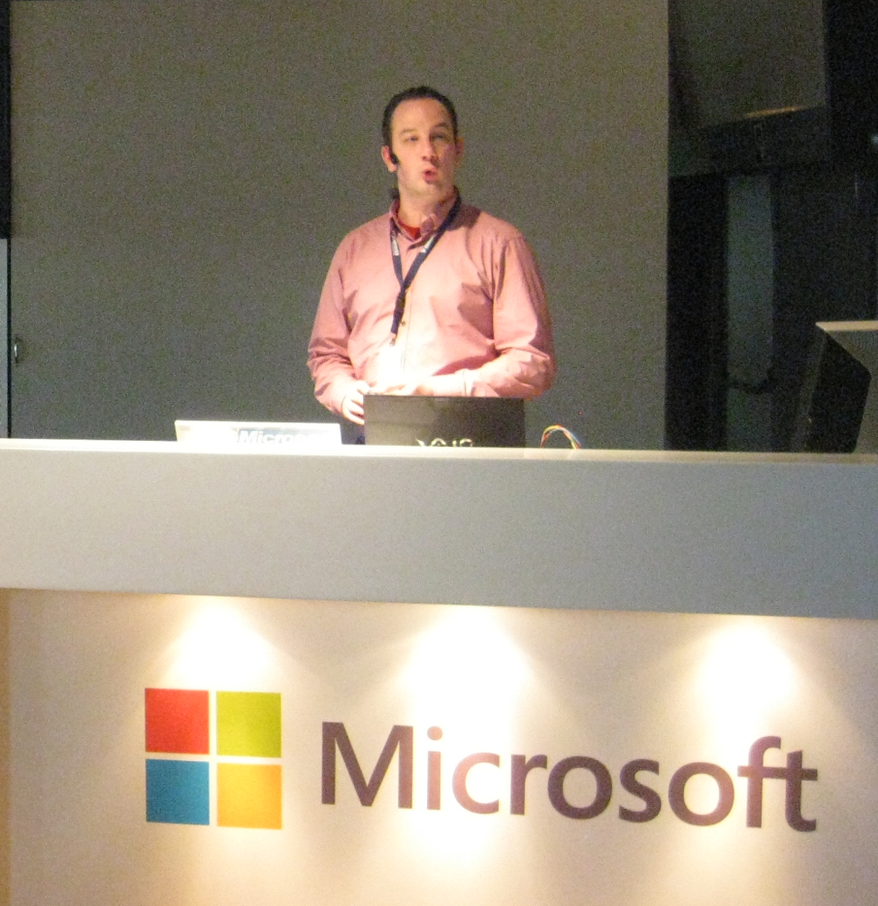
About Me…
IT Pro for 17 years
-
Independent
Trainer, Speaker, Technical Writer, Author, …
MSL Regional Lead
EU Chairman
BE Chapter Lead
@pdtit
info@pdtit.be
www.pdtit.be

Slide 4
Session Objectives And Takeaways
Session Objective(s):
Describe key Windows 8 / 8.1 exam objectives
Understand question styles
Prepare more effectively using available study material
Relate practical Windows 8 / 8.1 experience to exam topics
Key Takeaway 1
Identify areas that may require extra studying
Key Takeaway 2
Action Plan for exam preparation and success

Slide 5
Target Audience
Candidates for this exam are IT professionals already certified on Windows 7, and who configure or support Windows 8.
Candidates should have experience with previous Windows Client Operating systems and have MCSA Windows 7 certification

Slide 6
Microsoft Certification

Slide 7
For You
Increased confidence in your abilities at work
Enhanced product knowledge
Learn about certification to educate your coworkers and bosses

Slide 8
For Your Career
Makes a great commitment
Shows drive and initiative
Tangible way to demonstrate mastery of a product
Sets you apart from your peers at review time
Recognition inside and outside of Microsoft
Completely achievable at TechEd

Slide 9
Changes to Certifications and Exams
Relevance
Broader Skill Set
Rigor
Certification Requirement
Recertification
Deeper Skill Set

Slide 10
MCSE and MCSD Certifications
Private Cloud
Server Infrastructure
Desktop Infrastructure
Business Intelligence
Data Platform
Web Applications
Windows Store Apps

Slide 11
Increased Rigor
Reflection of the real world
Learn more, validate more
Solutions are more complex, questions must reflect that
Best way to measure candidates know what they know
New item types
Fewer multiple choice
Case studies
Scenario based
See big picture and make decisions
Innovative item types

Slide 12
Exam Tips

Slide 13
Exam Basics
40-60 questions
1-4 hours to complete exam
Can review questions
Cannot move between case studies
700 is passing
700 is not 70%

Slide 14
Exam Scoring
Each exam has a "cut score"
Each question is worth one point
No partial credit
No points deducted for wrong answers

Slide 15
How to interpret questions
Business Problem
All questions have a consistent anatomy
Goal Statement
One or Multiple Correct Answers
Questions are not intended to trick you
Multiple Distracters

Slide 16
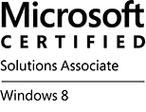
Upgrade to MCSA: Windows Client 8
Microsoft Certified Solutions Associate (MCSA)
If you hold the following certifications, you have been automatically upgraded to MCSA: Windows 7:
MCITP: Enterprise Desktop Administrator on Windows 7
MCITP: Enterprise Desktop Support Technician on Windows 7
Upgrading Your Skills to MCSA: Windows 8
689
EXAM
+
=
Windows 7

Slide 17
Steps to obtain the MCSA: Windows 8
Microsoft Certified Solutions Associate (MCSA)
Two exams are required and should be taken in the following order:
Configuring Windows 8
Managing and Maintaining Windows 8
687
688
EXAM
EXAM
+
=

Slide 18
Valuable Resources

Slide 19
Here at TechEd Resources
Hands on Labs
Visit the Hands on Labs to fine tune your knowledge. It can be easier to understand and memorize the technical tasks that are asked on the exam. Get a list of all the labs from the TechEd Website.
Study Hall
Visit the study hall to have access to practice exams, e-learning material and online text books to fine tune your knowledge about the exam objectives.
Live Session
The heart of TechEd are the sessions on various subjects. Attend various sessions on your subject area.
50% off Certification Exams
Test your knowledge with discounted exams at the certification center.

Slide 20
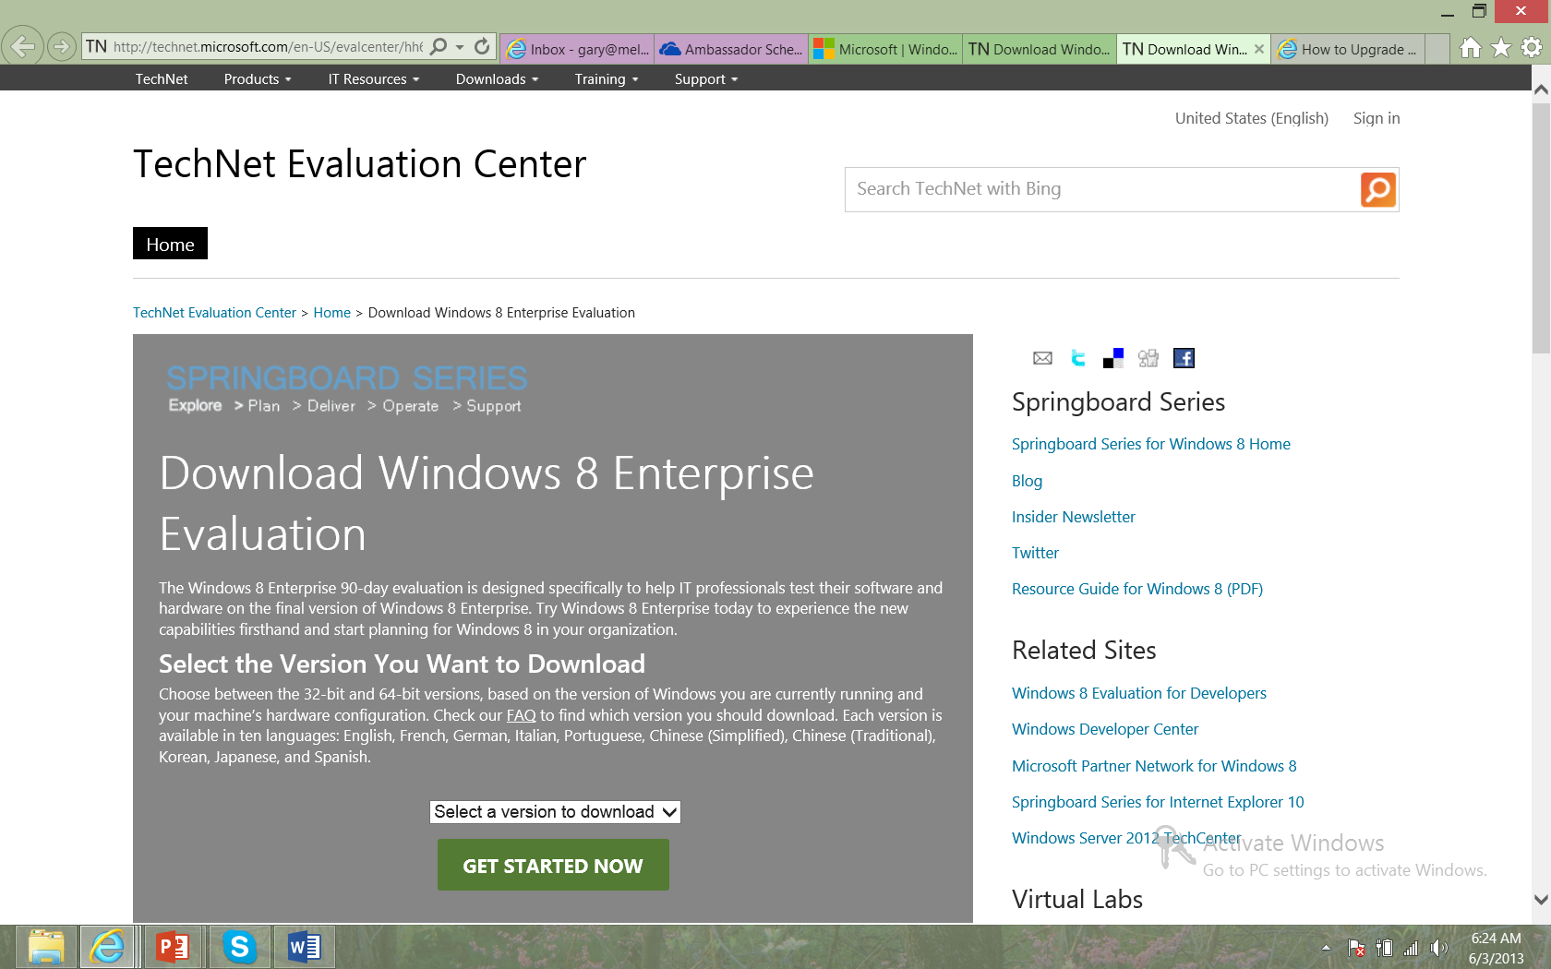
Evaluation Copy

Slide 21
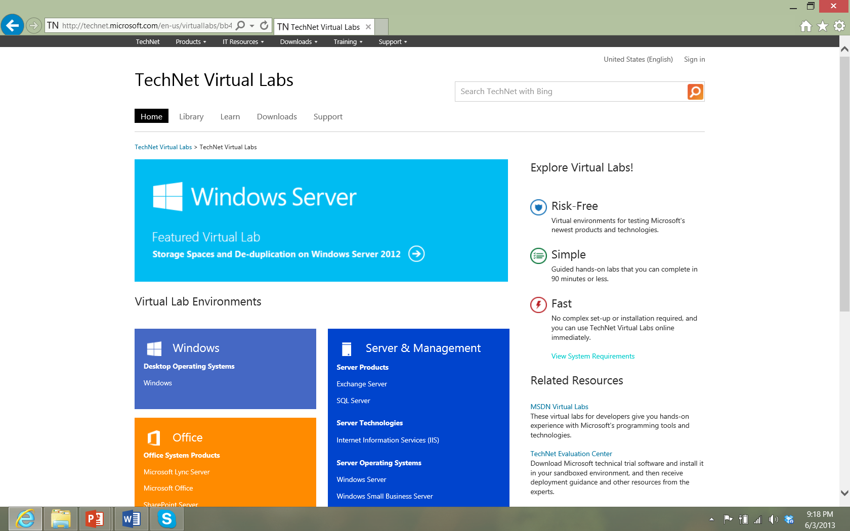
Virtual Labs

Slide 22
Ready to take flight 70-689 to Certification Beach?

Slide 23
Exam Objectives
Install and Upgrade to Windows 8 (25 - 30%)
Configure Hardware and Applications (25- 30%)
Configure Remote Access and Mobility (20- 25%)
Configure Backup and Recovery Options (25 - 30%)
Maintain Resource Access(25 - 30%)
Maintain Windows Clients and Devices (25 - 30%)
Manage Windows 8 Using Cloud Services and Microsoft Desktop Optimization Pack (20 -25%)

Slide 24
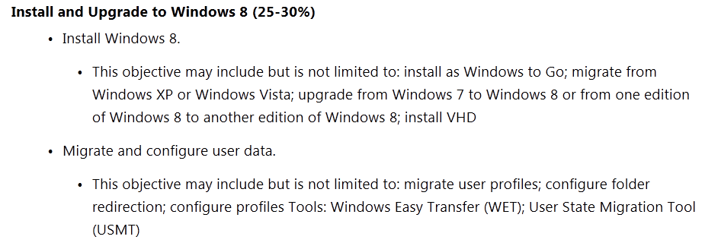
Install and Upgrade to Windows 8 / 8.1

Slide 25
Hardware Requirements
Architecture | 32-bit | 64-bit
Processor | 1 GHz 32-bit processor | 1 GHz 64-bit processor
Memory (RAM) | 1 GB of RAM | 2 GB of RAM
Graphics Card | DirectX 9 graphics processor with WDDM driver model 1.0 (For Aero)
HDD free space | 16 GB of available disk space | 20 GB of available disk space
Optical drive | DVD drive (only to install from DVD/CD Media)

Slide 26
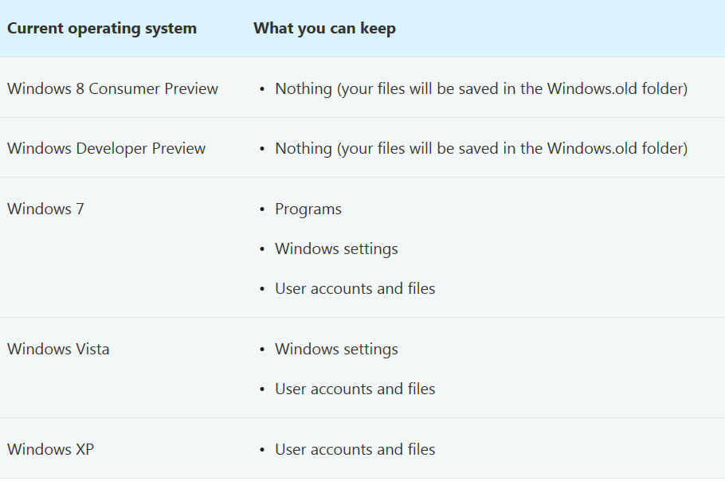
Upgrading to Windows 8 / 8.1

Slide 27
Exam 70-689 Exam Objectives
Install and Upgrade to Windows 8 (25 - 30%)
Configure Hardware and Applications (25- 30%)
Configure Remote Access and Mobility (20- 25%)
Configure Backup and Recovery Options (25 - 30%)
Maintain Resource Access(25 - 30%)
Maintain Windows Clients and Devices (25 - 30%)
Manage Windows 8 Using Cloud Services and Microsoft Desktop Optimization Pack (20 -25%)

Slide 28
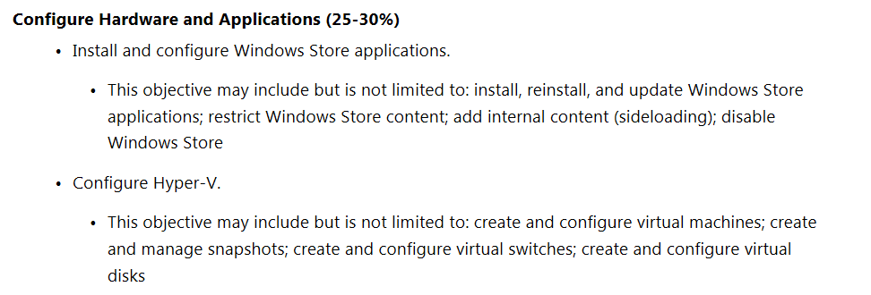
Configure Hardware and Applications

Slide 29
Windows Store
Download Metro style apps
Create Microsoft account
Add account to store
Install app to maximum of 5 PCs
Disable Windows Store
Configure the following policy:
\User Configuration\Administrative Templates\Windows Components\Store\Turn off the Store application

Slide 30
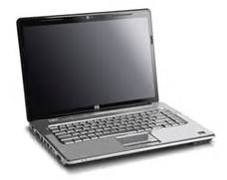
Sideloading
Distribute Metro style apps without Windows Store
Requires Enterprise version of Windows 8

Slide 31
Client Hyper-V
Same technology as Server Hyper-V
Can move VMs from client to server
VM sleep states follow host sleep states
Requires 64-bit host system with at least 4 GB RAM
CPU must support Second Layer Address Translation (SLAT)
Guest OS can be 32-bit or 64-bit
Client Hyper-V Survival Guide
http://social.technet.microsoft.com/wiki/contents/articles/7704.client-hyper-v-survival-guide.aspx

Slide 32
Question
What are two minimum hardware requirements to run Client Hyper-V on Windows 8 clients? Choose TWO.
Any x64 CPU
A x64 CPU with hardware virtualization
Support for Second Level Address Translation
8GB of RAM

Slide 33
Answer
What are two minimum hardware requirements to run Client Hyper-V on Windows 8 clients? Choose TWO.
Any x64 CPU
A x64 CPU with hardware virtualization
Support for Second Level Address Translation
8GB of RAM

Slide 34
Exam 70-689 Exam Objectives
Install and Upgrade to Windows 8 (25 - 30%)
Configure Hardware and Applications (25- 30%)
Configure Remote Access and Mobility (20- 25%)
Configure Backup and Recovery Options (25 - 30%)
Maintain Resource Access(25 - 30%)
Maintain Windows Clients and Devices (25 - 30%)
Manage Windows 8 Using Cloud Services and Microsoft Desktop Optimization Pack (20 -25%)

Slide 35
Configure Remote Access and Mobility

Slide 36
Windows to Go
Windows 8 installation on USB drive
Requires UEFI
Must use Windows 8 Enterprise to create the Windows to Go USB
To use the Windows to Go USB the host computer needs to run Windows 7 or Windows 8
Points to Note
Hibernation and sleep disabled by default
Internal disks offline
TPM not used
WinRE not available

Slide 37
Exam 70-689 Exam Objectives
Install and Upgrade to Windows 8 (25 - 30%)
Configure Hardware and Applications (25- 30%)
Configure Remote Access and Mobility (20- 25%)
Configure Backup and Recovery Options (25 - 30%)
Maintain Resource Access(25 - 30%)
Maintain Windows Clients and Devices (25 - 30%)
Manage Windows 8 Using Cloud Services and Microsoft Desktop Optimization Pack (20 -25%)

Slide 38
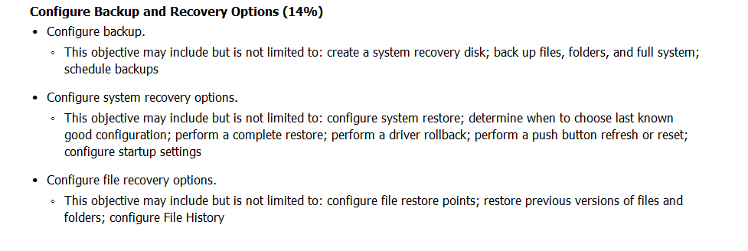
Configure Backup and Recovery Options

Slide 39
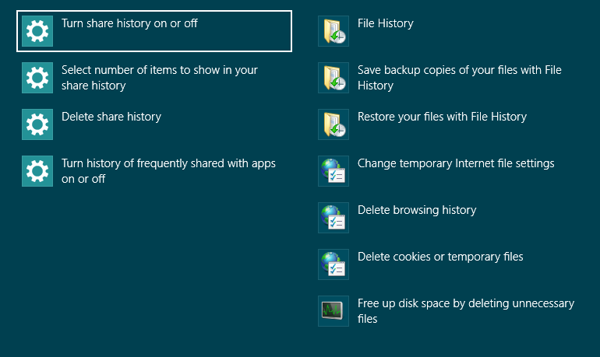
File History

Slide 40
Question
You are managing a computer that runs Windows 8. You noticed that the computer startup time has significantly increased.
You need to review the list of services that are starting automatically and disable services that are the cause of the problem. Which tool should you use?
System Information
System Configuration
Task Manager
Action Center

Slide 41
Answer
You are managing a computer that runs Windows 8. You noticed that the computer startup time has significantly increased.
You need to review the list of services that are starting automatically and disable services that are the cause of the problem. Which tool should you use?
System Information
System Configuration
Task Manager
Action Center
Questions courtesy of MeasureUP

Slide 42
Exam 70-689 Exam Objectives
Install and Upgrade to Windows 8 (25 - 30%)
Configure Hardware and Applications (25- 30%)
Configure Remote Access and Mobility (20- 25%)
Configure Backup and Recovery Options (25 - 30%)
Maintain Resource Access(25 - 30%)
Maintain Windows Clients and Devices (25 - 30%)
Manage Windows 8 Using Cloud Services and Microsoft Desktop Optimization Pack (20 -25%)

Slide 43
Maintain Resource Access

Slide 44
BranchCache
Two Modes:
Hosted Cache
Uses one or more servers on the branch office network to host the BranchCache cache
Distributed Cache
Cache is hosted across BranchCache clients and does not require locally deployed server
Configuring BranchCache
Install BranchCache for Network Files role service on file server
BranchCache feature needs to be installed on the server to function as hosted cache mode server
Enable BranchCache on client
BranchCache mode needs to be configured on the client

Slide 45
Exam 70-689 Exam Objectives
Install and Upgrade to Windows 8 (25 - 30%)
Configure Hardware and Applications (25- 30%)
Configure Remote Access and Mobility (20- 25%)
Configure Backup and Recovery Options (25 - 30%)
Maintain Resource Access(25 - 30%)
Maintain Windows Clients and Devices (25 - 30%)
Manage Windows 8 Using Cloud Services and Microsoft Desktop Optimization Pack (20 -25%)

Slide 46
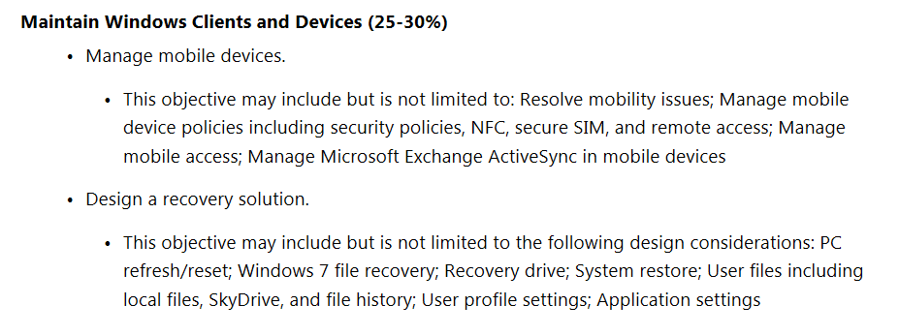
Maintain Windows Clients and Devices

Slide 47
Computer Reset
PC boots into Windows Recovery Environment
Windows RE erases and formats the hard drive partitions on which Windows and personal data reside.
Windows RE installs a fresh copy of Windows.
The PC restarts into the newly installed copy of Windows.
Thorough option overwrites all sectors (single pass)
Quick option does not overwrite

Slide 48
Computer Refresh
PC boots into Windows RE.
Windows RE scans hard drive
Scans for data, settings, and apps
Puts these aside (on the same drive).
Windows RE installs a fresh copy of Windows.
Windows RE restores data, settings, and apps into newly installed copy of Windows.
PC restarts into newly installed copy of Windows.

Slide 49
Refresh
Not preserved
File type associations
Display settings
Windows Firewall settings

Slide 50
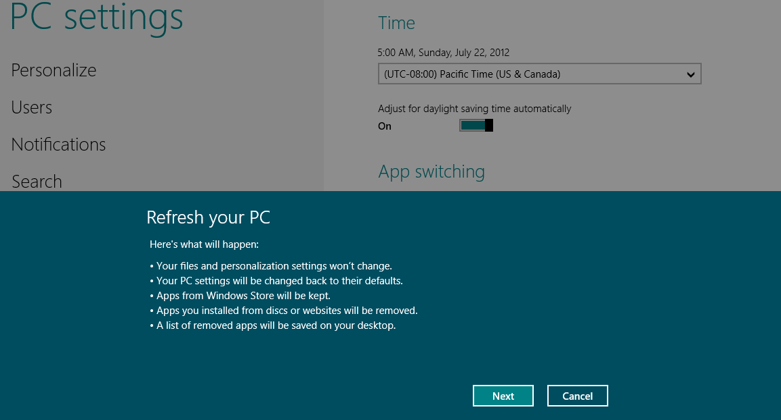
Refresh and Reset from Start Screen

Slide 51
Exam 70-689 Exam Objectives
Install and Upgrade to Windows 8 (25 - 30%)
Configure Hardware and Applications (25- 30%)
Configure Remote Access and Mobility (20- 25%)
Configure Backup and Recovery Options (25 - 30%)
Maintain Resource Access(25 - 30%)
Maintain Windows Clients and Devices (25 - 30%)
Manage Windows 8 Using Cloud Services and Microsoft Desktop Optimization Pack (20 -25%)

Slide 52
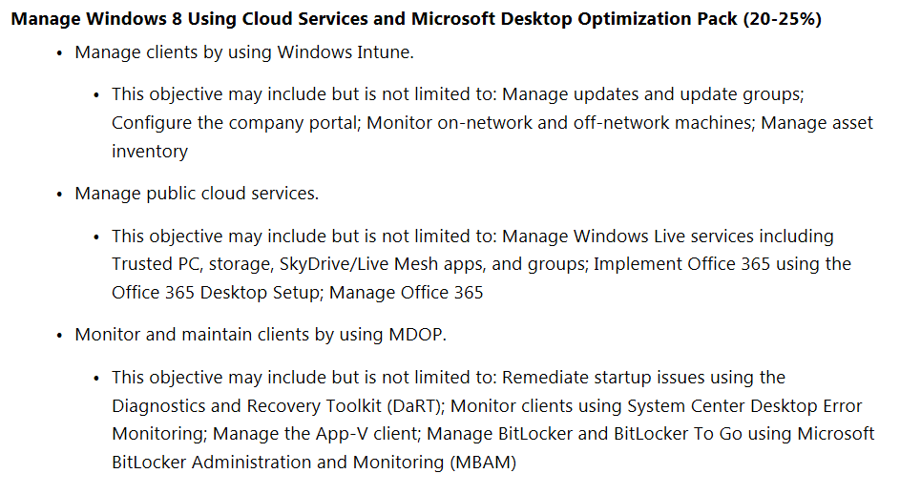
Using Cloud Services and MDOP

Slide 53
MDOP suite
Microsoft Application Virtualization (App-V)
Microsoft User Experience Virtualization (UE-V)
Microsoft Diagnostics and Recovery Toolset (DaRT)
Microsoft BitLocker Administration and Monitoring (MBAM)

Slide 54
Call To Action: GO BOOK IT! 50% discount here!

Slide 55
Call To Action 2: Sign up at http://www.techedyellowpantsteam.com to stay up to date about Microsoft certifications & TechEd news

Slide 56
Related content
Breakout Sessions on Windows 8.1 Client
HOL – Hands On Labs corner
Microsoft Solutions Experience Location (MSE)
Study Hall (free test exams)
Find Me Later At Certification Lounge & InfoDesk

Slide 57
Track resources
http://www.microsoft.com/learning
https://www.microsoft.com/learning/en-us/course.aspx?ID=20689C
http://technet.microsoft.com/en-US/library/hh832030.aspx
http://borntolearn.mslearn.net/

Slide 58
Resources
Learning
Sessions on Demand
Microsoft Certification & Training Resources
http://channel9.msdn.com/Events/TechEd
www.microsoft.com/learning
TechNet
msdn
Resources for IT Professionals
Resources for Developers
http://microsoft.com/technet
http://microsoft.com/msdn

Slide 59
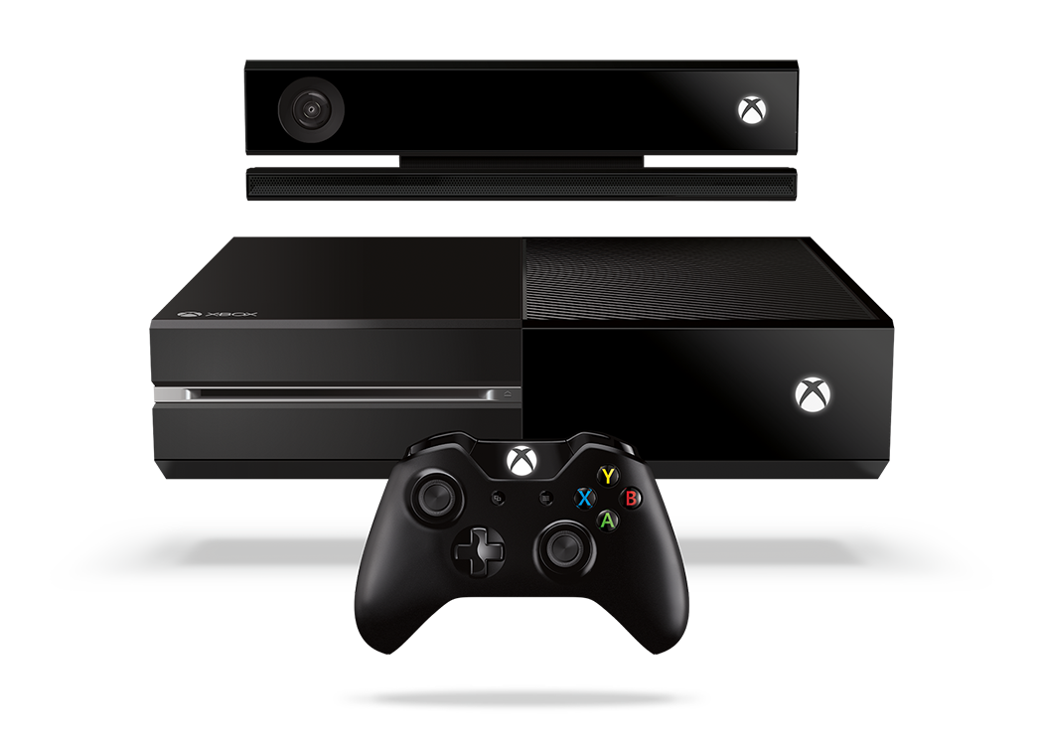
Complete an evaluation and enter to win!

Slide 60
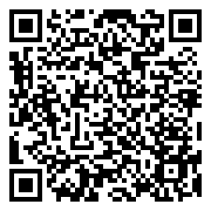
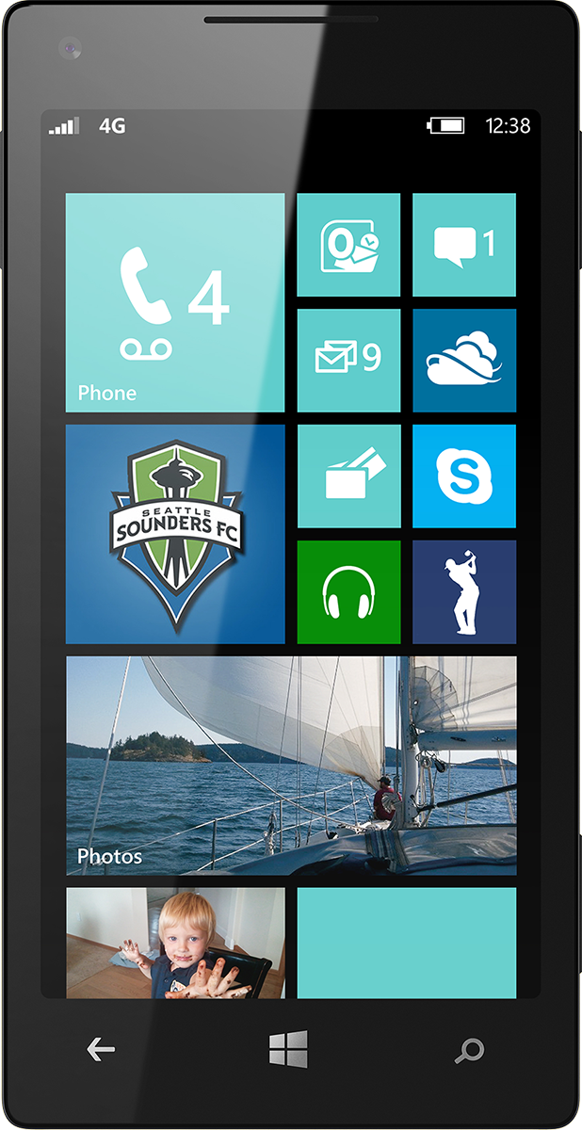
Evaluate this session
Scan this QR code to evaluate this session.

Slide 61
© 2014 Microsoft Corporation. All rights reserved. Microsoft, Windows, and other product names are or may be registered trademarks and/or trademarks in the U.S. and/or other countries.
The information herein is for informational purposes only and represents the current view of Microsoft Corporation as of the date of this presentation. Because Microsoft must respond to changing market conditions, it should not be interpreted to be a commitment on the part of Microsoft, and Microsoft cannot guarantee the accuracy of any information provided after the date of this presentation. MICROSOFT MAKES NO WARRANTIES, EXPRESS, IMPLIED OR STATUTORY, AS TO THE INFORMATION IN THIS PRESENTATION.

