Slide 2
Administering Microsoft SQL Server 2012 Databases
boB Taylor MCA, MCM, MCSD, MCSE, MCT
Principal Consultant - Premier Developer
Email: bob.taylor@Microsoft.com
Twitter: @sqlboBT
Blog: http://blogs.msdn.com/bobtaylor

Slide 3
You Know SQL Server 2012 How do you become certified?
Identify Certification Goal
Find Gaps
Fill Gaps
Take Exam

Slide 4
Microsoft Certification

Slide 5
For You
Increased confidence in your abilities at work
Enhanced product knowledge
Learn about certification to educate your coworkers and bosses

Slide 6
For Your Career
Makes a great commitment
Shows drive and initiative
Tangible way to demonstrate mastery of a product
Sets you apart from your peers at review time
Recognition inside and outside of Microsoft
Completely achievable at TechEd

Slide 7
Changes to Certifications and Exams
Relevance
Broader Skill Set
Rigor
Certification Requirement
Recertification
Deeper Skill Set

Slide 8
MCSE and MCSD Certifications
Private Cloud
Server Infrastructure
Desktop Infrastructure
Business Intelligence
Data Platform
Web Applications
Windows Store Apps

Slide 9
Increased Rigor
Reflection of the real world
Learn more, validate more
Solutions are more complex, questions must reflect that
Best way to measure candidates know what they know
New item types
Fewer multiple choice
Case studies
Scenario based
See big picture and make decisions
Innovative item types

Slide 10
Exam Tips

Slide 11
Exam Basics
40-60 questions
1-4 hours to complete exam
Can review questions
Cannot move between case studies
700 is passing
700 is not 70%

Slide 12
Exam Scoring
Each exam has a "cut score"
Each question is worth one point
No partial credit
No points deducted for wrong answers

Slide 13
How to interpret questions
Business Problem
All questions have a consistent anatomy
Goal Statement
One or Multiple Correct Answers
Questions are not intended to trick you
Multiple Distracters

Slide 14
Identify Your Certification Goals

Slide 15
MCSA: SQL Server 2012 Certification Requirements
Exam 70-461: Querying Microsoft SQL Server 2012
Exam 70-462: Administering Microsoft SQL Server 2012 Databases
Exam 70-463: Implementing a Data Warehouse with Microsoft SQL Server 2012
MCSA: SQL Server 2012

Slide 16
MCSE: Data Platform Certification Requirements
MCSA: SQL Server 2012
Exam 70-464: Developing Microsoft SQL Server 2012 Databases
Exam 70-465: Designing Database Solutions for SQL Server 2012
MCSE: Data Platform

Slide 17
Find knowledge Gaps

Slide 18
Check the Exam Guide
Exam 70-462 Guide
Skills Measured
Functional groups and individual topics
Relative weighting of functional groups
Links to more information about functional topics
Preparation Options

Slide 19
70-462 Exam Outline
Objective | %
Install and Configure SQL Server 2012 | 19%
Maintain Instances and Databases | 17%
Optimize and Troubleshoot SQL Server | 14%
Manage Data | 20%
Implement Security | 18%
Implement High Availability | 12%
Details of each area

Slide 20
Fill Knowledge Gaps

Slide 21
Topics Outline
Install and Configure SQL Server 2012
Maintain Instances and Databases
Optimize and Troubleshoot SQL Server
Manage Data
Implement Security
Implement High Availability

Slide 22
Plan Installation | Install Server and Related Services
Separate drives for data files, log files, tempdb
Filegroups, Partitioning, Filestream, FileTable
Core mode installation
Benchmark (SQLIO vs SQLIOSIM)
Install SSIS (not SRS and SSAS)
Enable and Disable Features

Slide 23
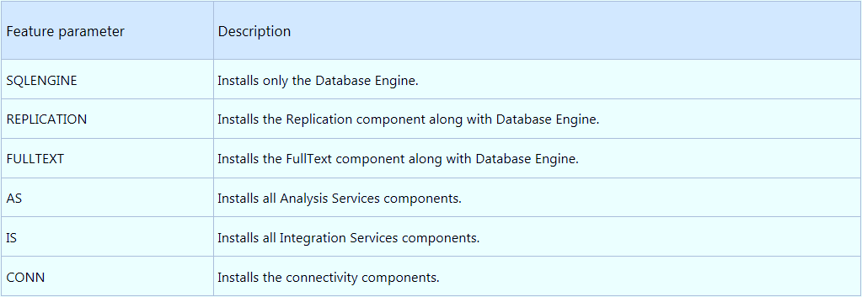
Core Installation

Slide 24
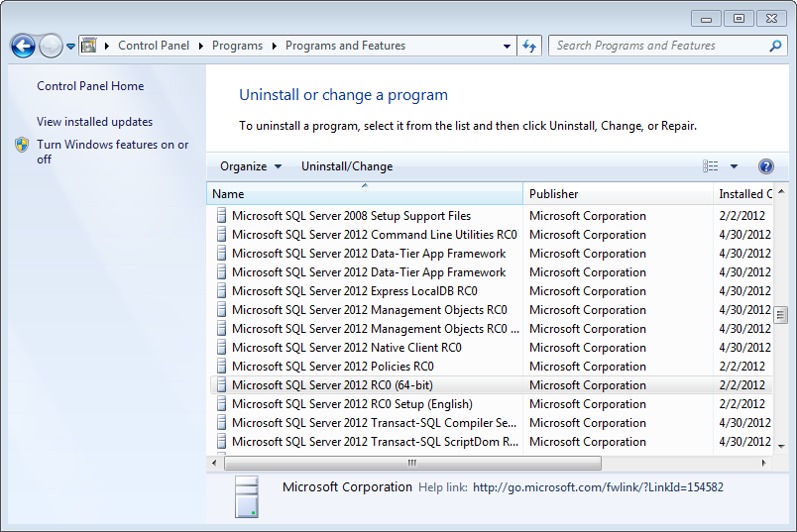
Add/Remove Features

Slide 25
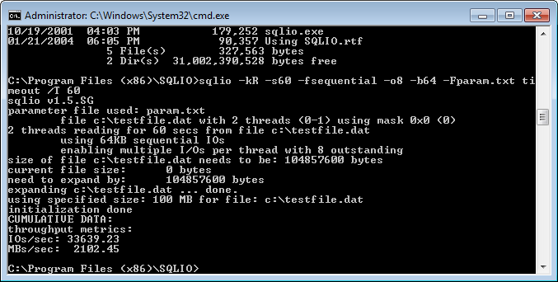
SQLIO

Slide 26
Implement a Migration Strategy
Backup/Restore
Detach/Attach
Migrate security (Transfer Logins)
Upgrade/Migrate

Slide 27
Configure SQL Server Components
Analysis Services
Reporting Services
Full text indexing
Integration Services security
Filestream, Filetable

Slide 28
Semantic Search
Add Full text feature (if not done during install)
Install Microsoft Office 2010 Filter Packs (for files)
Enable Filter Packs
Run SemanticLaguageDatabase.msi and register the database
Create Catalog and Index

Slide 29
Manage SQL Server Agent
Create, maintain and monitor jobs
Create operators and alerts

Slide 30
Question (Multiple Choice)
Your network contains a server named Server1 that runs Windows Server 2008 R2. Server1 access files stored on a SAN named SAN1 using the Microsoft iSCSI initiator.
You want to install SQL Server 2012 on. The IO requirements for the application specify that the database traffic will reach over 2000Mb/sec.
You need to determine if Server1 and SAN1 can handle the requirements.

Slide 31
Question (Multiple Choice)
What utility should you run?
SQLIO
SQLIOSIM
SQL Server Profiler
Database Engine Tuning Advisor
TIP: Plausibility
Every answer must be plausible, it has to exist on the current or prior version of the product
TIP: Eliminate wrong answers
When the right answer is not easy to spot, try to spot the wrong answers!

Slide 32
Topics Outline
Install and Configure SQL Server 2012
Maintain Instances and Databases
Optimize and Troubleshoot SQL Server
Manage Data
Implement Security
Implement High Availability

Slide 33
Manage and Configure Databases
Design Multiple Filegroups
Recovery Models: Simple, Bulk Logged, Full
Contained Databases
Data Compression
Transparent Data Encryption

Slide 34
Transparent Data Encryption
Create master key (master)
Create certificate with the master key (master)
Create database encryption key (db)
Backup certificate (best practice)
Turn on encryption

Slide 35
Configure SQL Server Instances
Affinity mask
Memory allocation
Database mail

Slide 36
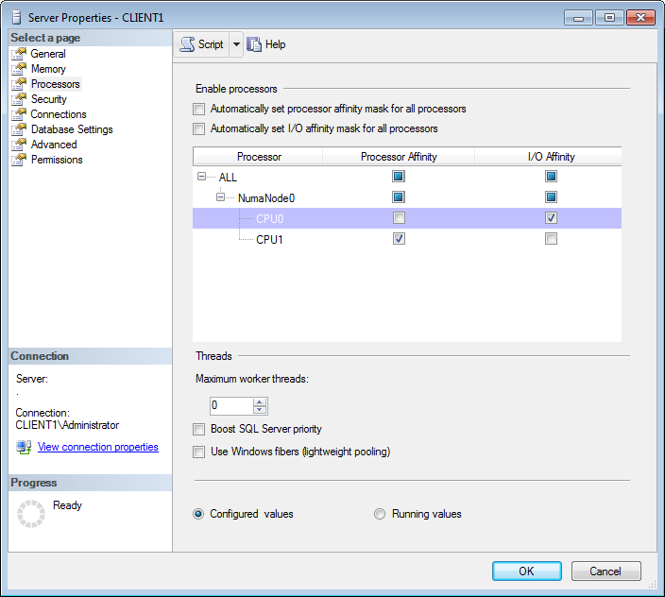
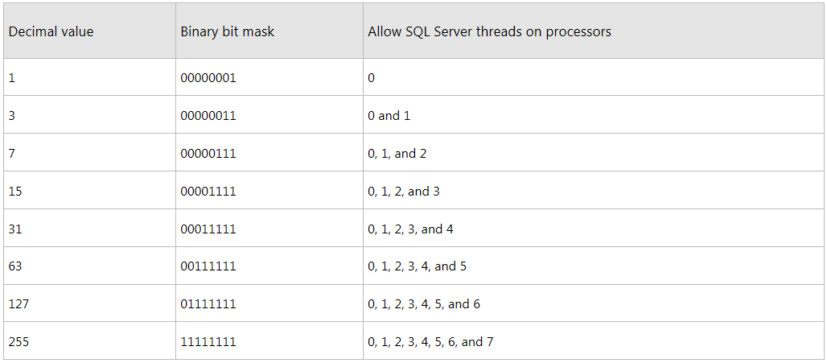
Affinity Mask

Slide 37
Implement a SQL Server Clustered Instance
Install a cluster
Manage multiple instances on a cluster
Recover from a failed cluster node

Slide 38
Manage SQL Server Instances
Install instances
Configure Resource Governor

Slide 39
Question (Build List)
Your network contains a server named Server1 that runs SQL Server 2012. Server1 contains a database named DB1. DB1 contains sensitive information.
You send a backup of DB1 to an offsite location every week.
You need to ensure that nobody in the offsite location is able to read the contents of DB1 in case they restore the database.
What should you do? To answer, drag the appropriate steps to the answer area and order then.

Slide 40
Question (Build List)
Steps:
Create a database encryption key
Create a master key
Create a certificate
Enable encryption
Create a credential
TIP: Find out the number of steps
Move all steps to the answer area. The system will alert you when the maximum number of steps is reached

Slide 41
Identify the number of steps
Steps:
Create a database encryption key
Create a master key
Create a certificate
Enable encryption
Create a credential
Create a database encryption key
Create a master key
Create a certificate
Enable encryption
Create a credential
TIP: Identify the right steps
Move the steps you believe to be necessary. Then reorder.

Slide 42
Identify the correct steps
Steps:
Create a database encryption key
Create a master key
Create a certificate
Enable encryption
Create a credential
Create a database encryption key
Create a master key
Create a certificate
Enable encryption
TIP: Identify the right steps
Move the steps you believe to be necessary. Then reorder.

Slide 43
Place Steps in Correct Order
Steps:
Create a master key
Create a certificate
Create a database encryption key
Enable encryption

Slide 44
Topics Outline
Install and Configure SQL Server 2012
Maintain Instances and Databases
Optimize and Troubleshoot SQL Server
Manage Data
Implement Security
Implement High Availability

Slide 45
Identify and Resolve Concurrency Problems
Examine deadlocks
DBCC TRACEON(1222,-1)
DMVs
sys.dm_tran_locks
sys.dm_os_waiting_tasks
sys.dm_exec_requests
Extended Events
System Health Session

Slide 46
Collect and Analyze Troubleshooting Data
SQL Profiler
Performance Monitor
Extended Events
Data Collector

Slide 47
Audit SQL Server Instances
Policy based management
On demand
Prevent (only for objects that support DDL triggers)
Audit and Audit Specifications

Slide 48
Question (Choose all that apply)
Your network contains a server named Server1 that runs SQL Server 2012. Server1 contains a database named DB1. Database developers report that their applications handle a lot of deadlock errors.
You need identify a solution to monitor deadlock activity.
What solution should you use?
Each answer presents complete solution.
Choose all that apply.

Slide 49
Question (Choose all that apply)
A. a SQL Profiler trace
B. an Extended event session
C. a Performance Monitor data collector set
D. a SQL Server Data Collection Set

Slide 50
Answer
A. a SQL Profiler trace
B. an Extended event session
C. a Performance Monitor data collector set
D. a SQL Server Data Collection Set

Slide 51
Topics Outline
Install and Configure SQL Server 2012
Maintain Instances and Databases
Optimize and Troubleshoot SQL Server
Manage Data
Implement Security
Implement High Availability

Slide 52
Configure and Maintain a Backup Strategy
Differential backups
Point in time restore
Backup filegroups

Slide 53
Restore a Database
Restore a database secured with TDE
Page level restore

Slide 54
Implement and Maintain Indexes
Identify fragmented indexes
sys.dm_db_index_physical_stats
Identify unused indexes
sys.dm_db_index_usage_stats
Identify useful indexes
sys.dm_db_missing_index_details
sys.dm_db_missing_index_columns

Slide 55
Implement and Maintain Indexes
Index that cover queries
Filtered indexes
Column store indexes
http://msdn.microsoft.com/en-us/library/gg492088.aspx#Described

Slide 56
Import and Export Data
Transfer data
Bulk copy
Bulk insert

Slide 57
Topics Outline
Install and Configure SQL Server 2012
Maintain Instances and Databases
Optimize and Troubleshoot SQL Server
Manage Data
Implement Security
Implement High Availability

Slide 58
Implement Security
Manage Login and Server roles
Server security
Server roles
Logins
Manage Database Permissions
Database level permissions
Manage user and database roles
Least privilege

Slide 59
Question (Choose all that apply)
Your network contains a server named Server1 that runs SQL Server 2012. Server1 contains a database named DB1.
DB1 contains several tables. Applications will execute CRUD operations by using stored procedures.
You need to ensure users are able to perform CRUD operations by using the applications available to them. Your solution must prevent users from accessing tables directly.
What should you do? Each answer presents part of the solution. Choose all that apply.

Slide 60
Question (Choose all that apply)
A. Deny access to all tables to users
B. Revoke access to all tables from all users
C. Grant access to all tables to all users
D. Revoke create access to all stored procedures from all users
E. Grant access to all stored procedures to all users

Slide 61
Topics Outline
Install and Configure SQL Server 2012
Maintain Instances and Databases
Optimize and Troubleshoot SQL Server
Manage Data
Implement Security
Implement High Availability

Slide 62
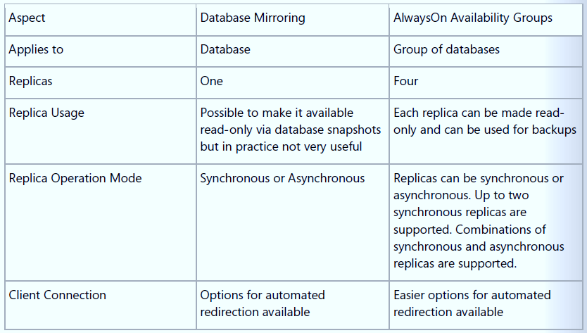
Implement High Availability
Implement AlwaysOn Availability Groups
Requires Windows Server Failover Clustering
One primary, up to four replicas
Asynchronous and synchronous
Automatic, planned manual and forced manual failover
http://msdn.microsoft.com/en-us/library/ff877884.aspx
Implement database mirroring
High safety vs high performance
Manual vs automatic failover
Implement replication

Slide 63
Question
Your network contains two servers named Server1and Server2. Server1 and Server2 run SQL Server 2012 and have access to SAN named SAN1. SAN1 stores all SQL data and log files used by Server1 and Server2. Server1 contains a database named DB1. DB1 is a heavily used database.
Users report that when running reports on DB1, regular CRUD operations run slower. They are also concerned that if the server crashes DB1 will become unavailable.
You need recommend a solution that can maintain DB1 availability automatically in case Server1 crashes. You solution must also provide a read-only copy of DB1 for reporting purposes.
What solution should you recommend?

Slide 64
Question
What solution should you recommend?
A. Create a failover cluster
B. Create an AlwaysOn availability group
C. Create a transactional replication
D. Create a Log shipping solution

Slide 65
Answer
What solution should you recommend?
A. Create a failover cluster
B. Create an AlwaysOn availability group
C. Create a transactional replication
D. Create a Log shipping solution

Slide 66
Preparation Options
Instructor-Led Training: 10775A – Administering Microsoft SQL Server 2012 Databases
Exam Prep Video
Self-Paced Training - Available on the Microsoft Virtual Academy Web Site Administering Microsoft SQL Server 2012 Jump Start
Practice Tests
MeasureUp
SelfTestSoftware/Transcender

Slide 67
Preparation Options
Books Training Kit (Exam 70-462): Administering Microsoft SQL Server 2012 Databases (I was technical reviewer / author on this)
Study Groups
Microsoft Learning’s Born to Learn site

Slide 68
Schedule and Take the Exam

Slide 69
Exam Tips
Before the Exam
Set a date
During the Exam
Don’t panic
Tough Question
Eliminate wrong answers
Set small goals
Sleep well
Keep an eye on time
Don’t spend too long on one question
Mark the question for review
Guess

Slide 70
Resources
Learning
Sessions on Demand
Microsoft Certification & Training Resources
http://channel9.msdn.com/Events/TechEd
www.microsoft.com/learning
TechNet
msdn
Resources for IT Professionals
Resources for Developers
http://microsoft.com/technet
http://microsoft.com/msdn

Slide 71
Complete an evaluation and enter to win!

Slide 72
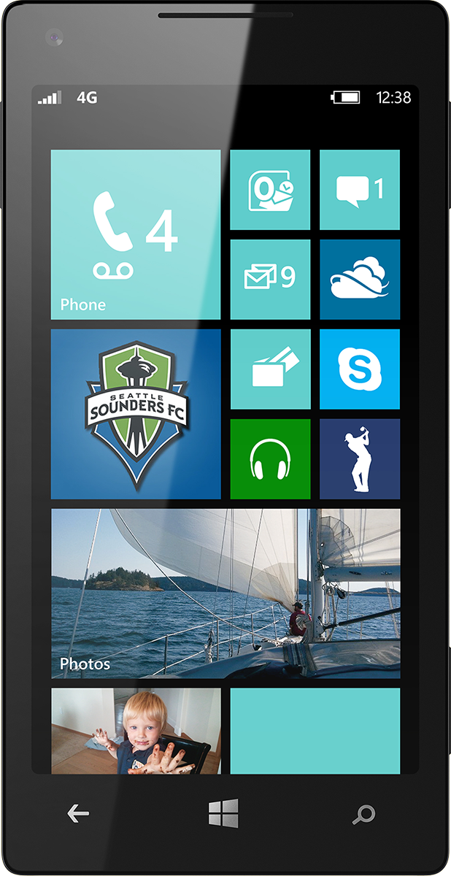
Evaluate this session
Scan this QR code to evaluate this session.

Slide 73
Related content
Breakouts DBI-B214 Introduction to SQL Server Management for the Non-DBA
Labs DBI-H306 What's New in Microsoft SQL Server 2014 for DBAs
Microsoft Solutions Experience Location (MSE)
Related Certification Exam 70-461 Querying Microsoft SQL Server 2012
Find Me Later At Ask The Experts
or Exam Prep for Exam 70-462

Slide 74
© 2014 Microsoft Corporation. All rights reserved. Microsoft, Windows, and other product names are or may be registered trademarks and/or trademarks in the U.S. and/or other countries.
The information herein is for informational purposes only and represents the current view of Microsoft Corporation as of the date of this presentation. Because Microsoft must respond to changing market conditions, it should not be interpreted to be a commitment on the part of Microsoft, and Microsoft cannot guarantee the accuracy of any information provided after the date of this presentation. MICROSOFT MAKES NO WARRANTIES, EXPRESS, IMPLIED OR STATUTORY, AS TO THE INFORMATION IN THIS PRESENTATION.

