Slide 2
Modern Application Lifecycle Management
FDN04
Brian Harry
Brian Keller

Slide 3
Modern Application Lifecycle
Plan
Monitor + Learn
BACKLOG
Development
Production
Develop + Test
Release
Collaboration

Slide 4
Agenda
Year in Review
  Updates since last TechEd
Migrating to Visual Studio Online
Visual Studio Online Extensibility
  REST API’s
  Service Hooks
  OAuth
DevOps
  Release Management
  Application Insights
  Azure Preview Portal

Slide 5
Work Item Tags
Removing Weekends from Burndowns
Push to Multiple Remotes (Git)
Release Management
Bulk Edit of Test Cases
Team Rooms
Query Tags
Build Images Updated for VS2013
Windows 8.1 in Hosted Builds
Work Items from Code Discussions
Visual Studio Online
Team Project Deletion
New Languages for Code Syntax Highlighting
Configurable CFD Dates
12 months
Backlog Mapping
Work Item Charts
Cloud-Based Load Testing
Work Item Chart Pinning
Color Picking in Charts
Agile Portfolio Management Updates
Shared Parameters for Test Cases
Team Foundation Server 2013
Application Insights Preview
Maven Support for Builds
Git Revert
Team Room Git push events
Java in Hosted Builds
Exporting Test Artifacts
Paste Images via Web
Git Annotate
Visual Studio 2013
Azure Preview Portal
Improved Code Commenting
Improved Git Permissions
VSO General Availability

Slide 6
Work Item Tags
Removing Weekends from Burndowns
Bulk Edit of Test Cases
Query Tags
Work Items from Code Discussions
Configurable CFD Dates
12 months
Backlog Mapping
Work Item Charts
Work Item Chart Pinning
Color Picking in Charts
Agile Portfolio Management Updates
Shared Parameters for Test Cases
Exporting Test Artifacts
Paste Images via Web

Slide 7
Push to Multiple Remotes (Git)
12 months
Git Revert
Team Room Git push events
Git Annotate
Improved Git Permissions

Slide 8
Build Images Updated for VS2013
Windows 8.1 in Hosted Builds
12 months
Maven Support for Builds
Java in Hosted Builds

Slide 9
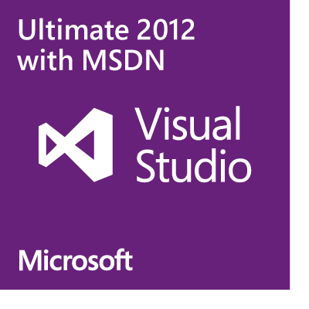
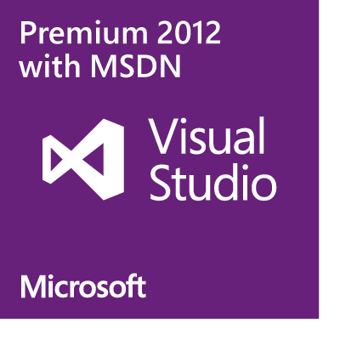
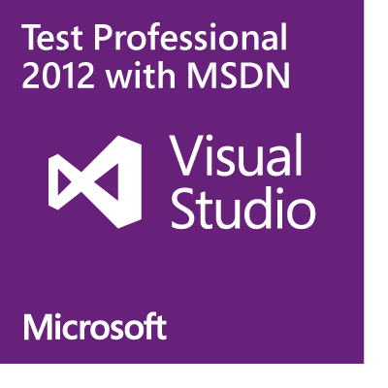
Visual Studio Online*
Free Plan for up to 5 users
Version control (TFVC or Git)
Comment on changesets & commits
Work item tracking and tagging
Team rooms
Agile planning tools
Feedback Management
Agile Portfolio Management
Build service
Web-based test case management
Cloud-based load testing
Included for certain
paid MSDN subscribers:
http://yourname.visualstudio.com
*The artist formerly known as “Team Foundation Service”

Slide 10
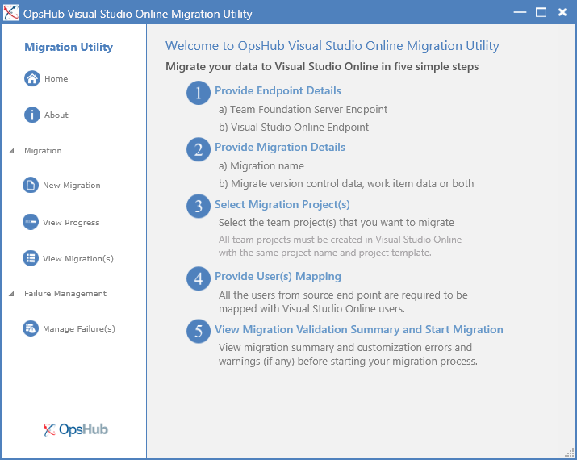
Announcing
OpsHub Visual Studio Online Migration Utility
Migrate your source code, history and work items to the cloud with a few simple steps
Map your users to maintain consistency and accountability after your migration
Get it FREE at http://aka.ms/OpsHubVSO

Slide 11
Capabilities and Limitations
Will Migrate:
From Team Foundation Server 2010, 2012, 2013
Standard process templates
Version control history, work items, work item attachments, test cases, test results, and links
Won’t Migrate
Anything from outside Team Foundation Server (SharePoint, SCVMM, etc.)
Builds, lab environments, team rooms
Security & Permissions
Team & Personal favorites, alerts and work item queries
Customized process templates
There are additional tools commercially available to support more complex migration scenarios

Slide 12
Five Simple Steps to the Cloud

Slide 13
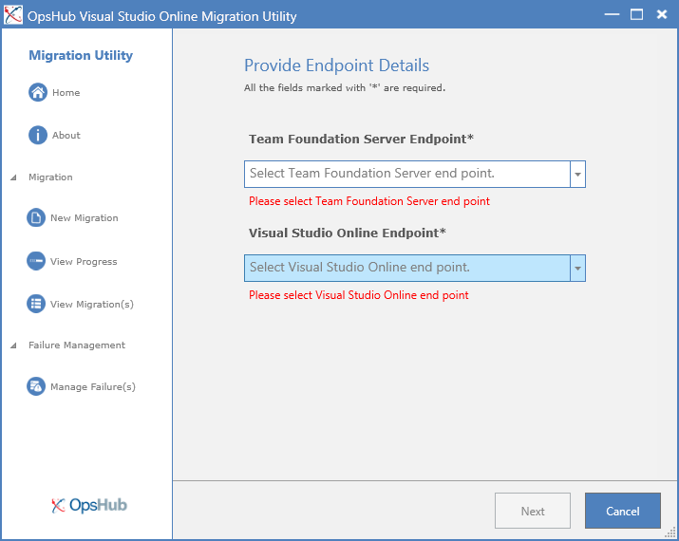
Simple Endpoint Selection
  The utility will prompt for missing or incomplete information
  The utility prevents moving on until all required information is valid

Slide 14
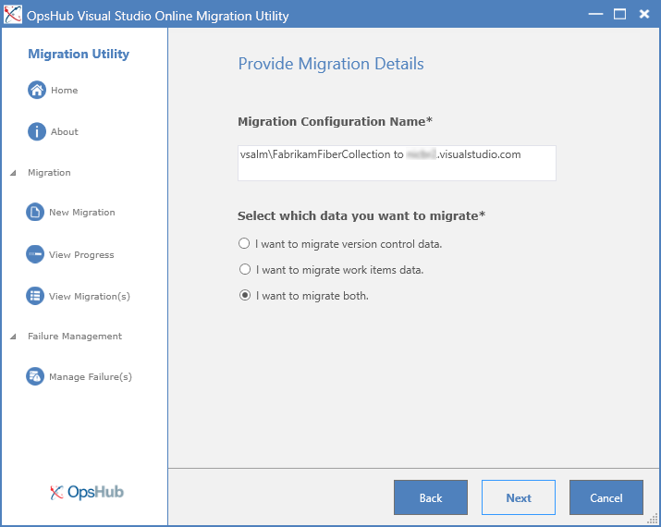
Data Migration Selection
  By default, the tool will move the version control data and the work item data

Slide 15
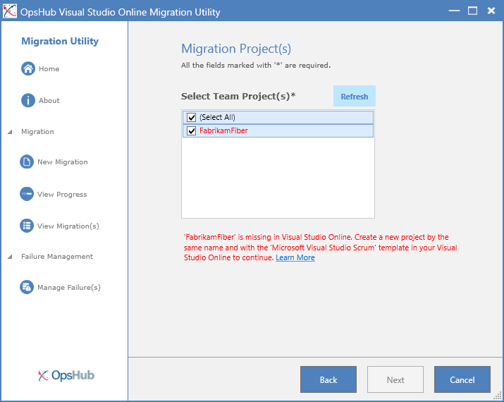
Project Selection and Validation
  If errors are encountered you will be prompted on how to resolve them

Slide 16
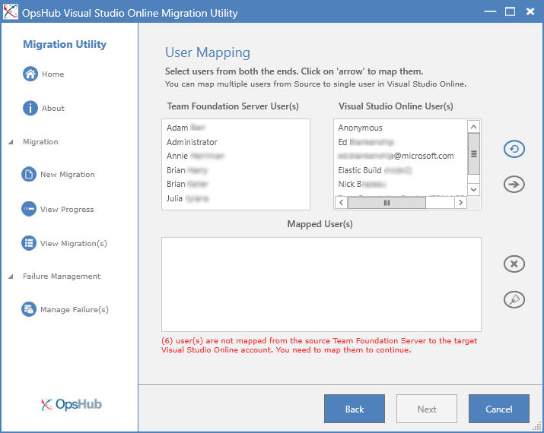
Map your Users
  Select the users you want to map. This supports a many-to-one mapping
  Refresh your user mappings if add users during the migration

Slide 17
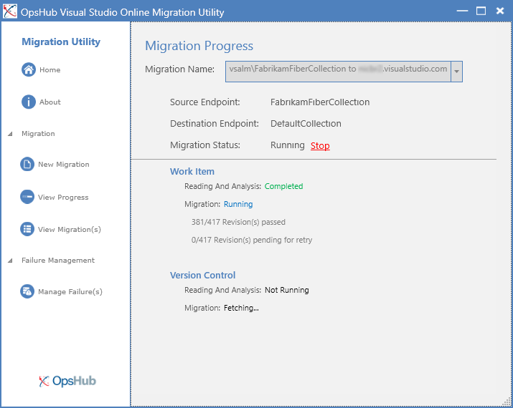
Your Migration
  Easily view the current status of the migration
  See where you are in the process of the migration

Slide 18
AAD Support for Visual Studio Online
Spring 2014
Later in 2014
Goal
AAD is provided for new accounts
AAD is offered for existing VSO accounts
Key Experiences
New VSO accounts from Azure can be connected to an AAD.
All VS clients and tools can access AAD Connected VSO accounts.
The VSO Benefit for MSDN Subscriptions supports AAD.
Create a new AAD VSO account from VisualStudio.com.
Link existing VSO Account to an AAD directory maintains users history.

Slide 19










Visual Studio Online APIs
REST
OAuth2
Service Hooks

Slide 20
Demo
Visual Studio Online APIs

Slide 21
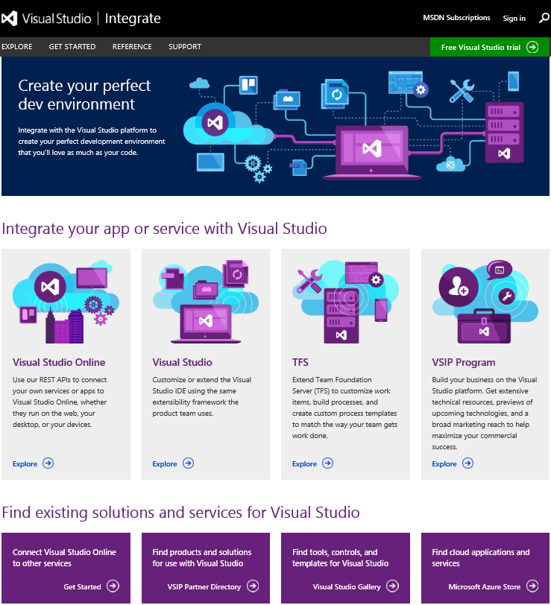

Visual Studio Online APIs
DEV-B368: Using Third-Party ALM Solutions with Visual Studio Online
Thursday, May 15 1:00 PM - 2:15 PM
Will Smythe
http://integrate.visualstudio.com

Slide 22
DevOps

Slide 23
DEV
OPS
Release Management
Configuration Management
Provisioning
Monitoring
Analytics
Incident Resolution

Slide 24


Release Management for Visual Studio
Release management is the process of managing software releases from development to production.
Testing Time
Provision
Deploy
Code
DEV
INT
QA
PROD
Coordination
Deploy the same code every time, every where, in the same way

Slide 25
PowerShell Desired State Configuration
Enables you to ensure that the components of your data center have the correct configuration
Allows “continuous deployment” and prevents “configuration drift”
Uses language extensions and providers to enable declarative, autonomous and idempotent (repeatable) Deployment, Configuration and Conformance of standards-based managed elements

Slide 26
Release Management and DSC
Coming in Visual Studio 2013 Update 3:
Integration between Release Management and PowerShell DSC
Supports deployments to on-premises, cloud, and hybrid environments
Application Lifecycle Management
Developer and workflow tools
Release Management
Configuration as code
Desired State Configuration
Deployment and Configuration
Windows

Slide 27
Demo
Release Management + DSC

Slide 28
Dev & Test On Premises
Challenges
Longer Infrastructure Wait Time
Higher Infrastructure Costs
Lower Developer Productivity
Developers
Use VMs
Your Datacenter
Provision VMs
VMs in dev & test environment
IT Admin

Slide 29
Dev & Test in the Cloud
Developers
Use VMs
Provision VMs
Benefits
Shorter Infrastructure Wait Time
Lower Infrastructure Costs
Higher Developer Productivity
Manage environment
IT Admin

Slide 30






{
MSDN Credits
$50/ month
professional
3 VMs for 16 hours a day
$100/ month
PREMIUM
80 VMs for 20 hours
$150/ month
ULTIMATE
Up to 500 web sites plus SQL DB

Slide 31
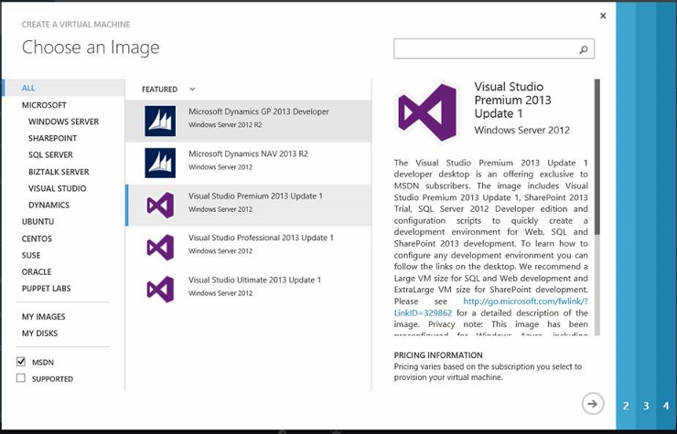
Announcing
Windows Client VMs for MSDN
Windows 7, Windows 8.1, and Windows 8.1 + Visual Studio 2013.2
Available to MSDN subscribers with Azure benefits

Slide 32
Demo
Release Management + IaaS

Slide 33

Release Management @ TechEd
DCIM-B324 PowerShell Desired State Configuration and DevOps in Azure
Monday, May 12 4:45 PM - 6:00 PM
Hemant Mahawar, Narayanan Lakshmanan
DEV-B216 Implementing a Release Pipeline w/ Release Management for Visual Studio
Tuesday, May 13 8:30 AM – 9:45 AM
Claude Remillard, Arun Chandrasekhar
DEV-B349 A Practical View of Release Management for Visual Studio 2013
Wednesday, May 14 3:15 PM – 4:30 PM
Claude Remillard, Donovan Brown

Slide 34
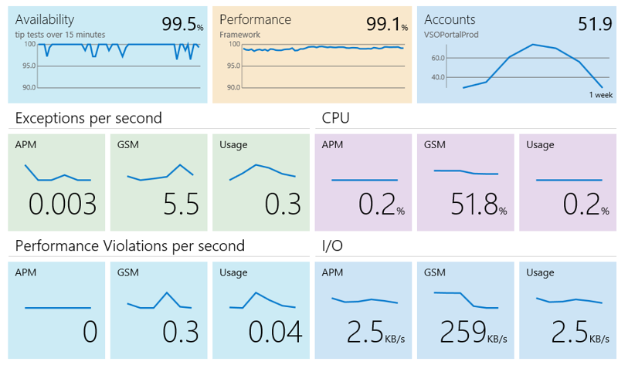
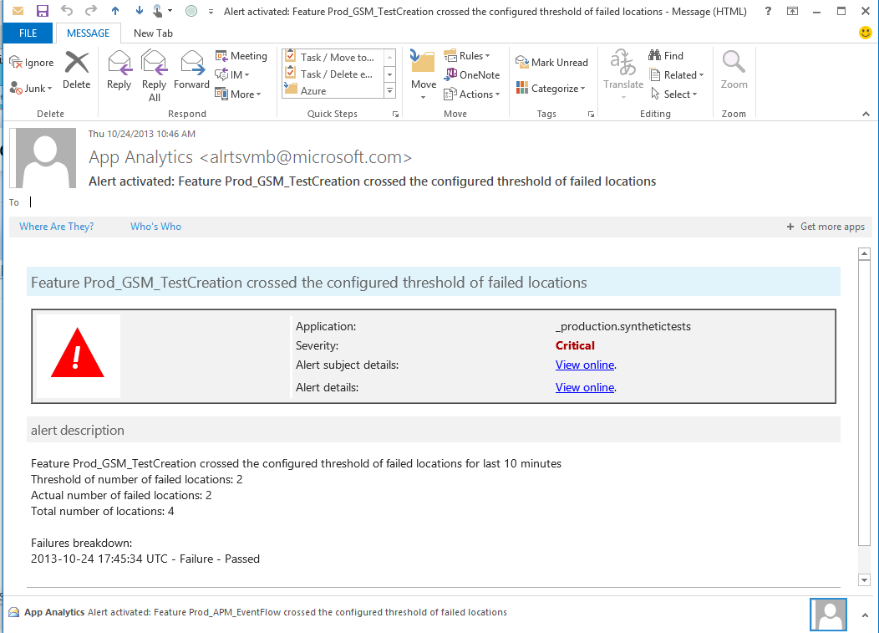
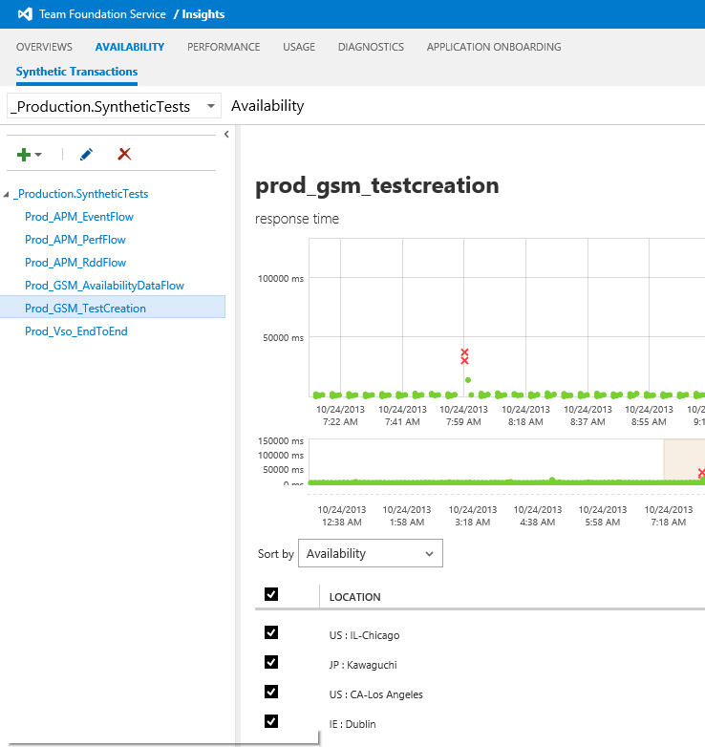
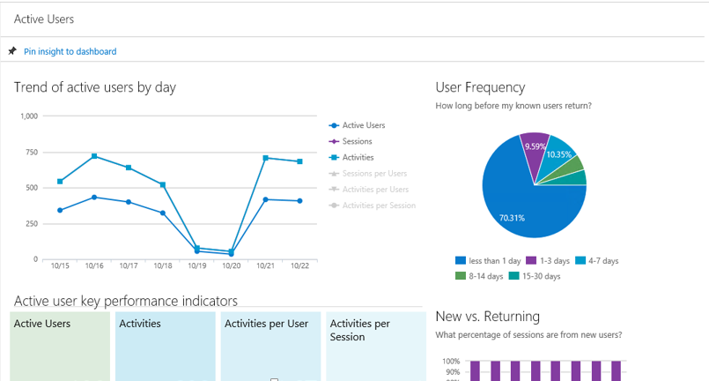
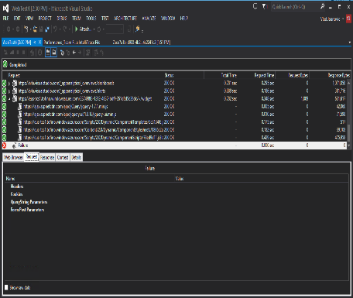
Visual Studio Online - Application Insights
Available
Performing
Succeeding
Health Dashboards
Notifications & Deep Insights
Usage Dashboards
Is my application available and
performing for users?
One Dashboard
What’s wrong?
Show me suspicious code and test cases
Where do we invest next?
Show me top features and customer
Usage patterns

Slide 35
Demo
Application Insights

Slide 36
Application Insights @ TechEd
DEV-B309 Make Data-Driven, High-Impact Improvements to an Application with Application Insights
Monday, May 12 4:45 PM - 6:00 PM
Bret Grinslade
DEV-B391 See How MS Game Studios Uses Application Insights to Gain Early Warning of Performance Issues, Failures, and Pinpoint the Root Causes
Tuesday, May 13 3:15 PM - 4:30 PM
Kyle McClellan, Vlad Joanovic
DEV-B222 Rapidly Detect Application Outages with Visual Studio Online Application Insights
Wednesday, May 14 1:30 PM - 2:45 PM
Vlad Joanovic

Slide 37

A vision for the future of DevOps
Mic
r
os
o
f
t Azu
r
e
:-)
10

Slide 38
Demo
Azure Preview Portal

Slide 39
Azure Preview Portal @ TechEd
DCIM-B223 The Future of Microsoft Azure DevOps: Building, Deploying, Managing, and Monitoring Your Cloud Applications in the New Azure Portal Monday, May 12 4:45 PM - 6:00 PM
Bradley Millington, Chandrika Shankar
DEV-B224 Microsoft Azure Resource Manager
Thursday, May 15 2:45 PM - 4:00 PM
Charles Lamanna, Gautam Thapar, Kevin Lam

Slide 40
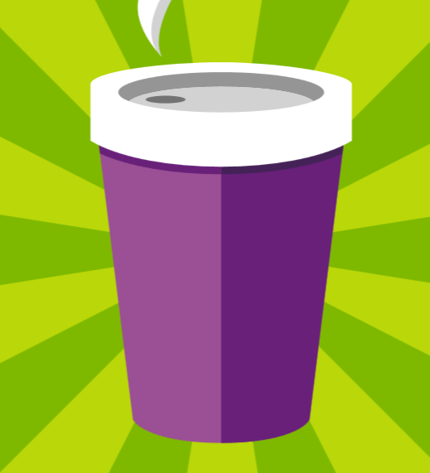







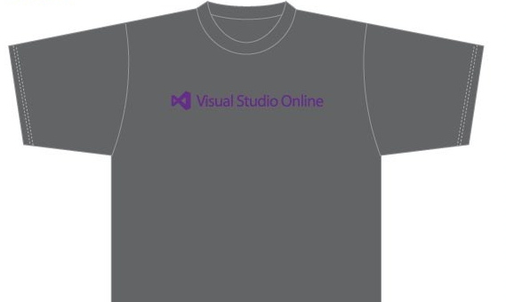
Visit the Developer Platform & Tools Booth
Having a friend
buy your coffee?
Yea, it’s kind of like that.
MSDN Subscribers get up to $150/mo in Azure credits.
Stop by the Developer Platform and Tools booth and visit the MSDN Subscriptions station to activate your benefits and receive a gift!
http://aka.ms/msdn_teched
3 Steps to New Gear! With Application Insights
Create a Visual Studio Online account http://visualstudio.com
Install Application Insights Tools for Visual
Studio Online http://aka.ms/aivsix
Come to our booth for a
t-shirt and a chance to win!
VSIP QR Tag Contests
Visit our booth to join the hunt for cool prizes!

Slide 41


Resources
Microsoft Engineering Stories
  Development tools & services for teams
  of all sizes
  How Microsoft Builds Software
  http://aka.ms/EngineeringStories
http://www.visualstudio.com
Visual Studio
Industry Partner
Program
Visual Studio | Integrate
  Meet Our New Visual Studio Online Partners
  or Join Now.
  http://vsipprogram.com
  Create Your Own Dev Environment
  http://integrate.visualstudio.com

Slide 42

Resources
Learning
  Sessions on Demand
  Microsoft Certification & Training Resources
http://channel9.msdn.com/Events/TechEd
www.microsoft.com/learning
TechNet
msdn
  Resources for IT Professionals
  Resources for Developers
http://microsoft.com/technet
http://microsoft.com/msdn

Slide 43



Complete an evaluation and enter to win!

Slide 44
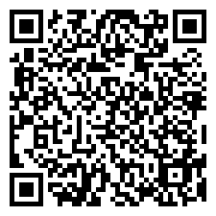

Evaluate this session
Scan this
QR code
to evaluate
this session.

Slide 45


© 2014 Microsoft Corporation. All rights reserved. Microsoft, Windows, and other product names are or may be registered trademarks and/or trademarks in the U.S. and/or other countries.
The information herein is for informational purposes only and represents the current view of Microsoft Corporation as of the date of this presentation. Because Microsoft must respond to changing market conditions, it should not be interpreted to be a commitment on the part of Microsoft, and Microsoft cannot guarantee the accuracy of any information provided after the date of this presentation. MICROSOFT MAKES NO WARRANTIES, EXPRESS, IMPLIED OR STATUTORY, AS TO THE INFORMATION IN THIS PRESENTATION.

