Slide 2
Overview of Business Intelligence in Microsoft Office and Office 365
OFC-B215
Peter Myers
Bitwise Solutions Pty Ltd
Seayoung Rhee
Microsoft

Slide 3
Presenter Introduction
Peter Myers
BI Expert, Bitwise Solutions Pty Ltd
BBus, SQL Server MCSE, MCT, SQL Server MVP (since 2007)
Experienced in designing, developing and maintaining Microsoft database and application solutions, since 1997
Focuses on education and mentoring
Based in Melbourne, Australia
peter.myers@bitwisesolutions.com.au
http://www.linkedin.com/in/peterjsmyers

Slide 4
Presenter Introduction
Seayoung Rhee
Senior Product Manager, Microsoft
syrhee@microsoft.com

Slide 5
Session Outline
Introduction
Enabling Microsoft SSBI:
Office
SharePoint
SQL Server
Summary
Resources

Slide 6
The World of Data is Changing
10x increase every five years
Data explosion
Consumerization of IT
4.3 connected devices per adult
85% from new data types
27%
using social media input
“By 2015, organizations integrating high-value, diverse, new information types and sources into a coherent information management infrastructure will outperform their industry peers financially by more than 20%.”
– Gartner, Regina Casonato et al., “Information Management in the 21st Century”

Slide 7
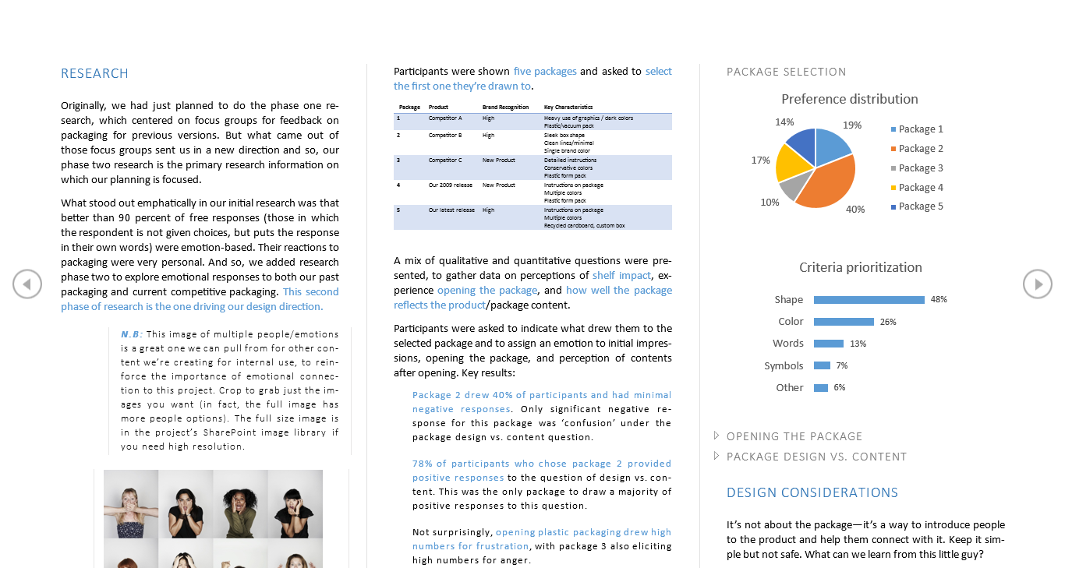
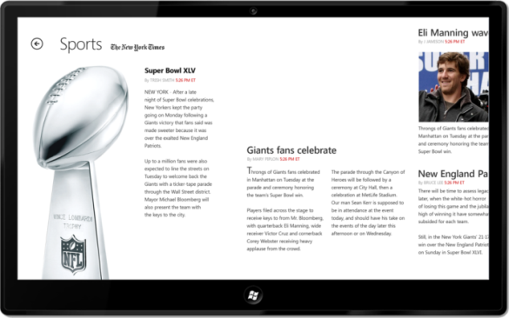
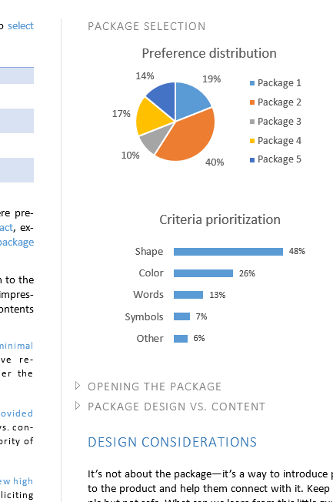
Introducing Microsoft’s Strategy and Vision Productivity
Hybrid
On Premises
Online
Best experience across devices
Cloud on your terms
Messaging
Voice & Video
Content
Management
Enterprise
Social
Data
& Analytics
Integrated best-of-breed solutions

Slide 8
Business Intelligence
Explore
Visualize
Control
Easily combine data from any source to create fully interactive reports and insights with guided exploration
Visually discover and share insights for collaborative decision making across the organization
Manage self-service BI with control & compliance for end user created assets

Slide 9
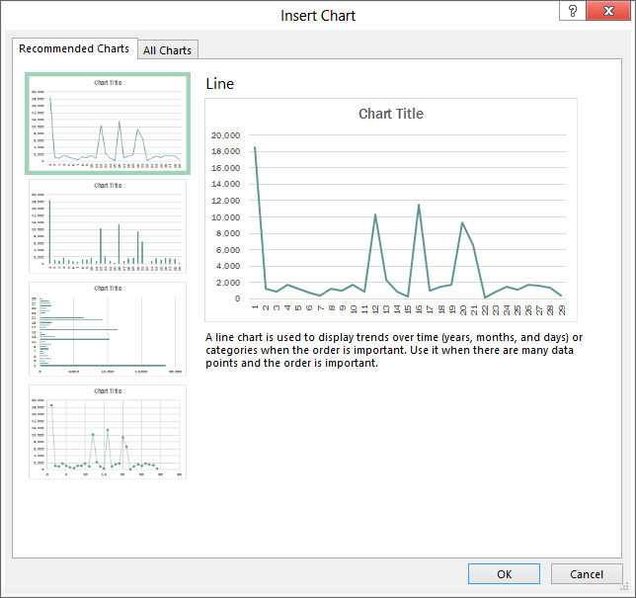
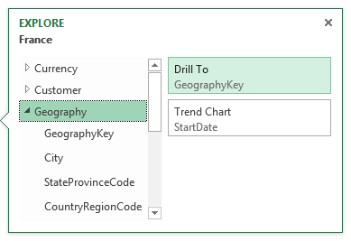
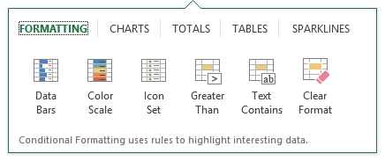
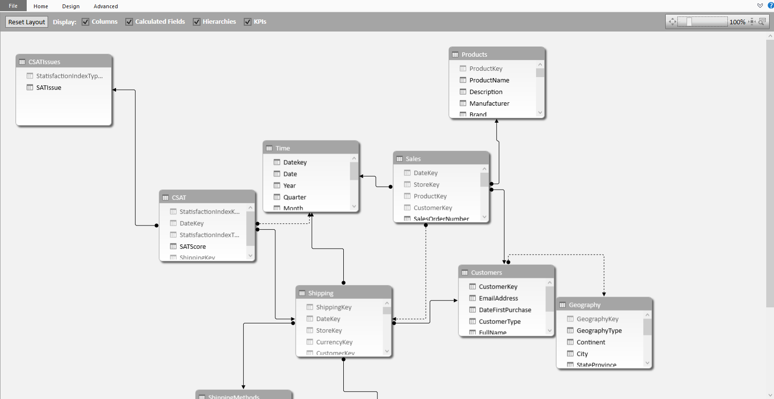
Explore
Combine and analyze large datasets
Summarize data and discover trends
Instantly preview charts and pivot tables

Slide 10
Visualize
Perform interactive data exploration
Share reports with your colleagues
Work together to make decisions on dashboards

Slide 11
Control
Consolidate and simplify management
Manage spreadsheet integrity and compliance

Slide 12
Enabling Microsoft SSBI
Office
SharePoint
SQL Server

Slide 13
Enabling Microsoft SSBI Office
Office comprises a suite of productivity desktop applications, well suited for analysts
These applications:
Play a major role in realizing Microsoft’s visions
Are designed to help users easily find, analyze, and more securely share business information
Notably, Excel plays a major role in delivering SSBI with the Power BI and Data Mining add-ins
Visio plays a role also, albeit a lesser one

Slide 14
Demo
Exploring the Power BI Add-ins

Slide 15
Enabling Microsoft SSBI Office: Excel: Other Reporting Capabilities
Excel reporting based on a Power Pivot data model can be achieved by using:
PivotTables and PivotCharts
CUBE functions
Apps for Office
Slicers and Timelines
Reports can be enhanced with:
Charts
Embedded images
Conditional formatting
Slicers
Timelines
Sparklines
Hyperlinks
Outlining
Apps for Office

Slide 16
Demo
Producing an Excel Dashboard with the CUBE Functions and Apps for Office

Slide 17
Enabling Microsoft SSBI Office: Visio
Visio allows creating diagrams, and this product plays a minor role in delivering SSBI
Diagrams can be connected to external data, and expressed through shape properties and graphics

Slide 18
Demo
Producing a Visio Data-Driven Diagram

Slide 19
Enabling Microsoft SSBI Office (Continued)
Today, there is choice:
Office 2013
Office 365

Slide 20
Enabling Microsoft SSBI Office: Office 2013
Easily combine data from any source to create fully interactive reports and insights with guided exploration (Power Pivot)
Visually discover and share insights for collaborative decision making across the organization (Power View)
Manage self-service BI with control & compliance for end user created assets (Inquire)

Slide 21
Enabling Microsoft SSBI Office: Office 365
Office 365 is available as a subscription
Deployed easily and quickly by Click-to-Run (C2R) and maintained through automatic updates
Some newer features, including Power BI functionality, is only available with this licensing mode

Slide 22
Enabling Microsoft SSBI SharePoint
SharePoint delivers content management, and rich BI services and capabilities, including governance
Today, there is choice:
On-premises: SharePoint 2013
Cloud: SharePoint Online
SharePoint can be purchased in the cloud as a standalone offering, or as part of an Office 365 suite that provides access to Exchange, Lync, the Office clients and web apps

Slide 23
Enabling Microsoft SSBI SharePoint 2013 (On-premises)
On-premises with SharePoint 2013:
Excel Services: Server-side workbook calculation and rendering
Visio Services: Server-side diagram rendering
PerformancePoint Services: Performance monitoring and analysis with scorecards and dashboards
Power Pivot: Data model querying and data refresh
Reporting Services: Rich report management and delivery
Power View: Interactive reporting based on Analysis Services data models (including Power Pivot)
Interactive web part dashboards

Slide 24
Enabling Microsoft SSBI SharePoint Online (Cloud)
SharePoint Online delivers the powerful features of SharePoint without the associated overhead of managing the infrastructure on your own:
Excel Online: Cloud workbook calculation and rendering
Visio Online: Cloud diagram rendering
Power BI:
Power Query (Data Catalog): Query storage, discover and monitoring
Power Pivot: Data model querying and data refresh
Power View: Interactive reporting
Power BI Sites: Storage and management of Excel workbooks
Power Q&A: Natural language querying and discovery
Power BI Windows Store App: Connected mobile delivery

Slide 25
Demo
Exploring the SharePoint Online and the Power BI Site

Slide 26
Enabling Microsoft SSBI SQL Server
The SQL Server product team are responsible for the development of the Power BI add-ins
Not part of the Power BI family, the Excel data mining add-ins deliver predictive analytics to the Excel user

Slide 27
Enabling Microsoft SSBI SQL Server – Data Mining Add-ins
Table Analysis Tools
Provide an easy-to-use interface to leverage SQL Server data mining to perform powerful end user analysis on workbook data
Client Tools
Offers a full data mining model development lifecycle directly within Excel
Has been designed to work through the entire data mining process
Include model and management options
Data Acquisition
Data Preparation
Modeling
Validation
Application

Slide 28
Demo
Exploring the Excel Data Mining Add-ins

Slide 29
Summary
All users can transform data into insight…
As a natural part of their day to day activities…
With the tools they already know and love

Slide 30
Summary
Microsoft continues to deliver on its long term commitment to deliver BI to the masses
Office, and notably Excel, achieve this with native reporting capabilities and Power BI add-ins
SharePoint delivers content management, and rich BI services and capabilities, including governance
SQL Server contributes Power BI and the Data Mining add-ins

Slide 31
Resources
Microsoft Business Intelligence web site
http://www.microsoft.com/bi
Microsoft Office web site
http://microsoft.com/office
Microsoft Office Excel web site
http://office.microsoft.com/excel
Microsoft Power BI for Office 365 web site
http://www.powerbi.com
Try a free one month trial today
SQL Server 2012 SP1 Data Mining Add-ins for Office
http://www.microsoft.com/en-us/download/details.aspx?id=35578

Slide 32
Related Content
Breakout Sessions
DBI-B320 Interactive Data Visualization with Power View (Tue May 13 8:30AM)
DBI-B318 Amazing Data Storytelling with Microsoft Power BI Q&A (Tue May 13 10:15AM)
DBI-B326 Forecasting with the Time Series Data Mining Algorithm (Tue May 13 3:15PM)
OFC-B211 Microsoft Excel Enhanced: SSBI for Everyone (Tue May 13 5:00PM)
DBI-B323 Power Query in Modern Corporate BI (Wed 14 May 3:15PM)
DBI-B321 Power View with SSAS Multidimensional Models (Thu May 15 8:30AM)
DBI-B322 Improving Power Pivot Data Models for Microsoft Power BI (Thu 15 May 8:30AM)
DBI-B210 Building the Modern Analytics Architecture: HDInsight and Power BI (Thu 15 May 1:00PM)

Slide 33
Related Content Continued
Labs
DBI-H302 Exploring Power Query in Microsoft Excel 2013
DBI-H201 Exploring Power View in Microsoft Excel 2013
DBI-H301 Exploring Power Map in Microsoft Excel 2013
OFC-H301 Building a Market Trends Dashboard Using Visio Services in Microsoft SharePoint Server 2013
OFC-H313 Create an Excel BI Report and Share on Microsoft SharePoint 2013
OFC-H315 Design BI Dashboards with PerformancePoint Services in Microsoft SharePoint Server 2013
OFC-H317 Embed a Data Connected Visio Diagram in Microsoft SharePoint 2013
Instructor-led Labs
DBI-IL300 Exploring Power BI in Microsoft Office 365 (Wed 14 May 10:15AM)

Slide 34
Track Resources
Visit www.powerbi.com

Slide 36
Resources
Learning
Sessions on Demand
Microsoft Certification & Training Resources
http://channel9.msdn.com/Events/TechEd
www.microsoft.com/learning
TechNet
msdn
Resources for IT Professionals
Resources for Developers
http://microsoft.com/technet
http://microsoft.com/msdn

Slide 37
Complete an evaluation and enter to win!

Slide 38
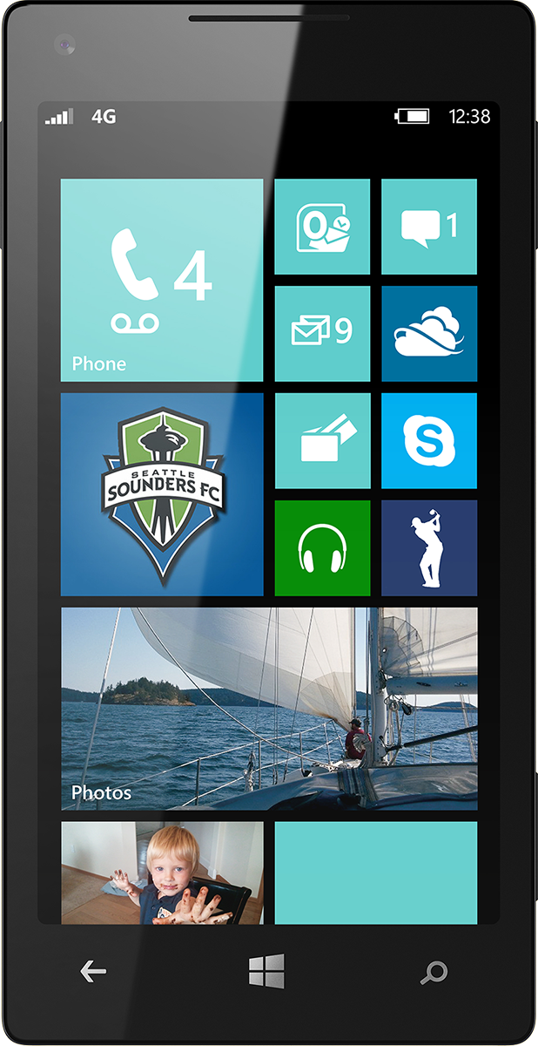
Evaluate this session
Scan this QR code to evaluate this session

Slide 39
© 2014 Microsoft Corporation. All rights reserved. Microsoft, Windows, and other product names are or may be registered trademarks and/or trademarks in the U.S. and/or other countries.
The information herein is for informational purposes only and represents the current view of Microsoft Corporation as of the date of this presentation. Because Microsoft must respond to changing market conditions, it should not be interpreted to be a commitment on the part of Microsoft, and Microsoft cannot guarantee the accuracy of any information provided after the date of this presentation. MICROSOFT MAKES NO WARRANTIES, EXPRESS, IMPLIED OR STATUTORY, AS TO THE INFORMATION IN THIS PRESENTATION.

