Slide 1


Slide 2

Outlook Connectivity
Current and Future
OFC-B216
Abdelkader Bahgat
Senior Program Manager

Slide 3
Agenda
Introduction
  Protocols for Outlook Connectivity
  Outlook Anywhere protocol overview
MAPI over HTTP protocol
  Advantages and benefits
  Requirements and pre-requisites
  Configuration and management

Slide 4
Introduction
Protocols for Outlook to connect to Exchange
  Outlook Anywhere
  MAPI over HTTP
  Protocols per Outlook/Exchange versions
Product | Exchange 2013 SP1 | Exchange 2013 RTM | Exchange 2010 SP3 | Exchange 2007 SP3
Outlook 2013 SP1 or later | MAPI over HTTP Outlook Anywhere | Outlook Anywhere | RPC Outlook Anywhere | RPC Outlook Anywhere
Outlook 2013 RTM | Outlook Anywhere
Outlook 2010
Outlook 2007

Slide 5
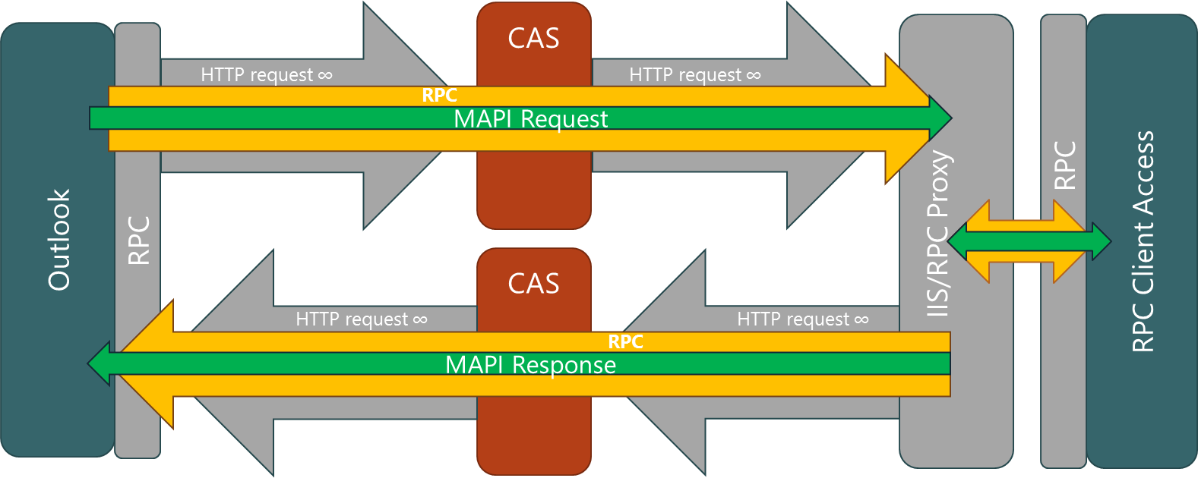
Outlook Anywhere
Overview
  Half duplex protocol
  Outlook opens 1 RPC session which gets split in 2 HTTP sessions RPC_IN_DATA & RPC_OUT_DATA
  HTTP maintained up to the RPC Proxy server
  RPC Proxy server then connects like an RPC client to the Exchange server
Configuration
  Use Set-OutlookAnywhere or partly on the EAC
  External/Internal URLs need to be configured for Exchange 2013

Slide 6
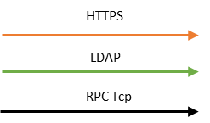





How Outlook Anywhere Works
HTTP
Domain Controller
LDAP
RPCTcp
Outlook
Microsoft.Exchange.FrontEnd.Proxy.dll
Consumes the remaining part
of the URL Mailbox_GUID@contoso.com:6001
Retrieves the mailbox from AD and active database
Generates the new URL to be used
Outlook
sends Autodiscover Request
to build profile
RPC Client Access Service verifies mailbox GUID and user used for SSL authentication to grant mailbox access
RPCProxy Dll Parses the http header to retrieve
Session GUID/User and passes it with the RPC request
To the RPC Client Access Service
Based on authenticated user
Autodiscover retrieves
mailbox settings
The CAS authenticate the user
RPC Client Access Service
Handles Outlook directory
Requests
Outlook opens two sessions on
https://mail.contoso.com/RPC with Negotiate
For RPC_IN_DATA and RPC_OUT_DATA
Microsoft.Exchange.FrontEnd.Proxy.dll opens
https connection on port 444
https://mbxserver.contoso.com:444/rpc/
The CAS proxies the autodiscover request to the Mailbox role
Autodiscover sends
Xml user configuration
To build the profile
Outlook Profile:
Outlook anywhere URL
  mail.contoso.com
Authentication to be used to access IIS
  Negotiate
Exchange Server
  Mailbox_GUID@contoso.com
Certificate
  msstd:mail.guygonprem.com
Client Access Server
Mailbox Server
Outlook Anywhere configuration
Internal/External Host Name
  Mail.contoso.com
Client Authentication
  Negotiate
Client Require SSL
  True
Mbxserver.contoso.com
RPC Client Access service
Retrieves Mailbox content and sends it back
Outlook built URL:
Https://mail.contoso.com/RPC/RPCProxy.dll?Mailbox_GUID@contoso.com:6001
Target database being on mbxserver the proxy dll builds the URL:
https://mbxserver.contoso.com:444/rpc/rpcproxy.dll?mbxserver.contoso.com:6001
To make this animation more understandable
Only MAPI connection is described in this slide
CAS and Mailbox roles were separated

Slide 7
MAPI over HTTP Overview

Slide 8
Why MAPI/HTTP?
Better Customer Experience
  Faster Connect Times to Exchange
  Designed for wireless and remote connectivity
Faster Innovations
  Multi-Factor Authentication
  Single Sign-on
Standard, Simple and Direct
  Simplified Architecture
  Uses HTTP request/response pattern + Hanging request for notifications, similar to OWA & EAS

Slide 9

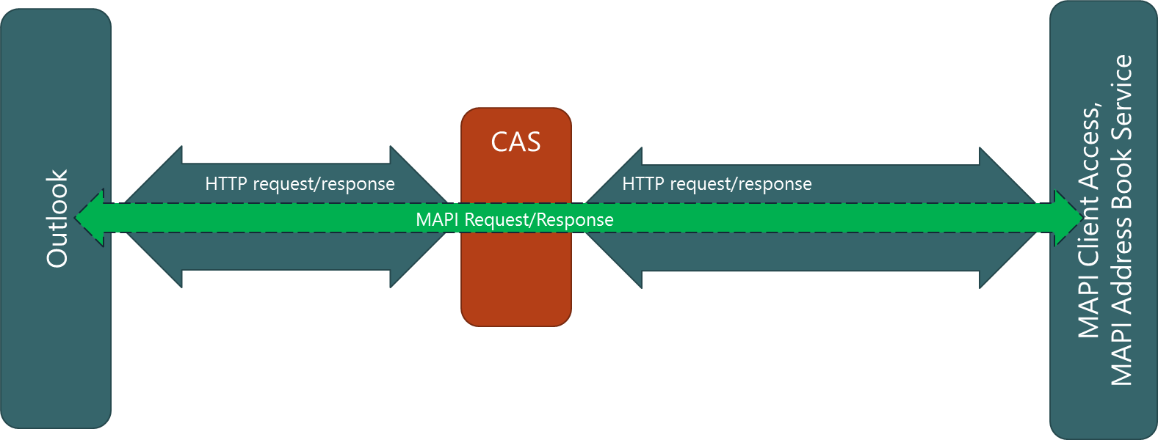
What is MAPI over HTTP?
Transport replacement for Outlook Anywhere
  Conforms to HTTP/1.1 protocol specification
  Based on HTTPS web requests
  Uses well known POST verb exclusively
  Connectionless, but still stateful
Reduced complexity
  No inner/outer channels, dual channel auth
  No paired in/out connections
  Session not tied to connection
Clearly defined protocol expectations and timeouts
  No infinitely long request/response

Slide 10
MAPI over HTTP & Autodiscover
1. Autodiscover request w/ X-MapiHttpCapability = 1 (protocol version)
2. Autodiscover response w/ MAPI/HTTP info
3. Outlook connects to Exchange using MAPI/HTTP
Outlook restarted
Outlook 2013 SP1
Exchange 2013 SP1
w/
MAPI/HTTP enabled

Slide 11
Autodiscover Response for MAPI/HTTP
Latest version supported by server AND client enables protocol changes without breaking Outlook
<Protocol Type="mapiHttp" Version="1">
<MailStore>
<InternalUrl>https://bos.mail.corp.contoso.com/mapi/emsmdb/?MailboxId
=<guid>@contoso.com</InternalUrl>
<ExternalUrl>https://bos.mail.contoso.com/mapi/emsmdb/?MailboxId
=<guid>@contoso.com</ExternalUrl>
</MailStore>
<AddressBook>
<InternalUrl>https://bos.mail.corp.contoso.com/mapi/nspi/?MailboxId
=<guid>@contoso.com</InternalUrl>
<ExternalUrl>https://bos.mail.contoso.com/mapi/nspi/?MailboxId
=<guid>@contoso.com</ExternalUrl>
</AddressBook>
</Protocol>
Settings to connect to Mailbox
Internal endpoint - URL used AS IS by Outlook
External endpoint
Settings to connect to Directory

Slide 12
Sync Start for Resume from Hibernate
❶
❸
❷
 MAPI/HTTP  Outlook Anywhere
❶ 80%+ of MAPI/HTTP Sync Start less than 30s compared to 40s+ for Outlook AnyWhere when resuming from hibernation
❷ New Pause/Resume Logic increases the # of syncs starting in less than 5 seconds
❸ New connections

Slide 13
Start Sync from Outlook Restart
70% of sessions started sync in less than 30s for MAPI/HTTP Vs 90s for Outlook Anywhere

Slide 14
Faster Connect Time

Slide 15
MAPI over HTTP & Outlook Anywhere
MAPI/HTTP is a long-term replacement for Outlook Anywhere
  Co-existence supported with older Exchange and Outlook versions that don’t support MAPI/HTTP
  Outlook Anywhere support will be removed as non-MAPI/HTTP Outlook versions are phased out
  Future innovation, especially for authentication, will be centered around MAPI/HTTP
Outlook support for MAPI/HTTP
  Outlook 2013 SP1
  Outlook 2010 support planned
Exchange support for MAPI/HTTP
  Shipped in Exchange 2013 SP1, OFF by default
  MAPI/HTTP being rolled out in phases through Office 365

Slide 16
Demo – MAPI/HTTP
Connecting using MAPI/HTTP and Outlook Anywhere
Diagnostics Example

Slide 17
MAPI over HTTP
Deployment & Management

Slide 18
Enabling MAPI over HTTP - Prerequisites
Read this article first
  MAPI over HTTP guidelines
Install .NET framework 4.5.1 for optimal MAPI/HTTP performance
Upgrade CAS and Mailbox servers to Exchange 2013 SP1
  All CAS servers MUST be upgraded before enabling MAPI/HTTP for the org
  Exchange CU5 required for Outlook to connect to same-forest legacy public folder using RPC
Upgrade Outlook clients to latest Outlook 2013 PU (SP1+)
  May 2014 PU eliminates restart prompt

Slide 19
Installing .NET 4.5.1 Really Helps …
Poor Outlook user experience
After 4.5.1 Installed

Slide 20
Enabling MAPI over HTTP - Configuration
Configure MAPI/HTTP virtual directory on all Client Access servers
  Set-MapiVirtualDirectory -Identity "Contoso\mapi (Default Web Site)" -InternalUrl https://Contoso.com/mapi -IISAuthenticationMethods Negotiate
Certificate used by Exchange must:
  Include InternalUrl & ExternalUrl
  Be trusted by Outlook
Verify load balancers, reverse proxies, and firewalls are configured to allow access to MAPI/HTTP virtual directory
  UAG SP3 not compatible w/ MAPI/HTTP even w/ all filtering options disabled. Support is coming
Enable MAPI/HTTP for your organization
  Set-OrganizationConfig -MapiHttpEnabled $true

Slide 21
Enabling MAPI over HTTP - Validation
Test end-to-end MAPI/HTTP connection
  Test-OutlookConnectivity -RunFromServerId ContosoMail -ProbeIdentity OutlookMapiHttpSelfTestProbe
  Microsoft Exchange Health Manager (MSExchangeHM) service must be started.
Inspect MAPI/HTTP logs
  CAS: %ExchangeInstallPath%Logging\HttpProxy\Mapi\
  Mailbox: %ExchangeInstallPath%Logging\MAPI Client Access\
  Mailbox: %ExchangeInstallPath%Logging\MAPI Address Book Service\
Check Outlook connection status dialog

Slide 22
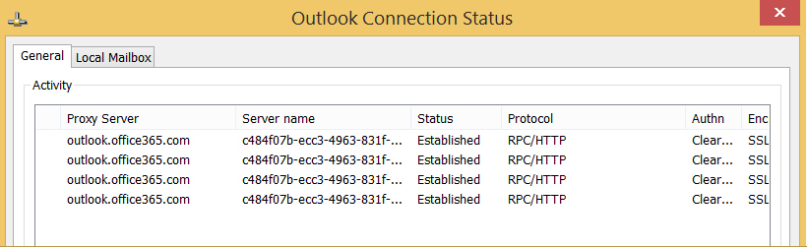
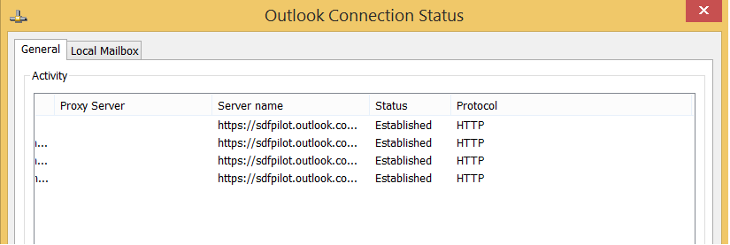
Outlook Connection Status Dialog

Slide 23
MAPI over HTTP – Sizing
Multi-role deployment
  Impact minimized even w/ higher CAS CPU utilization
Dedicated role deployment
  Recommend 3:8 ratio for CAS to Mailbox processor cores (50% increase)
Sizing guidance and role calculator
  Deployment guideline for Exchange 2013 SP1 release
  Exchange 2013 Server Role Requirements Calculator
Customer | RTM Guidance | SP1 Guidance
Customer 1 | 94% CPU at peak | 102% CPU at peak
Customer 2 | 82% | 88%
Customer 3 | 74% | 80%
Customer 4 | 44% | 47%
Customer 5 | 42% | 45%
Customer | RTM Guidance | SP1 Guidance
Customer 6 | 23 CAS / Site | 33 CAS / Site

Slide 24
MAPI/HTTP – Performance w/ Perfect Network
Higher CPU usage due to higher request rate
  50% increase in CAS CPU requirements relative to Exchange 2013 RTM
Lower memory usage on CAS and Mailbox with connection optimizations
  50-60% reduction on a per-user basis observed in Microsoft environment
  128 byte buffer for 1 MAPI/HTTP long-lived connection vs. 32 KB buffer for 2 OA connections
Lower connection count due to request/response + notification pattern
  Connection reduction of 0-50% based on user activity
  1 connection for idle client & 2 connections for completely active Outlook per mailbox
Higher bytes over wire due to MAPI/HTTP headers
  1.2% (4% vs. 2.8%) increase in packet size over Outlook Anywhere for average 50 KB packet size
  5-10% increase in bytes over wire for data transfer larger than 10MB

Slide 25
If You are on Office 365 …
Don’t worry about server configuration or sizing
  Autodiscover, and only Autodiscover, will do the work
  Outlook and Exchange negotiate the best protocol to use
Deploy latest Outlook 2013 updates
  Outlook 2013 May 2014 PU eliminates restart prompt
Take advantage of continuous improvements to Outlook connectivity

Slide 26
Wrap Up

Slide 27
Protocols & Versions Summary
Product | Exchange 2013 SP1 | Exchange 2013 RTM | Exchange 2010 SP3 | Exchange 2007 SP3
Outlook 2013 SP1 or later | MAPI over HTTP Outlook Anywhere | Outlook Anywhere | RPC Outlook Anywhere | RPC Outlook Anywhere
Outlook 2013 RTM | Outlook Anywhere
Outlook 2010 | Outlook Anywhere*
Outlook 2007 | Outlook Anywhere
* MAPI over HTTP Support Planned

Slide 28
What’s Next for MAPI over HTTP
Short-term (Q2-Q3 CY2014)
  Enable Outlook to access legacy public folders using RPC (CU5) when organization is enabled for MAPI/HTTP.
  Eliminate Outlook restart prompt for connected clients when switching to MAPI over HTTP (Outlook 2013 May 2014 Public Update).
Later …
  Add MAPI virtual directory management to Exchange Admin Center (EAC).
  Enable testconnectivity.microsoft.com to work with MAPI/HTTP.
  Investigate server-side per-user setting to enable MAPI/HTTP.
  Drive down CPU utilization by decreasing protocol chattiness.

Slide 29
MAPI over HTTP Summary
MAPI/HTTP is a long-term replacement for Outlook Anywhere
  Added value for customers
  Staying connected w/ server consolidation & increased use of wireless networks
  Designed for smooth deployment – coexistence w/ Outlook Anywhere
Enable MAPI/HTTP for your organization
  Review MAPI over HTTP guidelines
  Prepare your environment per sizing guidance.
Feedback welcome on your experience

Slide 30
Resources
Outlook Anywhere Troubleshooting tools
  Guided Walkthrough
    Outlook Connectivity Guided Walkthrough (Exchange On-Premises)
    Office 365 Outlook Guided Walkthrough
  Configuration Validation and Troubleshoot
    Office Configuration Analyzer Tool (OffCAT)
    Remote Connectivity Analyzer
Channel 9 related sessions
  Outlook Connectivity: Current and Future
  What's New in Outlook 2013 and Beyond
  What's New in Authentication for Outlook 2013

Slide 31


Slide 32



Complete an evaluation and enter to win!

Slide 33


Evaluate this session
Scan this
QR code
to evaluate
this session.

Slide 34


© 2014 Microsoft Corporation. All rights reserved. Microsoft, Windows, and other product names are or may be registered trademarks and/or trademarks in the U.S. and/or other countries.
The information herein is for informational purposes only and represents the current view of Microsoft Corporation as of the date of this presentation. Because Microsoft must respond to changing market conditions, it should not be interpreted to be a commitment on the part of Microsoft, and Microsoft cannot guarantee the accuracy of any information provided after the date of this presentation. MICROSOFT MAKES NO WARRANTIES, EXPRESS, IMPLIED OR STATUTORY, AS TO THE INFORMATION IN THIS PRESENTATION.

Slide 35
MAPI over HTTP Request
POST /mapi/emsmdb/?MailboxId=aba9a257-88b1-401c-9db8-e395cfbce1a0@contoso.com HTTP/1.1
Cache-Control: no-cache
Connection: Keep-Alive
Pragma: no-cache
Content-Type: application/octet-stream
Accept: application/octet-stream
User-Agent: Microsoft Office/15.0 (Windows NT 6.2; Microsoft Outlook 15.0.4526; Pro)
X-ClientInfo: {A7A47AAD-233C-412B-9D10-DDE9108FEBD7}-5
X-RequestId: {16AC2587-EED8-48EB-8A7B-D48558B68BD7}:1
X-RequestType: Connect
Content-Length: ?
Host: mail.contoso.com
Authorization: Basic Tm90IHJlYWxseSBhIHBhc3N3b3JkIHN0cmluZw==
[REQUEST DATA]
Common HTTP verb
Identifies endpoint and mailbox being accessed.
Tells server the type of request to perform.
Connect -> EcDoConnectEx
Disconnect - > EcDoDisconnect
Execute -> EcDoRpcExt2
NotificationWait -> EcDoAsyncWaitEx
Uniquely identifies an Outlook instance for server failure logging.
Uniquely identifies a client request for server failure logging & client failure tracing.
Serialized request properties. Format specific to request type header.

Slide 36
MAPI over HTTP Response
Return a 200 HTTP status except for Auth failure. Protocol failures in X-ResponseCode header.
HTTP/1.1 200 OK
Cache-Control: private
Transfer-Encoding: chunked
Content-Type: application/octet-stream
X-ClientInfo: {A7A47AAD-233C-412B-9D10-DDE9108FEBD7}-5
X-RequestType: Connect
X-RequestId: {16AC2587-EED8-48EB-8A7B-D48558B68BD7}:1
X-ExpirationInfo: 900000
X-ResponseCode: 0
Set-Cookie: MapiContext=iDmMObVmkEGJfzZb1M7jQbdrAAAAAAAA; path=/mapi/emsmdb/
Set-Cookie: MapiSequence=0-/Ww5Bg==; path=/mapi/emsmdb/
Persistent-Auth: false
Date: Mon, 21 Jun 2013 12:13:14 GMT
[RESPONSE BODY]
Quickly acknowledge request, update client of pending request status periodically before sending response data.
Exchange echoes what the client passed up.
Zero == No MAPI/HTTP protocol level failures.
Successful “Connect” returns session context as cookie(s). Outlook passes them back on subsequent requests.
Response body contains PENDING markers followed by serialized response data.

