Slide 1


Slide 2

From Waves to Ripples: Microsoft Office 365 Change Management
OFC-B258
Jake Zborowski

Slide 3
Our Agenda
Principles of the cloud
  What does it mean to be an evergreen service?
  What is the Office 365 release process and what’s different?
Coming improvements
  How do you get advanced warning on the roadmap?
  Is there a way to get early access to major features updates?
Staying ahead of change
  How do you stay informed keep your environment ready for change?
  Questions and Answers

Slide 4






Microsoft Office 365 - Cloud principles
Maintain
an evergreen
service
    Provide a platform built on security, privacy, and trust
Offer highly configurable and scalable services

Slide 5
Built for trust
Security
Best-in-class security
Compliance
Commitment to compliance
Privacy
Privacy by design

Slide 6



Highly configurable and scalable
Office 365 is highly configurable with some customization
Customers can mix and match services to meet their requirements
Choose the flexibility between cloud and hybrid deployment
Redundant datacenters and financially backed SLA provide uninterrupted and reliable access

Slide 7

Maintain an evergreen service

Slide 8


Going forward
waves
ripples
18-36 month release
continuous updates

Slide 9
What we’ve delivered
The New Office
SharePoint
Online Platform Improvements
Office 365 Adapter
Retention policy and tag management
Admin Add
Azure AD Password Sync.
Exchange Online Address Book Policies
Improved Sharing Emails
Exchange Online Archiving add-on
Directory Sync
Max Objects
Auto Increase
SkyDrive Pro Storage increase
Lync Online Q&A manager
Office Mobile for iPhone & Android phones
Excel Web App update
OWA for iPhone & OWA for iPad
Power Map for Excel
Shared with Me
IM mute
Office on the Web
Exchange group naming policy
SkyDrive Pro apps for
Windows 8 & iOS
Office 365 Admin Mobile App
Office 365 Switch Plans
Message Center
50 GB mailbox
2013
Go Daddy Integration
Connecting
Skype & Lync
Q&A manager
Yammer basic integration
SkyDrive Pro Sync
for Windows
Project codename “GeoFlow” preview
for Excel
Lync Online Remote PowerShell
OneNote for iPhone and Android phones
Lync mobile
clients
EXO: 50 GB Mailboxes
Encrypted Data
Directory Sync Max Objects
Auto Increase
Lync and SharePoint Service Reporting
OneNote
for iPad
Rights Management Services
Updated Lync mobile clients
Lync Online Integrated Reporting
Office Web
Apps Update
Windows Azure Active Authentication
Windows Azure Active Directory Sync
Tool-update
Lync meeting scheduling from OWA
Embedded
Images
PDFs in Word
Web Apps
Exchange Online Inactive Mailboxes
PDF support for
SharePoint Online
Directory Sync Max Objects Auto Increase
DirSync Scoping
and Filtering
Office 365 SSO with SAML 2.0 Identity Providers
SharePoint Newsfeed App
for Windows 8
Office Web Apps
real-time co-authoring

Slide 10
Impact of wave releases
Impact
Notification
Continuous updates make
the transition easier.
18-36 month releases
can be daunting…
Heavy
Impact
:)
?
?!
Impact
Skipped Update

Slide 11
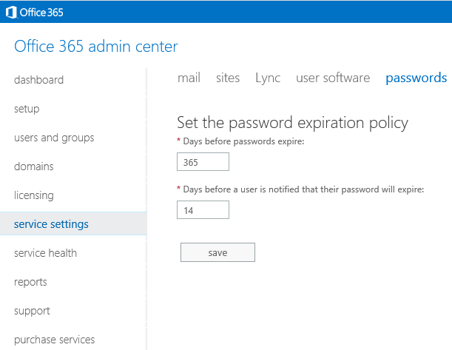

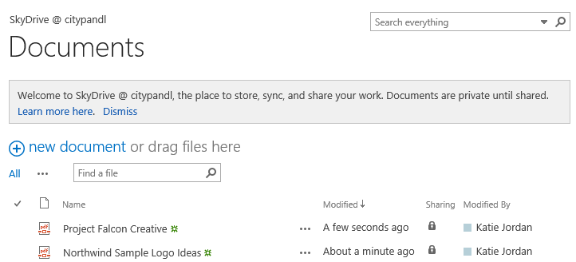
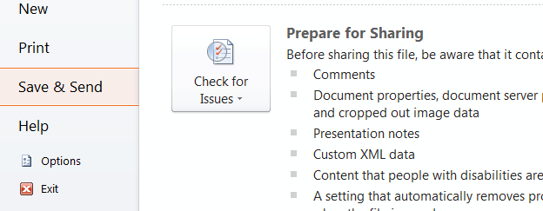


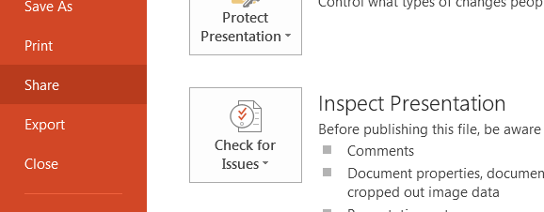

Office 365 responds to your feedback
Running a service brings Microsoft closer to the customer than ever before
Customer engagement
Old
Send-a-smile in-product feedback
New
Support and community aggregate
customers’ issues

Slide 12
Developing for a cloud service
Quality
Security
Speed
Agility
Transparency

Slide 13

Developing for a cloud service

Slide 14
Developing for a cloud

Slide 15
Evolving change management

Slide 16
What’s changing
Roadmap disclosure
Feature release process
Communications policies
Like all features of the service. How we approach updates, release, maintenance and communications will continue to evolve and improve.

Slide 17
Service updates
Functionality updates
Feature updates
  OneDrive for Business storage increases
  Major UI changes
New introductions
  Office Mobile for iPhone
  OWA for iPhone and iPad
Platform updates
Disruptive change
  API change
  Deprecations
  System requirement change
Configuration changes
  Auto-discovery configuration
  DNS record change
Infrastructure improvements
  Bug fix
  Performance enhancement
  Security updates

Slide 18
Office 365 Public Roadmap
Coming Soon
A public place where you can get information on service updates to help manage the faster paced release cycles of the cloud
Focuses on new and updated functionality*
Covers what’s coming in the near-term (30-90 days) and some longer-term
Offers high-level details, including name, description, status

Slide 19
Introducing:
First release

Slide 20

First release
Coming Soon
Targeted
Q4 FY14
New opt-in program available to all customers
Provides first access to select major end user feature updates
First public availability of fully supported, vetted, documented end user facing service updates
Scope
  Exchange and SharePoint
  Most significant end-user feature updates
  Tenant wide opt-in setting off by default
  Opt-in / opt-out changes respected within 24 hours
Benefit
  Get major SharePoint and Exchange end-user updates first
  Minimum of 2 weeks before standard rollout of updates

Slide 21
email sites voice & conferencing downloads passwords projects updates
manage feature rollout
Admins control how new features are rolled out to people in their organization. Learn more
service settings
First release
Select this option if you want people to receive new features as soon as they are available from Microsoft.
ON
When will my change take effect?
It can take up to 24 hours for this change to take effect.
MOCKUP

Slide 22
Current update process
NDA
Roadmap
Design/ Develop/ Test
Internal
Dog food
MSFT IT
Release
GA
customer notification
Customer notification at time of initiation of rollout
Some advance notification via the Office 365 technical blog
Roadmap NDA only

Slide 23
Service updates process
Public
Roadmap
(T-30-90)
First Release GA (T)
Design/ Develop/ Test
Internal
Dog food
MSFT IT
First
Release
Standard
Release
First Release notification (T-7)
All GA (T)
(First Release T+14)

Slide 24
Staying ahead of change

Slide 25
Communication vehicles
System Requirements
Lifecycle & disruptive change policy
Office 365
technical blog
Message Center
Public Roadmap

Slide 26

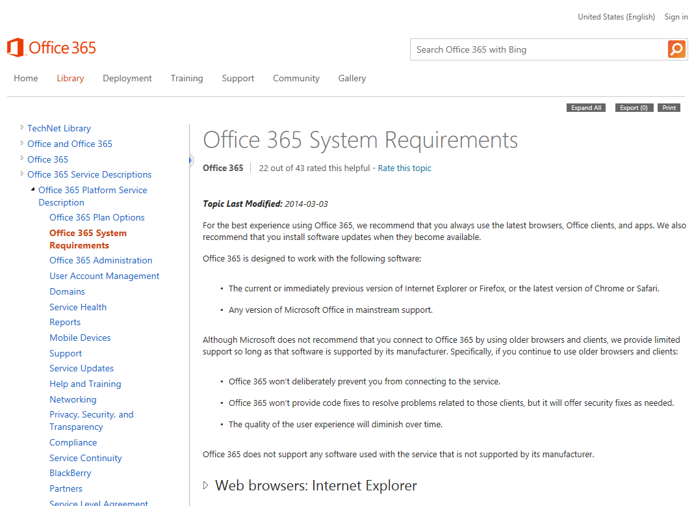


System Requirements & lifecycle policy
Current and previous version of Internet Explorer and Firefox
Current versions of Chrome and Safari
Web browser
Any Office client in mainstream support
Office client
Office 365 won’t deliberately block connections
Existing features may operate differently and not work over time
New features may not be available
Office 365 will only offer security fixes. No code fixes.
Older clients

Slide 27
Disruptive change policy
Unless otherwise noted, for all Microsoft Online Services, Microsoft will provide a minimum of 12 months prior notification before customers must accept any change that is deemed a "disruptive change".
"Disruptive change" means change where a customer or administrator is required to take action in order to avoid significant degradation to the normal operation of the Online Service.
The notice period will not apply to security related changes or updates.
http://support.microsoft.com/lifecycle/

Slide 28
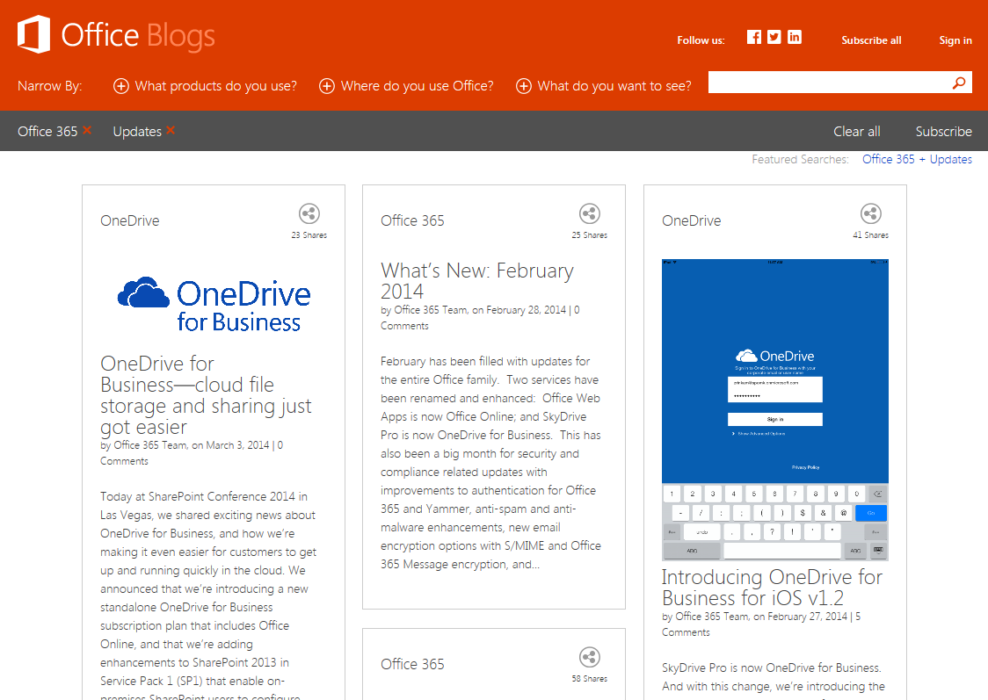
Office 365 Technology blog

Slide 29
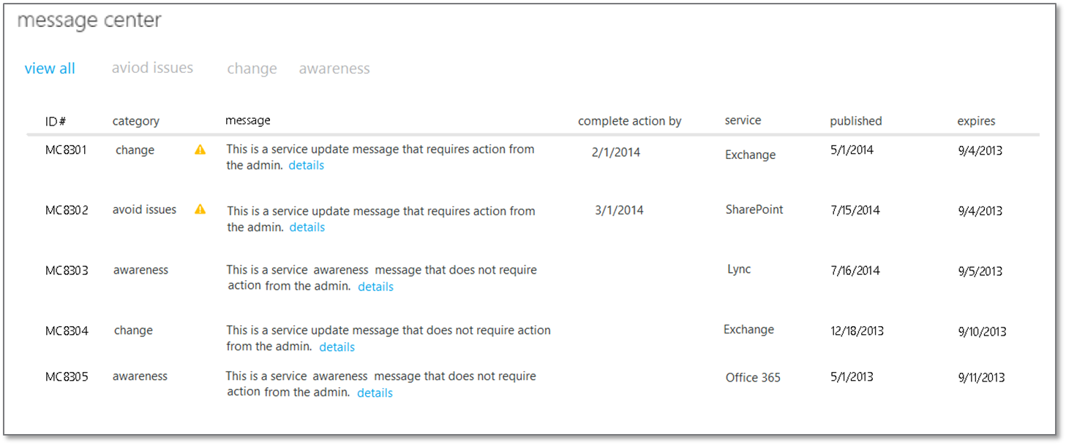
Message Center
Vision: single source for customer service communications.
Recent improvements
  Bell notifications
  Tenant targeting
April improvements:
  New message types
    Change: details on feature updates
    Awareness: general admin messages
  Message categorization
Future
  API
  Account management communications
  Admin App integration
  http://blogs.office.com/2014/04/01/managing-change-with-message-center/

Slide 30
Service updates
Functionality updates
Feature updates
  OneDrive for Business storage increases
  Major UI changes
New introductions
  Office Mobile for iPhone
  OWA for iPhone and iPad
Platform updates
Disruptive change
  API change
  Deprecations
  System requirement change
Configuration changes
  Auto-discovery configuration
  DNS record change
Infrastructure improvements
  Bug fix
  Performance enhancement
  Security updates

Slide 31
Communications
Source
Timeframe
Feature updates*
  OneDrive for Business storage increases
  Major UI changes
Public Roadmap
1-3 months
New introductions
  Office Mobile for iPhone
  OWA for iPhone and iPad
Message Center
At availability
Public Roadmap
Up to 12 months
Disruptive change
  API change
  Deprecations
  System requirement change
System Requirements
12+ months
Message Center
At 12 months (ongoing)
Message Center
Configuration changes
  Auto-discovery configuration
  DNS record change
1-12 months
Infrastructure improvements
  Bug fix
  Performance enhancement
  Security updates
Service Health Dashboard
5 day minimum
(planned maintenance outage)
*First Release feature update notifications (major SharePoint and Exchange end user updates) will be posted in message center.

Slide 32


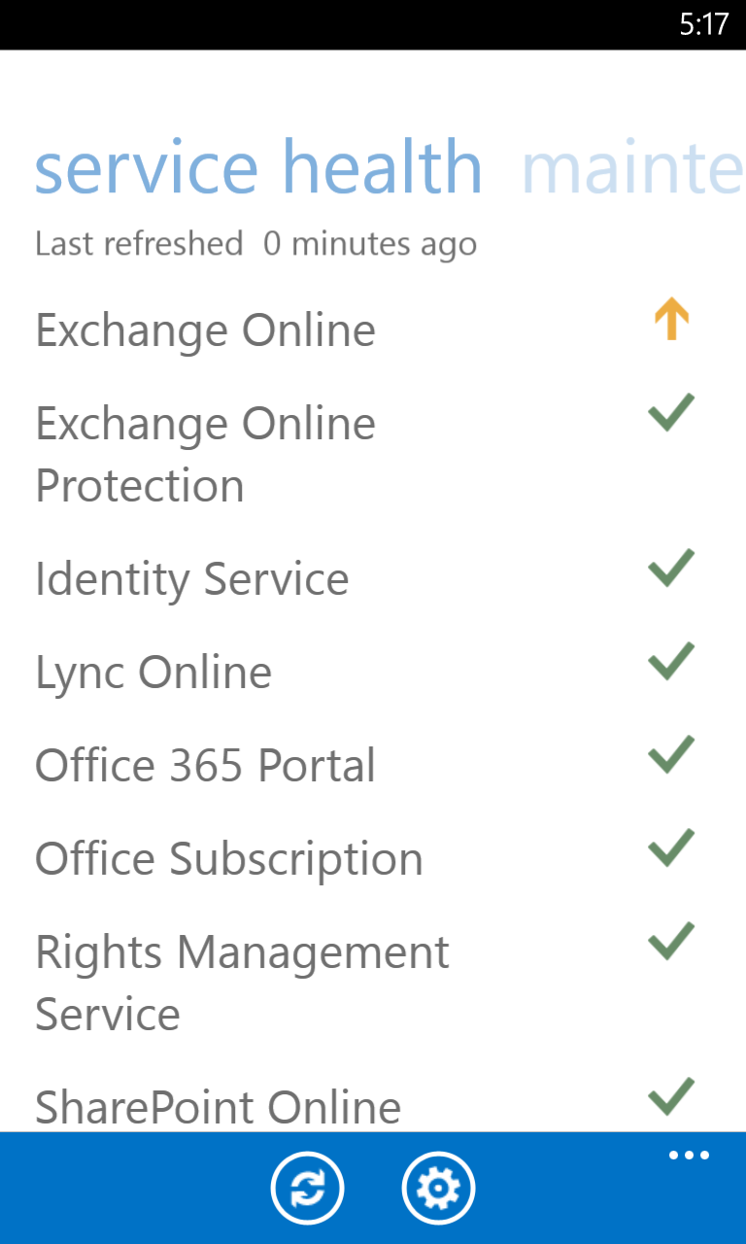
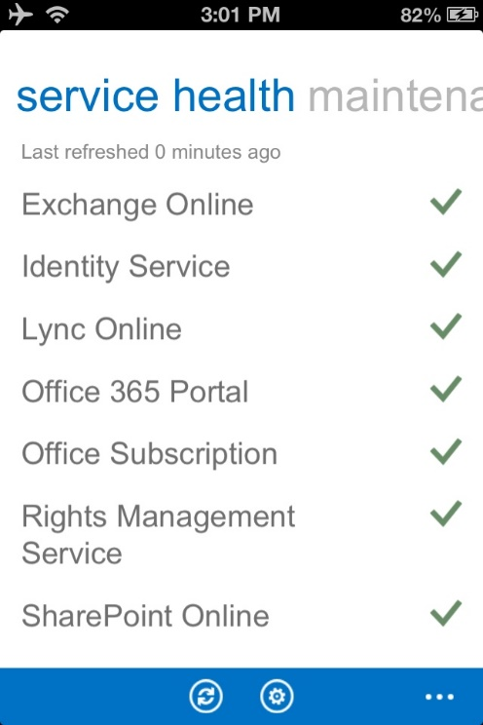
Stay Updated, Anywhere
Office 365 Admin App
Provides tenant specific Office 365 service health and maintenance information on the go
Available for Windows Phone, iOS and Android devices

Slide 33
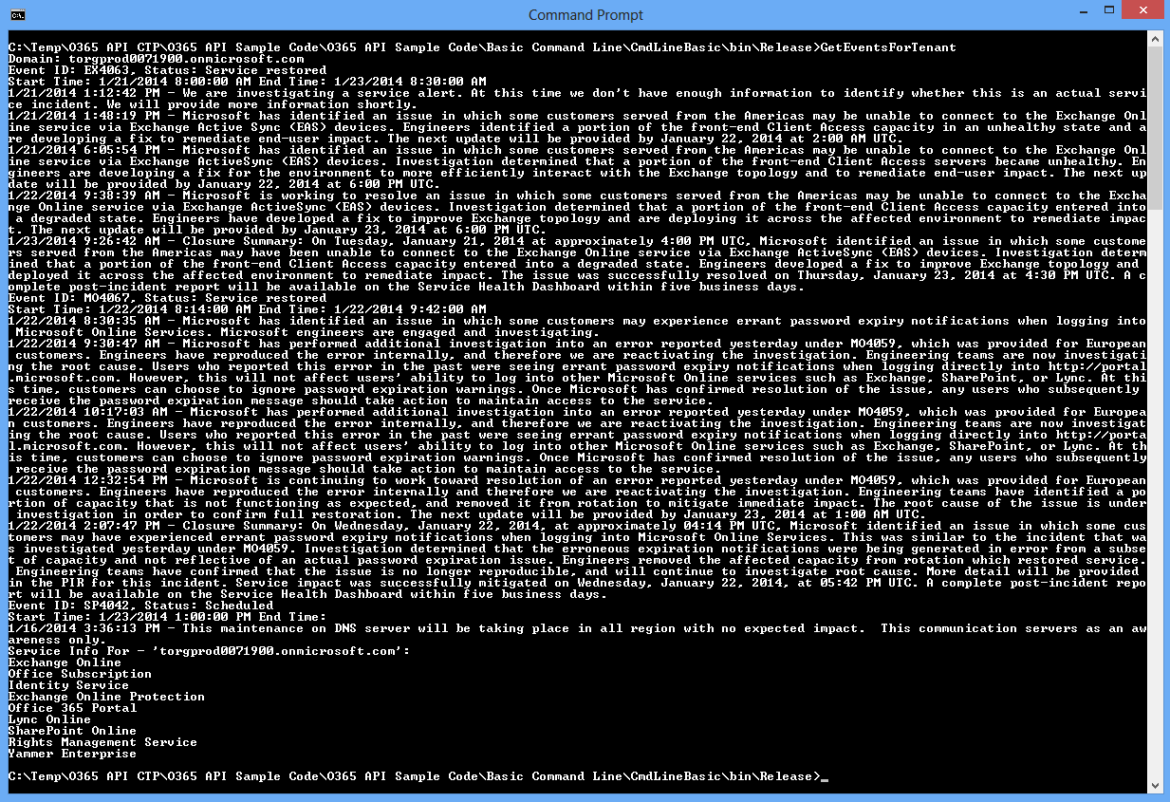
Coming Soon: API access
Ability to query a tenant and see service health results and Message center information.

Slide 34
Let’s summarize
Principles of the cloud
  Implications of a cloud service and differences from on premises.
  Coming improvements
  The timeframe for communications and expectations.
  Benefits of the new public roadmap
  Detail on the First Release program for major end user feature changes.
Staying ahead of change
  Our high level update policies and support matrix.
  Sources of truth on service updates communications to stay informed.

Slide 35
Thank you!

Slide 36
Related content
Breakout Sessions
  OFC-B258 From Waves to Ripples: Microsoft Office 365 Change Management
  OFC-B242 Getting Started with Microsoft Office 365 Deployment
  OFC-B272 Microsoft Office 365 for IT Professionals
  OFC-B335 Microsoft Office 365 Security, Privacy, and Compliance Deep-Dive
Find Me Later on the Expo Floor
  Or, Twitter @jakezbo
  Follow the Office Blogs
  Chat on the Office 365 Yammer ITPro Network https://www.yammer.com/itpronetwork

Slide 37


Slide 38

Resources
Learning
  Sessions on Demand
  Microsoft Certification & Training Resources
http://channel9.msdn.com/Events/TechEd
www.microsoft.com/learning
TechNet
msdn
  Resources for IT Professionals
  Resources for Developers
http://microsoft.com/technet
http://microsoft.com/msdn

Slide 39



Complete an evaluation and enter to win!

Slide 40


Evaluate this session
Scan this
QR code
to evaluate
this session.

Slide 41


© 2014 Microsoft Corporation. All rights reserved. Microsoft, Windows, and other product names are or may be registered trademarks and/or trademarks in the U.S. and/or other countries.
The information herein is for informational purposes only and represents the current view of Microsoft Corporation as of the date of this presentation. Because Microsoft must respond to changing market conditions, it should not be interpreted to be a commitment on the part of Microsoft, and Microsoft cannot guarantee the accuracy of any information provided after the date of this presentation. MICROSOFT MAKES NO WARRANTIES, EXPRESS, IMPLIED OR STATUTORY, AS TO THE INFORMATION IN THIS PRESENTATION.

