Slide 2
Beyond Deployment: How to Drive Office 365 Adoption
OFC-B263
Cyrielle Simeone, Microsoft
Dux Raymond Sy, AvePoint

Slide 3
Situation today & challenges
Your success is measured by long term user adoption
Driving adoption takes time
Deployment alone is not enough
Cloud Services are in constant motion

Slide 4
Session Objectives
Provide best practices & guidance
What do you need to be successful ?
Where to begin and how to proceed ?
What are the resources available ?

Slide 5
What do you need to be successful?
Common attributes to success
1. Listen & Plan
A deep understanding of the business goals, as well as people challenges and needs to achieve them.
2. Envision & Design
A solution that people love and that helps them achieve business goals and get things done more effectively.
3. Drive & Engage
A strategy to drive adoption including communications, readiness and community.
4. Measure & Grow
A benchmark, KPIs
and success stories to help demonstrate success internally, improve and expand.

Slide 6
What do you need to be successful?
Common attributes to success
1. Listen & Plan
A deep understanding of the business goals, as well as people challenges and needs to achieve them.
2. Envision & Design
A solution that people love and that helps them achieve business goals and get things done more effectively.
3. Drive & Engage
A strategy to drive adoption including communications, readiness and community.
4. Measure & Grow
A benchmark, KPIs
and success stories to help demonstrate success internally, improve and expand.

Slide 7
On-Prem
Cloud
Less Data
Big Data
#ShiftHappens
Workplace
Mobile
Reactive
Responsive

Slide 8
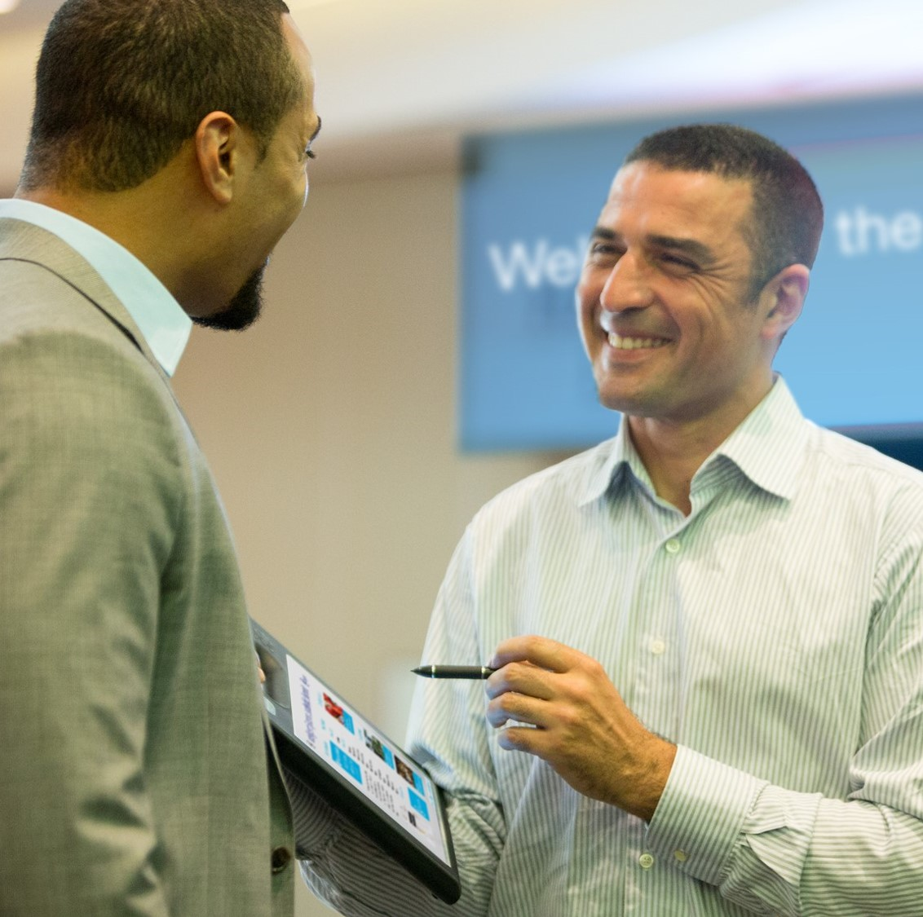
The New Role of IT: A Business Enabler
Create and implement solutions that solve business problems with success measured by user adoption.
Work with the business to identify needs
Translate technology into business value
Map capabilities into a solution

Slide 9
Business Matters. IT Doesn’t Matter.
Financial Gains
Expedite Innovation
Customer Value
$

Slide 11
Questions to ask…
What are your business goals and how do you prioritize them?
What are the main challenges and pain points you are facing when trying to achieve them?
What are the technical blockers impeding success?
What is keeping our people from communicating more effectively?

Slide 12
What do you need to be successful?
Common attributes to success
1. Listen & Plan
A deep understanding of the business goals, as well as people challenges and needs to achieve them.
2. Envision & Design
A solution that people love and that helps them achieve business goals and get things done more effectively.
3. Drive & Engage
A strategy to drive adoption including communications, readiness and community.
4. Measure & Grow
A benchmark, KPIs
and success stories to help demonstrate success internally, improve and expand.

Slide 13
Keep it simple to avoid overwhelming people
Simplify & Start Small
Identify “low hanging fruits” to begin with
Get the right team for your pilot
Break down your approach into incremental steps

Slide 14
Focus on the user experience
Define your Solution
Make the solution belongs to users
Ask people about areas for improvements
Put users at the center of the experience

Slide 15
Example

Slide 16
“We want them to love this tool, and part of that is not only listening to employees, but taking that feedback and truly turning it around and implementing that feedback.”
Jeff Schuman
Nationwide
Nationwide: Building a World-Renowned Intranet with SharePoint 2013 and Yammer (SPC311)
http://aka.ms/nationwidespot
Chris Plescia ; James Tsai ; Jeff Schumann ; Matt Huber ; Shawn Domer

Slide 17
Does your solution match these factors*?
Rogers defines several intrinsic characteristics of innovations that influence an individual’s decision to adopt or reject an innovation.
Everett M. Rogers (March 6, 1931 – October 21, 2004) was a communication scholar, sociologist, writer, and teacher. He is best known for originating the diffusion of innovations theory and for introducing the term early adopter.
Relative
Advantage
Compatibility
Complexity
or Simplicity
Trialability
Observability
1
2
3
4
5
* Source: Diffusion of innovations, Wikipedia

Slide 18
Demo: Resources & Programs Available
Cyrielle Simeone

Slide 19
What do you need to be successful?
Common attributes to success
1. Listen & Plan
A deep understanding of the business goals, as well as people challenges and needs to achieve them.
2. Envision & Design
A solution that people love and that helps them achieve business goals and get things done more effectively.
3. Drive & Engage
A strategy to drive adoption including communications, readiness and community.
4. Measure & Grow
A benchmark, KPIs
and success stories to help demonstrate success internally, improve and expand.

Slide 20
Drive Awareness & Excitement
“If people understand how it’s
going to help them they will
be more motivated to learn it.”
Show people what’s in it for them
Clearly communicate goals & milestones
Tailor your language & target your audience

Slide 21
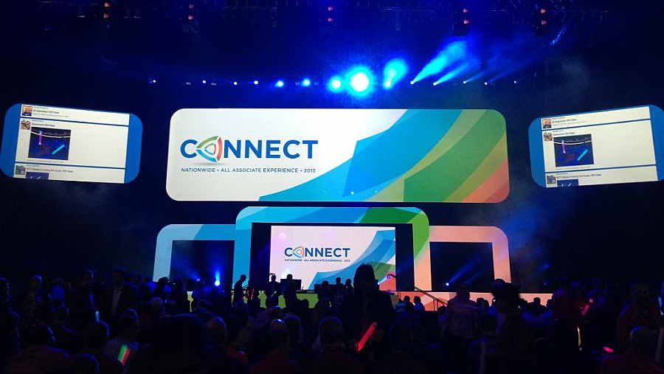
Nationwide: Building a World-Renowned Intranet with SharePoint 2013 and Yammer (SPC311)
http://aka.ms/natiowideSPOT
Chris Plescia ; James Tsai ; Jeff Schumann ; Matt Huber ; Shawn Domer

Slide 22
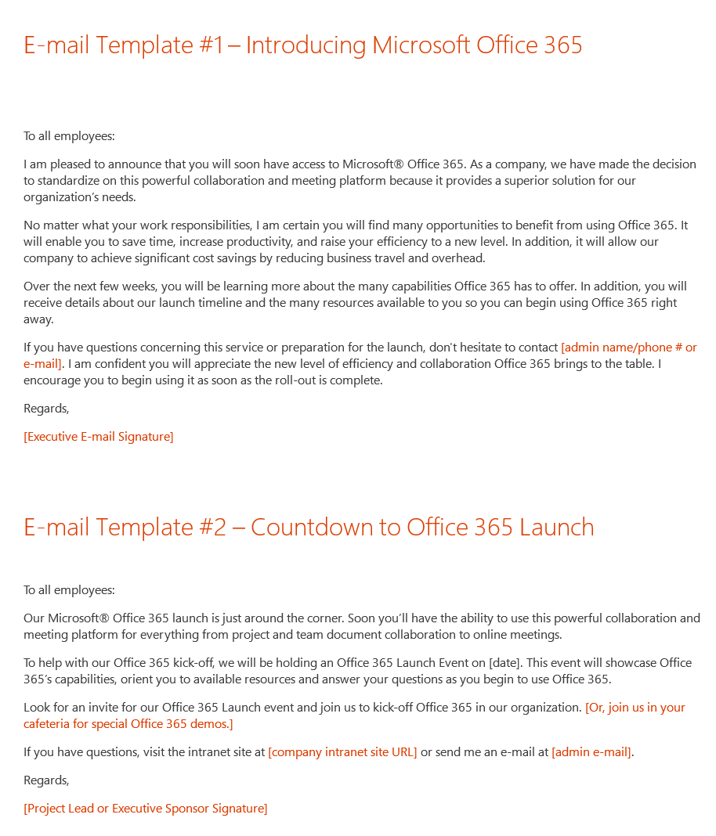
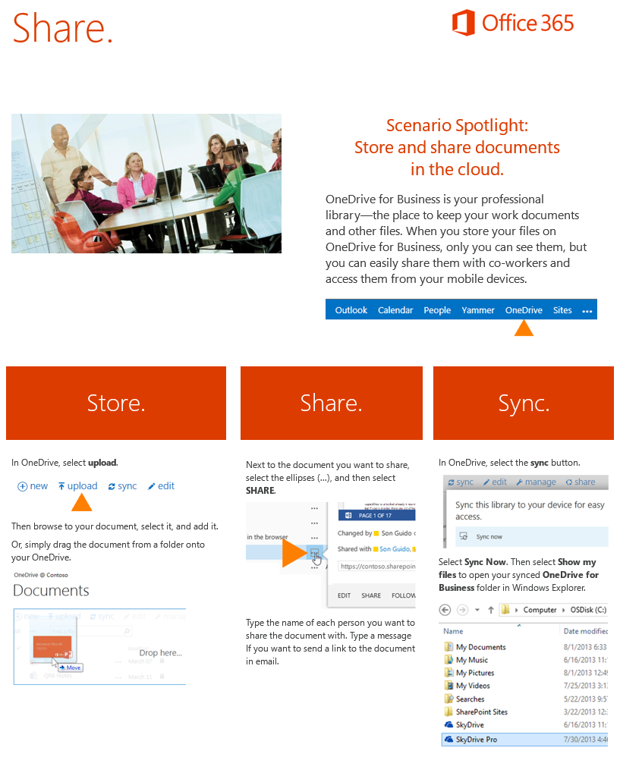
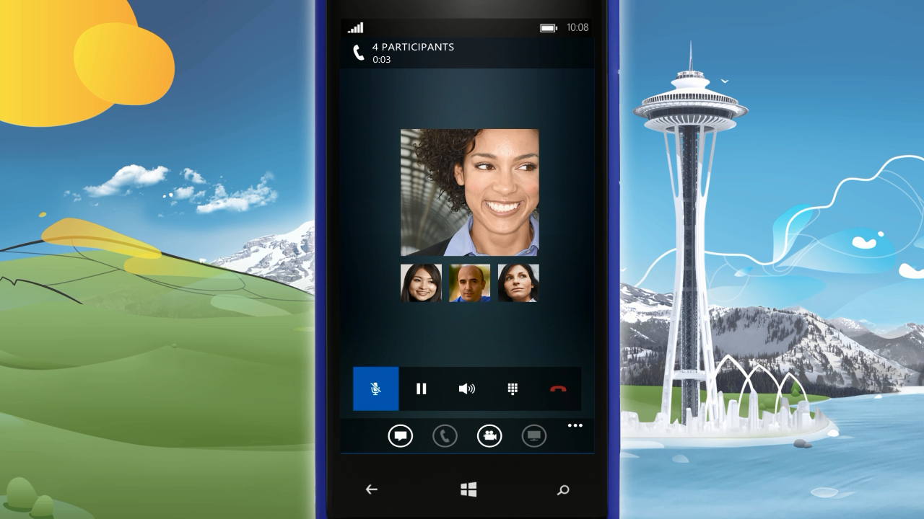
Awareness & Communications
Inform users of upcoming roll-out, and show what’s in it for them to create anticipation
Teasing Videos
A great way to get generate buzz and get people excited is to play teaser videos during an event or by the cafeteria...
Email Templates & Scenario Spotlight
Announce the upcoming rollout via emails, set up expectations, communicate benefits and show what’s in it for them.
http://aka.ms/o365kit
http://aka.ms/o365kit

Slide 23
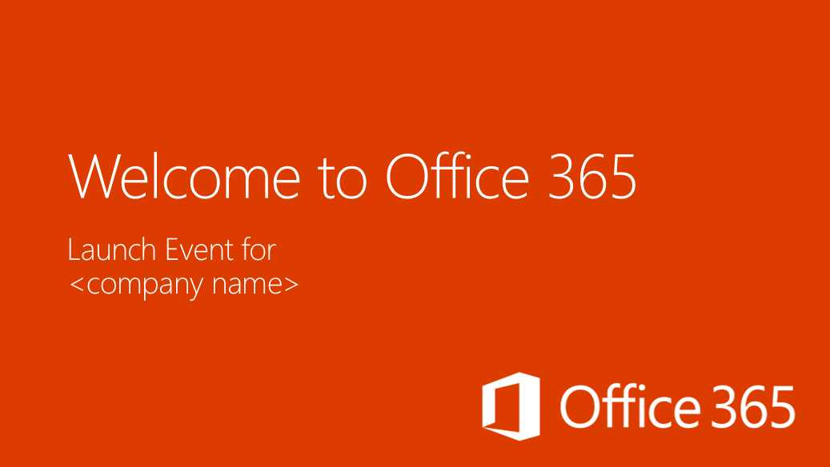
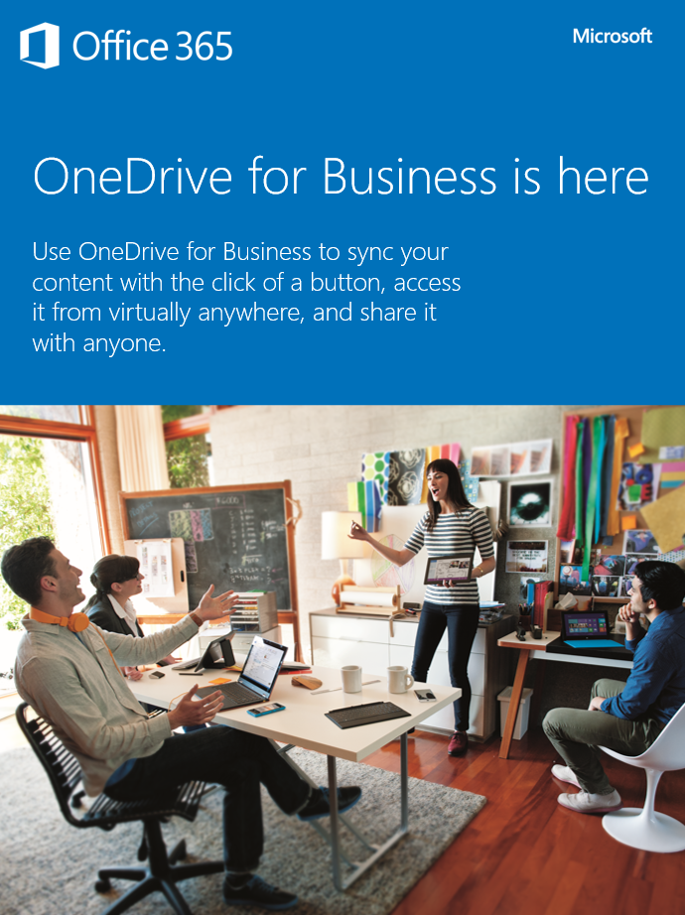
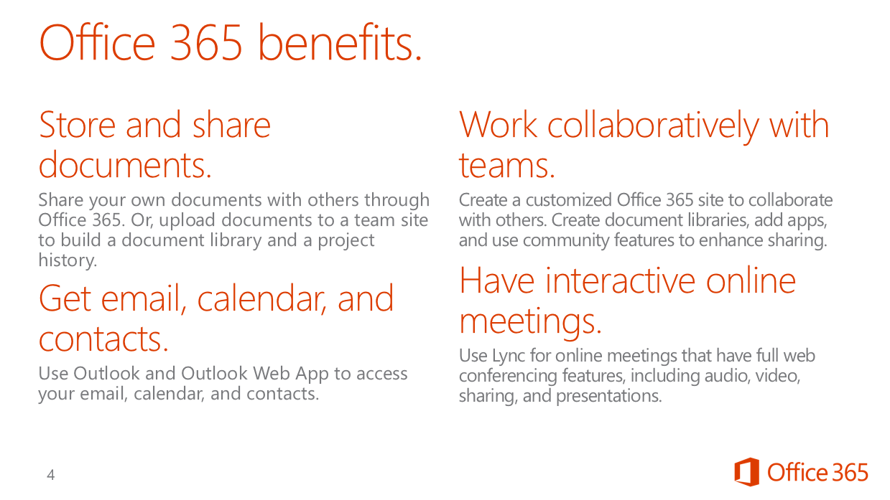
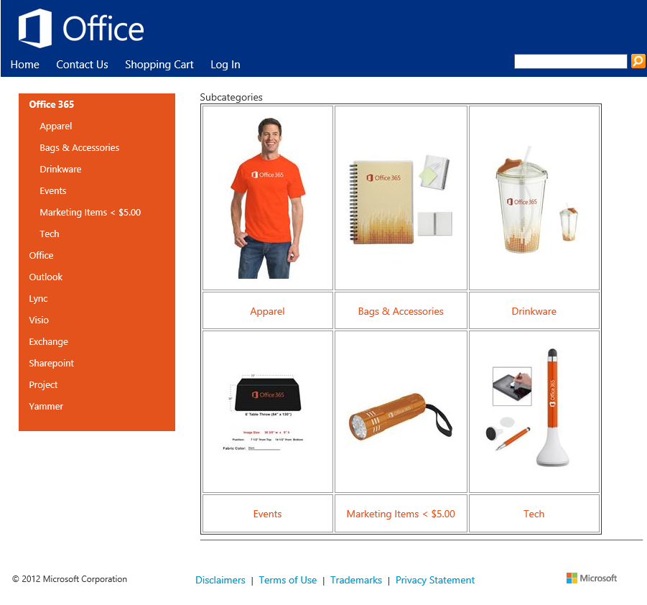
Awareness & Communications
Inform users of upcoming roll-out, and share benefits for them to create anticipation
Print Communications
Put colorful posters and flyers in the cafeteria, by the water cooler, or by the elevator to build awareness and sustain momentum post launch.
Buzz Days & SWAGs
“Buzz Days” are a great way to showcase benefits, get people excited, and involve Champions within your organization.
http://aka.ms/o365kit
http://www.co-store.com/iw
http://aka.ms/o365kit

Slide 24
Deliver simple, targeted & engaging training
Drive Adoption & Increase Confidence
Leverage early adopters & champions
Bring people together
Execute your readiness & community strategy to help people get started and transition to the new version.

Slide 25
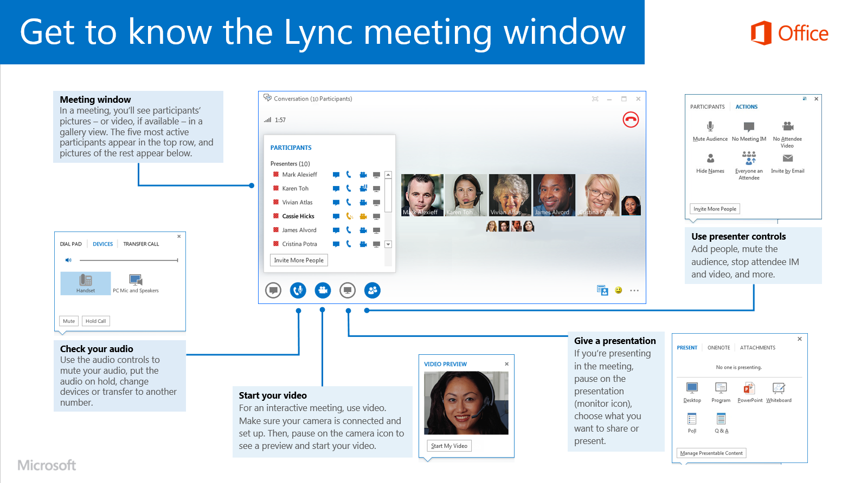
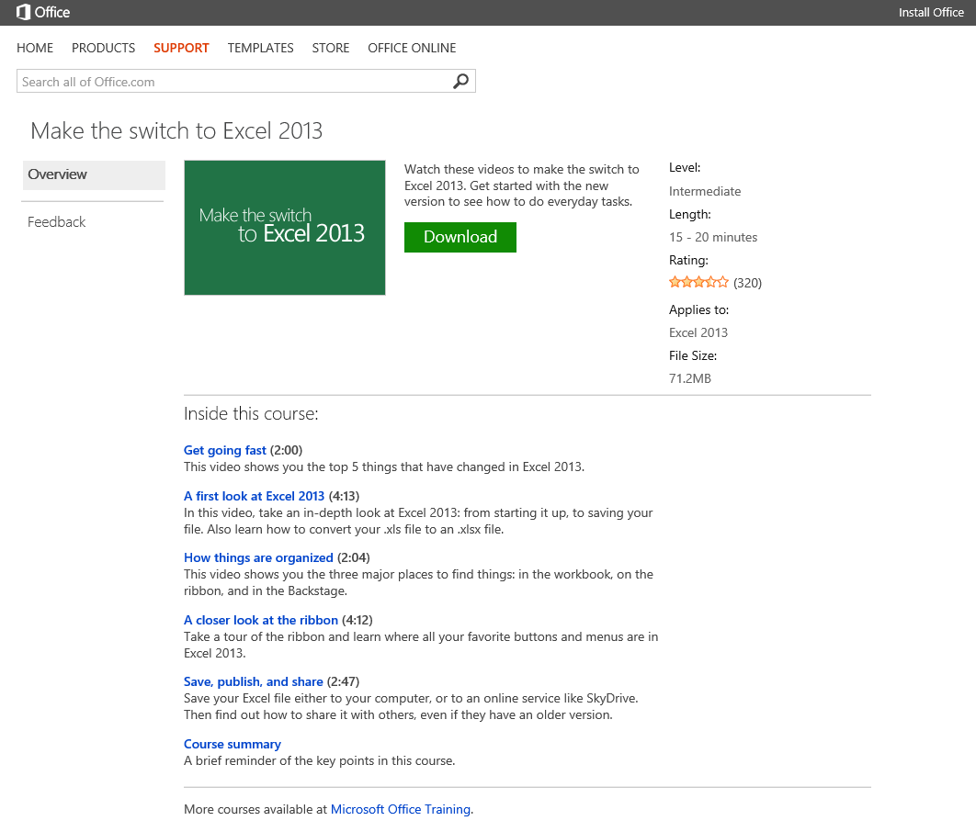
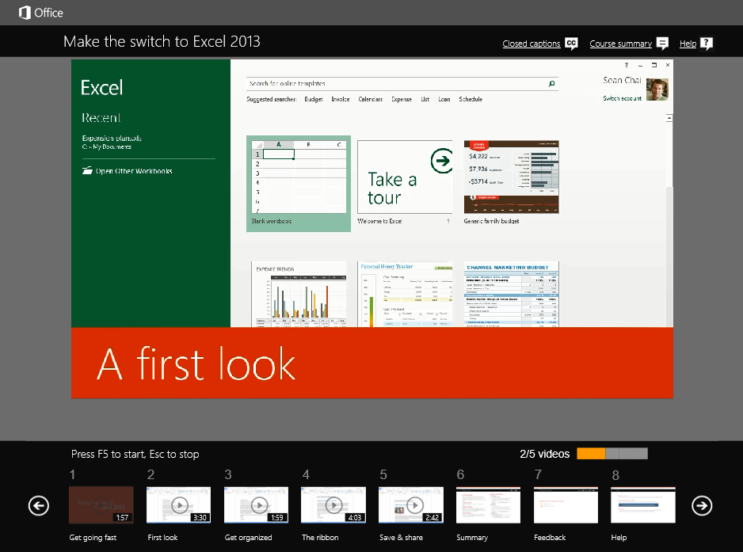
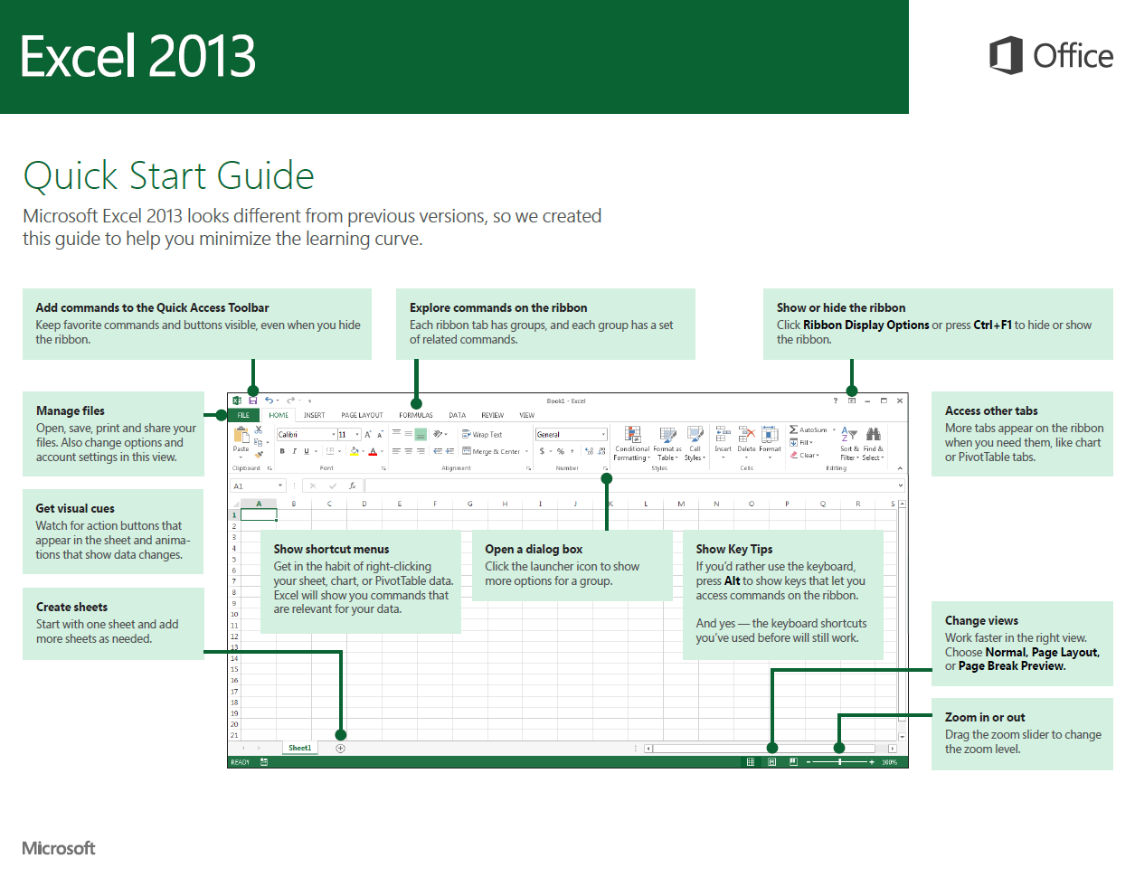
First days with Office 365
Help users transition and get started with the new apps
Quick Start Guides
These printable guides contain useful tips, shortcuts, and screenshots to help people find their way around Office 365.
Make the Switch Courses
Watch these videos to make the switch to the new Office. Get started with the new version to see how to do everyday tasks.
http://aka.ms/officestart
http://aka.ms/officetraining

Slide 26
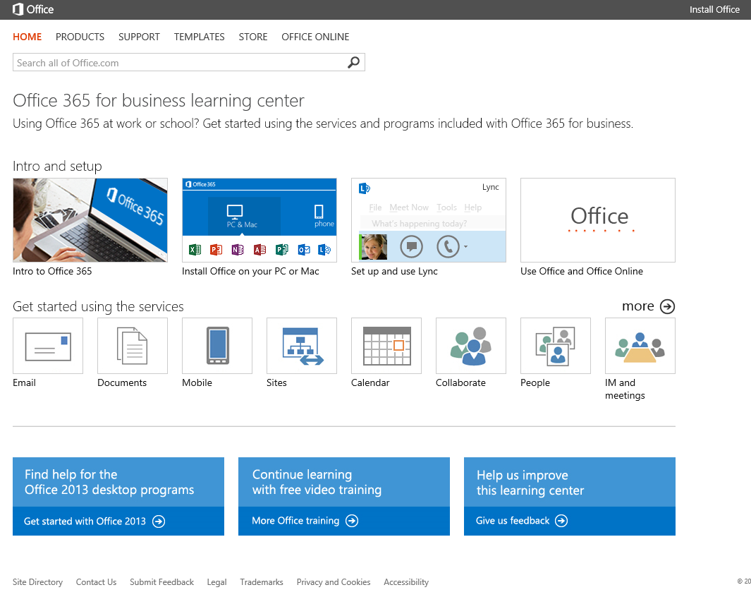
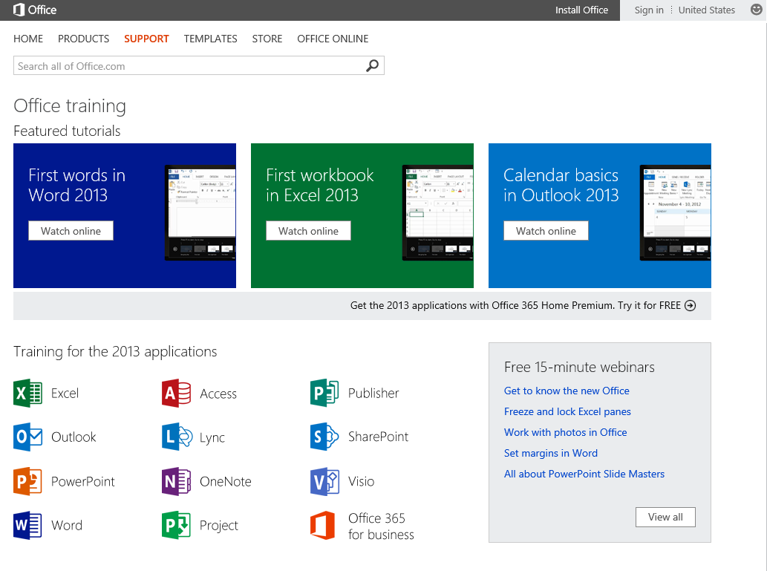
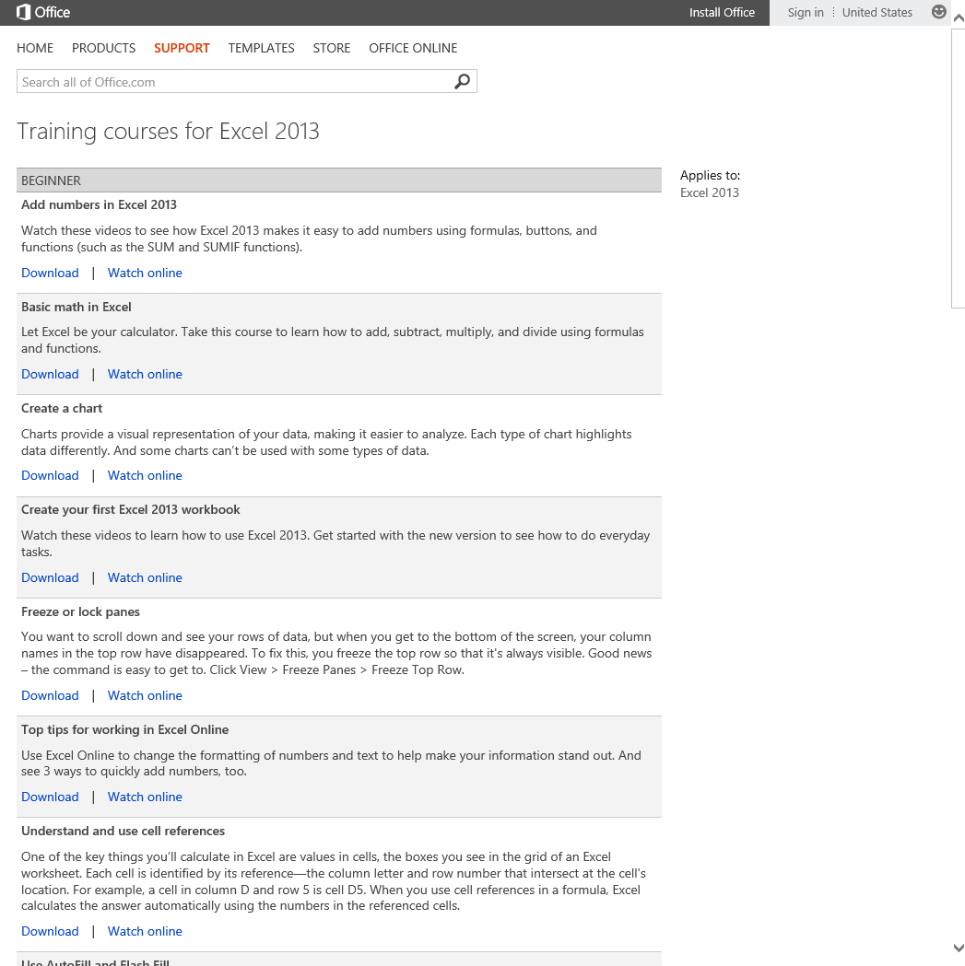
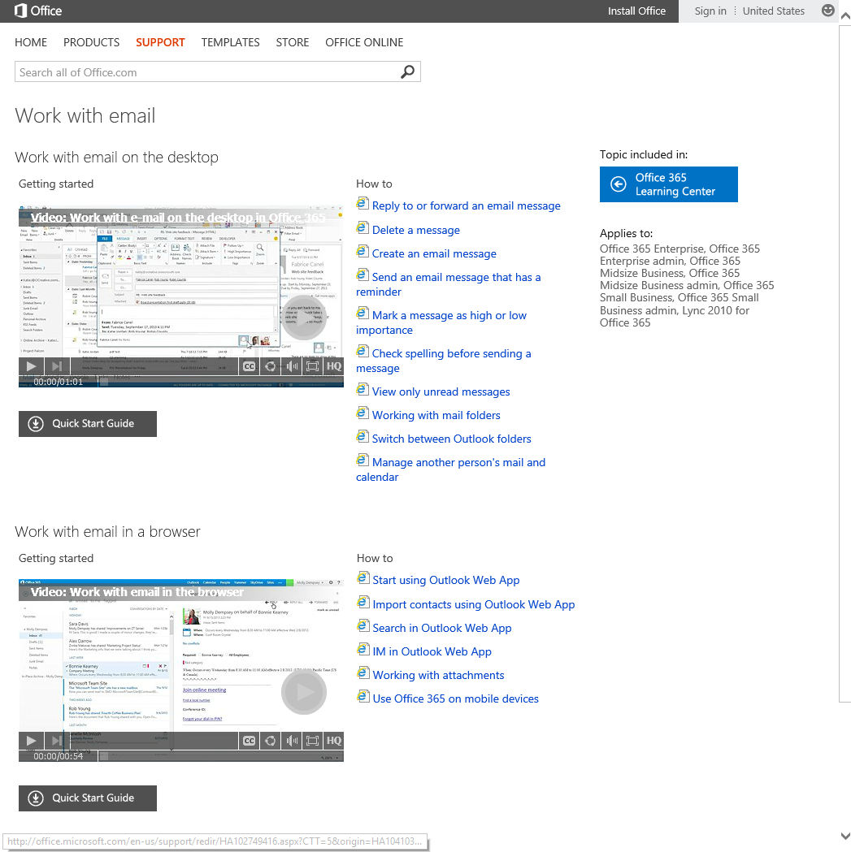
Ongoing Usage, Support & Change Management
Increase depth & breadth of usage and manage upcoming changes in the service
Office 365 Learning Center
Get people up and running quickly with these essential learning and training resources for Office 365.
Free Training Courses
Learn at your own pace with these free online training courses from Microsoft.
http://aka.ms/o365learning
http://aka.ms/officetraining

Slide 27
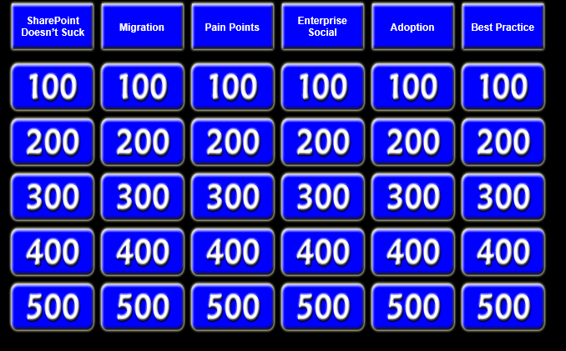
Activity: Office 365 Jeopardy

Slide 28
Activity: Office 365 Jeopardy

Slide 29
Groom
Champions
Champions are not only passionate about what they do, but are also excited to evangelize solutions, and help their peers to learn how to use them.

Slide 30
Learning via Co-Workers is among the most effective and most used methods
% USING METHOD TO LEARN
% WHO SAID METHOD WAS “VERY HELPFUL”
Percent Using Learning Method vs. Helpfulness
These methods are under-utilized (low usage, but have high effectiveness)
Co-Worker
(Non-Manager, Non-IT)
Learning via Co-Workers is among the most effective and most used methods
My Manager
IT Employee
Formal Training (External)
Formal Training (Internal)
Community
Forums
User Guide
or Manual
Self-learning is largely ineffective, but currently part of learning process for many
Microsoft’s Website
Online Tutorials or Webinars
Search Engine
Myself, Through
Trial and Error
L1. Thinking back to when you first started using SharePoint at work, as well as your use since, which of the following are ways that you learned to use SharePoint? Select all that apply.
L2. You indicated that you learned to use SharePoint in each of the following ways. Please use the scale below to indicate how helpful you would rate each of the learning experiences.
Base: Total Respondents (N = 783); Base sizes for L2 determined by responses in L1 (see Slide Notes)

Slide 31
How to motivate Champions?
55%
“It makes my job easier when others around me know how to use SharePoint”
Best Buy: The rise of the ninjas—a SharePoint 2013 user adoption story (SPC296)
http://aka.ms/bestbuyninjas
Matthew Ruderman; Sarah Haase
http://aka.ms/communityplaybook
29%
A formal program
24% Recognition for expertise and efforts
14% Minor compensation
12%
Certification

Slide 32
Drive New Behaviors & Stay Engaged
Rally people around the solution, keep listening, and drive change.
Establish communication avenues
Maintain momentum & dialog among users
Seek feedback and act on it

Slide 33
Nationwide: Building a World-Renowned Intranet with SharePoint 2013 and Yammer (SPC311)
http://aka.ms/natiowideSPOT
Chris Plescia ; James Tsai ; Jeff Schumann ; Matt Huber ; Shawn Domer

Slide 34
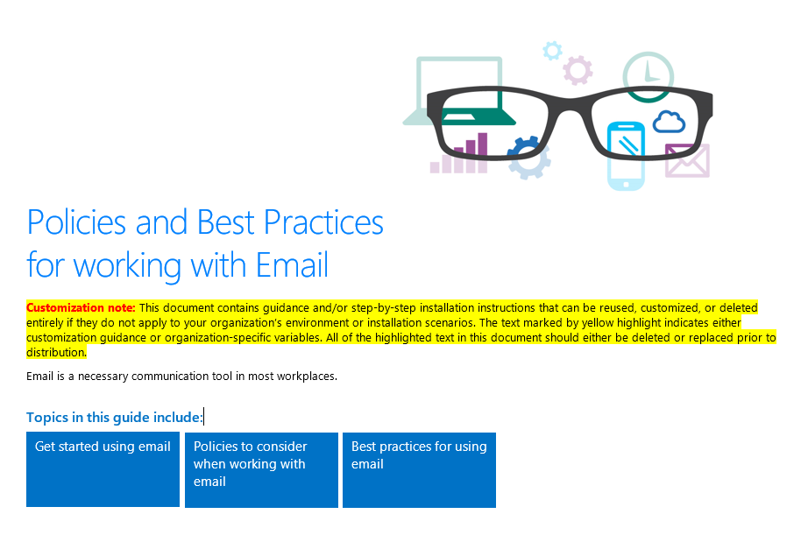
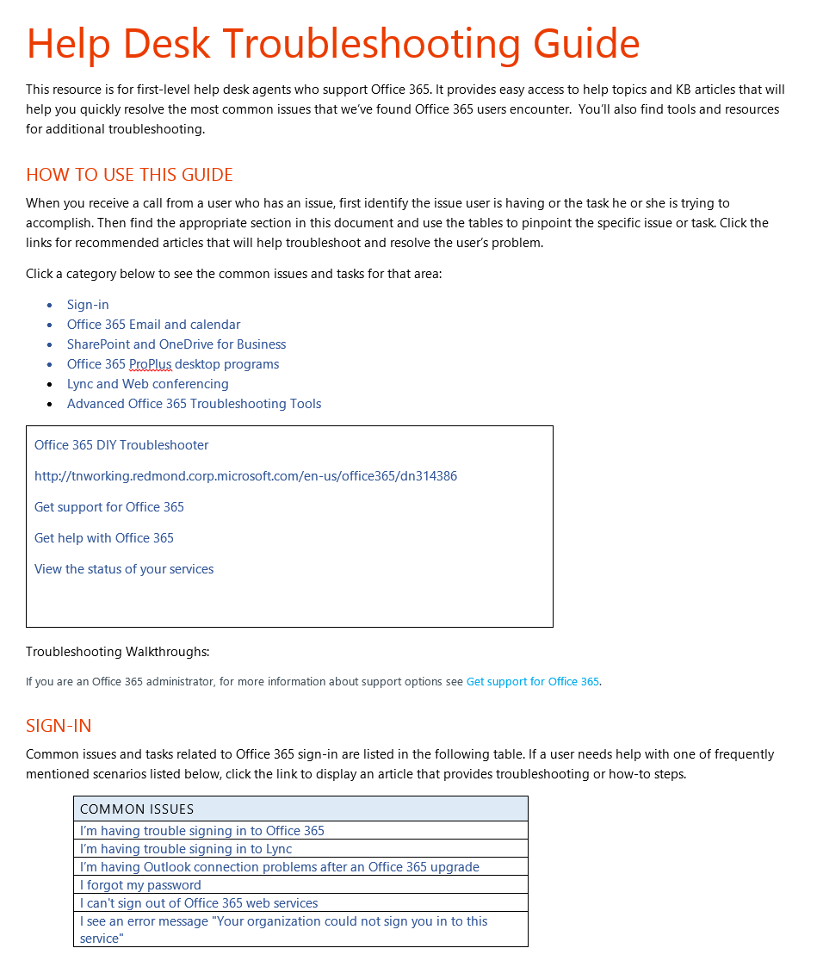
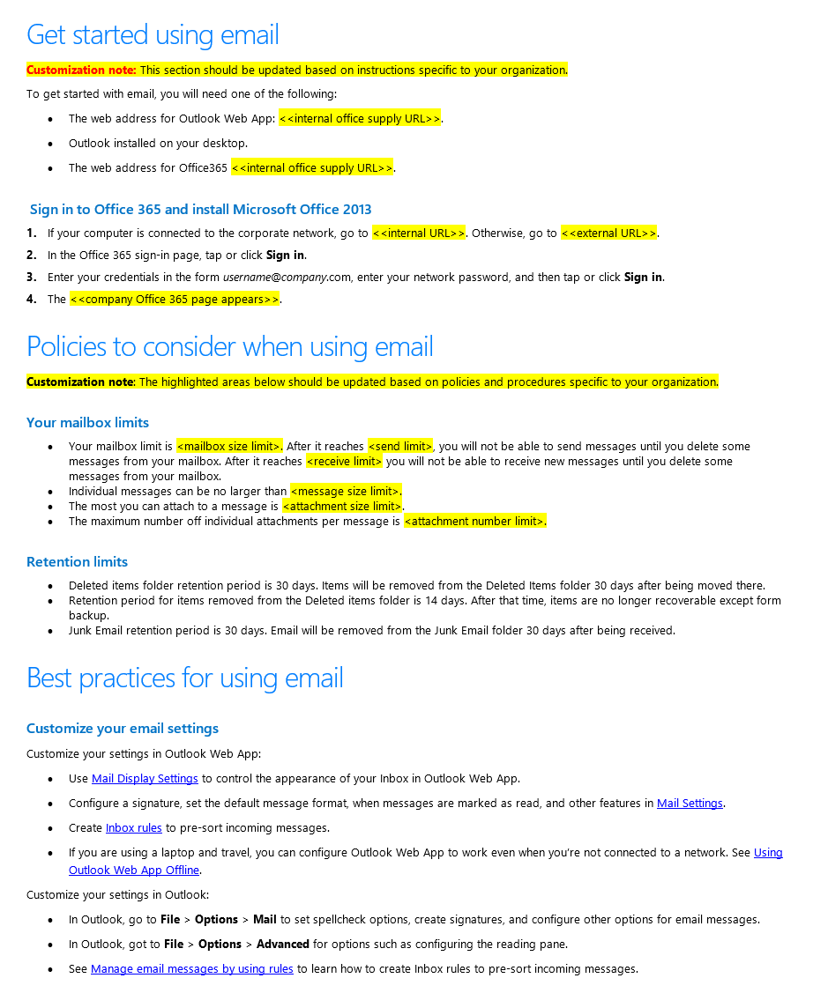
Ongoing Usage, Support & Change Management
Increase depth & breadth of usage and manage upcoming changes in the service
Policies Templates
Use the Policies templates to provide your users with guidelines about how to use Office 365 responsibly.
.
Helpdesk Resources
Leverage this guide to help get your Help Desk ready to troubleshoot Office 365 users.
http://aka.ms/o365kit
http://aka.ms/o365kit

Slide 35
What do you need to be successful?
Common attributes to success
1. Listen & Plan
A deep understanding of the business goals, as well as people challenges and needs to achieve them.
2. Envision & Design
A solution that people love and that helps them achieve business goals and get things done more effectively.
3. Drive & Engage
A strategy to drive adoption including communications, readiness and community.
4. Measure & Grow
A benchmark, KPIs
and success stories to help demonstrate success internally, improve and expand.

Slide 36
Measure & Expand
Showcase success, celebrate, and reiterate
Measure progress against benchmark
Improve approach based on user feedback
Add more scenarios, one step at a time

Slide 37
What do you need to showcase success?
A of mix Qualitative & Quantitative results
Evaluate where you are before getting started:
establish your benchmark and User Surveys.
Identify KPIs based on desirable outcomes (satisfaction, time to process an order, etc…).
Identify success stories and gather quotes using interviews and roundtables.
Measure progress against your KPIs to complement the qualitative analysis with data.

Slide 38
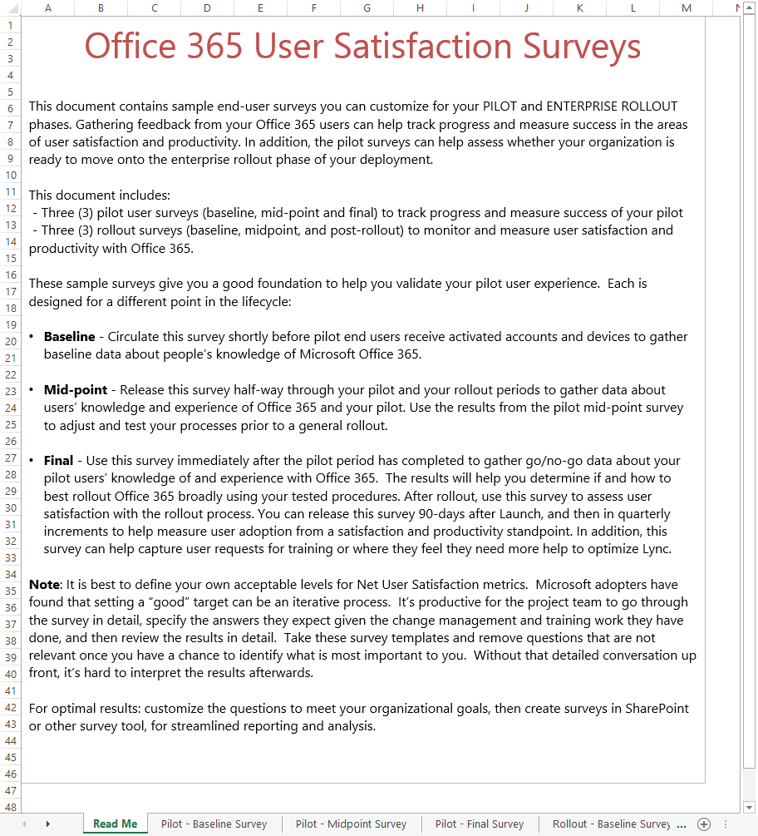
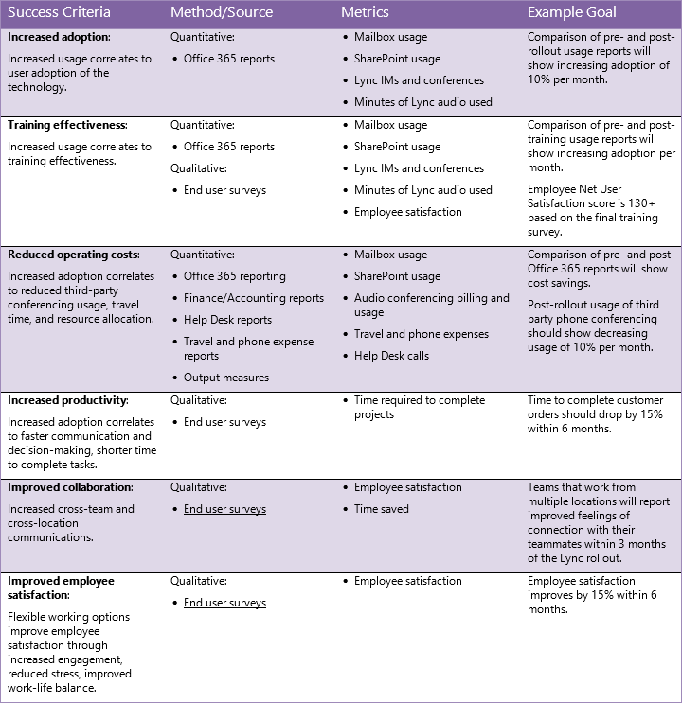
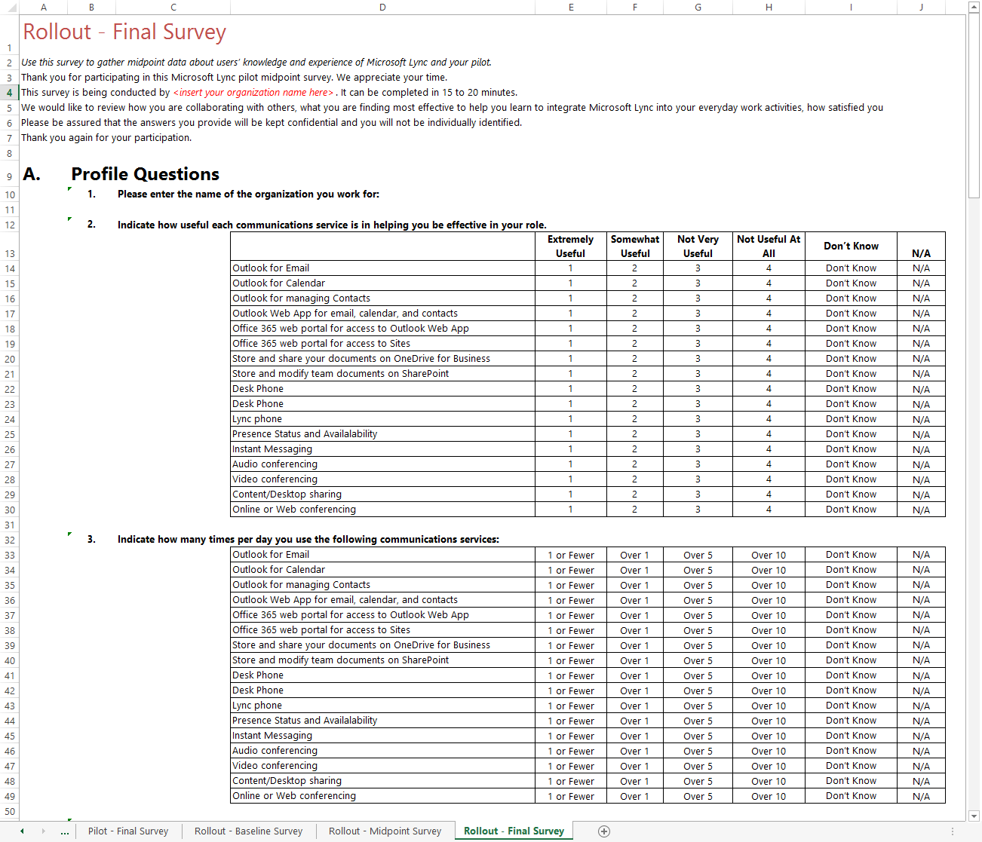
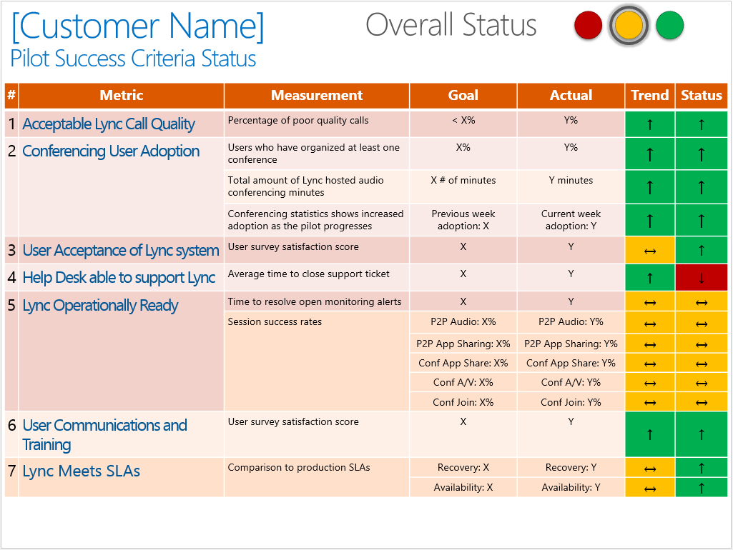
Ongoing Usage, Support & Change Management
Increase depth & breadth of usage and manage upcoming changes in the service
End User Survey Templates
Use the Survey Template to measure satisfaction and progress against your benchmark.
Success Criteria Examples Leverage Success Criteria Dashboard examples to track progress on roll-out & adoption.
http://aka.ms/o365kit
http://aka.ms/lyncrask
http://aka.ms/o365kit

Slide 39
Success Criteria Examples
Success Criteria | Method/Source | Metrics | Example Goal
Increased adoption: Increased usage correlates to user adoption of the technology. | Quantitative: Office 365 reports | Mailbox usage SharePoint usage Lync IMs and conferences Minutes of Lync audio used | Comparison of pre- and post-rollout usage reports will show increasing adoption of 10% per month.
Training effectiveness: Increased usage correlates to training effectiveness. | Quantitative: Office 365 reports Qualitative: End user surveys | Mailbox usage SharePoint usage Lync IMs and conferences Minutes of Lync audio used Employee satisfaction | Comparison of pre- and post-training usage reports will show increasing adoption per month. Employee Net User Satisfaction score is 130+ based on the final training survey.
Reduced operating costs: Increased adoption correlates to reduced third-party conferencing usage, travel time, and resource allocation. | Quantitative: Office 365 reporting Finance/Accounting reports Help Desk reports Travel and phone expense reports Output measures | Mailbox usage SharePoint usage Audio conferencing billing and usage Travel and phone expenses Help Desk calls | Comparison of pre- and post- Office 365 reports will show cost savings. Post-rollout usage of third party phone conferencing should show decreasing usage of 10% per month.
Increased productivity: Increased adoption correlates to faster communication and decision-making, shorter time to complete tasks. | Qualitative: End user surveys | Time required to complete projects | Time to complete customer orders should drop by 15% within 6 months.
Improved collaboration: Increased cross-team and cross-location communications. | Qualitative: End user surveys | Employee satisfaction Time saved | Teams that work from multiple locations will report improved feelings of connection with their teammates within 3 months of the Lync rollout.
Improved employee satisfaction: Flexible working options improve employee satisfaction through increased engagement, reduced stress, improved work-life balance. | Qualitative: End user surveys | Employee satisfaction | Employee satisfaction improves by 15% within 6 months.
Source: Change Management Guide - http://aka.ms/o365kit

Slide 40
Summary A Phased Approach to Drive Change Management and Manage Service Updates
Learn, Adjust & Iterate
1. Listen & Plan
Where do you want to go, why, and how do you get there?
Identify business goals, as well as people’s challenges and needs to achieve them.
Envision how Office 365 can help people get things done better and transform how they work together.
Prioritize and define use cases based on business priorities. Build business case.
2. Envision & Design
What are the tools you need to provide to empower the business?
Design a solution that helps people get things done more effectively and achieve business goals.
Use Pilot to get feedback, validate approach and identify Champions.
Plan for adoption approach.
Establish benchmark & define goals and objectives.
3. Drive & Engage
How do you ensure long term adoption of the solutions you provide?
Execute your strategy to drive adoption including communications, readiness, communities and change management.
Involve Champions to drive organic adoption.
Stay engaged & listen to improve solution & approach.
4. Measure & Grow
How do you measure progress, and increase usage breadth & depth?
Define your KPIs and measure progress against benchmark.
Gather feedback and success stories to demonstrate success internally, improve, and grow the user base.
Iterate with more solutions to transform your business.
Resources available:
Office 365 Adoption Kit: http://aka.ms/o365kit
Office 365 for Business Learning Center: http://aka.ms/o365learning

Slide 41
How to drive Office 365 adoption? A Phased Approach to Drive Change Management and Manage Service Updates
Onboarding Phase
Run State
Roll-Out
Scenario Spotlight
(ex: OneDrive for Business)
Scenario Spotlight
Dec | Jan | Feb | March | April | May | June | July
Launch Day
Buzz Day
Buzz Day
Buzz Day
Buzz Day
Buzz Day
Buzz Day
Follow those steps for each Phase. Measure Results, Adapt and Iterate.
Learn, Adjust & Iterate
1. Listen & Plan Work with the business to identify most important needs and challenges to achieve business goals.
2. Envision & Design
Kick off your pilot by getting the right team. Refine solution based on feedback.
3. Drive & Engage
Plan & execute your adoption strategy including readiness, communications and communities.
4. Measure & Grow
Measure progress against benchmark, improve, showcase success and iterate with new scenarios.

Slide 42
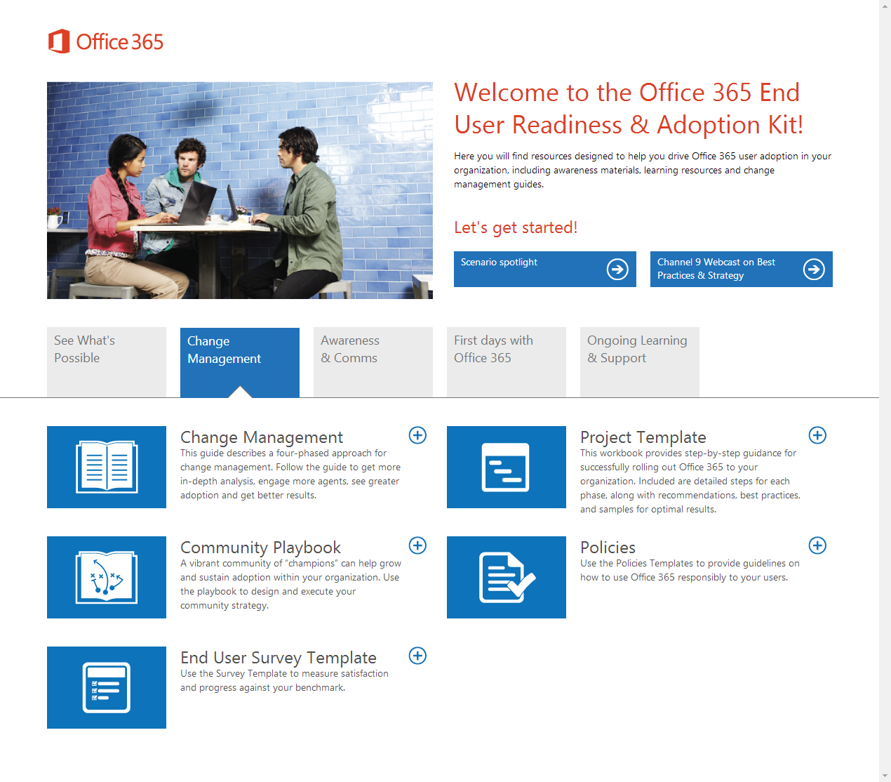
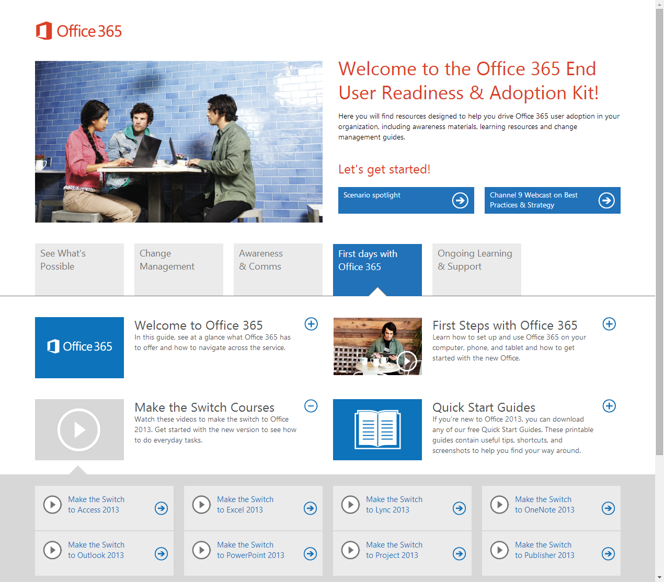
Resources available
Office 365 Adoption Kit - New
This kit is designed to help IT drive Office 365 adoption and usage within their organization, featuring scenarios, videos & guides, training courses, posters, email templates, and change management guidance and resources.
http://aka.ms/o365kit

Slide 43
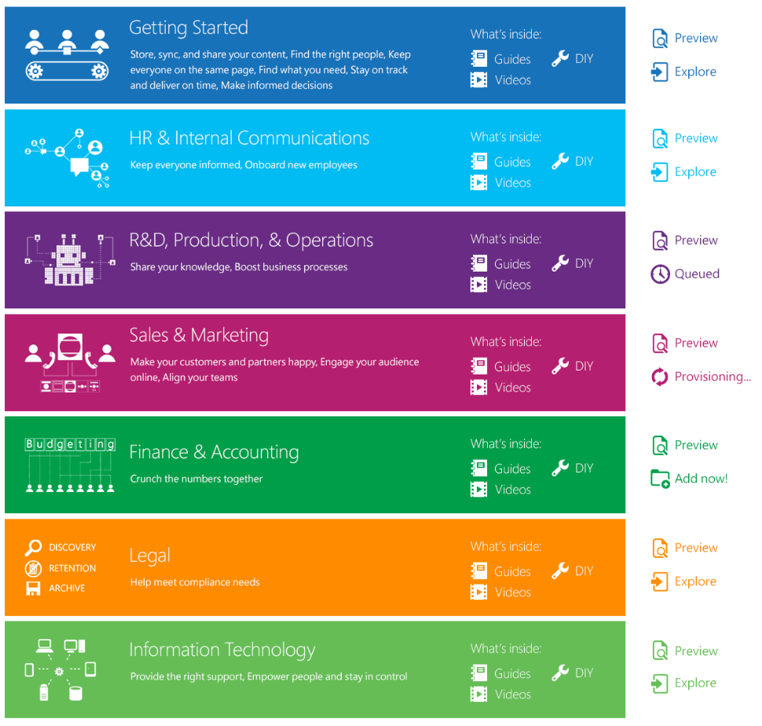
Get Started with Office 365 Today
Go to http://aka.ms/getfasttrack
Enter the Promo Code “TechEd”
Start your Office 365 experience
Provision scenarios to pilot members
Experience Exchange Online and the rest of Office 365 in minutes.
Utilize guided deployment plans and change management resources

Slide 44
Join us on the Office 365 IT Pro Network
The new Yammer network just for you.
Connect
Interact with Microsoft pros, engineers, MVPs, Insiders, and industry influencers.
Discover
Learn about the latest news, updates, trends, and best practices in the information technology industry.
Engage
Participate in community discussions around Office 365 topics, provide feedback, and ask questions.
Get started at www.yammer.com/itpronetwork
Join the “Driving Adoption” Group

Slide 45
Thank you!

Slide 47
Complete an evaluation and enter to win!

Slide 48
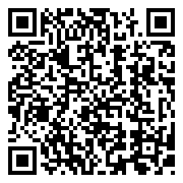
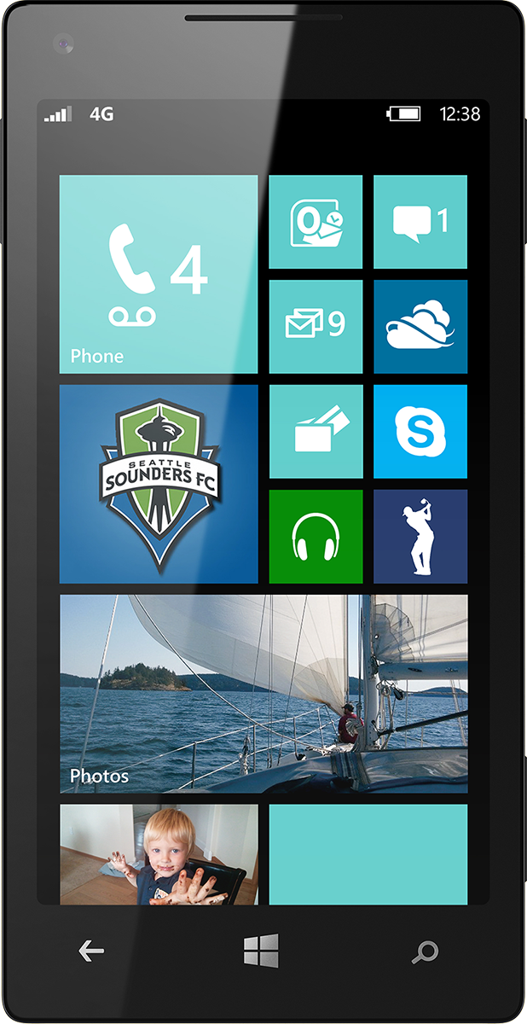
Evaluate this session
Scan this QR code to evaluate this session.

Slide 49
© 2014 Microsoft Corporation. All rights reserved. Microsoft, Windows, and other product names are or may be registered trademarks and/or trademarks in the U.S. and/or other countries.
The information herein is for informational purposes only and represents the current view of Microsoft Corporation as of the date of this presentation. Because Microsoft must respond to changing market conditions, it should not be interpreted to be a commitment on the part of Microsoft, and Microsoft cannot guarantee the accuracy of any information provided after the date of this presentation. MICROSOFT MAKES NO WARRANTIES, EXPRESS, IMPLIED OR STATUTORY, AS TO THE INFORMATION IN THIS PRESENTATION.

Slide 50
Appendix

Slide 51
What do people want?

Slide 52
End-Users Study, April 2013
United States:
8 Focus Groups (4 IT Pros; 4 Users)
6 Individual Interviews (IDIs) (IT Pros)
300 Respondents to Online Survey (users)
Germany:
300 Respondents to Online Survey (users)
Japan:
200 Respondents to Online Survey (users)
Global Approach - Summary
4 | 4 | 6 | 800
End Users Focus Groups (8 people/each) | IT Pros Focus Groups (8 people/each) | IT Pros IDIs (1:1) | Online Survey (users)

Slide 53
Top Benefits (800+ users)
QUANTITATIVE Appeal Rating
QUALITATIVE Importance Rating
Source: SharePoint End-User Study, Apr 2013, Microsoft Corporation

Slide 54
Top Tasks & Needs Differ by Functions
Engineering, Research & Development
Operations, Manufacturing & Logistics
Sales, Marketing, PR & Communications
Share best practices across geographies
Improve and monitor business processes
Align Sales and Marketing teams
HR & Legal Services
Accounting, Finance & Procurement
Administration
Gather & process forms from employees
Pull data and build financial reports
Organize teams and manage calendars
Source: SharePoint End-User Study, Apr 2013, Microsoft Corporation

Slide 55
Proposed Scenarios
Getting Started
Use cases by functions
Store, sync and share your content
Keep everyone on the same page
Stay on track and deliver on time
Find what you need
Find the right people
Make informed decisions
HR
Onboard new employees
Keep everyone informed
R&D, Production & Operations
Share your knowledge
Boost business processes
Sales & Marketing
Make customers & partners happy
Engage your audience online
Align your teams
Finance & Accounting
Crunch the numbers together
Legal
Help meet compliance needs
Information Technology
Provide the right support
Empower people and stay in control
Source: SharePoint End-User Study, Apr 2013, Microsoft Corporation

