Slide 1
Sneak Peek
Video
for Office 365
presented by marc mroz - 5/12/14
sharepoint program manager

Slide 2
Vision of Next-gen Portals
iPhone App
Video Portal
Out of the Box
Key Uses
Architecture
Azure Media Services
Discovery

Slide 3

Next-gen Portals
Simple, Fast & Mobile
A New Vision

Slide 4
Video is now a
REQUIREMENT
not a luxury

Slide 5
communicate
Video
is how you
ideas, concepts, changes
educate
onboarding & training
collaborate
share best practices

Slide 6

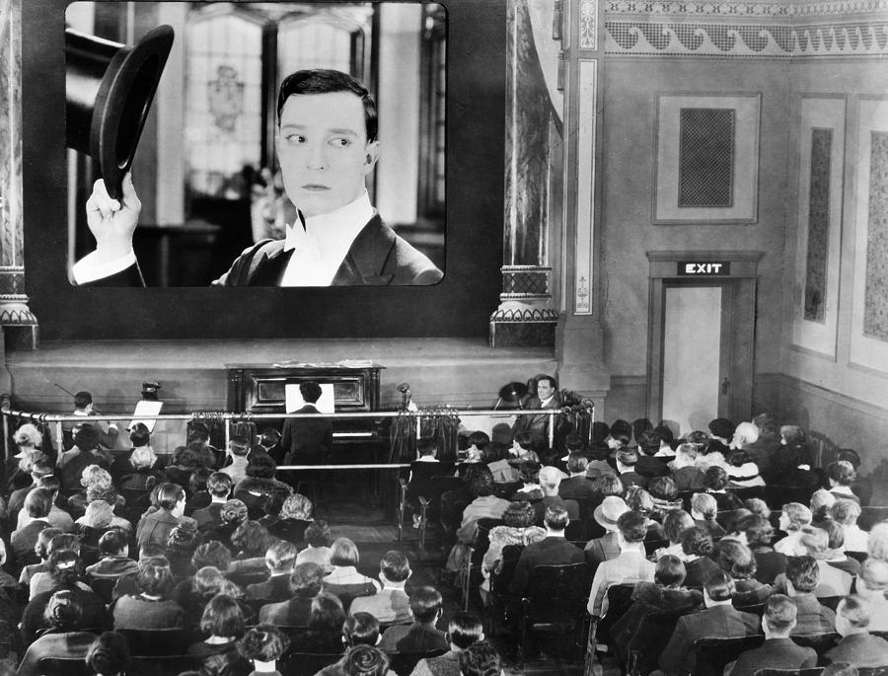

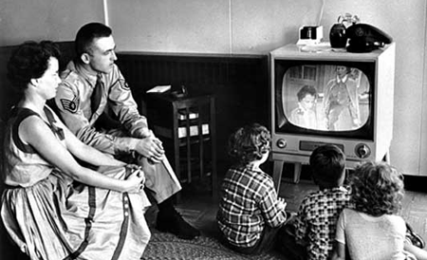

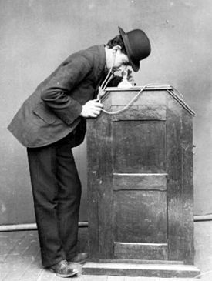
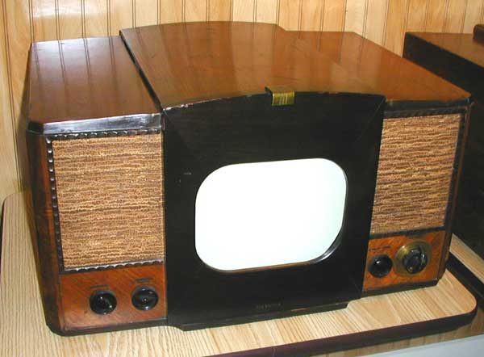
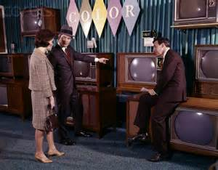


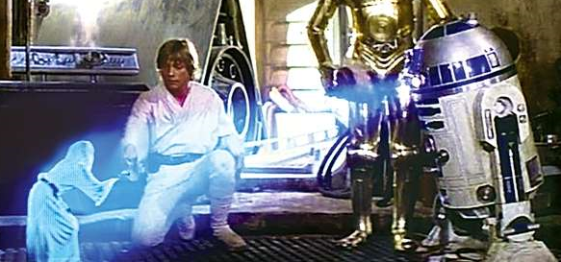
Video’s Reach
1,000
1
6 mil
100mil
time time time time
time time
time time
time
time
time time time
time time
time
time time time time time
1893
1920’s
1945
2006
2014
Future
1950
Long Time Ago
1960
2012
1
10,000
60 mil
217mil

Slide 7
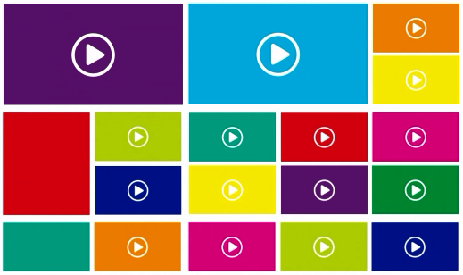
Introducing…
Video
for Office 365
An out of the box,
enterprise video streaming portal,
that is ready to use.

Slide 8

Demo
home & channels

Slide 9
Vision of Next-gen Portals
iPhone App
Video Portal
Out of the Box
Key Uses
Architecture
Azure Media Services
Discovery

Slide 10
video
simple
simple
simple
st fa
fast fast f
ast fast fas
fast fast f
fast fast fast fast fast fast
fast fast fast fast fast fast fas
fast fast fast fast fast fast fast fa
fast fast fast fast fast fast fast fast
fast fast fast fast fast fast fast fast fa
fast fast fast fast fast fast fast fast fast f
ast fast fast fast fast fast fast fast fas
st fast fast fast fast fast fast fast f
fast fast fast fast fast fas
st fast fast fast fast fa
ast fast fast fas
enterprise
secure secure secure s
secure secure secure se
secure secure secure sec
secure secure secure secure
ure s re secu
secure secur e secure
ure secure secure secure
ecure secure secure s
ecure secure secure se
secure secure se
cur
scalable scalable
ble scalable scalable
alable scalable scalable sc
scalable scalable scalable sca
scalable scalable scalable sca
scalable scalable scalable sc
scalable scalable scalable
scalable scalable scala
scalable scalable
scalable scalable
mobile mobile
mobile mobile mobile m
mobile mobile mobile mobile
mobile mobile mobile mobile
mobile mobile mobile mobile
mobile mobile mobile mobile
mobile mobile mobile mobile
bile mobile mobile mobile
e mobile mobile mobile
mobile mobile mobile
simple
mple simple
mple sim
simple simple si
simple simple
simple sim
simple s
simple si

Slide 11

video solution
out of the box
Portal
Adaptive Streaming
Oslo
Yammer
Channels
AES Secure Delivery
Mobile Apps

Slide 12
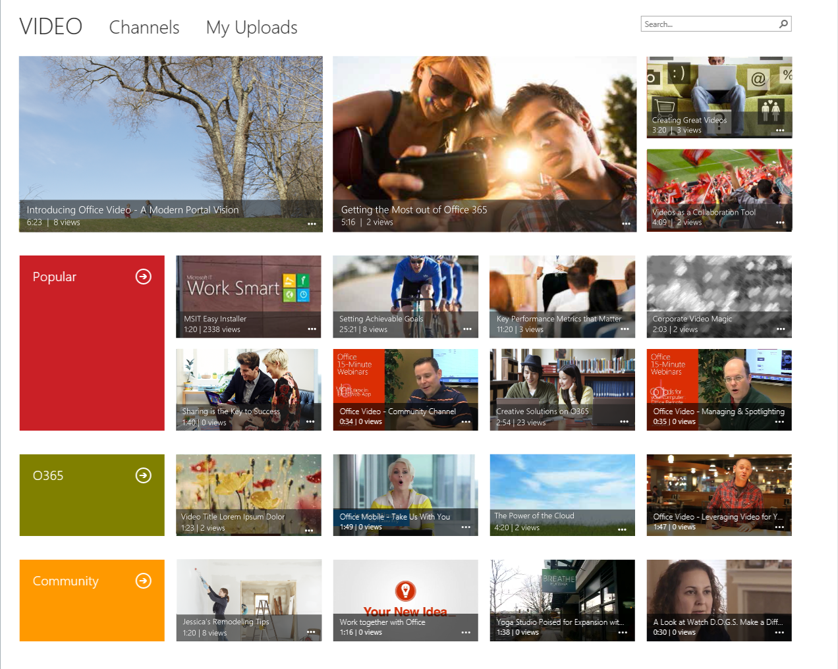
Out of the box…
just start using it!

Slide 13
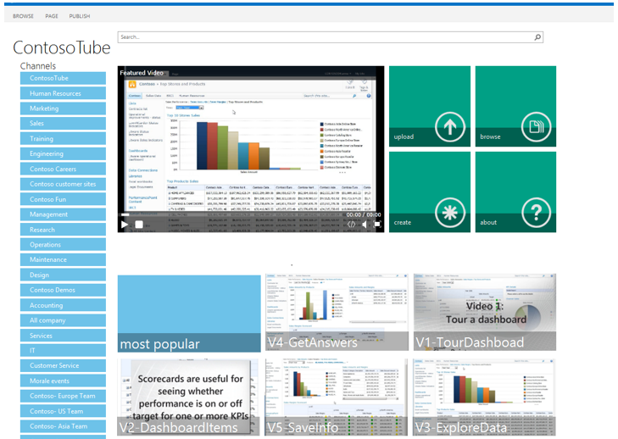
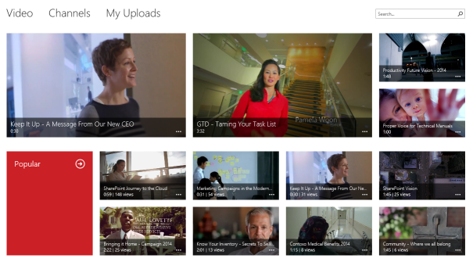
Project 3 – Customize Home Page
Add CBS WP for Popular
Add CBS WP for My Uploads
Add Media WP for Featured Video
Create Display Template for Popular
Create Display Template for My Uploads
Configure Popular Query
Configure My Uploads Query
SP 2013 – Building Blocks
Project 4 – Customize Channel Page
Insert WP Zone snippet
Configure CBS WP Query
Configure Appearance of CBS WP
Project 2 – Linking Videos & Channels
Add a Channel Column to the Asset Library
Project 5 – Customize Video Player Page
Add Recommended Items WP
Configure Recommended Items WP Query
Project 1: Create Master & Layout Page
Create Master Page
Add Search Box Code
Add Vertical Navigation
Create Term Set
Create Layout Page
Add WP Zone For Media WP Code
Add Create Channels Code
Add Upload Videos Code
Add WP Zone for CBS WP
Bonus – Style Portal With Custom CSS
Video for O365 – Already Built

Slide 14


Permissions
Categories
Add/Remove Channels
Management
Spotlight Channels
Settings
Spotlight Videos
Channel Color

Slide 15
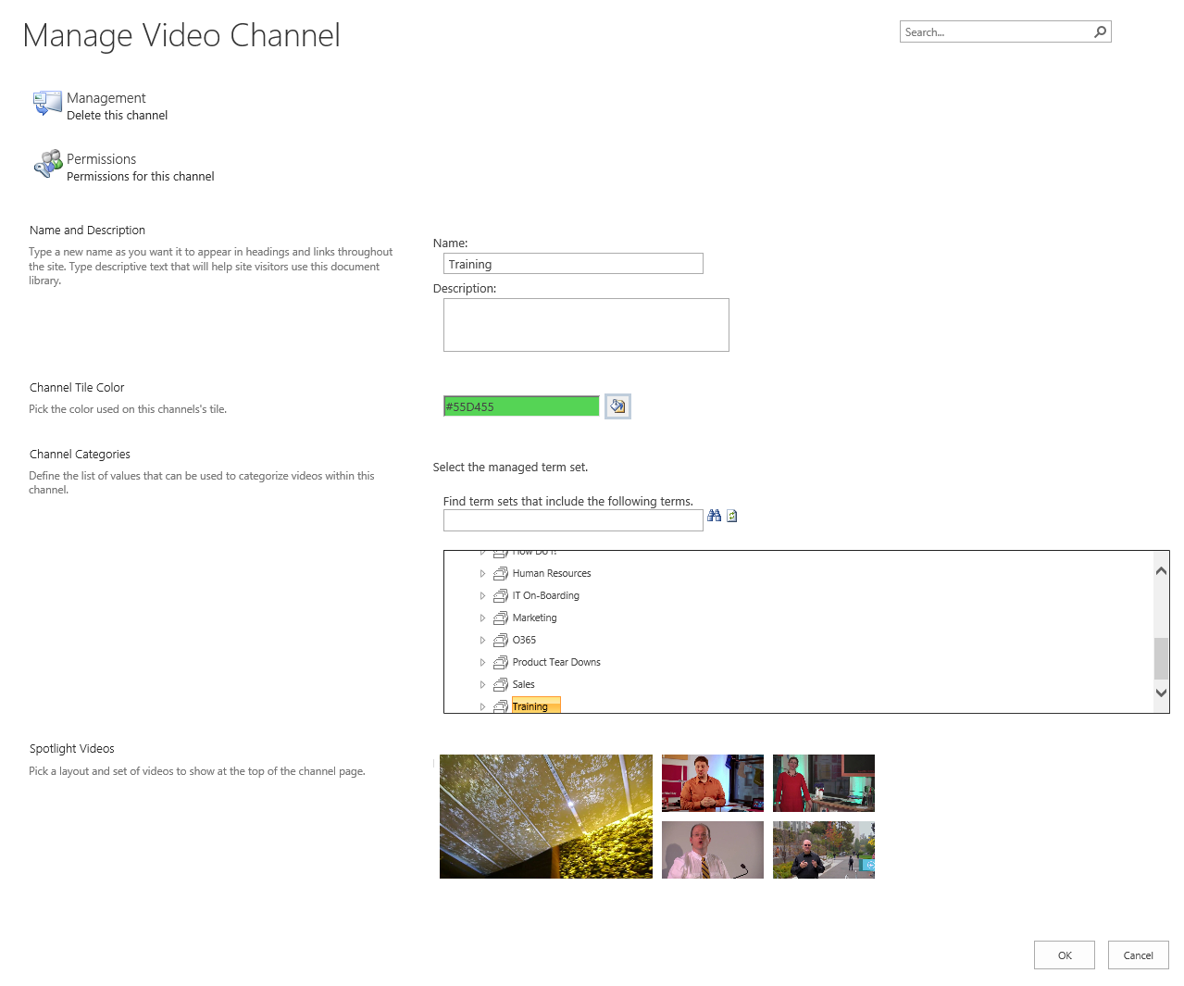
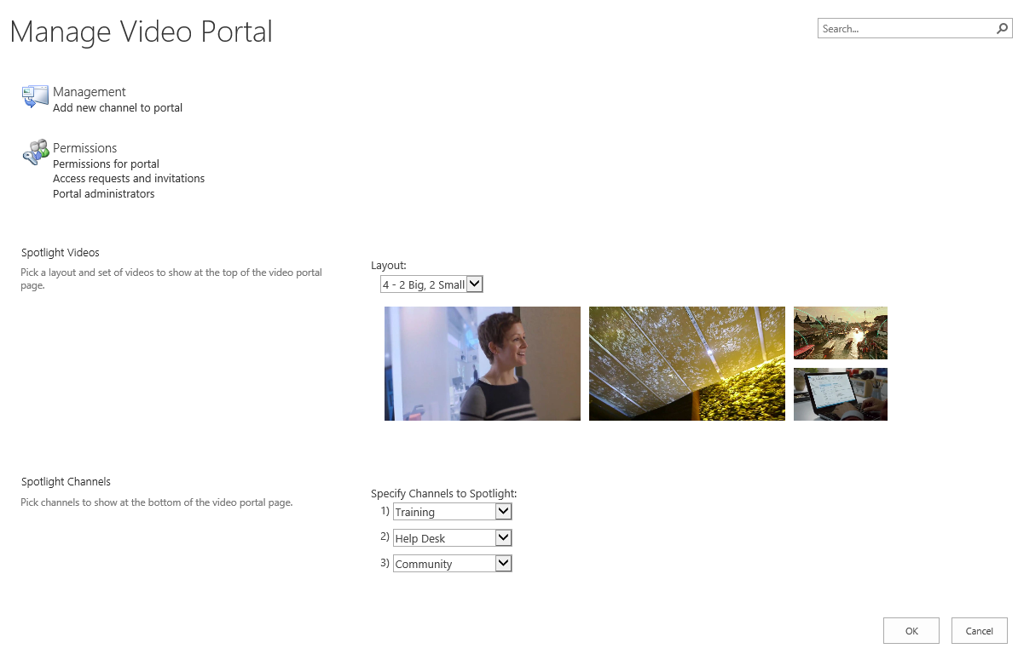
Management
Settings

Slide 16
Vision of Next-gen Portals
iPhone App
Video Portal
Out of the Box
Key Uses
Architecture
Azure Media Services
Discovery

Slide 17

Key Uses
Training
Corporate Messages
Community
Help Desk

Slide 18

Demo
scenarios

Slide 19
Vision of Next-gen Portals
iPhone App
Video Portal
Out of the Box
Key Uses
Architecture
Azure Media Services
Discovery

Slide 20
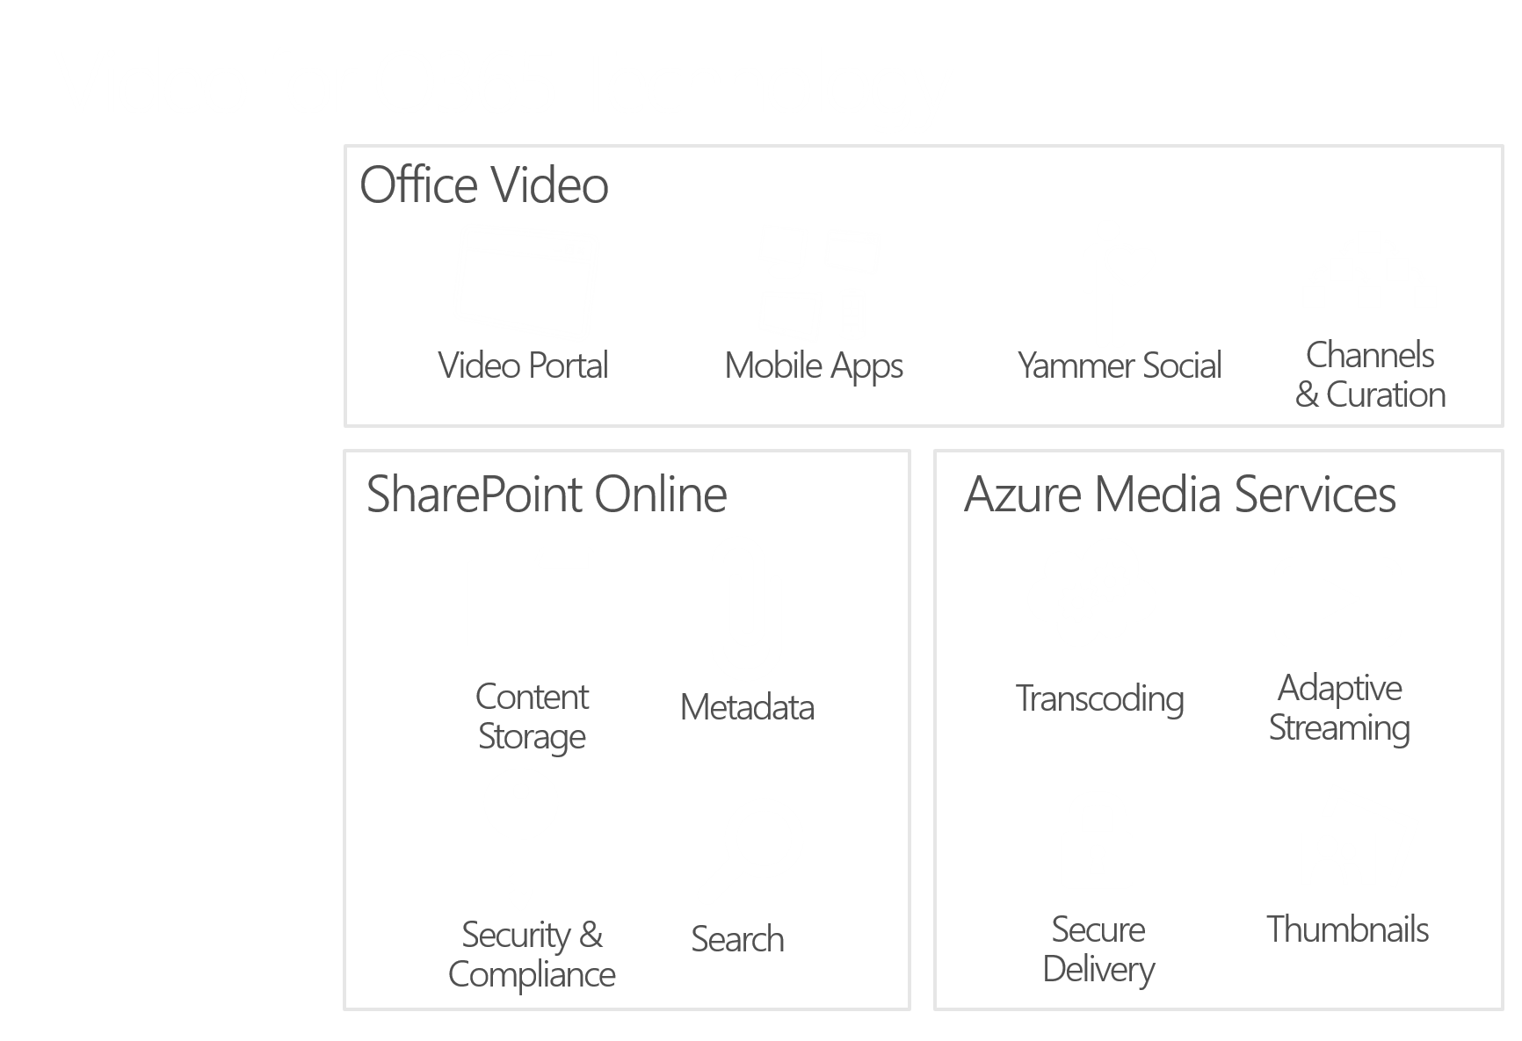

Slide 21





Uploader
Viewers


Video for O365



SharePoint Online
Azure Media Services

Secure
Delivery



Content Storage
Metadata
Transcoding

Thumbnail

Slide 22
SharePoint Online
SharePoint & Azure Components
Video Portal : Site Collection
Azure
Timer
Job
Compute
Blob Storage
Encoding/
Thumbnail
Events
Table Storage
Channel 1 : Asset Library
Channel 2 : Asset Library
Channel 3 : Asset Library
Add/Delete Events
Queue Storage
Scheduler
Active Directory
Traffic Manager
Media Services

Slide 23
Vision of Next-gen Portals
iPhone App
Video Portal
Out of the Box
Key Uses
Architecture
Azure Media Services
Discovery

Slide 24












Windows
Azure Media
Powered By
Services
Your
Organization

Slide 25
Azure Media Services
2012 Olympics
18.5 PB data delivered
160 M streams
217 M unique viewers
NBC Sports
PGA Golf - 57 Matches (195.5 hrs)
MLS - 15 games (45 hrs)
2014 Olympics
100 TB of video - 6,000+ hrs
204 channels
Record setting 2.1 M viewers for single event
NHL - 50 games (150 hrs)
English Premier League - 310 events (930 hrs)
Sunday Night Football - 22 events (66 hrs)
Pro Football Talk - 96 days (2.5 hrs/day)
XBOX One (Nov ‘13-Feb ‘14)
98 M videos
>1 PB of videos
207 M streams

Slide 26
}
{
Azure Media Services
H.264, MPEG-1, MPEG-2, MPEG-4 v2, VC-1, WMV, DV
In .mp4, .mpeg, .mpg, .avi, .wmv, .dv, .3gp, .3g2, .3gp2, .asf, .mts, .m2ts, .mod, .ts, .vob, .xesc, .m2v, .ismv
MP3, WMA, AC-3, AAC
H.264 at 720p
400 to 3,000 kbps
HLS, Smooth Streaming, MPEG-DASH
96 kbps stereo AAC audio
* But... We’ll always be working on better encoding patterns.
Multiple
Formats In
Stream Any Device Out
Transcoding

Slide 27

Azure Media Services
Stream to Any Device
Stream on Any Network
Dynamic Remux
}
}
Secure
Delivery
Smooth Streaming
Apple HLS
AES Encrypted Payload
– Delivered over HTTP
Adaptive
Streaming

Slide 28
Azure Media Service Session
DEV-B353
Building End-to-End Video Experiences with Microsoft Azure Media Services
Wednesday, May 14: 5:00 PM - 6:15 PM Room: 340
Speaker: Mingfei Yan
Track: Developer Platform and Tools
Session Type: Breakout
Topic: Microsoft Azure

Slide 29
Vision of Next-gen Portals
iPhone App
Video Portal
Out of the Box
Key Uses
Architecture
Azure Media Services
Discovery

Slide 30
Demo
oslo


Slide 31
Oslo & Office Graph Session
OFC-B240
Introducing Codename "Oslo" and the Office Graph
Tuesday, May 13: 5:00 PM - 6:15 PM Room: Hilton L2 Ballroom C
Speaker(s): Cem Aykan, Viral Shah
Track: Office Servers and Services
Session Type: Breakout

Slide 32
Video First Example in
Vision
Next-gen Portals
Simple
Fast
Mobile
Social




Everyone
Participates


Slide 33


Q
A
&
Sponsors |  | Jeff Teper Lauren Antonoff Bill Staples Scott Guthrie
Producers |  | Adam Harmetz Andy Seres Stanley Grant Douglas Olson Sudheer Sirivara
Program Leads |  | Daniel Kogan Vishal Sood
Development Leads |  | Yanxue Du Douglas Olson
QC Leads |  | Michelle Dauphiny Ram Venkatesan
Programming Directors |  | Gerald Ferry Marc Mroz Vishal Sood Mona Mohanty
Developers |  | Bin Zhang Gang Zhai Ghania Moussa Harry Hao Shiguang Dong Andrew Martin Douglas Olson Erik Jordan Douglas Shimonek Steve Herbert Steve Peterson Steven Yackel
QC & Monitoring |  | Janak Agarwal Josh Bertsch Justin Fagnan Dmytro Krasnoshtan Ben Spain Ram Venkatesan Shreyas Ranade
Marketing |  | Cem Aykan
Planning |  | Haris Majeed Michael van Dijken Vasu Rangaswami
Design Director |  | Ken Fry
IA Lead |  | Mick Gow
Lead Designer |  | Tyler Rasmussen
Designers |  | Andrew Lu Michael Pierce Marcela Vorel Gerald Ferry Marc Mroz Vishal Sood Douglas Olson
Style Mechanic |  | Andrew Martin
Office Video is based on actual events and real people. While some of the names have not been changed, some people may wish to be left anonymous, or actually change their name at a later time. The timing of certain events may have been adjusted for clarity or to make time for lunch. No engineers were significantly harmed in the making of Office Video or these credits.

Slide 34
Questions
&
Answers

