Slide 2
Exchange 2013 Public Folder Migration
OFC-B313
Allen Mock
amock@microsoft.com
Technology Solutions Professional

Slide 3
Session Overview
Limitations of Legacy Public Folders
Modern Public Folders
Current Investment Areas
Migrating to Modern Public Folders

Slide 4
Limitations of Legacy Public Folders
One Public Folder Database allowed in org with 2007 CCR
Exchange 2010 DAG no Log Shipping for Public Folders
Public Folders not supported in Office 365 (Exchange 2010) and BPOS
Troubleshooting!!!

Slide 5
Modern Public Folders
Switch to standard mailbox storage
Familiar mailbox based storage for high availability
No separate replication mechanism
Single-master model
Hierarchy is stored in PF mailboxes (one writeable)
Each public folder mailbox has a read only copy of the PF hierarchy
Content can be broken up and placed in multiple mailboxes
Hierarchy folder points to target content mailbox
No changes to end user
Support on-premises, hybrid & Office 365

Slide 6
Modern Public Folders Architecture
Architecture
Public folders are based on the mailbox architecture
Hierarchy is stored in all public folder mailboxes
Content can be broken up and placed across multiple mailboxes
Similar administrative features
Public Folder permission management in RBAC
Public
logon
Public Logon
Public
logon
CAS 2013
Hierarchy
Hierarchy
Hierarchy
Red Folder
Green Folder
Blue Folder
Pink Folder
Yellow Folder
Secondary PF Mailbox 1
Primary PF Mailbox
Secondary PF Mailbox 2

Slide 7
Public Folder Hierarchy Synchronization
Client connects to a PF mailbox
Client creates Folder2
Create request is proxied via the primary PF mailbox
PF hierarchy is updated on all PF mailboxes
Within 15 mins where users are connected
Within 24 hours where no users are connected
1
CAS 2013
Hierarchy
Hierarchy
Hierarchy
4
Folder1
Folder1
3
Folder1
Folder2
Folder2
2
Folder2
Secondary PF Mailbox 1
Primary PF Mailbox
Secondary PF Mailbox 2

Slide 8
Modern Public Folders
Hierarchy
Each public folder mailbox has a copy of the public folder hierarchy
There is only one writeable copy of the hierarchy at any given time.
Clients connect to their home hierarchy - DefaultPublicFolderMailbox
Uses Incremental Change Synchronization, Write Operations trigger immediate sync
Content
Public folder content is stored in a public folder mailbox
It is not replicated across multiple public folder mailboxes (although passive copies of the mailbox are supported through high availability services)
All clients access the same public folder mailbox for a given set of content

Slide 9
Current investment areas
Scale
Invest on increasing limits
Hierarchy sync performance optimizations
Migrations improvements
Cross-forest migrations for legacy public folders
Reliability and speed
Client connectivity
Access for Outlook for Mac clients to access legacy PFs
Calendar and contact folder support in OWA
Other areas
Auto-split infrastructure

Slide 10
Migrating from Legacy Public Folders
Migration – Overview
Prepare the environment for migration
Exchange 2010 Prerequisites
Exchange 2013 Prerequisites
Migration
Rollback the migration

Slide 11
Migration Overview
Mailboxes on Exchange 2007 and 2010 cannot access Public Folders on Exchange 2013
Exchange 2013 Mailboxes can access legacy Public Folders (but not both)
No coexistence → Migrate users first
All Public Folders cut over to Exchange 2013 together
Short downtime while migration is finalized
When migration completes, everyone switches at the same time
Can revert, but post migration changes are lost
Public Folder Migration is similar to online mailbox moves
Ensure healthy replication

Slide 12
Prepare for Migration - 2007/2010 Prereqs
Perform Snapshot of Exchange 2007/2010 PF environment
Public Folder structure:
Get-PublicFolder -Recurse | ConvertTo-CSV C:\PFMigration\Ex2010_PFStructure.csv
Public folder statistics (item count, size and owner):
Get-PublicFolder -Recurse | Get-PublicFolderStatistics | ConvertTo-CSV C:\PFMigration\Ex2010_PFStatistics.csv
Permissions:
Get-PublicFolder -GetChildren | Get-PublicFolderClientPermission | Select-Object Identity,User - ExpandProperty AccessRights | ConvertTo-CSV C:\PFMigration\Ex2010_PFPerms.csv
Verify that there is no previous migration recorded
Get-OrganizationConfig | FL PublicFoldersLockedforMigration, PublicFolderMigrationComplete

Slide 13
Prepare for migration – 2013 prereqs
Remove any “old“ Public Folder migration request(s)
Get-PublicFolderMigrationRequest | Remove-PublicFolderMigrationRequest -Confirm:$false
Remove any Public Folder in Exchange 2013
Get-MailPublicFolder | where $_.EntryId -ne $null | Disable-MailPublicFolder -Confirm:$false
Get-PublicFolder -GetChildren \ | Remove-PublicFolder -Recurse -Confirm:$false
Remove any Public Folder Mailboxes in Exchange 2013
Get-Mailbox -PublicFolder |Remove-Mailbox -PublicFolder -Confirm:$false

Slide 14
Demo: Migrating to Modern Public Folders

Slide 15
Migration – Generate Migration Files (Step 1a)
1. Export-PublicFolderStatistics.ps1 Create mapping File with Foldername and Foldersize Example: .\Export-PublicFolderStatistics.ps1 –PublicFolderServer E2K10 -ExportFile C:\PFstats.csv

Slide 16
Migration – Generate Migration Files (Step 1b)
2. .\PublicFolderToMailboxMapGenerator.ps1 Create Folder to Mailbox Mapping file Example: .\PublicFolderToMailboxMapGenerator.ps1 -ImportFile c:\PFstats.csv -exportfile c:\pfmap.csv -mailboxsize 1GB Note: Output on the right was manually edited

Slide 17
Migration – Create Public Folder Mailboxes (Step 2)
Create First Public Folder Mailbox (Writeable Hierarchy)
New-Mailbox -PublicFolder <Name> -HoldForMigration
Create additional Public Folder Mailboxes based on PublicFoldertoMailboxMapGenerator.ps1
New-Mailbox –PublicFolder –IsExcludedFromServingHierarchy:$true –Name <PFMB Name>

Slide 18
Migration – Submit migration request (Step 3)
Create a Migration Request to start the migration
New-PublicFolderMigrationRequest -SourceDatabase <SourceDatabaseName> -CSVData (Get-Content <FolderToMailboxMapPath> -Encoding Byte)
SourceDatabase defines source for Hierarchy & Content, if content not available in this DB, MRS chooses a random source server. (No site proximity)
Data copy rate can be 2 GB to 3 GB/hour (Technet)
Mailbox Replication Service copys data
Users still access legacy data
Transport still delivers mail to legacy Public Folders
Migration requests automatically stops before completing

Slide 19
Migration – Lock down Legacy access (Step 4)
Lock out all user access to Public Folders to complete migration requests (downtime required)
Set-OrganizationConfig -PublicFoldersLockedForMigration:$true

Slide 20
Migration – Finalize migration (Step 5)
Resume migration requests to sync remaining content
Set-PublicFolderMigrationRequest -Identity \PublicFolderMigration -PreventCompletion:$false
Resume-PublicFolderMigrationRequest -Identity \PublicFolderMigration

Slide 21
Migration – Test and Unlock Migration (Step 6)
Assign test mailboxes to use new Public Folders
Set-Mailbox -Identity <Test User> -DefaultPublicFolderMailbox <Public Folder Mailbox Identity>
Unlock Public Folders for all users (or rollback)
Get-Mailbox -PublicFolder | Set-Mailbox -PublicFolder -IsExcludedFromServingHierarchy $false
Legacy Public Folders
Set-OrganizationConfig -PublicFolderMigrationComplete:$true

Slide 22
Rollback the migration
Unlock the Exchange 2010 public folders
Set-OrganizationConfig -PublicFoldersLockedForMigration:$False
Delete the Public Folder Mailboxes
Get-Mailbox -PublicFolder | Where{$_.IsRootPublicFolderMailbox -eq $false} | Remove-Mailbox -PublicFolder -Force -Confirm:$false
Get-Mailbox -PublicFolder | Remove-Mailbox -PublicFolder -Force -Confirm:$false
Set the migration completed flag to false
Set-OrganizationConfig -PublicFolderMigrationComplete:$False
All Public Folder changes made in Exchange 2013 are lost

Slide 23
What’s different when migrating to Exchange Online?
Configure routing to Exchange Online for mail-enabled Public Folders
Export + Import Scripts for mail-enabled folders
Run New-PublicFolderMigrationRequest with the following additional parameters:
- OutlookAnywhereHostname: OA external host name
- RemoteCredential: Public Folder Admin with access to all folders
- RemoteMailboxLegacyDN: LegacyExchangeDN of PF Admin
- RemoteMailboxServerLegacyDN: ExchangeLegacyDN of Public Folder server
- Authentication: Basic or NTLM, depending on your OA authentication

Slide 24
Manage Public Folders and PF Mailboxes
Use the Exchange Administration Center (EAC) or Exchange Management Shell
EAC cannot manage legacy Public Folders
Legacy Public Folder management cmdlets still available
Get/Set/Remove/New-(Mail)
*-Mailbox cmdlets extended with Public Folder parameters for Public Folder Mailbox management
set-mailbox <Public Folder Name> -PublicFolder

Slide 25
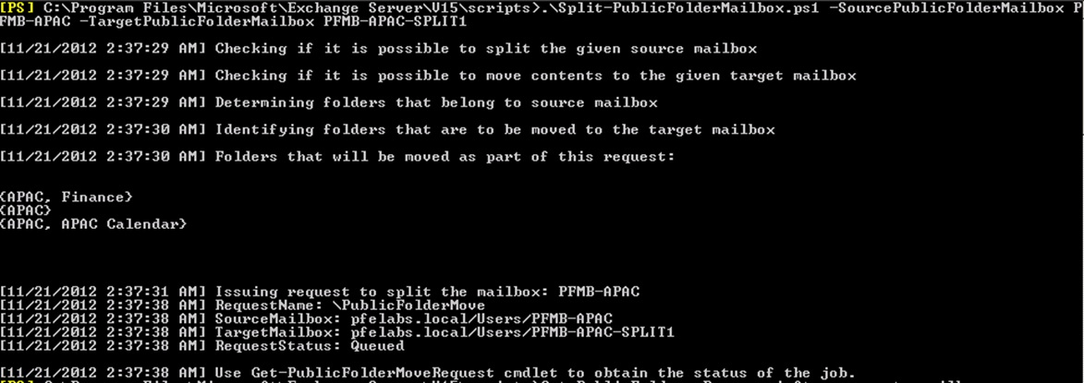
.\Split-PublicFolderMailbox.ps1
Moves content to other PF Mailboxes when 60% of quota reached
Before Split:
Split:
After Split:

Slide 26
Additional Planning Information
Outlook finds its PF Hierarchy Mailbox through AutoD
AutoD returns SMTP address of the Hierarchy Mailbox
Exchange uses a hashing scheme to split the users across Hierarchy Mailbox
Hierarchy is replicated via ICS, pulled regularly from writeable Hierarchy
MS Exchange Service Host handles Hierarchy replication (15 Minutes)
Performance: 500-600 Folders per minute
If a single Public folder is accessed from all over the world and latency is an issue → Add to favorites in Outlook (available offline)

Slide 27
Additional Planning Information
No Exfolders for Exchange 2013
Modern Public Folders support Single Item Recovery
Modern PF support Full Text Search
Retention Tags + Retention Policies are not available in Exchange 2013
E2010/2007 Age Limits are available (feature parity with legacy version)

Slide 28
Related content
Breakout Sessions
OFC-B244 Microsoft Exchange Server 2013 SP1 Tips and Tricks
OFC-B321 Monitoring and Tuning Microsoft Exchange Server 2013 Performance
OFC-B326 Microsoft Exchange Server 2013: Migration Experiences from the Field
Labs
OFC-H338 Migrating from Microsoft Exchange Server 2007 to Exchange Server 2013
Find Me Later At. . .
Office Server and Services booth – Go Deploy
Ask the Experts

Slide 29
Related Content
TechNet links
Overview & FAQs: http://technet.microsoft.com/en-us/library/jj150538%28v=exchg.150%29
Public Folder Limits: On premises PF limits, O365 PF limits
Public Folder Migration Scripts: http://www.microsoft.com/en-us/download/details.aspx?id=38407
Migrate Public Folders to E2013 From Previous Versions (same forest):
http://technet.microsoft.com/en-us/library/jj150486(v=exchg.150).aspx
Migrate Legacy Public Folders to Exchange Online (cross-premise):
http://technet.microsoft.com/en-us/library/jj983799(v=exchg.150).aspx
Configure Legacy on-premises Public Folders for a Hybrid Deployment:
http://technet.microsoft.com/en-us/library/dn249373(v=exchg.150).aspx
Hybrid Configuration scripts: http://www.microsoft.com/en-us/download/details.aspx?id=38408
EHLO Blogs
http://blogs.technet.com/b/exchange/archive/2013/05/02/public-folders-and-exchange-online.aspx
http://blogs.technet.com/b/exchange/archive/2012/11/08/public-folders-in-the-new-office.aspx

Slide 31
Resources
Learning
Sessions on Demand
Microsoft Certification & Training Resources
http://channel9.msdn.com/Events/TechEd
www.microsoft.com/learning
TechNet
msdn
Resources for IT Professionals
Resources for Developers
http://microsoft.com/technet
http://microsoft.com/msdn

Slide 32
Complete an evaluation and enter to win!

Slide 33
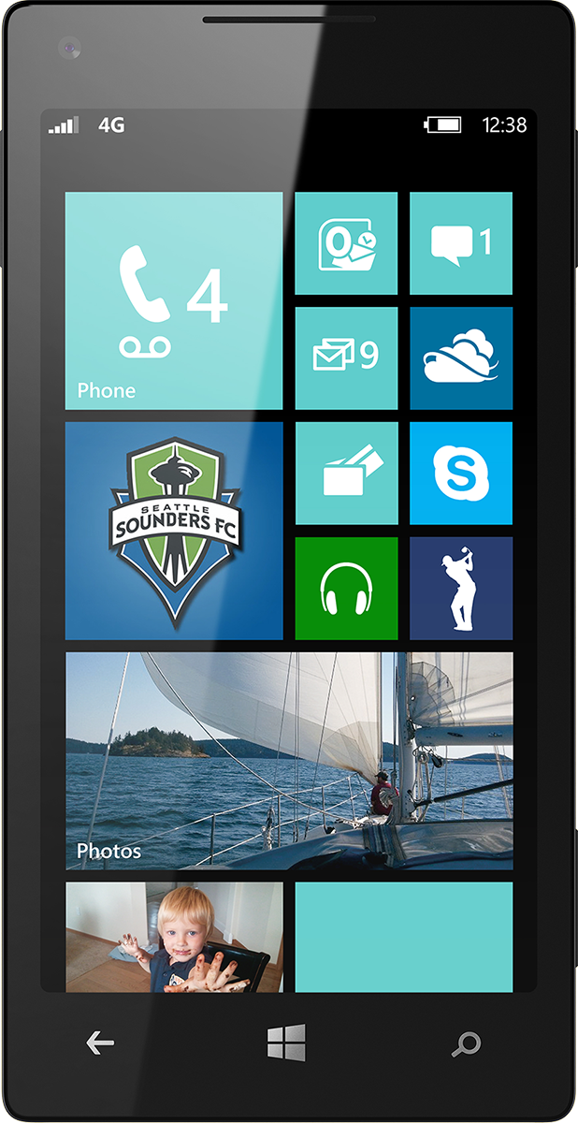
Evaluate this session
Scan this QR code to evaluate this session.

Slide 34
© 2014 Microsoft Corporation. All rights reserved. Microsoft, Windows, and other product names are or may be registered trademarks and/or trademarks in the U.S. and/or other countries.
The information herein is for informational purposes only and represents the current view of Microsoft Corporation as of the date of this presentation. Because Microsoft must respond to changing market conditions, it should not be interpreted to be a commitment on the part of Microsoft, and Microsoft cannot guarantee the accuracy of any information provided after the date of this presentation. MICROSOFT MAKES NO WARRANTIES, EXPRESS, IMPLIED OR STATUTORY, AS TO THE INFORMATION IN THIS PRESENTATION.

