Slide 1


Slide 2

Preserve, Delete, and Archive in Exchange
OFC-B324
Bharat Suneja

Slide 3
Our Vision for Compliance
Empower the User
Enable the Compliance Officer
Easy for IT
Outlook, Word, PowerPoint, SharePoint,
Mobile Apps, etc.
Exchange, SharePoint, Lync, AD, File Server,
third parties, etc.
Exchange/ SharePoint
In Place and Extensible
Exchange, SharePoint, Windows
Compliance built into workloads IT already deploys (Exchange, SharePoint)
End users workflow unchanged in the Office Client Experiences
One console for the Compliance Officer spanning all the workloads and data sources

Slide 4
Archiving

Slide 5
“ All truths are easy to understand once they are discovered; the point is to discover them.”
Galileo Galilei

Slide 6
What is the pattern here?
  Qualcomm – 2008 - $8.5 million
  Morgan Stanley – 2006 - $15 million
  Deutsche Bank Securities Inc., Goldman Sachs & Co., Morgan Stanley, Solomon Smith Barney Inc. and U.S. Bancorp Piper Jaffray Inc. - $1.65 million each
  Philip Morris International – 1999 - $2.75 million

Slide 7
Why Archive?
Archive
Reduce risk from PSTs
Reduce eDiscovery costs
Delete
Reduce risk by managing content lifecycle
Preserve
Legal & regulatory requirements
Business requirements

Slide 8
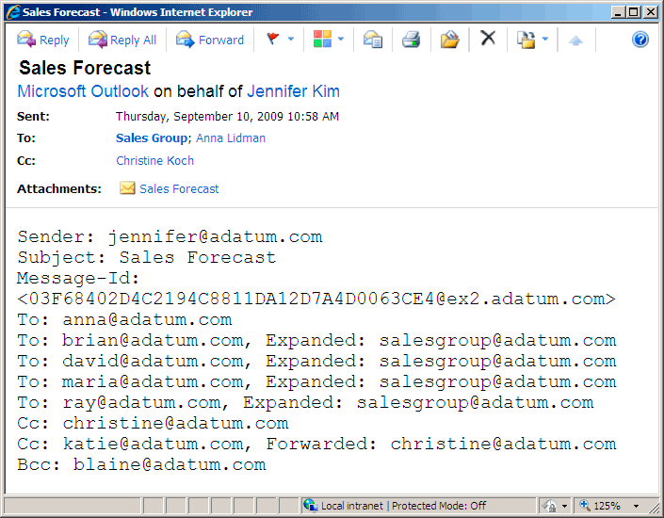
Journaling
  Original message attached
Feed journaling mailboxes or 3rd party archiving systems/service
Journaling agent on Hub Transport applies Journal Rules, generates journal reports (message + metadata)
Items not in transport pipeline not captured.
  More at aka.ms/journaling
  Metadata, including expanded Distribution Groups

Slide 9




Benefits of large mailbox with archiving
Access to all
email from
most clients
Less time spent managing
mailbox quota
Eliminate lost
or corrupted
.PST files
Simplify email discovery and retention mgmt.

Slide 10


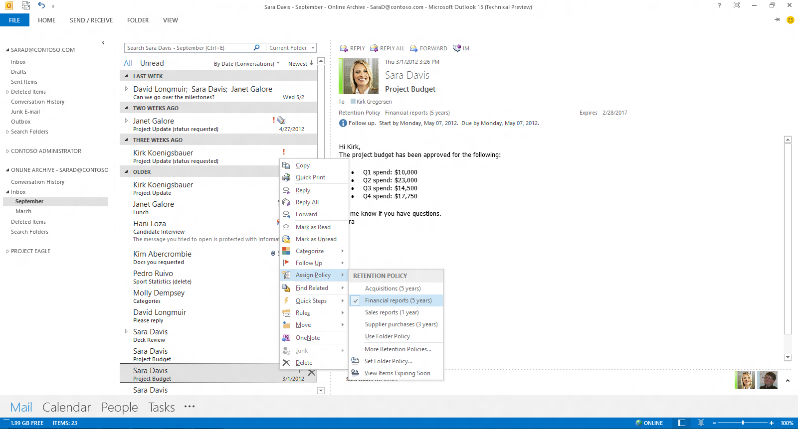
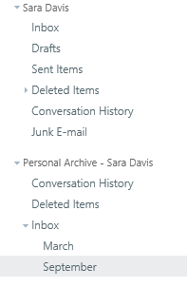
Outlook
OWA
Integrated, consistent experience
An integrated In-Place Archive enables users to save time by managing their archive as they do their mailbox

Slide 11
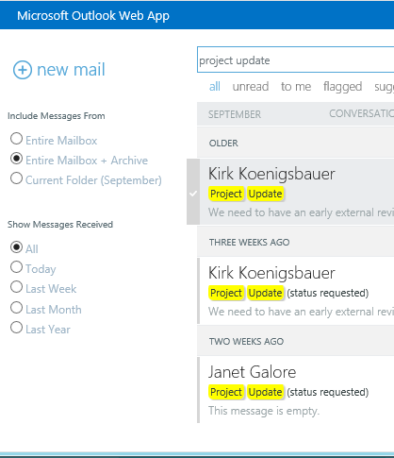
  Integrated search
  Search everywhere at once
Search everywhere at once
Quickly find new or historical email wherever you are with new, faster search technology
Single Search in OWA and Outlook returns results from Primary & Archive Mailboxes
Combined conversation view
Quickly find new or historical email wherever you are with new, faster search technology
  Combined conversation view

Slide 12
Demo
Archiving

Slide 13


Archive Admin Experience
How it works
  Second mailbox associated with user in online mode, not cached
  Use same tools to manage mailbox & archive
  Same HA and migration concepts as primary mailbox
Where it lives
On-premises only or cloud only
Hybrid
PRIMARY
PRIMARY
PRIMARY
ARCHIVE
PRIMARY
ARCHIVE
ARCHIVE
ARCHIVE
Cloud Archive (EOA)
PRIMARY
ARCHIVE

Slide 14
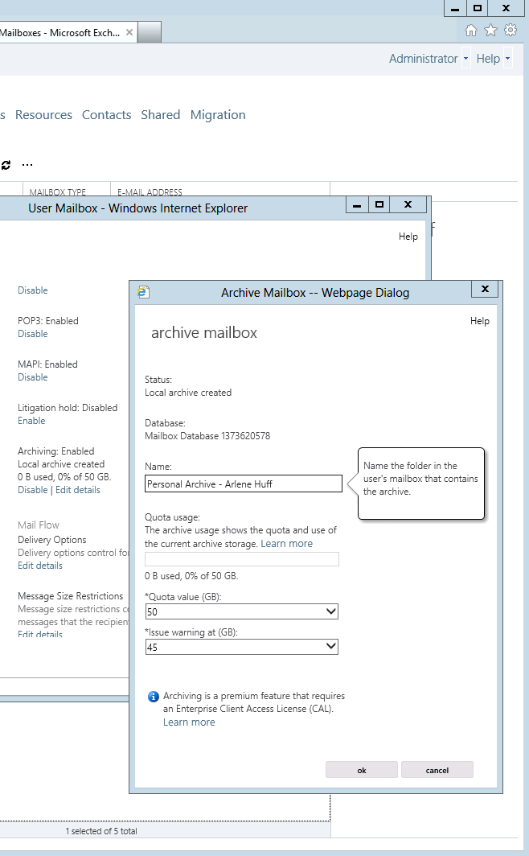
Rapid provisioning
Quickly enable in-place archiving for users – either on-premises, in the cloud, or as a hybrid.
  Enable or modify quickly

Slide 15





Lync Archiving
Single In-Place data store for Exchange & Lync compliance
Lync 2010
Exchange 2010
New Lync
New Exchange
Archive
Compliance
Compliance
Lync archives content into Exchange mailboxes when user is on In-Place Hold
Includes instant messaging and meeting content
In-Place Hold, eDiscovery, Delete of Lync data consolidated to Exchange tools

Slide 16

Lync Archiving: How does it work?
Server side archiving
All Lync modalities captured (PC, mobile, web, OWA)
User A on hold
User A Mailbox
Inbox
Deleted Items
Recoverable Items
Hold state synced

Slide 17
Preserve
(Hold)

Slide 18
Immutability
Preserve items
Protect from deletion
Protect from tampering
Whitepaper Achieving Immutability with Exchange Online and Exchange Server 2013 aka.ms/immutability

Slide 19
Terminology housekeeping:
There’s no dumpster. It’s Recoverable Items.

Slide 20
Evolution: In-Place Hold
Litigation Hold
Time-Based Hold
In-Place Hold
Exchange 2013
Office 365
Exchange 2010
Query based hold
Time Based hold
Mailbox Hold
Hold across Ex, SP, Lync
Preserve all content
Preserve - time received
Ex Only
Preserve all content
Preserve Indefinitely
Ex Only

Slide 21
Demo
In-Place Hold

Slide 22
Lifecycle of mailbox items
1 Message delivered
User A Mailbox
Inbox
2 Message moved to Deleted Items
…
Deleted Items
Recoverable Items
3 Message deleted
SOFT DELETE
Deletions
5 Message Edited
4
Message “purged” by user (Litigation Hold / Single Item Recovery)
Versions
6
Messages purged by DIR Policy (or maintained for Litigation Hold)
Purges
Audits
DiscoveryHold
Mailboxes with SIR and In-Place Hold enabled have expired messages moved
Message “purged” by user (In-Place Hold)
Calendar Logging
MFA evaluates item against hold queries set on mailbox
HARD DELETE

Slide 23
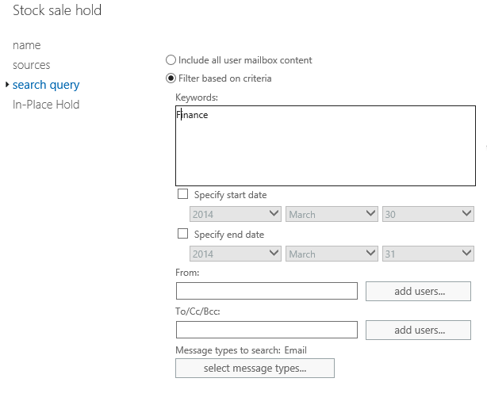
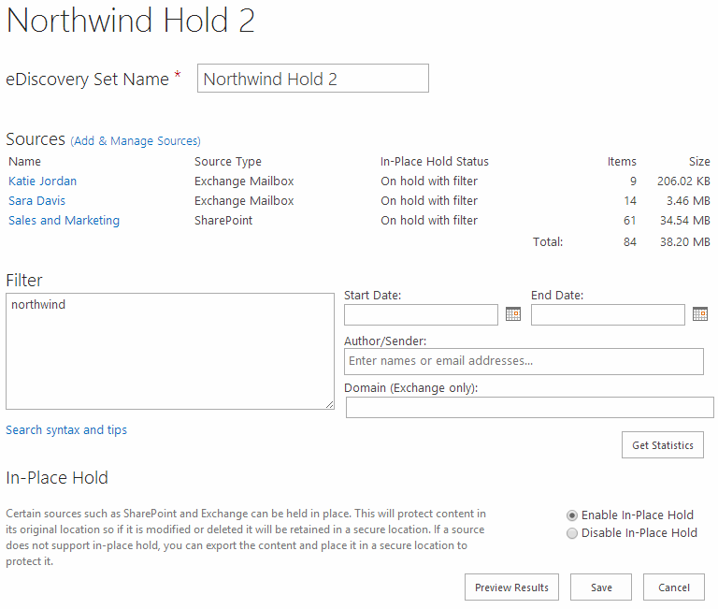
In-Place Hold as you want it
Exchange Admin Center (EAC)
SharePoint eDiscovery Center
  Preserve message recipients in distribution groups
New

Slide 24
Implementation considerations
  Storage requirements
  Recoverable Items quotas separate from mailbox quotas
  Placing all users on hold for a fixed duration
  Placing a user on multiple In-Place Holds
  In-Place Hold and Litigation Hold

Slide 25
Key Benefits
Risk mitigation
  Legal hold preservation is proactively enforced and centrally managed
  Fewer data collection touch points
  Consistency lends itself to a more defensible, repeatable eDiscovery process
Minimal business interruption
  Legal holds are transparently applied and do not interfere with collaboration features
  Data is preserved in place minimizing the need for offline copies
  Live indexed data is instantly searchable and exportable from our primary data stores
Lower costs
  Targeted in-place hold allows irrelevant data to be expunged while potentially relevant data is kept
  Reduced/replaced need for offline processing tools and offline storage

Slide 26
Delete
(Messaging Records Management)

Slide 27



Message Records Management (MRM)
Storage
Business Requirements
Legal & Regulatory Requirements

Slide 28
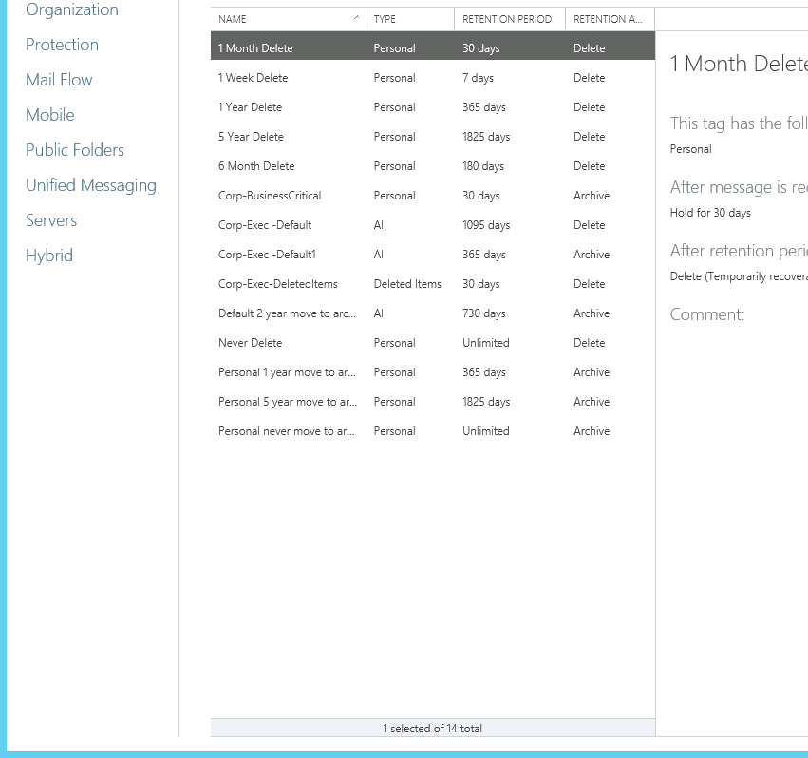
Data governance
Manage storage and risk proactively with archive and delete policies
  Delete Policy
  Archive Policy

Slide 29
Retention Policies
Container for Retention Tags
Flexibility to apply different policies to different sets of users

Slide 30
Retention Tags
Tag type
Determines where it’s applied
Action
Determines what it does
  Move to Archive
  Delete
  Do nothing
Age
Determines when the action is performed

Slide 31
DPT – Default Policy Tag
Applies to the entire mailbox
Full control for the admin

Slide 32
RPT – Retention Policy Tag
Applies to system folders – Inbox, Sent Items etc.
Full control for admin (with granularity)

Slide 33
Personal tags
Power to the end user!
Useful for exceptions due to business requirements
(if an item is important, do not delete it/keep it for longer than the DPT/RPT)
Useful for quota management
(delete emails in this folder faster)
Item level, folder level

Slide 34
Retention Tags Defined
Tag type | Applies to | Supported actions | Max tags per retention policy
Default Policy Tag (DPT) | Entire mailbox including archive | Move to archive Delete and allow recovery Permanently delete | Up to three 1. Move to Archive 2. Delete (All items) 3. Delete (Voicemail)
Retention Policy Tag (RPT) | Default folders such as Inbox, Deleted Items Sent Items, Junk Mail Drafts | Delete and allow recovery Permanently delete | One per Default Folder
Personal Tags | Applied by user to any supported folder or items | Move to archive Delete and allow recovery Permanently delete | Unlimited (Recommended approx. 20 for better user experience)

Slide 35
Implementing Message Records Management (MRM)
Admin controlled (DPT + RPT)
Admin + User participation (DPT + RPT + Personal tags)
MRM + In-Place Hold

Slide 36
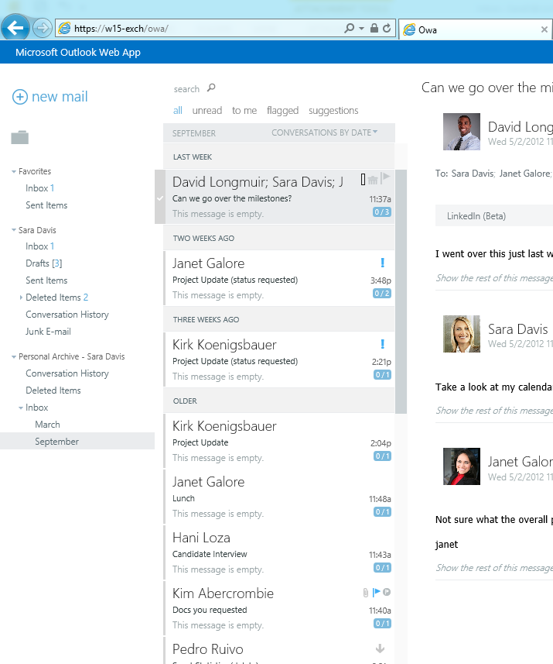
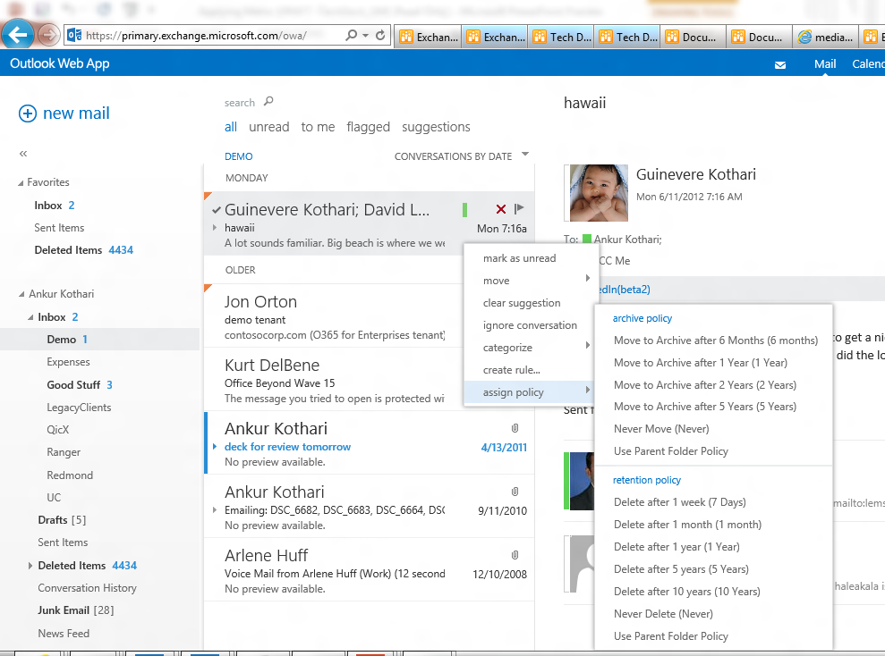
Improved Workflow
Automate the deletion and archiving of email and other Exchange data to meet data retention requirements
Assign personal tags to system folders in Outlook and OWA
View default mailbox policy
Automate the deletion and archiving of email and other Exchange data to meet data retention requirements
  Single menu for policies

Slide 37
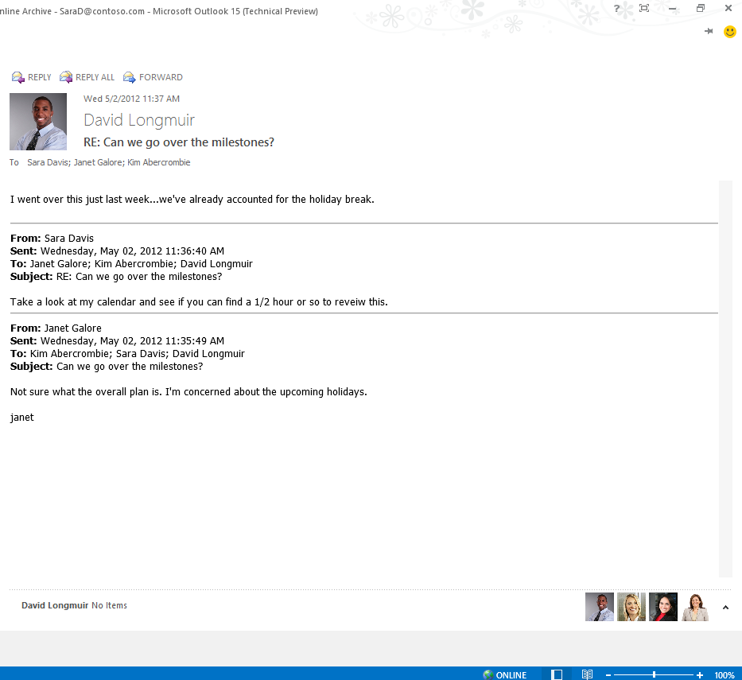
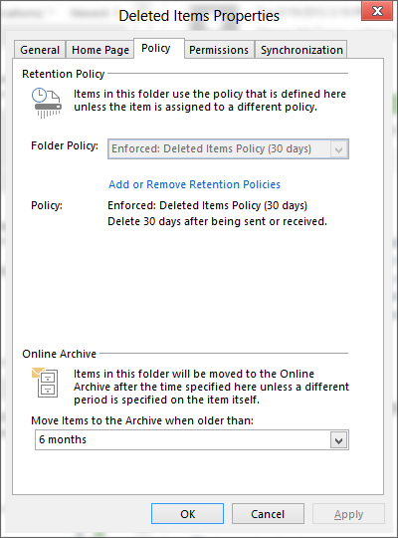
Transparent user experience
  Retention policy and expiry details
Put information workers in charge of their email by keeping them informed of when items are to be moved or archived
  Assign to an individual item, folder, or all email

Slide 38
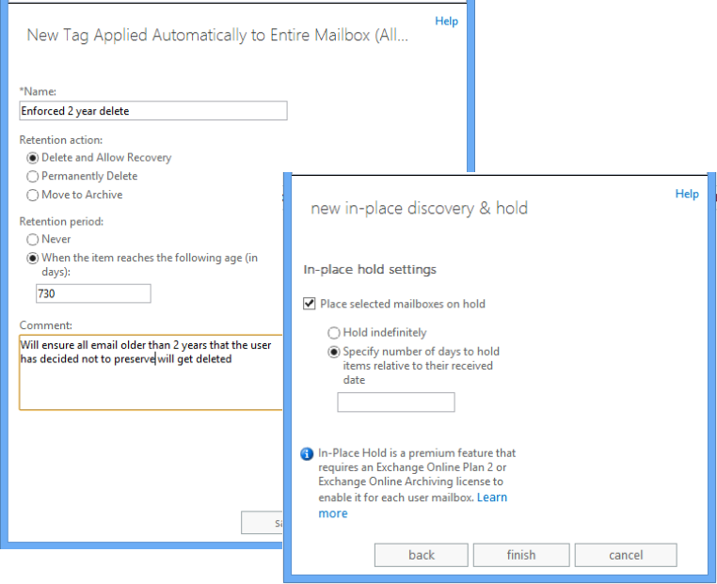
Guaranteed Email Lifecycle
Delete + Hold

Slide 39
Summary:
  Archiving
  Single In-Place data store for Exchange & Lync compliance
  Enables archive access via OWA, Outlook
  In-Place Hold & eDiscovery
  Enables In-Place Hold for Exchange, SharePoint and Lync data
  Provides preservation (time-based and query based)
  Allows real-time search with EAC, eDiscovery Center (SharePoint) or PowerShell
  Message Records Management (MRM)
  Provides ability to delete and move content to archive
  Guaranteed retention and deletion

Slide 40
Q&A

Slide 41
Related content
OFC-B330 eDiscovery and Organizational Search in Microsoft Office (Thu 10:15 AM – 332A)
Office 365 booth
Exam 70-341 Core Solutions of Microsoft Exchange Server 2013
Find Me Later At. . . Office 365 Booth (Go Deploy / Working Together) & #GarageSeries
Follow @bsuneja | @msftexchange
Hash tags #MSExchange #Office365 #Archiving

Slide 42
Track resources
In-Place Archiving (aka.ms/archive)
Retention Tags & Retention Policies (aka.ms/delete)
In-Place Hold (aka.ms/preserve or aka.ms/hold)
EHLO: In-Place eDiscovery & In-Place Hold in the New Exchange – Part I & Part II (aka.ms/iphp1 and aka.ms/iphp2)

Slide 43
Solutions Advisory Board - Let’s talk solutions
Microsoft provides lab-tested, cross-product, end-to-end solutions.
SAB members hear about Microsoft’s solution ideas, and influence solutions by providing feedback!
Ask the Experts
Meet the SAB team and ask us questions!
Experts from Microsoft Azure, Office, Cloud and Datacenter teams will be there
SAB Session
Presenters from Microsoft Azure, Office, Cloud and Datacenter, and Microsoft Consulting Services will talk about their latest work.
  SAB Table @ Ask the Experts
  Tues 6:30 – 8:30pm
  Hilton Americas, Room 335A
  Wed 4:00 – 5:30pm

Slide 44


Slide 45

Resources
Learning
  Sessions on Demand
  Microsoft Certification & Training Resources
http://channel9.msdn.com/Events/TechEd
www.microsoft.com/learning
TechNet
msdn
  Resources for IT Professionals
  Resources for Developers
http://microsoft.com/technet
http://microsoft.com/msdn

Slide 46



Complete an evaluation and enter to win!

Slide 47
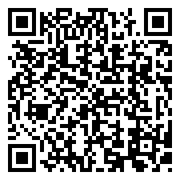

Evaluate this session
Scan this
QR code
to evaluate
this session.

Slide 48


© 2014 Microsoft Corporation. All rights reserved. Microsoft, Windows, and other product names are or may be registered trademarks and/or trademarks in the U.S. and/or other countries.
The information herein is for informational purposes only and represents the current view of Microsoft Corporation as of the date of this presentation. Because Microsoft must respond to changing market conditions, it should not be interpreted to be a commitment on the part of Microsoft, and Microsoft cannot guarantee the accuracy of any information provided after the date of this presentation. MICROSOFT MAKES NO WARRANTIES, EXPRESS, IMPLIED OR STATUTORY, AS TO THE INFORMATION IN THIS PRESENTATION.

