Slide 2
PowerShell Administration with SharePoint 2013 and SharePoint Online
OFC-B328
Corey Roth
@coreyroth

Slide 3
Agenda & Key Takeaways
Configuring PowerShell permissions
PowerShell for Upgrades
Useful scripts
PowerShell with SharePoint Online
Using client object model with SPO
PowerShell Tips

Slide 4
Getting Started
Launch with:
SharePoint 2013 Management Shell link
Run SharePoint.ps1 (Add-PSSnapin Microsoft.SharePoint.PowerShell)

Slide 5
Assumptions
You have a basic understanding of PowerShell
You’re interested in doing “real stuff” with PS
You want to know more than the basics

Slide 6
Permissions
Many installations do not have permissions correct
Farm / local administrator is NOT enough
Don’t use the farm account!
PowerShell is more forgiving in SharePoint 2013
Permissions for PowerShell are now configured OOTB
Don’t forget to run as administrator

Slide 7
Granting permission to PowerShell
Get-SPShellAdmin – determine access to PowerShell
Add-SPShellAdmin – add users to PowerShell
Must execute for each content database
Get-SPShellAdmin
Add-SPShellAdmin –username sharepoint\sp_newadmin
$database = Get-SPContentDatabase MyContentDb
Add-SPShellAdmin –username domain\username –database $database

Slide 8
Add-SPShellAdmin
Corey Roth
@coreyroth

Slide 9
Getting ready for Upgrade

Slide 10
Getting Ready for Upgrade
Test-SPContentDatabase and Mount-SPContentDatabase still used
Deferred Site Collection Upgrade = New cmdlets
Test-SPContentDatabase –Name Wss_Content –WebApplication http://servername
Mount-SPContentDatabase –Name Wss_Content –WebApplication http://servername

Slide 11
Content Database Upgrade
Corey Roth
@coreyroth

Slide 12
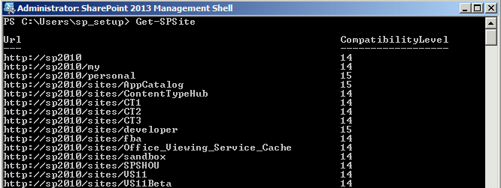
Deferred Site Collection Upgrades
Cmdlets to:
Manage Health Checks
Upgrade
Request Evaluation Site Collections
Copy
View upgrade status with Get-SPSite

Slide 13
Site Collection Health Checks
Test-SPSite
Runs Site Collection Health Checks
All rules by default or specify specific rule
Repair-SPSite
Automatically repairs all issues
Test-SPSite –Identity http://server/sitecollection
Repair-SPSite –Identity http://server/sitecollection

Slide 14
Upgrading Site Collections
Upgrade-SPSite
Starts Upgrade Process on Site Collection
Also resumes failed upgrades
-Unthrottled – bypasses throttle limits
-VersionUpgrade – used to upgrade from version 14
Upgrade-SPSite http://server/sitecollection -VersionUpgrade

Slide 15
Monitoring Upgrade Status
Get-SPSiteUpgradeSession
Reports upgrade status for content db and site collection
Use with -ContentDatabase or -Site
Content Database requires a filter parameter:
-HideWaiting
-ShowCompleted
-ShowFailed
-ShowInProgress
Get-SPSiteUpgradeSession –Site http://server/sitecolection
$database = Get-SPContentDatabase MyContentDb
Get-SPSiteUpgradeSession –ContentDatabase $database -ShowInProgress

Slide 16
Upgrade Evaluation Site Collections
Request-SPUpgradeEvaluationSite
Requests an upgrade evaluation site collection
Target URL auto-generated
-Email – specify whether site collection owner and farm admin receive notification
Request-SPUpgradeEvaluationSite http://server/sitecollection

Slide 17
Copying Site Collections
Copy-SPSite
Copies a site collection to a new URL
-Identity – source URL
-TargetUrl – destination URL
-DestinationDatabase (optional) – name of new database
Copy-SPSite http://server/sitecollection -DestinationDatabase MyContentDb -TargetUrl http://server/sitecollection2

Slide 18
Site Collection Upgrade
Corey Roth
@coreyroth

Slide 19
When tools are needed

Slide 20
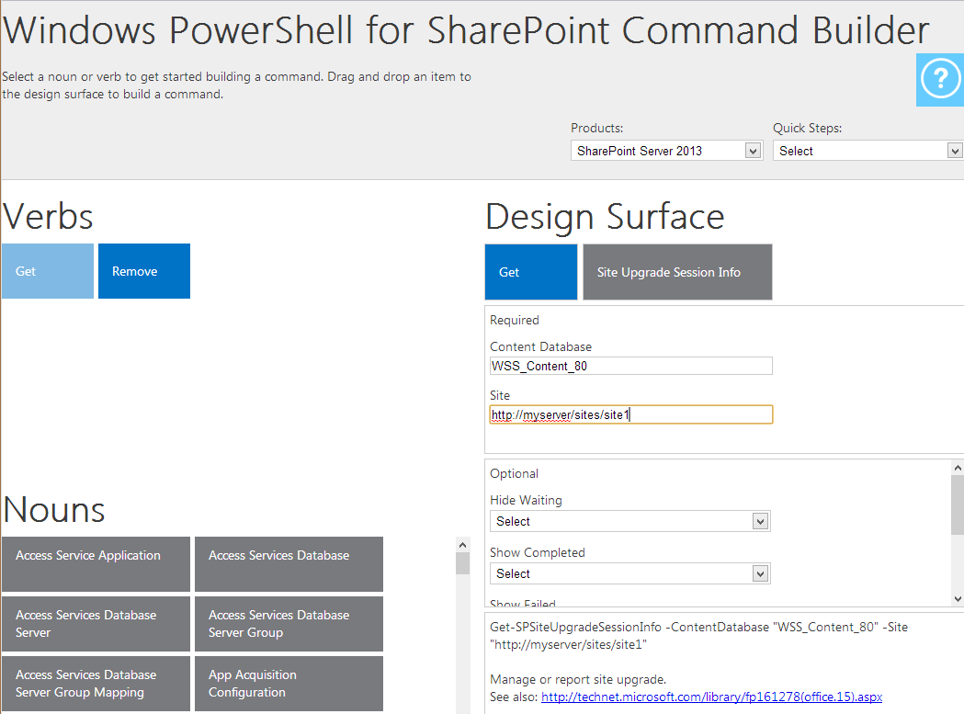
Windows PowerShell for SharePoint Command Builder

Slide 21
PowerShell Command Builder and Scripts
Corey Roth
@coreyroth

Slide 22
Licensing

Slide 23
The Challenge
Only some users need Enterprise features
Previously, no way to audit Enterprise use
SharePoint 2013 License Checking feature helps

Slide 24
SharePoint 2013 Licensing
Map license types to AD Groups
Enterprise
Standard
Project
OfficeWebAppEdit
Standard users blocked from Enterprise features
Enterprise Web Parts blocked from Add Web Part menu
License Error on existing web parts
Disabled by default
Enable with SP-EnableUserLicensing

Slide 25
License Mapping
Get-SPUserLicense
Shows available license types (i.e.: Standard or Enterprise)
New-SPUserLicenseMapping
Maps an AD group to a license type
Also supports roles and claims
-SecurityGroup – Active Directory Group
-License – License type
Add-SPUserLicenseMapping
Adds the new license mapping
No parameters, pipe input from New-SPUserLicenseMapping

Slide 26
Enable / Disable Licensing
Enable-SPUserLicense
Activates license checking mode
No parameters necessary
Disable-SPUserLicense
Deactivates license checking mode
No parameters necessary

Slide 27
Enabling Licensing
$standardusers = New-SPUserLicenseMapping –SecurityGroup “SharePoint Standard Users” –License Standard
$enterpriseusers = New-SPUserLicenseMapping – SecurityGroup “SharePoint Enterprise Users” –License Enterprise
$standardusers | Add-NewSPUserLicenseMapping
$enterpriseusers | Add-NewSPUserLicenseMapping
SP-EnableUserLicensing

Slide 28
License Mapping
Corey Roth
@coreyroth

Slide 29
SharePoint Online

Slide 30
Getting Started with PowerShell and SPO
Install Windows PowerShell 3.0 from Windows Management Framework 3.0 (Windows 7)
Already included with Windows 8 / 8.1 and SharePoint 2013
Install SharePoint Online Management Shell
http://bit.ly/1hHX5qR
Identify your global administrator account
Launch SharePoint Online Management Shell
Microsoft.Online.SharePoint.PowerShell.dll

Slide 31
PowerShell for SPO Tips
Remember to use https instead of http
Commands have similar names
Get-SPO prefix
Global Administrator account required
Use -NoWait for cmdlet to execute immediately

Slide 32
Connecting to SharePoint Online
Connect-SPOService
Connects to SharePoint Online
-Url – URL to SharePoint Online tenant administration
i.e.: https://mytenant-admin.sharepoint.com
-Credential – complete username of a global administrator
i.e.: admin@mytenant.onmicrosoft.com
Connect-SPOService –Url https://mytenant-admin.sharepoint.com –Credential admin@mytenant.onmicrosoft.com

Slide 33
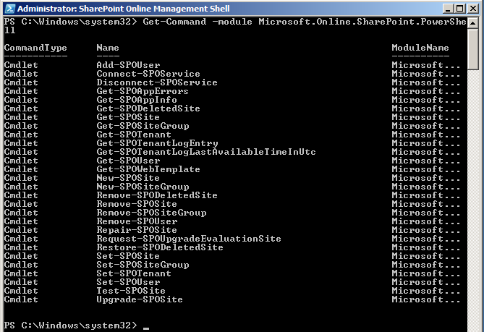
What commands are available?
Get-Command –Module Microsoft.Online.SharePoint.PowerShell

Slide 34
Working with Site Collections
Get-SPOSite
Returns one or more site collections
-Identity (optional) – URL of site collection
-Limit (optional) – number of site collections to return
Default 200, ALL can be used
-Filter (optional) – server side filtering using { }
Used in lieu of –Identity
Note case sensitive operators (-like, -notlike, -eq, -ne)
-Detailed – Returns non-default properties such as CompatibilityLevel
Get-SPOSite
Get-SPOSite -Detailed
Get-SPOSite –Identity https://mytenant.sharepoint.com
Get-SPOSite –Filter {Url -like “*term*}

Slide 35
Creating new Site Collections
New-SPOSite
Creates a site collection
-Url – full URL of new site collection
-Owner – full user name of site owner
i.e.: admin@mytenant.onmicrosoft.com
-StorageQuota – in MB
-Template (Optional) – i.e.: STS#0
Get-SPOWebTemplate – returns all installed site templates
-Title (Optional) – name of site collection
New-SPOSite -Url https://mytenant.sharepoint.com/sites/mynewsite -Owner user@domain.com -StorageQuota 1000 -Title "My new site collection“ –Template STS#0

Slide 36
Deleting Site Collections
Remove-SPOSite
Moves site collection to recycle bin
-Identity – URL of site collection
Supports –confirm and -NoWait
Remove-SPOSite –Identity http://mytenant.sharepoint.com/sites/sitename -NoWait

Slide 37
Restoring Site Collections
Restore-SPODeletedSite
Restores a site collection from the recycle bin
-Identity – URL of site collection
Restore-SPODeletedSite –Identity http://mytenant.sharepoint.com/sites/sitename -NoWait

Slide 38
Working with Users
Get-SPOUser
-Site – full URL of site collection
-LoginName (Optional) – specific user account name
i.e.: admin@mytenant.onmicrosoft.com
Add-SPOUser
Adds existing user to a SharePoint Group
-Site – full URL of site collection
-LoginName – specific user account name
-Group – SharePoint group
Get-SPOUser -Site https://mytenant.sharepoint.com -LoginName user@domain.com
Add-SPOUser -Site https://mytenant.sharepoint.com -LoginName user@domain.com -Group "Team Site Members“

Slide 39
PowerShell with SharePoint Online
Corey Roth
@coreyroth

Slide 40
What's missing?

Slide 41
PowerShell with the Client Object Model

Slide 42
Why CSOM?
Many functions not available in PowerShell for SPO
CSOM lets us do things such as
Work with sites
Create lists
Activate features (even hidden ones)

Slide 43
Steps for using CSOM with PowerShell
Install CSOM libraries or run from SharePoint 2013
Use Add-Type to reference CSOM libraries
Microsoft.SharePoint.Client.dll
Microsoft.SharePoint.Client.Runtime.dll
Create ClientContext object
Authenticate to SPO
Load objects
Call ExecuteQuery()

Slide 44
PowerShell and CSOM
Corey Roth
@coreyroth

Slide 45
PowerShell Tips

Slide 46
Use PowerShell More Effectively
Use the TAB key!
Enumerators
-Debug
-WhatIf

Slide 47
Agenda & Key Takeaways
Configuring PowerShell permissions
PowerShell for Upgrades
Useful scripts
PowerShell with SharePoint Online
Using client object model with SPO
PowerShell Tips

Slide 48
Resources
Site Collection Upgrades with PowerShell
http://bit.ly/Su5GTQ
Create and Manage SPO sites with PowerShell
http://bit.ly/1mw0lZn

Slide 50
Resources
Learning
Sessions on Demand
Microsoft Certification & Training Resources
http://channel9.msdn.com/Events/TechEd
www.microsoft.com/learning
TechNet
msdn
Resources for IT Professionals
Resources for Developers
http://microsoft.com/technet
http://microsoft.com/msdn

Slide 51
Complete an evaluation and enter to win!

Slide 52
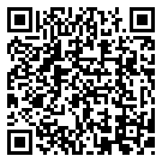
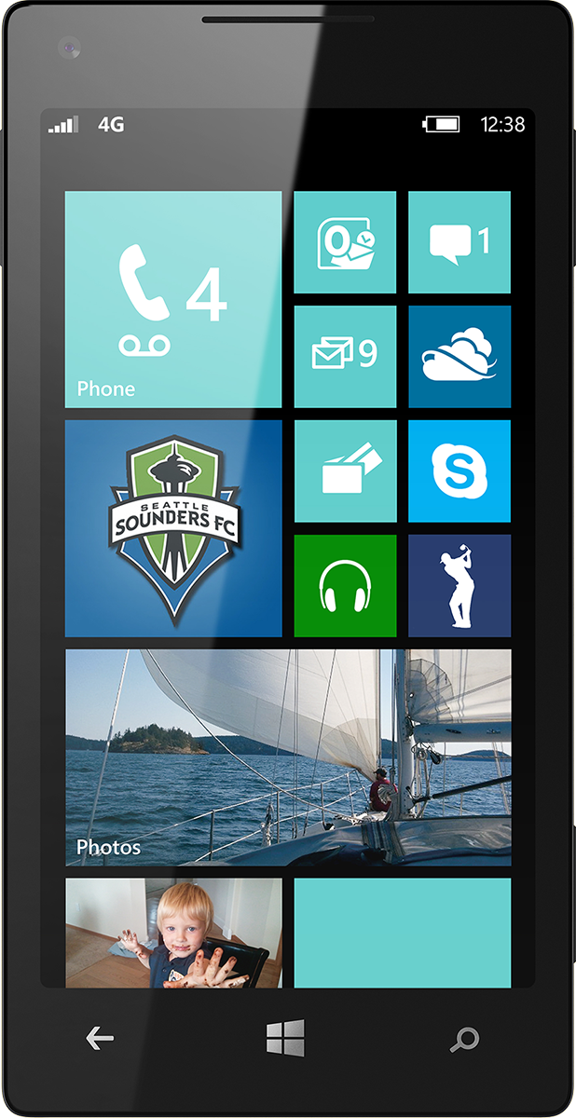
Evaluate this session
Scan this QR code to evaluate this session.

Slide 53
© 2014 Microsoft Corporation. All rights reserved. Microsoft, Windows, and other product names are or may be registered trademarks and/or trademarks in the U.S. and/or other countries.
The information herein is for informational purposes only and represents the current view of Microsoft Corporation as of the date of this presentation. Because Microsoft must respond to changing market conditions, it should not be interpreted to be a commitment on the part of Microsoft, and Microsoft cannot guarantee the accuracy of any information provided after the date of this presentation. MICROSOFT MAKES NO WARRANTIES, EXPRESS, IMPLIED OR STATUTORY, AS TO THE INFORMATION IN THIS PRESENTATION.

