Slide 2

Deploying & Managing Lync Voice
OFC-B337
Zahid Saeed (Lync MCM & CCIE Voice)
Communications TSP

Slide 3
Session Objectives And Takeaways
Session Objective(s):
  Provide quick recap of Lync Call Routing
  Explain Lync Server 2013 location-based routing capabilities.
  Recommend solutions using location-based routing to enable regulatory compliance or optimize call paths.
  Explain Lync Call Handling Services available out of the Box with Lync Server 2013

Slide 4
Agenda
Choosing your Project Sponsors
Lync Architecture Overview
Lync Voice Call Routing Recap
Location Based Routing (LBR)
Lync Call Handling Services

Slide 5
Sponsors

Slide 6
Get support for your project
Executive sponsorship must be appropriate and accountable for the scale of deployment planned. The level and intensity of sponsorship will also change as projects progress from pilot to full deployment.
  Is the executive sponsorship appropriate and properly accountable for the scale of the next phase of the deployment?
  Is the anticipated return on investment clear and measurable?
  Is the sponsoring executive accountable to achieve the ROI and the overall value of the Lync deployment?

Slide 7
Lync Voice Architecture Overview

Slide 8


Deployment Types
On-premises
Hybrid
Cloud
Lync Server 2013
Private cloud/dedicated
Single domain and directory
Users split—server/online
Microsoft Office 365, Lync Online
Partner-hosted or multi-tenant
Enabling gradual migration and coexistence between Lync private and public clouds

Slide 9
Overview of Lync Offerings
Lync Server 2013 on-premises – Full UC including Enterprise Voice
May be used with Exchange Online or Exchange Server on-premises
Lync Online – IM, Presence, & Meetings without Enterprise Voice
May be used with Exchange Online or Exchange Server
Lync Hybrid – Lync Server & Lync Online in a shared setup
Combining both worlds, on-premises users with Full UC including Enterprise Voice , IM & Presence, and Conferencing for Online users. Sharing the same namespace.

Slide 10



























Lync Server High-Level Topology
Identity
Edge
More secure federation and interoperability
External user ingress
New!
Public
Providers
MIIS
AD
Edge
server
UC end points
Voicemail/
Archive
Federated
Network
Front-end
Exchange
Back-end
Monitoring

Pool
Fewer, consolidated servers
Virtualized and higher scale
EE pool
SCOM
Hybrid
File store
IP-PSTN
gateway
Mediation Server
(optional)
New!
DFS
Web Access
Reverse
proxy
Services
Consolidated archiving
SCOM, AD, DFS
Office Web Apps
PSTN
Persistent
Chat (optional)
CDR/QoE/
Report DB
PBX
SQL
External
Perimeter network
Internal

Slide 11
Voice Routing in Lync
A quick recap of the most important elements

Slide 12
msRTCSIP-Line
msRTCSIP-PrivateLine
1
SIP URI
Inbound Routing
7
Reverse Number Lookup
PSTN Fallback for
CAC and Network
Outages
Dial Plan
User=phone
Emergency
Call?
Match
External Normalization
Rules
Yes
No match
8
Apply Called
Party Prefs
EAP?
2
Select usages
Internal
Normalization Rules
No
9
From trunk with usages?
Usages on inbound trunk
UC Endpoint Receives Call
Global?
Emergency call?
Usage from location policy
Client-side
normalization
3
Yes
Conference dial-out?
Usages of meeting organizer
10
RFC 3966
Starts with +
No
Unassigned number?
Announcement or
Call Park Application
Call Park?
Gateway
Mediation
Server
Location-based routing?
Usages from network site
Dial Plan
Referred-by?
Usages of referrer
4
Normalization Rule
Convert #
to Local Format
Normalization Rule
Normalization Rule
Usages of caller
13
Trunk Configuration /
Number Translation
5
Must Match
A Rule
Call Park Orbit Range
Voice Policy
Routes
PSTN Usage
12
Route
Gateway / IP-PBX / SIP Trunk
6
PSTN Usage
Route
11
PSTN Usage
Route
Route
External Endpoint Receives Call
Voice Routing
14
Dialing
Behaviors
Routing &
Authorization
12
Notes:
Start Time xx:xx / Length: 1 minute
Walk the students through each of the elements in the diagram, explaining their roles in the configuration process and any dependencies.
Discuss the difference between Dialing Behaviors and Routing & Authorization.
Dialing behaviors happen when the client dials a number. With the exception of emergency numbers, its sole purpose is to get the number into a routable (= E.164) format.
Routing & Authorization takes place after the number is globally unique. This is the process used to select the right route to the final destination, and then check to determine whether the user is authorized to make the call.
Advance through the animations by clicking and use the arrows to explain every step in the process.

Slide 13
Routing and Authorization
The big picture of the most important elements
Voice policies
PSTN usages
Routes
User authorization
Class of service
Voice feature set
Purpose (usage, caller’s intent)
Calling location
Priority
Called number
Cost of call

Slide 14
Voice Policies
Can be assigned per user, per site or global
Provides admins with flexibility to control user voice entitlements
Call Forwarding, Delegation, Call Transfer, Call Park, Simultaneous Ringing, Team Call, PSTN Rerouting, BW Policy override Malicious call tracing
Control dialing capabilities (class of service) by assigning public switched telephone network (PSTN) usages
Not only for users. Also useful to address common area device requirements
Assign a Voice Policy to a common area phone to prevent misuse and high cost

Slide 15
PSTN Usages
A PSTN usage record specifies a class of call (such as internal, local, or long distance) that can be made by various users or groups of users in an organization
By themselves, PSTN usage records do not do anything. For them to work, they must be associated with the following
Voice policies, which are assigned to users
Routes, which are assigned to phone numbers

Slide 16
Routes
A voice route associates destination phone numbers with one or more PSTN gateways or session initiation protocol (SIP) trunks, and one or more PSTN usage records
A route is selected based on a matching pattern
PSTN usages control if a user is allowed to use the route
Routes are associated with one or more trunks

Slide 17
Controlling Gateway Preference
Multiple trunks in same route
Gateway will be selected randomly.
Useful when there is no gateway preference and multiple gateways are available for same path to PSTN.
Multiple routes in the same usage
Gateway selected based on matching pattern.
If multiple routes match, do not rely on route ordering for enforcing preference.
Used when different gateways are used for different called numbers but all belong to the same class of service.
Routes in different usages
Gateway selected based on the order of the usages in the user’s voice policy.
Useful for enforcing primary/secondary relationships between gateways.

Slide 18
Location Based Routing

Slide 19
Regulatory Requirements
57+ countries regulate voice over internet protocol (VoIP)
  Countries include: UAE, India, Egypt, Pakistan, Oman, Qatar, parts of China, many African and Asian countries
Regulation Examples
  No allowed to toll bypass
  No allowed to bypass local telephony providers
Regulations may provide exceptions for closed user groups (such as enterprises, educational institutions, and so on) and allow VoIP and video within the user group, even if international
Location-Based Routing (LBR) was designed specifically to enable compliance in India

Slide 20
Introducing Location-Based Routing
LBR is designed to enable compliance with regulatory requirements that restrict toll bypass
Routes the call based on the location of the caller
Enforce routing of PSTN calls to prevent toll bypass
Scoped to specific sites, gateways, and users
Delivered in the July 2013 update to Lync Server 2013
LBR for PSTN calls was introduced in the February 2013 update
The July 2013 update adds support for dial-out conferencing

Slide 21
Least Cost Routing vs. Location-Based Routing
Least cost routing (LCR)
  Route call to the gateway closest to the called party
  Minimize toll charges (toll bypass)
  Prioritize the use of the WAN
Location-Based Routing
  Route call to the gateway closest to the calling party
  Minimize use of WAN
  Enable compliance with regulations that do not allow toll bypass
Toll Bypass
Use the own (WAN) infrastructure as much as possible
Egress to the PSTN closest to the destination
Avoid international (costly) PSTN charges

Slide 22

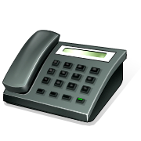
Routing Considerations for LBR
Outbound Routing
Routing decisions are made based on where the user is located and what PSTN number they are trying to dial
Inbound Routing
Routing Decisions are made based on where the call enters the Lync system and where the called party is located
Location A
Location B
Location A
Location B
WAN
WAN
Alice
Alice
PSTN
PSTN
Bob
Bob

Slide 23
Routing Considerations for LBR
Outbound Routing
Routing decisions are made based on where the user is located and what PSTN number they are trying to dial
Inbound Routing
Routing Decisions are made based on where the call enters the Lync system and where the called party is located
UM
Location A
Location B
Location A
Location B
WAN
WAN
Alice
Alice
PSTN
PSTN
Bob
Bob

Slide 24
Location-Based Routing Capabilities
Enforces that outgoing calls must egress from an allowed PSTN gateway in the caller’s voice policy, based on the callers location
Can prevent the incoming call to the Lync client if the endpoint is not in the PSTN gateway’s location
Lync Conferencing honors LBR policies for PSTN dial-out

Slide 25
LBR Regulatory Compliance Limitations
Call park and response groups
  Call flows with these scenarios could violate the regulatory principles
  Either a) do not deploy or b) deploy only to users within a single site
Dial-in conferencing
  Dialing in may create a conference that has PSTN and VoIP users from different sites
  For strict compliance, do not deploy dial-in access numbers and require dial-out
UM routing
  Denied inbound calls are sent to UM
  For strict compliance, place the UM server for a group of users in same site as the gateway that terminates their direct inward dialing (DID)

Slide 26
Location Based Routing
Support & Configuration

Slide 27
Location-Based Routing Basics
    Site
  One or more Lync subnet(s) assigned to a location
  Uses existing network sites as defined for LIS, Media Bypass, and E911
    Voice Routing Policy
  Voice policy that only contains usages
  Specifically assigned to a site for LBR
  Contains all allowed usages for that specific site or trunk
    Unknown Location
  Location (subnet) that is not known as a Lync Site
    Trunk
  Connects gateways and mediation servers
  Can be enabled for LBR and must be assigned to site

Slide 28
Pool Support for Location-Based Routing
Pool version | Mediation server version | Supported
Lync Server 2013 February 2013 Cumulative Update | Lync Server 2013 February 2013 Cumulative Update | Yes
Lync Server 2013 February 2013 Cumulative Update | Lync Server 2013 | No
Lync Server 2013 February 2013 Cumulative Update | Lync Server 2010 | No
Lync Server 2013 February 2013 Cumulative Update | Office Communications Server 2007 R2 | No
Lync Server 2013 | Any | No
Lync Server 2010 | Any | No
Office Communications Server 2007 R2 | Any | No

Slide 29
Client Support for Location-Based Routing
Client type | Supported | Details
Lync 2013 | Yes | Including Lync 2013 February 2013 Cumulative Update
Lync 2010 | Yes
Office Communicator 2007 R2 | No
Lync Phone Edition | Yes
Lync Attendant | Yes
Lync for Windows 8 | No
Lync Mobile 2013 | No | VoIP must be disabled for Lync Mobile 2013 clients if used by users with Location-Based Routing enabled.
Lync Mobile 2010 | Yes

Slide 30
Configuring Location-Based Routing
  Enable Location Based Routing for Network Sites
  New-CsVoiceRoutingPolicy
    -Identity <voice routing policy ID>
    -Name <voice routing policy name>
    -PstnUsages <usages>
  Create the Voice Routing Policy
  Enable Location Based Routing and assign a Voice Routing Policy to the Network Site
  Set-CsNetworkSite
  -Identity <site ID>
  -EnableLocationBasedRouting <$true|$false>
  -VoiceRoutingPolicy <voice routing policy ID>
  Enable Location Based Routing through Trunks
  New-CsTrunkConfiguration -Identity < trunk configuration ID>
  Create a Trunk Configuration
  (Only for PSTN gateways, not Internal PBX routes)
  Set-CsTrunkConfiguration
    -Identity <trunk configuration ID>
    -EnableLocationRestriction $true
    -NetworkSiteID <site ID>
  Enable Location Based RoutingOn the Trunk

Slide 31
Configuring LBR (Continued)
  Enable LBR through Voice Policy
  Modify the Voice Policy
  Set-CsVoicePolicy
  -Identity <voice policy ID>
  -PreventPSTNTollBypass <$true|$false>
  Enable Location Based Routing Globally
  Set-CsRoutingConfiguration
  -EnableLocationBasedRouting $true
  Create a Trunk Configuration
  (Only for PSTN gateways, not Internal PBX routes)

Slide 32
Design Considerations
    When using LBR, the site routing policy must include a route for all possible calls
  It is possible that a call would be allowed by the user’s policy, but if it were not allowed by the site’s policy, it would be blocked
    Trunks are associated with one network site
  For LBR, your campus must be represented as one site if using centralized SIP Trunks

Slide 33
Lync Voice Applications Update

Slide 34
Lync Call-Handling Services
Lync Call Handling Services
Response Group
Call queuing, treatment, and routing for departments
Unassigned Numbers Service
Prompt playback
and transfer capability for unassigned numbers
Team Call
Users define who their calls are forked to
Call Park
Asynchronously transfer of a call between users, endpoints, or both
Group Call Pickup
Users in a group can retrieve calls presented to another user
Administrator Configured
User Configured *

Slide 35
Response Group Service
Basic ACD functionality
  Scenarios including Receptionist, Helpdesk, Departmental call routing
  Installed with Enterprise Voice, licensed with Lync Plus CAL.
  Server side media application that runs on all Front Ends along with web-based administration
Not intended as a contact center replacement
  Limited Management Capabilities – no real time views, monitoring/barge-in/whisper, agent reporting
  Limited Integration – no database dips, programmability, skills matching, weighted routing

Slide 36
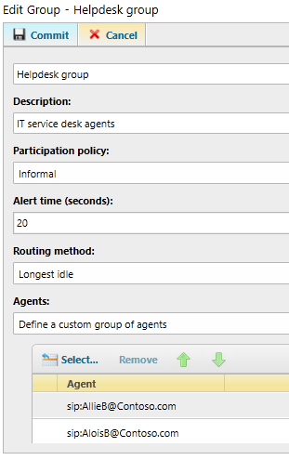
Managing RGS- Groups
Agents
List of individuals or DL
Participation policy-
Informal- Lync user sign in
Formal- Specific queue activation
Routing method
Longest idle, parallel, round robin, serial, attendant
Alert time
Time to wait before iterating through routing tree

Slide 37
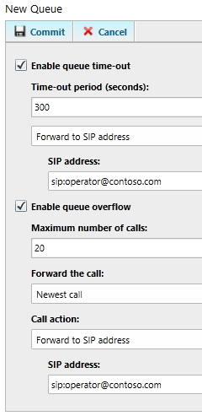
Managing RGS- Queues
Groups
One or more Agent groups servicing queue
Queue timeout
  How long can a caller sit in the queue?
  Where to send those callers after timeout(another queue, URI, disconnect, phone number, VM)
Queue overflow
Maximum queue size
Action- Which call to dispatch and where

Slide 38
Managing RGS- Workflows
Hunt Group
Basic recorded greeting
Business hours or holiday based recordings and routing/queuing
Interactive Response Group
Hunt group basic time of day options
2-tier IVR with custom messages and routes/queues
DTMF or voice based response

Slide 39
Response Group Administration by Roles
Response Group Administrator
Configuration for all RGS settings and all groups (including creation)
Improves RG admin scalability by delegating workflow to managers
Response Group Manager
Manages specific Workflow settings for designated groups
Cannot manage resources not owned by that manager

Slide 40
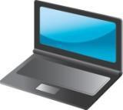
Agent Anonymity
Caller dials helpdesk
Ringing
RGS
Caller Alice
Caller navigates IVR and is put into queue. Agent is alerted.
Established
RGS
Ringing
Caller Alice
Agent Bob
If Bob is Anonymous
Bob answers. Call continues to pass through RGS.
Established
RGS
Established
Caller Alice
Agent
Agent Bob
If Bob is not anonymous
Bob and Alice connect directly.
Established
Caller Alice
Agent Bob

Slide 41
Unassigned Number Service
Call treatment for dialing numbers owned by the enterprise but unassigned to users
  Avoid busy tones if callers misdial
  Transfer to predetermined destination
    Phone number
    SIP URI
    Voicemail
    Announcement Service

Slide 42
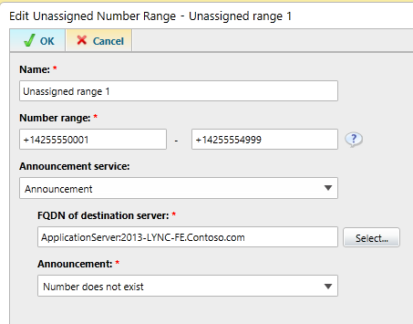
Unassigned Number Management
Create announcement message and transfer target
Text to speech or audio file announcement
Target URI if forwarding is desired
Then define applicable number range
Only define ranges that are
owned by Lync!
PS > New-CsAnnouncement -Identity ApplicationServer:2013-lync-fe.conto
so.com -Name "Number does not exist" -TextToSpeechPrompt "The number you dialed is not in service.
You will now be sent to the operator for assistance" -Language "en-US" -TargetUri "sip:garthf@contos
o.com"

Slide 43
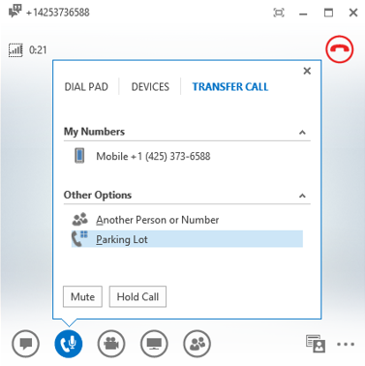
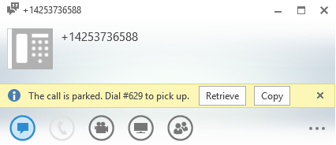
Call Park
Call Park and Retrieve
Orbit (number) returned when call is parked
Parked user is listening to Music on Hold (MoH)
Call can be retrieved from PBX phone dialing orbit
Parker notification when call is retrieved
Ring back
Calls not retrieved are transferred to parker
Transfer to fallback destination
Abandoned calls are forwarded to configurable target (receptionist, response group, etc.)

Slide 44
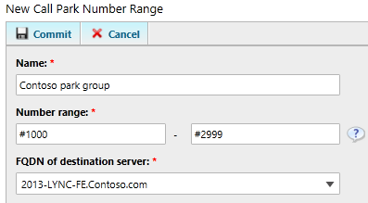
Call Park- Configuration
Call Park Service installed when configured for Enterprise Voice
Enable in user policy (off by default)
Configure orbit ranges
Number ranges per pool
Range is globally unique, not DIDs
Digits must be of uniform length

Slide 45
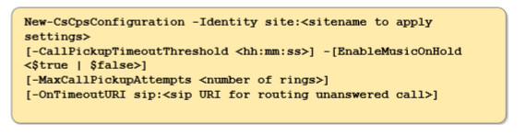
Call Park- Additional settings in PowerShell
Music on hold
  Enabled or Disabled (service wide). Default enabled.
  To change music- Set-CsCallParkServiceMusicOnHoldFile
Ring back attempts
  1 – 10, default 2.
  Ring back timeout
  10-600s, default 00:01:30
Fallback destination
Routing destination after ring back expires
Default NULL

Slide 46


Call Park- Flow
1- Initial call setup
Media
Media
Incoming call
Incoming call
Incoming call
Alice
Mediation Server
Lync Front End
(CPS)
Bob

Slide 47

Call Park- Flow
1- Initial call setup
2- Bob parks call
Media
Media
Transfer to CPS
Park call
OK- orbit #199
Alice
Mediation Server
Lync Front End
(CPS)
Bob

Slide 48

Call Park- Flow
1- Initial call setup
2- Bob parks call
3- Charlie dials #199
Media
Dial #199
Charlie
Media
“Charlie picked up #199”
Transfer to Charlie
Mediation Server
Bob
Alice
Lync Front End
(CPS)

Slide 49
Group Call Pickup
  Feature
  Incoming calls to a user are intercepted by group member by dialing a predefined orbit number
  Private Line, Delegation, Teamcall, Simulring, RGS & Personal Contact calls cannot be picked up
  Administration
  Call Park Orbits can be flagged for Group Call Pickup - Users are enabled by being assigned an orbit number
  GCP group members are managed by administrator (SEFAUtil). NOT end user configurable.
  Calls to GCP user ring the callee AND fork to CPS.

Slide 50
Question?

Slide 51
Track resources
http://technet.microsoft.com/en-us/library/jj205403.aspx
http://technet.microsoft.com/en-us/library/jj205321.aspx
http://technet.microsoft.com/en-us/library/jj994038.aspx

Slide 52


Slide 53

Resources
Learning
  Sessions on Demand
  Microsoft Certification & Training Resources
http://channel9.msdn.com/Events/TechEd
www.microsoft.com/learning
TechNet
msdn
  Resources for IT Professionals
  Resources for Developers
http://microsoft.com/technet
http://microsoft.com/msdn

Slide 54



Complete an evaluation and enter to win!

Slide 55
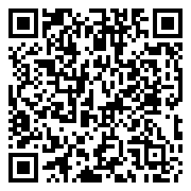

Evaluate this session
Scan this
QR code
to evaluate
this session.

Slide 56


© 2014 Microsoft Corporation. All rights reserved. Microsoft, Windows, and other product names are or may be registered trademarks and/or trademarks in the U.S. and/or other countries.
The information herein is for informational purposes only and represents the current view of Microsoft Corporation as of the date of this presentation. Because Microsoft must respond to changing market conditions, it should not be interpreted to be a commitment on the part of Microsoft, and Microsoft cannot guarantee the accuracy of any information provided after the date of this presentation. MICROSOFT MAKES NO WARRANTIES, EXPRESS, IMPLIED OR STATUTORY, AS TO THE INFORMATION IN THIS PRESENTATION.

