Slide 1


Slide 2
You Sound Marvelous:
An Introduction to the Lync Call Quality Methodology
OFC-B347
Andrew Sniderman
Kent Tilger

Slide 3
What we’re going to talk about
Fundamentals – the Science of CQM
Application – the Art of CQM
Introducing the CQM Scorecard

Slide 4
Fundamentals - the Science of CQM

Slide 5
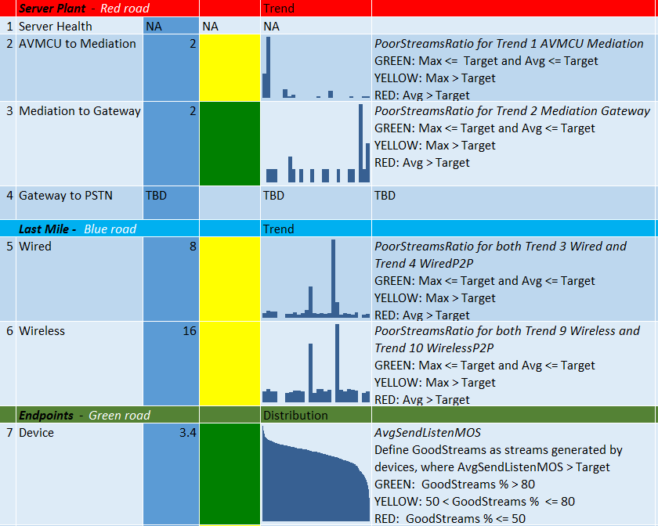
The Quality Problem
Voice support cases often cite call quality
We experienced this ourselves – and we see it as customers scale up
CQM was built to address this problem.

Slide 6
Why is Call Quality hard to achieve?
There is a complex set of dependencies from the endpoint to the access point to the core network to the server.
Degradation in any aspect lowers quality for the entire call or conference.
READ IT!! Lync 2013 Networking Guide

Slide 7
What about our existing tools
We have a rich set of data and tools in the product to troubleshoot issues
We need a systemic operational approach to proactively view and improve call quality – that’s CQM.
CQM doesn’t replace:
SCOM
Monitoring Server Reports
Support

Slide 8
Ten CQM elements across three dimensions
Three Dimensions
Server Plant
Endpoints
Last Mile
Each Dimension has a prioritized set of focus areas
There are 10 areas in total
9 query QoE for data to identify problem areas
Customers can customize the approach
POSTER!! Lync CQM Poster

Slide 9
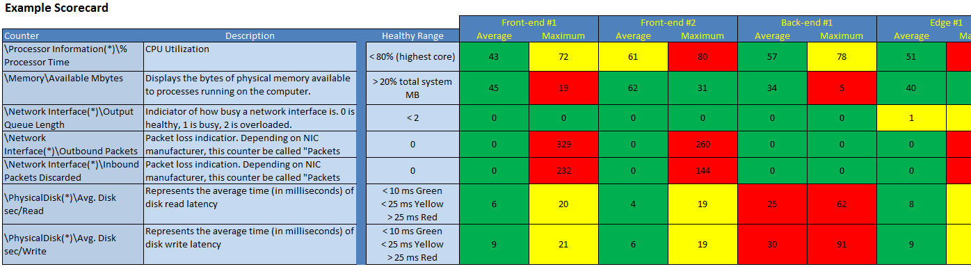
Server Coverage - KHIs
80 KHIs (from 1,000s of Counters)
KHI spreadsheet shows snapshot for collection period.
POSTER!! Lync KHIs

Slide 10
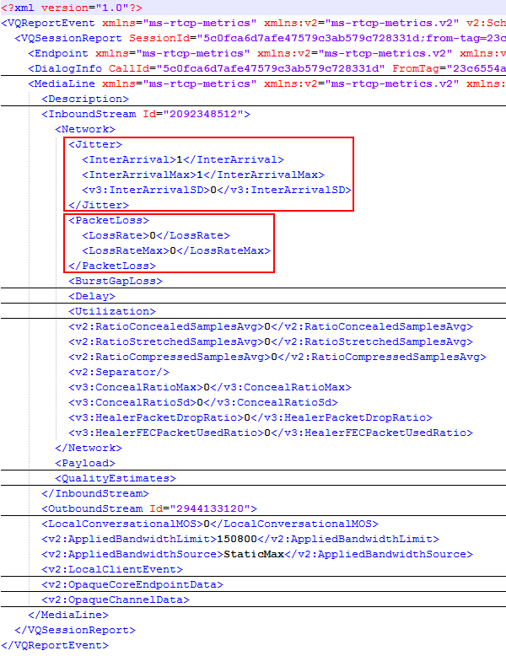
QoE Data collection
  How QoE data gets collected
  After a media session is complete the end point sends QoE data to home pool
  All media end points have these capabilities – Lync Clients, Mediation Server, AVMCU, Edge, CAA, etc.
  These reports are based on RTCP exchanges between the two endpoints

Slide 11
Quality of Experience (QoE) considerations
Lync 2010 and Lync 2013 use different QoEMetrics instances - Co-existence challenge
Different database schemas
  2013 - http://technet.microsoft.com/en-us/library/gg398687.aspx
  2010 - http://technet.microsoft.com/en-us/library/gg398687(v=ocs.14).aspx
Main differences
  Support for video and application sharing media streams
  Network connection
  Subnet and IP addresses
  ClassifiedPoorCall location
  New Views for Audio and Video streams
Best Practice: Single instance per deployment

Slide 12
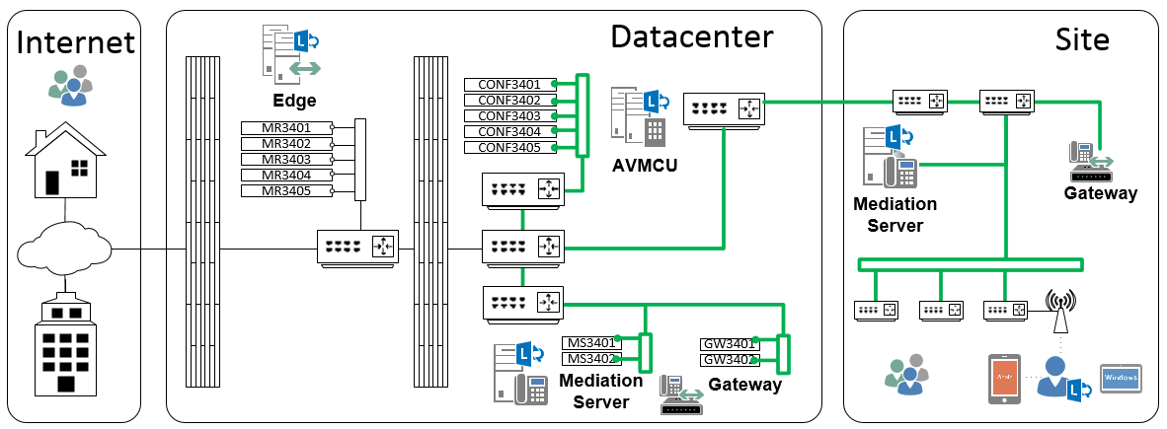
Network Coverage
The Quality of Experience (QoE) Database provides telemetry across the network
Mediation
to
Gateway
Plant_2
PCD
AVMCU
to
Mediation
Plant_1
AVMCU
to
Mediation
Plant_1
Wired
And
Wireless
LastMile_0_and_1
Mediation
to
Gateway
Plant_2
Wired
And
Wireless
LastMile_0_and_1
PCD

Slide 13
Comparing CQM and Monitoring Reports
ClassifiedPoorCall – MediaLine table in 2013
AudioStream Value | QoE | CQM | Explanation
DegradationAvg | > 1.0 | - | Network Mean Opinion Score (MOS) degradation for the whole call. This metric shows the amount the Network MOS was reduced because of jitter and packet loss
RoundTrip | > 500 | - | Round trip time
PacketLossRate | > 0.1 | >0.01 or PacketLossRateMax > .05 | Average network packet loss
JitterInterArrival | > 30 | - | Average network Jitter in milliseconds
RatioConcealedSamplesAvg | > 0.07 | - | Average ratio of concealed samples generated by audio healing to typical samples
http://blogs.technet.com/b/jenstr/archive/2013/09/20/what-is-the-basis-for-classifying-a-call-as-poor-in-lync-2013-qoe.aspx

Slide 14
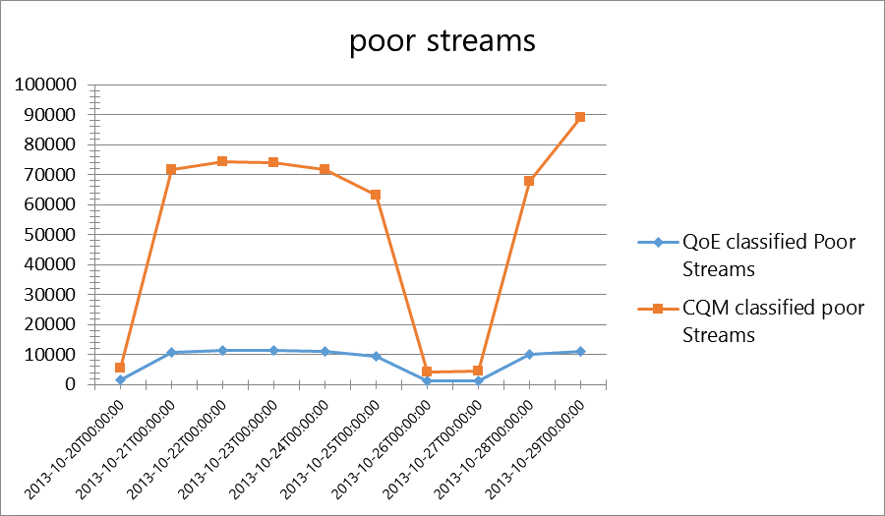
CQM Amplifies Results to spot problems
We do this intentionally to find hot spots
Difference: CQM & QoE

Slide 15
Server Plant
0: Server Health
1: AVMCU to Mediation
2: Mediation to IP PSTN GW
3:IP PSTN GW Health

Slide 16
Server Plant – four elements
 | Category | Target & Remediate
 | Server Health | KHIs in healthy range If not, prioritize finding and fixing root cause until healthy
 | AVMCU to Mediation | Poor streams are PacketLossRate > .01 or PacketLossRateMax > .05 Determine your target for poor stream thresholds Default scorecard threshold is 2% Use detailed queries to find hot pairs with poor streams Investigate why so many poor streams Network equipment issue, gateway configuration issue etc
 | Mediation to Gateway
 | Gateway to PSTN | Identify relevant PSTN Gateway or SIP Trunk statistics

Slide 17
Endpoints
0: Device
1: System
2: Media Path
3: Media Transport

Slide 18

Endpoints – four elements
 | Category | Target & Remediate
 | Device | Define target cut-off, default scorecard threshold is 3.6 AvgSendListenMOS < 3.6 for #Streams > 100 Identify problematic devices and come up with strategy to fix/replace
 | System | Define goal (AudioMicGlitchRate < 1) Default scorecard threshold is 1,000 Define golden PC configuration with drivers etc.
 | Media Path | Define goal for Media over VPN (target 0%) Define goal for internal calls using relay (target 0%) Identify problem subnets and investigate firewall rules, packet shapers etc. configuration
 | Media Transport | Define goal for media over TCP (target 0%) Identify problem subnets and investigate firewall rules, packet shapers etc. configuration

Slide 19
Last Mile
0: Wired
1: Wireless

Slide 20
Last Mile – two elements
 | Category | Target & Remediate
 | Wired | Define threshold for Wired Poor Streams query Scorecard default: PoorStreamsRatio < 5% for subnets with > 100 streams Remediate ordered from worst to best Isolate subnets and fix Implement QoS
 | Wireless | Determine if Wireless will be managed Define threshold for Wireless Poor Streams query Scorecard default: PoorStreamsRatio < 10% for sites with > 100 streams Remediate ordered from worst to best Isolate subnets and fix Implement wireless best practices Inventory wireless gear and determine UC capabilities

Slide 21
Application – the Art of CQM

Slide 22

CQM Process Overview (3 Pillars)
Assert
Maintain
Achieve
1. Assert Health
(Pre-emptive)
2. Achieve Health
3. Repeat Process to Maintain Health

Slide 23
Server Plant 0 -
Assert Lync Server Health
<Process Example>

Slide 24
Health Assertion Process (Step 1)
Design & Capacity Planning

Slide 25
Health Assertion Process (Step 2)
Platform/System
Design & Capacity Planning

Slide 26
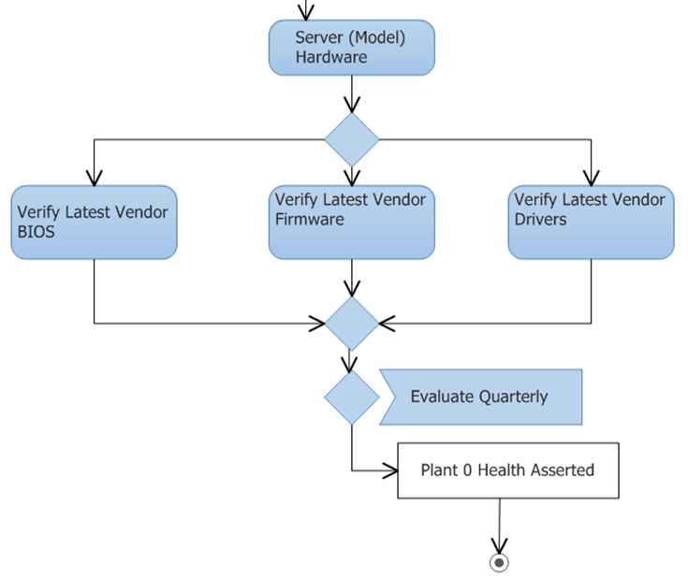
Health Assertion Process (Step 2)
Assert Health
Platform/System

Slide 27
Health Assertion Process (Step 3)
Software & Configuration
Platform/System
Design & Capacity Planning

Slide 28
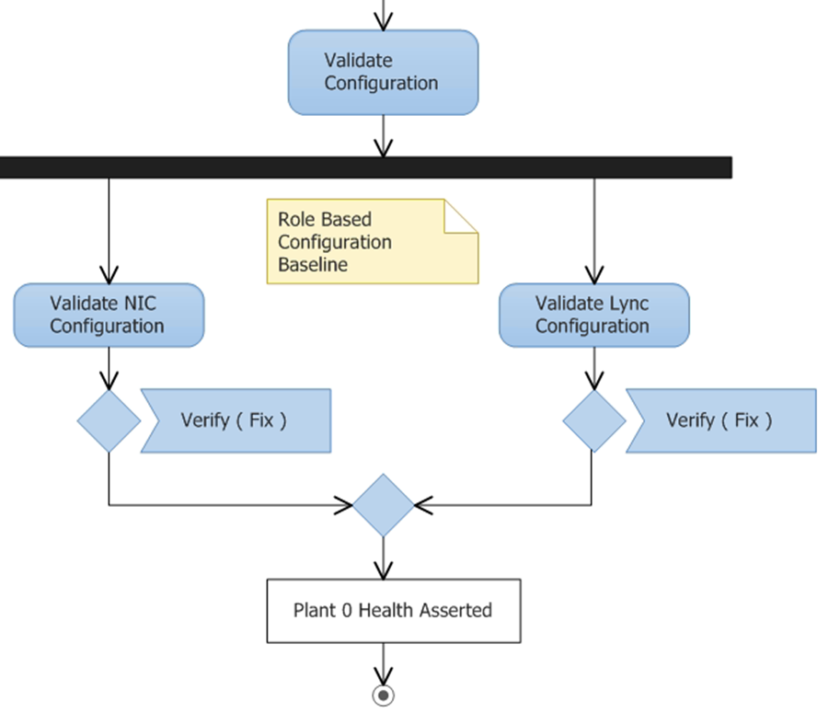
Health Assertion Process (Step 3)
Assert Health
Software & Configuration
NIC Config
Including: RSS, Offloading, Static routes, etc.
Lync Config
QA including: Edge connectivity, MRAS, Certificates, etc.

Slide 29
Health Assertion Process (Step 4)
Lync KHI’s
AS MCU = Application Sharing Multi-point Control Unit
AV MCU = Audio/Video MCU
IM MCU = Instant Messaging MCU
UCWA = Unified Communications Web API
AV Edge = Traversal of audio/video via edge
AV Auth = Audio/Video Authentication
SIP Stack = Lync’s core SIP implementation
Data Proxy = Used for edge conferencing
LySS = Lync Storage Service
Lync KHI’s
Software & Configuration
Platform/System
Design & Capacity Planning

Slide 30
Lync Server
2013
–
Front
-
end Servers
Lync KHI Example
(Front End)
AS
/
AV
/
IM MCU
Web Components
MCU Health State
<
2
Distribution List expansion AD timeouts
<
0
ABWQ failures
=
0
LIS failures
=
0
Authentication Errors
<
1
/
sec
ASP
.
NET v
4
Requests Rejected
=
0
SIP Stack
Avg
.
Incoming Message Processing
<
1
sec
Authentication Errors
<
1
/
sec
Incoming Responses Dropped
<
1
/
sec
Incoming Messages Timed Out
<
2
Incoming Requests Dropped
<
1
/
sec
Avg
.
Incoming Message Hold
<
1
sec
Queue Latency
<
100
ms
Flow Controlled Connections
<
2
Sproc Latency
<
100
ms
Avg
.
Out Queue Delay
<
2
sec
Throttled Requests
=
0
%
of space used by Storage Service DB
<
LySS
80
#
of replica replication failures
=
0
#
of data loss event
=
0
SQL
Page life expectancy
>
300
Sec
.
Batch requests
/
sec
<
2500
CPU
Disk
Memory
Network
CPU Utilization
<<EACH CORE>>
<
80
%
Avg
.
Disk Write
<
10
ms
Available MB
Queue Length
<
2
Avg
.
Disk Read
<
10
ms
>
20
%
System Total
Discarded
(
in
/
out
)
=
0

Slide 31
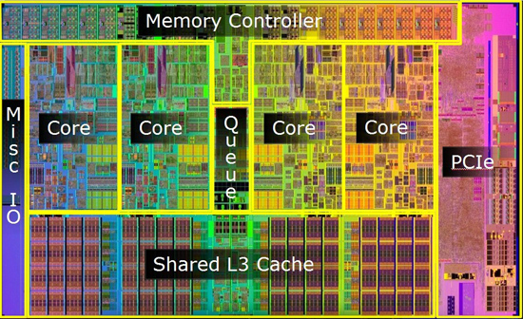
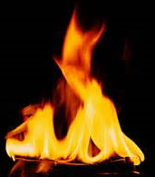
KHI Example (CPU)
KHI Measures individual cores (not _Total)

Slide 32
Remediation Flow for all Server Roles
Collect KHI
For each role
Yes
Yes
:
Role Pass
KHI Review
Performance Data
System Pass
?
For all servers
?
Complete
No
No
Remediate System
Remediate role
Performance
.
Performance
.
Recollect KHI and
Recollect KHI and
ensure system health
.
ensure role health
.

Slide 33
Server Plant 0: (Health Asserted)
0: Server Health
1: AVMCU to Mediation
2: Mediation to IP PSTN GW
3:IP PSTN GW Health

Slide 34
Server Plant 1 -
Assert Server to Server Health
<Process Example>

Slide 35
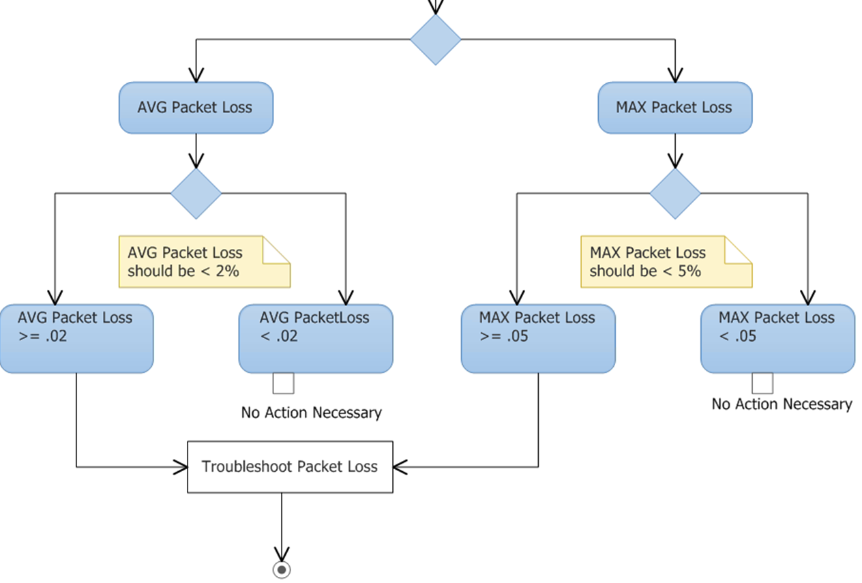
Server Plant 1 (AVMCU<->MED)

Slide 36
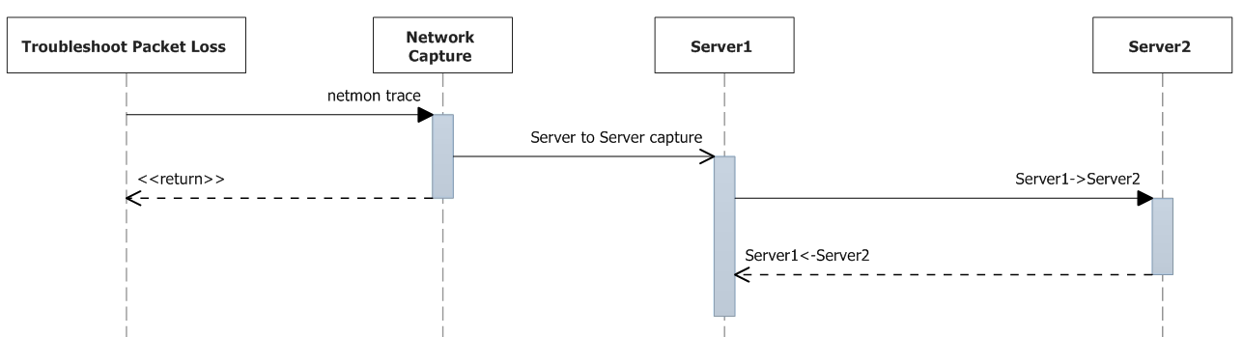
Packet Loss Troubleshooting (Step 1)
(Simultaneous) Packet Captures from both Endpoints

Slide 37
RTCP - Packet Types
SR (Sender Report) | Contains information regarding the quality of the RTP session.
RR (Receiver Report) | Contains information regarding the quality of the RTP session.
SDES (Source Description) | Contains information regarding the identity of each participant in the RTP session.
BYE (Goodbye) | Indicates that one or more sources are no longer active in the RTP session.
APP (Application-defined) | For experimental use by new applications.
Note: Look at SR if you are on the receiving side, RR if you are on the sending side

Slide 38
RTCP SR Information
NTP Timestamp | Contains the Network Time Protocol (NTP) time stamp or absolute wall clock time. If wall clock time is not available, then the sender can use the elapsed time since joining the RTP session for the NTP Timestamp value. If the elapsed time is used, then the high-order bit is set to zero. If neither wall clock time nor elapsed time is available, then the complete NTP Timestamp value is set to zero.
RTP Timestamp | Contains the same time as the NTP Timestamp, except that the RTP Timestamp is given in the same units and with the same random offset as the time stamp included in the header of the RTP packets.
Sender’s Packet Count | Contains the total number of RTP packets sent by the sender from the beginning of the RTP session up to the sending of this SR packet. This value is reset if, for some reason, the SSRC value of the sender has changed.
Sender’s Octet Count | Contains the total number of octets sent by the sender from the beginning of the RTP session up to the sending of this SR packet. This value is reset if, for some reason, the SSRC value of the sender changes.

Slide 39
RTCP Report Block Structure
SSRC_n | Contains the synchronization source identifier for each report block included in the RTCP packet.
Fraction Lost | Contains the fraction of RTP packets lost from the source (SSRC_n) since the last SR or RR packet was sent.
Cumulative Number of Packets Lost | Contains the total number of packets lost from the source (SSRC_n) since the initiation of the session. This value is derived from the sequence numbers found in RTP packets, where the dropped RTP packets are indicated by a gap in sequence numbering.
Extended Highest Sequence Number Received | This field is divided into two parts. The least significant 16 bits contain the highest sequence number received in an RTP packet from the source (SSRC_n). The most significant 16 bits contain the number of sequence number cycles.
Interarrival Jitter | Contains an estimate of the variance in the interarrival time of RTP packets. This value is measured in RTP time stamp units and is derived from the difference between packet spacing, as measured from both the receiver and sender for two packets.

Slide 40
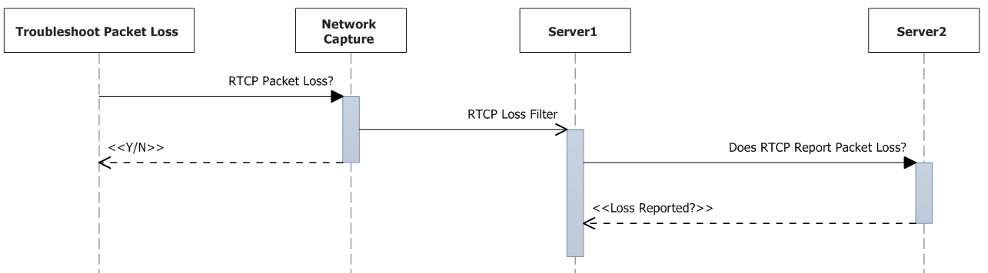
Packet Loss Troubleshooting (Step 2)
Does RTCP Report Packet Loss? <Y/N>

Slide 41
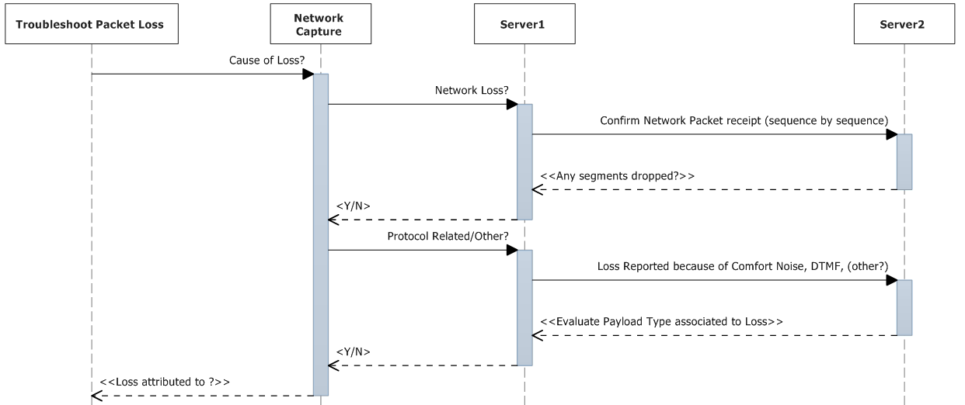
Packet Loss Troubleshooting (Step 3)
Network Sequence Lost? <Y/N> (Other)

Slide 42
Demo: (Server Plant)
Packet Loss troubleshooting with network monitor.
Kent Tilger

Slide 43
Server Plant 1: (Health Asserted)
0: Server Health
1: AVMCU to Mediation
2: Mediation to IP PSTN GW
3:IP PSTN GW Health

Slide 44
Introducing – the CQM Scorecard

Slide 45
CQM Tenets
Structured
End-to-end
Inside-out
Managed
Managed network
Unmanaged Network
Service
Ops Process
Tools
User Experience

Slide 46
Demo:
CQM Scorecard
Andrew Sniderman

Slide 47


Slide 48

Resources
Learning
  Sessions on Demand
  Microsoft Certification & Training Resources
http://channel9.msdn.com/Events/TechEd
www.microsoft.com/learning
TechNet
msdn
  Resources for IT Professionals
  Resources for Developers
http://microsoft.com/technet
http://microsoft.com/msdn

Slide 49



Complete an evaluation and enter to win!

Slide 50


Evaluate this session
Scan this
QR code
to evaluate
this session.

Slide 51


© 2014 Microsoft Corporation. All rights reserved. Microsoft, Windows, and other product names are or may be registered trademarks and/or trademarks in the U.S. and/or other countries.
The information herein is for informational purposes only and represents the current view of Microsoft Corporation as of the date of this presentation. Because Microsoft must respond to changing market conditions, it should not be interpreted to be a commitment on the part of Microsoft, and Microsoft cannot guarantee the accuracy of any information provided after the date of this presentation. MICROSOFT MAKES NO WARRANTIES, EXPRESS, IMPLIED OR STATUTORY, AS TO THE INFORMATION IN THIS PRESENTATION.

