Slide 2

Lync 2013:
High Availability and Disaster Recovery
OFC-B415
Bryan Nyce

Slide 3
Session Objectives And Takeaways
Session Objective(s):
  Identify the High Availability and Disaster Recovery (HADR) Features in Lync 2013
  Analyze the supporting technologies of Lync Server 2013 HADR
  Analyze the design implications when incorporating Lync Server 2013 HADR technologies
Key Takeaways:
  Compare and contrast Lync High Availability and Disaster Recovery technologies
  Prepare for the design and operational impact of Lync Server 2013 HADR features

Slide 4
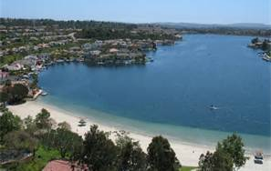
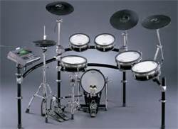




About Bryan
bryanyce
@microsoft.com
Mission Viejo, CA
MCS: Enterprise Communications CoE
Architect
Since 2011
MCSM: Communications
MCM

Slide 5
HA/DR overview

Slide 6
HA capabilities
HA:
server failure
Server clustering via HLB and Domain Name Service (DNS) load balancing
Mechanism built in to Lync to automatically distribute groups of users across the various front end servers in a pool
HA:
back-end failure
Use synchronous SQL mirroring between two back-ends without the need for shared storage
Support auto failover (FO)/failback (FB) (with witness) and manual FO/FB
Integrated with into the core product tools such as Topology Builder, Lync Server Control Panel and Lync Management Shell

Slide 7
DR capabilities
DR:
pool failure
Maintain voice resiliency introduced in Lync 2010
Enhance PSTN voice resiliency with trunk auto FO/FB
Support presence and conferencing resiliency via pool pairing
Backup Service for real-time persistent data replication between two paired pools
Manual FO/FB cmdlets
Integrated with into the core product tools such as Topology Builder, Lync Server Control Panel and Lync Management Shell
Does not cover RGS/CPS/CAC
Persistent Chat covered by stretched pool model
DR:
site failure
Same support as for pool failure as above for Lync 2013 pools but with pools in geographically distributed data centers
Supported for Lync 2013 pools only

Slide 8










Brick Model
Lync 2010 Pool
Lync 2013 Pool
10 FE + tightly coupled back end
Lync 2013 (FE s+ loosely coupled Back-end store)
DB used for storing “Blobs”—persisted store
Blob Storage
SQL® Server database (DB) bottleneck—business logic
DB used for presence updates and subscriptions
Dynamic data: Presence updates handles on FEs
1-10 Front End Servers
1-N Front End Servers

Slide 9
High Availability

Slide 10
Front End HA

Slide 11
Windows Fabric
Replaces Cluster Manager from Lync 2010
Lync adopts Windows Fabric to leverage the following
  Primary election
  Failover management
  Secondary election
  Replication between primary and secondary replicas
  With increased scale and high availability, Windows Fabric enables Lync to meet the requirements of both on-premise deployment as well as meet the Scale and High Availability requirements of the Online offering.

Slide 12
Pool Quorum
When Servers detect another Server or Cluster to be down based on their own state, they consult the Arbitrator before committing that decision.
Voter system
  A minimum number of voters are required to prevent service startup failures and provide for pool failover as shown in the following table.
Total Number of Front End Server in the pool (defined in Topology) | Number of Servers that must be running for pool to be functional
1-2 | 1
3-4 | 2
5-6 | 3
7-8 | 4
9-10 | 5
11-12 | 6

Slide 13

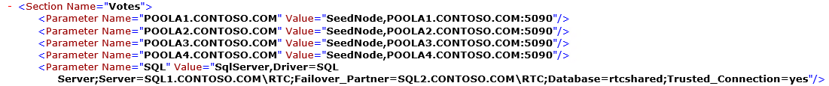
Pool Quorum - Voters
Two Server Pool
Three Server Pool
Four Server Pool
  C:\ProgramData\Windows Fabric\Settings.xml

Slide 14


Fabric in Lync
Group 1
Group 1
Lync Requirements
  Services for MCU Factory, Conference Directory, Routing Group, LYSS
  Fast failover with full service
  Automatic scaling and load balancing
Failover Model – Users
  Users are mapped to Groups
  Each group is a persisted stateful service with up to 3 replicas
  User requests serviced by primary replica
Group 1
Group 3
Group 2
Fabric node
Fabric node
Fabric node
User Group 1
Group 3
Group 3
Group 2
Fabric node
Group 2
Group 1
Fabric node
Fabric node
User Group 2

Slide 15
Group Based Routing
All users assigned to a group are homed on same FE
Groups failover to other registrar in pool when primary fails
Groups are rebalanced when FEs are added/removed
Routing Groups assigned to Replica Set

Slide 16
Intra-Pool Load Balancing & Replication
Persistent User Data
  Synchronous replication to two more FEs (Backup / Replicas)
  Presence, Contacts/Groups, User Voice Setting, Conferences
  Lazy replication used to commit data to Shared Blob Store (SQL Backend)
  Deep Chunking is used to reduce Replication Deltas
Transient User Data
  Not replicated across Front End servers
  Presence changes due to user activity, including
    Calendar
    Inactivity
    Phone call
  Minimal portions of conference data replicated
    Active Conference Roster
    Active Conference MCUs
Limited usage of Shared Blob Storage
  Data rehydration of client endpoints
  Disaster recovery
16

Slide 17
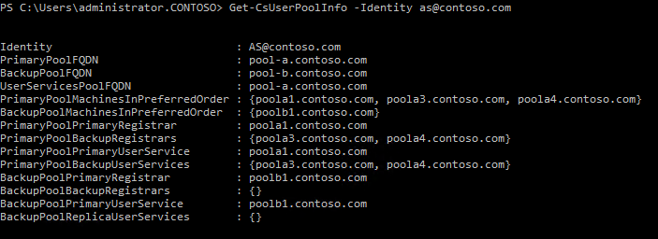
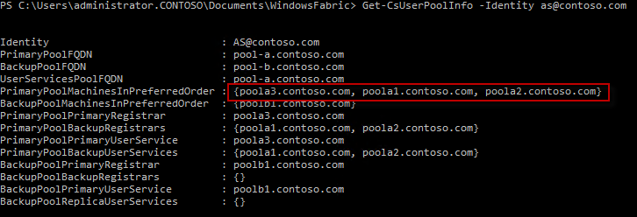
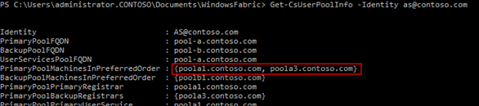
Replica Sets
Three replicas – 1 primary, 2 secondaries (quorum)
If one replica goes down another one takes over as the primary
  For 15-30 minutes fabric will not attempt to build another replica*
If during this time one of the two replicas left goes down the replica set is in quorum loss
  Fabric will wait indefinitely for the two replicas to come up again
*User Count impacts

Slide 18
Pool Startup
Cluster Bootup
  Primary is created for each Routing Group service
  Primary syncs data available in blob store to local database
  The elected Secondaries for each routing group will be sync’ed with the primary
Frontend restarts
  Windows Fabric load balances appropriate services to this Frontend.
  Front-end is made idle secondary for services, subsequently to active secondary
  To manage any service, only 3 nodes need to talk to one another

Slide 19
Stateful Service Failover
Replication
OS
Stateful Service
(Secondary)
OS
OS
Stateful Service
(Secondary)
Stateful Service
(Primary)
Node
2
Node
1
Node
3
OS
OS
Node
5
Node
4
Stateful Service
(Primary)
Stateful Service
(Secondary)

Slide 20
Survivable Branches and RGs
What about SBA/SBS-homed users?
  SBA/SBS will have a pool defined for User Services
  This pool will contain the Routing Groups for the users assigned to the SBS/SBA
  One pool can service multiple SBA/SBS
Each SBS/SBA gets it’s own unique Routing Group
All users homed on SBS/SBA are in the same RG
  This can include up to 5000 users based on current sizing guidelines
  This Routing Group will have up to 3 copies, like any other Routing Group

Slide 21

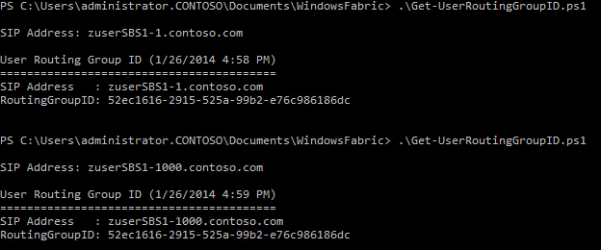
Survivable Branches and RGs
Let’s check out some SBS users…

Slide 22
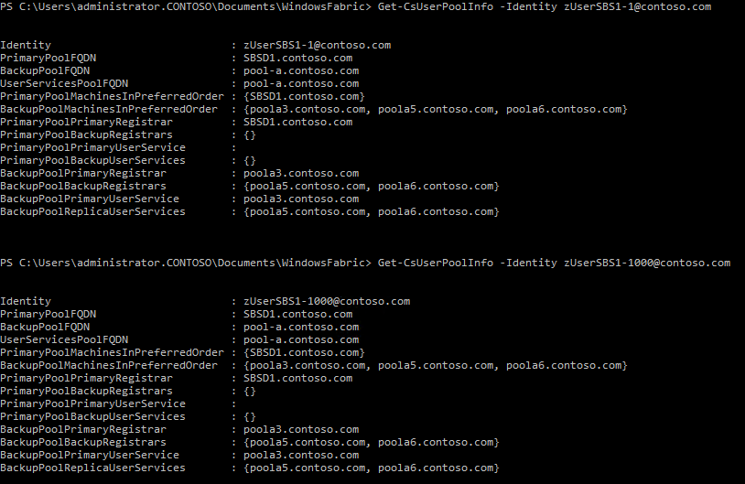
Survivable Branches and RGs

Slide 23
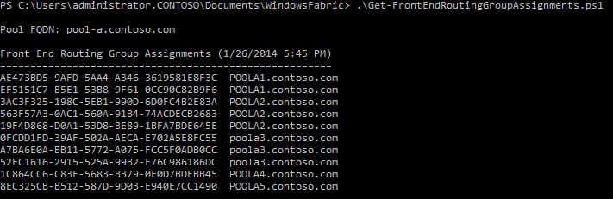
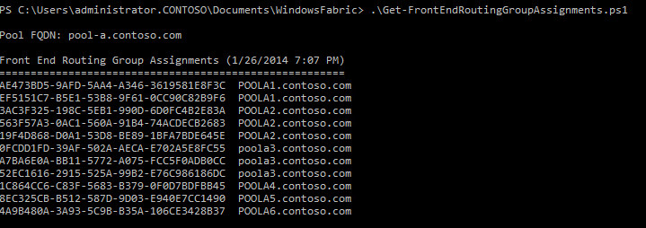
Survivable Branches and RGs
Let’s add a new SBS to the topology….first we’ll check the Routing Group distribution
Now…after publishing the new SBA, let’s look again….

Slide 24
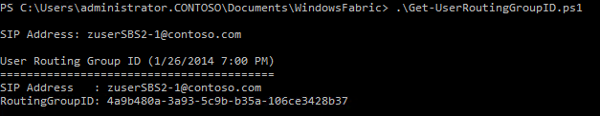
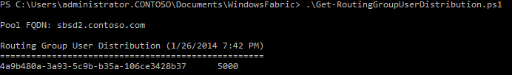
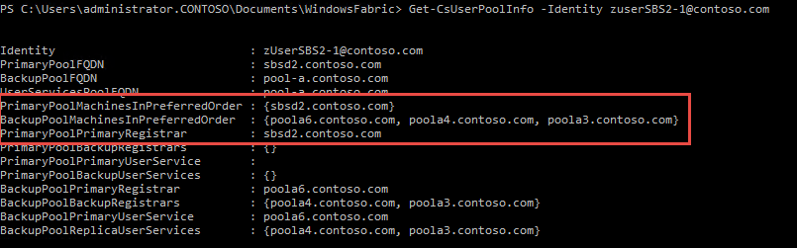
Survivable Branches and RGs
After creating users on the new SBS, let’s check the routing group ID
Look familiar?

Slide 25
HA Management

Slide 26
Server Grouping – Upgrade Domains
Logical grouping of servers on which software maintenance such as upgrades, and security updates are performed at the same time.
Do not upgrade or patch at one time more than the number of servers required to maintain quorum so that you do not introduce a service outage where you cannot restart services afterwards

Slide 27
Upgrade domains and service placements
UD:/UpgradeDomain1
UD:/UpgradeDomain2
UD:/UpgradeDomain3
Node 1
Node 2
Node 3
P
S
S
P
S
S
S
P
Node 4
Node 5
Node 6
S
P
S
S
P
S
S

Slide 28
Upgrade Domains
Related to number of FEs in pool at creation time (TB Logic)
How can I tell?
Get-CsPoolUpgradeReadinessState | Select-Object –ExpandProperty UpgradeDomains
What if I add more FEs to the pool?
Depending on initial creation state, more UD may be created, or more servers placed into existing UDs
Initial Pool Size | Number of Upgrade Domains | Front End Placement per Upgrade Domain
12 | 8 | First 8 FEs into 4 UD with 2 each, then 4 UD with 1 each
8 | 8 | Each FE placed into its own UD
9 | 8 | First 2 FEs into one UD, then 7 UD with 1 each
5 | 5 | Each FE placed into its own UD

Slide 29
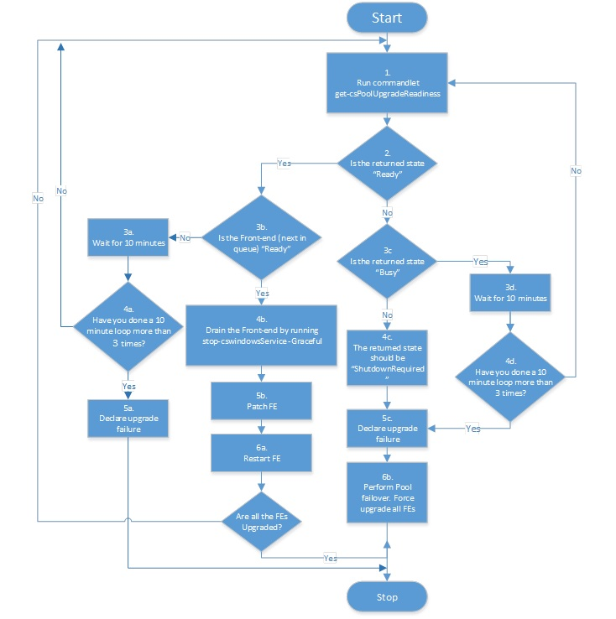
Upgrade Procedure
One Upgrade Domain at a time
Get-CsPoolUpgradeReadinessState
  Busy –> wait 10 minutes
  Busy 3x, InsufficientActiveFrontEnds -> problem with pool
  Ready -> Drain, Patch, Restart
WAIT.

Slide 30
Two-Node Front End Pools
Not recommended (but still supported)
Stopping Lync services does not affect Windows Fabric services that remain online, maintaining quorum.
If both servers need to be offline at the same time
Restart both FEs at the same time (when the downtime is finished)
  If this is not possible, bring them back up in reverse order
  If reverse order not possible, use –ResetType QuorumLossRecovery

Slide 31
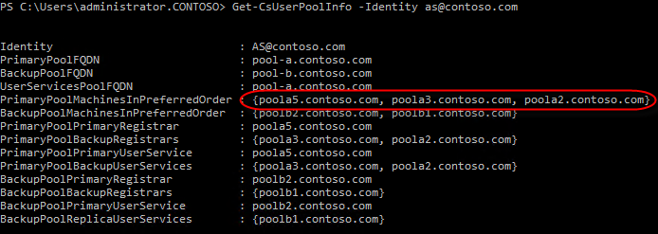
Cmdlets
Get-CsUserPoolInfo -Identity <user>
  Primary pool/FEs, secondary pool/FEs, routing group

Slide 32
More Cmdlets
Get-CsPoolFabricState
  Detailed information about all the fabric services running in a pool
Get-CsPoolUpgradeReadinessState
  Returns information indicating whether or not your Lync Registrar pools are ready to be upgraded/patched

Slide 33
Resetting the Pool
Reset-CsPoolRegistrarState
  FullReset – cluster changes 1->Any, 2->Any, Any->2, Any->1, Upgrade Domain changes
  QuorumLossRecovery – force fabric to rebuild services that lost quorum
  ServiceReset – voter change (default if no ResetType specified)
  MachineStateRemoved – removes the specified server from the pool

Slide 34
Troubleshooting Service Startup
Look for:
Voter nodes > 50%
RtcSrv won’t start until all the routing groups have been placed (quorum loss)
(32169 – Server startup is being delayed because fabric pool manager is initializing.)
For pools that were fully stopped – all FEs (>85%) must be started in order to get to a functional state

Slide 35
User Experience
Primary Copy Offline

Slide 36
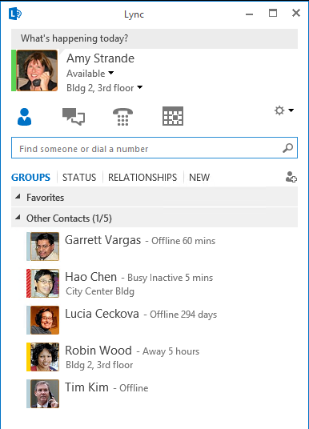
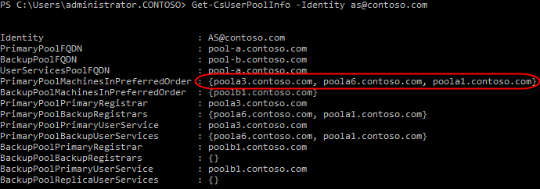
User Experience
Now, stop services on POOLA3……

Slide 37
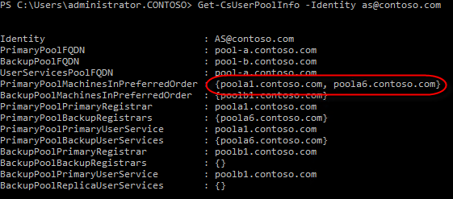
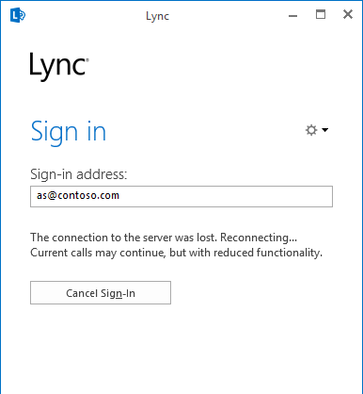
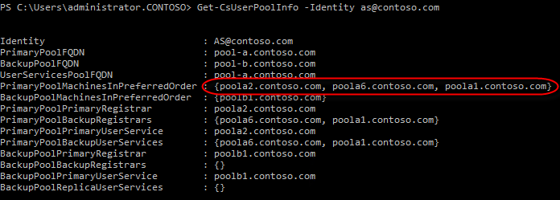
User Experience
Notice that one of the secondary copies was promoted to primary
And within a few minutes, redistribution and new copy added

Slide 38
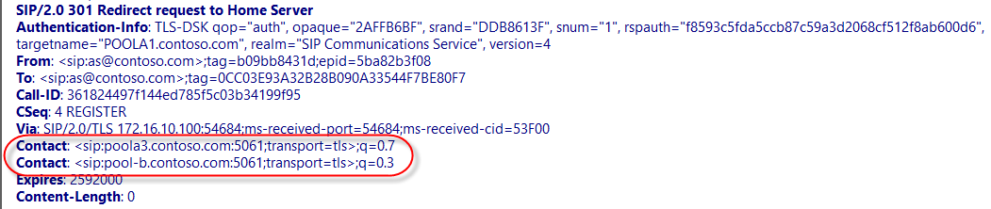

User Experience
Amy’s client logs show her client trying to REGISTER, but 301 to POOLA3 (down)
Amy’s client logs show her client trying to REGISTER, this time 301 to POOLA2 (up)

Slide 39
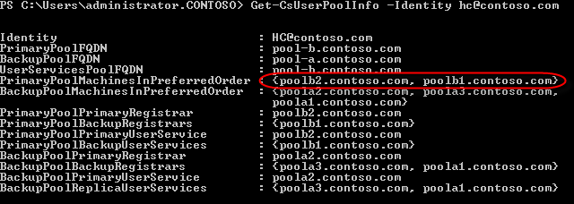
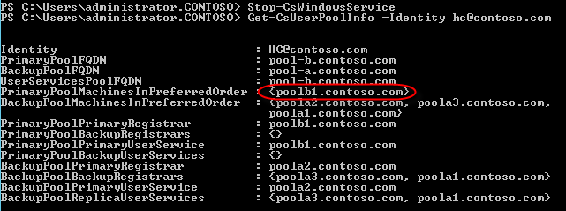
User Experience
But what about a 2-FE pool? Is it different because we don’t have 3 copies?
Nope…still works fine.*

Slide 40
User Experience
All Copies Offline

Slide 41
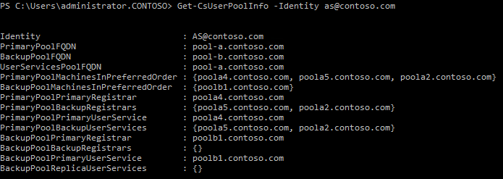
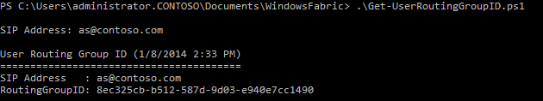
User Experience
Now, stop VMs POOLA4, POOLA5, POOLA2…..

Slide 42
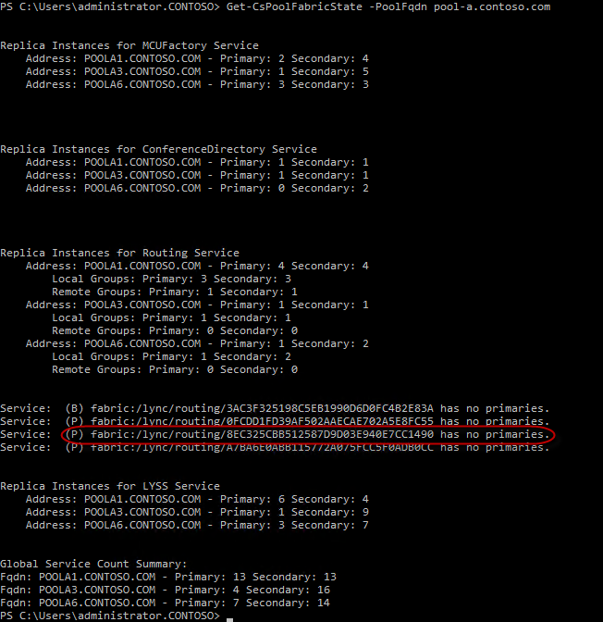
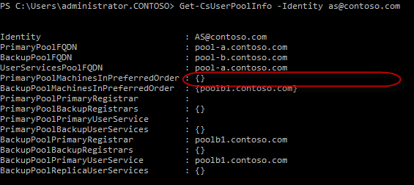
User Experience
Amy’s Routing Group is in Quorum Loss (No Primaries)

Slide 43
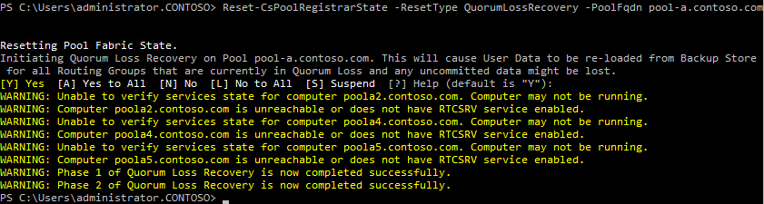
User Experience
HOW DO I GET OUT OF THIS?!?!?!
Perform a QuorumLossRecovery on the affected pool.

Slide 44
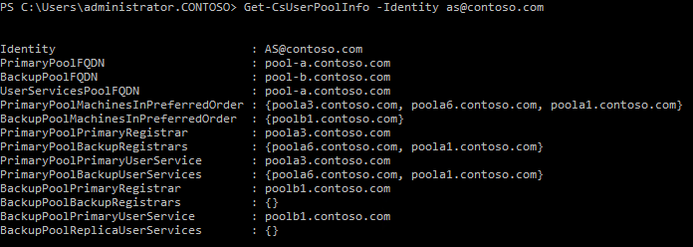
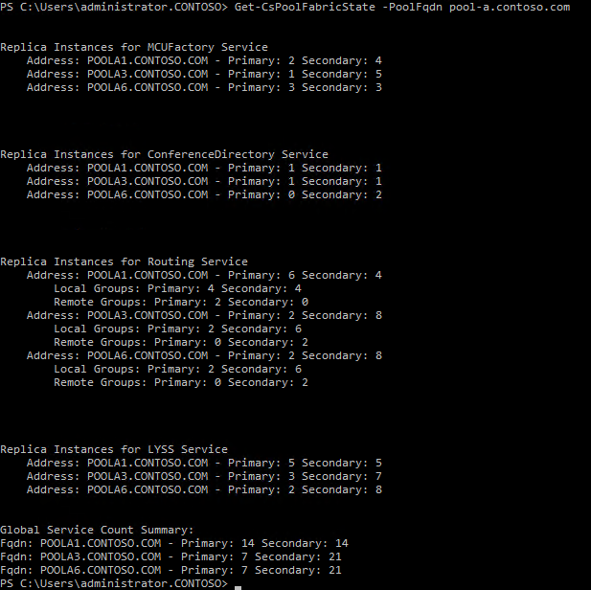
User Experience

Slide 45
Back End HA

Slide 46
SQL Mirroring Backend HA Diagram

Slide 47
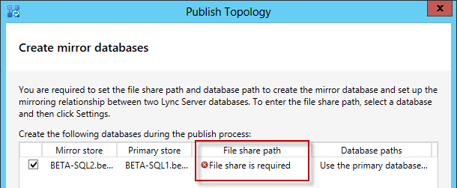
Mirroring File Share
What is it?
  Temporary location used during setup
  BAK files written here.
  Primary SQL needs R/W, Mirror R/O
Where should it go?
  Any file server, with proper permissions for SQL Service access
  Do NOT use DFS! .BAK files are excluded from replication by default
  Do not use the Lync Pool File Share
This is a one-time use share.

Slide 48
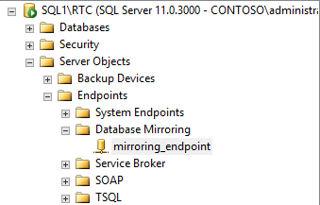
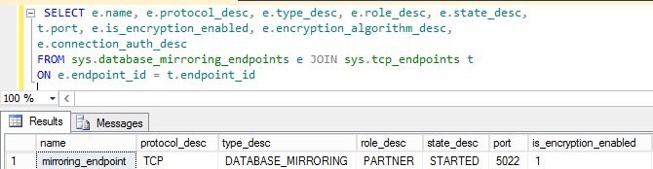
Mirroring Ports
Port Defaults (defined in Topology Builder)
  TCP/5022 (mirror relationship)
  TCP/7022 (witness relationship)
These become mirroring endpoints in SQL

Slide 49
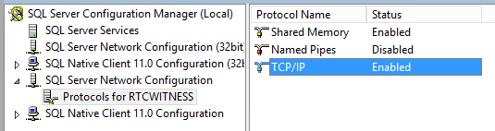
Witness as SQL Express
SQL Express fully supported as a witness
Remember to enable TCP/IP
Start SQL Browser Service (if using dynamic ports)
Open necessary firewall ports

Slide 50
Announcing: AlwaysOn Availability Groups
Targeted for Q3 CY2014
You asked, we implemented
  Forthcoming support for SQL Server AlwaysOn Availability Groups with Lync Server 2013
More HA flexibility
  Choose from AlwaysOn, Clustering and Mirroring for Lync Server Back-end Server HA solutions
Takes the best of SQL & Windows HA and moves into a single technology
  No reliance on shared disk (better safety)
  Reduced complexity (from fail-over clustering)
  Better RTO (faster failover than mirroring)
  No need for a SQL Server Witness instance (compared to mirroring)

Slide 51
AlwaysOn Availability Groups
Logistics
  Up to two synchronous replicas (no potential
  for data loss during failover)
  No shared storage needed; Nodes use local
  storage
  2 Clustered Nodes: File Share Quorum
  recommended
  3 Clustered Nodes: Node Majority
  Recommended
Requirements
  SQL Server 2012 SP1 – Enterprise Edition
WSFC Resource Group
Node 1
Node 2
Node 3
Primary Secondary Tertiary

Slide 52
Disaster Recovery

Slide 53
Pool Pairing
Backup service replicates data between blob stores.
Replicas have a single master (pool’s blob store)
VoIP automatic failover puts users in resiliency mode on backup pool.
Manual failover provides full service on backup pool:
  VoIP, Presence, Conferencing

Slide 54
Lync Backup Service
Synchronizes user data and conference content between paired Enterprise Pools or Standard Edition servers.
Synchronization cycle occurs every two minutes (by default).
Changes are exported in batches to zip files on Backup pool
Source pool signals Backup pool to import changes

Slide 55
Lync Backup Service
When changes have been imported, zip file is removed and a cookie is returned to the Source pool (high watermark).
At beginning of next synchronization cycle, Source pool uses cookie as starting point for exporting changes to Backup pool.
Additionally, when the Backup-CsPool or Invoke-CsPoolFailover cmdlets are run, they trigger the Backup Service to check for changes and send them to the paired pool.
The same process is simultaneously running to replicate changes from Backup Pool to the Source Pool as well.

Slide 56
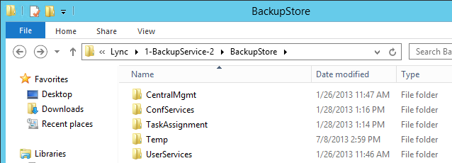
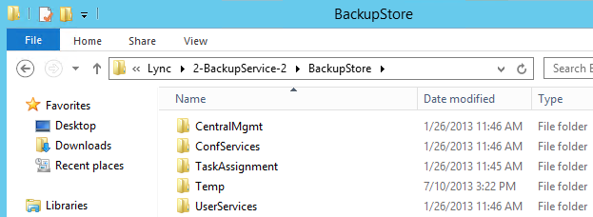
BackupStore
Data on the File Share
  Backup service writes to local file store BackupStore\Temp (Working Folder)
  Backup service transfers file to paired pool file store
Pool A File Store
Pool B File Store

Slide 57
Central Management Store Failover
The CMS DB is critical to Lync service and should be made available most of the time.
There is only one CMS DB per forest and is usually hosted in the Back End of a Pool.
When the Pool hosting CMS fails over, CMS should be failed first and then the Pool.
No need to failback (but you can)
Configuring Pool Pairing:
  Paired Pool Computer Accounts get added to the RTCConfigReplicator group, however this membership does not take effect until server reboot
  The solution is to reboot each server before you execute CMS failover
Cmdlets
  Invoke-CSManagementServerFailover
  Get-CSManagementStoreReplicationStatus –CentralManagementStoreStatus

Slide 58
Geo DNS
Geo-DNS serves two purposes
    to distribute traffic based on geo-proximity in normal case
    provide site resiliency during disaster recovery.
It works best for Lync Server 2013 high availability and disaster recovery deployments when the two sites of a forest are active-active with roughly 50% of the traffic on either side.
It ensures that all users homed on one site use resources on the same site. It is also useful where external users are the majority of Lync users.
The advantage of Geo DNS is it takes away some manual configuration needs.
Geo DNS is not a requirement.

Slide 59
Persistent Chat
Planning a stretched Persistent Chat pool includes:
  Understanding Topologies Supported
  Database Requirements
  Log Shipping is used between datacenters
  File shares required for log shipping
Deployment includes:
  Defining Persistent Chat Pool Active/Passive members
  Configure Log Shipping in SQL Management Studio

Slide 60
DR Management

Slide 61
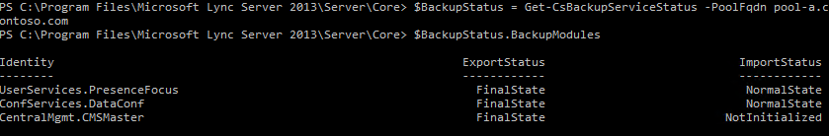
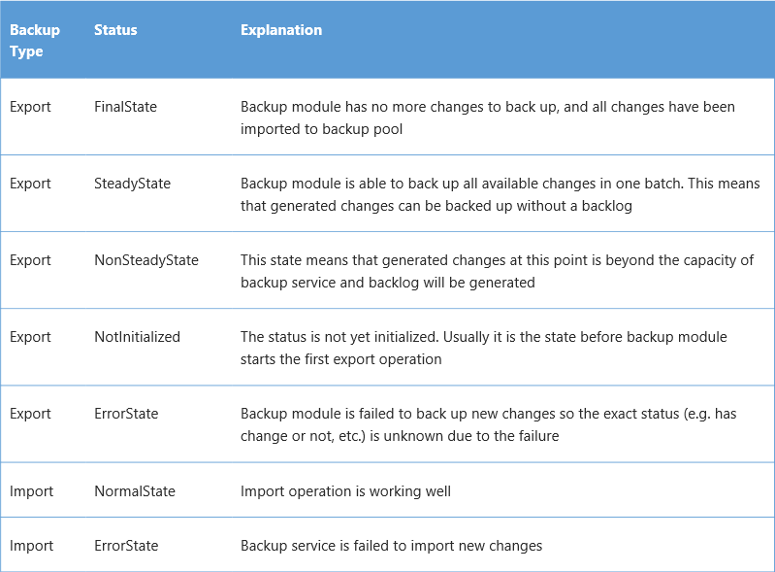
BackupService
Get-CsBackupServiceStatus

Slide 62
Cmdlets
Get-CSBackupServiceConfiguration
Get-CSPoolBackupRelationship
Invoke-CSBackupServiceSync

Slide 63
Q&A

Slide 64
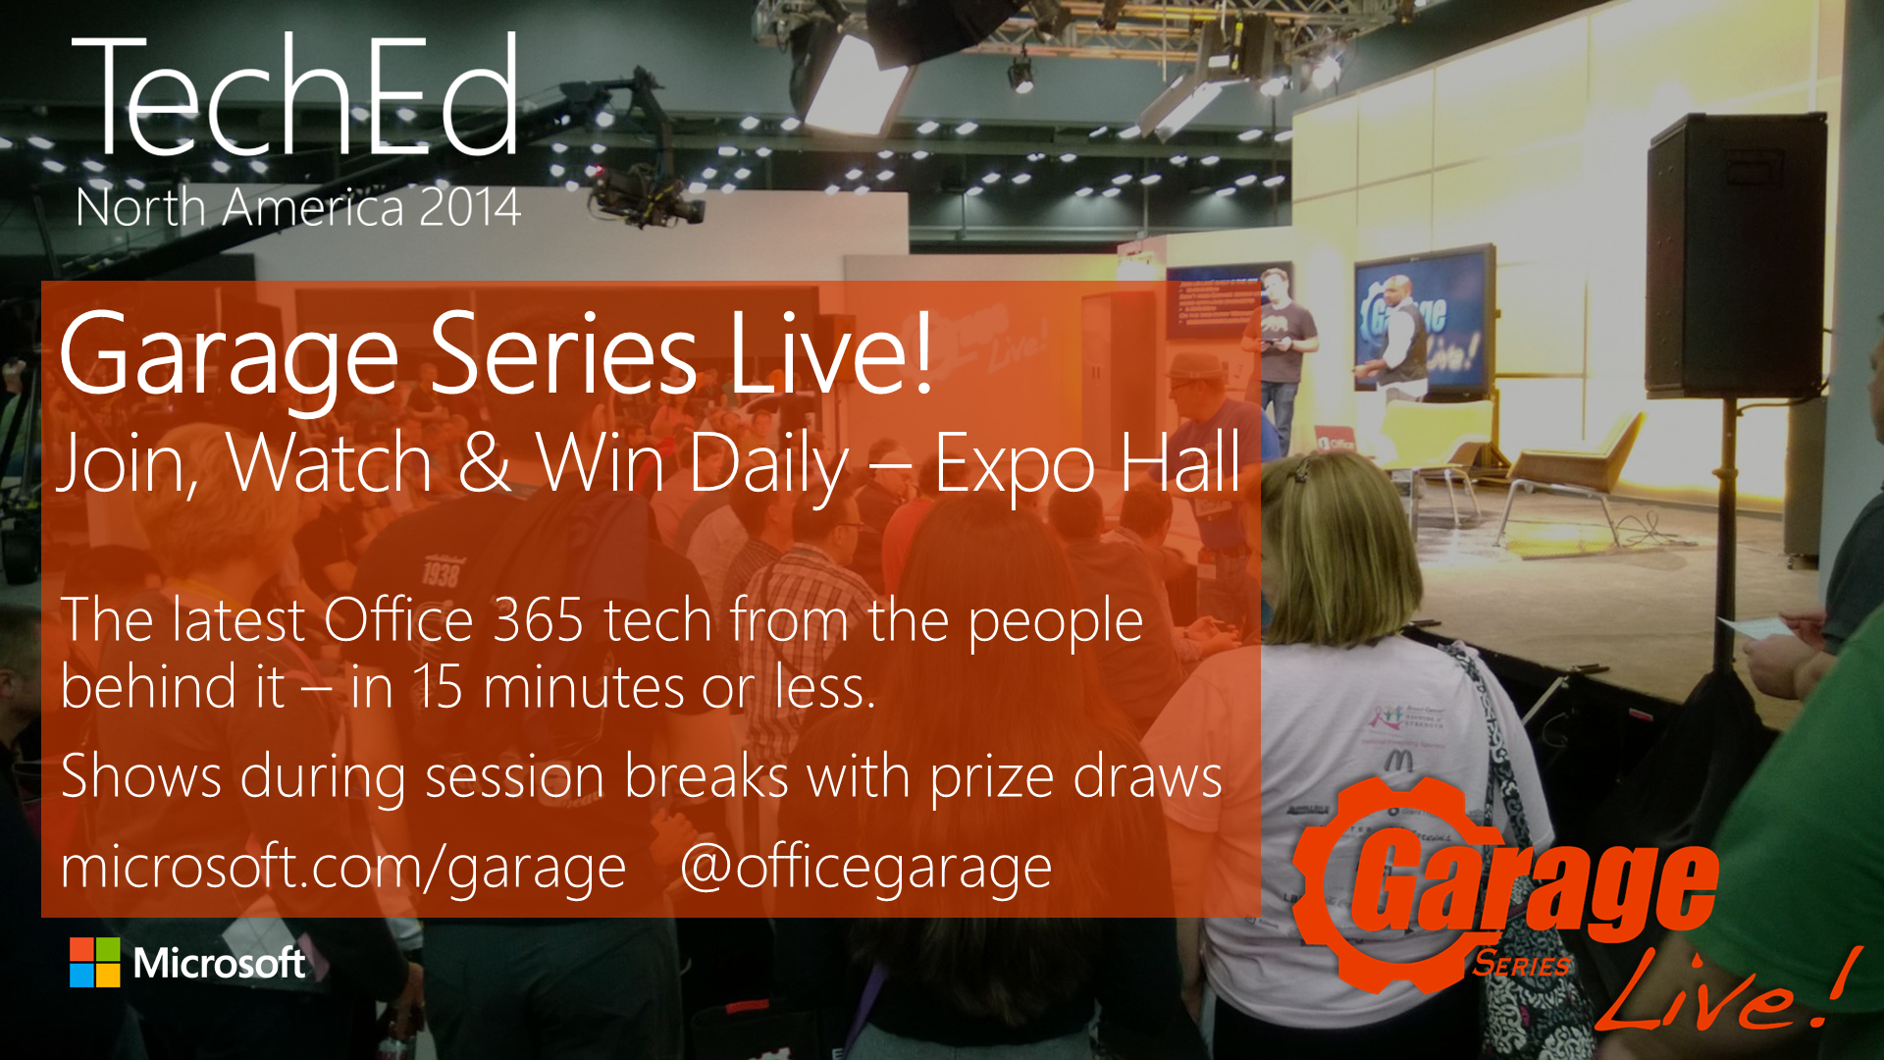

Slide 65

Resources
Learning
  Sessions on Demand
  Microsoft Certification & Training Resources
http://channel9.msdn.com/Events/TechEd
www.microsoft.com/learning
TechNet
msdn
  Resources for IT Professionals
  Resources for Developers
http://microsoft.com/technet
http://microsoft.com/msdn

Slide 66



Complete an evaluation and enter to win!

Slide 67


Evaluate this session
Scan this
QR code
to evaluate
this session.

Slide 68

© 2014 Microsoft Corporation. All rights reserved. Microsoft, Windows, and other product names are or may be registered trademarks and/or trademarks in the U.S. and/or other countries.
The information herein is for informational purposes only and represents the current view of Microsoft Corporation as of the date of this presentation. Because Microsoft must respond to changing market conditions, it should not be interpreted to be a commitment on the part of Microsoft, and Microsoft cannot guarantee the accuracy of any information provided after the date of this presentation. MICROSOFT MAKES NO WARRANTIES, EXPRESS, IMPLIED OR STATUTORY, AS TO THE INFORMATION IN THIS PRESENTATION.

