Slide 2

Surviving the
New IT Reality
PCIT-B211
Janwillem Kok
Enterprise Architect
Microsoft Services
Ruud van Velsen
Principal Consultant
Microsoft Services

Slide 3
Introduction
IT has changed forever
The new IT reality requires a new mindset
Risk Based Management is key to survival

Slide 4
So What Is This New Reality About?
Less Direct Control Than Ever
More Risk Than Ever

Slide 5



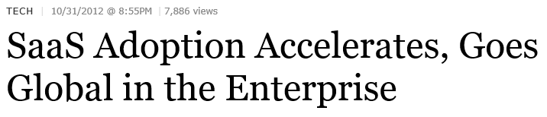

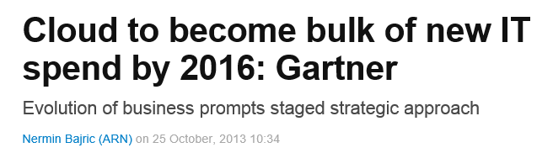
Less Control - Cloud
SaaS
IaaS
PaaS
Data
Application
Operating System
Hardware
Network

Slide 6
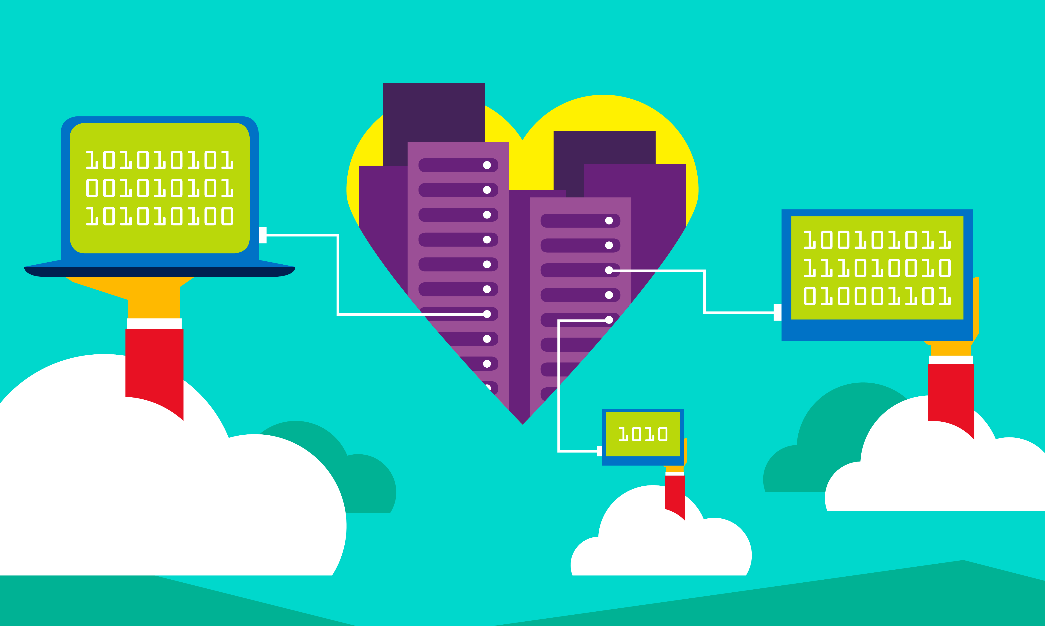
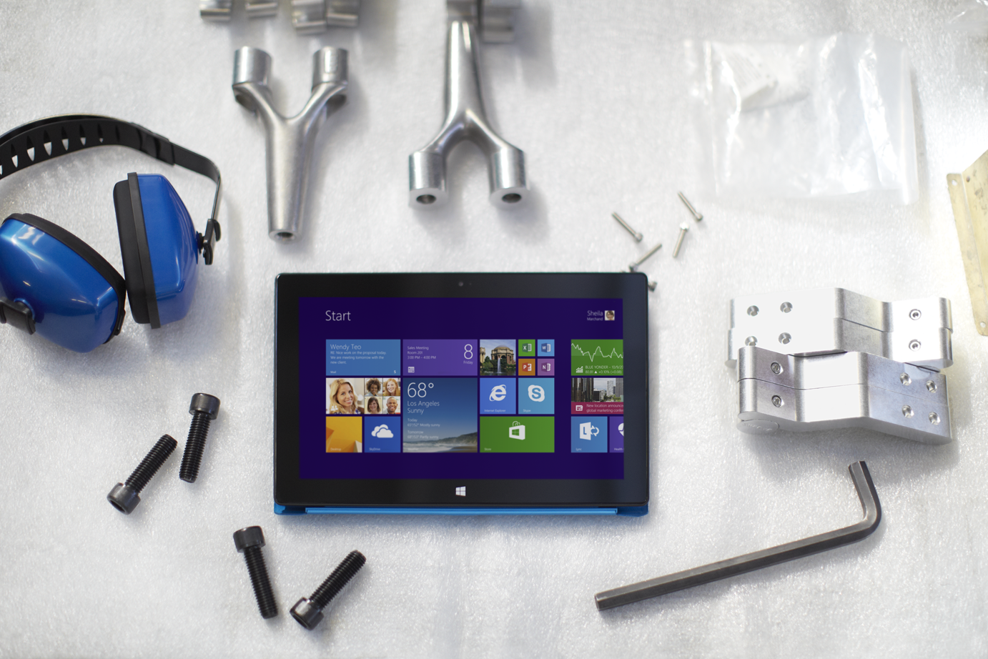

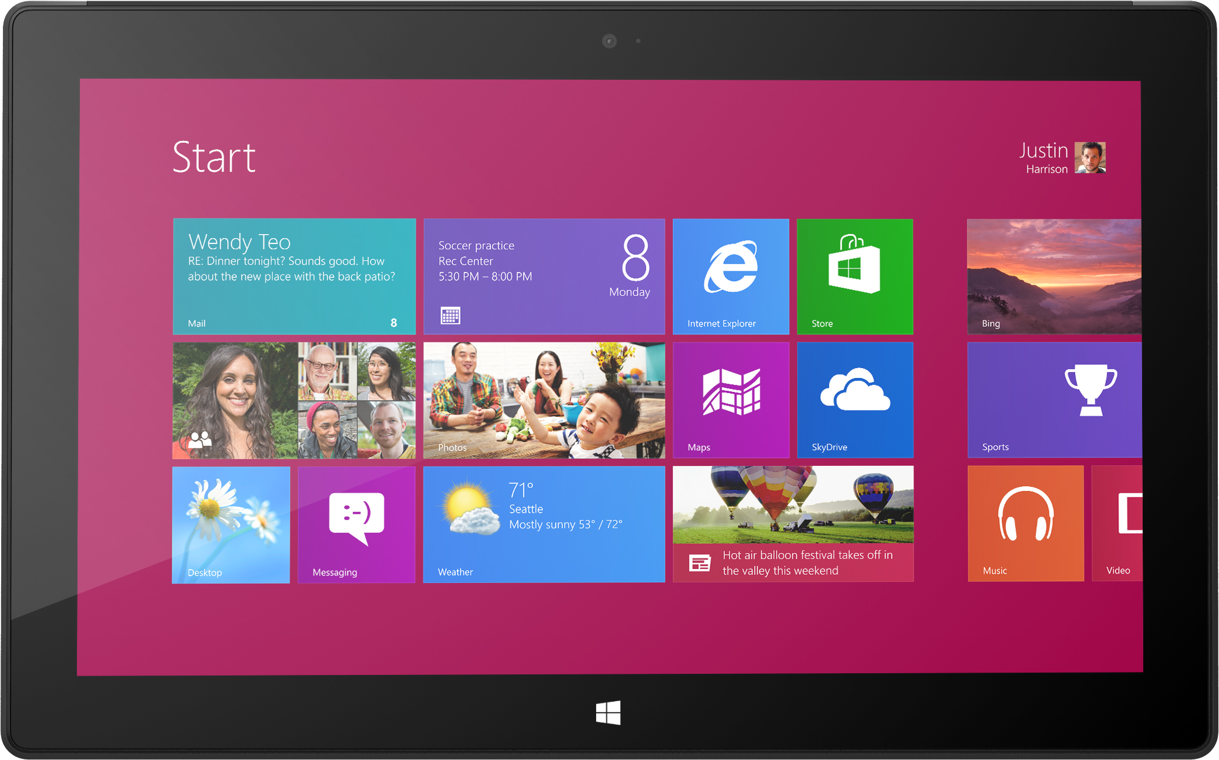
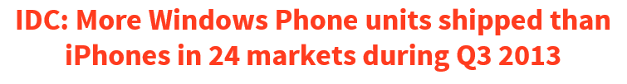
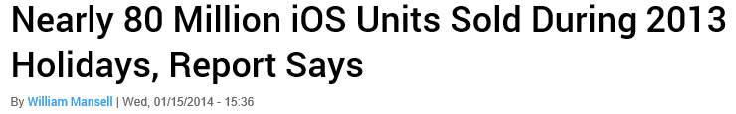
Less Control - Devices
Data
Data
Data
B
Y
O
D
Bring
Your
Own
Disaster
App
App
App
Operating System
Hardware
Network

Slide 7
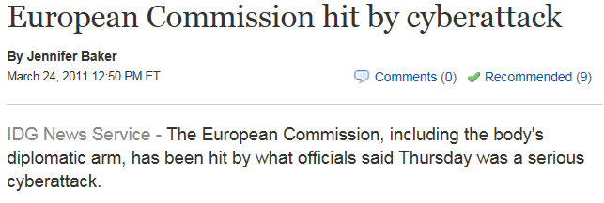
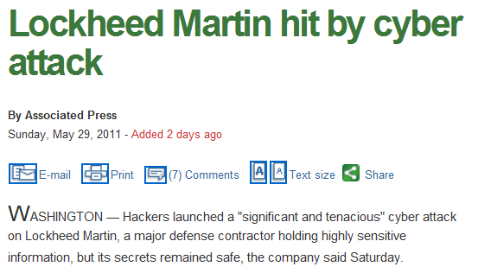

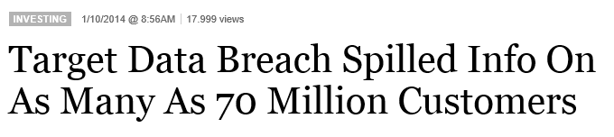
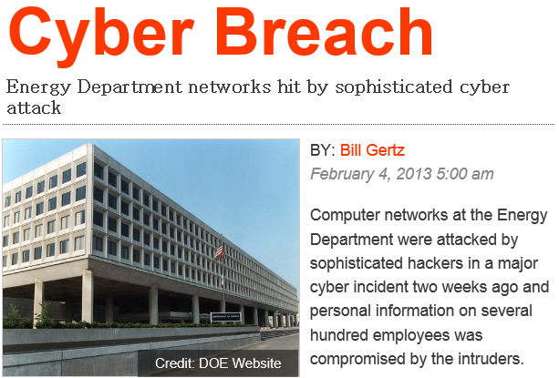
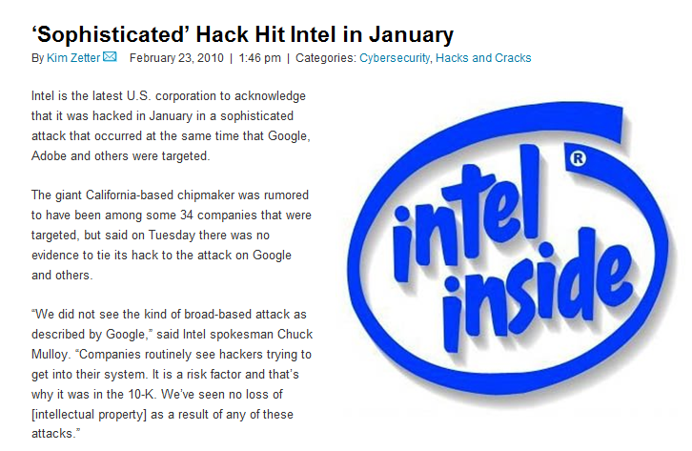
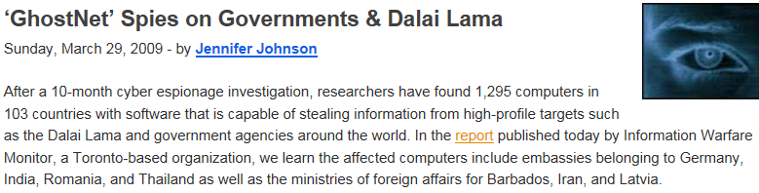
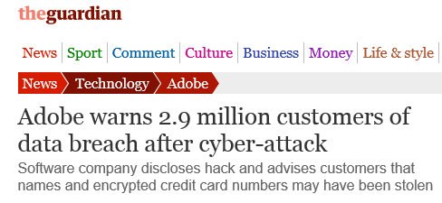
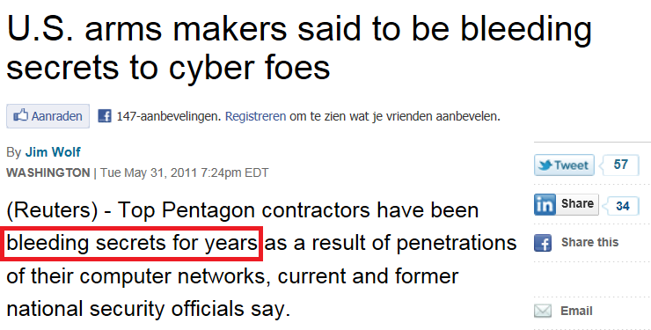

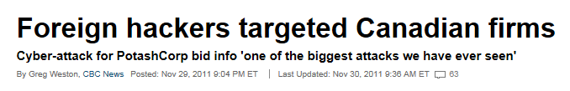
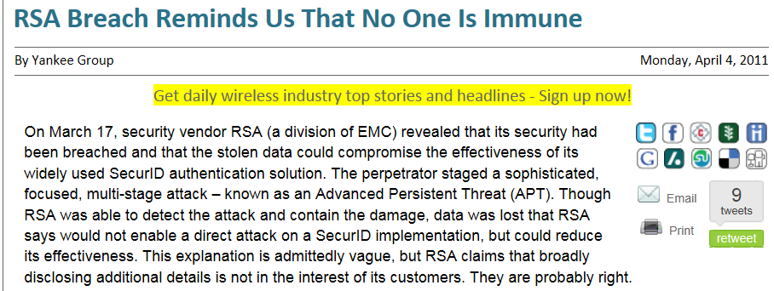
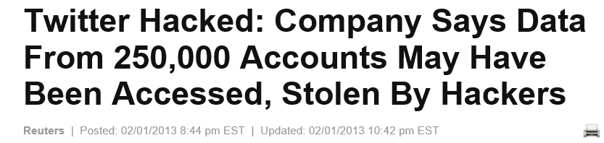
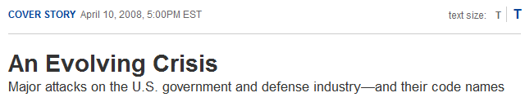
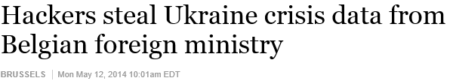
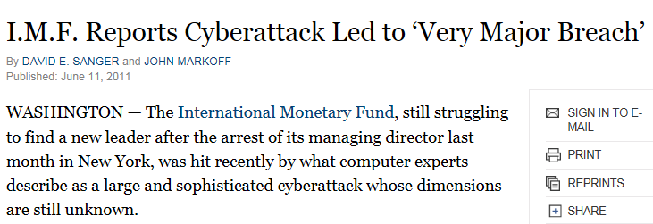
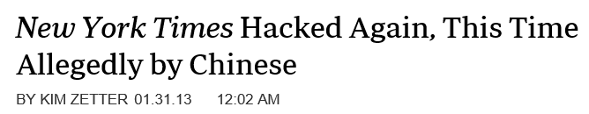
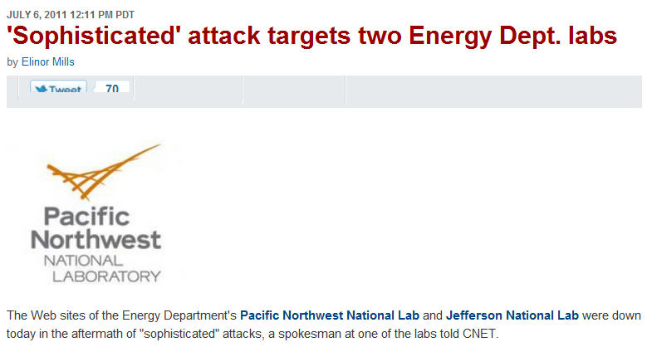
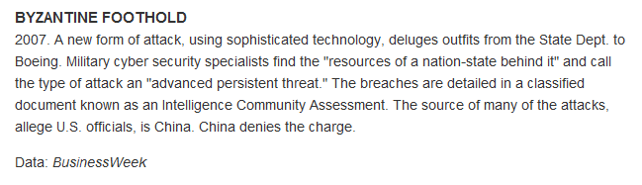

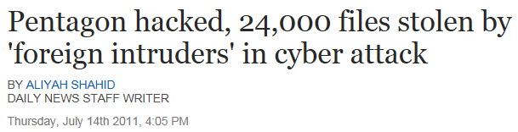
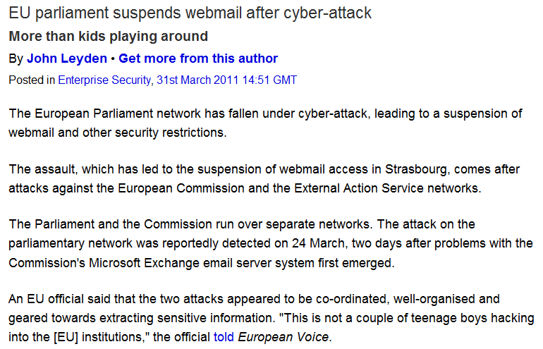

More Risk, Really?

Slide 8
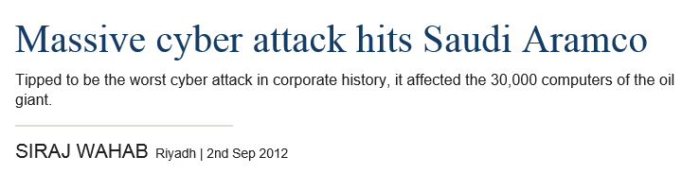

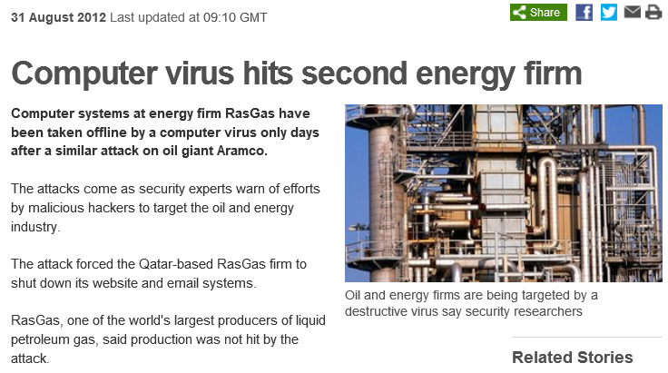
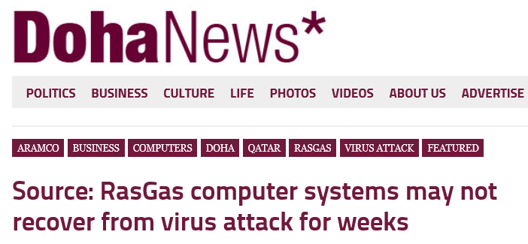
  This is, in fact, the only risk to which we can lose the entire company.
  Chief Risk Manager

Slide 9

Competitors want
your Intellectual Property
Intel Agencies want
your personal data
Organized crime wants
your money
Terrorists want
your life

Slide 11
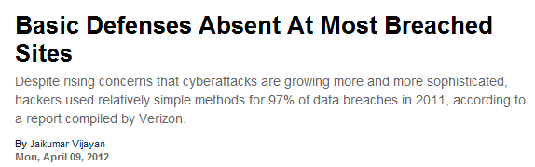
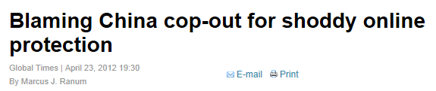
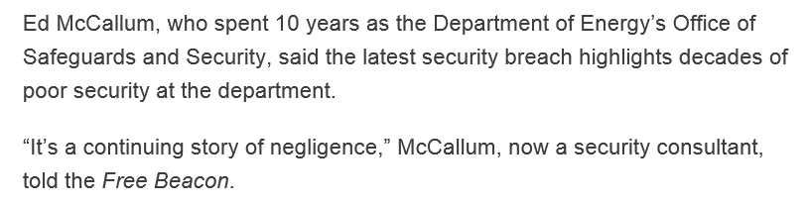
Why Is This Happening?
Security is something we all love to hate
Many IT environments are close to indefensible
  (Application) patch management
  Asset management
  Anti-malware
  Firewall rules
  Code quality
  Legacy hard- & software
  End-user/administrator awareness & maturity
At the same time:
  Attackers have learned the value of living in a connected world
  They have invested deeply in security for well over a decade
There’s a huge gap between the threats and our protective measures to defend against those attacks.
Khalid Kark, vice president and research director, Forrester Research Inc.

Slide 12
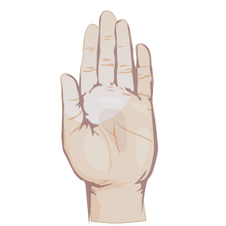
Ok, So What to Do ?
Start with the right assumptions:
  You are a target
  Your IT is, or will be, compromised
  You cannot defend or control everything

Slide 13
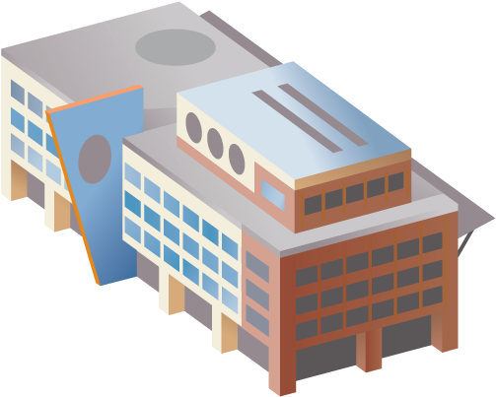

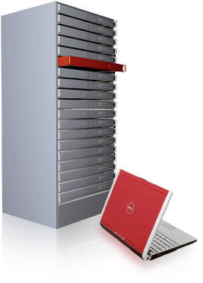
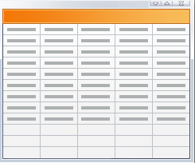
Risk Based Management
Attack Scenarios
“If you protect your paper clips and diamonds with equal vigor, you’ll soon have more paper clips and fewer diamonds”
-Attributed to Dean Rusk, US Secretary of State, 1961-1969
Business Critical Processes
Actors
High Value Assets
Business Owned
IT Supported

Slide 14
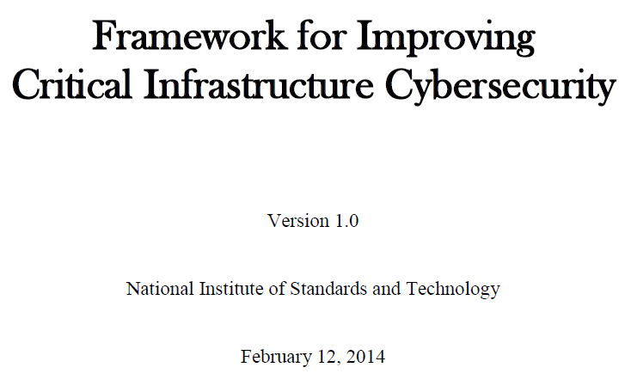
Risk Based Decision Framework
Actors
High Value Assets
Identify
Attack High Privilege accounts
Protect
Desired state Cyber Capabilities
Current state Cyber Capabilities
High Privilege Accounts
Detect
Anomaly Detection
Respond
Analyse:
Tactics
Techniques
Procedures
Incident Response
Recover
Detailed Capability Model

Slide 15
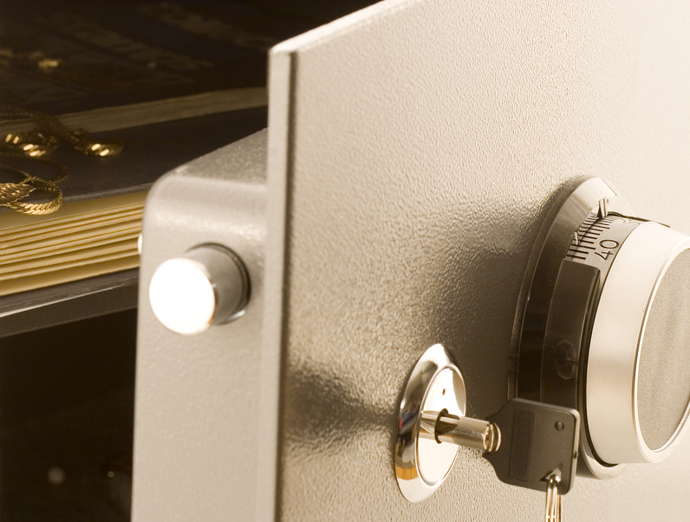
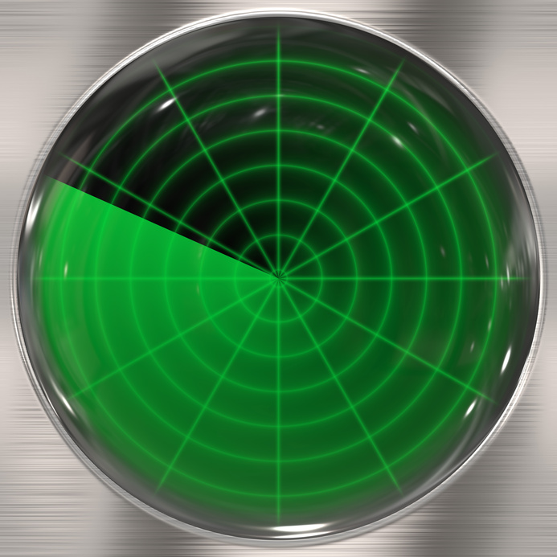


OK, So What To Do?
Protect
Detect
Respond & Recover

Slide 16
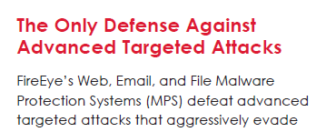
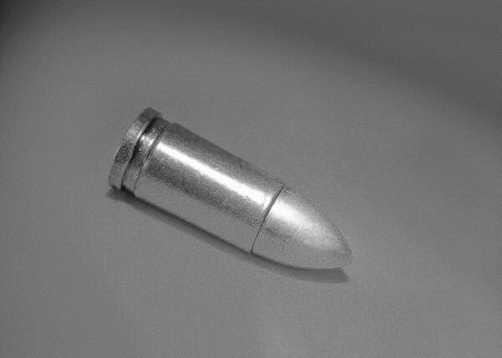
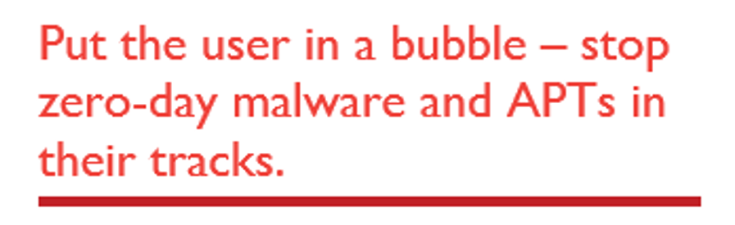
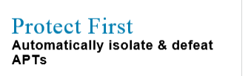
One More Thing…
No such thing as a
silver bullet…

Slide 17
Protect

Slide 18
Risk Based Protection: Zoning
High Risk Data Zone
$$$$$
High Business Impact Data
Medium Risk Data Zone
$$$
Medium Business Impact Data
Low Risk Data Zone
$
Low Business Impact Data

Slide 19
Zoning: Expected Benefits
Goal | Benefit
Differentiation of controls per Zone | Cost avoidance
Reduce risk of attack moving from one Zone to another | Risk likelihood and impact reduction
Enable secure adoption of Cloud and Consumerization | Business enablement

Slide 20
Zoning High Level Architecture
High Risk Data
Move the most valuable assets to a highly secure environment
Move the most exposed assets to a separate environment
Move the most vulnerable assets out of the Open Network
One Open Network
Secure Cell
Access Services
Secure Cell
Secure Cell
Secure.com
Access Services
Medium/Low Risk Data
External Connect
Office Automation
Office Automation
Office Automation
Contoso.com
Contoso.com
Internet Facing Apps
External.com
Containment
W2K, Old Java, Test
W2K, Old Java, Test
Contain.com
Internet Facing Apps

Slide 21
A Note On Impact Reduction
Titanic Architecture
Not strong enough
Not high enough
Bulkheads

Slide 22
Zone Bulkhead Height
Application Services
E.g. LDAP, Search
Security
Identity and Access management
Management
Asset Management (incl AV, patching and configuration)
Basic Infrastructure
Network, Storage, Desktop, Servers, etc.

Slide 23
Remember That Thing About Less Control?
Fully isolated application
Internal server application
Other data
MBI Data
MBI Data
Part of Medium Risk Zone
Application
Application
Application
Operating System
Operating System
Network stack
Network stack
“Bring your own device” or Cloud

Slide 24

Zoning Decision Tree
Start
Example Controls
Data Protection
Adequate?
Yes
Done
Encryption (e.g. RMS)
LBI
No
Application Protection
Adequate?
Yes
Done
Sandboxing, Presentation virtualization (e.g. RDS)
No
MBI
Operating System
Adequate?
Yes
Done
Health check/contractual, Mobile Device Management
Network stack
No
H
B
I
Fully managed corporate device

Slide 25
Protect: Fireable Offenses
Browsing on domain controllers/servers
Browsing in admin context
Favors for friends
Running stuff from USB sticks
Using the network for personal stuff
…

Slide 26

Protect – Non Negotiables
Weak protocols (ie: LMHash, FTP)
Weak/shared/well-known passwords
Unsupported software (ie: Windows 9x/NT/2000/XP/Java/Linux)
Hostbased protection (firewall, etc)
OWASP (ie: SQL injections, XSS)
Any-to-Any firewall rules
Application level patching
We’ll fix things once we’re live…

Slide 27
Protect - Must-Do’s
Incident response organization
Security information & event management
Asset / configuration management
Implement clean, current baselines
Secure coding practices (SDL)
Service account management
Protect & restrict high privilege accounts

Slide 28
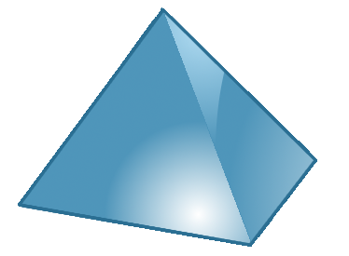








Protect the High Privilege Accounts
Credential partitioning
  No privilege account logon to lower trust systems
  Also applies to privileged service accounts
Use dedicated admin workstations
Multifactor authentication
Restrict local admin accounts
Power:
Domain
Controllers
Data:
Servers and
Applications
Crown jewels
Access:
Users and
Workstations
  DCIM-B213 TWC: Pass-the-Hash and Credential Theft Mitigation Architectures
  DCIM-B359 TWC: Pass-the-Hash: How Attackers Spread and How to Stop Them

Slide 29
Detect

Slide 30
“69% of breaches were discovered by external parties”
“66% took months or more to discover”
“In most cases...the victim could have discovered the breach had they been more diligent in monitoring and analyzing event-related information at the time of the incident.”
2013 Verizon Data Breach Report

Slide 31

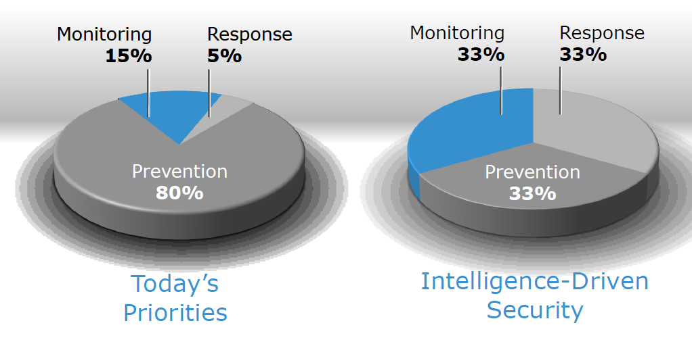

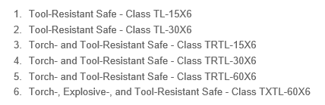
A Complete Security System
Protective Controls
Detective Controls
Why not just protective controls?
By 2020, 60% of enterprise information security budgets will be allocated to rapid detection and response approaches, up from less than 10% in 2013
(Gartner, May 2013)
Nobody can think of everything
Time/tools erode all protections

Slide 32

Actor - Tactics, Techniques, Procedures
Reconnaissance
Weaponization
Delivery
Exploitation
Installation
Command and Control
Actions on Objective
Great reference: Mitre.org
E.g. Facebook
E.g. Flash in Word
E.g. Email/Waterhole/USB
E.g.
Standard functionality
/vulnerability
E.g. RAT
Call home
e.g
Extract IP/Destruct
Note: From Lockheed Martin, Intelligence-Driven Computer Network Defense

Slide 33
Detection – The Basic Plan
First, get “Many Eyes” on the environment
Inventory assets
  Computers, Devices, People
Select high-risk and high-value
Collect baselines
Define behavior characteristics and statistics
  Logons, Software, Performance, Netflows, Traffic
Define thresholds, message throttling
Create alerts
Start simple

Slide 34
Respond /
Recover

Slide 35





Don’t…
PANIC…
…try to boil the ocean
…overestimate ability to execute
…underestimate the power of wishful denial

Slide 36
Do…
Assess extent of compromise
Focus on what’s important
Prioritize and take small steps

Slide 37
Boiling the Ocean
The Perfect Plan
  Close all internet / remote access
  Change all passwords
  Rebuild Active Directory
  Rebuild all hosts from scratch
  Update all software, defenses, policies
  Fix vulnerabilities
  Restore data and legitimate applications
  Educate end-users
  Turn everything back on

Slide 38
The Perfect Plan…
…not so much
  Too big
  Too complex
  Too costly
  Too disruptive
Which leaves… “Plan B”

Slide 39
A More Realistic Recovery Plan…
Women and children first!
    Define & locate “Diamonds”
    Create safe haven
    Move Diamonds over
Declare old environment to be a
    Zoo
    Graveyard

Slide 40
Recovery Plan Characteristics
Low Attacker Skill/Presence
0% chance of persistence
High Attacker Skill/Presence
100% chance of persistence
1
Scan and Clean
$
2
Scan, Clean, and Rebuild DCs
$$$
3
Build New Environment
$$$$$$$
Inherent High Effectiveness
Effectiveness Depends on Execution
Inherent Low Effectiveness

Slide 41
Recovery Dynamics
There is never 100% guarantee of recovery
  There is never 100% guarantee of security either
  Skill level of adversary impacts likelihood of success
Adversaries are human operators
  Bad – Can adapt and adjust to our tactics
  Good – Reaction speed is human, like the defenders
As we get better, so will they
  New places to hide, new techniques, etc.

Slide 42
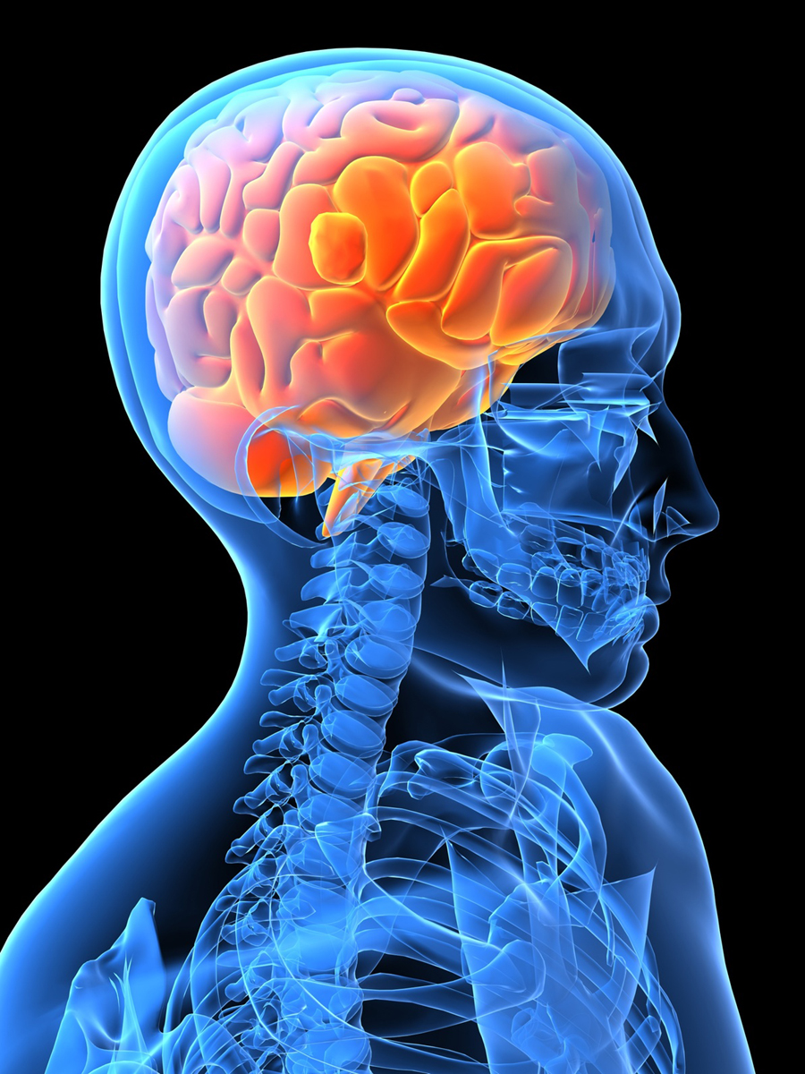
The New Mindset
We all swim in a sea full of sharks
We cannot defend or control everything
Risk is a business issue

Slide 43
Surviving in the New IT Reality
Focus on your diamonds
Choose solutions that match the risk
Be prepared, start today

Slide 44
Related content
Breakout Sessions (session codes and titles)
  DCIM-B213 TWC: Pass-the-Hash and Credential Theft Mitigation Architectures
  DCIM-B366 TWC: Hacker’s Perspective on Your Windows Infrastructure: Mandatory Check List
  DCIM-B359 TWC: Pass-the-Hash: How Attackers Spread and How to Stop Them
  DCIM-B216 TWC: Securing Your Business: Getting the Most from Your Premier Services
  PCIT-B319 TWC: Social Engineering: Manipulations, Targeted Attacks, and IT Security
  WIN-B335 Making Sense of the Microsoft Information Protection Stack
  DCIM-B374 TWC: Fighting Evil with Good
Microsoft Solutions Experience Location (MSE)

Slide 45

Resources
Learning
  Sessions on Demand
  Microsoft Certification & Training Resources
http://channel9.msdn.com/Events/TechEd
www.microsoft.com/learning
TechNet
msdn
  Resources for IT Professionals
  Resources for Developers
http://microsoft.com/technet
http://microsoft.com/msdn

Slide 46



Complete an evaluation and enter to win!

Slide 47


Evaluate this session
Scan this
QR code
to evaluate
this session.

Slide 48


© 2014 Microsoft Corporation. All rights reserved. Microsoft, Windows, and other product names are or may be registered trademarks and/or trademarks in the U.S. and/or other countries.
The information herein is for informational purposes only and represents the current view of Microsoft Corporation as of the date of this presentation. Because Microsoft must respond to changing market conditions, it should not be interpreted to be a commitment on the part of Microsoft, and Microsoft cannot guarantee the accuracy of any information provided after the date of this presentation. MICROSOFT MAKES NO WARRANTIES, EXPRESS, IMPLIED OR STATUTORY, AS TO THE INFORMATION IN THIS PRESENTATION.

