Slide 1


Slide 2

Deploying RMS for Cloud-Friendly and Cloud-Reluctant Organizations
PCIT-B321
Enrique Saggese
Sr. Program Manager – Information Protection

Slide 3
Session Objectives And Takeaways
Session Objective(s):
  Quick recap of RMS + How it has evolved + the problems it solves (or does not solve).
  You are capable of selling and deploying a set of key RMS ‘recipes’ now.
Key Takeaway 1: RMS is a fantastic ‘data protection pattern’
Key Takeaway 2: while you can’t do *everything* with RMS today, some scenarios are very effective and easy to achieve

Slide 4
What we hear
Data privacy is important; often mandated/regulated
The perimeter is fading; there is no more time to wait
DLP is too reactive; persistent data protection is proactive
IT services must ‘reason over data’; P2P encryption fails
P2P federation not practical; need ‘federated communities’
Generic protection (PFILE) is better that we generally think

Slide 5
Why Rights Management?
RMS protects the data itself.
Protection is lasting – it endures data movement
Great pre-auth protection; effective controls post-auth.
Educate users as to their rights; attempts enforcement
Future-proof: Can delegate reasoning-over-data to services
Some capabilities are file format agnostic
Extremely flexible pattern: Files, data stores, CEGs, libs.

Slide 6
Microsoft RMS – Building Blocks
File is protected by symmetric key
Usage rights + symmetric key stored in file as ‘license’
License protected by org-owned RSA key
Use Rights + .
Secret
Cola Formula
Water
HFCS
Brown #16
#!@#!#!@#!
()&)(*&)(@#!
#!@#!#!@#!
()&)(*&)(@#!
#!@#!#!@#!
()&)(*&)(@#!
Secret
Cola Formula
Water
HFCS
Brown #16
Protect
Unprotect

Slide 7

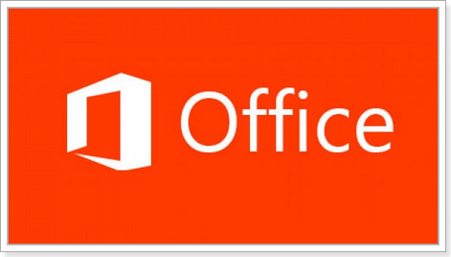
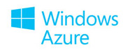

Microsoft RMS – Building Blocks
RMS-enlightened apps enforce rights
Generic Protection offered by the RMS Sharing App
Enlightened apps use RMS SDK
RMS SDK communicates with RMS
Use Rights + .
#!@#!#!@#!
()&)(*&)(@#!
#!@#!#!@#!
()&)(*&)(@#!
#!@#!#!@#!
()&)(*&)(@#!
RMS
SDK
RMS App, Foxit,
etc

Slide 8

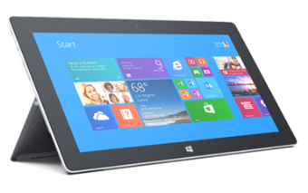



Microsoft RMS – Building Blocks
KMSP
(HSM)
Operating in 3-Geos NA, EU, AP
EXO
Azure KMS
AD
Azure AD
Azure AD
SPO
Internal users
External Collaboration
Identity and
Collaboration
AD RMS
Azure RMS
New mobile
REST endpoints
Exchange
Exchange
RMS
Connector
SharePoint
SharePoint
Windows Server FCI
Windows Server FCI
Office 2007
Office 2010
Office 2013
Office 2007
Office 2010
Office 2013

Slide 9
Why is RMS not everywhere yet?
The perimeter was effective at keeping out the pests
RMS used to only work on limited flows
  Only worked on Windows
  only supported Word/Excel/PowerPoint
  imposed more friction than users felt acceptable
  limited collaboration scenarios
  was an ordeal to deploy (in multi-forest orgs)
We’ve made HUGE improvements since
  Still, there remain quite a few caveats / pain points

Slide 10
Cooking with RMS

Slide 11
The Raw Ingredients
RMS App, SDK, & Services
  AD RMS (on premises)
  Azure RMS (cloud Service)
Exchange DLP
  Data loss prevention optimized for email
SharePoint Secure Doc Libs
  Document libraries with protection on egress
File Server FCI
  Protects existing/new files on file servers
Office Mail Encryption
  Identity-agnostic email collaboration
Intune MDM (related)
Bitlocker Suite (related)
Partner Offerings
  Secure Islands / Watchful Software / GigaTrust
  Secude SAP data protection
  RMS App (and other viewers)
  PDF – Foxit and NitroDesk
  <Many more coming!>

Slide 12
“I have sensitive Data”
What: Most orgs have some ‘Red Zone’ data. This data is for the eyes of a trusted few. The data owner wants persistent data protection for when it leaves the default perimeter; they want their trusted few to be the gate data keepers, not the underlying data store or email.
Who: Concerned CxOs want to understand how MSFT can help them protect this most sensitive data.

Slide 13
Office 365
Core use pattern
  Use Office 2013 + Exchange Online + SharePoint Online with RMS
Configuration
  Buy E3/E4 and it’s a one-click turn on of RMS / EXO offer delightful DLP / SPO offers Secure libraries.
  B2B collaboration with all other Office 365 tenants ‘just works’ (given automatic AAD federation).
  RMS for Individuals makes sharing with anyone easy
Assessment
  This is the easiest – by far – way to get RMS for cloud-ready organizations.
  Gap: Office 2010 requires config via RMS App to function with Azure RMS
  Gap: “Bring your own Key” is supported by SharePoint Online but not Exchange Online today; your key must be given to EXO outside of the ByoK HSMs

Slide 14
On-premise SharePoint Secure Library
Core use pattern
  The checked out file – Office files and PDF only – is protected on egress to a single user or small group
Configuration
  Within the org, data centralization exists or is an obtainable state for the set of sensitive data
  ADRMS + AD as authorization service; SharePoint 2010, 2013 as data repository
  Document formats are Office documents (Word, Excel, PowerPoint) and/or PDF
  The org will need to use Foxit or Nitro PDF readers (for the time being).
Assessment
  Technically approachable and isolated from other IT teams
  SharePoint and AD Admins must be trustworthy as data resides in an unprotected state
  Gap: Office not yet available or not RMS-enabled on common mobile platforms (Mitigation: 3rd party offers)
  Other file formats are not protected by the Secure Library

Slide 15
SharePoint Secure Library with Azure RMS
Core use pattern
  The checked out file – Office files and PDF only – is protected on egress to a user (or group)
Configuration
  Azure RMS + RMS connector + BYOK + AD/AAD/DirSync/ADFS ; SP2010/13 or SPO as data repository
  Document formats are Office documents (Word, Excel, PowerPoint) and/or PDF
    Office 2010+ only; no MacOffice yet -- Office 2003, 2007 and MacOffice don’t talk to Azure RMS
  The org will need, for now, to use Foxit or Nitro PDF readers. Support in Adobe coming soon!
Assessment
  Very approachable given to ease of deploying RMS in Azure
  SharePoint and AD Admins must be trustworthy as data resides in an unprotected state.
  Though Azure RMS servers NEVER SEE THE FILE, there is a usage privacy consideration (access logs).
  Gap: Restricted file formats and lack of support for old Office versions can limit the scenario

Slide 16
File Server with the File Classification Infrastructure
Core use pattern
  Files saved on a FCI-protected file share are continuously monitored; RMS is applied when triggered by content rules.
  In-box protection provided for Office files; PDF and generic protection can be enabled via scripts.
Configuration
  WS 2012 / 2012 R2 with the FCI role enabled
  AD RMS or Azure RMS Connector
  IT set rules to control the protection behavior
  Optional RMS App + PowerShell command-lets for PDF and Generic Protection (PFILE)
Assessment
  Simple to deploy and operate isolated from other IT teams
  Once a file is protected, even the File server administrator can’t see it.
  Gap is that this protects local server files or synchronized (Work Folders) files; no protection for NAS shares, third party file servers or libraries

Slide 17
Simple Email Classification
Core use pattern
  Start simple vs continuous planning / never deploying
    Ask users to only protect sensitive emails, to simple company templates.
  Automate protection with Exchange 2013 (or ISV) DLP rules. E.g.: Trigger on “Company Confidential”
Configuration
  Exchange, Office, and AD-RMS or Azure ADRMS with the RMS Connector.
  Simple Policies: Restricted (View only), Sensitive (No print), Confidential (Full Rights) and unprotected.
  Per-department (HR Only; Legal Only) policies possible;
  Look at RightsWatch, Titus, Secure Island, and GigaTrust if wanting more options
Assessment
  For internal email, this works. It’s far better than the alternatives. ITPros often boil the ocean.
  Pain: Lack of built in iOS support. Samsung, TouchDown do RMS via Exchange ActiveSync. Mitigation: Limit use to really sensitive stuff.
  Pain: Can’t freely share outside of your organization with guaranteed access (you don’t know if the email is going to be read on a PC).

Slide 18
“Collab with a leash”
Organizations have data they share. They can tolerate *some* data filtering out but today it’s just too much. They want some help in controlling the flow / accountability.
This IT leader is willing to take a gamble as they are hemorrhaging today and the alternative is not to collaborate.

Slide 19
Sharing with others
Core use pattern
  Share Protected from Word, Excel, PowerPoint, or from the Windows Explorer
  Share a Protected whiteboard photo from your phone (RMS App)
  Share to people in other ORGANIZATIONS (B2B; B2C not yet supported)
  Recipients without the ability to sign in, can sign up for free RMS
Configuration
  Paid ADRMS/ Azure RMS or even free RMS for Individuals
  Appropriate applications based on desired use case (below)
Assessment
  Secure sharing with rights enforcement requires
    Office 2013 or Office 2010 (RMS App) or Foxit Reader. Identities are native or free (shadowed) OrgID
  Secure sharing without rights enforcement implies a trusted user (over untrusted transport) use case
    Any application, on any device as long as RMS App is available. Same identity requirements

Slide 20
Demo
Quick refresher of the sharing flow

Slide 21
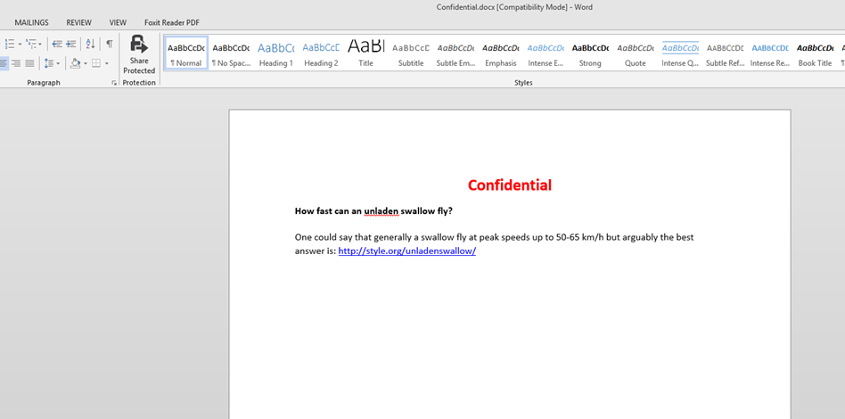
Sharing a word document

Slide 22
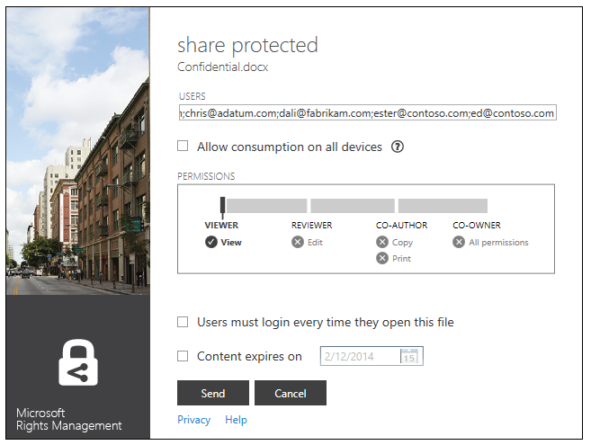

Slide 23
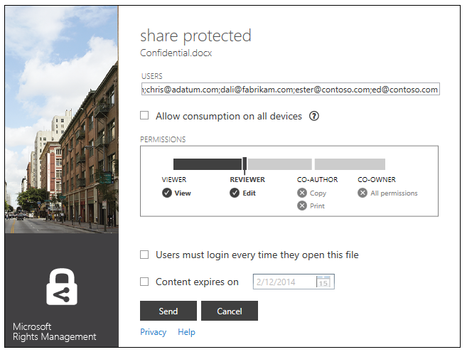

Slide 24
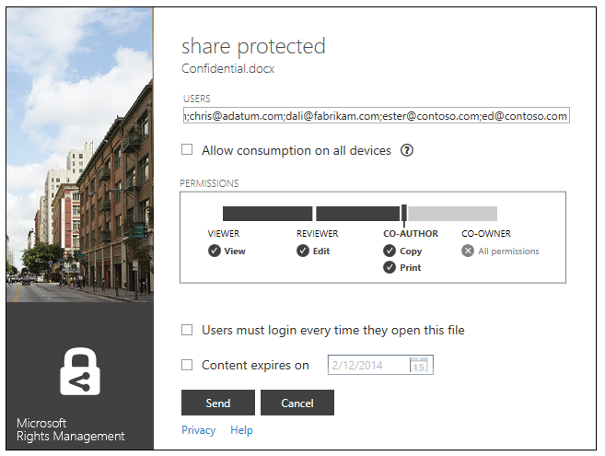

Slide 25
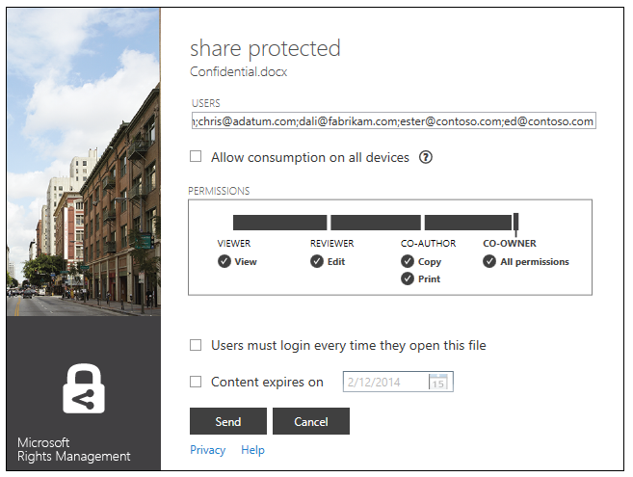

Slide 26
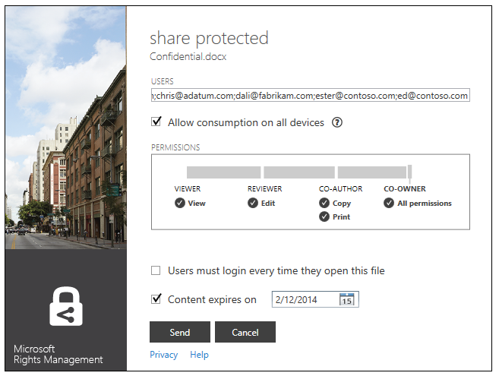

Slide 28
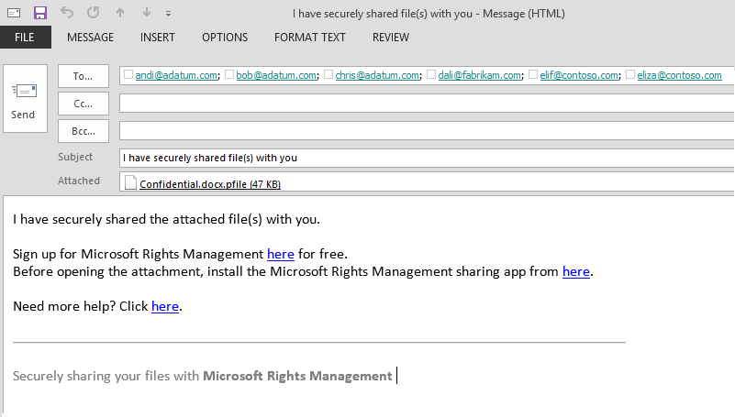


Slide 29
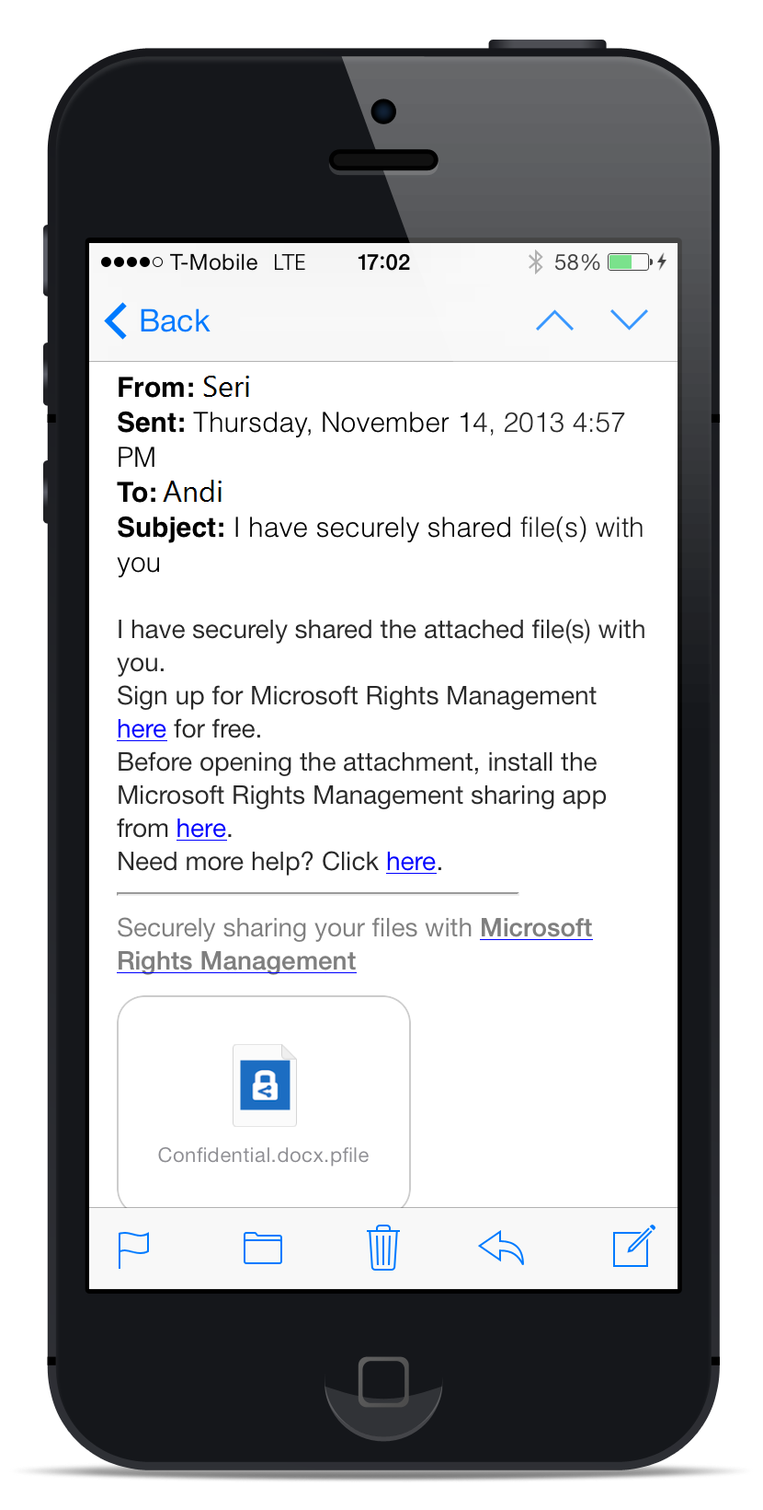
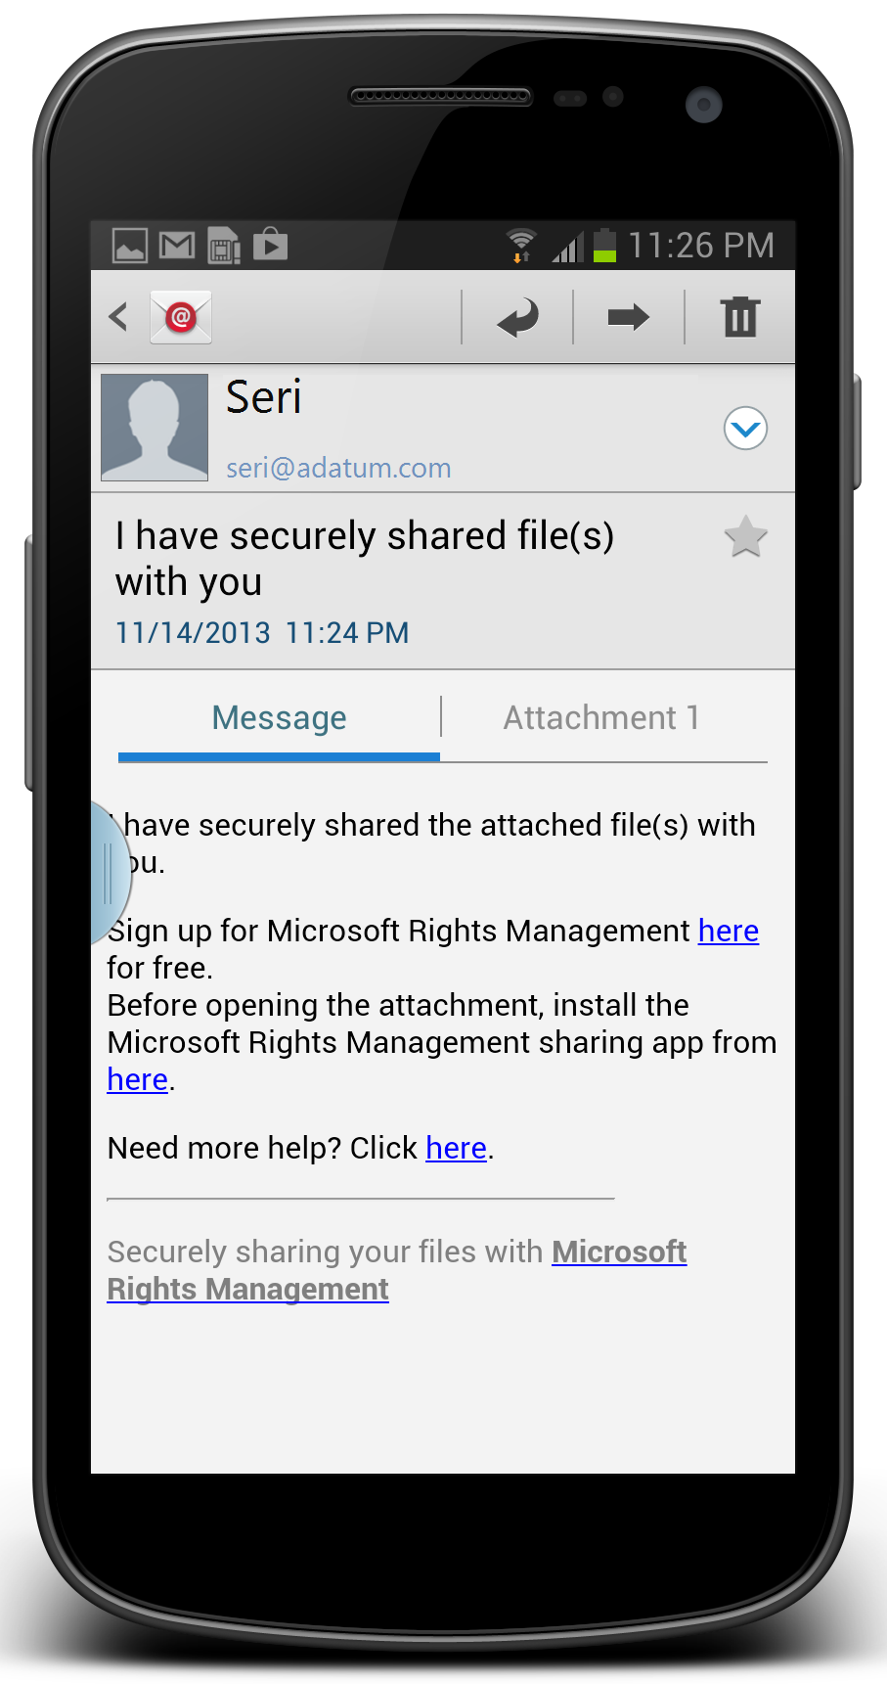
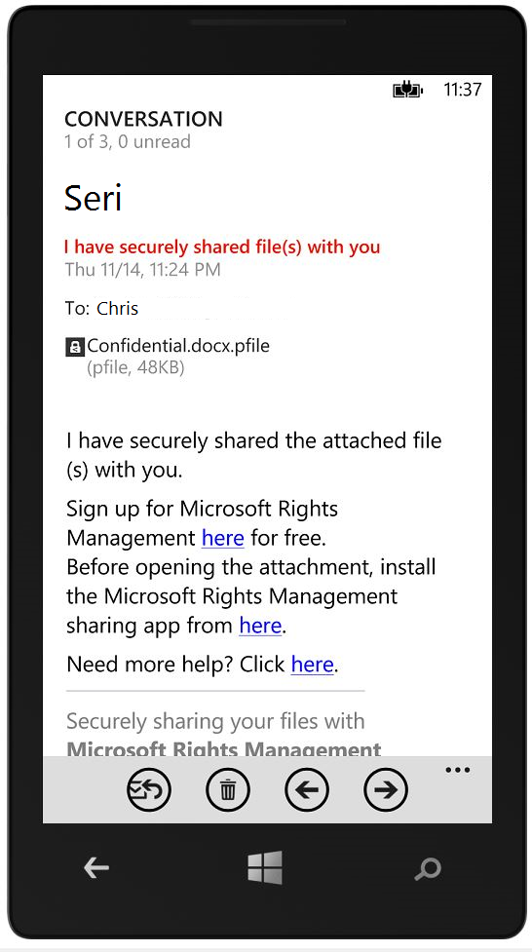

Slide 30
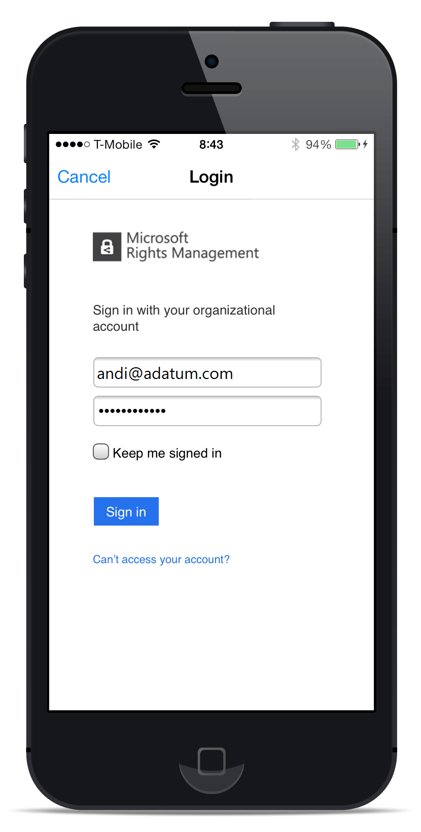
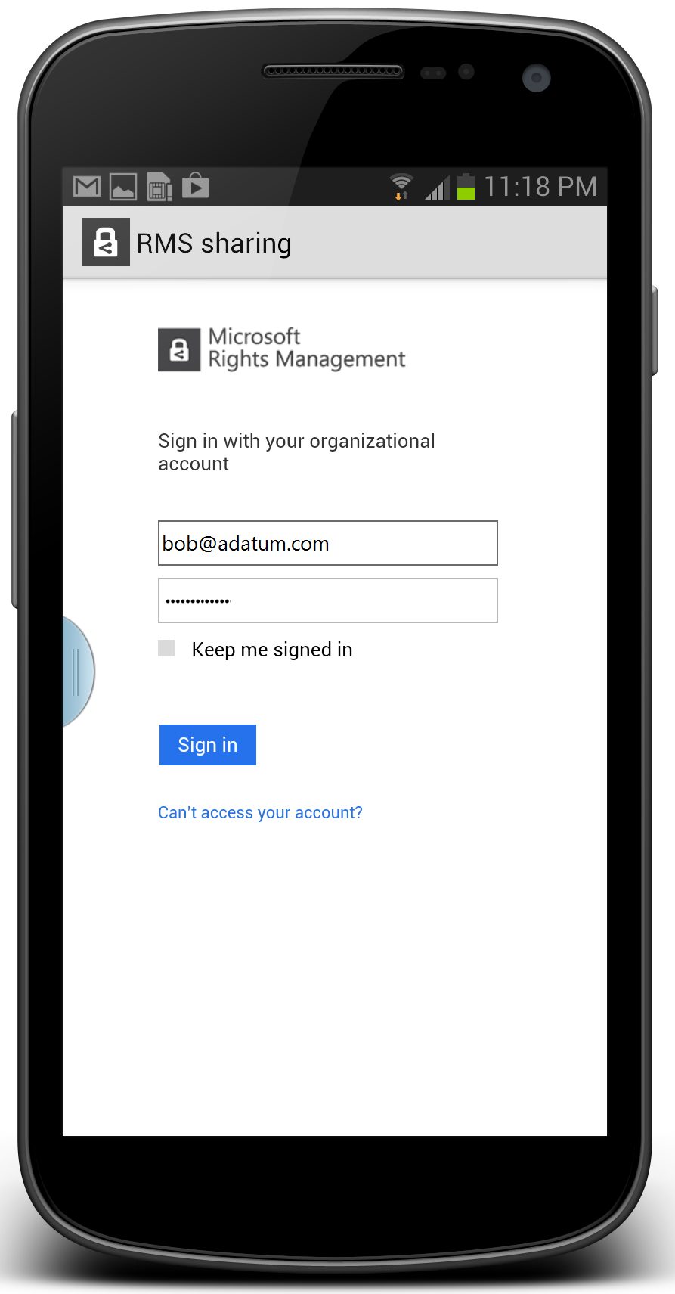
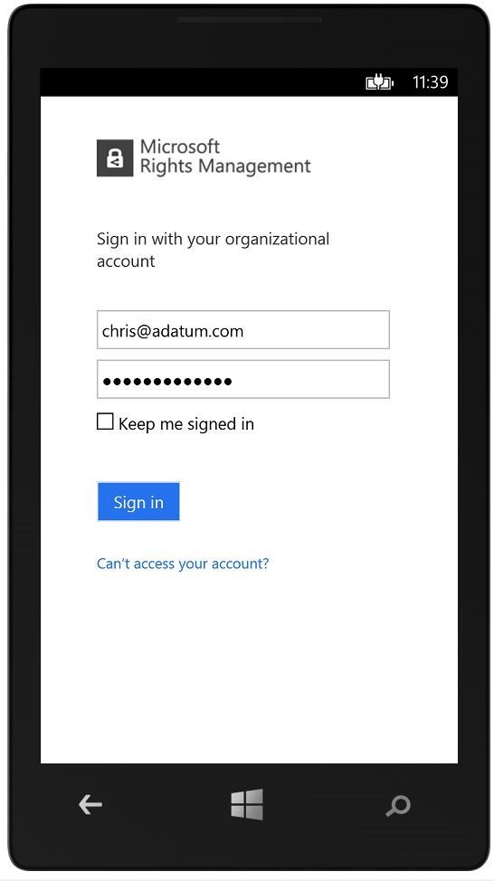

Slide 31
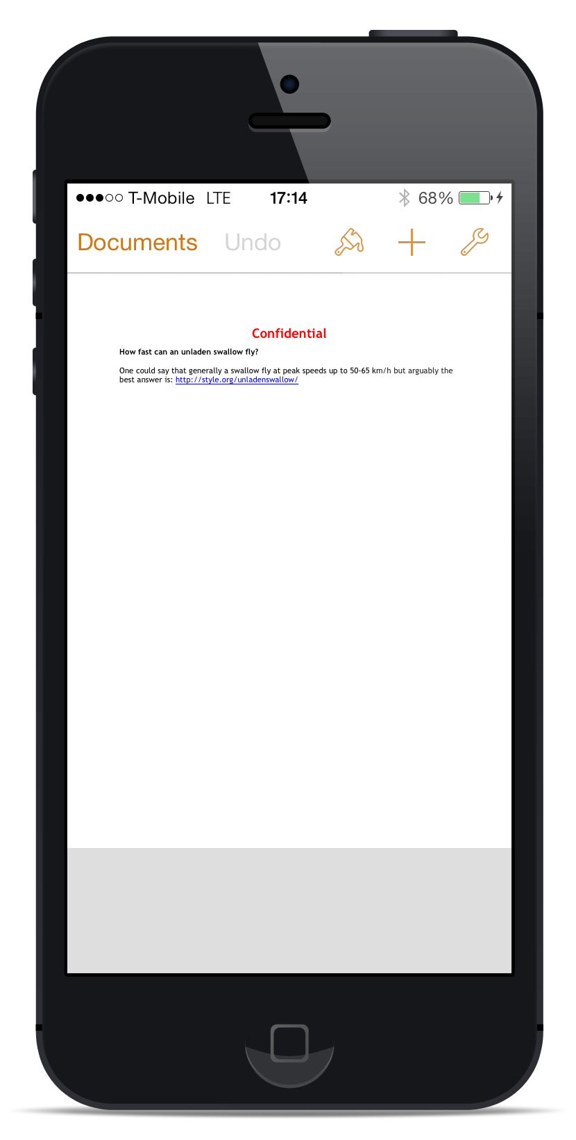
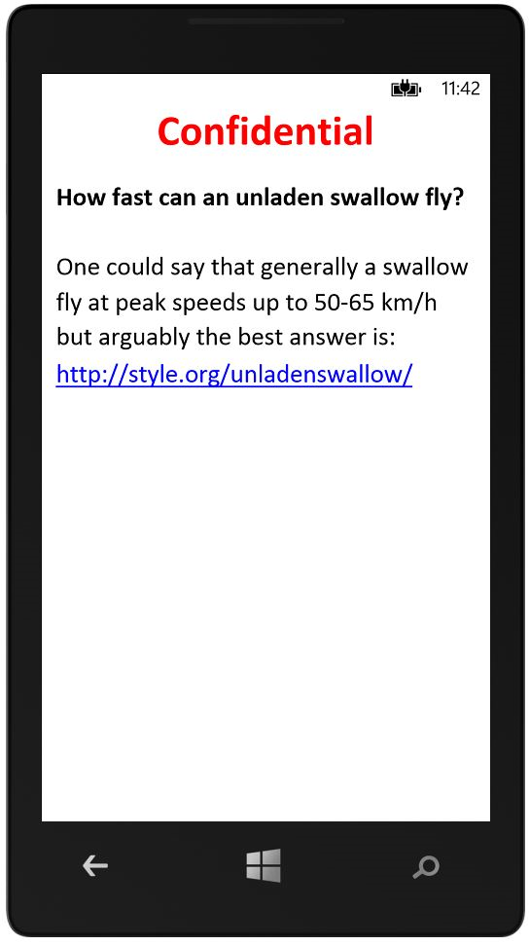
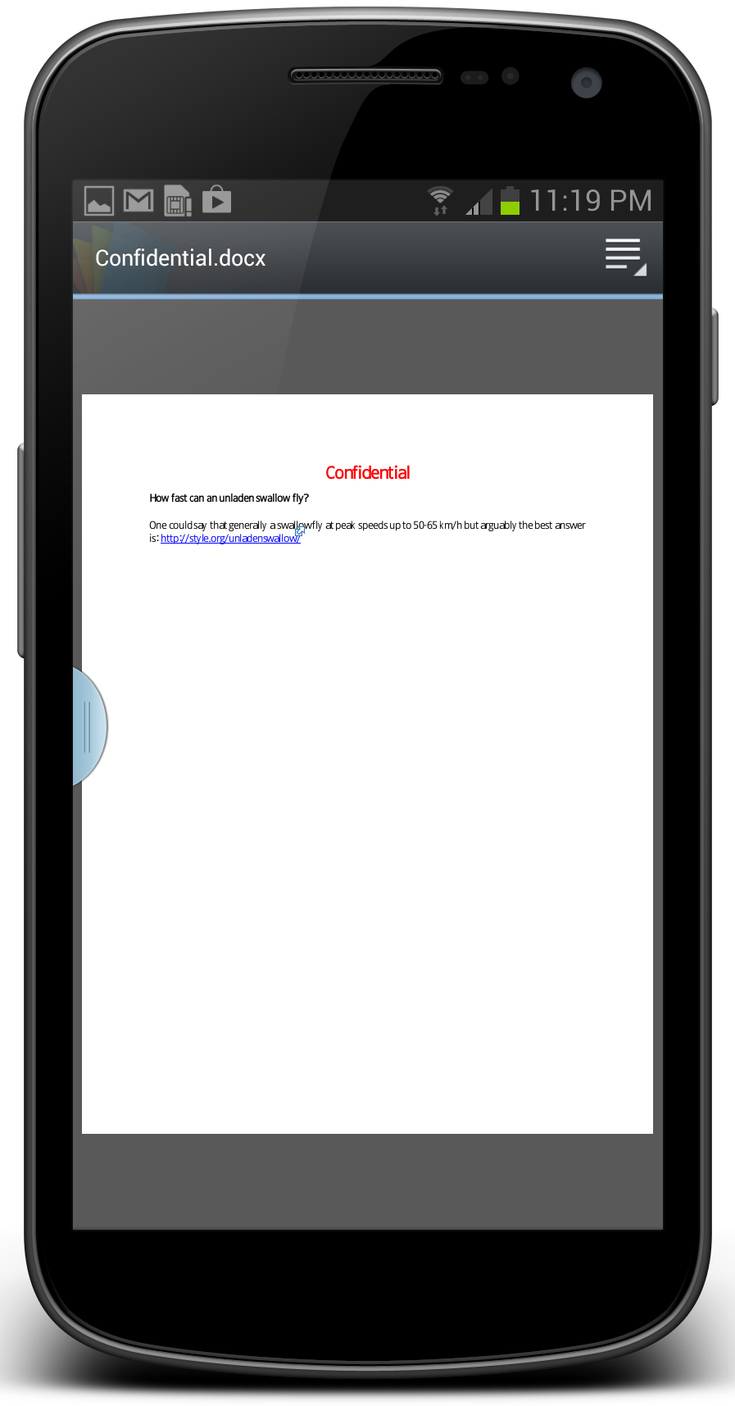
Generically protected files are viewed in each of the device’s native applications

Slide 32
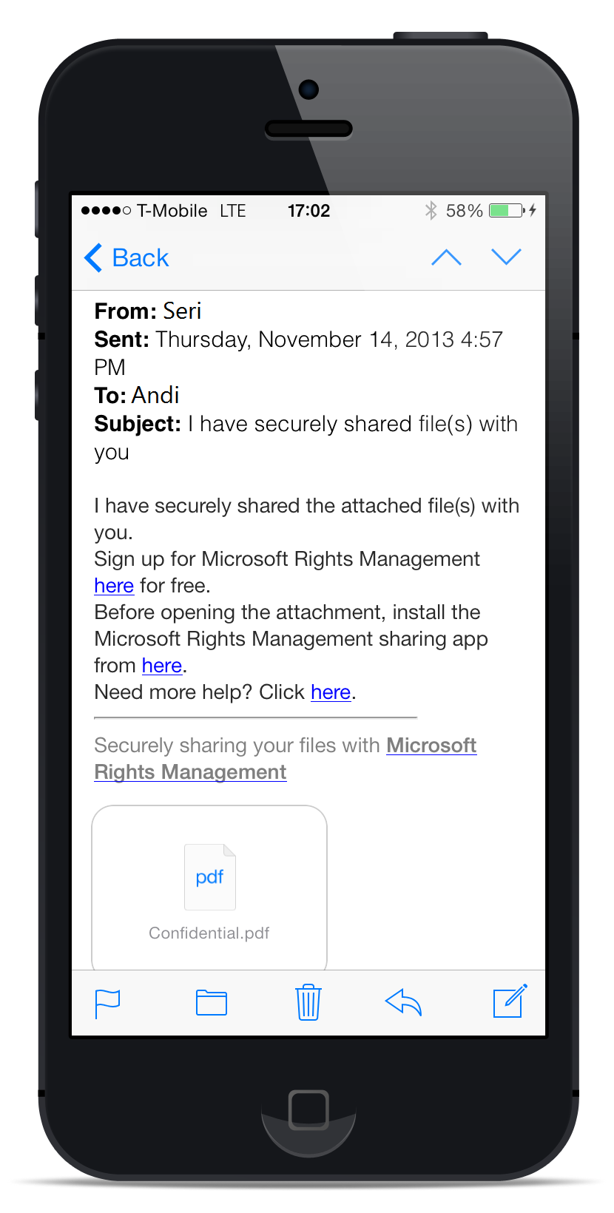
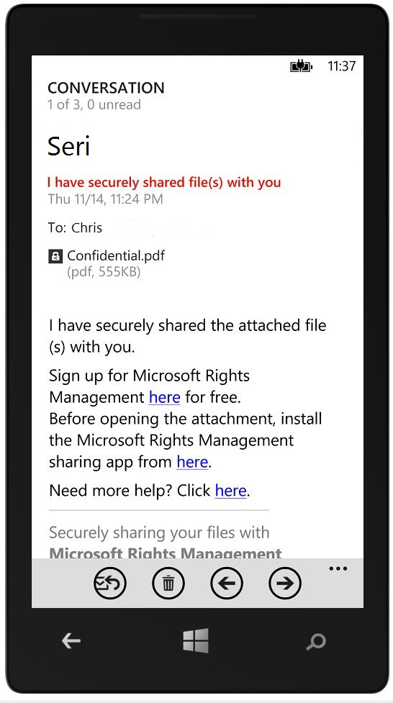
Enlightened applications can enforce use permissions (rights)

Slide 33
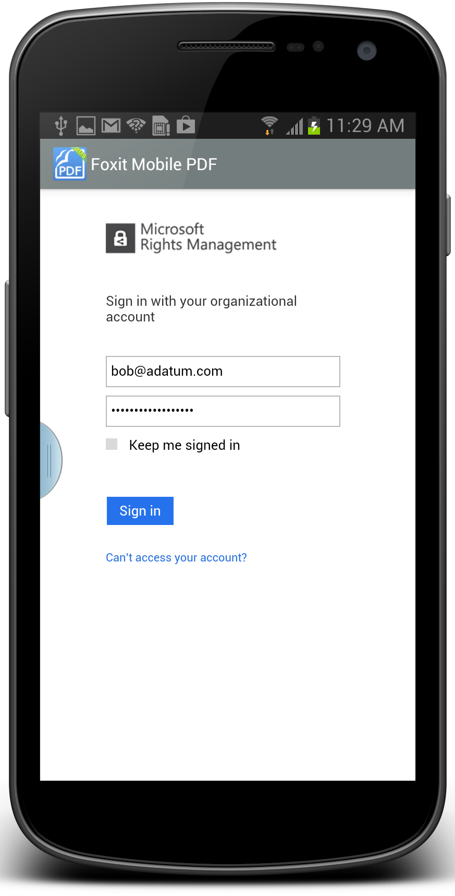

Slide 34
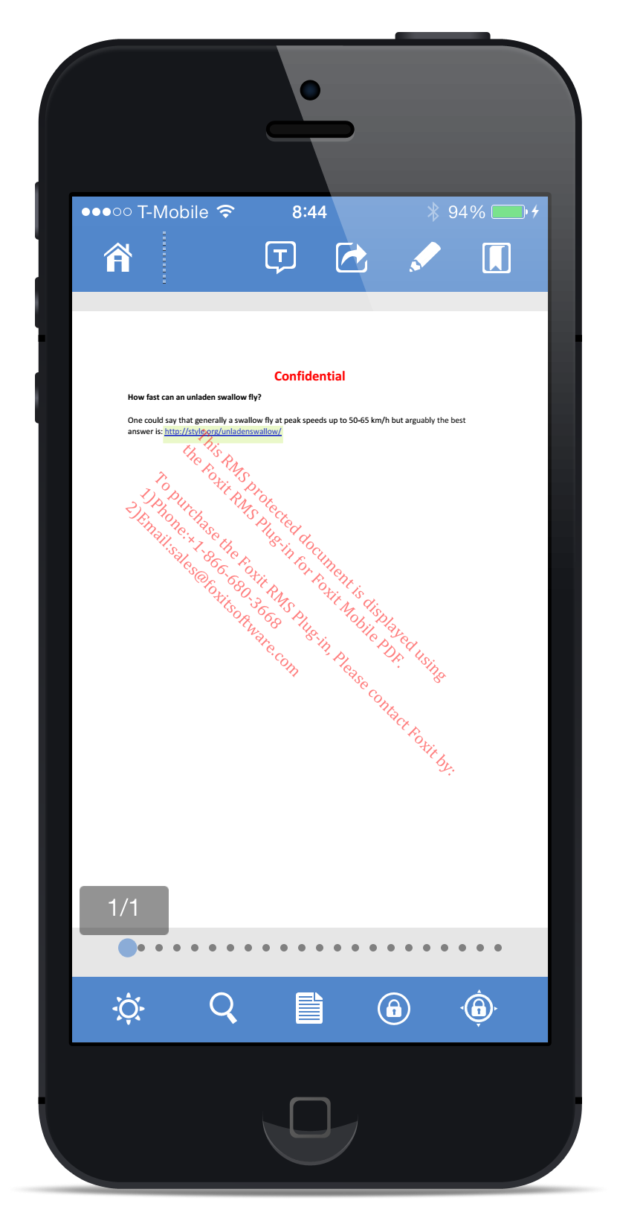
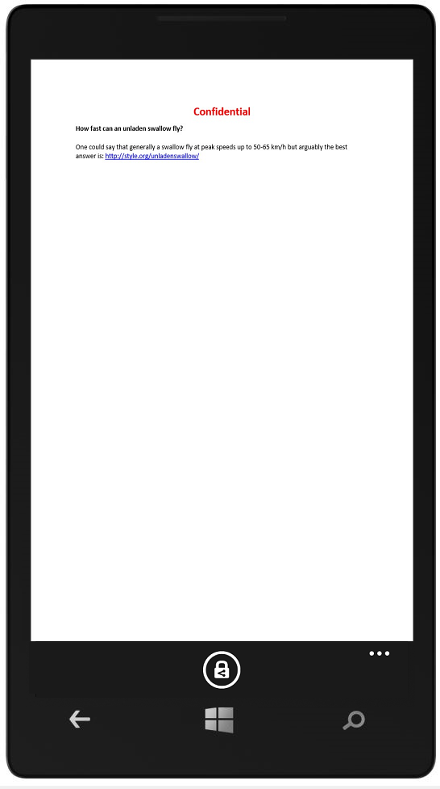
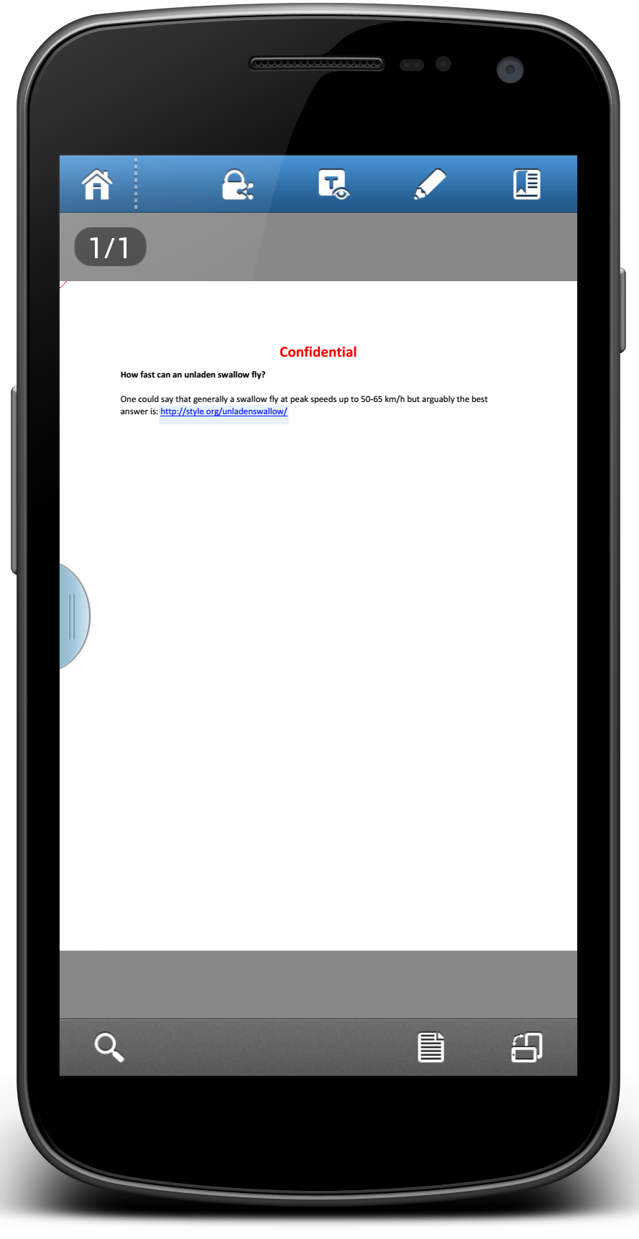

Slide 35


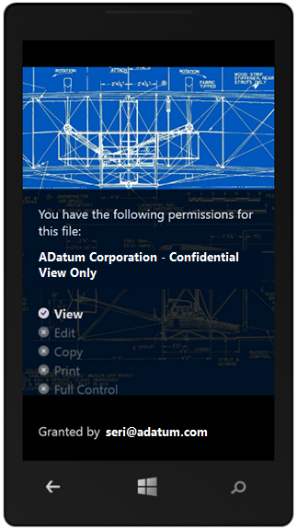
Consume on any device

Slide 36
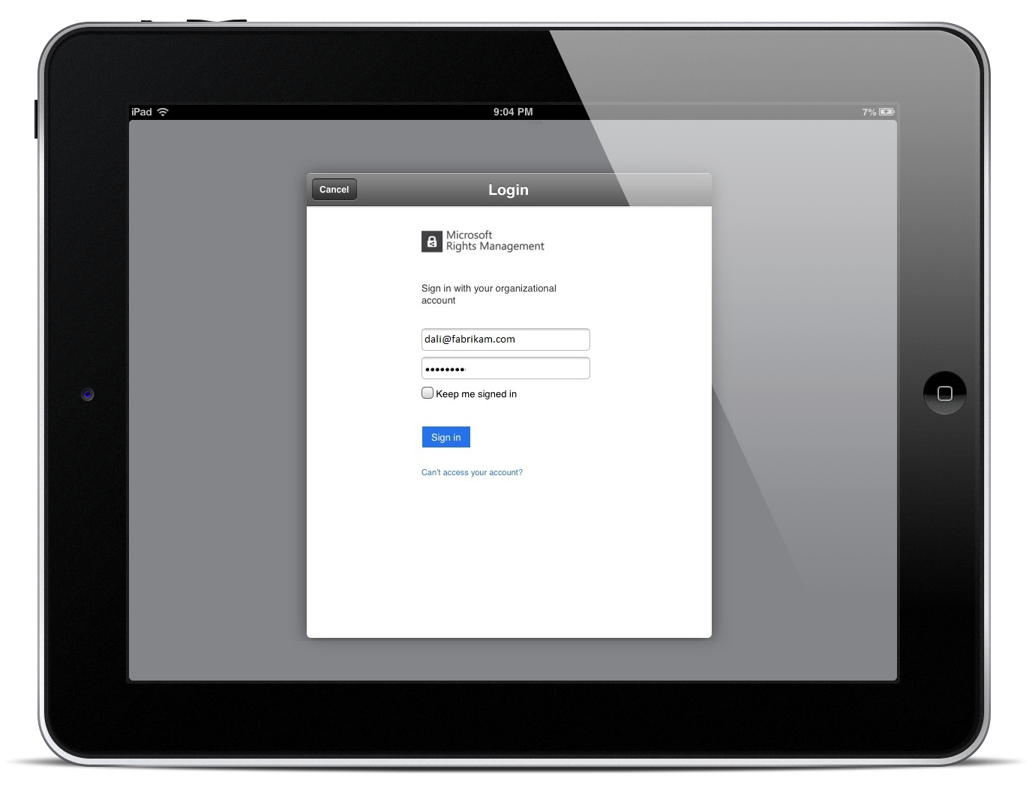

In the steady state, the flow is personalized to the organization

Slide 37
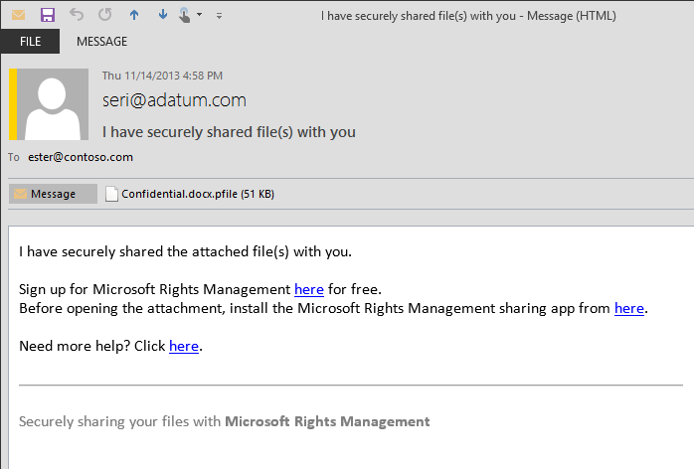
Some users do not – yet – have an account; we offer viral signup

Slide 38
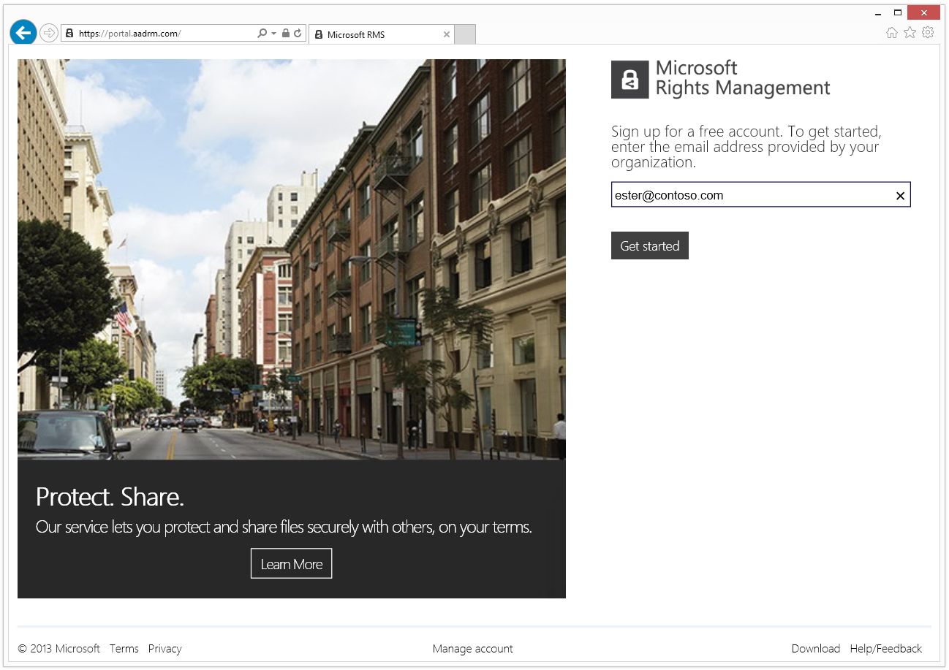

Slide 39
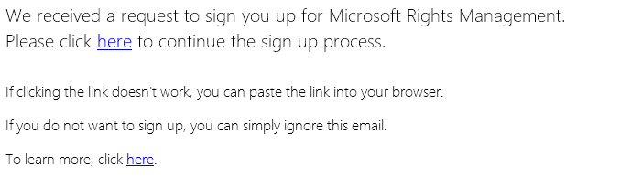
Microsoft Rights Management Sign Up – Message (HTML)
MicrosoftRMSTeam@microsoft.com
Microsoft Rights Management Sign Up

Slide 40
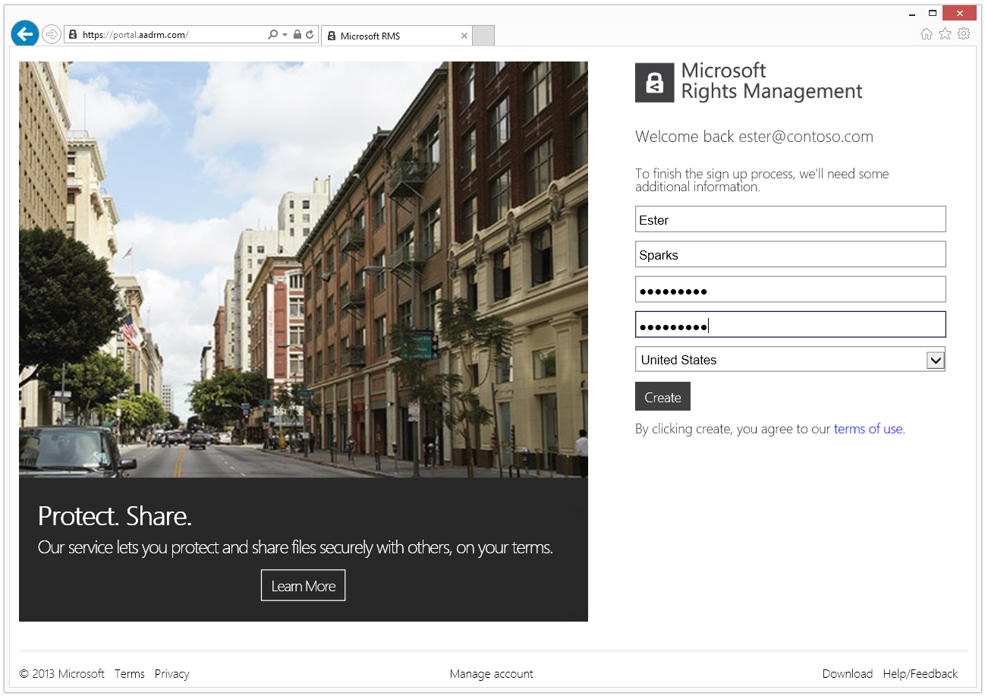

Slide 41
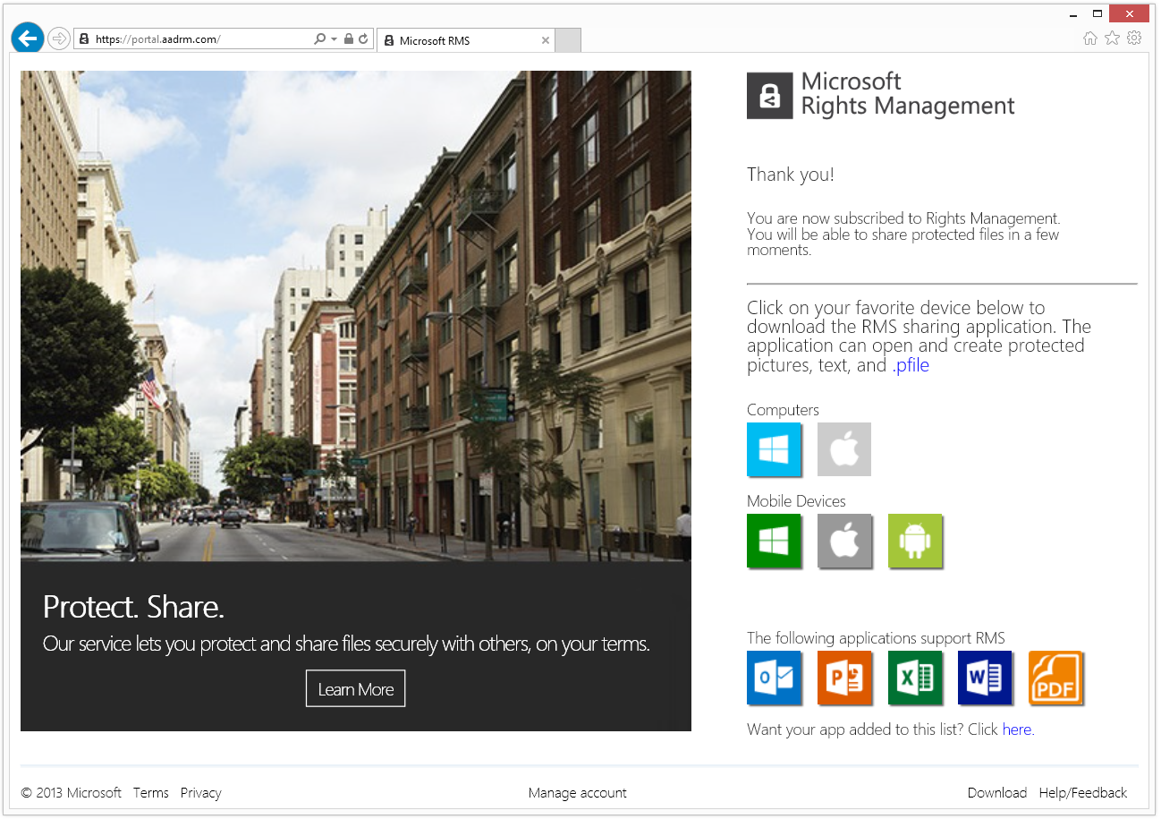

Slide 43


IT Control- First user, company created
Azure AD
contoso.com
Domain Verification: Email Verified
Subscription: RMS for Individuals
Administrative access: Off
Federation: Off
1
ESTER@contoso.com
Subscription: RMS for Individuals

Slide 44
IT Control- Admin Takeover
Azure AD
contoso.com
Domain Verification: DNS Verified
Subscription: RMS for Individuals
Administrative access: Yes
Federation: No
1
ESTER@contoso.com
Subscription: RMS for Individuals
Admin@contoso.com
Manage users
Manage policies
Manage subscriptions

Slide 45
IT Control- Admin Takeover
Azure AD
contoso.com
Domain Verification: DNS Verified
Subscription: RMS for Individuals
Administrative access: Yes
Federation: Yes (or password sync)
1
ESTER@contoso.com
Subscription: RMS for Individuals
Admin@contoso.com
Manage users
Manage policies
Manage subscriptions

Slide 46
IT Control- Subsequent Users
Azure AD
contoso.com
Domain Verification: DNS Verified
Subscription: RMS for Individuals
Administrative access: Yes
Federation: Yes (or password sync)
1
Admin@contoso.com
Manage users
Manage policies
Manage subscriptions
ESTER@contoso.com
Federated login
RMS for Individuals

Slide 47
IT Control- Subsequent Users
Azure AD
contoso.com
Domain Verification: DNS Verified
Subscription: RMS for Individuals
Administrative access: Yes
Federation: Yes (or password sync)
2
1
ED@contoso.com
Federated Login
RMS for Individuals
Admin@contoso.com
Manage users
Manage policies
Manage subscriptions
ESTER@contoso.com
Federated login
RMS for Individuals

Slide 48
IT Control- Upgrade to Azure RMS
Azure AD
contoso.com
Domain Verification: DNS Verified
Subscription: Azure RMS (Paid) Administrative access: Yes
Federation: Yes (or password sync)
2
1
Ed@contoso.com
Federated Login
Office CAL (Paid)
Azure RMS (Paid)
Admin@contoso.com
Manage users
Manage policies
Manage subscriptions
ESTER@contoso.com
Federated Login
Azure RMS (Paid)
Office 365 E1 (Paid)

Slide 49

User with a federated account… without knowing it

Slide 50


Slide 51
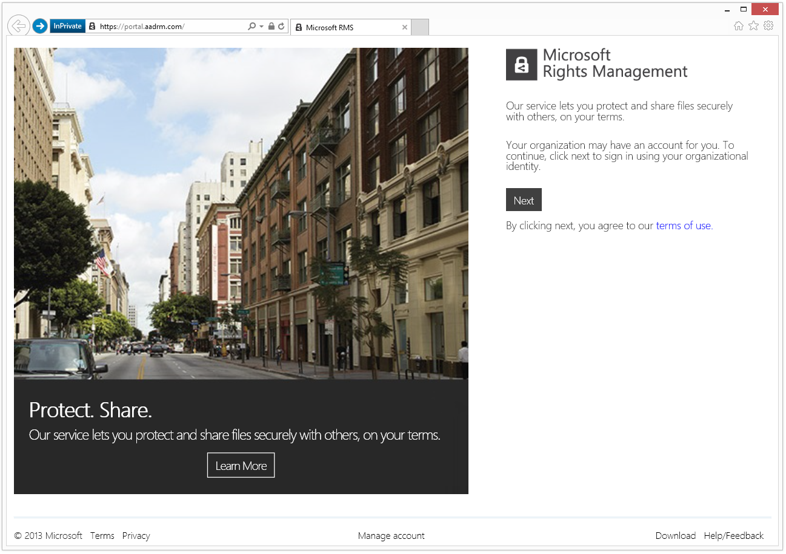

Slide 52
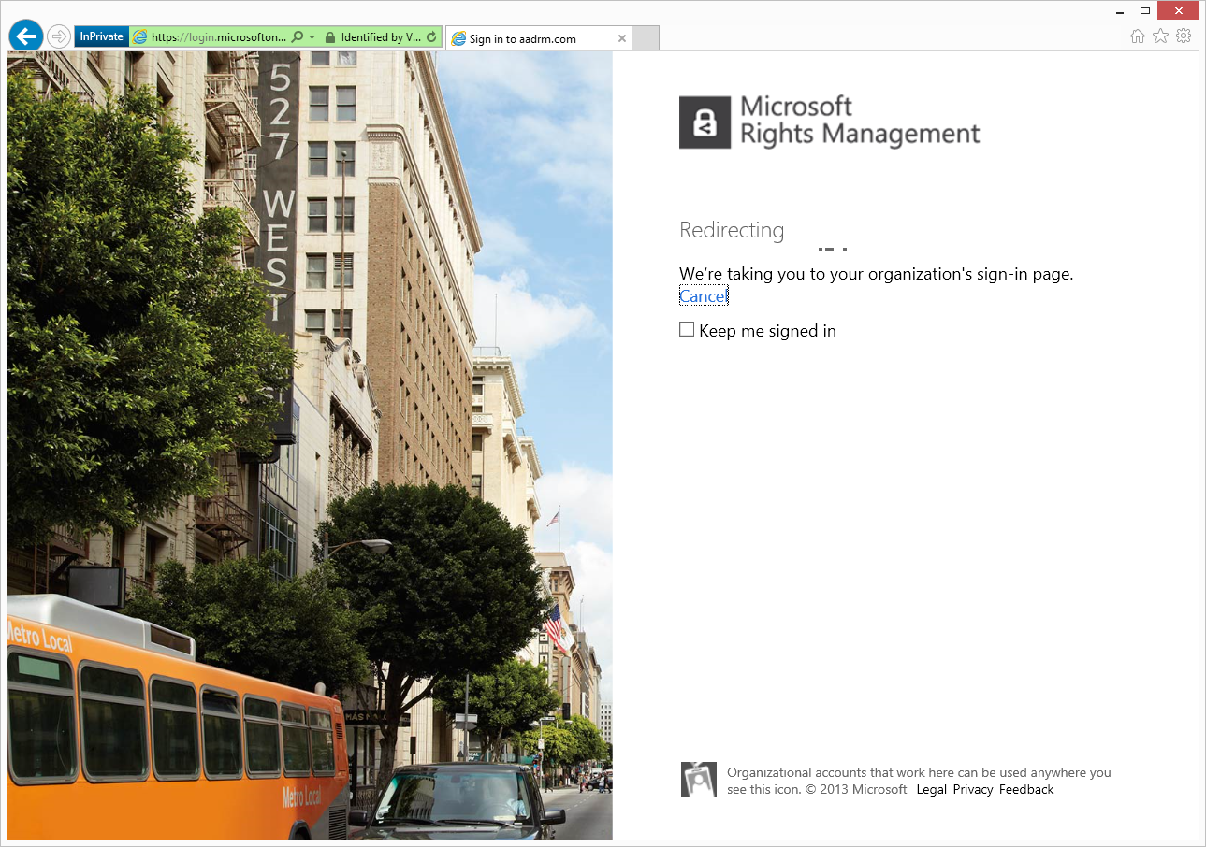

Slide 53



Sign in with your Contoso account
Need help? Contact Contoso Help Desk at (206) 555-1234. This site for the exclusive use of Contoso employees and partners. Visit www.contoso.com/terms for details.

Slide 54
“The Crown Jewels”
SAP is a widely-deployed ERP system that hosts critical data. All customers have rigorous SAP access policies. However, once a report is generated, all bets are off.
They have lost control of: who, what, where, when.
“RMS for SAP” is an easy sell that works well with upper management… which helps with other scenarios.

Slide 55
SAP hosts critically important data
Core use pattern
  With Secude’s HaloCore product installed, a few users generate reports/feeds to share with others
  Those reports (Excel, TXT, XML, etc) are now RMS protected as native Excel, or PFILE (out.XML.PFILE)
Configuration
  AD RMS or Azure RMS + Secude’s HaloCore product + compatible Office applications
  The IT staff responsible for SAP farms define the export behaviors (Rules + protection: Native/PFILE)
  As SAP reports are generated, HaloCore implements the intelligent (rules based) policies.
Assessment
  This is the quickest way to get RMS approved by management – it’s the most isolated offer / fewest stake holders
  Once RMS is then chase Office scenarios, Exchange 2013 integration, SharePoint Secure Libraries, FCI.
  Secude: US: Michael.Kummer@secude.com EU: Holger.Hinzmann@secude.com, India: Kannan.Vijay@secude.com

Slide 56
“I know so little”
What: Email and documents are being overshared today. Organizations have no idea of just how bad it is, both internally and externally. They want to know even if the data continues to be shared/ They just want to know.
Who: Concerned CxOs and data owners would like data intelligence.

Slide 57
Logging for Insight
Core use pattern
  Use of RMS with: Office, Exchange / EXO**, SharePoint / SPO, FS + FCI, Secude, and other offerings
  IT wants to learn the data flow; less pressure is applied with restrictive templates.
  e.g.: Use of “All Users – All Rights” encourages continued sharing within the company.
Configuration
  [ Same as many previous configurations ]
  ADRMS logs to SQL. Azure RMS logs to org-owned Azure storage.
  Customized reports using the new breed of reporting tools: Power BI, Splunk, Tableau, etc.
Assessment
  New BI tooling enables never seen before usage activity: permitted, undesired, and attempted (failures)
  Pain point: The current generation of logs lacks some key fields. We’re on it!

Slide 58
“My future Snowden?”
Recent news has large organizations very concerned that they too may suffer a Snowden-like event. Narrowing data access + persistent data protection are seen as the natural answer. ACLs are insufficient.
The ITPro / CxO, is now willing to listen.

Slide 59
Protected docs even Admins can’t see
Core use pattern
  This is the PGP/SMIME play – users are involved; use common tools: Office, and now RMS App.
  Data is protected before being stored/send: SharePoint, File servers, local PC MyDocuments, SkyDrive Pro, SkyDrive, DropBox, etc.
  IT can still perform GRC, eDiscovery, DLP, classification, journaling, Archival (unprotected), etc.
Configuration
  RMS + Office/RMS App lets a user protect files on their own: In-place / Sent-To / Save-As
  Organizations can use SharePoint or SharePoint Online as “Sharing Folders”.
  Consumer grade email or Cloud Drives can be used as a transport too.
Assessment
  Usage is more awkward than the integral SP/FCI but protection is higher. The user must really want this.
  RMS is far better than PGP because the Organization (uber-trusted IT only) can still perform eDiscovery, GRC, etc. on this protected data. PGP (and SMIME) puts many organizations out of compliance. RMS also provides group-based protection, tracking, expiration, SSO and more.

Slide 60
Cooking with RMS
Recap:
Doc Repositories with SP/SPO
Doc Protection with FS+FCI
Email protection (within org)
Secure sharing: O365, RMS app, free RMS
Biz Intelligence Reporting over logs
User-initiated critical assert protection
SAP report protection
Protect against the rogue admin

Slide 61
Buying RMS
AD RMS available alone or in ECAL
  Current licensing terms required payment for publishing AND consume-only users
Azure RMS available Stand Alone, with Office 365 or with EMS
  Pay only for authors (direct or indirect authors, e.g. DLP, FCI, SP)
  Azure RMS free with Office 365 E3/E4
  New advanced features may require stand-alone RMS or EMS
  Azure RMS for Individuals is free (but you don’t have any management capabilities)
Azure SKU includes ADRMS so always buy Azure
  When factoring in the only-pay-for-publishers term, this is the better deal and keeps options open.

Slide 62
In review: Session Objectives And Takeaways
Session Objective(s):
  Quick recap of RMS + How it has evolved + the problems it solves (or does not solve).
  You are capable of selling and deploying a set of key RMS ‘recipes’ now.
Key Takeaway 1: RMS is a fantastic ‘data protection pattern’
Key Takeaway 2: while you can’t do *everything* with RMS today, some scenarios are very effective and easy to achieve

Slide 63
Related Content
Breakout Sessions/Chalk Talks
  PCIT-B316 - View into the Next On-Premises RMS
  PCIT-B332 - Securely Collaborating with Anyone, Everywhere, with the New RMS
Instructor-Led Labs
  PCIT-IL302 - Enabling Hybrid Information Protection with the RMS connector
RMS web sites
  Official web site: www.microsoft.com/rms
  Official blog for IT Pros: blogs.technet.com/rms
  Official blog for developers: blogs.msdn.com/rms

Slide 64

Resources
Learning
  Sessions on Demand
  Microsoft Certification & Training Resources
http://channel9.msdn.com/Events/TechEd
www.microsoft.com/learning
TechNet
msdn
  Resources for IT Professionals
  Resources for Developers
http://microsoft.com/technet
http://microsoft.com/msdn

Slide 65



Complete an evaluation and enter to win!

Slide 66


Evaluate this session
Scan this
QR code
to evaluate
this session.

Slide 67


© 2014 Microsoft Corporation. All rights reserved. Microsoft, Windows, and other product names are or may be registered trademarks and/or trademarks in the U.S. and/or other countries.
The information herein is for informational purposes only and represents the current view of Microsoft Corporation as of the date of this presentation. Because Microsoft must respond to changing market conditions, it should not be interpreted to be a commitment on the part of Microsoft, and Microsoft cannot guarantee the accuracy of any information provided after the date of this presentation. MICROSOFT MAKES NO WARRANTIES, EXPRESS, IMPLIED OR STATUTORY, AS TO THE INFORMATION IN THIS PRESENTATION.

