Slide 1
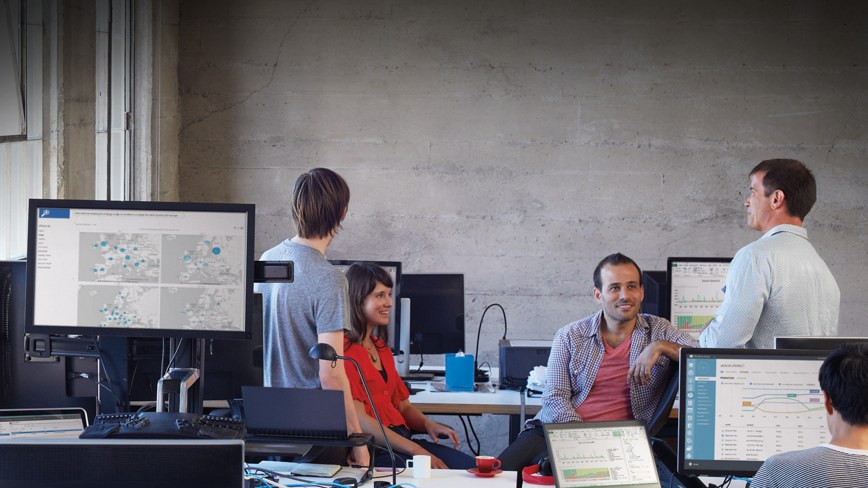

Slide 2

Deploying Remote Desktop Services in Microsoft Azure, Hosted, and Private Clouds
PCIT-B338
Senthil Baladhandayutham - Dell
Clark Nicholson - Microsoft

Slide 3
Session Outline
Cloud Computing
  What do we mean by cloud computing?
RDS Overview
  What are Remote Desktop Services?
RDS in Cloud Computing Environments
  What architectural and deployment guidance does Microsoft provide?
On-Premises Deployment
Does Dell have a hardware implementation for RDS in hosted and private clouds?
RDS Scale Guidance
  How does RDS scale in a cloud computing environment?
Licensing
  How is RDS licensed in cloud computing environments?

Slide 4
Cloud Computing

Slide 5
“ All problems in Computer Science can be solved by another layer of indirection.”
David Wheeler (1927-2004)
Computer Scientist
Cambridge University

Slide 6
Cloud Computing: Grand Abstraction Layer
Datacenter Abstracted
  Microsoft solutions abstract compute, storage, and network resources
Benefits
  Flexibility/elasticity to optimization of hardware resources w/o impacting services
  Reduces cost by sharing fabric resources across multiple tenants and increasing utilization
  Simplifies movement of services from one cloud to another
Critical Design Considerations
  Security
  Performance
  Scalability
  Flexibility
  Reliability

Slide 7
Microsoft’s Cloud Computing Solutions
Microsoft Azure
  Abstracts the Azure datacenters
  Infrastructure and Platform Services
  Azure Management Portal GUI and PowerShell APIs
Microsoft Cloud OS
  Abstracts your datacenters
  Windows Server and System Center 2012 R2
    Hyper-V (machine virtualization)
    Software Defined Networking (network virtualization)
    Scale-Out File Server (storage virtualization)
  VMM console & Windows Azure Pack GUIs & PowerShell APIs

Slide 8
RDS Overview

Slide 9

Remote Desktop Services Components
Session Host (RDSH)
  User’s desktop and applications execute on the RDSH servers
Connection Broker (RDCB)
  Distributes connections to RDSH servers
Web Access (RDWeb)
  Provides user logon and selection
  of desktops and applications
Gateway (RDGW)
  Routes RDP traffic between the
  Internet and a tenant’s network
License Server (RDLic)
Tracks usage of the system
Web Access
Connection Broker
Session Host
database
Gateway
Licensing Server

Slide 10
Windows Server 2012 R2 RDS: Optimized for Cloud
Quick Connect
  Significant reduction in connect/re-connect time
Improved RemoteApp Behavior
  RemoteApp programs integrate seamlessly with Windows desktop
  (frame, thumbnails, transparent windows)
RemoteFX Media Streaming & Codec Improvements
  Up to 50% reduction in bandwidth
Dynamically Resize Monitors
  Automatic resizing of the session window: monitor added, removed, or rotated.

Slide 11

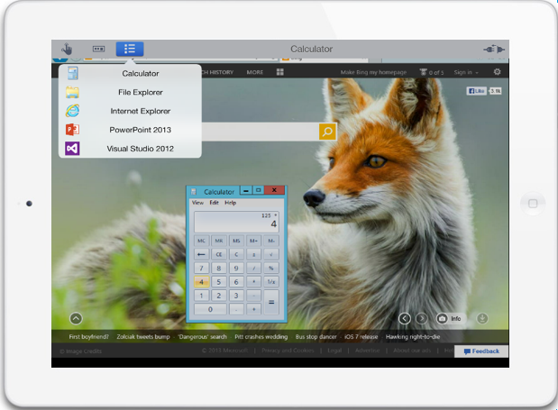
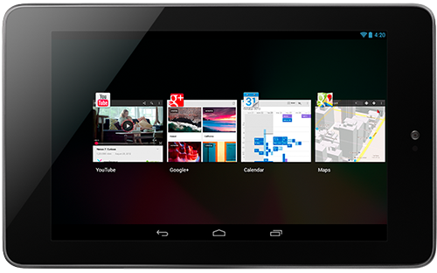
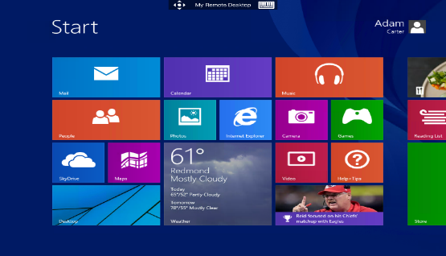
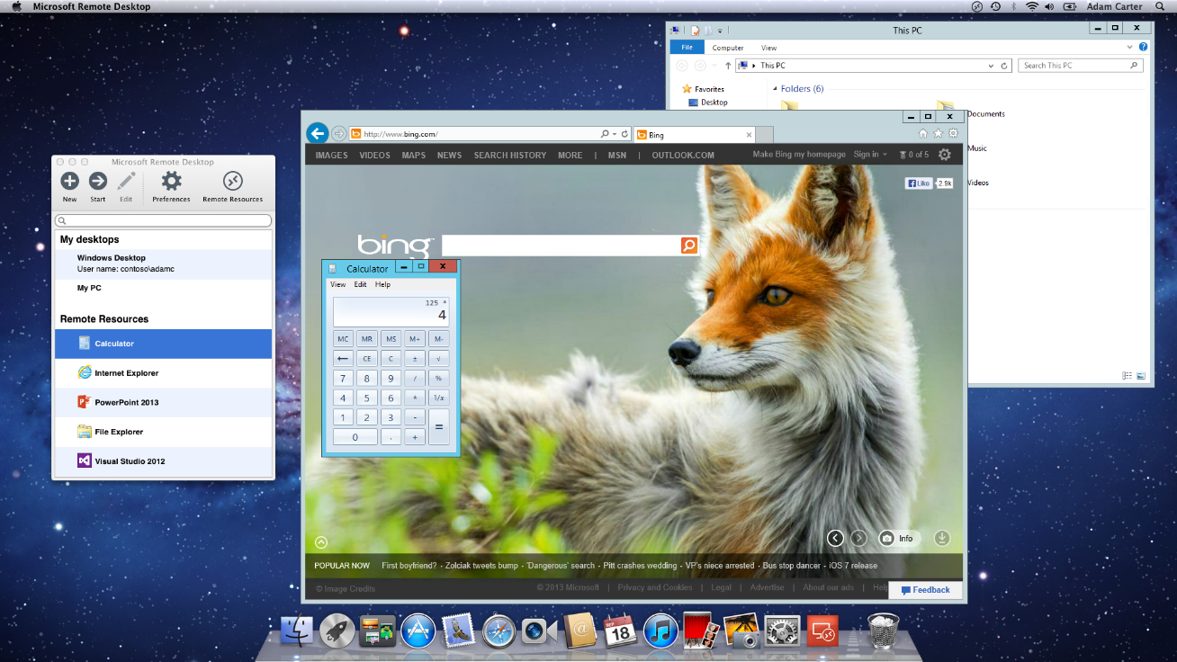
Microsoft Remote Desktop App
Multiple device platforms:
  Windows
  Windows RT
  Windows Phone 8.1
  iOS
  Mac OS X
  Android
Provides access to:
  Session-based desktops
  RemoteApp programs
Great Windows experience
Productivity with secure data

Slide 12
RDS In Cloud Computing Environments

Slide 13
Desktop Hosting Key Design Goals
Secure
  Strong tenant-to-tenant and tenant-to-provider isolation
Performance
Quick connect/reconnect, responsive user experience
Scalable
  Wide range of tenant sizes (e.g. 15 to 5000 users)
Flexible
  Desktops & RemoteApps, variety of offerings (e.g. admin access)
Reliable
  Resilient to failures and servicing events

Slide 14
Reference Architecture Concepts
Basic RDS Deployment
  Azure Infrastructure Services
  Hybrid deployment
  On-premises
Extended RDS Deployment
  RemoteApp collections
  High availability

Slide 15
Basic RDS Deployment: Azure Cloud

Slide 16
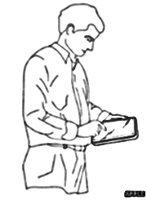
Mobile Worker Access: Azure Cloud
User Access
via Internet

Slide 17
Basic RDS Deployment: Azure Hybrid Cloud

Slide 18
Basic RDS Deployment: On-Premises Cloud

Slide 19
Basic RDS Deployment: Azure Cloud

Slide 20
Basic RDS Deployment: On-Premises Cloud
User Access
via Internet

Slide 21
Tenant Basic Deployment Steps
Create tenant’s networking environment
Create tenant’s VMs
Deploy AD, DNS, and file share
Run RDS deployment wizard
Add RD Licensing, RD Gateway, session desktop collection
Secure the deployment
Color key: Azure Mgt Portal, VMM Console Server Manager

Slide 22
Extending Basic Deployment
Create custom RDSH image
Add a RemoteApp collection
High availability and scale out:
  Add RD Session Host servers to each collection
  Add RDWeb and Gateway servers to create a farm
  Create RD Connection Broker cluster using SQL Server
  Add a second RD License server
  Add replica domain controller
  File Server guest cluster

Slide 23
Basic RDS Deployment: Azure Cloud

Slide 24
Extended RDS Deployment: Azure Cloud

Slide 25
Basic RDS Deployment: On-Premises Cloud

Slide 26
Extended RDS Deployment: On-Premises Cloud

Slide 27
Demo: RDS in Azure Cloud
Clark Nicholson

Slide 28
On-Premises Deployment
Senthil Baladhandayutham

Slide 29
On-Premises Cloud
Hosted Cloud
On-Premises Cloud
Private Cloud

Slide 30
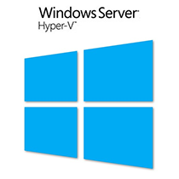
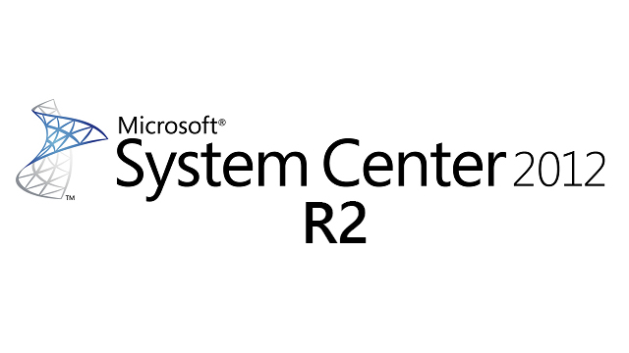
Building the On-Premises Cloud
On-Premises Cloud
Cloud OS
Hardware Fabric

Slide 31

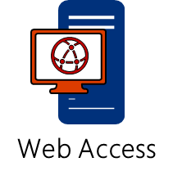

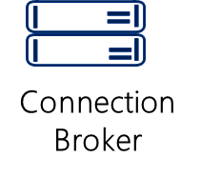
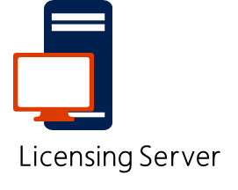
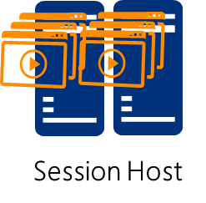

Steps to Create the On-Premises Fabric
Prepare Tenant Networking Environment
Prepare the RDS Tenants
Create tenant environment with isolated tenant VM networks
Prepare the Management Environment
Prepare the Management Environment with SystemCenter & Active Directory
Prepare the Perimeter Environment
Prepare the Perimeter Environment with NVGRE gateway
Prepare Hardware Infrastructure
Connect Server, Storage and Network for On-Premises buildup
Prepare the Multi-Tenant Storage Fabric
Prepare the Storage Fabric with JBODS and SOFS Clusters

Slide 32

Building the Multi-Tenant Storage Fabric
Scale out File Server
Dell R720
\\sofs\mgmt
\\sofs\tenant
Storage
Pool
Management Volume
Tenant Volumes
SAS 6Gbps
MD1220 JBOD
Tenant Disks
Management Disks

Slide 33
Multi-Tenant Storage Configurations
Multiple tenants on single volume
Multiple tenants on multiple volume
Physical disk tenancy
\
Dell R720
\
\
Dell R720
\\sofs\ten1
\\sofs\ten3
Dell R720
\\sofs\ten1
\\sofs\ten2
\\sofs\ten3
\\sofs\ten1
\\sofs\ten2
\\sofs\ten3
\\sofs\ten2
Storage
Pool
Tenant Volume
Storage
Pool
Tenant1 Volume
Tenant2 Volume
Tenant3 Volume
Storage
Pool-SSD
Ten1 Volume
Storage Pool-15K
Ten2 Volume
Storage Pool-10K
Ten3 Volume
SAS 6Gbps
SAS 6Gbps
SAS 6Gbps
MD1220 JBOD
MD1220 JBOD
MD1220 JBOD
Ideal for hosting large groups of smaller tenants
Ideal for hosting tenants with varied storage needs
Ideal for hosting tenants with varied performance and security SLA’s

Slide 34
Basic On-Premises Deployment
Steps we took in building the Basic On-Premises Deployment on our demonstration system
  Building the Host Group Fabric
  Building the Tenant Virtual Network Environment
  Build the RDS Tenants
Demo of key technologies on the demonstration system

Slide 35
Building the Host Group Fabric
Management
Perimeter
Tenants
Active Directory
SCVMM 2012R2
SQL
Windows Server Gateway (HNVGW)
2 x CPU
2 x CPU
2 x CPU
1 x
R720
32 GB RAM
1 x
Hyper-V
16 GB RAM
N x
Hyper-V
Hyper-V
R720
R720
128 GB RAM
2 x 15K HD
2 x 15K HD
2 x 15K HD
Management Logical Network -192.168.1.x
External Logical Network -144.168.3.x
Storage Logical Network -192.168.2.x
NVGRE Logical Network-192.168.3.x

Slide 36
Complete On-Premises Cloud Fabric
Perimeter
Tenant
Management
Active Directory
SCVMM 2012R2
SQL
Windows Server Gateway (HNVGW)
2 x CPU
2 x CPU
2 x CPU
1 x
Hyper-V
16 GB RAM
N x
Hyper-V
1 x
R720
32 GB RAM
R720
R720
128 GB RAM
Hyper-V
2 x 15K HD
2 x 15K HD
2 x 15K HD
Management Logical Network -192.168.1.x
External Logical Network -144.168.3.x
Storage Logical Network-192.168.2.x
NVGRE Logical Network-192.168.3.x
Dell R720 SOFS
MD1220 JBOD
2xCPU
Tenant Disks
2 x
R720
32GB RAM
SAS 6Gbps
Management Disks
2 x 15K HD

Slide 37
Build Tenant Network and RDS Tenants
AD
CB/LS
RDSH
RDGW/WA
Tenant
10.10.10.x Virtual Network
Management
Perimeter
Windows Server Gateway (HNVGW)
Active Directory
SCVMM 2012R2
SQL
2 x CPU
2 x CPU
2 x CPU
N x
1 x
Hyper-V
R720
16 GB RAM
Hyper-V
R720
128 GB RAM
1 x
Hyper-V
R720
32 GB RAM
2 x 15K HD
2 x 15K HD
2 x 15K HD
Management Logical Network -192.168.1.x
External Logical Network -144.168.3.x
Storage Logical Network -192.168.2.x
NVGRE Logical Network-192.168.3.x
Dell R720 SOFS
MD1220 JBOD
Tenant Disks
R720
2xCPU
2 x
32GB RAM
SAS 6Gbps
Management Disks
2 x 15K HD

Slide 38
Summary : Steps to Create the On-Premises Fabric
Prepare Tenant Networking Environment
Prepare the RDS Tenants
Create tenant environment with isolated tenant VM networks
Prepare the Management Environment
Prepare the Management Environment with SystemCenter & Active Directory
Prepare the Perimeter Environment
Prepare the Perimeter Environment with NVGRE gateway
Prepare Hardware Infrastructure
Connect Server, Storage and Network for On-Premises buildup
Prepare the Multi-Tenant Storage Fabric
Prepare the Storage Fabric with JBODS and SOFS Clusters

Slide 39
Demo: RDS On-Premises Cloud Management
Senthil Baladhandayutham - Dell

Slide 40
RDS Scale Guidance

Slide 41








Workload Configuration
Light
Medium
Heavy
HD
*LoginVsi 4.0 Workload

Slide 42
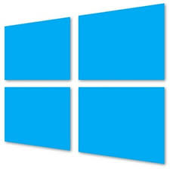
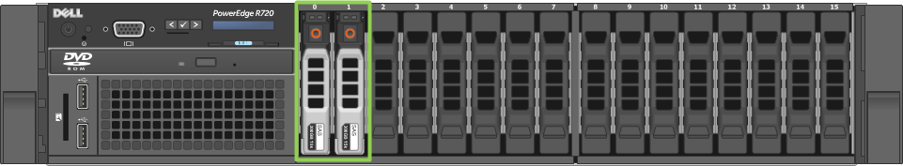
Test Configuration
System Under Test
Light
Medium
Heavy
RDSH1VM
10vCPU
31GB Memory
RDSH2VM
10vCPU
31GB Memory
RDSH3 VM
10vCPU
31GB Memory
RDSH4 VM
10vCPU
31GB Memory
Dell PowerEdge R720
Dual Socket 10C Intel® Xeon® processor E5-2600v2
40 Logical cores, 128 GB Memory

Slide 43
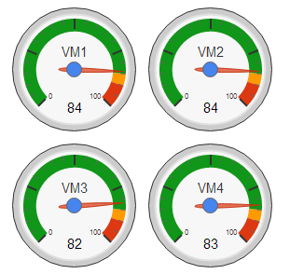
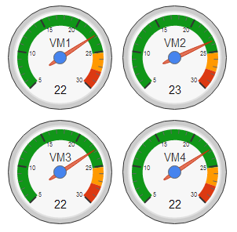
Light User Profile Scaling
Input Configuration
Users login every 30 sec until CPU threshold(85%) or Memory threshold(120GB)
Login: 4:06 PM to 6:50 PM
Steady State: 6:50PM to 7:36PM
Results:
320 Light Users @85% CPU Utilization
8 users/vCPU
270MB/User
Network : 1Mbps/user
Total IOPS: 2 IOPS/user
Steady State
Steady State
Login
Login
RDSH VM: CPU Utilization(%)
RDSH VM: Memory Utilization(GB)

Slide 44
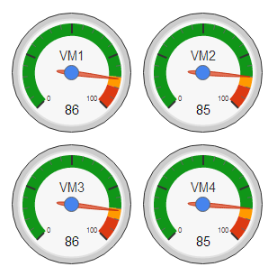
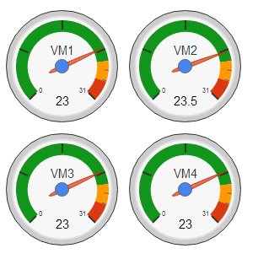
Medium User Profile Scaling
Input Configuration
Users login every 30 sec until CPU threshold(85%) or Memory threshold(120GB)
Login: 4:53 PM to 6:33 PM
Steady State: 6:33PM to 7:32PM
Results:
200 Medium Users @85% CPU Utilization
5 users/vCPU
450 MB/User
Network : 1Mbps/user
Total IOPS: 2 IOPS/user
Steady State
Login
Steady State
Login
RDSH VM: CPU Utilization(%)
RDSH VM: Memory Utilization(GB)

Slide 45
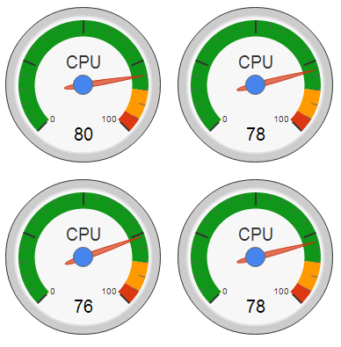
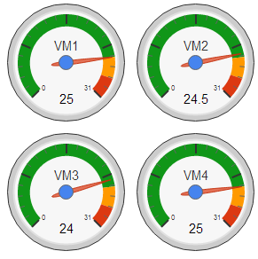
Heavy User Profile Scaling
Input Configuration
Users login every 30 sec until CPU threshold(85%) or Memory threshold(120GB)
Login: 10:35 AM to 11:55 AM
Steady State: 11:55 AM to 1:00PM
Results:
160 Heavy Users @78% CPU Utilization
4 users/vCPU
630 MB/User
Network : 1Mbps/user
Total IOPS: 2 IOPS/user
Steady State
Steady State
Login
Login
RDSH VM: CPU Utilization(%)
RDSH VM: Memory Utilization(GB)

Slide 46
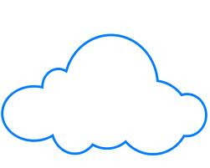
On-Premises Tenant Sizing
Workload Profile | Users/vCPU | Memory/user
Light | 8 | 270 MB
Medium | 5 | 450 MB
Heavy | 4 | 630 MB
Example: Sizing Tenant with 40 Medium Users
On-Premises
vCPUs:
40/5 = 8 vCPU
Memory
450*40 = ~18GB
40 Users requires VM with 8vCPU,18GB Memory

Slide 47
Example: On-Premises to Azure Migration
Workload Profile | On-Premises* Users/vCPU | Azure * Users/vCPU | On-Premises Memory/user | Azure Memory/user
LoginVSI Medium | 5 | 4 | 450 MB | 450MB
*Azure VM uses AMD Opteron CPU’s and On-Premise setup uses Dual Socket Intel Xeon E5-2600 v2 CPU’s
Example: Sizing 30 Medium Users On-Premises & Azure:
On-Premises
Azure
Azure XL VM
6vCPU,14GB Memory
8vCPU,14GB Memory

Slide 48
Licensing

Slide 49

Changes in RDS CAL Licensing in WS2012 R2
20% increase in RDS CAL prices effective Nov 1, 2013
Open NL ERP Price | Old Price | New Price
Device CAL (L) | $85 | $102
User CAL (L) | $98 | $118
User SAL (per month)* | $3.45 | $4.19
VDI Suite w/o MDOP (per month) | $0.93 | $1.07
RDS External Connector (L) | $8484 | $10180
WS 2012 CALs provide entitlement to R2 functionality
RDS User CALs Extended Rights through Software Assurance*
Customers will be able to access the Windows Server GUI running on Windows Azure or on a 3rd party’s shared server, without acquiring a separate RDS SAL. (*effective Jan. 1, 2014) See details here.

Slide 50
Remote Desktop Licensing
 | Enterprise Private Cloud
Type | CAL
Mode | Per user or per device
Technical | CALs added to RD License Server
Basis | Unique users or devices accessing
Source | Microsoft or CAL reseller
Who pays MSFT? | End customer
Service Provider
SAL
Per user
SPLA agreement number only
unique users authorized to access
From SPLA reseller*
Service provider*
Self-Hosted SA Customers
CAL
Per user
CALs added to RD License Server
Unique users accessing
Microsoft or CAL reseller
End customer
  *Special case: SA customers may bring their own per user CALs.

Slide 51
Summary

Slide 52
Key Takeaways
Cloud computing solutions abstract the datacenter
  Public cloud: Microsoft Azure
  On-premises cloud: Windows Server 2012 R2 and SCVMM 2012 R2
RDS in a cloud provides many benefits
  Isolation, portability, lower cost
Dell and Microsoft provide resources to help
  Software and hardware architectures, deployment guides, sizing guidance

Slide 53
Related content
PCIT-B318 Microsoft Desktop Virtualization Overview Session
PCIT-H325 Remote Desktop Services (RDS) on Microsoft Azure
OFC-B343 Software-Defined Networking: An Overview …
DCIM-B397 Maximize Storage Efficiency w/ Dell & Storage Spaces
Web: Desktop hosting: architecture and deployment guides
  http://msdn.microsoft.com/library/azure/dn451351.aspx
  http://www.microsoft.com/en-us/download/details.aspx?id=39285
  http://en.community.dell.com/techcenter/extras/m/mediagallery/20439163.aspx
Find us later @ Microsoft and Dell booths

Slide 54

Resources
Learning
  Sessions on Demand
  Microsoft Certification & Training Resources
http://channel9.msdn.com/Events/TechEd
www.microsoft.com/learning
TechNet
msdn
  Resources for IT Professionals
  Resources for Developers
http://microsoft.com/technet
http://microsoft.com/msdn

Slide 55



Complete an evaluation and enter to win!

Slide 56
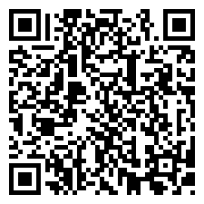

Evaluate this session
Scan this
QR code
to evaluate
this session.

Slide 57


© 2014 Microsoft Corporation. All rights reserved. Microsoft, Windows, and other product names are or may be registered trademarks and/or trademarks in the U.S. and/or other countries.
The information herein is for informational purposes only and represents the current view of Microsoft Corporation as of the date of this presentation. Because Microsoft must respond to changing market conditions, it should not be interpreted to be a commitment on the part of Microsoft, and Microsoft cannot guarantee the accuracy of any information provided after the date of this presentation. MICROSOFT MAKES NO WARRANTIES, EXPRESS, IMPLIED OR STATUTORY, AS TO THE INFORMATION IN THIS PRESENTATION.

