Slide 1


Slide 2

How Microsoft IT Manages Their Microsoft System Center Configuration Manager Application Lifecycle with Zero Touch
PCIT-B339
Marc Hurley
Dharmendra Thotakura

Slide 3
Session Objectives and Takeaways
Session Objectives
  Provide a framework which can accelerate onboarding modern application service
  Explain the business benefits of automating the publishing of Modern Applications
  Demonstrate Orchestrator Runbooks to automate the application publishing process
Key Takeaways
  How automating Application publishing can help you to save time and cost
  Share examples of how Microsoft IT uses System Center Orchestrator to automate our application lifecycle
  Give away the Orchestrator Runbooks and source binaries to start testing the automation process in your test environment

Slide 4
THIS SESSION IS DESIGNED FOR
Someone familiar with System Center 2012 Orchestrator and is familiar with Runbook design
Someone who has an understanding of Application model in System Center 2012 Configuration Manager R2
Someone who is familiar with ticketing request systems such as Visual Studio Team Foundation Server
Someone who loves automation and looking to reduce administrative overhead and avoid manual errors

Slide 5
Why Automate Application Publishing?
Marc Hurley

Slide 6
Our Manual Publishing Process
Only publishing 4-6 applications per month
  Prior to Windows 8 internal testing – everything was MSI / SCRIPT based
  Windows 8 dogfooding started internal Dev teams producing Line of Business (LOB) modern apps
Packaging/Test team supporting multiple customers
  Redmond – 4 resources support during Redmond business hours
  India – 3 resources support after Redmond business hours
Microsoft IT SLA for Application provisioning/deployment
  Maximum of 1 PRI1 request active at any time
  Priority level is modified between Package request and then Deployment request
  1 package = 12 work hours to complete for UAT
  1 deployment = 2 work hours to release
  84 hours / month to support existing requests but may
  stretch across multiple days/weeks depending on queue
TFS WI Priority | Packaging/Test SLA | Deployment SLA
PRI1 | 3 business days to UAT | 4 business hours
PRI2 | 8 business days to UAT | 8 business hours
PRI3 | 14 business days to UAT | 24 business hours
PRI4 | As time permits | As time permits

Slide 7
Need for Publishing Automation
Provide Self Service publishing model
  Similar to Windows Store – for publishing and monitoring LOB applications
Requests for Modern Application publishing increasing
  Multiple internal development teams releasing LOB modern applications
  Publishing requests estimated to increase to 10 – 30 per month (averaging 40 – 70 per month)
IT DevCenter requires requests to be completed faster than PRI1
  Current Microsoft IT Packaging SLA did not fit IT DevCenter business requirements
    Multiple requests at same time all > PRI1
    Total application certification to release = 10 days – publishing request provided 24 hours
Reduction in team size but Increase in workload
  Current requests covered in 84 work hours - Future requests will require 980 or more
  Team unable to handle expected load
Risk of more errors in manual workload
  Increase in volume
  Reduction in time to complete
 | Total Per Month | Work Hours Required
Previous Requests | 6 | 84
Future Requests | 70 | 980
11x Increase!

Slide 8
Current Application Metrics
Windows Modern App focused
  Windows 8 and Windows Phone 8 LOB modern applications comprise 72% of total published applications
Next 6 months
  Expected to reach 1000+ offered applications
Deployment Type | Currently Offered
Windows 8 | 249
Windows Phone 8 | 121
Script | 107
Windows Phone 8 Deep Link | 34
iOS Deep Link | 16
MSI | 12
MAC | 5
iOS | 3

Slide 9
Automation Solution

Slide 10


SOLUTION OVERVIEW
Requirements
Technology
Benefits
  Self service of Modern Application publishing
  Rapid turnaround time from request time to deployment
  Reduction of Configuration Manager Administrative Overhead
  Remove manual provisioning and deployment errors
  IT DevCenter – application developer’s request portal
  Visual Studio 2012 Team Foundation Server
  System Center 2012 Orchestrator
  System Center 2012 R2 Configuration Manager cmdlets
  Custom PowerShell modules
  Active Directory cmdlets
  Publishing process that mimics the Windows Store process
  Use of scripts & templates to enforce standardization
  Reduce publishing time from 3 days to 6 hours
  Admins can focus on deployment errors rather than publishing
  95% of app publishing work completed zero touch

Slide 11

End to End Workflow
Pre-Process
App owner submits application to Dev Center
Dev Center Assigns Task
Orch. Runbooks wake on schedule
Check TFS tasks waiting for Automation
Update task Status
“In Process”
Process
Create, Deploy, Create & Deploy, Delete, Pause, Supersede
Create XML files from TFS Task
Identify “Activity Type”
Call Power Shell Modules
Update Task Status
Assigns Task to Dev Center

Slide 12
Application Submission Process

Slide 13
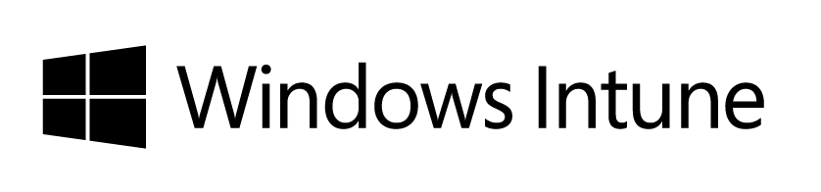
IT Dev Center
platform
publish
marketplace
dashboard
A straight forward, cost effective way for developing authenticated line-of-business applications which deliver compelling, contextual experiences across the full spectrum of Microsoft devices.
A single, efficient app publishing/certification process for all modern app models supporting an enterprise’s need for governance and management of their app portfolio.
A familiar and consistent cross-device experience for the discovery, install and updates of corporate apps building upon the capabilities of the public store.
Tools and services which enable corporate app developers to monitor, support, improve and manage their app portfolio over its full lifecycle.
“IT Dev Center” portal

Slide 14

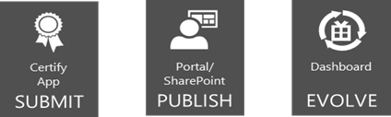

IT Dev Center Portal
“One Stop Shop” for app developers:
Self-Service Publishing to Company Portal for internal developers
Education on app modernization via the learning center
App certification, code signing and publishing to Company Portal
Analytics using dashboard and
reporting
IT Dev Center
Company Portal

Slide 15
Request Management

Slide 16
Team Foundation Server
Used for our Request Management/Ticket System
  Project work – User Story & Tasks
  BUG tracking
  All team workloads tracked in this system
Task work item used for engagement
  Shared Fields
    Status, Classification, Planning, Scheduling, Details, History
  Custom Tabs per Service Area
    Application Management, Patch Management, Test Pass, Remediation
Application Management tab
  Sections for each type of Metadata required to complete request
  Application, Deployment Type, Deployment, Results, (Packaging)

Slide 17
Demo
Ticket Request System using TFS
Marc Hurley

Slide 18
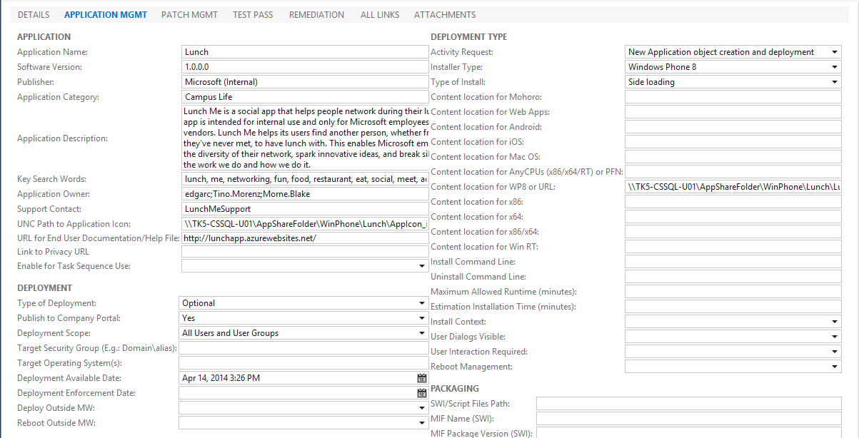
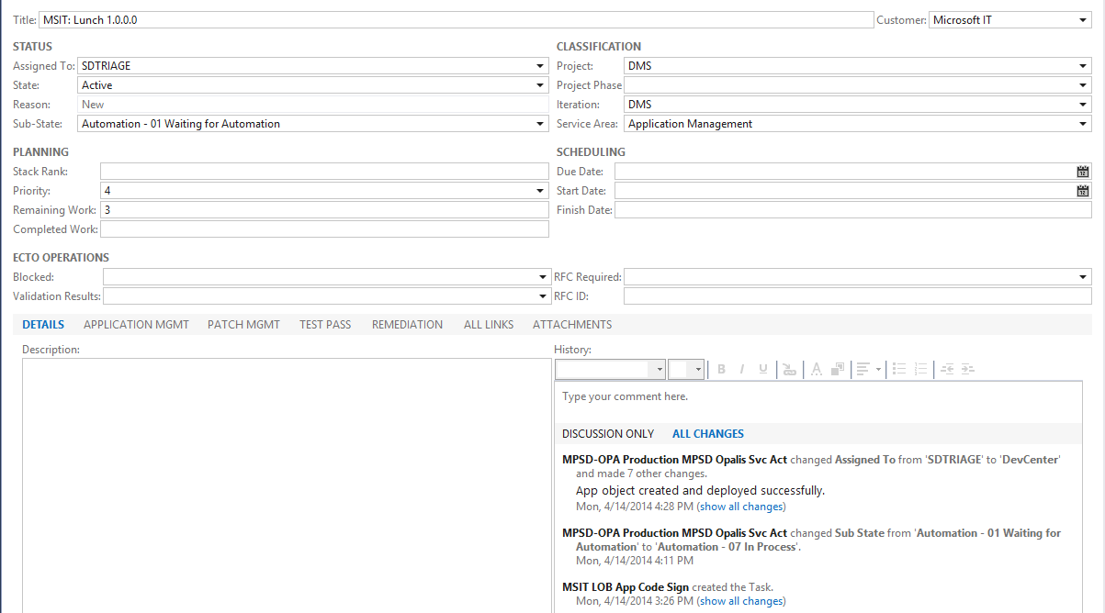
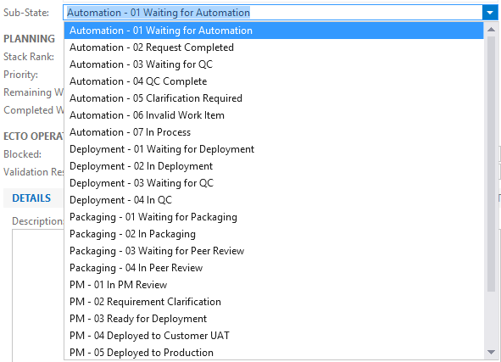
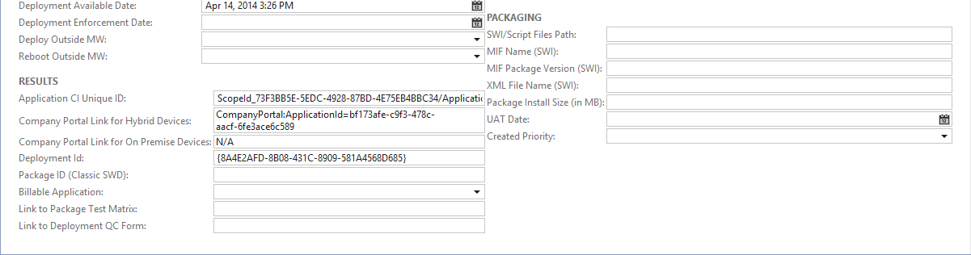
Ticket Request System using TFS

Slide 19
How We Read & Write to TFS
Used to manage the application metadata
Use TFS com based object model (DLL files & API)
  PowerShell cmdlets call the APIs
TFS APIs - Metadata
IT Dev Center
INPUT
Polling
TFS
OUTPUT
Polling
Orchestrator
TFS APIs - Results

Slide 20
Create Objects in Configuration Manager
Use native Configuration Manager cmdlets
  Create Application and Deployment Type
  Deploy Application
  Application metadata updates
Created some custom modules
  Supersedence
  Icon
  Delete
  Pause and Resume (Deployment)
Input XML
Configuration Manager & Custom cmdlets
CREATE
DEPLOY
DELETE
Output XML
LOGS
&

Slide 21
Deployment Options Offered Today
New Application object creation
Deploy an Application
New Application object creation and deployment
Pause an Application deployment
Resume an Application deployment
Superseding the old Application
Update Application Metadata
Delete an Application

Slide 22
Publishing Scenarios and Demos
Scenario 1: New Application and Deployment
Scenario 2: Application Supersedence
Scenario 3: Delete an Application

Slide 23
New Application and Deployment
Application Platforms
  WP8.x Applications
  Windows 8.x Applications (RT/x86/x64)
  iOS Applications
Methods of Deployment
  Side Load
  Deep Link
Targeting
  All Users and User Groups
  Active Directory Security Groups
  Active Directory Distribution Lists

Slide 24
Demo: New Application and Deployment
Dharmendra Thotakura

Slide 25
Application Supersedence
Must retain single TFS WI for entire app lifecycle
Deep link does not require supersedence
Count of Deployment Types between v1 and v2 must match
Always supersede with “Automatically upgrade” enabled
Option to set different time for Availability and AutoUpgrade
Can change the targeting to different users between releases

Slide 26
Demo: Application Supersedence
Dharmendra Thotakura

Slide 27
Delete an Application
Only used to terminate Application Lifecycle
  Devices will remain on the last version of the application they installed
Entire application object chain is removed
  Remove the oldest application in the chain first sequence
  Delete any dependency applications only if they are not shared by another app
Target collection is removed
  Only if nothing else is targeted to the same collection
  Will not remove Out of Box (default) Configuration Manager collections
Hosted content is removed
Reporting will no longer be available

Slide 28
Demo: Delete an Application
Dharmendra Thotakura

Slide 29
Lessons Learned
Scalability issues with using AD and Security Groups
  Issue
  SLA required < 6 hours from publishing
  Nested Security Group bloated the overall total discovered
  1500 Security Groups took 25 hours for delta discovery on single Primary site
  Solution
  Needed to clean up unused security groups from AD
  Load balanced the security groups across multiple Primary sites

Slide 30
Lessons Learned
Expanding services for new devices and OS
  Issues
  Expanding the UI in TFS to accommodate new platforms, new OS, and OS updates
  Understanding the matrix for long term supportability
  Future Planning
  Working on a UI redesign in TFS and updated backend code
Managing N-? Application chains
  Did not pre define criteria to retire old app versions in the supersedence chain
  Bloated database with old compliance data for superseded apps
  Excessive number of policies effected the performance on the MDM clients

Slide 31
RESOURCES
Link for Orchestrator Runbook and binaries: http://1drv.ms/1gfFw1U
  Runbook password: teched2014
If you love automation, then don’t forget to check out 400+ Configuration Manager R2 PowerShell Cmdlets available here: http://aka.ms/Iiusmk
New updated toolkit for Configuration Manager R2 for additional add ons download from here: http://aka.ms/Tjepxf

Slide 32
IN REVIEW
Session Objectives
  Provided an example of our modern application publishing process to help you accelerate onboarding modern application service
  Explained the business benefits of automating the publishing of Modern Applications
Key Takeaways
  Example our ticketing request system used to support publishing requests
  The actual Microsoft IT Orchestrator Runbooks and binaries used to automate our application lifecycle

Slide 33
Related Sessions
PCIT-B333 How Microsoft IT Solves BYOD Using Microsoft System Center 2012 R2 Configuration Manager and Windows Intune

Slide 34
FOR MORE INFORMATION
System Center in Action Site
      http://blogs.technet.com/b/system_center_in_action/
Technical Case Study: How Microsoft IT Deployed System Center 2012 Configuration Manager
  http://technet.microsoft.com/en-us/library/hh913620.aspx
Microsoft Solves BYOD Using Microsoft System Center Configuration Manager and Windows Intune
  http://technet.microsoft.com/en-us/library/dn482435.aspx

Slide 35

Resources
Learning
  Sessions on Demand
  Microsoft Certification & Training Resources
http://channel9.msdn.com/Events/TechEd
www.microsoft.com/learning
TechNet
msdn
  Resources for IT Professionals
  Resources for Developers
http://microsoft.com/technet
http://microsoft.com/msdn

Slide 36



Complete an evaluation and enter to win!

Slide 37
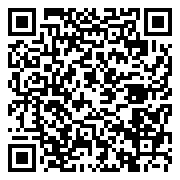

Evaluate this session
Scan this
QR code
to evaluate
this session.

Slide 38


© 2014 Microsoft Corporation. All rights reserved. Microsoft, Windows, and other product names are or may be registered trademarks and/or trademarks in the U.S. and/or other countries.
The information herein is for informational purposes only and represents the current view of Microsoft Corporation as of the date of this presentation. Because Microsoft must respond to changing market conditions, it should not be interpreted to be a commitment on the part of Microsoft, and Microsoft cannot guarantee the accuracy of any information provided after the date of this presentation. MICROSOFT MAKES NO WARRANTIES, EXPRESS, IMPLIED OR STATUTORY, AS TO THE INFORMATION IN THIS PRESENTATION.

