Slide 1


Slide 2



PCIT-B342
Microsoft Azure RemoteApp ^{PREVIEW}
Demi Albuz
Senior Product Marketing Manager
Samim Erdogan
Principal Engineering Manager
Thomas Willingham
Technical Product Manager

Slide 3

Today’s challenges
Deliver applications to mobile platforms (BYOD)
Respond to dynamic business requirements for IT:
  Seasonal/temporary workers
  Vendors
  New employees (mergers and acquisitions)
Reduce infrastructure costs (move CAPEX to OPEX)
Provide access to legacy applications
Protect corporate resources and ensure compliance

Slide 4

Azure RemoteApp
Azure RemoteApp
combines Windows application experience and powerful RDS capabilities
on Azure’s reliable platform and helps IT to bring, scale, agility and global access to corporate applications.
Microsoft Confidential

Slide 5
Introducing Azure RemoteApp Preview
Remote applications delivered from Azure’s reliable platform
Access from Windows, iOS, Mac OS X,
and Android devices
Delivered via Microsoft Remote Desktop Protocol and RemoteFX
Scale without large capital expense
Flexible hybrid or cloud deployment options
Microsoft Confidential

Slide 6
Why Azure RemoteApp?
Scale
Enable
Protect
Scale up or down to meet dynamic business needs without large capital expense or management complexity
Provide access to corporate applications from anywhere, on any device
Centralize and protect corporate resources on Azure’s reliable platform
Microsoft Confidential

Slide 7
Two Deployment Choices
RemoteApp Cloud Deployment
Office 2013 ProPlus preinstalled
Rapid provisioning: apps quickly available
RemoteApp Hybrid Deployment
Apps, OS and settings are fully customizable
User logon with corporate credentials federated with Azure AD
Users can logon with Microsoft Account or with corporate credentials federated with Azure AD
Automatic maintenance: OS and apps always up-to-date, Microsoft anti-malware
Full access to on-premises network
IT can manage template images and apply updates via Azure Portal
Server 2012 R2 Session Virtualization
Secure,
WAN-ready connectivity
Clients for Windows, Mac, iOS, Android
Global presence
High Fidelity with RDP
Dynamic Scalability

Slide 8
Demo:
Cloud Deployment
Microsoft Azure RemoteApp ^{Preview}

Slide 9
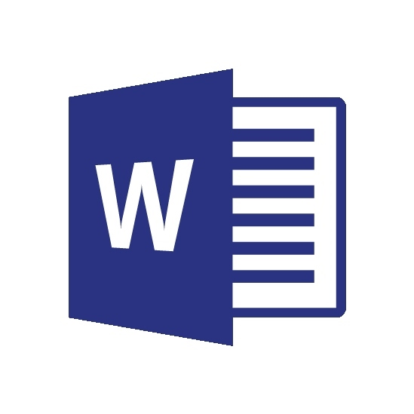
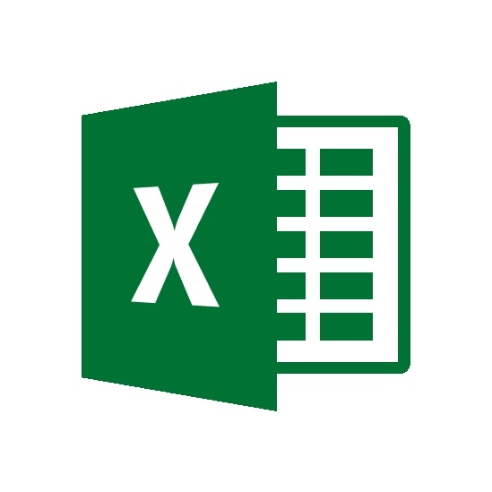
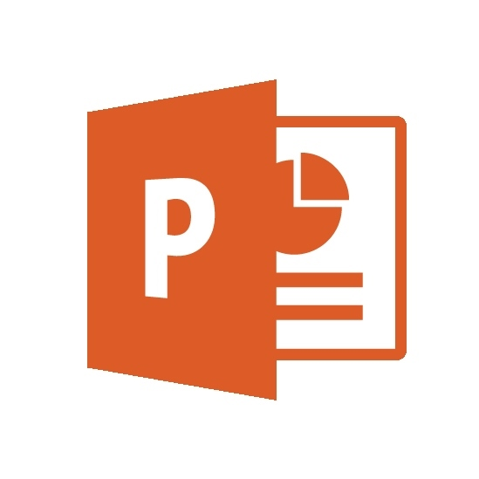
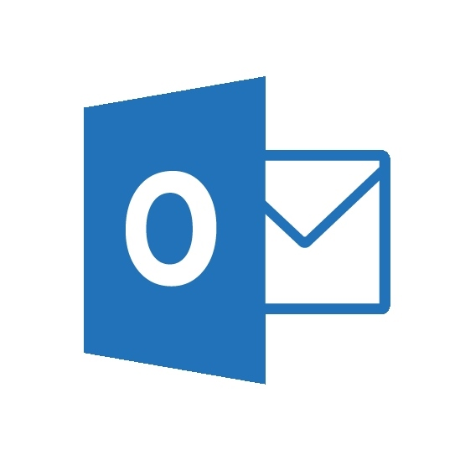
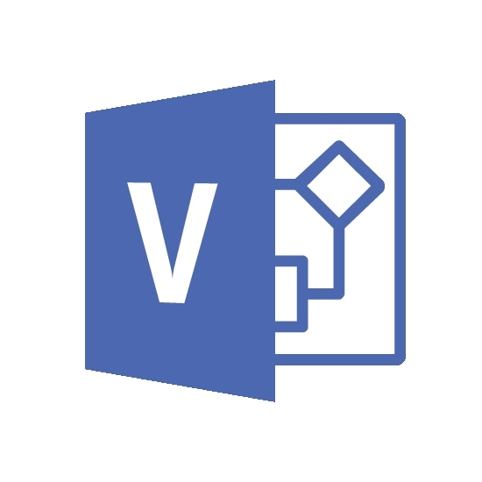
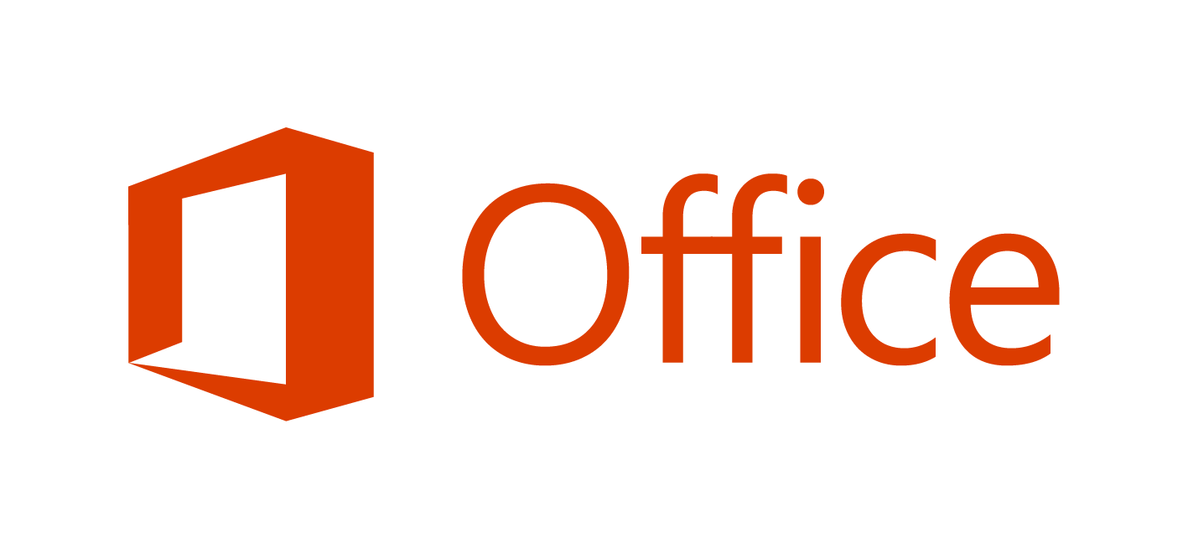
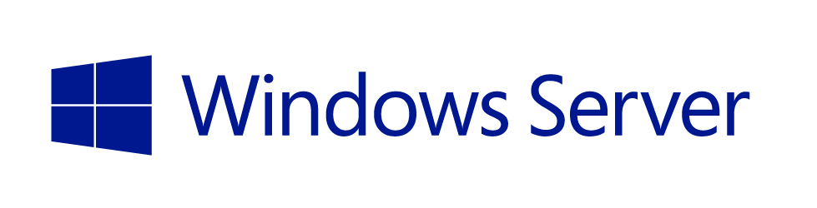
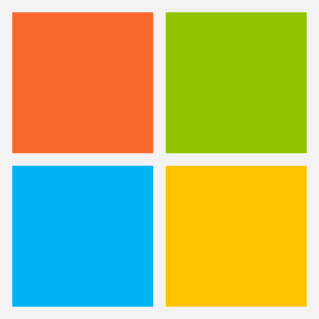
RemoteApp Cloud Deployment
RemoteApp Service
RDP
Published Apps
Elastic Runtime
Session Host
Session Host
Session Host
…
Persistent user data
(50GB per user)
Pre-built template image
Automatically maintained
Authentication
On-premises Network
Microsoft Account
Identity Options
Azure Active Directory
DirSync
(optional)
Windows Server Active Directory

Slide 10
Hybrid Cloud Deployment
Federated Identity
Hybrid Networking
Hybrid Management
Core technology: Azure Active Directory with DirSync
RemoteApp leverages Azure AD to control user access and enable Single Sign-On
Core technology: Azure Virtual Networking with Site-to-Site VPN
RemoteApp Virtual Networks build on Azure networking to seamlessly access on-premises resources
Core technology: Windows Server Active Directory on-premises
RemoteApp hybrid resources are domain-joined and conform to on-premises policies

Slide 11
Demo:
Hybrid Deployment
Microsoft Azure RemoteApp ^{Preview}

Slide 12
Patching and Updates
Cloud Deployment: Automatically maintained
  Latest OS and application updates rolled out on an ongoing basis
  Always the latest Microsoft Office 2013 ProPlus
Hybrid Deployment: Updates under IT Control
  Ongoing updates: Running RDSH VMs can be updated with GP, WSUS, SC, and other management tools from on-premises.
  Image-based updates: You can upload a new template image and apply it to a RemoteApp service instance. Update will be rolled out automatically.

Slide 13
Demo:
Updating a Hybrid Deployment using a Template Image
Microsoft Azure RemoteApp ^{Preview}

Slide 14
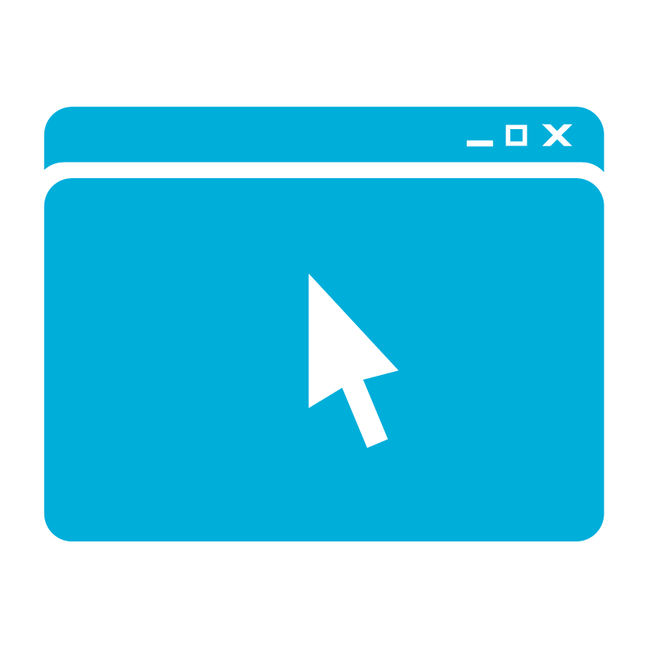
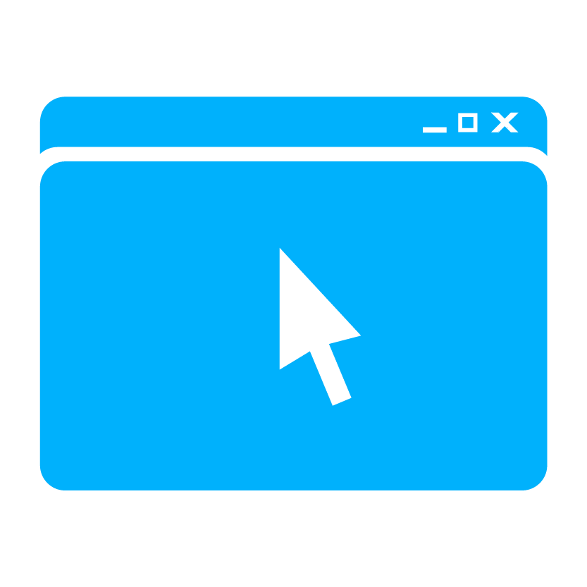

RemoteApp Hybrid Deployment
RemoteApp Service
On-premises Network
RDP
Published Apps
Elastic Runtime
Subject to IT policy via GP, System Center, or other enterprise management tools
Session Host
Session Host
Session Host
…
Domain Joined
Corporate Apps
Azure VPN
Files
LOB
Persistent user data
(50GB per user)
Custom template image
Maintained via Azure Portal
Authentication
Azure Active Directory
Windows Server Active Directory
DirSync

Slide 15
Demo:
User Access
Microsoft Azure RemoteApp ^{Preview}

Slide 16
Two Deployment Choices Compared
RemoteApp Cloud Deployment
Windows apps from Microsoft as a turn-key, scalable, globally available service
RemoteApp Hybrid Deployment
Your corporate apps as a service that can be access from anywhere
Server 2012 R2 Session Virtualization
Dynamic Scalability
Global presence
High Fidelity with RDP
Secure,
WAN-ready connectivity
Clients for Windows, Mac, iOS, Android

Slide 17
Features
Price (per user) | Free during preview
Window Server version | Windows Server 2012 R2
Remoting Protocol | RDP 8.1
Microsoft Office Professional Plus 2013 | 
Bring your own applications | 
Device platforms | Windows 7/8.x, iOS, Android Coming soon: Windows Phone, Windows RT, Mac OS X
Microsoft Account support | 
Federated Identity with Active Directory | 
Integration with On-Premises IT Infrastructure | 
Storage (per user) | 50 GB
Initial capacity at preview | 20 users per Azure account. Customers can request additional capacity during the preview.
Regions | US East, US West, Europe North, Europe West, Asia Pacific East, Asia Pacific Southeast

Slide 18
Related content
PCIT B338: Deploying RDS in Clouds
Hands-on-Lab: Microsoft Azure RemoteApp
Meet us at the People-Centric IT booth
Resources:
  RDS Team blog
  RDS TechNet Wiki
Try it today!
http://remoteapp.azure.com

Slide 19

TechEd Resources
Learning
  Sessions on Demand
  Microsoft Certification & Training Resources
http://channel9.msdn.com/Events/TechEd
www.microsoft.com/learning
TechNet
msdn
  Resources for IT Professionals
  Resources for Developers
http://microsoft.com/technet
http://microsoft.com/msdn

Slide 20



Complete an evaluation and enter to win!

Slide 21
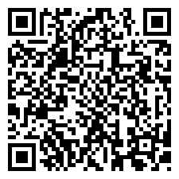

Evaluate this session
Scan this
QR code
to evaluate
this session.

Slide 22


Thank You.
© 2014 Microsoft Corporation. All rights reserved. Microsoft, Windows, and other product names are or may be registered trademarks and/or trademarks in the U.S. and/or other countries.
The information herein is for informational purposes only and represents the current view of Microsoft Corporation as of the date of this presentation. Because Microsoft must respond to changing market conditions, it should not be interpreted to be a commitment on the part of Microsoft, and Microsoft cannot guarantee the accuracy of any information provided after the date of this presentation. MICROSOFT MAKES NO WARRANTIES, EXPRESS, IMPLIED OR STATUTORY, AS TO THE INFORMATION IN THIS PRESENTATION.

