Slide 1


Slide 2

Troubleshooting Active Directory Federation Services (AD FS) and the Web Application Proxy
PCIT-B411
John Craddock
Infrastructure and Identity Architect
XTSeminars Ltd

Slide 3
Agenda
Understand AD FS changes and concepts
How to use the troubleshooting logs
Enhance troubleshooting using Fiddler
Using security auditing
Troubleshooting the Web Application Proxy

Slide 4
Warning
Always test, document and approve any changes before implementation in a production environment
Much of this presentation is based on field experience
  No two fields are the same – test with your environment
  You must take ownership and responsibility for any changes you implement
Demos are to provide educational examples and the demo environment should not be treated as fit for production
Every effort has been made to make this seminar as complete and as accurate as possible but no warranty or fitness is implied. The presenter, authors, publisher and distributor assume will not be liable for errors or omissions, or for damages resulting from the use of the information presented and contained herein

Slide 5
Windows Server 2012 R2 AD FS
Uses HTTP.SYS not IIS
Installed files now at c:\Windows\ADFS
Supports additional claims including device claims
Supports global and per relying party authentication policies based on the client/user
  Location
  Device type
  Group membership
Adds support for OAuth 2.0

Slide 6
Windows Server 2012 R2 AD FS (continued)
Customizable including the addition of multi-factor authentication providers
Includes the Device Registration Service
The Web Application Proxy provides
  An AD FS proxy
  Application publishing
  Preauthentication using AD FS and claims
  Support for authenticating to Kerberos applications via a claims token
    Uses Kerberos Constrained Delegation (KCD)
PowerShell support now even better

Slide 7


Key concepts
Issuer IP-STS
Authenticates user
Identity Provider (IP)
Security Token Service (STS)
User / Subject /Principal
Requests token for AppX
Active
Directory
ST
Issues Security Token
crafted for Appx
The Security Token
Contains claims about the user
For example:
Name
Group membership
User Principal Name (UPN)
Email address of user
Email address of manager
Phone number
Other attribute values
Security Token “Authenticates”
user to the application
AppX
Relying party (RP)/
Resource provider
Trusts the Security Token
from the issuer
Signed by issuer

Slide 8
Working with partners
Partner
AD FS STS & IP
Active
Directory
Your Claims-aware app
Your AD FS STS
App trusts STS
Your STS
trusts your
partner’s STS
Partner
user
Browse app
Not authenticated
Redirect to your STS
Home realm discovery
Redirected to partner STS requesting ST for partner user
Authenticate
Return ST for consumption by your STS
ST
ST
Redirected to your STS
Return new ST
ST
Process token
ST
Send Token
Return cookies
and page

Slide 9
Demo environment
adfs-p
Proxy-p
partner.xtseminars.com
ISP DNS
Client
Internet
dc1
adfs1
Proxy
Client2
example.com
srv1

Slide 10
The federation experience
Demo…

Slide 11
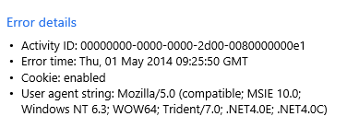
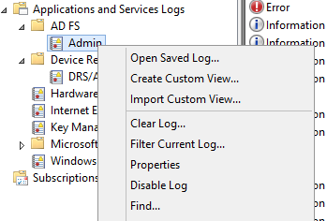
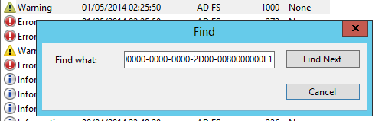
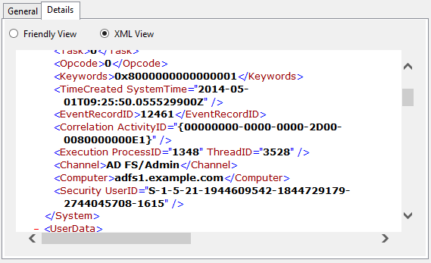
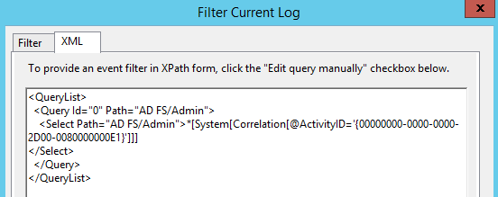
How to troubleshoot?
Use Find…
Shown as the ActivityID:
Create an XPath form query

Slide 12
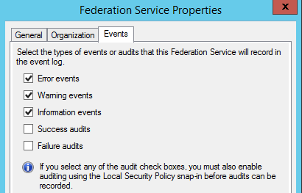
Setting the logging details
PS C:\>Set-AdfsProperties -LogLevel Errors, Warnings, Information, Verbose
Verbose cannot be set via the UI
For security auditing the AD FS service must have the right to “Generate security audits”
To enable auditing run:
  auditpol.exe /set /subcategory:"Application Generated" /failure:enable /success:enable

Slide 13
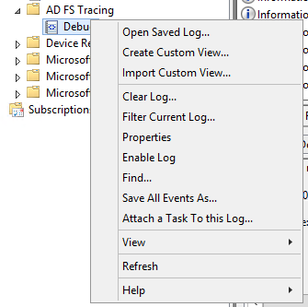
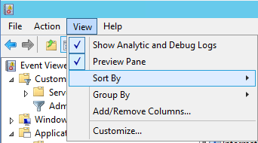
Debug tracing
Shown the AD FS tracing node in Event Viewer
For verbose logging run:
wevtutil sl "AD FS Tracing/Debug" /l:5
Restart the AD FS service
Useful as a debugging aid
  Can have a performance impact
  Stop tracing when troubleshooting is complete

Slide 14
WCF and WIF tracing
<sources>
<!-- To enable WIF tracing, change the switchValue below to desired trace level - Verbose, Information, Warning, Error,
Critical -->
<!-- Set TraceOutputOptions as comma separated value of the following; ProcessId ThreadId CallStack. Specify None to not
include any of the optional data-->
<!-- NOTE THAT THE CHANGES TO THIS SECTION REQUIRES SERVICE RESTART TO TAKE EFFECT -->
<source name="Microsoft.IdentityModel" switchValue="Off">
<listeners>
<add name="ADFSWifListener" traceOutputOptions="ProcessId,ThreadId" initializeData="Wif"
type="Microsoft.IdentityServer.Diagnostics.ADFSTraceListener,Microsoft.IdentityServer.Diagnostics,Version=6.3.0.0,
Culture=neutral, PublicKeyToken=31bf3856ad364e35, processorArchitecture=MSIL" />
</listeners>
</source>
Review the files to locate the appropriate debug configurations
Config files in c:\windows\adfs
  Microsoft.IdentityServer.Servicehost.exe.config (AD FS)
  Microsoft.DeviceRegistration.ServiceHost.exe.config (Workplace Join)

Slide 15
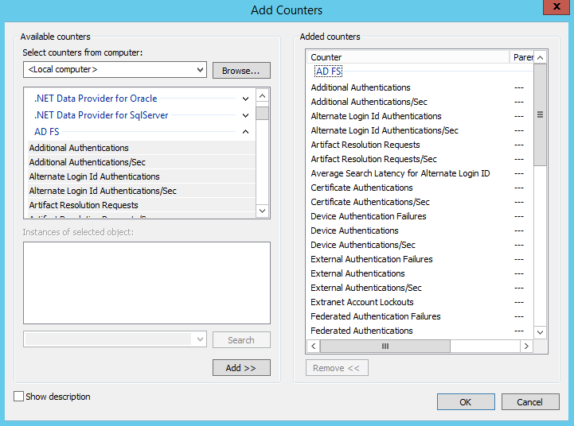
AD FS performance counters
Many performance counters to monitoring, troubleshooting and tuning

Slide 16
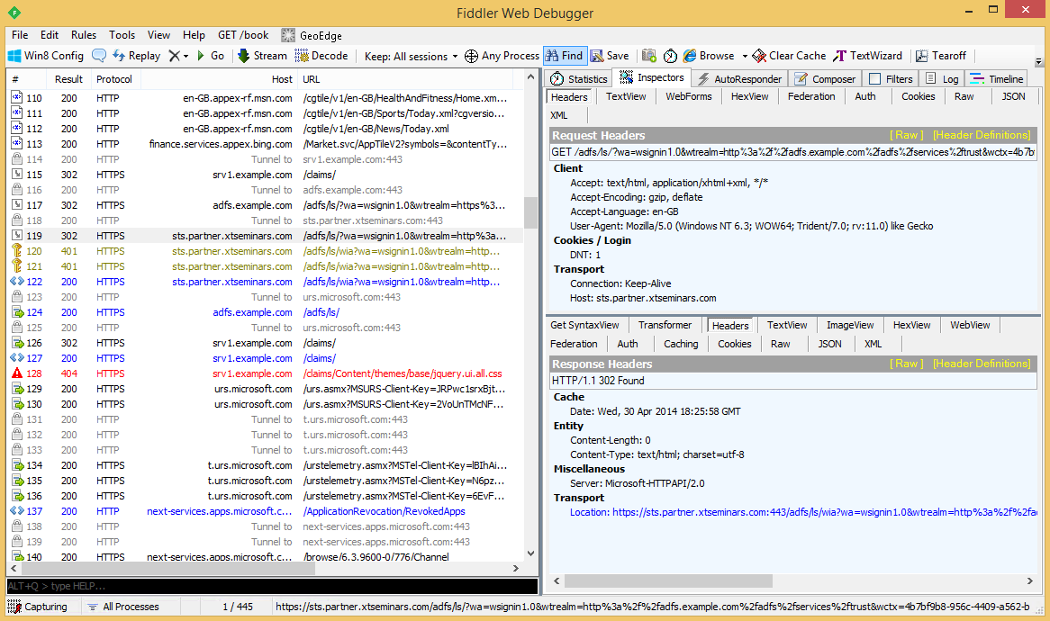
An essential tool

Slide 17

Fiddler as a man in the middle
Browser
WinINET
Fiddler
Webserver
Spoof certificate
Fiddler can intercept HTTPS traffic
  Creates a certificate that represents the destination website
Browser will display certificate as invalid unless added to certificate store
  If you add it to the store make sure you remove it after testing

Slide 18
Recognising WS-Federation on-the-wire
Claims-aware app
AD FS STS
Active Directory
App trusts STS
Our user
Browse app
Not authenticated
Redirected to STS
Authenticate
Return security token
ST
Query for user attributes
ST
Send Token
Return cookies
and page

Slide 19
First redirect to STS
AD FS logon endpoint
Action to perform
%2f decodes to /
Decoded redirect URL:
https://adfs.example.com/adfs/ls/?
wa=wsignin1.0&
wtrealm=https://site1.example.com/Federation/&
wctx=rm=0&id=passive&ru=%2fFederation%2f&
wct=2011-04-15T15:12:28Z
Security realm of RP
Consumed by RP passed through unchanged by all actors
Time Stamp

Slide 20
Web page returned after authentication
Hidden form with POST method
POST back URL defined via RP configuration in AD FS
SAML claims
SAML
Token
Signature
X.509 Certificate of signing party (includes public key)
Begins / ends with
saml:Assertion
Unchanged since initial request
wctx=rm=0&id=passive&ru=%2fFederation%2f&
Submit button
Java Script to automatically POST page
The SAML data is always signed, it can be encrypted if required

Slide 21
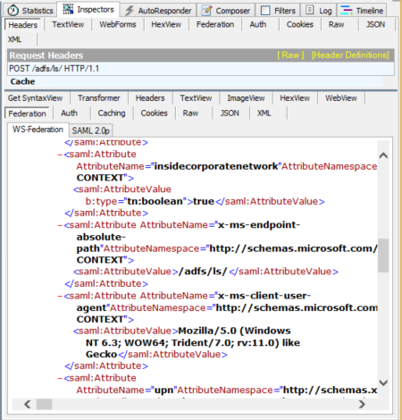
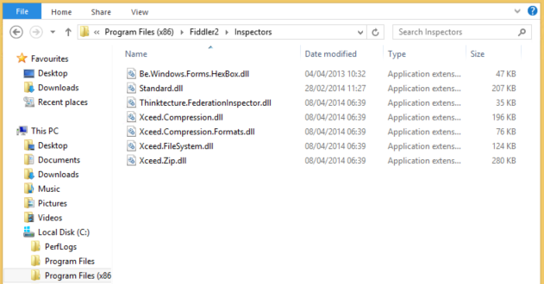
Federation inspector
Add the binaries to the Inspectors folder
Download the Fiddler inspector from
  http://identitymodel.codeplex.com/releases/view/52187

Slide 22
AD FS cookies
AD FS
After Authentication with AD FS
  MSISSelectionPersistent: identifies authenticating IP-STS
    Located through Home Realm Discovery (HRD)
  MSISAuth…: authenticated session cookies
  MSISAuthenticated: time when the authentication took place
  MSISSignOut: Keeps track of all RPs to which the session has authenticated
  MSISLoopDetectionCookie: Prevents multiple authentication request due to configuration error
    Time-out default: 6 request for authentication to same RP within a short space of time

Slide 23
Web app cookies
APP
FedAuth cookies
  Allows browser session to remain authenticated to web application

Slide 24
Winning the augment
Demo…

Slide 25
AD FS security event log (simplified)
Claims Provider Trusts
Claims Pipeline
Relying Party Trusts
Issuance Authorization rules
Deny
324
AD
4624
412
Acceptance Transform rules
299
Logon
ST
501
501
501
500
Issuance
Transform rules
299
Username,
user & group SIDs
Issued
claims
501
RP
500
Token
authentication
Claims
ST
Acceptance Transform rules
412
STS
501
501
Username
user & group SIDs

Slide 26
An alternative approach
Demo…

Slide 27

Web Application Proxy
WAP
Publish applications and services to the Internet
ADFS
Web application
Pass-through
Claims-aware
web application
KCD
Web application with Windows Authentication
Kerberos constrained delegation
Users are authenticated and authorized before gaining access to the corporate network
AD FS
preauthentication

Slide 28
Main token types
Time
SAML
SWT
JWT
Security Assertion Markup Language
SAML 1.1/2.0
Simple Web Token
(Microsoft, Google, Yahoo)
JSON Web Tokens (JWT)
Complex to:
Create
Parse
Validate
Transmit
Too simple!
Easy to:
Create
Parse
Validate
Transmit
JWT token mandated for Open ID Connect
  Used in most OAuth 2.0 implementations
  Decoder: http://openidtest.uninett.no/jwt

Slide 29
Communications and trust
STS
Sign with STS
token signing certificate private key
encrypt with RP
encryption certificate public key
ST
User
RP
Validate with STS
token signing certificate public key
Decrypt with RP
encryption certificate private key
User trusts website and STS via SSL certificates
Certificate path validated and CRL checked
CNG certificates are not supported

Slide 30
Solving proxy problems
Demo…

Slide 31

If you make changes to facilitate troubleshooting remember to revert the changes when you have finished

Slide 32
Summary
We have covered
  AD FS changes and concepts
  How to use the troubleshooting logs
  Enhance troubleshooting using Fiddler
  Using security auditing
  Troubleshooting the Web Application Proxy

Slide 33

Consulting services on request
John.craddock@xtseminars.co.uk
John has designed and implemented computing systems ranging from high-speed industrial controllers through to distributed IT systems with a focus on security and high-availability. A key player in many IT projects for industry leaders including Microsoft, the UK Government and multi-nationals that require optimized IT systems. Developed technical training courses that have been published worldwide, co-authored a highly successful book on Microsoft Active Directory Internals, presents regularly at major international conferences including TechEd, IT Forum and European summits. John can be engaged as a consultant or booked for speaking engagements through XTSeminars. www.xtseminars.co.uk
John Craddock
Infrastructure and security Architect
XTSeminars Ltd

Slide 34
Related content
PCIT-B324 How to Rapidly Design and Deploy an Active Directory Federation Services Farm: The Do's and the Don'ts
PCIT-B327 Introducing Web Application Proxy in Windows Server 2012 R2: Enable Work from Anywhere
PCIT-H324 Windows Server 2012 R2: New Features in Active Directory Federation Services
PCIT-B411 Troubleshooting Active Directory Federation Services (AD FS) and the Web Application Proxy

Slide 35

Resources
Learning
  Sessions on Demand
  Microsoft Certification & Training Resources
http://channel9.msdn.com/Events/TechEd
www.microsoft.com/learning
TechNet
msdn
  Resources for IT Professionals
  Resources for Developers
http://microsoft.com/technet
http://microsoft.com/msdn

Slide 36



Complete an evaluation and enter to win!

Slide 37
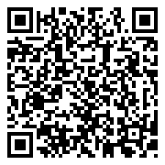

Evaluate this session
Scan this
QR code
to evaluate
this session.

Slide 38


© 2014 Microsoft Corporation. All rights reserved. Microsoft, Windows, and other product names are or may be registered trademarks and/or trademarks in the U.S. and/or other countries.
The information herein is for informational purposes only and represents the current view of Microsoft Corporation as of the date of this presentation. Because Microsoft must respond to changing market conditions, it should not be interpreted to be a commitment on the part of Microsoft, and Microsoft cannot guarantee the accuracy of any information provided after the date of this presentation. MICROSOFT MAKES NO WARRANTIES, EXPRESS, IMPLIED OR STATUTORY, AS TO THE INFORMATION IN THIS PRESENTATION.

