Slide 1


Slide 2

Live Tiles and Notifications for Windows Phone 8.1
WIN-B211
Saral Shodhan
Program Manager
Windows Developer Platform

Slide 3
Suresh Parameshwar
Smriti Yamini
Ezhilan Rasappa
Lei Xu
Jon Liperi
Melanie Roberts
Tony East
Jorge Raastroem
Ben Stewart
Sudipta Dey
Thomas Fennel
Larry Jin
Douglas Pearce
Somak Bhattacharyya
Justin Horst
Matus Lipka
Matt Hidinger
Dustin Bachrach
Scott Bragg
Saral Shodhan
Ashwini Varma
Stephen Speicher
Austin Laugesen
Dmitry Anipko
Mustafa Almaasrawi
Steve DiAcetis
Max Morris
Bill Dinkuhn
Tobin Valenstein
Joe Bourne
Darya Mazandarany
James Drage
Vahid Jazayeri
Anousha Shoulami
Ali Rafiee
Andy Dwersteg

Slide 4
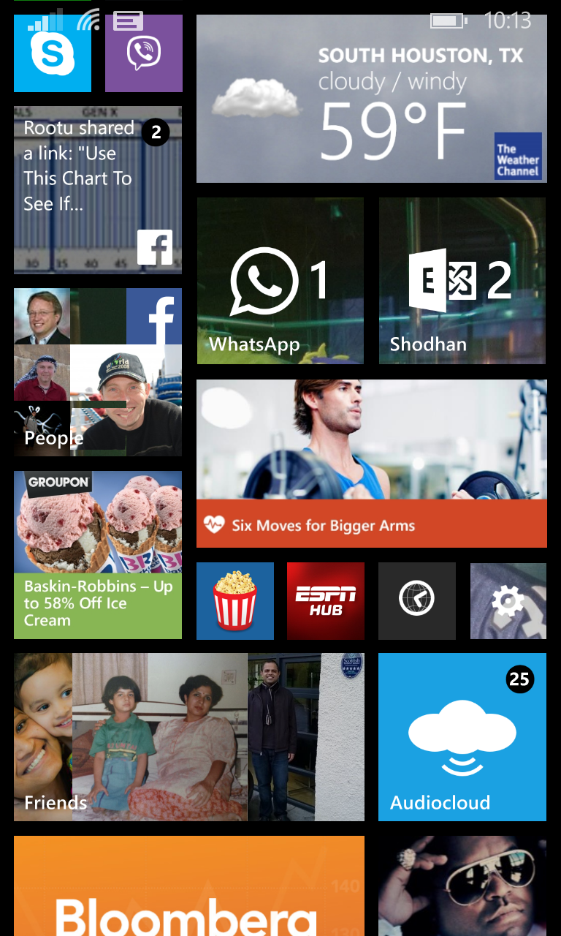
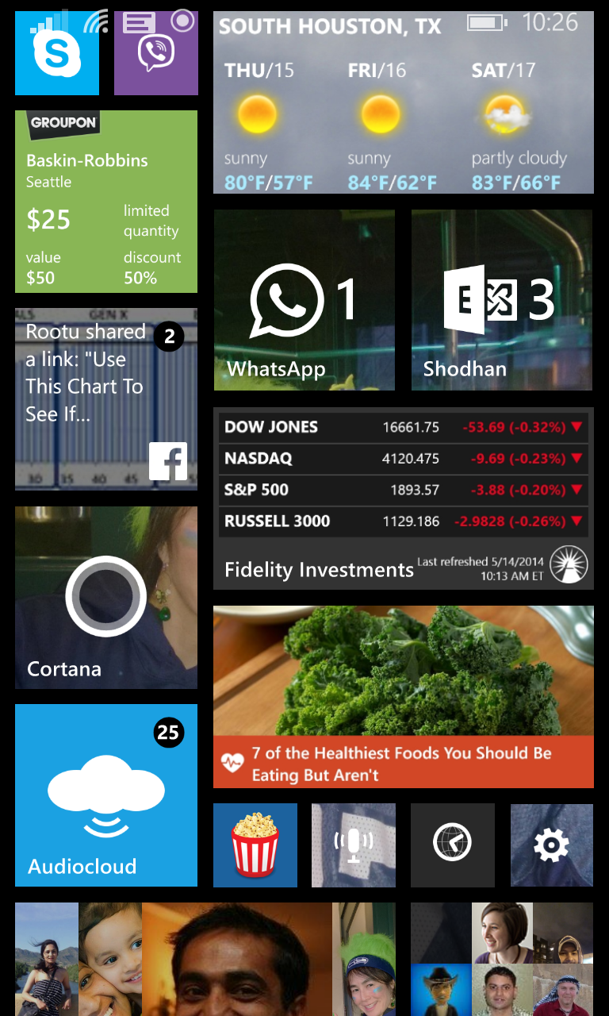
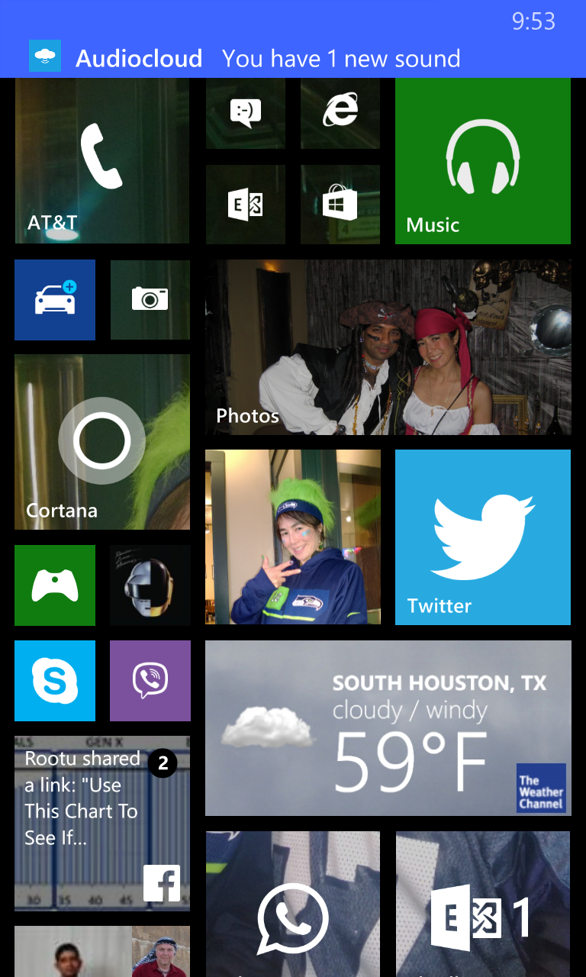

Types of Notifications
Live Tiles
Toast
Badge
Raw

Slide 5
Why use notifications?
Multitasking
Engagement
Relationship
Differentiation

Slide 6
Session Objectives And Takeaways
What we heard:
One Platform
Improved MPN
Notifications & LOB Apps
Tooling
Notification Center
Flexibility

Slide 7
What is the converged platform?

Slide 8
Converged Notification Platform
Windows Phone 8 uses Microsoft Push Notifications
Windows 8/8.1 uses Windows Notification Service
Windows Phone 8.1 uses Windows Notification Service

Slide 9
What if I already use MPN?

Slide 10
MPN – Back Compat
Lets call these the “.NET/MPN APIs”
We’re here for you
  Microsoft.Phone.Notification, Microsoft.Phone.Shell
  HttpNotificationChannel, ShellTile, ShellTileSchedule, ShellToast
There is some magic happening
  Platform is pure WNS with a .NET notification frosting
  OS upgrades
  The Shim

Slide 11
MPN – Shim Architecture
5
Send MPN Shim Push URI
WNS will create a channel using the MPN shim domain
(both http & https)
WP8.1
Device
3
WP8.0 APP
App Cloud
Service
MPN
Shim
MPN NOTIFY
1
6
.NET APIs
WinRT APIs
WNS
WNS NOTIFY
MPN shim does all the authentication and translation logic to WNS.
4
Notification Client Platform
WNS sends notification to device
Platform requests MPN Shim channel from WNS
7
2
PERSISTENT CONNECTION

Slide 12
Existing MPN Developers – Client Code
No need to rewrite or change
All .NET APIs are there – nothing is deprecated
Behavioral improvements
  BindToShellTile and BindToShellToast always succeeds
  IsShellTileBound and IsShellToastBound always true
  BindToShellTile doesn’t need the URI list anymore, but doesn’t break if you give it
  Find→Returns Null→You call Open→ChannelUriUpdated -every launch and resume

Slide 13
Existing MPN Developers – Server Code
No need to rewrite or change
If you domain whitelist
  We are keeping the existing format http://*.notify.live.net
  Very likely to look like http://s.notify.live.net but don’t depend on it
Don’t use URI length restrictions
  We used to return URIs around 130 characters
  Approximately 200 characters currently

Slide 14
What if I want to use WNS?

Slide 15
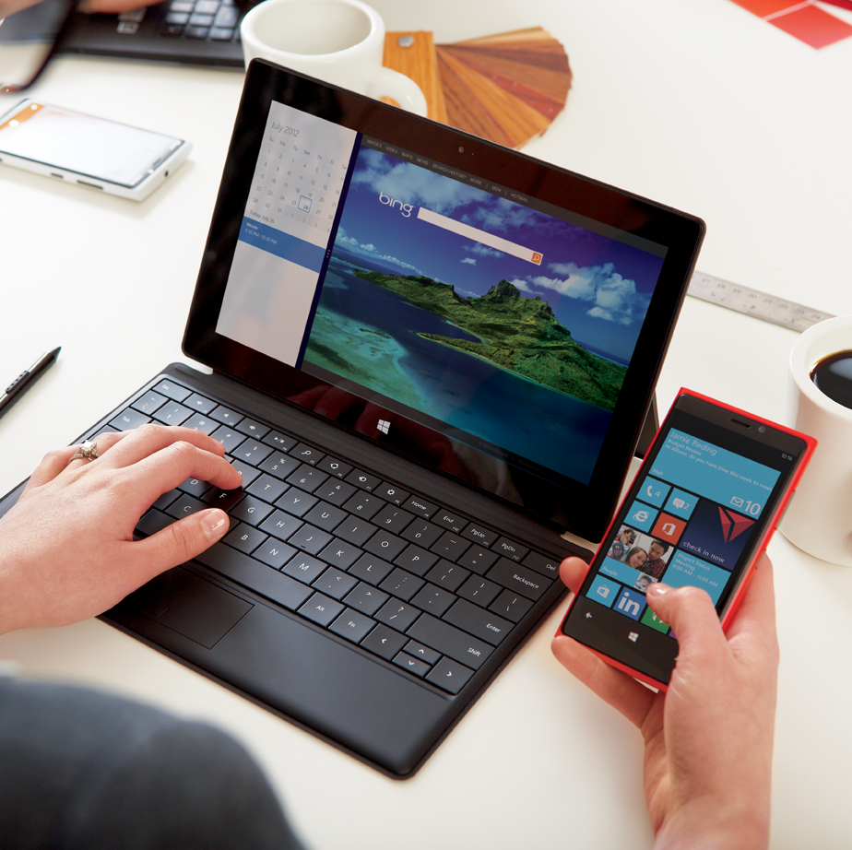
WNS - Platform
Let’s call these the “WinRT APIs”
All the familiar namespaces are here:
  Windows.UI.Notifications, Windows.UI.StartScreen, Windows.Networking.PushNotifications
The code just works
(Go ahead, try the notifications code behind the Windows samples, they’ll work – seriously!)

Slide 16
Step-1: Request Channel
Secure WNS channel for your application
WP8.1
Device
WP8.1 APP
1
.NET APIs
WinRT APIs
WNS
Notification Client Platform
Platform requests channel from WNS
PERSISTENT CONNECTION

Slide 17
1. Request Channel URI
using Windows.UI.Notifications;
using Windows.Data.Xml.Dom;
using Windows.Networking.PushNotifications;
…
PushNotificationChannel channel = null;
try
{
channel = await PushNotificationChannelManager.CreatePushNotificationChannelForApplicationAsync();
}
catch (Exception ex)
{
// Could not create a channel.
}

Slide 18
Step-2: Register with your Cloud Service
2
WNS Push URI
WP8.1
Device
WP8.1 APP
App Cloud
Service
1
.NET APIs
WinRT APIs
WNS
Notification Client Platform
Platform requests channel from WNS
PERSISTENT CONNECTION

Slide 19
2. Register with your Cloud Service
String serverUrl = "http://www.contoso.com";
// Create the web request.
HttpWebRequest webRequest = (HttpWebRequest)HttpWebRequest.Create(serverUrl);
webRequest.Method = "POST";
webRequest.ContentType = "application/x-www-form-urlencoded";
byte[] channelUriInBytes = System.Text.Encoding.UTF8.GetBytes("ChannelUri=" + channel.Uri);
// Write the channel URI to the request stream.
Stream requestStream = await webRequest.GetRequestStreamAsync();
requestStream.Write(channelUriInBytes, 0, channelUriInBytes.Length);
try
{
// Get the response from the server.
WebResponse response = await webRequest.GetResponseAsync();
StreamReader requestReader = new StreamReader(response.GetResponseStream());
String webResponse = requestReader.ReadToEnd();
}
catch (Exception ex)
{
// Could not send channel URI to server.
}

Slide 20
Step-3: Authenticate with WNS
2
WNS Push URI
WP8.1
Device
3
WP8.1 APP
Request access token
App Cloud
Service
1
.NET APIs
WinRT APIs
WNS
Notification Client Platform
Platform requests channel from WNS
PERSISTENT CONNECTION

Slide 21
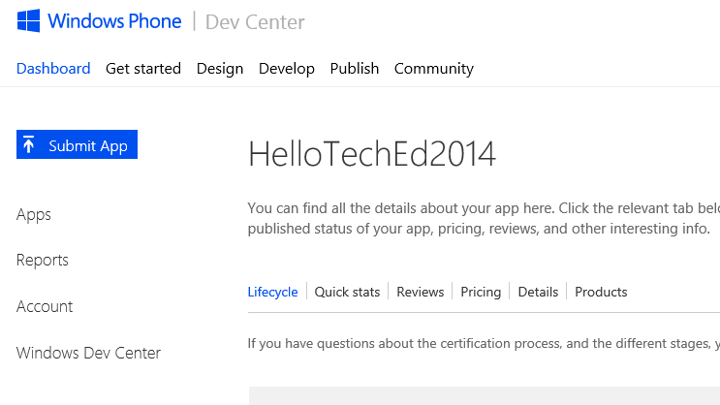
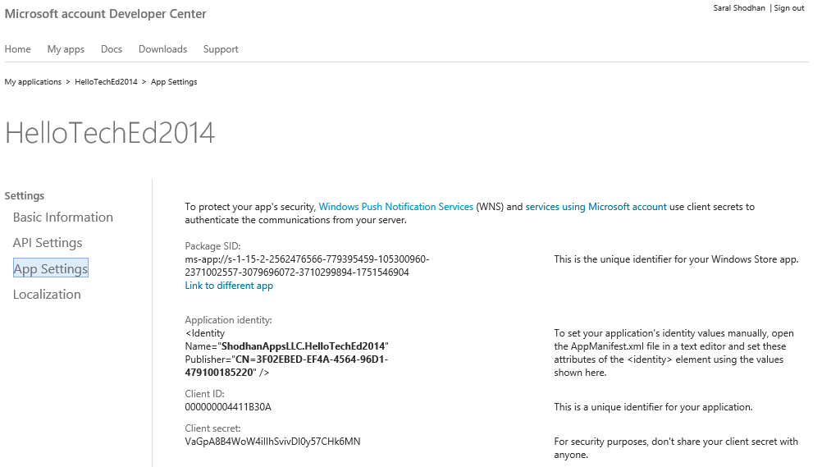
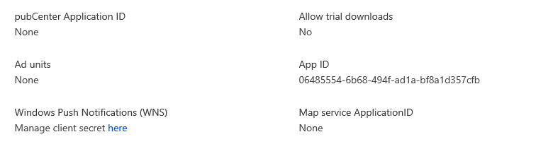
3. Register APP & Get Credentials
Submit your APP
Get Credentials
MSDN: http://msdn.microsoft.com/en-us/library/windows/apps/xaml/hh868206.aspx

Slide 22
3. Authenticate with WNS
POST /accesstoken.srf HTTP/1.1
Content-Type: application/x-www-form-urlencoded
Host: https://login.live.com
Content-Length: 211
grant_type=client_credentials&client_id=ms-app%3a%2f%2fS-1-15-2-2562476566-779395459-105300960-2371002557-3079696072-3710299894-1751546904&client_secret=VaGpA8B4WoW4iIIhSvivDI0y57CHk6MN&scope=notify.windows.com

Slide 23
3. Authenticate HTTP Response
HTTP/1.1 200 OK
Cache-Control: no-store
Content-Length: 422
Content-Type: application/json
{
"access_token":"EgAcAQMAAAAALYAAY/c+Huwi3Fv4Ck10UrKNmtxRO6Njk2MgA=",
"token_type":"bearer"
}

Slide 24
Step-4: Send Push Notification
2
WNS Push URI
WP8.1
Device
3
Request access token
WP8.1 APP
App Cloud
Service
1
4
WNS
Send Push Notification
.NET APIs
WinRT APIs
Notification Client Platform
WNS sends notification to device
Platform requests channel from WNS
PERSISTENT CONNECTION

Slide 25
4. Push Notification HTTP Request
POST https://db3.notify.windows.com/?token=AgUAAADCQmTg7OMlCg%2fK0K8rBPcBqHuy%2b1rTSNPMuIzF6BtvpRdT7DM4j%2fs%2bNNm8z5l1QKZMtyjByKW5uXqb9V7hIAeA3i8FoKR%2f49ZnGgyUkAhzix%2fuSuasL3jalk7562F4Bpw%3d HTTP/1.1
Authorization: Bearer EgAaAQMAAAAEgAAACoAAPzCGedIbQb9vRfPF2Lxy3K//QZB79mLTgK
X-WNS-RequestForStatus: true
X-WNS-Type: wns/toast
Content-Type: text/xml
Host: db3.notify.windows.com
Content-Length: 196
<toast launch="">
<visual lang="en-US">
<binding template="ToastImageAndText01">
<image id="1" src="World" />
<text id="1">Hello</text>
</binding>
</visual>
</toast>

Slide 26
3. Push Notification HTTP Response
HTTP/1.1 200 OK
Content-Length: 0
X-WNS-NOTIFICATIONSTATUS: received
X-WNS-MSG-ID: 1ACD59E4683FE4BF
X-WNS-DEBUG-TRACE: DB3WNS4011434
Important Notes
Device can be offline or disconnected. Success indicates that the request was successfully received by WNS; not necessarily that the user saw it.
The server will cache and retry if the client reconnects within a certain time.
Additional headers in the response for notification and device status.

Slide 27
WNS - Learnings from WP8
Same APIs
You screamed asked, we deliver: Raw to wake a task!
Reliable during intermittent client connectivity issues
Per type offline queue depth better suited to app needs
End to end delivery significantly faster
No more certificates to manage - OAuth!

Slide 28
WNS – Key differences from .NET/MPN
Request a new URI at every app launch
Renew your URI periodically (expire)
OAuth requires App Identity in Store
Can cross-use App Identity and SID/Secret
*

Slide 29
WNS on Windows Phone Demo

Slide 30
Windows Phone Silverlight 8.1

Slide 31
Silverlight 8.1 – Why?
Protect your existing investment
Access to new features
  Tile templates
  Toast behaviors
  Action center management
  Raw to wake a task
  WNS for push

Slide 32
Silverlight 8.1 – How To
You can call 8.1 WinRT notification APIs!
  Convert project to Silverlight 8.1
  Opt in to WNS from the WMAppManifest
Don’t mix the .NET/WinRT feature sets
  If you want to use the WinRT notification APIs, use them entirely and vice versa for .NET MPN/ShellTile/ShellToast APIs
    For example, don’t use WNS for raw push but ShellTile for local tile updates
    Or, don’t use MPN for push toasts and WNS for local toasts
  Why? Platform provisioning makes assumptions, but doesn’t enforce them

Slide 33
What about Notifications with LOB Apps?

Slide 34
Notification Services for LOB apps
App Type/ Service | Windows Notification Service (WNS) | Microsoft Push Notification (MPN)
Windows Runtime App (AppX)* | 8.1 | not supported
Windows Phone Silverlight App (XAP) | 8.1 | 8.0/8.1
Windows Runtime Phone App (AppX on WP)* | not supported | not supported
*Note: Appx files signed with a Symantec cert cannot use WNS

Slide 35
Toasts

Slide 36

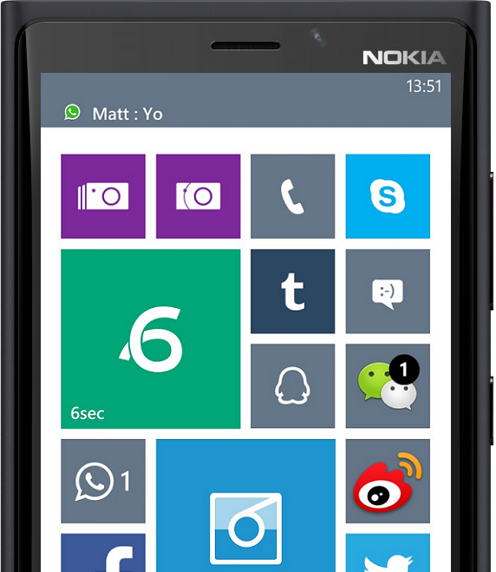



The Converged Toast Notification World

Slide 37
Action Center User Experience

Slide 38
Action Center User Experience
A user can:
Chase individual notifications
Remove per app group
Clear all

Slide 39
Action Center User Experience
Persist 7 days or less
Up to 20 most recent notifications per app
  FIFO
  “More” notification
  Offline notification grouping

Slide 40
Action Center Developer Experience

Slide 41
Action Center Developer Experience
Windows Phone 8.0 and Windows Phone Silverlight 8.1 apps using MPN will be removed when the app is launched from the primary tile
Windows Phone Silverlight 8.1 and Store apps using WNS are fully in charge of managing their own notifications

Slide 42
Action Center Management
Removal: remove 1 to many notifications
Scenarios – A sold-out deal
Replacement: replace a notification with a new one
Scenarios – Hourly stock price
Matching Tag and Group with automatically trigger replacement
Expiration: set expiration time on notifications
Scenarios – A limited time deal is only valid until midnight

Slide 43
Action Center Management
Ghost Toast: send a notification directly into notification center and suppress the “popup” UI in shell
Scenarios
Social notifications
Missed VoIP calls

Slide 44
Tiles + Templates

Slide 45
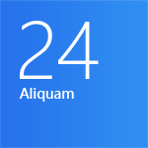
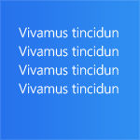



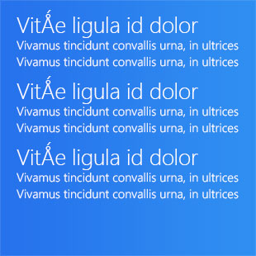


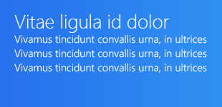
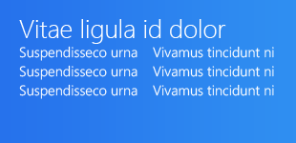
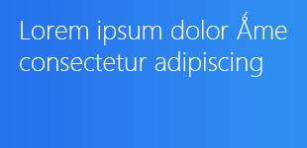
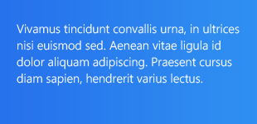
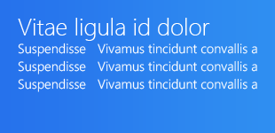
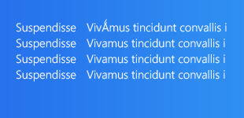
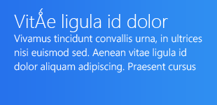

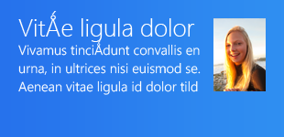
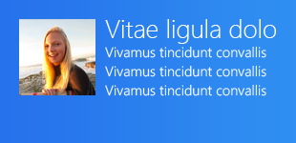
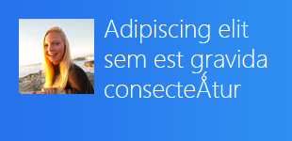
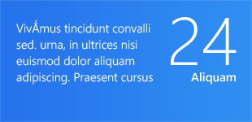
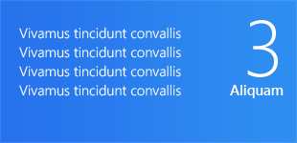
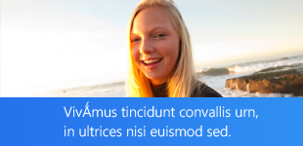
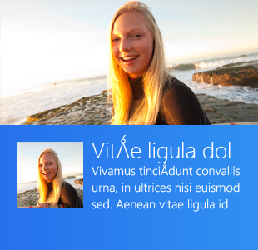
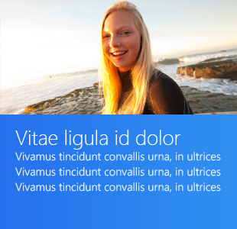
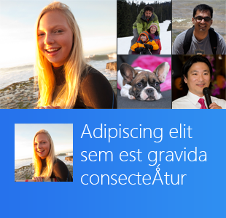
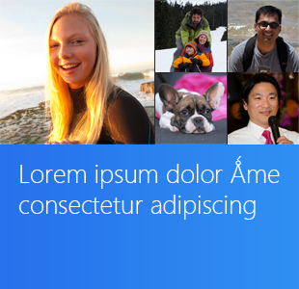
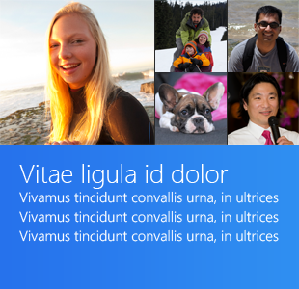


Slide 46
Tile template catalog
Consistent, harmonious experience
Now on Windows and Windows Phone
http://bit.ly/TileTemplateCatalog

Slide 47
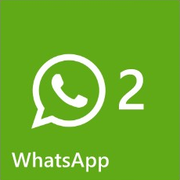
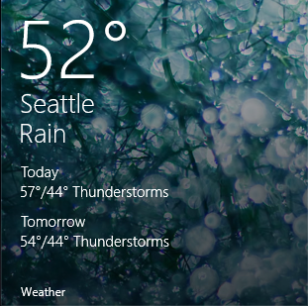

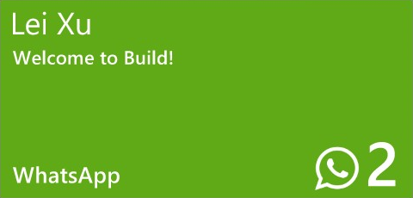

A little about the templates
Windows phone will accept all templates, but might not support every field due to space constraints.
Phone will ignore any Square310x310 templates.
Phone has its own unique templates.

Slide 48
How can I send tile updates?
Mechanism | Scenario | Expires | WinRT API
Local | Update a tile immediately, while the app is running or from a background task | Never | TileUpdateManager tileUpdater.Update()
Scheduled | Update a tile once, at a specific date and time. E.g., tomorrow at 4pm | 3 days | TileUpdateManager tileUpdater.AddToSchedule()
Periodic | Update a tile by polling a remote URI on an interval. E.g., every 30 minutes | 3 days | TileUpdateManager tileUpdater.StartPeriodicUpdate()
Push | Update a tile immediately, by sending a push notification from your server -or- Send a Raw notification to wake a background task that triggers a tile update | 3 days | PushNotificationChannelManager

Slide 49
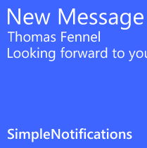
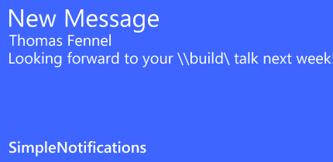

All update mechanisms use the same payload
<tile>
<visual version="2">
<binding template="TileSquare150x150Text01">
<text id="1">New Message</text>
<text id="2">Thomas Fennel</text>
<text id="3">Looking forward to your TechEd talk next week</text>
<text id="4"></text>
</binding>
<binding template="TileWide310x150SmallImageAndText02">
    <image id="1" src="http://favoritesocialmediasite.com/profiles/thomas.png" />
<text id="1">New Message</text>
<text id="2">Thomas Fennel</text>
<text id="3">Looking forward to your TechEd talk next week</text>
<text id="4"></text>
    <text id="5"></text>
</binding>
</visual>
</tile>
TechEd

Slide 50
Identical to Windows
Which means brand new stuff for phone!
Periodic polling!
Scheduled updates!
Tile notification queue!
Expiration support!
More templates!

Slide 51
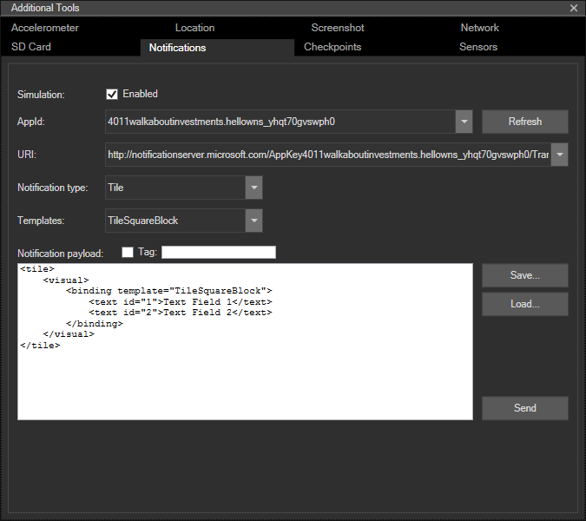
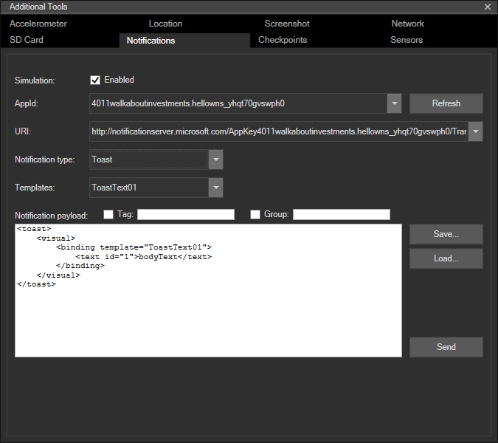
Notifications Simulation Engine (NSE)
Notification testing can be cumbersome
Requires store registration
Requires server expertise
Great tools are in our DNA

Slide 52
Demo

Slide 53
Session Objectives And Takeaways
What we delivered:
Fully converged platform
MPN on WNS is uber reliable and scalable
Notification Simulation Engine
Action Center
More templates, raw to wake a task
One Platform
Improve MPN
Tooling Gaps
Notification Center
Flexibility

Slide 54
Windows Track Resources
Windows Enterprise windows.com/enterprise windowsphone.com/business
Windows Springboard microsoft.com/springboard
Microsoft Desktop Optimization Package (MDOP)
microsoft.com/mdop
Windows To Go microsoft.com/windows/wtg
Windows Phone Developer developer.windowsphone.com

Slide 55

Resources
Learning
  Sessions on Demand
  Microsoft Certification & Training Resources
http://channel9.msdn.com/Events/TechEd
www.microsoft.com/learning
TechNet
msdn
  Resources for IT Professionals
  Resources for Developers
http://microsoft.com/technet
http://microsoft.com/msdn

Slide 56

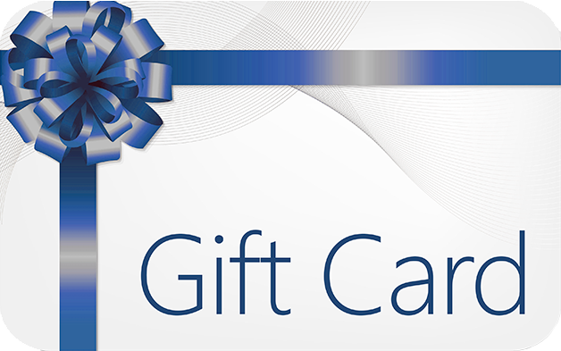
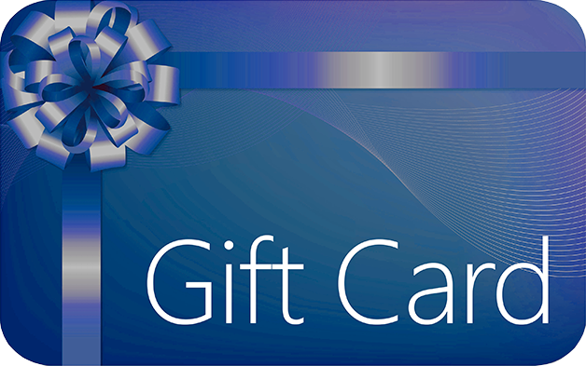
Complete an evaluation and enter to win!

Slide 57
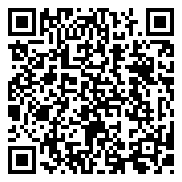

Evaluate this session
Scan this
QR code
to evaluate
this session.

Slide 58


© 2014 Microsoft Corporation. All rights reserved. Microsoft, Windows, and other product names are or may be registered trademarks and/or trademarks in the U.S. and/or other countries.
The information herein is for informational purposes only and represents the current view of Microsoft Corporation as of the date of this presentation. Because Microsoft must respond to changing market conditions, it should not be interpreted to be a commitment on the part of Microsoft, and Microsoft cannot guarantee the accuracy of any information provided after the date of this presentation. MICROSOFT MAKES NO WARRANTIES, EXPRESS, IMPLIED OR STATUTORY, AS TO THE INFORMATION IN THIS PRESENTATION.

