Slide 1


Slide 2

Windows Phone 8.1
The right choice for your business, just got better!
WIN-B221
Alan Meeus

Slide 3

Mobility has changed the way we live and work

Slide 4
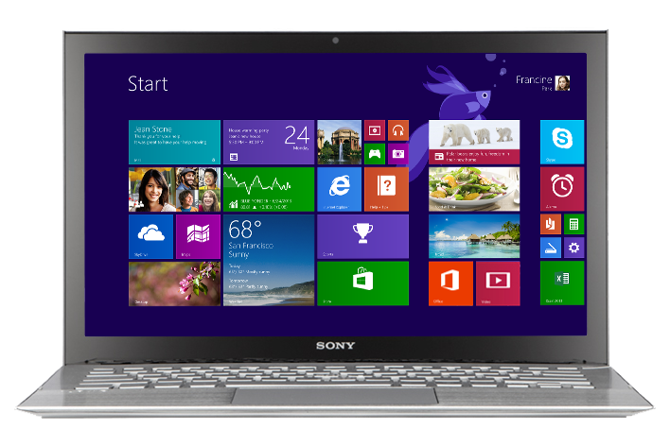
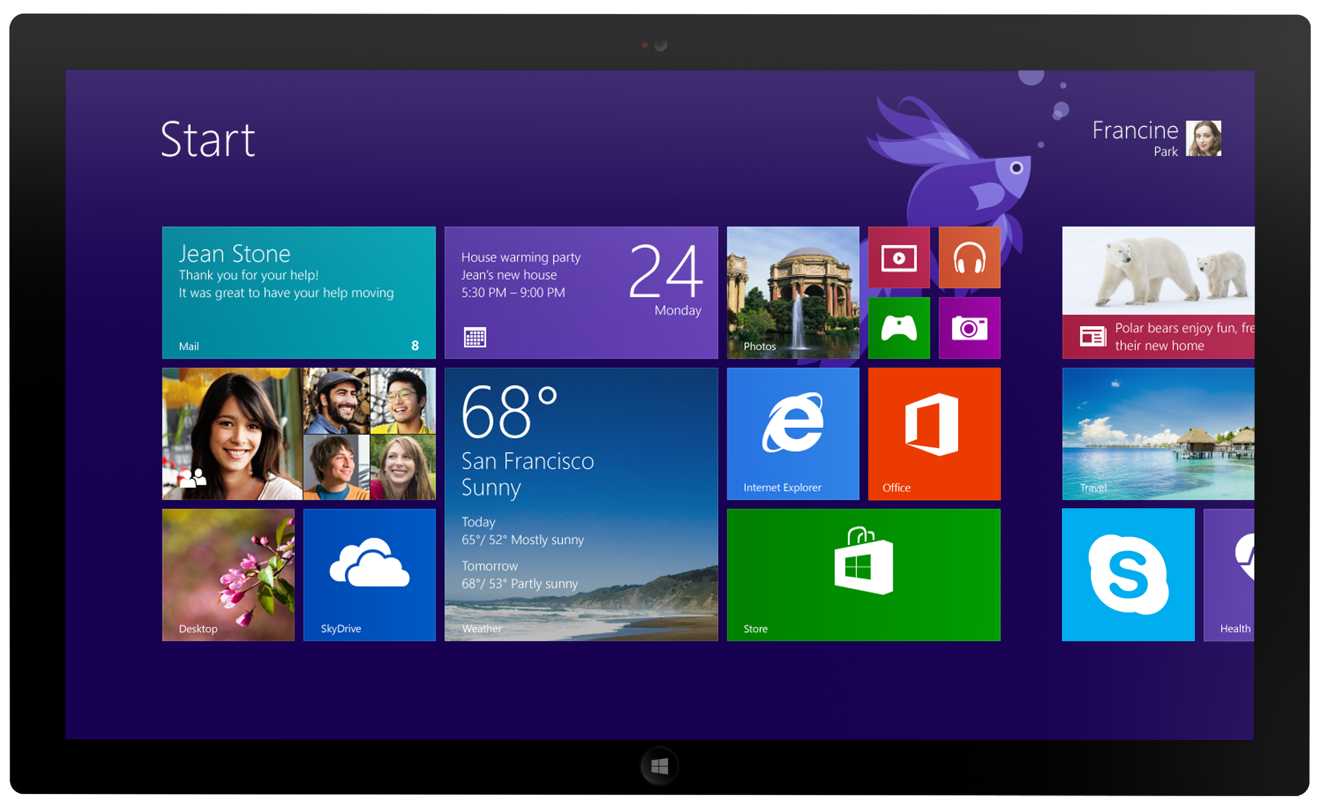
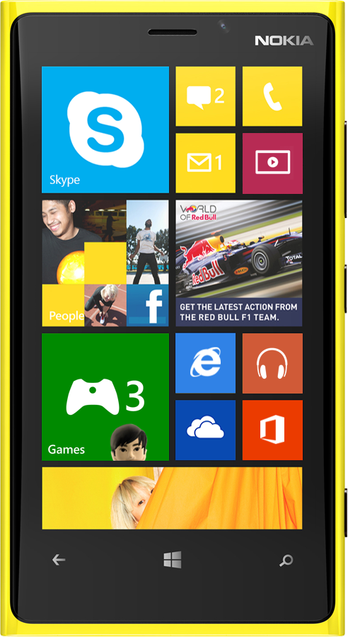

Devices & experiences people love
Infrastructure support business requires

Slide 5
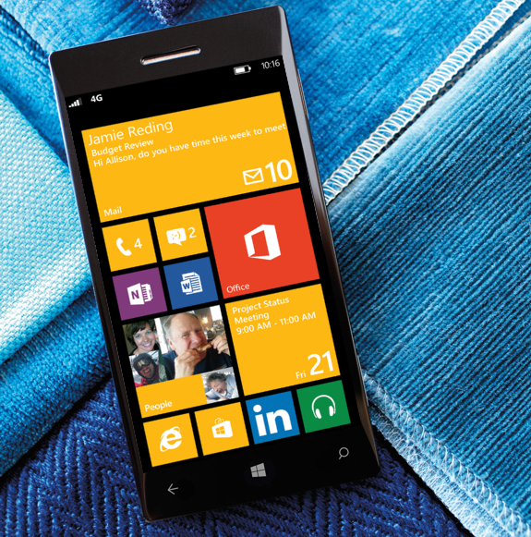
Meet Windows Phone 8.1

Slide 6


Windows Phone 8.1 release
Built-in Office Collaboration Apps
Enterprise VPN and Wi-Fi
S/MIME Support for Secure, Encrypted Email
Cortana, your more personal personal assistant
  For existing Windows Phone 8 handsets
  Available summer 2014
Business users
Anywhere productivity
Enhanced Device and App Management
Windows App Platform Convergence
Certificate Management
Enterprise Wipe
Enhanced Asset Management and User Assistance
Assigned Access
IT professionals
Putting IT
in control

Slide 7
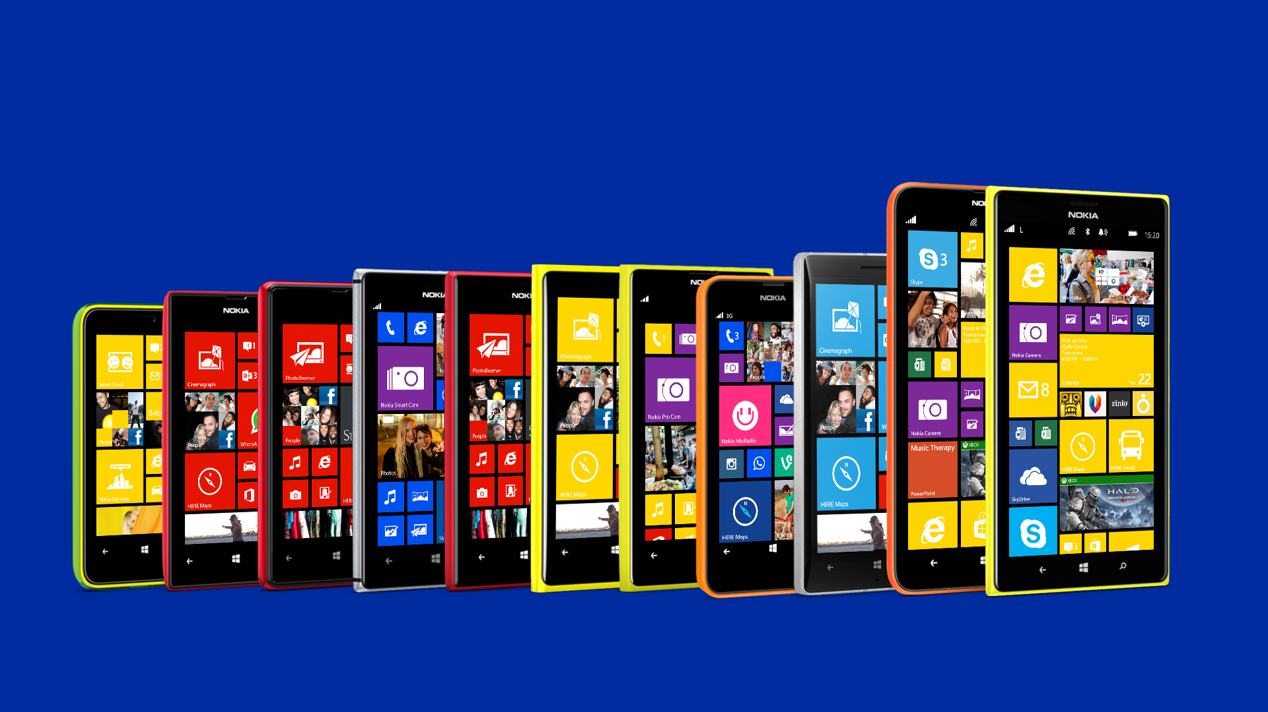
Nokia Lumia for business
Choice, price, consistency. Why compromise?

Slide 8
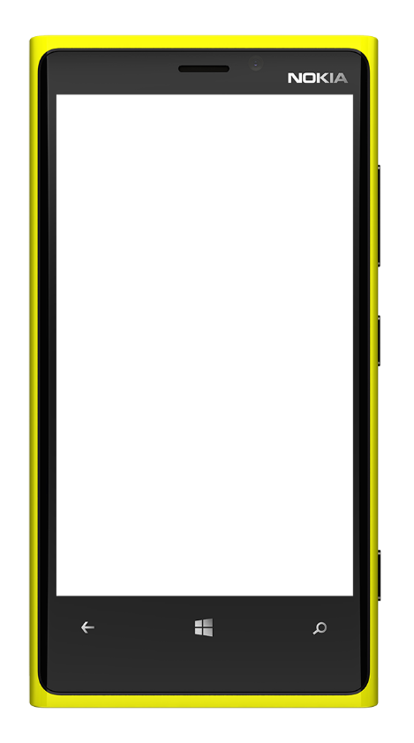
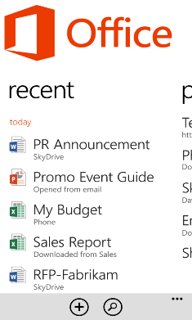
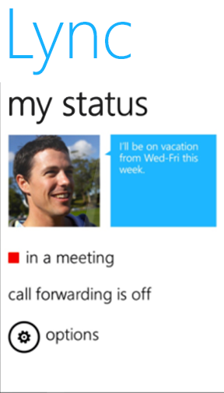
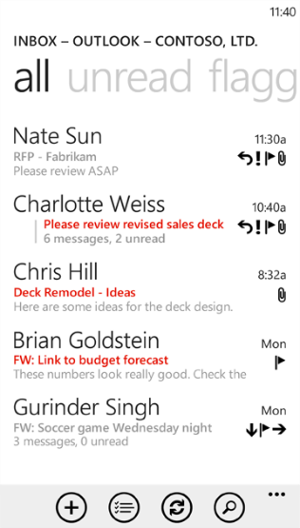
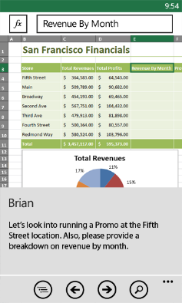
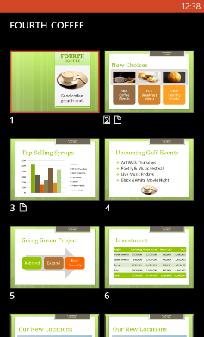
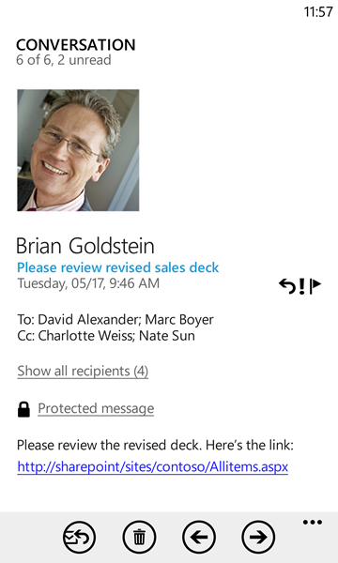
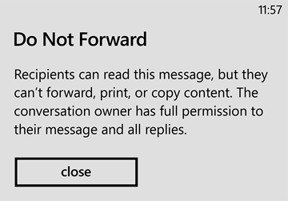
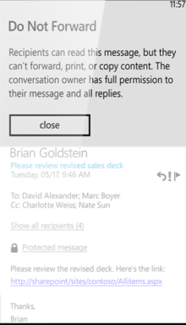
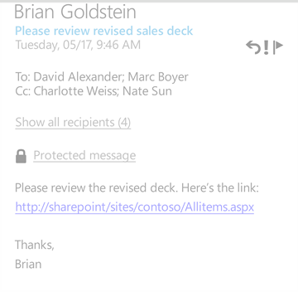
Anywhere productivity with Office built-in
Outlook Mobile and Office Mobile built-in
Read and edit with Word, Excel,
and PowerPoint, plus OneNote!
Seamless integration with Office 365,
Exchange Server, SharePoint and Lync
Integrated IRM rights management and S/MIME

Slide 9
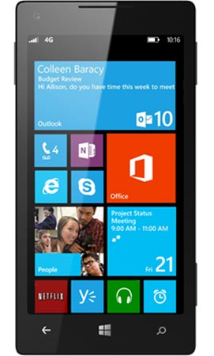

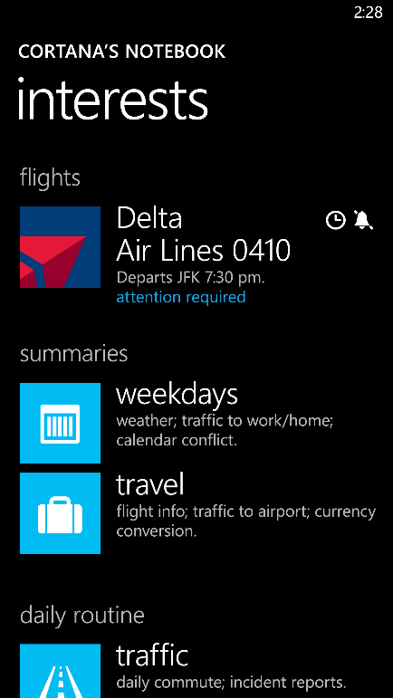
Introducing Cortana
A more personal personal assistant
Cortana learns about you and the topics you care about, people in your life, and even your routines.
Cortana stores this information in her notebook
(with your permission, of course) and uses it to make recommendations and suggestions tailored to you.
She also works on your behalf by anticipating your needs, be it a weather update, driving directions or reminders about friends and loved ones.
Cortana is powered by Bing, so your interests and alerts go with you to bing.com.

Slide 10
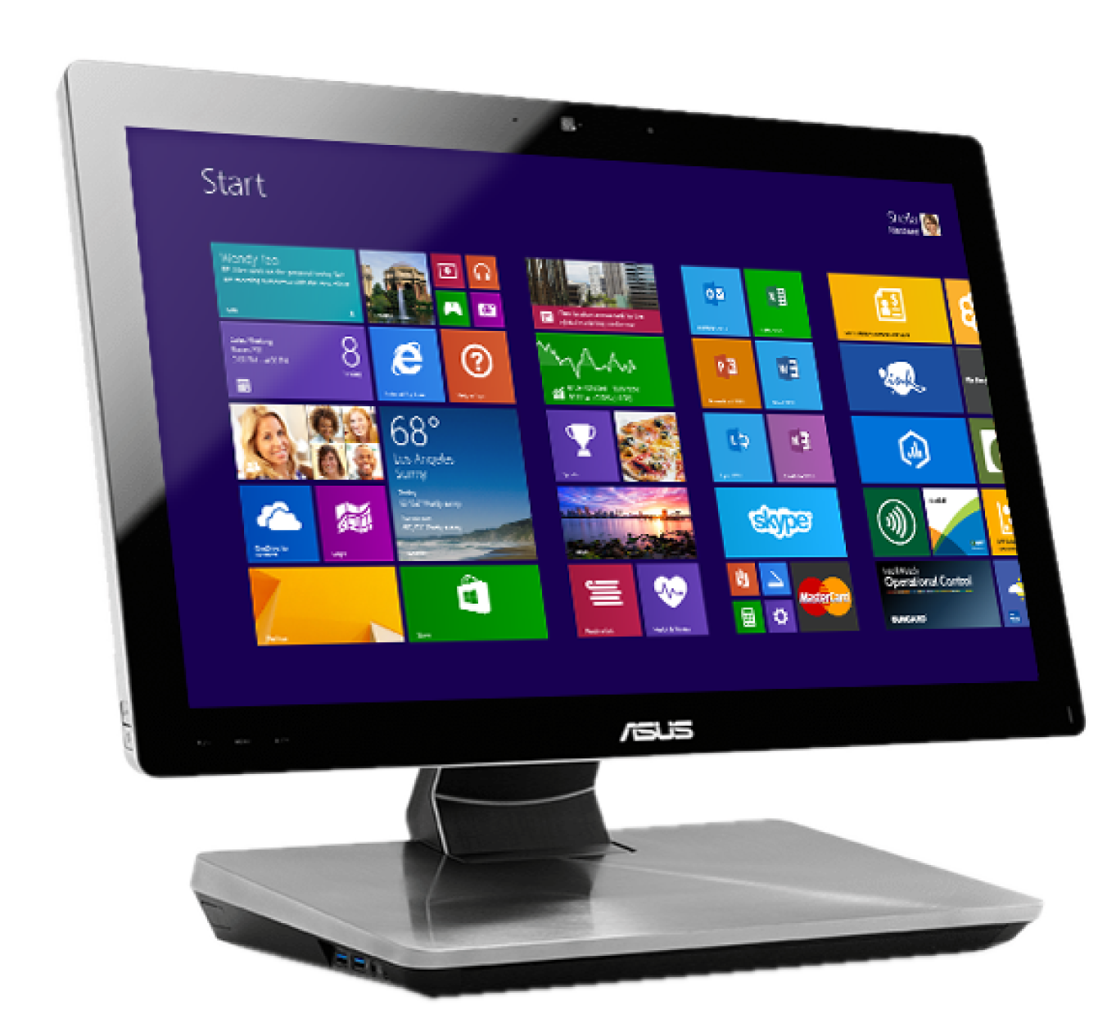
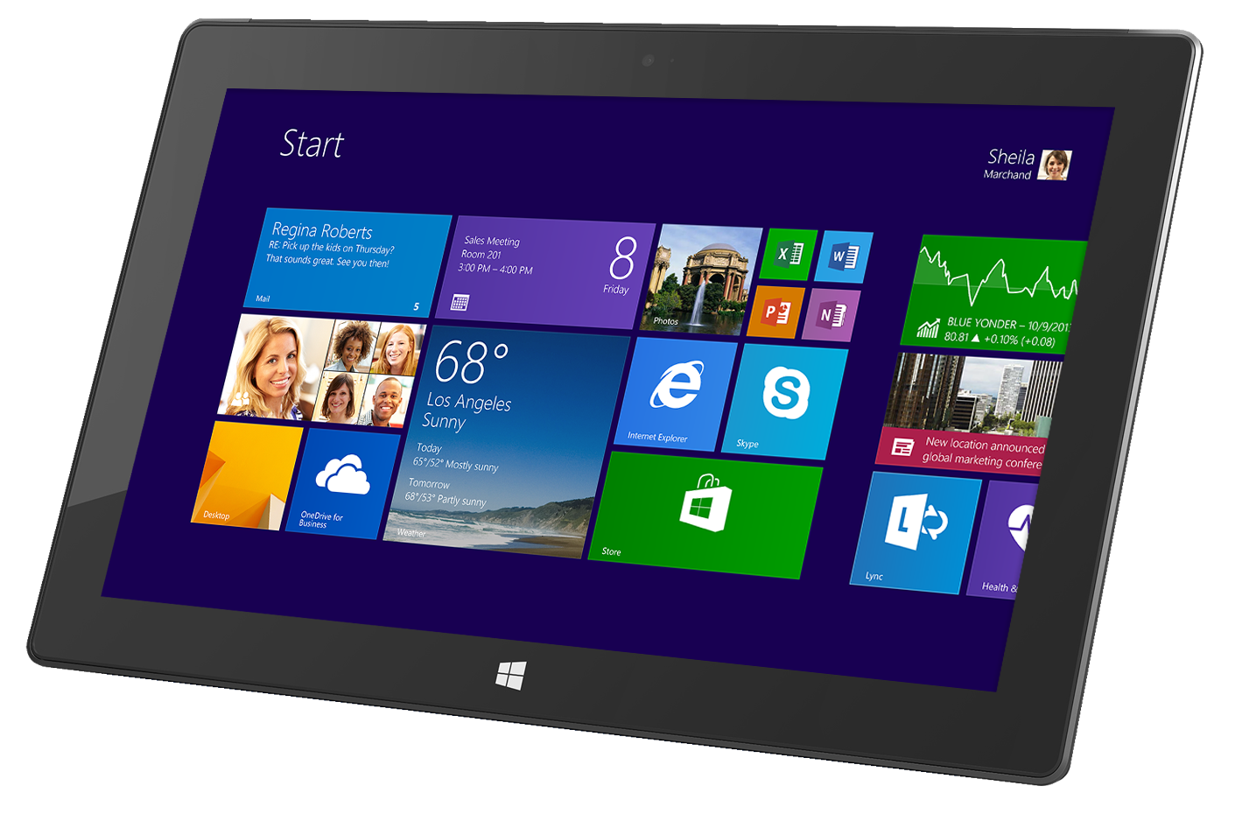
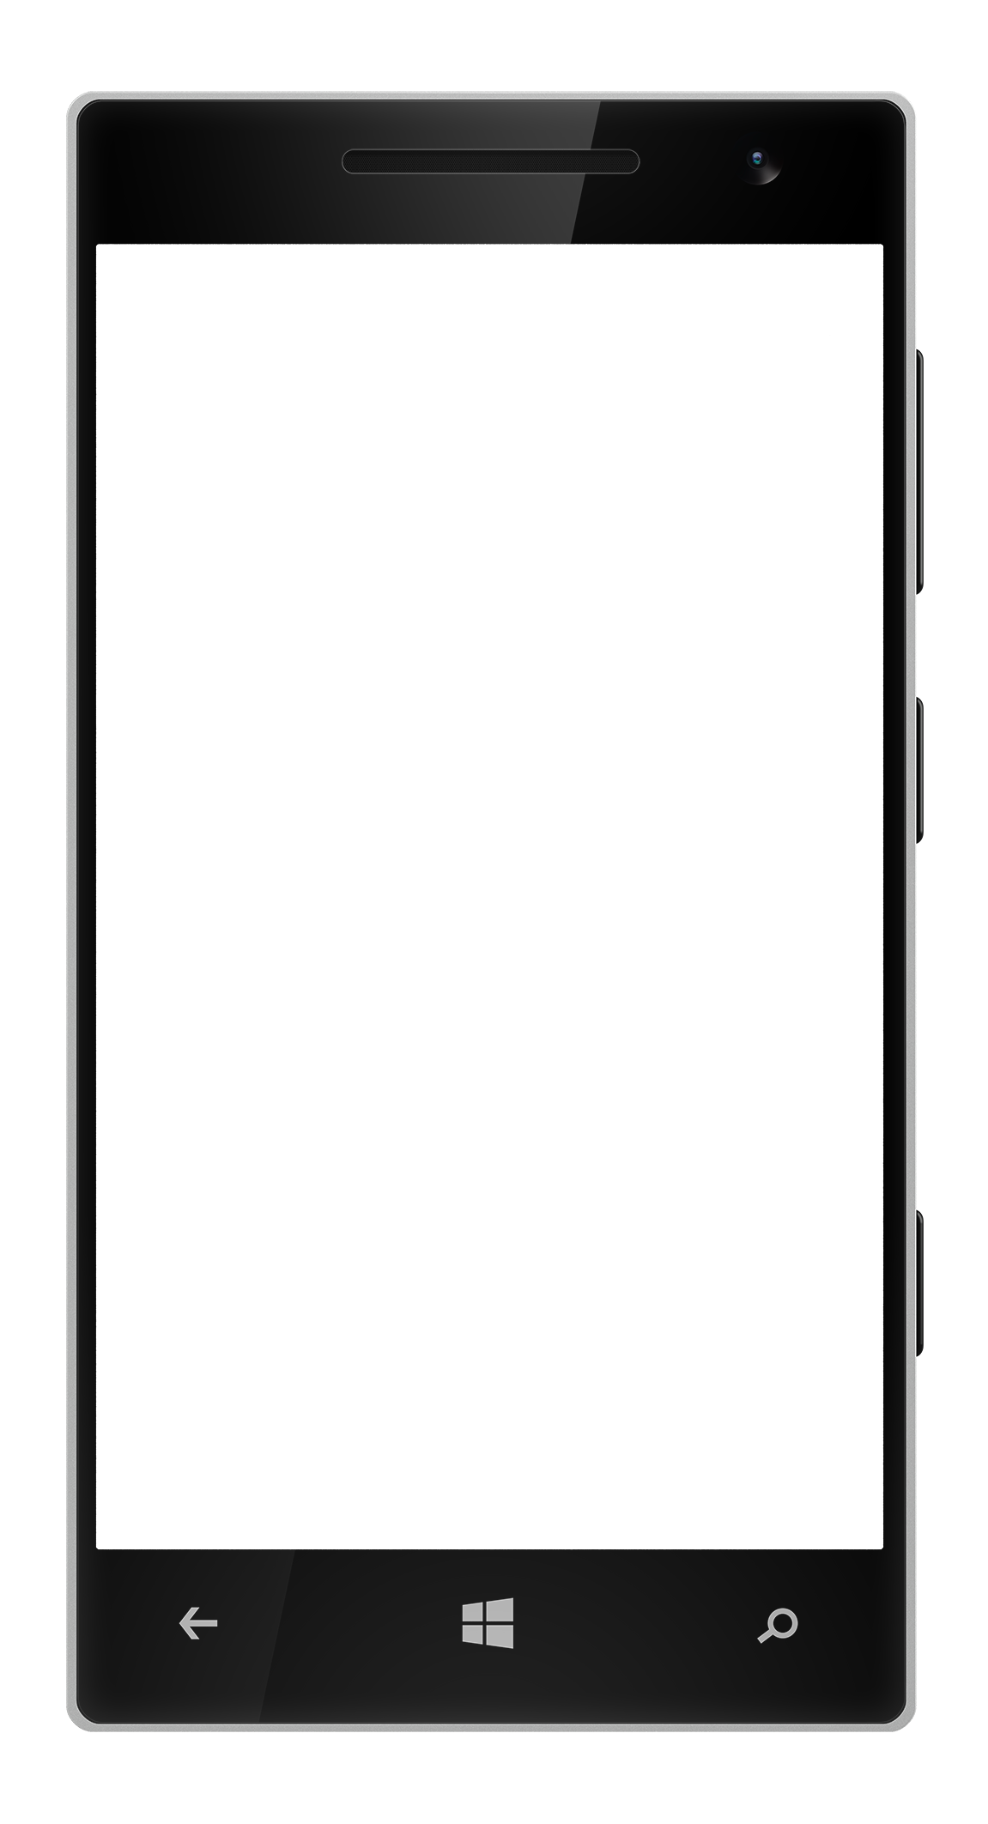
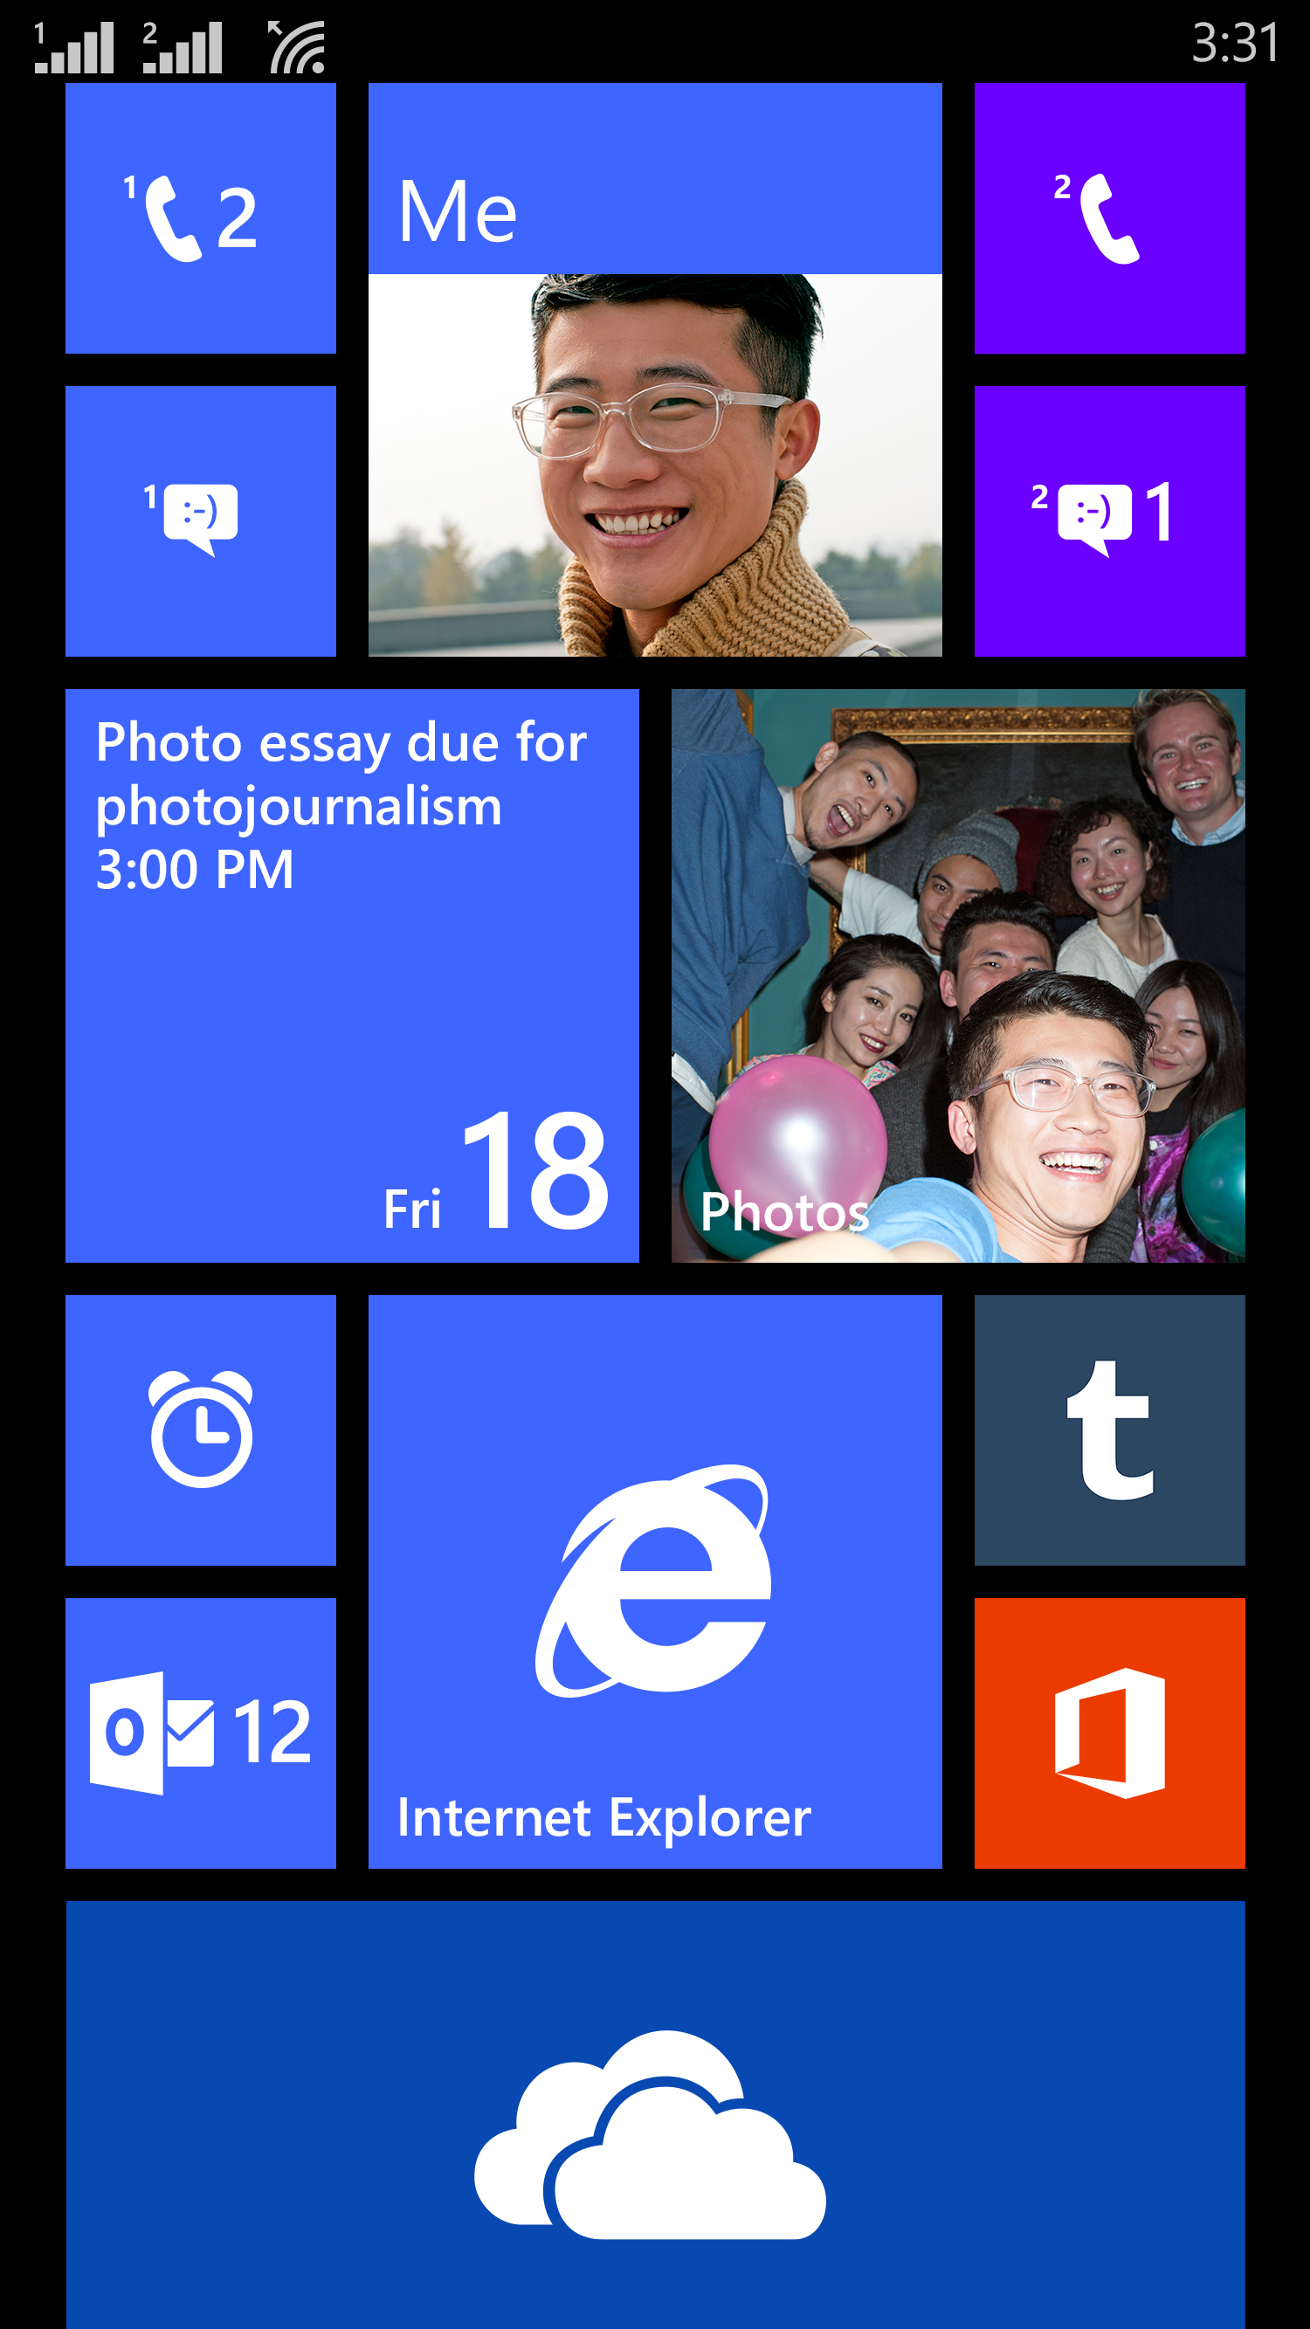
Windows app platform convergence
Shared API set across
Windows devices
Unified app model and services
Familiar developer tools
Private app distribution
and management

Slide 11

Uncompromising security and encryption
System integrity with secure hardware
and trusted boot
Malware protection with application
sandboxing and certification
Keep data safe with full device encryption
Secure Access with Wi-Fi EAP-TLS and auto triggered app specific IPsec or SSL VPN

Slide 12

Layered Security Architecture
Servers and
Cloud Services
SSL 3.0 with AES128 and AES256, IPsec and SLL VPN
Internal Storage
Data protection API
IRM & SMIME built-in
User Partition
Apps
Files and data
App Containers
Secure browser
01011001
Device-Lock
Encryption based on BitLocker technology
OS Partition
Single source updates
Fixes from MSRC
Security
Networking
Graphics
Windows NT Kernel
Drivers
Developer platform
UEFI Firmware
Hardware
UEFI Secure Boot
Code-signed chain
of trust
Certified hardware
TPM 2.0 – all phones

Slide 13
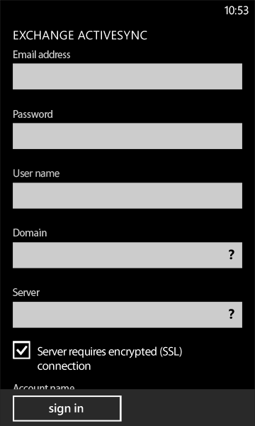
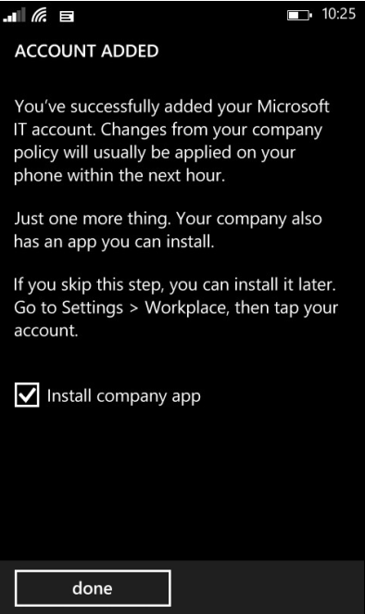
Putting IT in control with MDM
Easy enrollment to access corporate
resources from anywhere
  IT pushes enterprise collection and configures accounts, VPN, Wi-Fi, certificates, apps, and restrictions with an extensive set of policies
  IT monitors assets and assists user
  Enterprise Wipe removes all company data but preserves consumer data
  MDM support by Windows Intune and 3rd party vendors

Slide 14
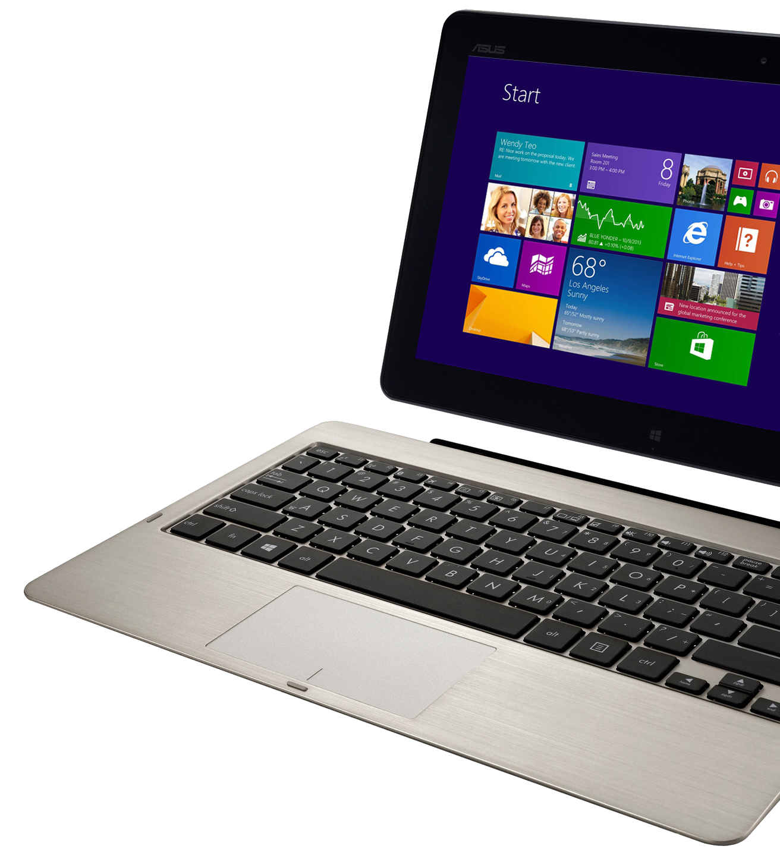


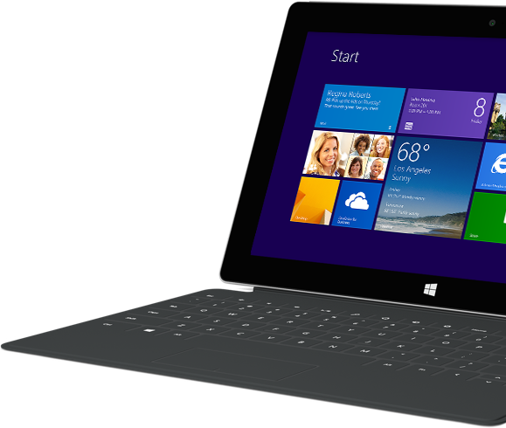
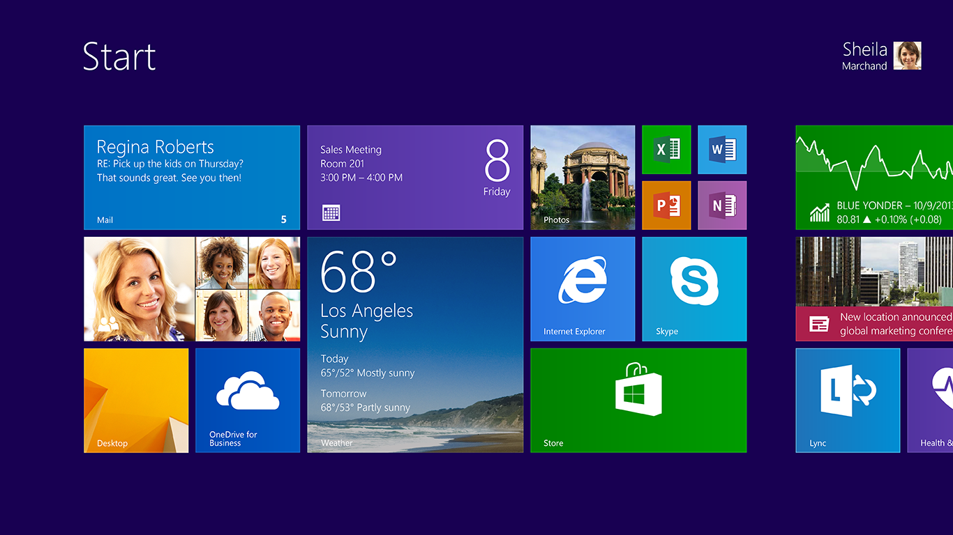


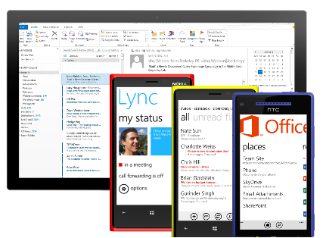
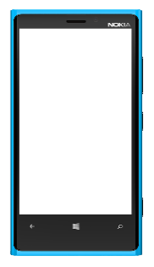
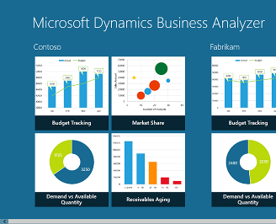
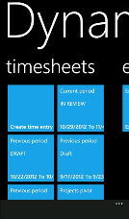

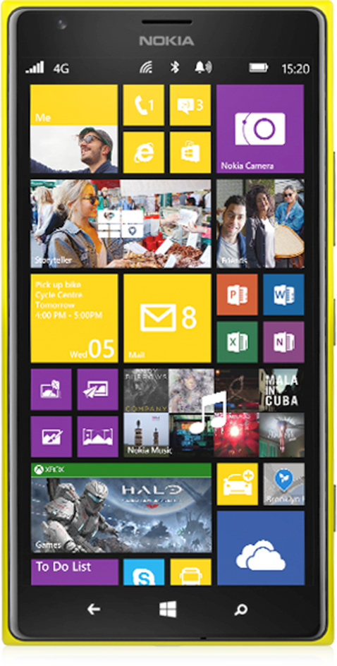
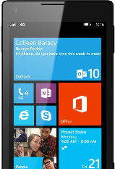
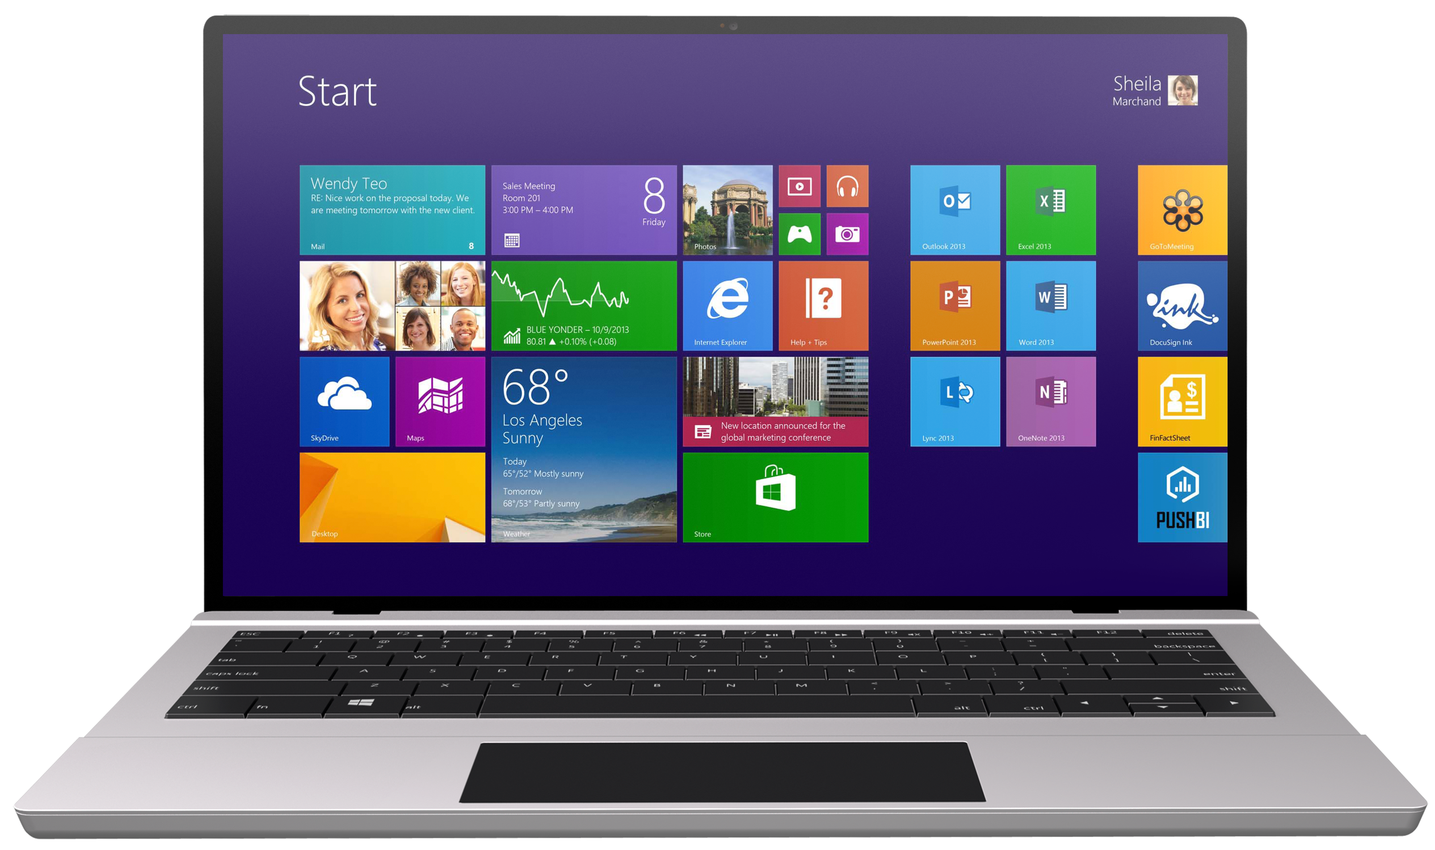

Windows Phone 8.1, the right choice for business
The right device, at the right price
Anywhere productivity
One converged apps platform
Unified, open device management
Enterprise grade security
The right device, at the right price
Built-in communication and collaboration
One Platform for all your mobile business apps
Unifed, open device management; corp & BYOD
Enterprise grade security
Rich ecosystem of operators, integrators, and ISV partners

Slide 15













Slide 16

Windows Phone resources
IT Professionals - Windows Phone 8.1 TechNet Center and White Papers
TechNet Tech Center aka.ms/wptech
Windows Phone 8.1 Security Overview
Windows Phone 8.1 Mobile Device Management
Company app distribution for Windows Phone

Slide 17
Windows Track Resources
Windows Enterprise windows.com/enterprise windowsphone.com/business
Windows Springboard microsoft.com/springboard
Microsoft Desktop Optimization Package (MDOP)
microsoft.com/mdop
Windows To Go microsoft.com/windows/wtg
Windows Phone Developer developer.windowsphone.com

Slide 18

Resources
Learning
  Sessions on Demand
  Microsoft Certification & Training Resources
http://channel9.msdn.com/Events/TechEd
www.microsoft.com/learning
TechNet
msdn
  Resources for IT Professionals
  Resources for Developers
http://microsoft.com/technet
http://microsoft.com/msdn

Slide 19



Complete an evaluation and enter to win!

Slide 20


Evaluate this session
Scan this
QR code
to evaluate
this session.

Slide 21


© 2014 Microsoft Corporation. All rights reserved. Microsoft, Windows, and other product names are or may be registered trademarks and/or trademarks in the U.S. and/or other countries.
The information herein is for informational purposes only and represents the current view of Microsoft Corporation as of the date of this presentation. Because Microsoft must respond to changing market conditions, it should not be interpreted to be a commitment on the part of Microsoft, and Microsoft cannot guarantee the accuracy of any information provided after the date of this presentation. MICROSOFT MAKES NO WARRANTIES, EXPRESS, IMPLIED OR STATUTORY, AS TO THE INFORMATION IN THIS PRESENTATION.

