Slide 2
The state of Windows 8.1 Security: Malware Resistance
WIN-B315
Chris Hallum Christopher Walstad
Senior Product Manager Senior Program Manager
Windows Security Windows Security
Microsoft Corporation Microsoft Corporation

Slide 3
Agenda
Client Malware Resistance Strategy
Hardware Rooted Trust
Platform Security
Application Security
Protection from the Cloud
How does it all stack up - Measuring Success

Slide 4
Client Malware Resistance Strategy

Slide 5
Client Malware Resistance Strategy
Security to be rooted in standards based hardware
Deliver platform that can maintain integrity, prevent tampering
Provide trustworthy and safe app ecosystem
Provide app platform that inherently prevents malicious app activity
Deliver a safe browsing experience
Enable resource access to be gated based on ability to prove health
Everything needed is right in the box, pay extra only for management

Slide 6
Microsoft Stack - Defense in Depth
Cloud
Leveraged for services data correlation & threat analysis
Applications leverage protection features of Operating System & Services
Consumer & Enterprise antimalware products share common core
Windows Security at the Core
Built on Trusted Hardware
Internet Explorer
Antimalware Products
Forefront Client Security
Tools
Malicious Software Removal Tool
MDOP MSDaRT
Windows Intune
Enterprise
Consumer
Windows Defender (XP, Vista, Windows7)
Window Defender in Windows 8, 8.1
Windows Defender Offline
Microsoft Safety Scanner
Microsoft Security Essentials
System Center 2012 Endpoint Protection, Forefront Endpoint Protection 2010/2012
Smart Screen
Apps
Windows Firewall
Common Antimalware Engine
Early Load Antimalware (ELAM)
6
Trusted Boot
Measured Boot
ASLR/DEP
UEFI
TPM

Slide 7
Hardware Rooted Trust

Slide 8
The Threat – Mebromi
Malware
Mebromi, similar it MyBIOS is a trojan and bootkit
Infects Award BIOS and controls the boot up process
Used in combination with another malware package
Activity
Mebromi is to provide persistence to malware that uses the MBR to boot
If an antimalware solution is able to clean the system of malware infected BIOS redeploys it
How it stays hidden
By living in the firmware Mebromi can remain hidden from most antimalware solutions
Additional malware that Mebromi deploys helps with persistence and tampers with AV

Slide 9
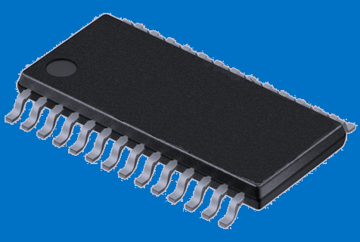
Unified Extensible Firmware Interface
What is UEFI?
A modern replacement for traditional BIOS
A Windows Certification Requirement (UEFI 2.3.1)
Key Benefits
architecture-independent solution
initializes device and enables operation (e.g.; mouse, apps)
Key Security Benefits:
Secure Boot - Supported by Windows 8, Linux, …
Eliminates Bootkit threat by securing the boot process
Encrypted Drive support for BitLocker
Network unlock support for BitLocker

Slide 10
Platform Security

Slide 11
End to end protection from power on to power down
Boot
Core
Post Boot

Slide 12
The Threat – Alureon RootKit
Malware
Alureon (also known as TDSS) is a rootkit based trojan
Second most active botnet in the second quarter of 2010, and infected million's of computers
Became known when update MS10-015 caused Alureon infected systems to crash
Activity
Steals data by intercepting and redirecting system's network traffic
Searches for usernames, passwords, credit card data, click fraud
How it stays hidden
Used privileges of the print spooler to update MBR to point to itself and bootstap further infection
Infects low level system drivers (e.g.: atapi.sys) to implement its rootkit.
Disables mandatory kernel-mode driver signing

Slide 13

Trusted and Measured Boot
Trusted Boot
End to end boot process protection (Bootloader to Windows Sign-In)
Protects Antimalware solution with ELAM
Automatic remediation/self healing if compromised
BIOS
OS Loader
(Malware)
3rd Party Drivers (Malware)
Anti-Malware Software Start
Windows Logon
Native UEFI
Windows 8
OS Loader
Anti-Malware Software Start
Windows Logon
3rd Party Drivers
Windows 8
Windows 7
Measured Boot and Remote Attestation
Creates comprehensive set of measurements based on Trusted Boot execution
Can offer measurements to a Remote Attestation Service for analysis

Slide 14
Securing the Code and Core
Preventing vulnerabilities before they’re written
  Security Development Lifecycle (SDL)
  Tools - Threat Models, Code Analyzers, Fuzzers, Visual Studio, …
  Impact - Microsoft products not in Top 10 vulnerabilities list – Kaspersky (Q3 2012 Report)
Reduce the ability to exploit vulnerabilities
  Many exploit mitigation features vastly improved - ASLR, DEP, Windows Heap
  Chris Valasek from a senior security researcher at IOActive, Inc said:
    “the security advancements from Windows XP to Windows 7 are leaps and bounds.. the advancements from version 7 to 8 are just as great.”
    “I wouldn’t want to be tasked with creating a heap exploit for Windows 8.”
Training
Requirements
Design
Implementation
Verification
Release
Response

Slide 15

Enhanced Mitigation Experience Toolkit (EMET)
Helps raise the bar against attackers
Protects against zero day attacks
12 security mitigations
Securing the Code and Core
Compliments Windows Defender other AV products
Works well for the enterprise
Deploy EMET via SCCM, Group Policies in Active Directory
Optional command line tool
Supports shared Remote Desktop
Helps protect in a wide range of scenarios
Provides mitigation protection for legacy software
Works for a range of client and server operating systems
Certificate pinning to validate SSL certificates during logon for O365, Skype, Twitter, Facebook
www.microsoft.com/emet
Protect your Enterprise. Deploy EMET today.

Slide 16
What’s New in EMET 5.0 Technical Preview
Attack Surface Reduction (ASR)
  Generic plugin blocker to reduce attack surface of programs
  Configurable per process with support of Security Zone on
  Internet Explorer
  Can limit exposure to external attacks using Java, Flash, Silverlight,
  VML, etc.
Export Address Filtering+ (EAF+)
  Additional protection on top of existing EAF mitigation
  Protect KERNELBASE exports in addition to KERNEL32 and NTDLL
  Perform additional integrity checks on stack registers/limits when export tables are read
  Prevent read operations on export tables from modules prone to memory corruption bugs
Fixes & Hardening
  Experimenting “Deep Hooks” enabled by default
  Hardening to protect EMET runtime configuration

Slide 17
Windows Defender in 8.1
Windows Defender
Windows Defender, is a comprehensive anti-malware solution. Included in all editions
Based on Security Essentials but improved (e.g.: takes advantage of ELAM)
System Center Endpoint Protection (SCEP) provides a managed Windows Defender Engine
Windows Defender improvements in 8.1
  Able to scan javascript and code sent to binary extensions when using IE
  Hardened to prevent against malicious shut-down
  Enhanced behavior monitoring to signal connections to known malicious locations
  Improved Ux to prevent users from ignoring warnings when protection is disabled
  Integrated with Provable PC Health to provide cloud based protection

Slide 18
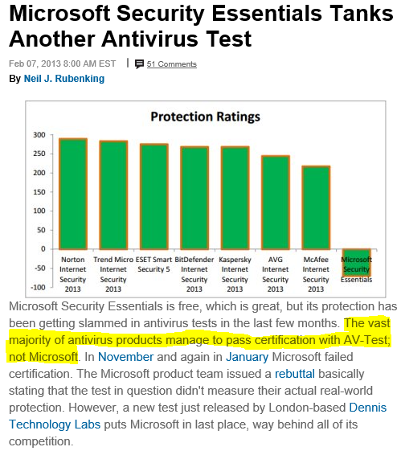
So how good is Windows Defender?

Slide 19
Nov-Dec 2013 AV Comparatives
Why we “failed”?
Microsoft protects based on prevalence of threats to our customers
Microsoft does not focus on comparative tests, as the sample sets conflict with rule 1
The test is an instant in time, and we get to them in accordance to rule 1
Why was the #1 prevalent family not in the comparative sample set?
How do other vendors $core better than Microsoft products on comparative tests?
4
1
3
The samples encountered by our customers in this test impacted .004% of our customer base
1
2

Slide 20
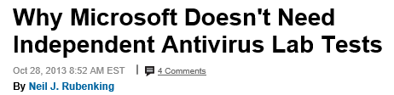
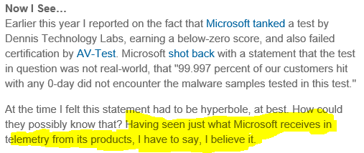
The facts have changed the narrative…
From February 2013…
…to October 2013

Slide 21
Application Security

Slide 22
Securing the System Post Boot - AppContainer
Powerful apps that are inherently more secure
  Sandboxed apps (AppContainer) run with least priv; Secures system, apps, and data from malicious apps
  Access to user data and sensitive Windows capabilities require declaration and user approval
  App Capability Declarations
  Apps declare which user and system resources they will access (e.g.:Pictures, Webcam)
  Access is declared in its package manifest so unlike Desktop apps there is full disclosure
  App Contracts
  Enable app to app interaction using Source and Target contracts
  Source Contract Example - IE has a Source contract to share site info (URL, Image(s), etc).
  Target Contract Example - Mail declares ability to receive data and formats it
  App Extensions
  Extensions lets app developers extend or customize standard Windows features
  Example - HP could can use a Windows Store device app to customize the Device -> Print flyout.

Slide 23


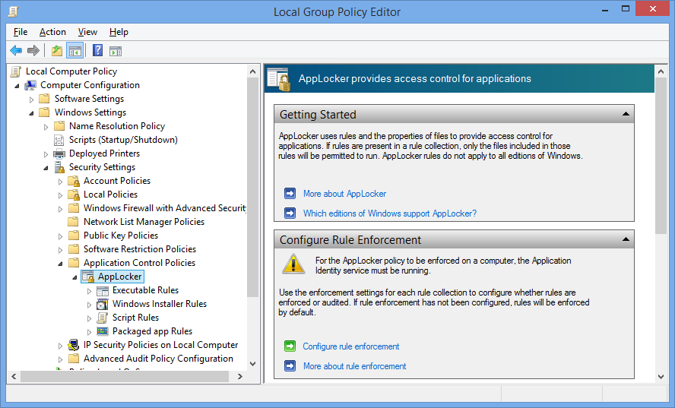

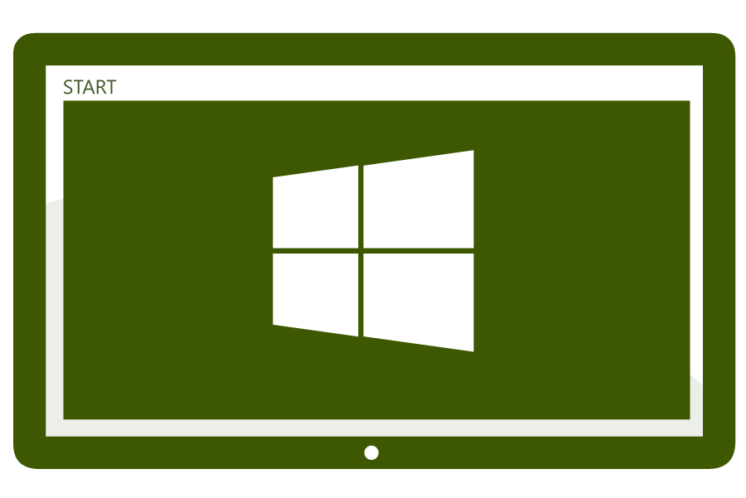
Securing the System Post Boot – Desktop Apps
Active Directory
Users with even the best intentions will use applications that put your organization’s data at risk
Well intentioned apps may be used to leak corporate data and malicious apps will harm or steal it
AppLocker can put IT back in control of which application can and can not be used using policy based white and black lists

Slide 24
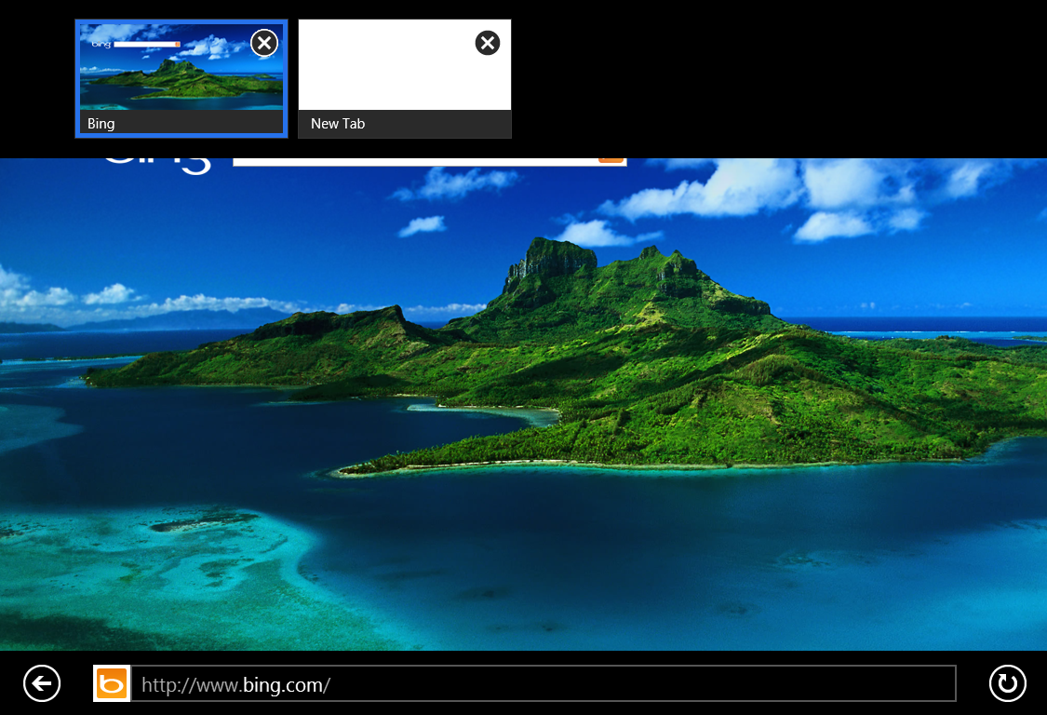
Securing the Browser - Internet Explorer
Two Experiences, Single Browser
Flash Support w/ Site Whitelisting
Enhanced Protected Mode
AppContainer Support
Process Isolation for Tabs
Prevents unauthorized access to data
Leverages Kernel Mitigations (ASLR/DEP)
ActiveX Filtering
Tracking Protection
Plug-In-less in Immersive

Slide 25
Protecting from the Cloud

Slide 26
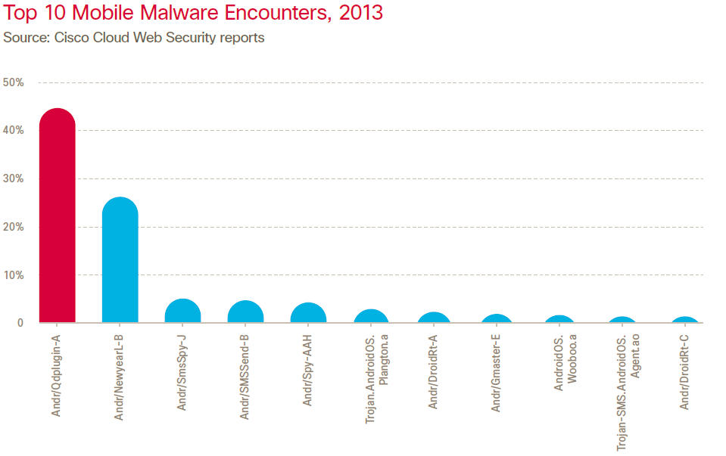

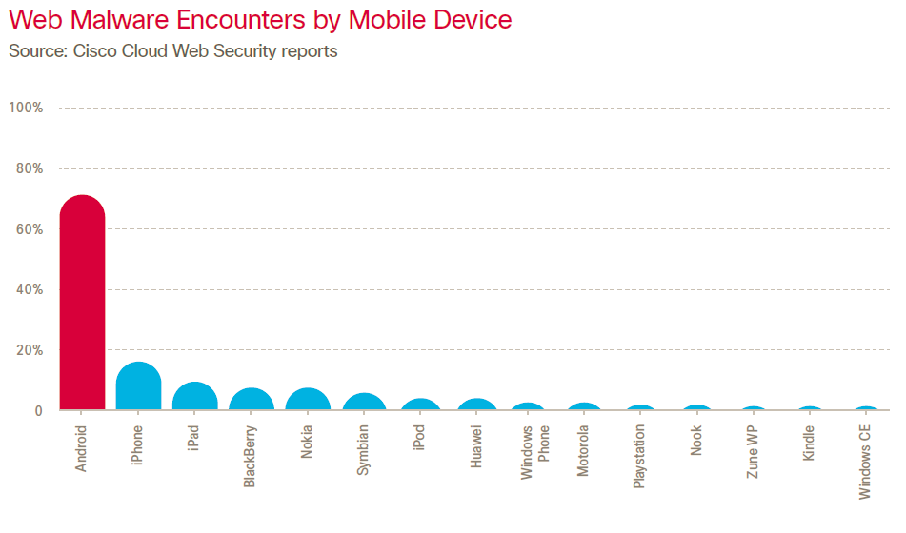
Public Cloud – App Store Strategy
Safe app ecosystem with the Windows Store
  ISV onboarding and app screening process
  Community based ratings and reviews
  Hugely successful for mobile platforms, at least for some. Window will enjoy similar results.
Think mobile malware isn’t bad. Think again!
The #1 encountered malware on mobile (Android.Qdplugin) is a Trojan that steals the device and user’s identity, enables tracking, and can install and remove packages.
Android 71% of encounters
iOS (Phone) 14% of encounters
iOS (iPad) 10% of encounters
Windows Phone <5% of encounters
It gets worse with another example from Android
Backdoor.AndroidOS.Obad.a is a vicious Trojan that racks up charges on premium rate SMS numbers, installs and proliferates additional malware

Slide 27
Public Cloud – SmartScreen
SmartScreen URL Reputation
Allows or blocks URL access based on cloud based URL reputation service
Support for Internet Explorer and Windows Store Apps
Over 3 Billion malware warnings delivered
Over 230 Million phishing warnings
Over 17 Trillion reputation lookups
SmartScreen Application Reputation
Integrated in Internet Explorer download manager and at the OS level (@shellExecute)
Application Reputation checks the cloud on program launch in Windows (all browsers)
Targeted warnings on unknown higher risk applications
Alerts are highly effective – under 5% of IE users bypass alert on later known malware
No warnings for known apps/publishers

Slide 28
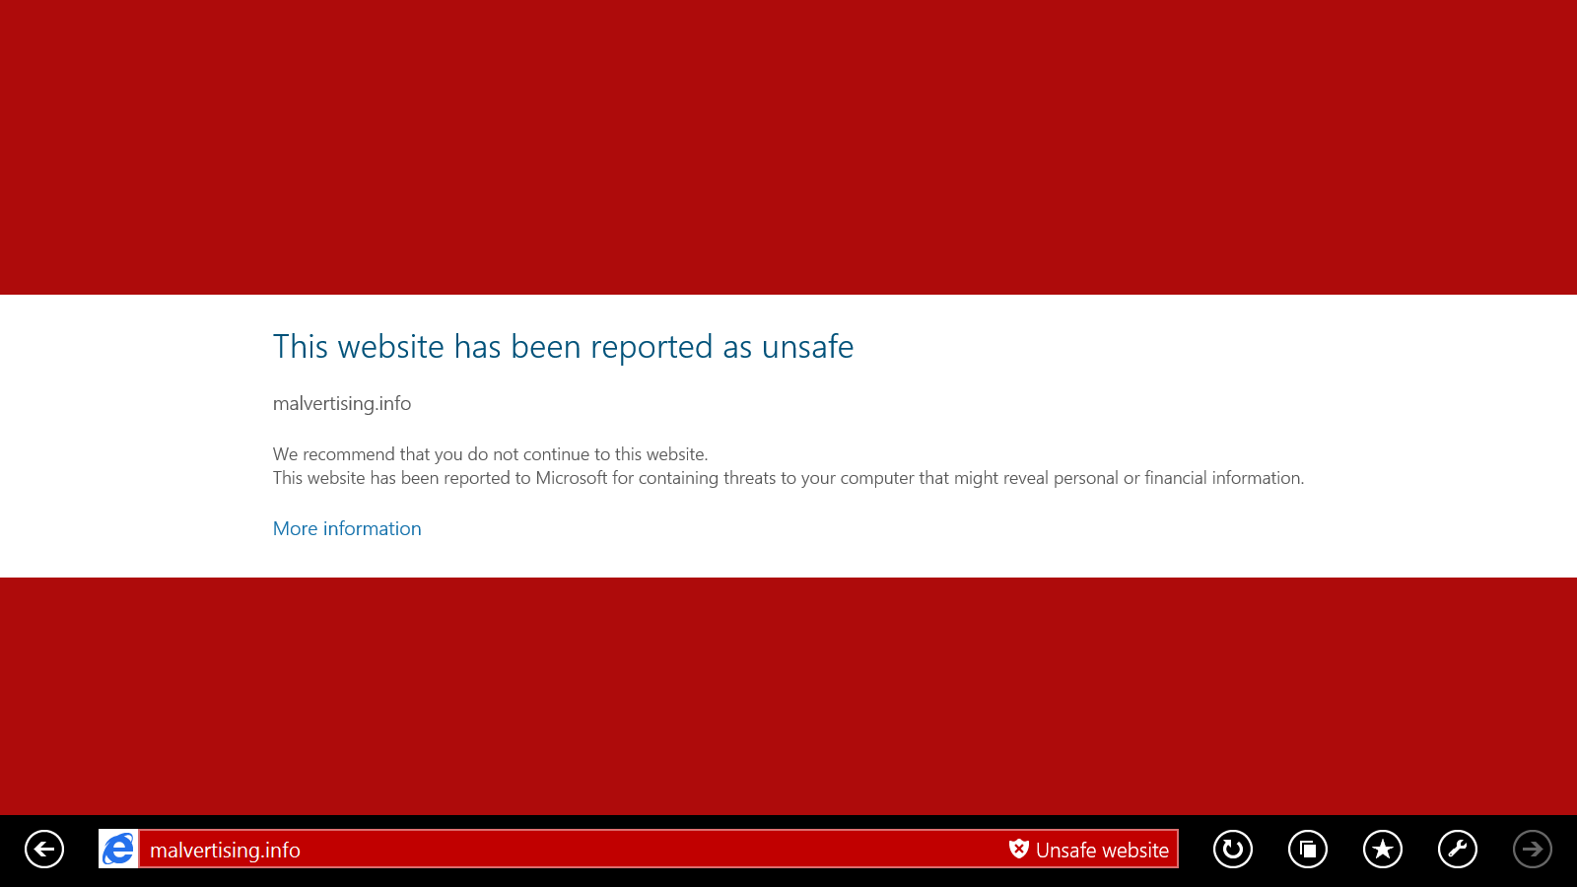

Slide 29
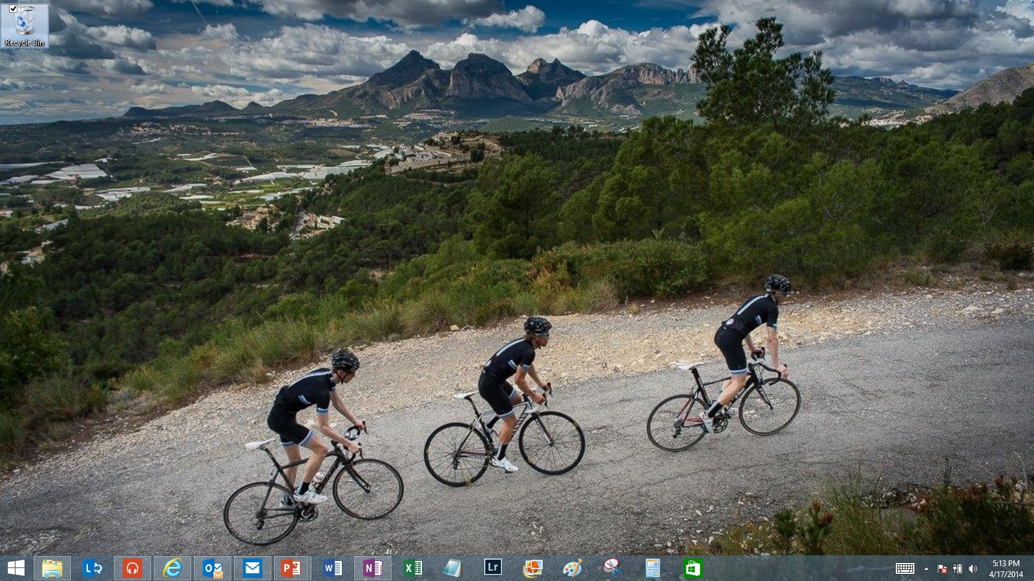
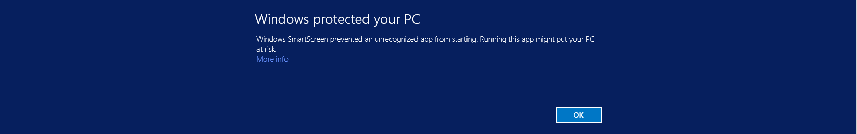

Slide 30

Public Cloud – Provable PC Health
The Challenge
UEFI and Trusted Boot very effective, no promises
Malware still able to hide by turn off defenses
No great way for devices to vet themselves
Opportunities
Leverage the boot integrity & security status data
Remote health analysis
Remote attestation
Our Goal in Windows 8.1
Deliver Remote Health Analysis service for Windows
Provide remediation and notification services
Optimize solution for consumers and BYOD

Slide 31
Public Cloud – Provable PC Health
Protecting from the Cloud
Client sends heartbeat with health state data
  Measured Boot
  Action Center Status
  Malware encounters
Cloud service consumes data and analyzes it
  Heuristics; Correlation
If issue is detected cloud sends message to Client with remediation recommendation
Client responds to recommendation
  Machine Remediation
  Account Remediation
Improved forensics with data correlation yield better and immediate protection
  Platform hardening
  Family Targeted Research
Analysis and Response
Windows Cloud Service
2
1
3
Signature Update
Windows Client
4a
4b
Machine
Remediation
Account
Remediation

Slide 32
Private Cloud - Remote Attestation
Traditional Access Control
Access based on an Access Control List that defines rights and auditing policy
Access is granted based entirely on successful authentication of the user
The Challenge
Good at making sure the right users get access
Unable to prevent compromised devices from getting access to resources
Modern Access Control
Adds vetting of a devices security state to the access control decision making process
Leverages Windows 8.1 Measured Boot, Action Center, Remote Attestation, Kerberos, …

Slide 33
Private Cloud – Scenarios/Challenge/State
Scenarios
Secure Access to Corporate Resources Secure Transactions and Banking
Protection of Digital Content More…
Challenges
Mixed Windows environments (Windows XP, 7, and 8)
Remote Attestation components will be delivered by 3rd party ISV’s
Current Windows 8.1 deployments not pervasive enough
Current State
Tier 1 ISV’s interested but not yet committed to delivering solutions, waiting…
Near terms solutions will need to come from Microsoft Services and Solution Integrators

Slide 34
Private Cloud – Remote Attestation Components
Windows 8’s Measured Boot (MB)
Measurements are secured and protected by the system’s Trusted Platform Module (TPM)
BIOS/UEFI
Windows 8
OS Loader
Windows Kernel & Drivers
3rd Party Drivers
Anti-Malware Software
Remote Attestation
3rd Party Remote Attestation Service and Client
Remote Attestation Client communicates with Remote Attestation service
Service analyzes data on request. Compares data vs. known good MB values and other policy requirements
Service issues security health determination via Health Claim; Becomes part of the users Kerberos ticket
Access Control Policy
Windows Access Control policy doesn’t natively support claims, However…
Dynamic Access Control and SharePoint do. Claim support can be added through extensibility

Slide 35
Device Registration & Periodic Refresh of Health Data
Step 1: User registers personal device
Step 2: Portal redirects new device to ADFS
Step 3: User auths with domain creds
Step 4
Step 4: ADFS extension doesn’t find user/device info
Step 5: Client agent installed on device
Step 6
Step 6: Agent sends device health data
Step 1
Step 2
Step 7: Agent enroll vSC for logon cert
Step 3
Step 5
Attestation & Verified Access to Secure Resources
Step 7
Step 5
Step 1: User tries to access project site
Step 3
Step 2: Project site needs device claims
Step 3: Device requests claim from ADFS server
Step 4: ADFS extension verifies health using Attestation Server
Step 5: ADFS issues claims token
Step 1
Step 2
Step 6
Step 6: Device uses claim to gain access to documents
BYOD – Proof of Concept Flow

Slide 36

Remote Attestation - Vendor's
Existing Software Options
(http://www.wave.com)
Custom Solution Options - Solution Integrators (SI)
JW Secure Inc. (http://www.jwsecure.com)
General Dynamics C4 Systems (http://www.gdc4s.com)
ID Data/Web (http://www.iddataweb.com)
DMI (http://www.dminc.com)

Slide 37
Measuring Success

Slide 38
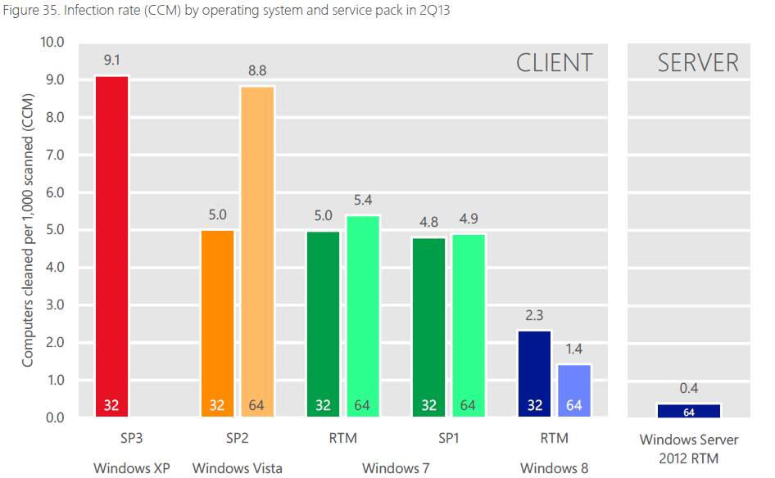

Measuring Windows 8’s vs it’s predecessors
Our investments have already produced great results!
Chart from the Microsoft Security Intelligence Report v15

Slide 39
So What’s the Conclusion?
Hardware
Security and integrity rooted in standards based hardware
Secure device firmware and operating system start-up with UEFI
TPM provides a Hardware based crypto processer for verifying device integrity
Windows 8.1 is a game changer when it comes to malware resistance!
Platform
Platform inherently resistant to malware from power on to the desktop
Secure code with SDL and vulnerabilities are less exploitable using improved ASLR/DEP
Trusted Boot prevents boot infections and Windows Defender protects the desktop
Apps
Apps are inherently more secure
App sandboxing with AppContainers prevent malicious apps from tampering
Safer browsing online with Internet Explorer 11
Cloud
A cloud based operating system who’s security is powered by the cloud
Maintain device integrity and eliminate boot and root kits with UEFI and Trusted Boot
Block Windows malware SmartScreen, Windows Defender, and sandboxed apps

Slide 40
Related content
Breakout Sessions
The State of Windows 8.1 Security: Malware Resistance - May 12th 4:45PM; Room: 371A
Malware Hunting with Mark Russinovich - May 15th 10:15AM; Room: Grand Ballrm C
Bulletproofing Your Network Security - May 12th 1:15 PM; Grand Ballrm A
Social Engineering: Targeted Attacks, and IT Security - May 13 5:00 PM - 6:15 PM Room: Grand Ballrm A
Instructor Led labs
Implementing Endpoint Protection in SCCM - May 13th 10:15; AM Room: Hall E ILL Room 3
Implementing Endpoint Protection in SCCM - May 15th 8:30; AM Room: Hall E ILL Room 3

Slide 41
Windows Track Resources
Windows Enterprise windows.com/enterprise windowsphone.com/business
Windows Springboard microsoft.com/springboard
Microsoft Desktop Optimization Package (MDOP)
microsoft.com/mdop
Windows To Go microsoft.com/windows/wtg
Windows Phone Developer developer.windowsphone.com

Slide 42

Resources
Learning
  Sessions on Demand
  Microsoft Certification & Training Resources
http://channel9.msdn.com/Events/TechEd
www.microsoft.com/learning
TechNet
msdn
  Resources for IT Professionals
  Resources for Developers
http://microsoft.com/technet
http://microsoft.com/msdn

Slide 43



Complete an evaluation and enter to win!

Slide 44
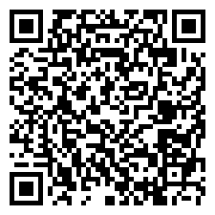

Evaluate this session
Scan this
QR code
to evaluate
this session.

Slide 45


© 2014 Microsoft Corporation. All rights reserved. Microsoft, Windows, and other product names are or may be registered trademarks and/or trademarks in the U.S. and/or other countries.
The information herein is for informational purposes only and represents the current view of Microsoft Corporation as of the date of this presentation. Because Microsoft must respond to changing market conditions, it should not be interpreted to be a commitment on the part of Microsoft, and Microsoft cannot guarantee the accuracy of any information provided after the date of this presentation. MICROSOFT MAKES NO WARRANTIES, EXPRESS, IMPLIED OR STATUTORY, AS TO THE INFORMATION IN THIS PRESENTATION.

