Slide 2

Deploying Microsoft BitLocker Administration and Monitoring (MBAM) 2.5 in Complex Environments
WIN-B318
Lance Crandall
Program Manager

Slide 3
Session Objectives And Takeaways
Session Objective(s):
  Articulate the value proposition of MBAM 2.5
  Show customers how MBAM 2.5 can help drive improved compliance (encryption, regulations)
  MBAM can be easily deployed in complex environments
MBAM 2.5 adds significant value and addresses many top customers pain points

Slide 4
Agenda
A walk down memory lane…
What’s new in MBAM 2.5
Deploying MBAM in complex environments
Enforce Policy Deeper Dive

Slide 5
A Walk Down Memory Lane

Slide 6


History of MBAM
  MBAM 1.0
  Simplify provisioning
  and deployment
  Provide reporting
  (e.g.: compliance & audit)
  Reduce costs
  (e.g.: Simplified Recovery)
  MBAM 2.0
  Improving compliance
  and security
  Integrating with existing systems
  (e.g.: SCCM)
  Reduce costs
  (e.g.: Self Service)
  MBAM 2.0 SP1
  Localization
  Support for Blue wave of products
  Bug Fixes

Slide 7
MBAM Compete Landscape
  #1 reasons customers are moving from 3rd party to BL + MBAM
  Better Performance, Better Reliability
  Ease of Deployment, Lower Costs
  3rd Party management of BitLocker growing, could hit critical mass in 2014
  Sophos, Dell (Credant), Wave Systems already supporting
  Expect Symantec and McAfee to most likely follow suit.
  Why MBAM vs Competition?
  Features/MBAM 2.5
  Price/MDOP

Slide 8

MBAM 2.0 Feedback
Localization
Performance
Enforce Policy
Federal Reqs
AD Integration
Enterprise Deployment

Slide 9
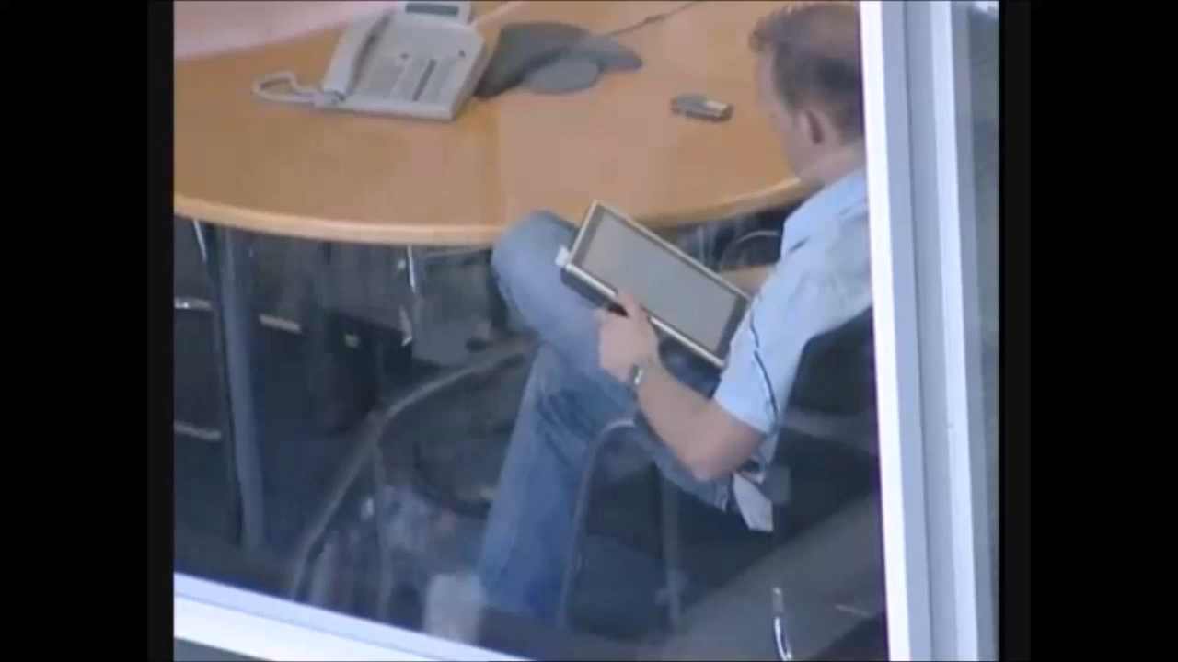
Product Group Feedback Mechanism

Slide 10
We take your feedback very seriously
We’ve felt your pain
We’ve made it WAY BETTER!!!

Slide 11
What’s New in MBAM 2.5

Slide 12

Improved Compliance & Enforcement
Challenges
Driving maximum compliance
Users able to perpetually postpone encryption
Lack of PIN complexity
Solutions for MBAM 2.5
Added grace period for encryption postponement
Automatic encryption enforcement
Prevent use of simple PINs (1234, 1111, etc)
Support use of Enhanced PINs (Unicode/ASCII, etc)

Slide 13
FIPS 140-2
Support
Challenges
FIPS required for Federal and other customers
BL recovery options for FIPS increase TCO
Solutions for MBAM 2.5
Added support for FIPS with DRA for Win7/Win8
Added support for new Windows 8.1 FIPS compliant recovery password

Slide 14
Localization
Support
Challenges
Generally localization support comes 6 months after a major release
Customers want localization sooner
Solutions for MBAM 2.5
Sim-shipping 11 languages on client and server
English (en-US), Simplified Chinese (zh-CN), Korean (ko-KR), German (de-DE), Portuguese (pt-BR), Spanish, es-ES, Traditional Chinese (zh-TW), French (fr-FR), Italian (it-IT), Japanese (ja-JP), Russian (ru-RU)

Slide 15
Performance
Challenges
Improved scalability on less hardware
More real-time reports
Solutions for MBAM 2.5
500k clients on minimal hardware
Major database and other performance improvements
No more CreateCache job for Enterprise Compliance Report

Slide 16
AD Integration
Challenges
Used local groups for administration
Network service and machine accounts
Solutions for MBAM 2.5
AD groups for administrative roles
Removed System Admin role
Using AD accounts and groups across the board

Slide 17
Support for Enterprise Scenarios and Topologies
Challenges
Enterprises want high availability and DR
Limitations in complex multi-forest environments
Lack of deployment agility
Solutions for MBAM 2.5
Support for load balancing of web components
Support for highly available SQL configurations
Support for both multi-forest and FQDN’s
PowerShell/UI support for feature configuration

Slide 18
MBAM 2.5 Deployment

Slide 19
Stand Alone Server Components
Database Components
Compliance and Audit Reports
Recovery
Database
Compliance /Audit
Database
Reporting
Web Service
Reporting
Web Site
SSRS
Self-Service Server
Administration and Monitoring Server
Self-Service
Web Service
Self-Service
Web Site
Admin
Web Service
Admin
Web Site

Slide 20
CM Server Components
Self-Service Server
Administration and Monitoring Server / Audit Report
Self-Service
Web Service
Self-Service
Web Site
Admin
Web Service
Admin
Web Site
Database Components
Configuration Manager Components
Recovery
Database
Audit
Database
Management Console
CM Reports
SSRS

Slide 21
Sizing Guidance
Two server topology (web/SQL) recommended to support 500k clients
Web
Hardware Component | Minimum Requirement | Recommended Requirement
Processor | 2.33 GHz (quad-core) | 2.33 GHz or greater (quad-core)
RAM | 4 GB | 8 GB
Disk Space | 1 GB | 2 GB
SQL
Hardware Component | Minimum Requirement | Recommended Requirement
Processor | 2.33 GHz (quad-core) | 2.33 GHz or greater (quad-core)
RAM | 8 GB | 12 GB
Disk Space | 5 GB | 5 GB or greater

Slide 22
New Prereqs for Server
.NET 4.5 Framework
  May need to run aspnet_regiis –I if .NET 4.5 installed after IIS
ASP.NET MVC 4 for SSP
PowerShell 3.0+
If using a custom hostname for the web components, create an A record
Set up constrained delegation on the app pool creds after the SPN is created
No prereqs for clients

Slide 23
SPN for Web Components
What the heck is an SPN?
  Required for Kerberos authentication
  Like a DNS CNAME for services that Kerberos uses to authenticate the client to the service
Can’t MBAM create it for me?
  We’ll sure try, but you need rights in AD.
  Install will give a warning with instructions if you don’t have rights.
Fine, how do I set one up manually
  Setspn –s http/<your host name (or virtual host name)> <mbam app pool credential>
  Example: Setspn –s http/nlb.corp.contoso.com corp\mbampoolaccount

Slide 24
Migrating to Load Balancing
MBAM 2.0 set up the SPN on the machine account
Load balancing requires SPNs on the app pool creds
MBAM 2.5 behavior and mitigation
  If a custom hostname was used, installer detects existing SPNs on the hostname specified and does nothing.
  Assuming same hostname will be used for NLB, do the following
    Delete the existing SPN on the machine account by running setspn –d http/<your custom hostname> <your machine account>
    Either remove the web sites and rerun the installer if you have rights to create SPNs, or get someone with rights to create SPNs and run setspn –s http/<your custom hostname> <MBAM app pool creds>
    Set up constrained delegation for the SPN on the app pool account

Slide 25
Migrating to Load Balancing
MBAM 2.5 behavior and mitigation
  If a non-custom hostname was used, and a custom hostname is used during configuration, installer will create a new SPN on the app pool creds if you have rights.
  If no rights, have someone with rights to create SPNS run the
    setspn –s http/<your custom hostname> <MBAM app pool creds>
  The old SPN does not need to be removed
  Set up constrained delegation for the SPN on the app pool account

Slide 26
Accounts
Feature | Account | Account Type
Databases | Access Account | User or Group
Databases | Report Account | User or Group
Reports | Compliance And Audit DB Credential | User
Reports | Reports Read Only Access Group | Group
Web Apps | Advanced Helpdesk Access Group | Group
Web Apps | Helpdesk Access Group | Group
Web Apps | Reports Read Only Access Group | Group
Web Apps | Web Service Application Pool Credential | User

Slide 27
Old Deployment Experience
All or nothing – couldn’t add or remove individual features
Reinstalling or upgrading CM resulted in lost compliance data
Couldn’t install into a remote SQL box
Challenging to know which certificate to select
No PowerShell so couldn’t rerun on multiple machines
Lots of screens depending on the path you took – some with one control

Slide 28
New Experience
Installation separated from configuration
Remote SQL Installation
Set you up for success with MBAM load balancing ready
Streamlined UI
Extensive PowerShell to help you set up MBAM in your web farm
In place CM object upgrades
Better prereq and validation checking to help you be successful
Improved logging
ADMX templates downloadable from microsoft.com\downloads

Slide 29
Deployment
Bootstrapper
Lays down bits and PowerShell cmdlets
MBAM Server Configuration Utility
UI for server configuration
Can export PowerShell
PowerShell
Enable-MbamDatabase
Enable-MbamReports
Enable-MbamWebApplication
Enable-MbamCMIntegration

Slide 30
Demo
Server Installation

Slide 31
Server Upgrade Paths
MBAM 1.0 to 2.5 Process
1.0
2.0 SP1
2.5
MBAM 2.0 to 2.5 Process
2.0
2.0 SP1
2.5
Client can go from any version to the latest

Slide 32
Upgrade Steps (Standalone)
Uninstall web components
Back up databases
Uninstall other components, databases remain
Install new version. Databases upgraded in place
Update group policies if needed for new features
Deploy updated MBAM agent (uninstalls old/no reboot)

Slide 33
Upgrade Steps (CM Integrated)
Uninstall web components
Back up databases
Uninstall other server components, reports; databases remain
Update MOF files
Install new version. Databases, CM objects, and CM reports upgraded in place, preventing data loss
Update group policies if needed for new features
Deploy updated MBAM agent (uninstalls old/no reboot)

Slide 34
Enforce Policy Deeper Dive

Slide 35
Enforce Policy – Grace Period
User can postpone encryption until grace period.
Calculated based on when volume was determined to be non-compliant.
Value cleared when compliant
Non-compliance date pushed to MBAM db per volume, but not exposed in reports
Can help determine how long machines have been non-compliant
Fixed data drives encrypt after OS drive is compliant

Slide 36
Enforce Policy - Enforcement
TPM only
Encryption begins after grace period expires
Encryption in the background – no UI!
TPM+PIN or Password
MBAM wizard appears and can’t be closed
Topmost window
Can move the window, however

Slide 37
Demo
Enforce Policy

Slide 38
Feature Summary
Completely new server setup experience
Rich HA and DR support
Multi-forest/FQDN
Grace periods before policy enforcement
Automatic encryption after grace period expiration
PIN Complexity and Enhanced PIN support
FIPS support on Windows 7, 8, and 8.1
Perf improvements
Localization

Slide 39
Available as of May 1!

Slide 40
Q&A

Slide 41
In Review: Session Objectives And Takeaways
Session Takeaways:
  MBAM can easily be deployed in complex customer environments
  Start selling to Federal and other customers who have FIPS requirements
  Compliance is even easier to attain with MBAM 2.5
MBAM 2.5 adds significant value by addressing many top customers pain points

Slide 42
Related Content
Breakout Sessions/Hands on Labs
  WIN-B215: Deploying Microsoft App-V 5 and Citrix XenDesktop 7 – Thursday 14:45
  WIN-B318: Deploying Microsoft BitLocker Administration and Monitoring (MBAM) 2.5 – Monday 15:00
  WIN-B330: Everything You Need to Know for a Successful Office 2013 Deployment on App-V Deployment – Tuesday 15:15
  WIN-B331: UE-V: Keeping a personalized experience across Virtual & physical environments
  – Tuesday 15:15
  WIN-B355: The Circle of Life for an App-V 5.0 Package: From Sequence to Termination – Thursday 13:00
  WIN-B360: Sizing App-V 5: Planning and Designing a Highly Available, Scalable, and Resilient Management and Delivery System – Thursday 14:45
  WIN-B362: Project Virtual Reality Check: Microsoft App-V 5 Performance, Tuning, and Optimization (App-V PTO) - Thursday 10:15
  WIN-H309: Implementing App-V 5 in Microsoft System Center 2012 R2 Configuration Manager

Slide 43
Windows Track Resources
Windows Enterprise windows.com/enterprise windowsphone.com/business
Windows Springboard microsoft.com/springboard
Microsoft Desktop Optimization Package (MDOP)
microsoft.com/mdop
Windows To Go microsoft.com/windows/wtg
Windows Phone Developer developer.windowsphone.com

Slide 44
Appendix

Slide 45
Accounts
Feature | Account | Account Type | Description
Databases | Access Account | User or Group | User or group with read/write access to dbs. Web app pool credential should be the same account, or in the group specified.
Databases | Report Account | User or Group | User or group that has read only access to the compliance and audit data. Compliance and Audit DB credential should be the same account, or in the group specified.
Reports | Compliance And Audit DB Credential | User | User that the local SSRS instance will use to connect to the MBAM Compliance and Audit Database. The domain user in the credentials must be the same as the user account you specified for the Report Account parameter when enabling the databases. If you specified a domain user group for the Report Account parameter, this domain account credential must be a member of that group.
Reports | Reports Read Only Access Group | Group | Specifies the domain user group that has read access to the reports. The group you specify must be the same group you specified for the Reports Read Only Access Group parameter when the web apps are enabled.
Web Apps | Advanced Helpdesk Access Group | Group | Specifies the domain user group that has access to all areas of the Administration and Monitoring Website except the reports.
Web Apps | Helpdesk Access Group | Group | Specifies the domain user group that has access to the "Manage TPM" and "Drive Recovery" areas of the Administration and Monitoring Website.
Web Apps | Reports Read Only Access Group | Group | Specifies the domain user group that has read access to the Reports area of the Administration and Monitoring Website. The group you specify must be the same group you specified for the Reports Read Only Access Group parameter when enabling reports.
Web Apps | Web Service Application Pool Credential | User | Specifies the domain user that the application pool for the MBAM web applications will use. The user you specify must be the same domain user account you specified in the Access Account parameter when enabling databases, or a member of the group specified.

Slide 46
PIN Complexity
Enables Enhanced PIN
Supports Unicode characters – make sure preboot supports it! We don’t check!
Can force to ASCII only – better preboot compatibility
Prevents use of simple PINs (1234, 1111, etc)

Slide 47

Resources
Learning
  Sessions on Demand
  Microsoft Certification & Training Resources
http://channel9.msdn.com/Events/TechEd
www.microsoft.com/learning
TechNet
msdn
  Resources for IT Professionals
  Resources for Developers
http://microsoft.com/technet
http://microsoft.com/msdn

Slide 48



Complete an evaluation and enter to win!

Slide 49
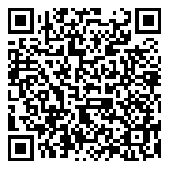

Evaluate this session
Scan this
QR code
to evaluate
this session.

Slide 50

© 2014 Microsoft Corporation. All rights reserved. Microsoft, Windows, Windows Vista and other product names are or may be registered trademarks and/or trademarks in the U.S. and/or other countries.
The information herein is for informational purposes only and represents the current view of Microsoft Corporation as of the date of this presentation. Because Microsoft must respond to changing market conditions, it should not be interpreted to be a commitment on the part of Microsoft, and Microsoft cannot guarantee the accuracy of any information provided after the date of this presentation. MICROSOFT MAKES NO WARRANTIES, EXPRESS, IMPLIED OR STATUTORY, AS TO THE INFORMATION IN THIS PRESENTATION.

