Slide 2
Internet Explorer App Compat
WIN-B320
Fred Pullen

Slide 3
Enterprise Browser Versions
Internet Explorer 11
Internet Explorer 10
Internet Explorer 9
Internet Explorer 8
Windows 8.1
Windows 8
Internet Explorer 7
Internet Explorer 6
Windows Vista
Windows 7
Windows XP

Slide 4
Enterprise Mode
for Internet Explorer 11
Enterprise Mode for Internet Explorer 11 provides improved Internet Explorer 8 compatibility for Windows 7 and Windows 8.1.
By making it easier to upgrade to the latest version of Internet Explorer, Microsoft is helping customers stay up-to-date with the latest software, services, and devices.
Legacy Web Apps

Slide 5
Improved Compatibility
Internet Explorer 11 emulates Internet Explorer 8 with configuration & code changes
User Agent String
ActiveX and Binaries
Deprecated Functions
Enterprise Mode
Caching / Pre-Rendering

Slide 6
Enterprise Mode Management
Easy-to-use Group Policies and Registry Keys
Group Policies
“Let users turn on and use Enterprise Mode from the Tools menu”
“Use the Enterprise Mode IE website list”
Registry Keys
HKLM\SOFTWARE\Policies\Microsoft\Internet Explorer\Main\EnterpriseMode
Enable the Tools menu: “Enable” = “” or “{URL}{:port}”
Enable the XML site list: “SiteList” = “{File Path or URL}”
✓

Slide 7
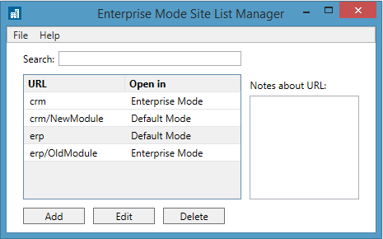
XML Site List & Manager Tool
True/false “exclude” syntax enables fine-grained control
<rules version="3">
<emie>
<domain exclude="false">crm
<path exclude="true">/NewModule</path>
</domain>
<domain exclude="true">erp
<path exclude="false">/OldModule</path>
</domain>
<domain>timecard</domain>
</emie>
</rules>
Specify Enterprise Mode by domain or web path

Slide 8
Easier Web App Testing & Remediation
Pilot users test web apps, using Enterprise Mode as needed
Optionally, when Enterprise Mode is turned on or off, a collection point can be notified
Web Apps
Enterprise Mode
Collection Point
Site List
XML File
IT
Pilot Users
Crowd-sourced submissions can be evaluated for inclusion in the Enterprise Mode Site List

Slide 9
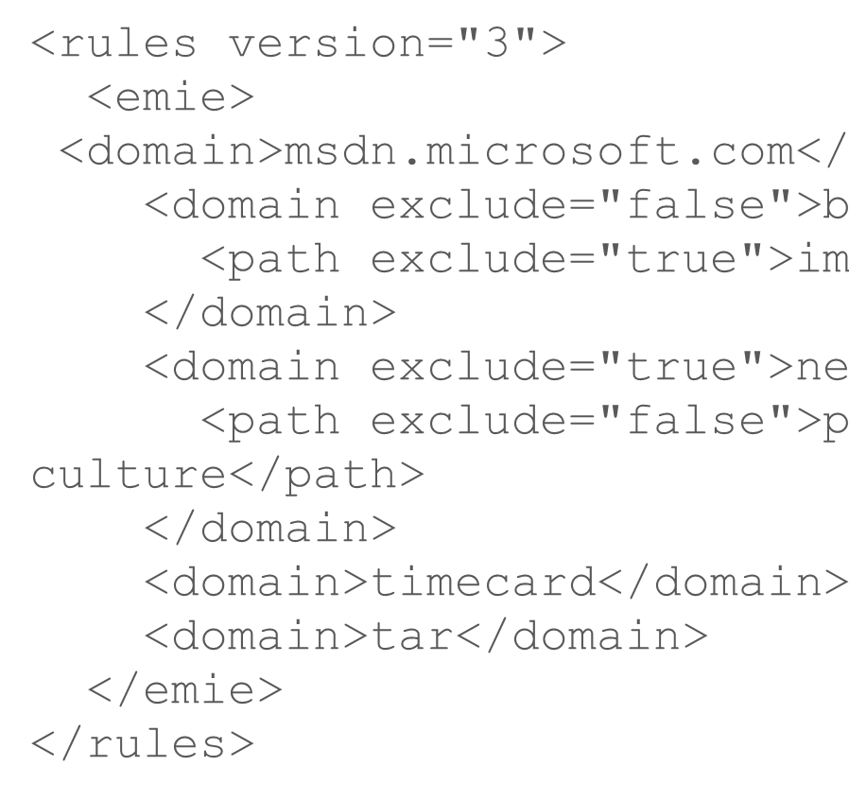
Seamless Web Browsing
Internet Explorer 11 switches modes dynamically
Internet Explorer 11
Enterprise Mode
Site List
Enterprise Mode
Edge Mode
List Location Set via Group Policy
Windows 8.1 or Windows 7

Slide 10
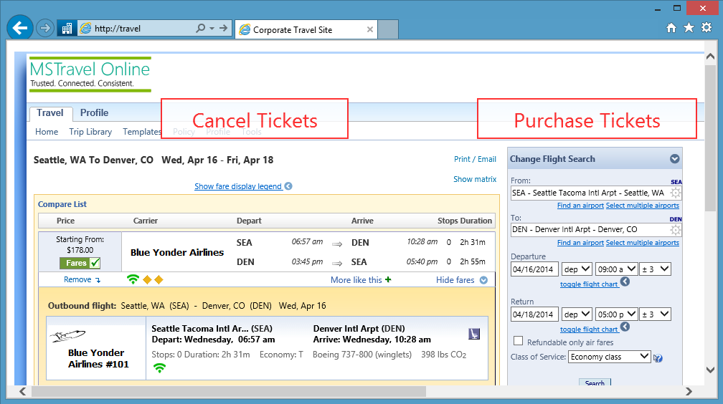
Enterprise Mode
Demo

Slide 11
Easier Web App Testing & Remediation
Pilot users test web apps, using Enterprise Mode as needed
Optionally, when Enterprise Mode is turned on or off, a collection point can be notified
Web Apps
Enterprise Mode
Collection Point
Site List
XML File
IT
Pilot Users
Crowd-sourced submissions can be evaluated for inclusion in the Enterprise Mode Site List

Slide 12
Seamless Web Browsing
Internet Explorer 11 switches modes dynamically
Internet Explorer 11
Enterprise Mode
Site List
Enterprise Mode
Edge Mode
List Location Set via Group Policy
Windows 8.1 or Windows 7

Slide 13
Benefits from
Internet Explorer 11
FASTER
Modern Web Standards
Increased Performance
Improved Security
Better Reliability
HTML5
CSS Level 3
SVG 1.1 2nd Edition
WebGL
EcmaScript 6th Edition
Hardware-Accelerated Browsing
New Script Engine
New Layout Engine
Pre-Fetching & Pre-Rendering
Network Improvements
Network Prioritization
SmartScreen Filter Improvements
Tracking Protection
Enhanced Protected Mode
TLS 1.2 Enabled by Default
Password Manager Enhancements
IExtensionValidation Anti-Virus API
Improved Compatibility
Process Isolation
Script Debugging
Automatic Crash Recovery
Integrated Flash Player

Slide 14
Enterprise Mode Proof of Concept
Piloted with Top Enterprise Customers from October, 2013 to March, 2014
Pilot participant industries:
Energy
Entertainment
Financial Services
Healthcare
Manufacturing
Media
Pharmaceuticals
Professional Services
Public Sector
Telecommunications
Pilot participant countries:
Australia
Belgium
Canada
Denmark
France
Germany
Italy
Japan
Netherlands
Portugal
Sweden
Switzerland
UAE
United Kingdom
United States
Russia
South Africa

Slide 15
Early Pilot Observations
Microsoft commissioned Forrester Consulting to study the value of upgrading to Internet Explorer 11 on Windows 7. Early pilot customer observations include:
The migration to IE11 is much easier than previous upgrades.
Testing and deployment efforts are significantly reduced.
Support takes less effort, and user productivity is improved.
Forrester Consulting will continue to track these customers as they deploy Internet Explorer 11 with Enterprise Mode, to complete this Total Economic Impact study. Forrester’s TEI methodology includes evaluating benefits, costs, flexibility, and risks.

Slide 16
Customer
Guidance
Still on Internet Explorer 8?
Evaluate Internet Explorer 11 with Enterprise Mode.
Piloting Internet Explorer 9 or 10?
Continue your evaluation, but start testing Internet Explorer 11 in parallel. Enterprise Mode may simplify your migration.
Deploying Internet Explorer 9 or 10?
Start evaluating Internet Explorer 11. There are significant benefits from staying up-to-date with the latest browser.

Slide 17
Related Content
http://technet.microsoft.com/ie
Find Me Later At The Windows Booth

Slide 18
Windows Track Resources
Windows Enterprise windows.com/enterprise windowsphone.com/business
Windows Springboard microsoft.com/springboard
Microsoft Desktop Optimization Package (MDOP)
microsoft.com/mdop
Windows To Go microsoft.com/windows/wtg
Windows Phone Developer developer.windowsphone.com

Slide 19
Resources
Learning
Sessions on Demand
Microsoft Certification & Training Resources
http://channel9.msdn.com/Events/TechEd
www.microsoft.com/learning
TechNet
msdn
Resources for IT Professionals
Resources for Developers
http://microsoft.com/technet
http://microsoft.com/msdn

Slide 20
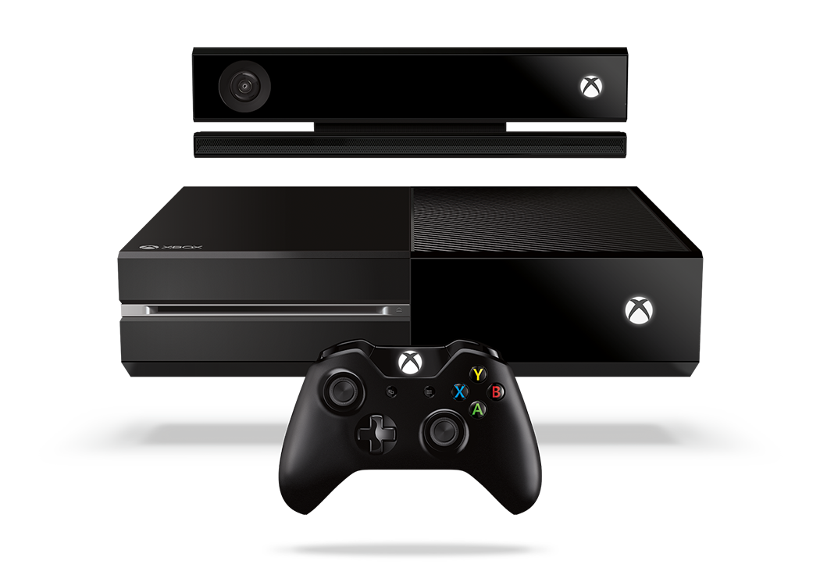
Complete an evaluation and enter to win!

Slide 21
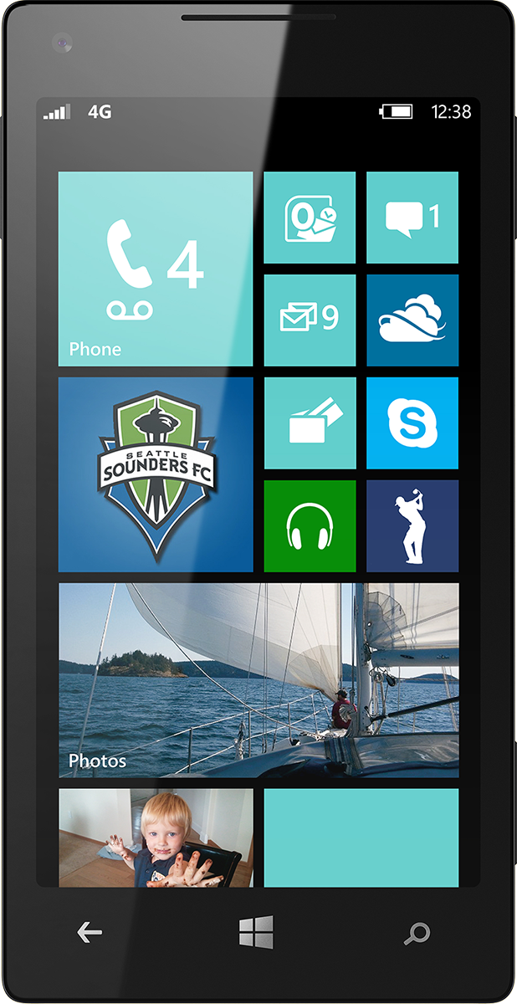
Evaluate this session
Scan this QR code to evaluate this session.

Slide 22
© 2014 Microsoft Corporation. All rights reserved. Microsoft, Windows, and other product names are or may be registered trademarks and/or trademarks in the U.S. and/or other countries.
The information herein is for informational purposes only and represents the current view of Microsoft Corporation as of the date of this presentation. Because Microsoft must respond to changing market conditions, it should not be interpreted to be a commitment on the part of Microsoft, and Microsoft cannot guarantee the accuracy of any information provided after the date of this presentation. MICROSOFT MAKES NO WARRANTIES, EXPRESS, IMPLIED OR STATUTORY, AS TO THE INFORMATION IN THIS PRESENTATION.

