Slide 2
Deploying Windows 8.1 in the Enterprise
WIN-B323
Bill Moore Dell, Inc.
Greg Ramsey Dell, Inc.

Slide 3
Overview
OSD Planning
Windows Experience
Application Delivery and OS Maintenance

Slide 4
A Little Background….
109K workstations (73% mobile)
ConfigMgr 2012 R2
Early Adopter Programs
Self-Service Apps installs since SMS 2003

Slide 5
OSD Planning and Reference Build

Slide 6
Application Compatibility
Antivirus
3rd Party Encryption
Office 32-bit or 64-bit
IE Enterprise Mode

Slide 7
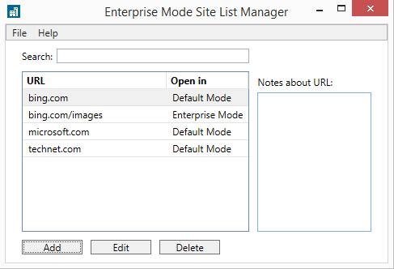
Enterprise Mode IE 11
What is it?
EMIE is a bridge between modern browsing and investments in older applications.
How does it work?
Locally – User specifies sites to be rendered in IE8 compatibility view.
Managed – Crowd sourcing centralizes compatibility lists identified by users or I/T to be shared across systems.
How do I turn it on?
Group policy
Registry
<rules version="1">
<emie>
<domain exclude="true">desktop.mycom.com<path exclude="false">/8.1/SitePages/Home.aspx</path></domain>
</emie>
</rules>

Slide 8
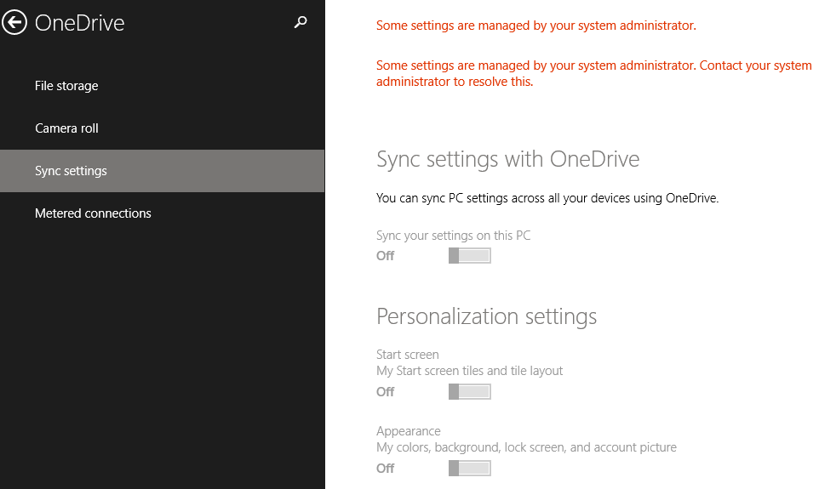
Group Policy Considerations
Sync Items
OneDrive options need to be reviewed to avoid overlap between home and work environments. Sync options are managed by group policy.
Start screen
Appearance
Desktop Personalization
Apps (installed)
Passwords (apps, websites)
App data
Languages
Ease of Access
Other Windows Settings
Web Browser (tabs, favorites)

Slide 9
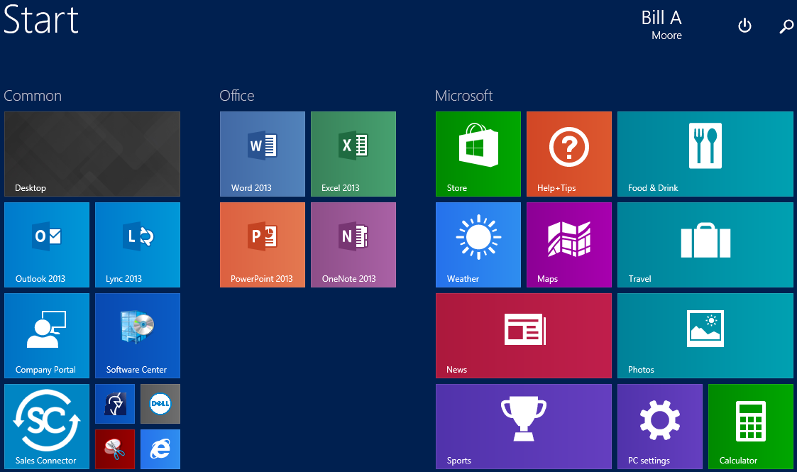
Customizing Start
Why Customize?
Better OOBE
Train by example
Fit and Finish
Options
Copy Profile
AppsFolderLayout
StartTiles
Group Policy
User Friendly
Ease of Administration
With Windows 8.1 Update, touch devices will default to Start while non-touch will default to the Windows desktop.

Slide 10
Start Balancing
Method | Add Tiles | Remove Tiles | Resize Tiles | Label Tile Groups | Arrange Tiles | Set Start Color | Set Start Accent | Set Desktop Background
CopyProfile (Unattend.xml) | * | * | * | * | * | * | * | *
AppsFolderLayout (File copy) | * | * | * | * | * | Secret Sauce
StartTiles (Unattend.xml) |  |  |  |  | *
Group Policy (Export-StartLayout) | * | * | * | * | * | * | * | *
HKCU\Software\Microsoft\Windows\CurrentVersion\Explorer\Accent
AccentColor DWORD (4285822584)
MotionAccentID_v1.00 DWORD (219)
StartColor DWORD (4280624421)
Reference: http://blog.coretech.dk
StartTiles – Limit to default apps
Group Policy – No user changes.

Slide 11
Demo: Windows Experience in the Enterprise
Bill Moore

Slide 12
UEFI Secure Boot
Enhances security in pre-boot environment
Windows 8 Logo Certification requires support for Secure Boot
Pre-Boot
Malware

Slide 13
UEFI
Unified Extensible Firmware Interface (UEFI)
Replacement for BIOS
Secure
Faster boot and resume time
>2TB Hard Disk Support
Signed binary to boot
Operating System
UEFI
Firmware
Hardware

Slide 14
Secure Boot
Requires UEFI Native (no legacy boot option ROMs)
When to enable Secure Boot
Deploying Windows 8 or newer on Windows 8 Compatible hardware
Deploying Windows 7 on Windows 8 Compatible (proactive plan for upgrades)

Slide 15
OSD Challenges with Secure Boot
x64 hardware requires x64 OS Boot Disk, and x64 OS
x86 hardware requires x86 OS Boot Disk, and x86 OS
Manual Touch to enable and configure
UEFI PXE

Slide 16
Demo: Deploying the OS
Greg Ramsey
Bill Moore

Slide 17
Supporting Remote Employees
Day 1 | Day 2-3 | Day 3-4
Failure | Service Call | Tool Delivery | Service Call | Whole
Golden Rule: Don’t be on the bleeding edge if you can’t stand the sight of blood.
Remote employees drive onsite processes.
Consistency of experience from any location.
Know the infrastructure and the players.
The tools for remote join are generally owned by others.
Cert | Access | Tunnel | Join | Policy

Slide 18
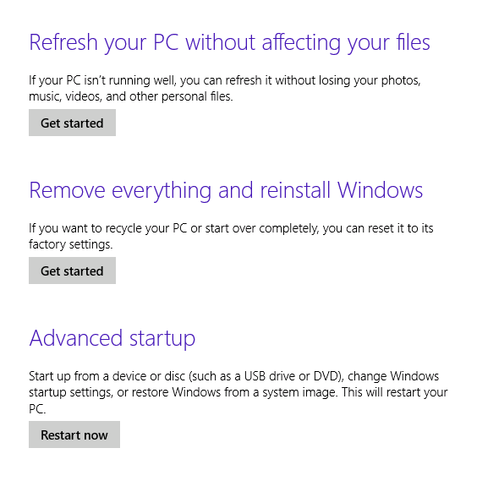
Refresh/Reset
Use your Corporate Image….

Slide 19
Application Delivery and Maintenance

Slide 20
Deploying Modern Applications
Deploy vs. Provision
Deploy: Standard process to install applications – each user installs desired modern app.
Provision: Stage application so that when user logs on, application is installed

Slide 21
Demo: Deploying and Provisioning Modern Applications
Greg Ramsey

Slide 22
Pinning Applications to Start Screen
(this page intentionally left blank)

Slide 23
Upgrading 8.0->8.1
"setup.exe" /auto:upgrade
Command Line Options: http://technet.microsoft.com/en-us/library/hh824834.aspx
MS White Paper: http://tinyurl.com/CM81Upgrade
Disk cleanup wizard, windows.old (automated script on www.ramseyg.com)

Slide 24
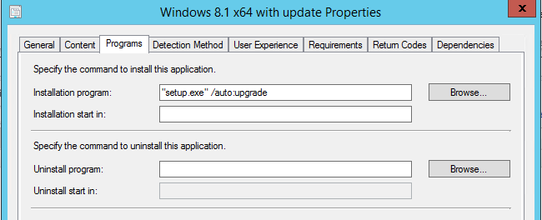
Upgrade using the ConfigMgr Company Portal

Slide 25
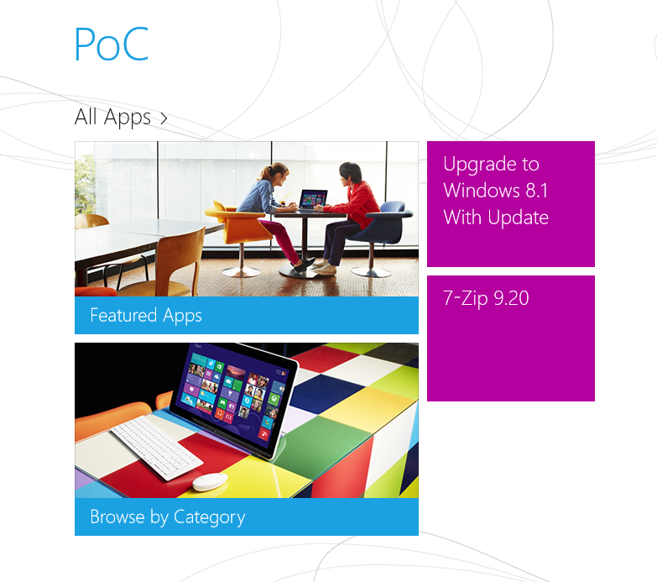
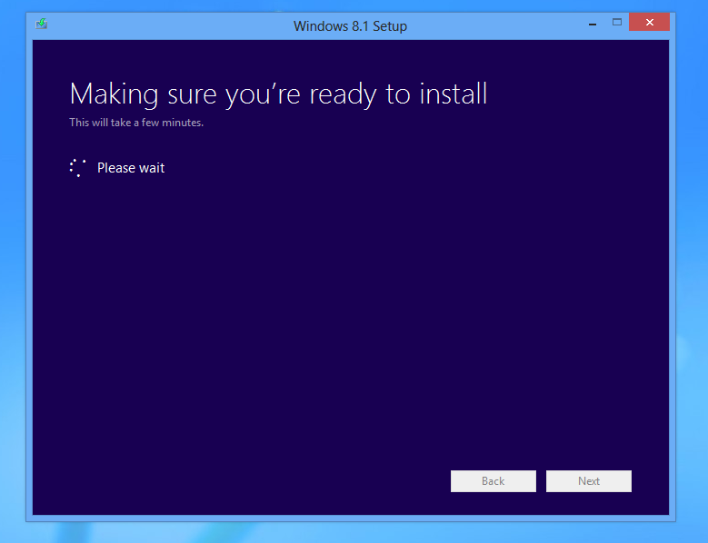
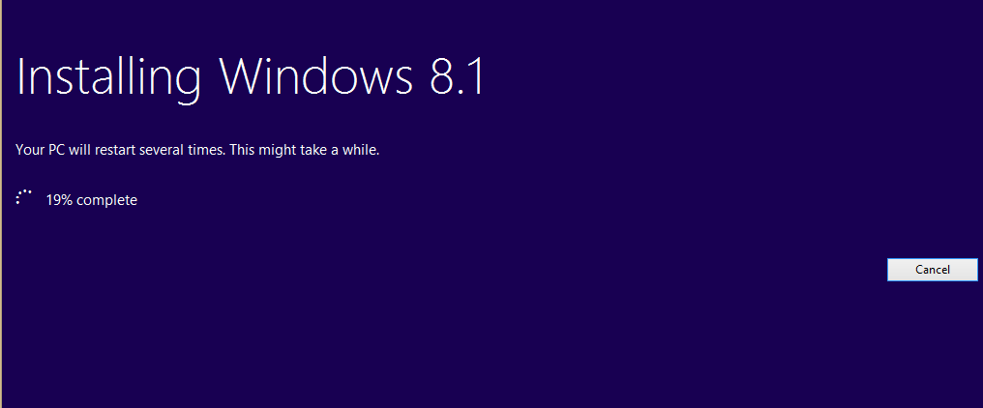
Upgrade from Company Portal - 2

Slide 26
Patching?
Previously (win7)– only deployed security patches
Moving forward - *all* recommended Win8 and Office 2013 patches

Slide 27
Windows Track Resources
Windows Enterprise windows.com/enterprise windowsphone.com/business
Windows Springboard microsoft.com/springboard
Microsoft Desktop Optimization Package (MDOP)
microsoft.com/mdop
Windows To Go microsoft.com/windows/wtg
Windows Phone Developer developer.windowsphone.com

Slide 28
Resources
Learning
Sessions on Demand
Microsoft Certification & Training Resources
http://channel9.msdn.com/Events/TechEd
www.microsoft.com/learning
TechNet
msdn
Resources for IT Professionals
Resources for Developers
http://microsoft.com/technet
http://microsoft.com/msdn

Slide 29
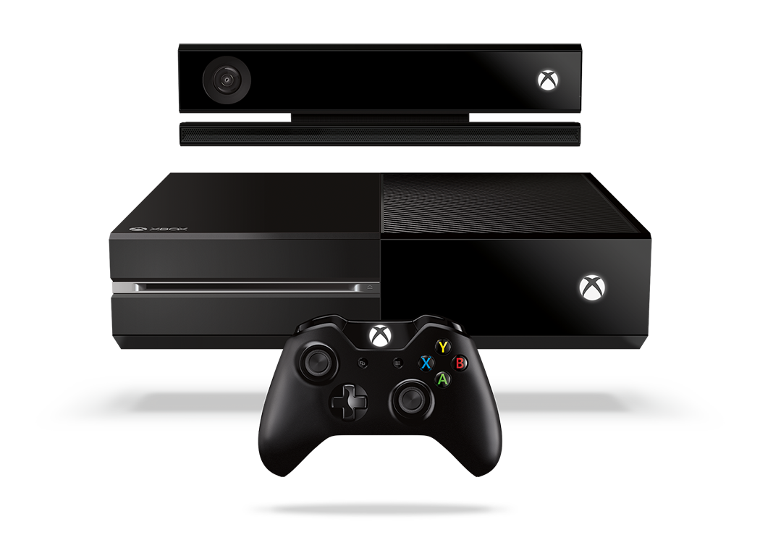
Complete an evaluation and enter to win!

Slide 30
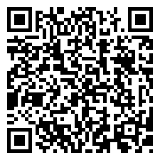
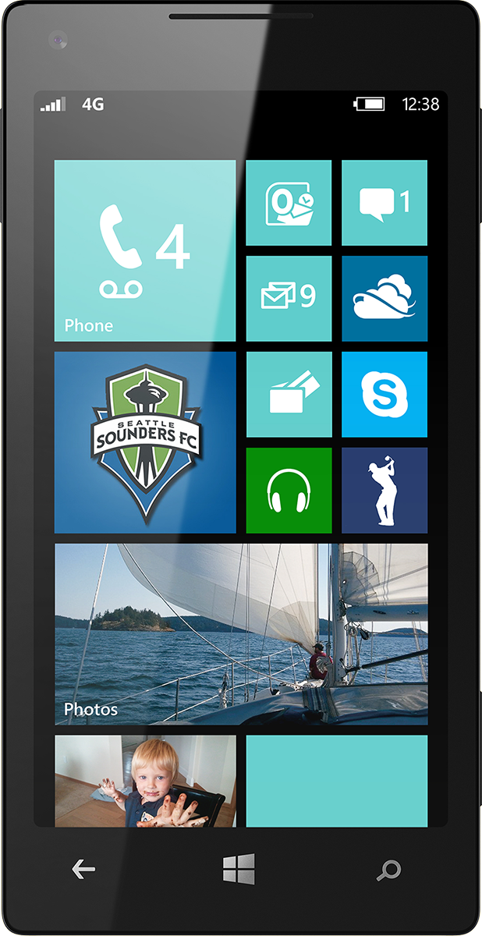
Evaluate this session
Scan this QR code to evaluate this session.

Slide 31
© 2014 Microsoft Corporation. All rights reserved. Microsoft, Windows, and other product names are or may be registered trademarks and/or trademarks in the U.S. and/or other countries.
The information herein is for informational purposes only and represents the current view of Microsoft Corporation as of the date of this presentation. Because Microsoft must respond to changing market conditions, it should not be interpreted to be a commitment on the part of Microsoft, and Microsoft cannot guarantee the accuracy of any information provided after the date of this presentation. MICROSOFT MAKES NO WARRANTIES, EXPRESS, IMPLIED OR STATUTORY, AS TO THE INFORMATION IN THIS PRESENTATION.

Slide 32
Supplemental Info

Slide 33
Software Center, App Catalog, Company Portal ?
Feature | Software Center | Application Catalog | Company Portal
Machine Targeted
User Targeted
Supports Application Uninstall
Supports Deployment of Task Sequence
Supports Deployment of Software Updates
Limits view of available software based on Operating System Platform
Supports Windows 7
Supports Windows 8.x
Supports Package/Program
Supports Applications (Application Model)
Supports Optional Modern (Metro) Applications
Supports Featured Application Setting

