Slide 2
Windows 8.1 and Windows Phone 8.1 Networking Survival Kit
WIN-B326
Andy Wigley
Technical Evangelist, Microsoft
t: andy_wigley b: http://andywigley.com

Slide 3
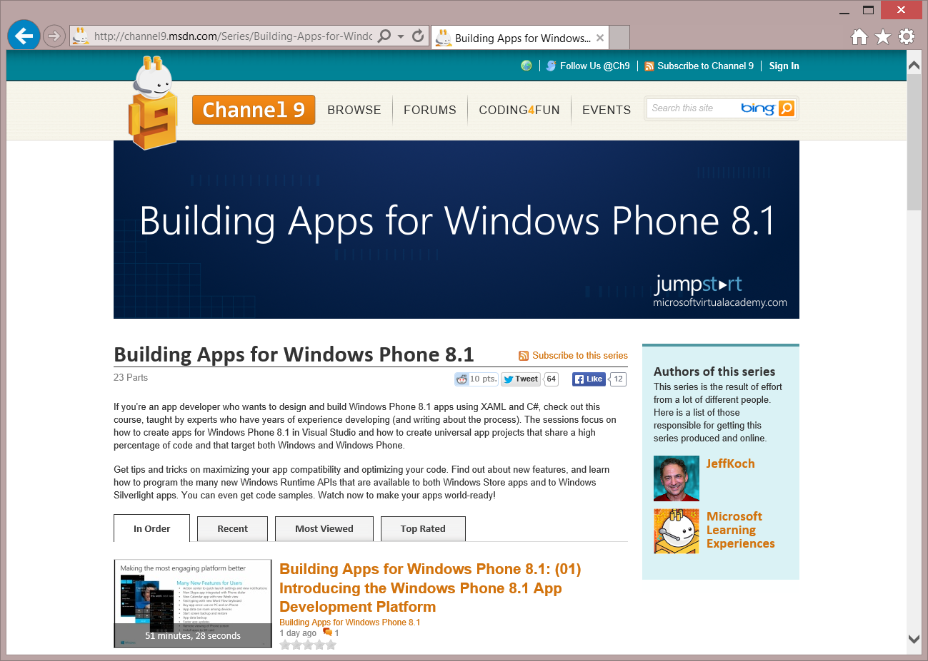
Building Apps for Windows Phone 8.1 Jump Start
http://aka.ms/wp81js
23 Sessions
Approx. 18 hours of training videos
Sample code at http://aka.ms/wp81jumpstartdemos
“Thanks guys for a great information packed day. head is spinning!”
“Well done guys. Intense sessions”
“This is the best ever JumpStart that I have attended (seven so far). THANK YOU!”

Slide 4
In this module…
Networking basics
What everyone should know
Building Backend Services with Azure Mobile Services
Visual Studio tools for working with Azure Mobile Services
Roaming Settings Data
Sharing state across devices
HttpClient
Networking with the Windows.Web.Http.HttpClient class and related infrastructure
Authentication
Authenticating users with Web Authentication Broker and securing credentials with CredentialLocker

Slide 5
Basics

Slide 6
Considerations
Mobile devices (tablets, etc.) are not always connected
Caching is important
Different networks can have different cost models associated
More expensive to use cellular data than WiFi in most cases
Startup experience, especially disconnected startup, is very important
No one likes an app that has to wait for a download or a timeout before it becomes responsive

Slide 7
Use higher-level abstractions where possible
Better to use high-level frameworks and services where available
Use Microsoft Azure Mobile Services to build a cloud backend services, but use WebRoles, WorkerRoles, Queues etc if you need more flexibility
Use Microsoft Azure Notification Hubs to send notifications from backend services in preference to writing low-level networking code to achieve this
Use BackgroundTransfer to download/upload files
Use WebAuthenticationBroker to perform OAuth2 authentication against Internet identity providers
Use HttpClient for low level HTTP networking

Slide 8
Introduction to Microsoft Azure Mobile Services

Slide 9
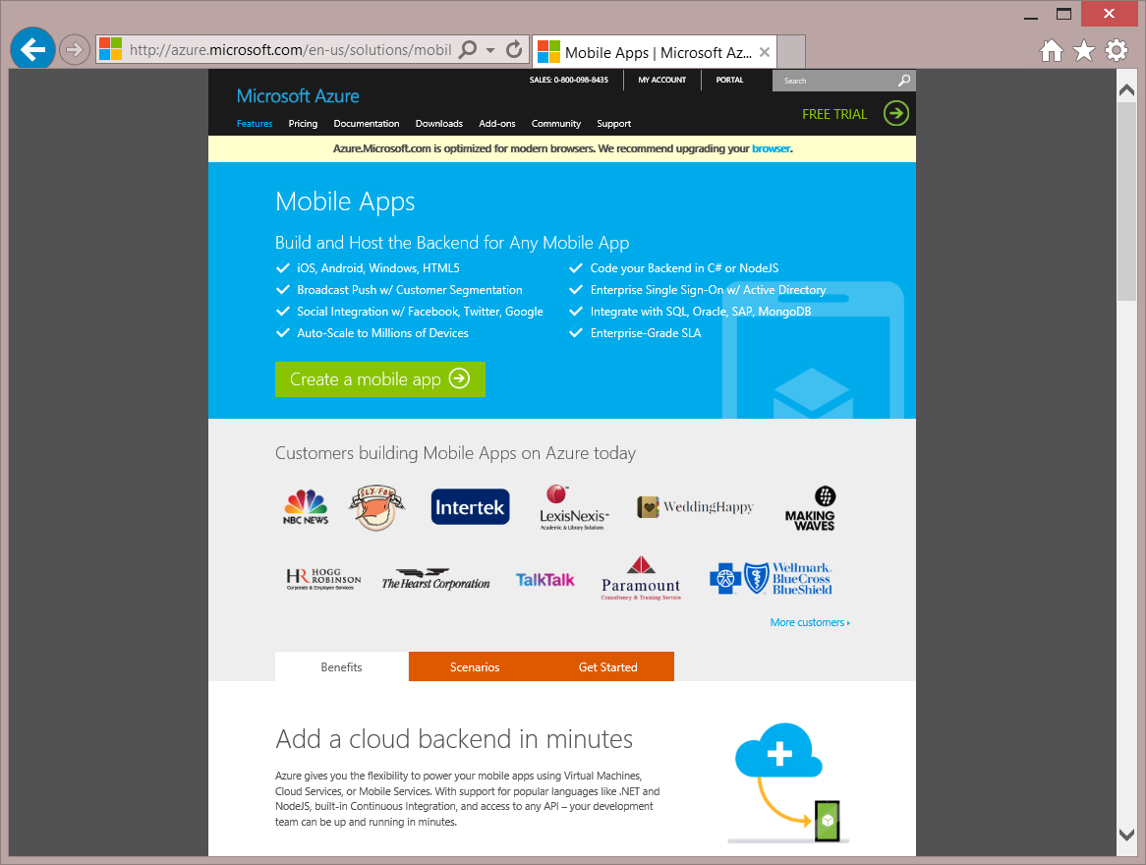
Microsoft Azure Mobile Services
Build and Host the Backend for Any Mobile App
iOS, Android, Windows, HTML5
Code Backend in C# or NodeJS
Broadcast Push w/ Customer Segmentation
Enterprise Single Sign-On w/ Active Directory
Social Integration w/ Facebook, Twitter, Google
Integrate with SQL, Oracle, SAP, MongoDB
Auto-Scale to Millions of Devices
Enterprise Grade SLA

Slide 10
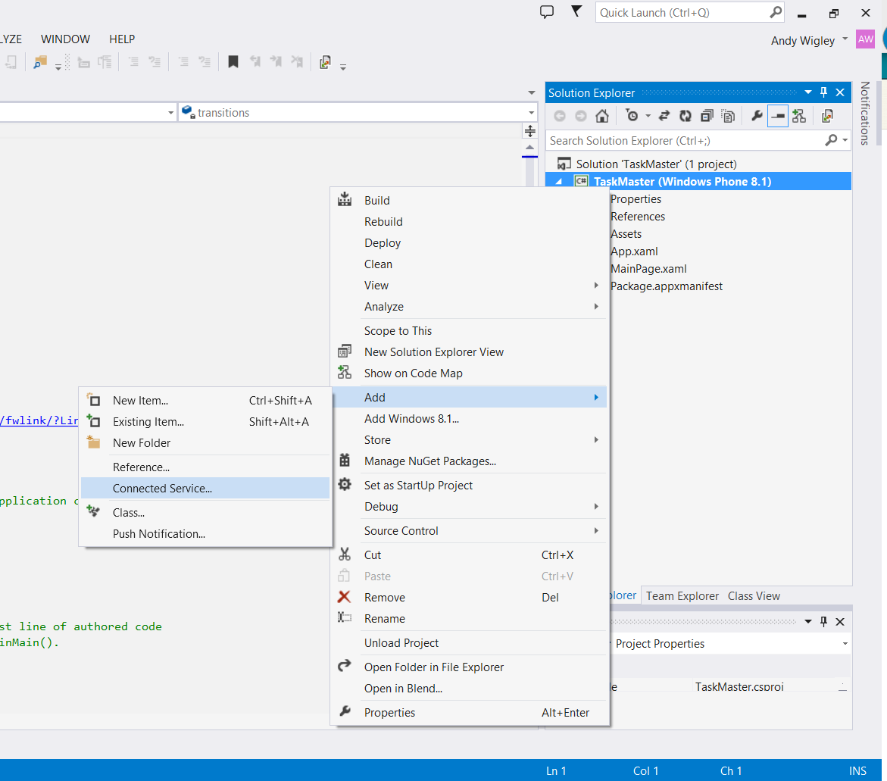
Adding Azure Mobile Services to your app
In Visual Studio 2013, you can do all your Azure Mobile Service configuration without visiting the Microsoft Azure Portal http://manage.windowsazure.com
Add -> Connected Service launches

Slide 11
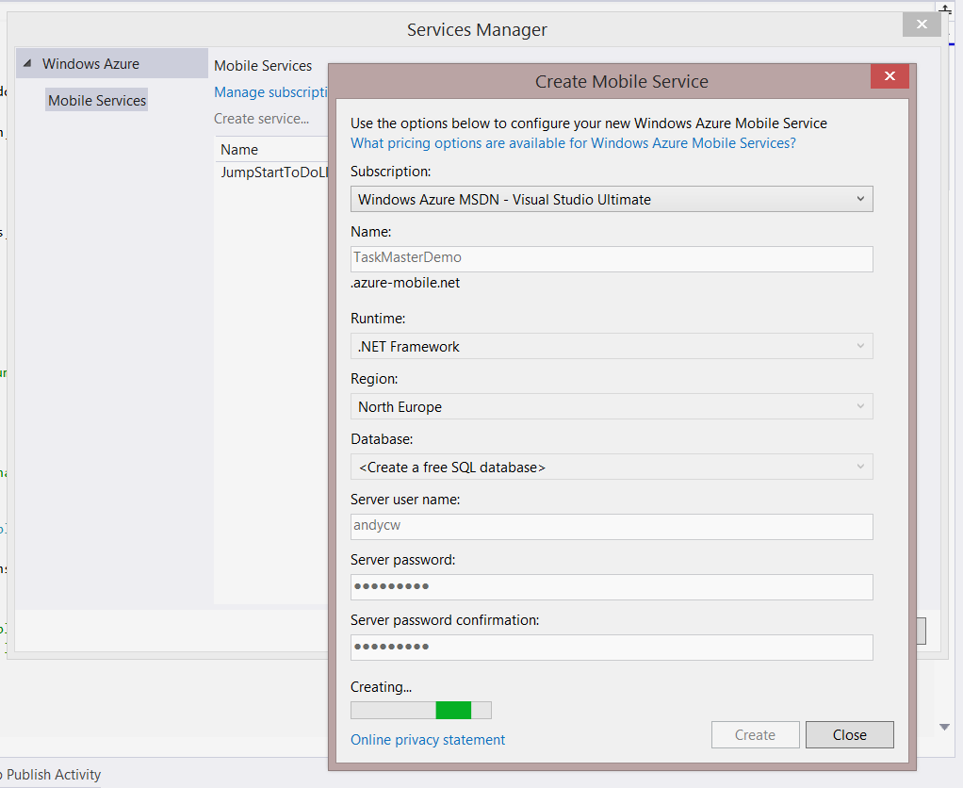
Creating a Mobile Service
Services Manager allows you to:
Manage Microsoft Azure Subscriptions and import into Visual Studio
Create Mobile Services
After Creating a Mobile Service:
Adds references to Azure Mobile Services client libraries to your project
Adds code to App.xaml.cs to declare and configure a Microsoft.WindowsAzure.MobileServ-ices.MobileServiceClient instance

Slide 12
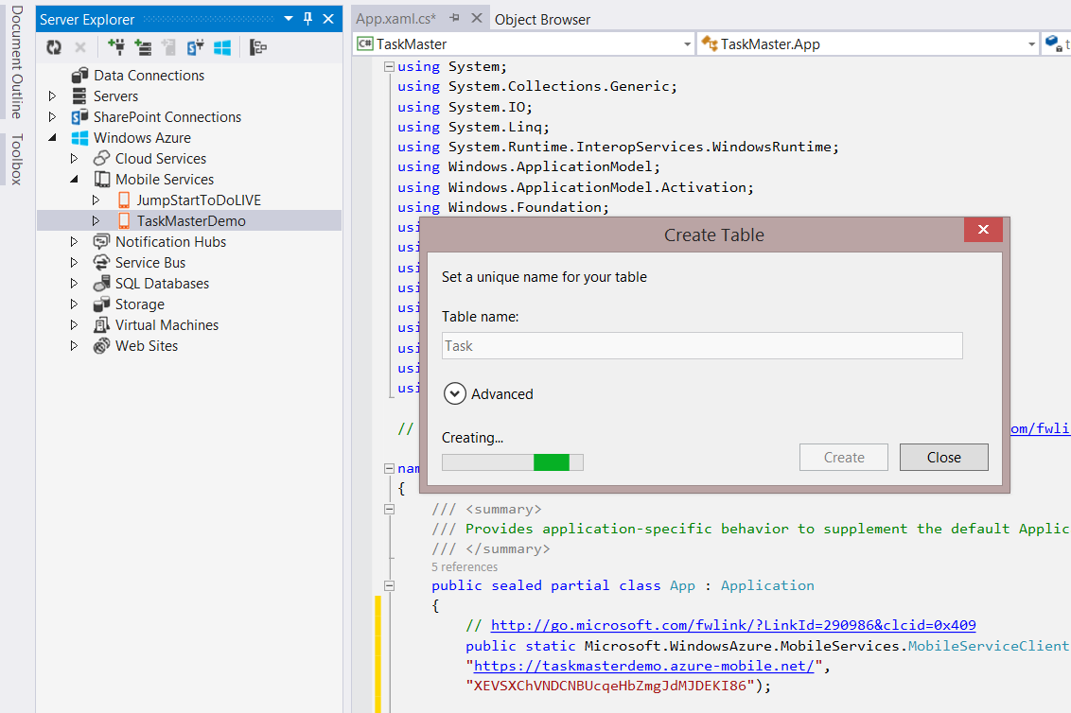
Modify your Mobile Service from Server Explorer
Work with your Mobile Service from Server Explorer
Create Tables
Edit server scripts

Slide 13
Write code to work with your Mobile Service
private async System.Threading.Tasks.Task InsertToDoItem()
{
IMobileServiceTable<TodoItem> TodoTable = App.TaskMasterDemoClient.GetTable<TodoItem>();
TodoItem t = new TodoItem();
t.Title = titleTextBox.Text;
t.Description = descriptionTextBox.Text;
t.DueDate = dueDatePicker.Date.ToString();
t.AssignedTo = assignedToTextBox.Text;
try
{
await TodoTable.InsertAsync(t);
}
catch (Exception)
{ /* TODO: Insert error handling code */ }
}

Slide 14
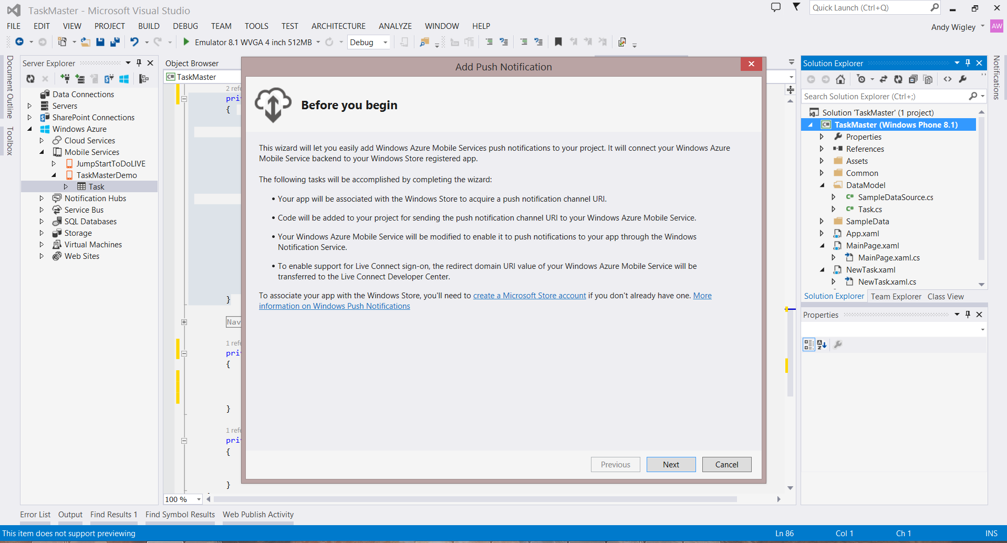
Add Push Notifications

Slide 15
Much, much more
Easily add Authentication against Microsoft Account, Twitter, Google, Facebook or Azure Active Directory
Partition data by user
Customize Mobile Services server scripts
Implement business logic
Handle database write conflicts when two or more clients write to the same record
Call 3rd party services
Implement scheduled background tasks
*NEW*: Offline support
Clients can now work disconnected and sync changes to the online database when reconnected

Slide 16
Demo Windows Azure Mobile Services

Slide 17
Sharing state across devices: Roaming Data and OneDrive

Slide 18
Roaming Settings and Roaming Folder
If a user obtains your application and installs it on multiple devices it is nice if all the devices can share the same settings information
Changes on one device are reflected on all the other devices owned by that user
Roaming data is shared between Windows Phone 8.1 Store Apps and Windows 8.1 Store Apps that have the same Package Family Name (PFN) (i.e. Reserved Name)
Roaming data provides a way that an application can synchronise data and/or settings across a number of different physical devices
It takes the form of a folder and a settings dictionary which are automatically stored in the users’ OneDrive
Roaming data is limited to value of ApplicationData.RoamingStorageQuota (usually 100KB) but do not count against the users’ OneDrive quote
If your roaming data exceeds the quota, it won’t roam until its size is less than the quota again

Slide 19
Roaming Data
Other clients are notified of updated data via Windows Notification Service. If app is running when sync occurs, an event is raised.
Sync engine transfers data periodically based on triggers (user idle, battery, network, etc.)
PFN 12345
Roaming
folder
Roaming
settings
OneDrive stores up to 100kb of roaming data per app (not included in user quota). If app exceeds the limit, sync stops.
WP 8.1 App – PFN 12345
Windows App – PFN 12345
Roaming
Local
Temp
Temp
Local
Roaming
App writes data using standard file/settings APIs.

Slide 20
Using the Roaming settings
private void name_TextChanged(object sender, TextChangedEventArgs e)
{
Windows.Storage.ApplicationDataContainer roamingSettings =
Windows.Storage.ApplicationData.Current.RoamingSettings;
roamingSettings.Values["userName"] = name.Text;
}
The RoamingSettings are exposed as a key-value dictionary into which an application can save data
The data is persisted on the device and also shared with other devices
Note: On Windows 8.1, there is a special HighPriority setting. This has no effect on Windows Phone.

Slide 21
Reading the Roaming settings
Windows.Storage.ApplicationDataContainer roamingSettings =
Windows.Storage.ApplicationData.Current.RoamingSettings;
if (roamingSettings.Values.ContainsKey("userName"))
{
name.Text = roamingSettings.Values["userName"].ToString();
}
Retrieve from Roaming settings by using the key
The roaming settings will be roamed across multiple devices (including Windows 8.1 ones)

Slide 22
Receive notification on roaming data update
The DataChanged event fires when the roaming data has changed
Windows.Storage.ApplicationData.Current.DataChanged += Current_DataChanged;
...
void Current_DataChanged(ApplicationData sender, object args)
{
// Refresh your settings...
}
The event is only fired if the application is active at the time of the change
You should still load up all your data when your app starts

Slide 23
Tips on using roaming data
Applications can store data in the roaming folder as they would any other folder on the device, or in roaming settings in the same way as local settings
The synchronisation takes place in the background
Good for app customisation settings, most recent activity, partially completed work
Bad for synchronising large amounts of data or “instant syncing” scenarios
Last writer wins
HighPriority setting is available on Windows for quick sync, but has no effect on Windows Phone

Slide 24
Demo: Roaming Data

Slide 25
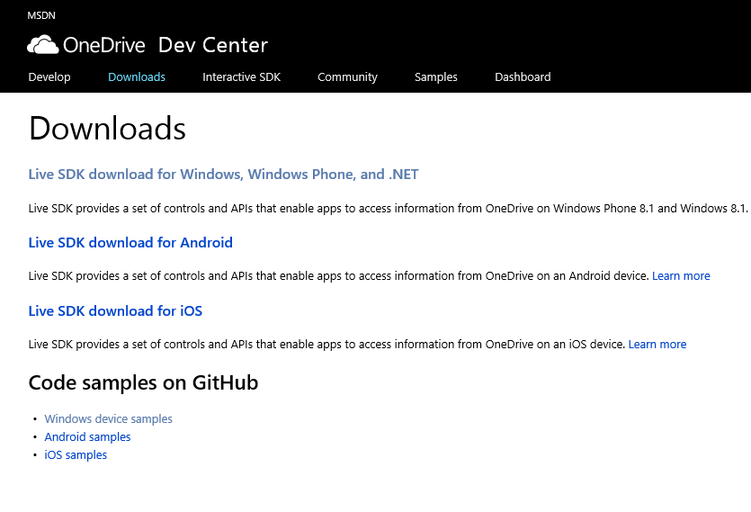
OneDrive for more…
Download Live SDK
Controls and APIs that enable apps to access information from OneDrive
Live SDK enables access to users’ identity profile info and allows your apps to:
Upload and download photos, videos, documents, and other files in OneDrive
Personalize your users’ experience
Take advantage of single sign-on using Microsoft Account in Windows 8.1 and Windows Phone 8.1
Create, read, and update contacts, calendars, and events in Outlook.com

Slide 26
HttpClient

Slide 27
Simple example: Get a string
try
{
// Create the HttpClient
HttpClient httpClient = new HttpClient();
// Optionally, define HTTP headers
httpClient.DefaultRequestHeaders.Accept.TryParseAdd("application/json");
// Make the call
string responseText = await httpClient.GetStringAsync(
new Uri("http://services.odata.org/Northwind/Northwind.svc/Suppliers"));
}
catch (Exception ex)
{
...
}

Slide 28
Tip
Resolve the correct type
System.Net.Http.HttpClient is slightly different in the most basic use, and quite different when you get into advanced work.
Always make sure you’re using Windows.Web.Http
System.Net.Http shows up first

Slide 29
Get full response
HttpResponseMessage
Content
Headers
StatusCode
ReasonPhrase
IsSuccessStatusCode
Source
Version
RequestMessage
try
{
var client = new HttpClient();
var uri = new Uri(" http://example.com/customers/1");
var response = await client.GetAsync(uri);
// code and results
var statusCode = response.StatusCode;
// EnsureSuccessStatusCode throws exception if not HTTP 200
response.EnsureSuccessStatusCode();
var responseText = await response.Content.ReadAsStringAsync();
}
catch (Exception ex)
{
...
}
HttpClient
If you want response codes, headers, and other information, use GetAsync instead of GetStringAsync

Slide 30
Reading response headers
try
{
var client = new HttpClient();
var uri = new Uri("http://example.com/customers/1");
var response = await client.GetAsync(uri);
// display headers
foreach (var header in response.Headers)
{
HeadersText.Text += header.Key + " = " + header.Value + "\n" ;
}
ResultsText.Text = await response.Content.ReadAsStringAsync();
}
catch (Exception ex)
{ ...}

Slide 31
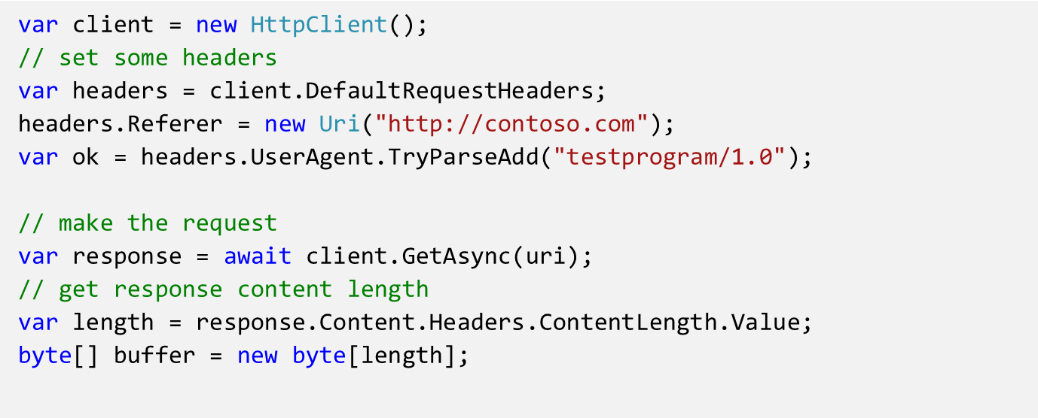
Writing request headers
Headers
Header | Access
Accept | read/write collection
AcceptEncoding | read/write collection
AcceptLanguage | read/write collection
Authorization | read/write
CacheControl | read/write collection
Connection | read/write collection
Cookie | read/write collection
Date | read/write
Expect | read/write collection
From | read/write
Host | read/write
IfModifiedSince | read/write
IfUnmodifiedSince | read/write
MaxForwards | read/write
ProxyAuthorization | read/write
Referer | read/write
TransferEncoding | read/write collection
UserAgent | read/write collection
Headers
Strongly typed headers make setting and getting values simple and safe.
Use the TryParseAdd method to receive a bool on failure rather than an exception

Slide 32
Demo: Accessing the response

Slide 33
Sending a request
HttpMethod
Delete
Get
Head
Options
Patch
Post
Put
Also, new HttpMethod(string) for your own methods
try
{
var client = new HttpClient();
// we're sending a delete request
var request = new HttpRequestMessage(HttpMethod.Delete, uri);
// we don't expect a response, but we'll snag it anyway
var response = await client.SendRequestAsync(request);
// display result code
HeadersText.Text = "Status: " + response.StatusCode + "\n";
}
catch (Exception ex)
{ … }
SendRequestAsync
The HttpClient includes discrete methods for Put and Post, but you can also use the SendRequestAsync method to make any type of request, including Delete.

Slide 34
The filter pipeline
Your code
This is also a filter
Your app
HttpClient
GetAsync
GetBufferAsync
GetInputStreamAsync
GetStringAsync
PostAsync
PutAsync
SendRequestAsync
503 Retry Filter
Metered Network Filter
Auth Filter
Http Base Protocol Filter
Has in-depth settings
REST / Web Service
HttpRequestMessage
⛭
HttpResponseMessage
HttpContent
String • Stream • Buffer • Multipart • FormUrlEncoded

Slide 35
Using HttpBaseProtocolFilter For compression, credentials etc
HttpBaseProtocolFilter filter = new HttpBaseProtocolFilter();
// When AutomaticDecompression is true (the default), the Accept-Encoding header is added
// to the headers and set to allow gzip and compress
filter.AutomaticDecompression = true;
PasswordCredential creds = new PasswordCredential("JumpStart", userName, password);
filter.ServerCredential = creds;
filter.ProxyCredential = creds;
// Create the HttpClient
HttpClient httpClient = new HttpClient(filter);
// Make the call
string responseText = await httpClient.GetStringAsync(uri);
...

Slide 36
Make Smart Decisions About Data Transfer

Slide 37
Tips for accessing mobile services
Mobile devices are often connected to poor quality network connections
Best chance of success in network data transfers achieved by:
Keep data volumes as small as possible
Use the most compact data serialization available (use JSON instead of XML)
Avoid large data transfers
Avoid transferring redundant data
Design your protocol to only transfer precisely the data you need and no more

Slide 38
Demo: Wire Serialization

Slide 39
Wire Serialization Affects Payload Size
Simple test case: download 30 data records
Each record just 12 fields
Measured bytes to transfer
Wire Serialization Format | Size in Bytes
ODATA XML | 73786
ODATA JSON | 34030
JSON ‘Lite’ | 15540
JSON ‘Lite’ GZip | 8680

Slide 40
Network Awareness in your apps
Making Decisions based on Data Connections
Mobile apps shouldn’t diminish the user experience by trying to send or receive data in the absence of network connectivity
Mobile apps should be intelligent about performing heavy data transfers only when the appropriate connectivity is available
Use the NetworkInterfaceType object to detect network type and speed
Subscribe to the NetworkChange event to detect when network state changes
Make your app aware of its networking environment and state!

Slide 41
Network Information in Windows Runtime
private bool IsOnWiFi()
{
ConnectionProfile InternetConnectionProfile = NetworkInformation.GetInternetConnectionProfile();
if (internetConnectionProfile == null) return false;
return InternetConnectionProfile.IsWlanConnectionProfile;
}
private bool IsConnectedtoDataRoaming()
{
bool isRoaming = false;
ConnectionProfile internetConnectionProfile = NetworkInformation.GetInternetConnectionProfile();
if (internetConnectionProfile != null && internetConnectionProfile.IsWwanConnectionProfile)
{
ConnectionCost cc = internetConnectionProfile.GetConnectionCost();
isRoaming = cc.Roaming; // See if user is currently roaming
}
return isRoaming;
}
private void AddEventHandlers()
{
// NetworkStatusChanged fires when the network status changes for a connection
NetworkInformation.NetworkStatusChanged += OnNetworkStatusChanged;
}

Slide 42
What is Data Sense?
Data Sense is a set of components designed to help:
End users: understand and manage data consumption
Mobile Operators: reduce cellular consumption & optimize connectivity
3rd party developers and ISVs: Build smart data consuming applications

Slide 43
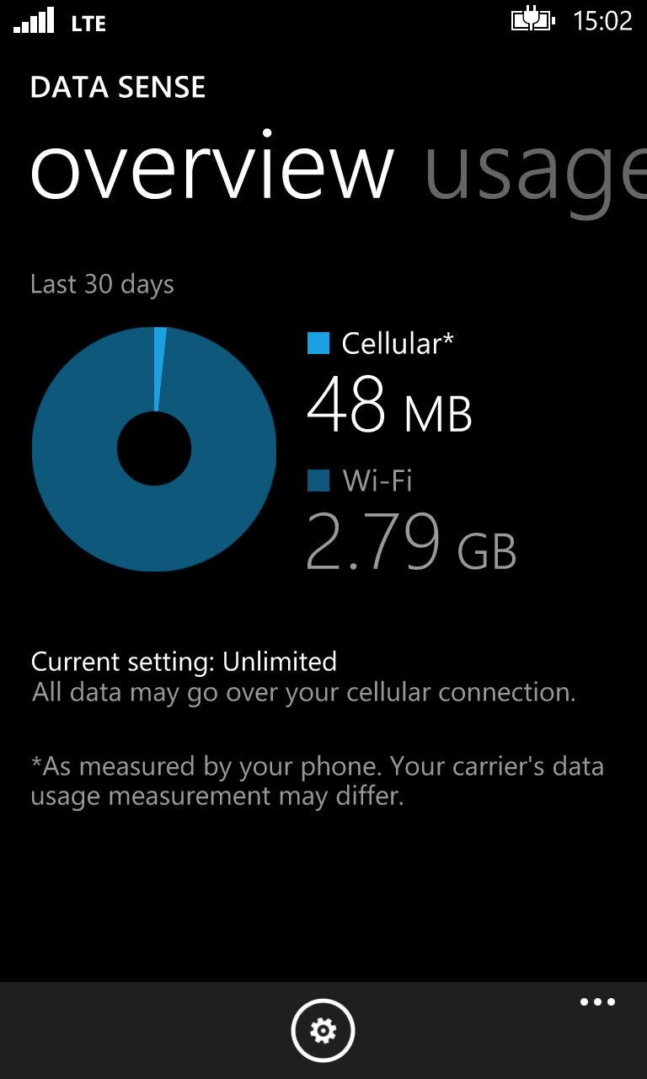
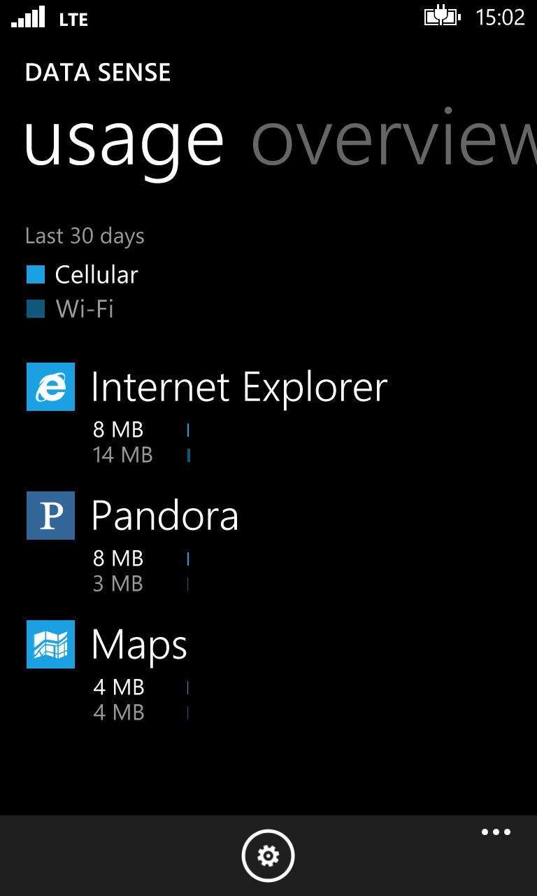
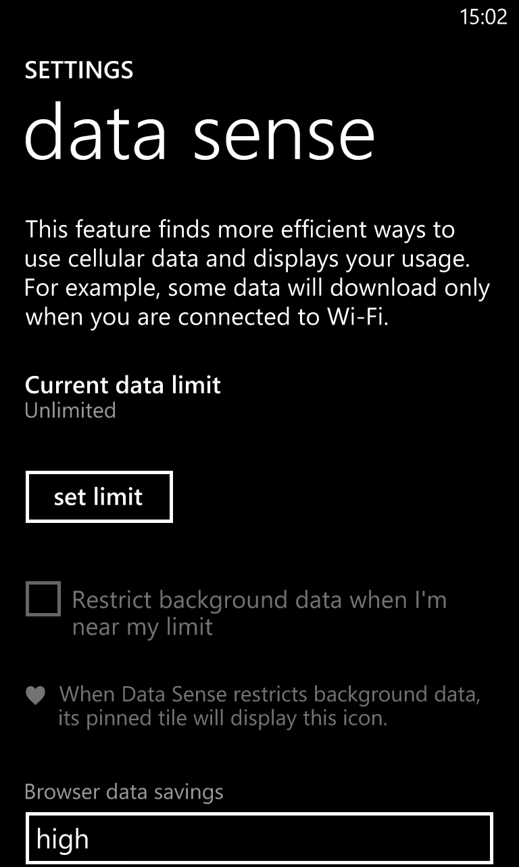
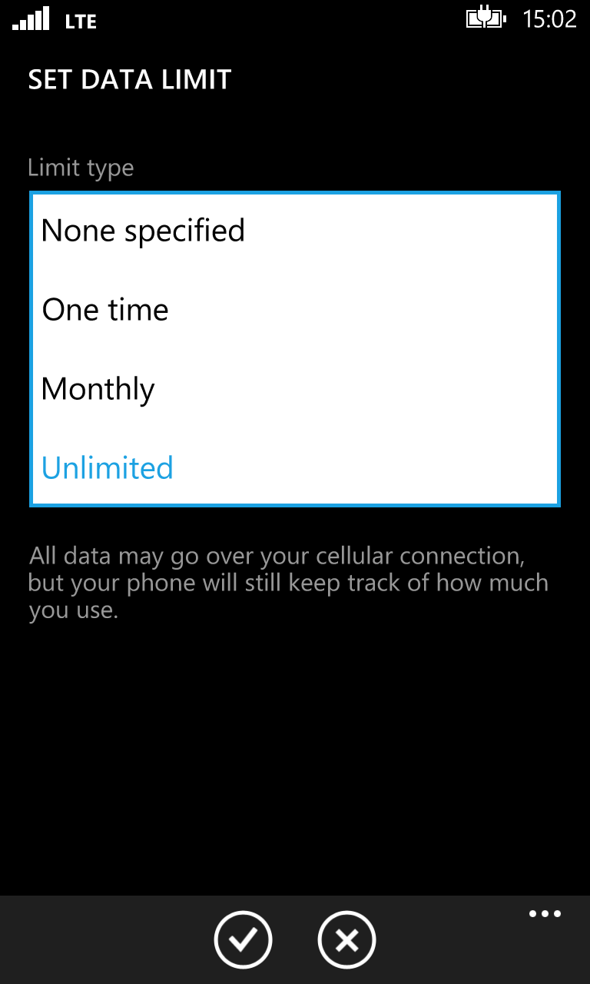
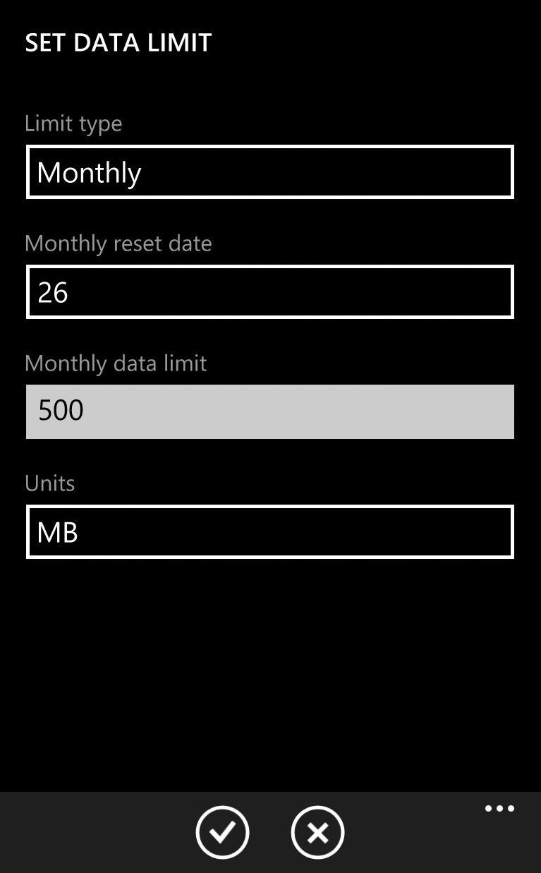
What Makes Up “Data Sense”?
Data Sense components include:
The Data Sense platform
Data Sense (UI)
Browser Optimization Service
WiFi hotspot Mapping

Slide 44
Building a Data Smart Application
Scenarios
Content streaming app
Example: Netflix; Hulu like app
File sharing app
Example: OneDrive; Dropbox like app
WiFi only app
Example: background sync

Slide 45
Content Streaming Scenario - 1 of 2
ConnectionProfile internetConnectionProfile = NetworkInformation.GetInternetConnectionProfile();
if (internetConnectionProfile != null)
{
if (internetConnectionProfile.IsWlanConnectionProfile)
{
// connected on WiFi interface; double check it is not a metered WiFi hotspot
ConnectionCost cc = internetConnectionProfile.GetConnectionCost();
if ((NetworkCostType.Unknown == cc.NetworkCostType) || (NetworkCostType.Unrestricted == cc.NetworkCostType))
{
// assume free network; connect and start streaming content
}
}
else if (internetConnectionProfile.IsWwanConnectionProfile)
{
...

Slide 46
Content Streaming Scenario – 2 of 2
else if (InternetConnectionProfile.IsWwanConnectionProfile)
{
ConnectionCost cc = InternetConnectionProfile.GetConnectionCost();
// check the type of data plan - make sure user is not currently roaming
if (!cc.Roaming)
{
if ((NetworkCostType.Unknown == cc.NetworkCostType) || (NetworkCostType.Unrestricted == cc.NetworkCostType))
{
// assume free network; connect and start streaming content
}
else if (NetworkCostType.Fixed == cc.NetworkCostType)
{
// make sure user not currently over limit or near limit
if ((!cc.OverDataLimit) && (!cc.ApproachingDataLimit))
{
// connect and start streaming content
}
}
}
}

Slide 47
Identity and Authentication

Slide 48
Most apps need it…
Many applications need to be able to identify and authenticate users
Personalization, content
Integration with online service providers
The Paradox: Users dislike signing on…
The goal: Users Sign in once. And that’s it.
Several new APIs in Windows Phone 8.1 that apps should use

Slide 49
Credential Locker securely store and roam user credentials

Slide 50
Overview
APIs to store credentials (user name, password) securely
Windows.Security.Credentials
Benefits:
Secure storage
Credential isolation
Roaming

Slide 51
Isolation
Apps can only access their own credentials
App A
Credential
Locker
App Sandbox Boundary
App B

Slide 52
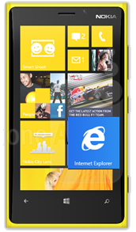
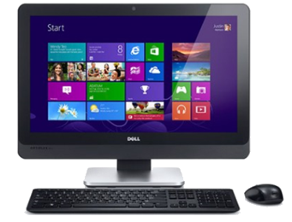
Roaming
Credentials roam across trusted devices
MSA
App
App

Slide 53
Credential Locker sample
void SaveCredential(string username, string password)
{
PasswordVault vault = new PasswordVault();
PasswordCredential cred = new PasswordCredential("MyAppResource", username, password);
vault.Add(cred);
}
IReadOnlyList<PasswordCredential> RetrieveCredential(string resource)
{
PasswordVault vault = new PasswordVault();
return vault.FindAllByResource(resource);
}

Slide 54
Web Authentication Broker (WAB) Easy authentication against online Service Providers e.g. Facebook, Twitter, etc.

Slide 55
Overview
Many apps connect to popular online service providers to provide a more personalized/social experience
Online service providers allow users to authorize other applications to interact with user data

Slide 56
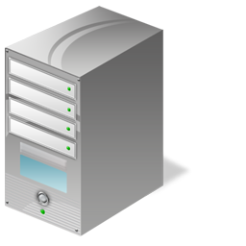
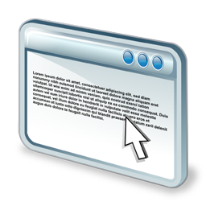
Typical OAuth flow
7. Data access
6. Authorization token (Redirect URL)
App
1. Authorization Request (Start URL)
Online
service
2. Login page
3. Credentials
4. Authorization page
5. User decision
User

Slide 57
Problems
Usually implemented with an embedded browser control
However…
No single sign-on
Credentials are entered into the application
Complicated to implement

Slide 58
The Solution
Web Authentication Broker (WAB)
Windows.Security.Authentication.Web
Authenticate to online service providers over web protocols like OAuth
Benefits
Supports SSO (Single sign-on)
Simple API
Credential Isolation

Slide 59
Web authentication broker
7. Data access
Web auth broker
WinRT
6. Authorization token (Redirect URL)
App
1. Authorization request (Start URL)
Online
service
2. Login page
Windows Phone 8.1 app
3. Credentials
Dialog
4. Authorization page
5. User decision
User

Slide 60
Launching WebAuthenticationBroker Usage Differs on Windows and Windows Phone
Windows
Windows Phone
// Authenticate using WAB
async void Authenticate()
{
WebAuthenticationResult result =
await WebAuthenticationBroker.AuthenticateAsync( WebAuthenticationOptions.None, startUri, endUri);
if (WebAuthenticationResult.ResponseStatus == WebAuthenticationStatus.Success)
{
// Parse the returned data to get the token out
// token is used in requests to online service
GetToken(WebAuthenticationResult.ResponseData);
}
else
{
// handle failures (user cancel, HTTP error)
}
}
//Initiate authentication using WAB
void Authenticate()
{
WebAuthenticationBroker.AuthenticateAndContinue( startUri, endUri);
}
App suspended, may be terminated
App activated when WAB returns
{
// Code runs on reactivation to handle response from WAB
}

Slide 61
Activation after WebAuthenticationBroker 1 of 3 – App.xaml.cs (Windows Runtime Xaml Apps)
protected override async void OnActivated(IActivatedEventArgs args)
{
if (args is WebAuthenticationBrokerContinuationEventArgs)
{
Frame rootFrame = Window.Current.Content as Frame;
// Do standard logic to create the Frame if necessary and restore state
if (rootFrame == null)
{
rootFrame = new Frame();
SuspensionManager.RegisterFrame(rootFrame, "AppFrame");
if (args.PreviousExecutionState == ApplicationExecutionState.Terminated)
{
try { await SuspensionManager.RestoreAsync(); }
catch (SuspensionManagerException) { }
}
// Place the frame in the current Window.
Window.Current.Content = rootFrame;
}
...

Slide 62
Activation after WebAuthenticationBroker 2 of 3 – App.xaml.cs (Windows Runtime Xaml Apps)
...
if (rootFrame.Content == null)
{
if (!rootFrame.Navigate(typeof(MyPageThatDoesAuth)))
{
throw new Exception("Failed to create target page");
}
}
// Pass the continuation event args to the target page
var p = rootFrame.Content as MyPageThatDoesAuth;
// ContinuationArgs is a property that we’ve added to MyPageThatDoesAuth
p.ContinuationArgs = (WebAuthenticationBrokerContinuationEventArgs)args;
// Ensure the current window is active
Window.Current.Activate();
}
}

Slide 63
Activation after WebAuthenticationBroker 3 of 3 – Page where WAB was initiated (Windows Runtime Xaml Apps)
private WebAuthenticationBrokerContinuationEventArgs _continuationArgs = null;
public WebAuthenticationBrokerContinuationEventArgs ContinuationArgs
{
get { return _continuationArgs; }
set {
_continuationArgs = value;
ContinueWebAuthentication(_continuationArgs); }
}
public async void ContinueWebAuthentication(WebAuthenticationBrokerContinuationEventArgs args)
{
WebAuthenticationResult result = args.WebAuthenticationResult;
if (result.ResponseStatus == WebAuthenticationStatus.Success)
{
String outputToken = result.ResponseData.ToString();
await DoSomethingWithTheTokenAsync(outputToken);
}
else { /* handle failures (user cancel, HTTP error) */ }
}

Slide 64
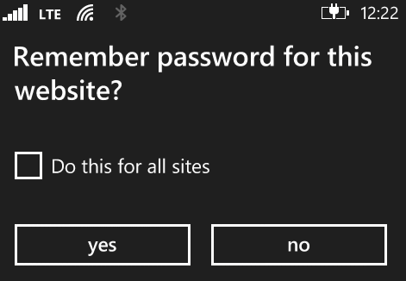
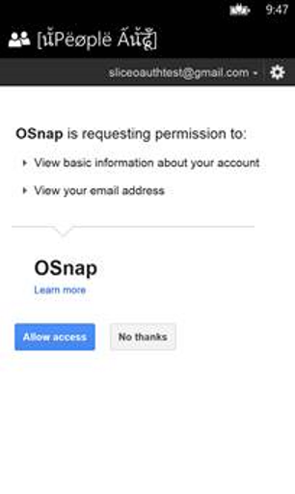
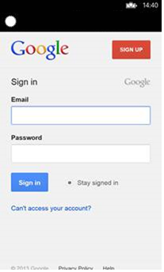
User Experience
Contoso
Credentials pre-populated if any app previously authenticated to this provider
1
Authenticate
2
Consent
3
Authorize app

Slide 65
Demo: Web authentication broker Authentication - online service providers e.g. Facebook, Twitter, etc.

Slide 66
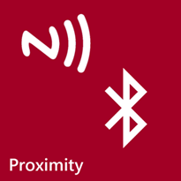
Proximity: NFC and Bluetooth

Slide 67
Near Field Communications
NFC provides a connection between devices that are very close together (within 3-4 centimetres)
The data is transferred at a rate of 106, 212 or 424 Kbit/second
NFC operates at slower speeds than Bluetooth (BT v2.1 is up to 2.1Mbit/s) but consumes less power and doesn’t require pairing
It is assumed that this data transfer is intentional so there is not normally any authentication as such
The user has positioned their device close to the other device

Slide 68
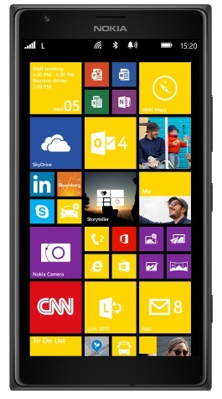
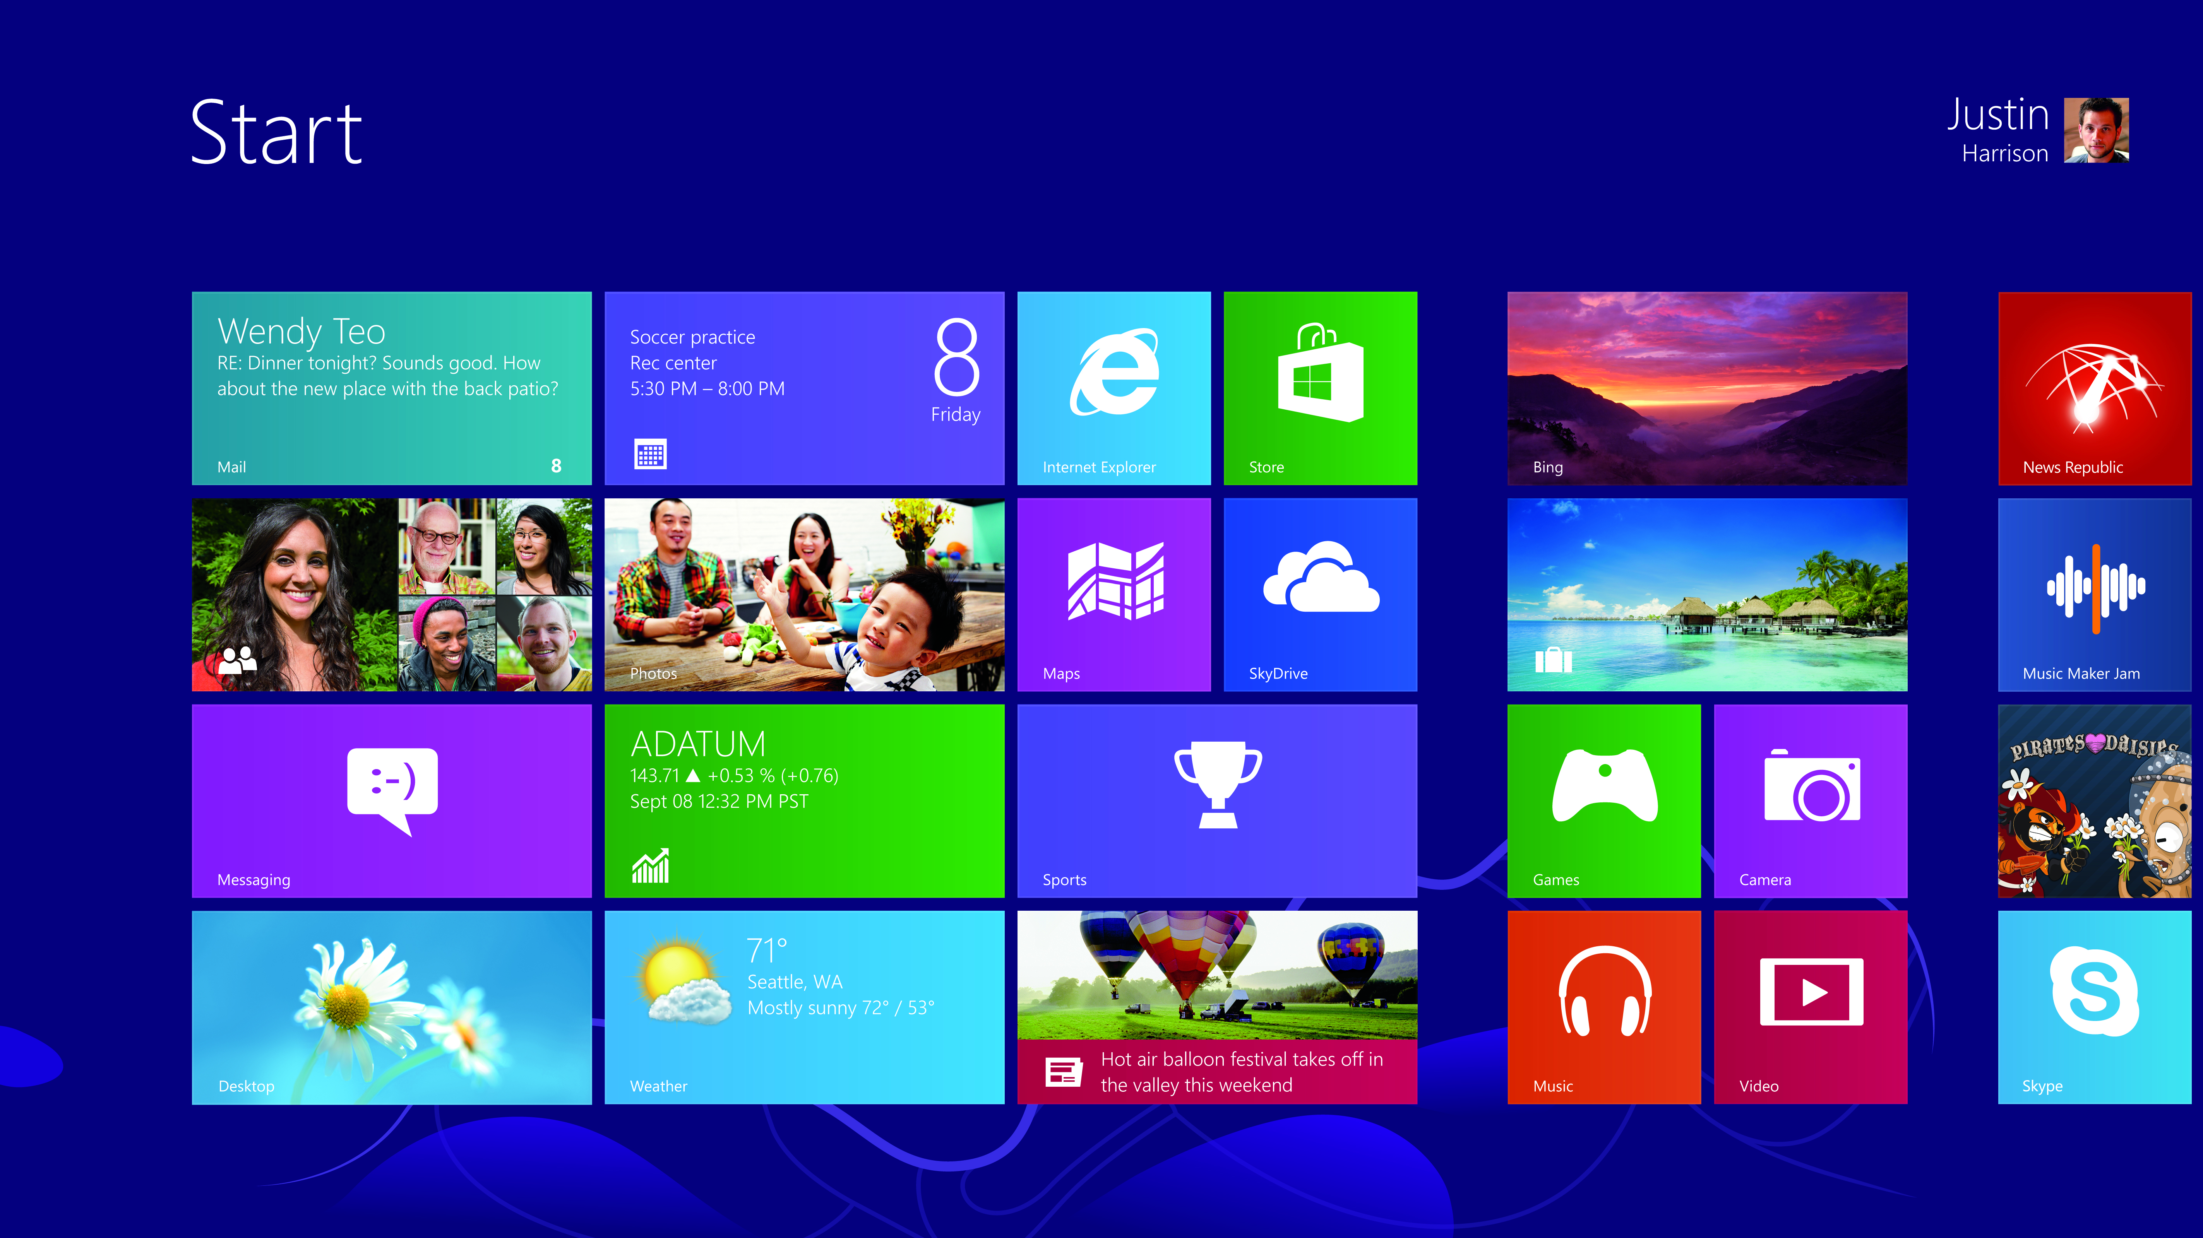
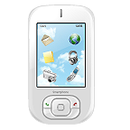
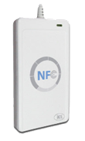
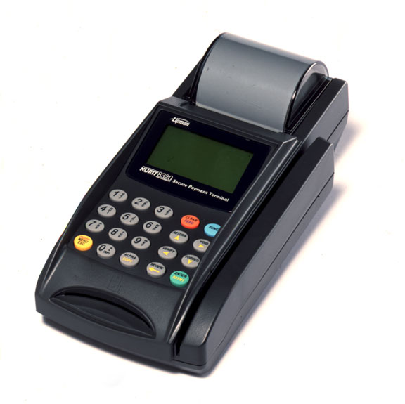
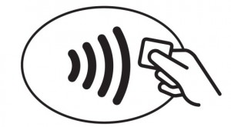
NFC Scenarios
Read and Write NFC Tags or smartcards
Short message
exchange
Read
Read/Write
Bootstrap higher capacity connections
Tap to share
Picture
Contact cards
URLs
Videos
Smartcard emulation
Secure NFC Payment
Transit passes
Enterprise access control
Mobile Payments (Credit/debit cards etc)

Slide 69
Bluetooth Scenarios
There are four Bluetooth communication scenarios supported by Windows 8.x and Windows Phone 8.1 devices
App to device
A program running on a Windows Phone can establish a connection to an external device
The Windows Phone must be paired with the device
App to app
An application can communicate with another instance of itself running on a different device
In this situation pairing is not required
Bluetooth RFCOMM (*new in Windows Phone 8.1)
A program can interact with a device using RFCOMM protocols, often called serial port emulation
Bluetooth GATT to access Bluetooth LE devices (*new in Windows Phone 8.1)
A program can use the Bluetooth GATT APIs to access Bluetooth LE services, descriptors, and characteristics

Slide 70
Bluetooth Smart (BLE) - GATT
Familiarity
&
Extensibility
GATT Client support
Windows Runtime API for GATT
Windows.Devices.Bluetooth.GenericAttributeProfile
Flexibility to build your own GATT-based profiles

Slide 71
Declaring app capabilities
<m2:DeviceCapability Name="bluetooth.genericAttributeProfile">
<m2:Device Id="model:xxxx;xxxx"|"any">
<m2:Function Type="name:heartRate"/>
<!-- use name:<service> as above, or… -->
<m2:Function Type="serviceId:xxxxxxxx"/>
</m2:Device>
</m2:DeviceCapability>
You cannot modify the Bluetooth GATT device capability using the Manifest editor in Microsoft Visual Studio. You must right-click the Package.appxmanifest file in Solution Explorer and select Open With..., and then XML (Text) Editor.

Slide 72
Example: Bluetooth LE Health Thermometer Service
async void Initialize()
{
var themometerServices = await Windows.Devices.Enumeration
.DeviceInformation.FindAllAsync(
GattDeviceService.GetDeviceSelectorFromUuid(
GattServiceUuids.HealthThermometer), null);
GattDeviceService firstThermometerService = await GattDeviceService.FromIdAsync(themometerServices[0].Id);
Debug.WriteLine("Using service: " + themometerServices[0].Name);
GattCharacteristic thermometerCharacteristic =
firstThermometerService.GetCharacteristics(GattCharacteristicUuids.TemperatureMeasurement)[0];
thermometerCharacteristic.ValueChanged += temperatureMeasurementChanged;
await thermometerCharacteristic.WriteClientCharacteristicConfigurationDescriptorAsync(
GattClientCharacteristicConfigurationDescriptorValue.Notify);
}

Slide 73
Example: Bluetooth LE Health Thermometer Service
void temperatureMeasurementChanged(GattCharacteristic sender, GattValueChangedEventArgs eventArgs)
{
byte[] temperatureData = new byte[eventArgs.CharacteristicValue.Length];
Windows.Storage.Streams.DataReader.FromBuffer(eventArgs.CharacteristicValue).ReadBytes(temperatureData);
var temperatureValue = convertTemperatureData(temperatureData);
temperatureTextBlock.Text = temperatureValue.ToString();
}
double convertTemperatureData(byte[] temperatureData)
{
// Read temperature data in IEEE 11703 floating point format
// temperatureData[0] contains flags about optional data - not used
UInt32 mantissa = ((UInt32)temperatureData[3] << 16) |
((UInt32)temperatureData[2] << 8) | ((UInt32)temperatureData[1]);
Int32 exponent = (Int32)temperatureData[4];
return mantissa * Math.Pow(10.0, exponent);
}

Slide 74
Demo: Proximity

Slide 75
Summary

Slide 76
Summary
Easily build cloud backend with Microsoft Azure Mobile Services
Use Windows.Web.Http.HttpClient class for Http Networking
Share state across devices using Roaming Data and/or OneDrive
Make smart decisions about network usage using the NetworkInformation API
Store credentials securely and roam to all your devices using CredentialLocker
To seamlessly connect to online service providers, use Web Authentication Broker APIs
NFC and Bluetooth Proximity APIs for near-field communications

Slide 77
Windows Track Resources
Windows Enterprise windows.com/enterprise windowsphone.com/business
Windows Springboard microsoft.com/springboard
Microsoft Desktop Optimization Package (MDOP)
microsoft.com/mdop
Windows To Go microsoft.com/windows/wtg
Windows Phone Developer developer.windowsphone.com

Slide 78
Related content
Breakout Sessions
WIN-B363 Build for Both: Building Shared Apps for Windows Phone and Windows 8.1
DEV-B343 Building Microsoft Azure Mobile Services with Visual Studio
DEV-B317 Mobile Line-of-Business Applications in Microsoft Azure
DEV-B345 High-Volume, Low Latency Mobile Push Notifications
DEV-B344 Building Web Apps and Mobile Apps Using Microsoft Azure Active Directory for Identity Management
Find Me At Ask The Experts – Tuesday evening

Slide 79
Resources
Learning
Sessions on Demand
Microsoft Certification & Training Resources
http://channel9.msdn.com/Events/TechEd
www.microsoft.com/learning
TechNet
msdn
Resources for IT Professionals
Resources for Developers
http://microsoft.com/technet
http://microsoft.com/msdn

Slide 80
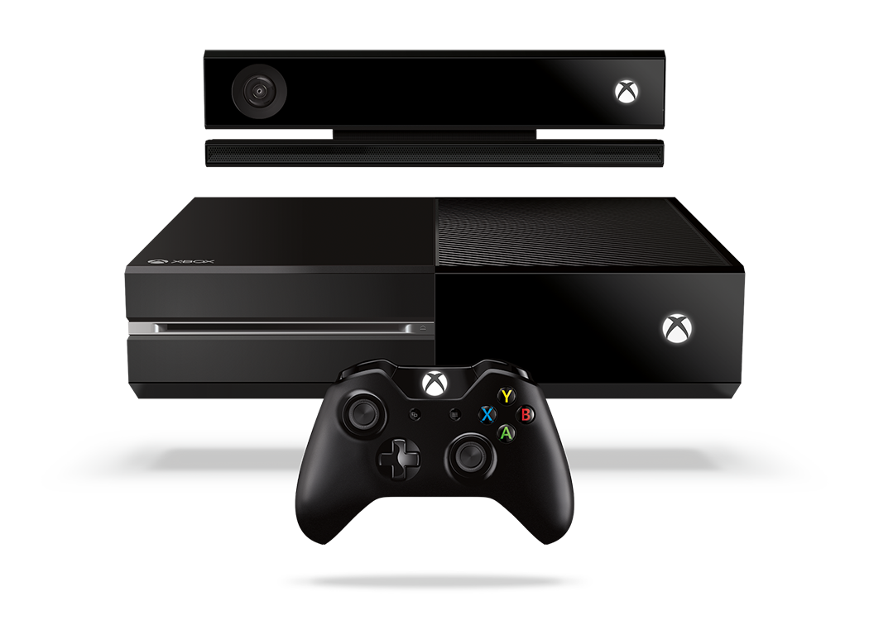
Complete an evaluation and enter to win!

Slide 81
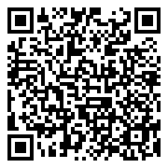
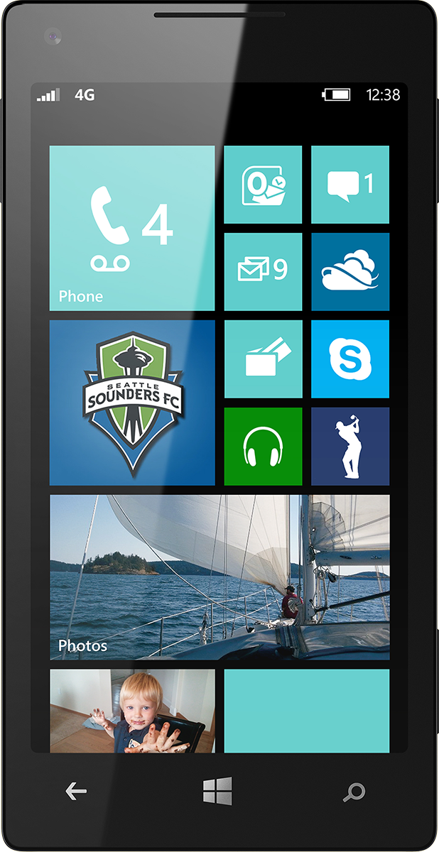
Evaluate this session
Scan this QR code to evaluate this session.

Slide 82
© 2014 Microsoft Corporation. All rights reserved. Microsoft, Windows, and other product names are or may be registered trademarks and/or trademarks in the U.S. and/or other countries.
The information herein is for informational purposes only and represents the current view of Microsoft Corporation as of the date of this presentation. Because Microsoft must respond to changing market conditions, it should not be interpreted to be a commitment on the part of Microsoft, and Microsoft cannot guarantee the accuracy of any information provided after the date of this presentation. MICROSOFT MAKES NO WARRANTIES, EXPRESS, IMPLIED OR STATUTORY, AS TO THE INFORMATION IN THIS PRESENTATION.

