Slide 2
Application Compatibility and Modernization in a Fast Moving, Post-XP World
WIN-B327
Chris Jackson
http://www.appcompatguy.com
appcompatguy@microsoft.com
@appcompatguy

Slide 3
Farewell Windows XP 10/25/01 - 4/8/14 #ripwindowsxp

Slide 4
Windows is one of the most stable platforms for application investment in all of computing. #durablesoftwareinvestments

Slide 6
Stable is not the opposite of agile #modernplusdurable

Slide 7
Collect Analyze Remediate #dontknowwhatyouvegotuntilyouupgrade

Slide 8
Manage Assess Update #agileappframework

Slide 9
Manage

Slide 10
Don’t get blinded by desktop apps #allappsmatter

Slide 11
Don’t try a full inventory #combinatorialexplosion

Slide 12
Managed Supported Unsupported Banned #appinsurancepolicies

Slide 13
Gold Silver Bronze #ifeverythingisimportantnothingisimportant

Slide 14
Quantify risk and act appropriately #canaryinacoalmine

Slide 15
Stick with known solutions #knownsolutions

Slide 16
Assess

Slide 17
The hunt for silver bullets #dontmakemework

Slide 18
$$P\left(W | L\right)=\frac{P\left(L | W\right)P\left(W\right)}{P\left(L\right)}=\frac{P\left(L | W\right)P\left(W\right)}{P\left(L | W\right)P\left(W\right)+P\left(L | M\right)P\left(M\right)}$$ #whydidntipayattentioninmathclass

Slide 19
Windows XP to Windows 8 85% 59% #thatseemsalittlelow

Slide 20
Windows 7 to Windows 8 60% 12% #thatseemsalotlow

Slide 21
IE 6 to IE 11 30% 13% #thatalsoseemsalotlow

Slide 22
IE 8 to IE 11 30% 2% #thatseemslikeaterribleidea

Slide 23
Has no bugs on the platform you want that stop you from working #definitionofcompatible

Slide 24
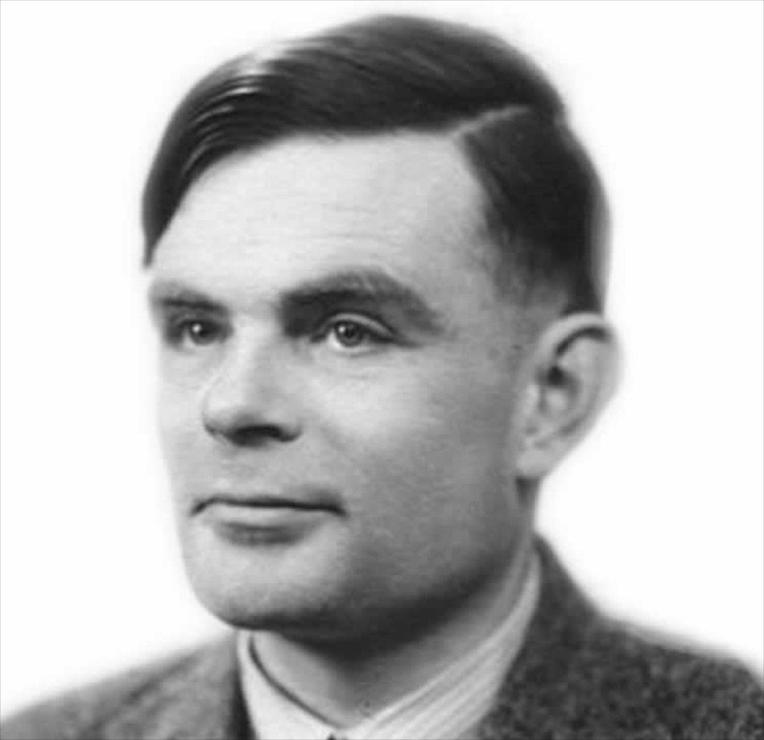

Slide 25
Technical due diligence User testing #processbeforetools

Slide 26
Tools Industrialized approaches Crowd sourcing #onlyautomateefficiency

Slide 27
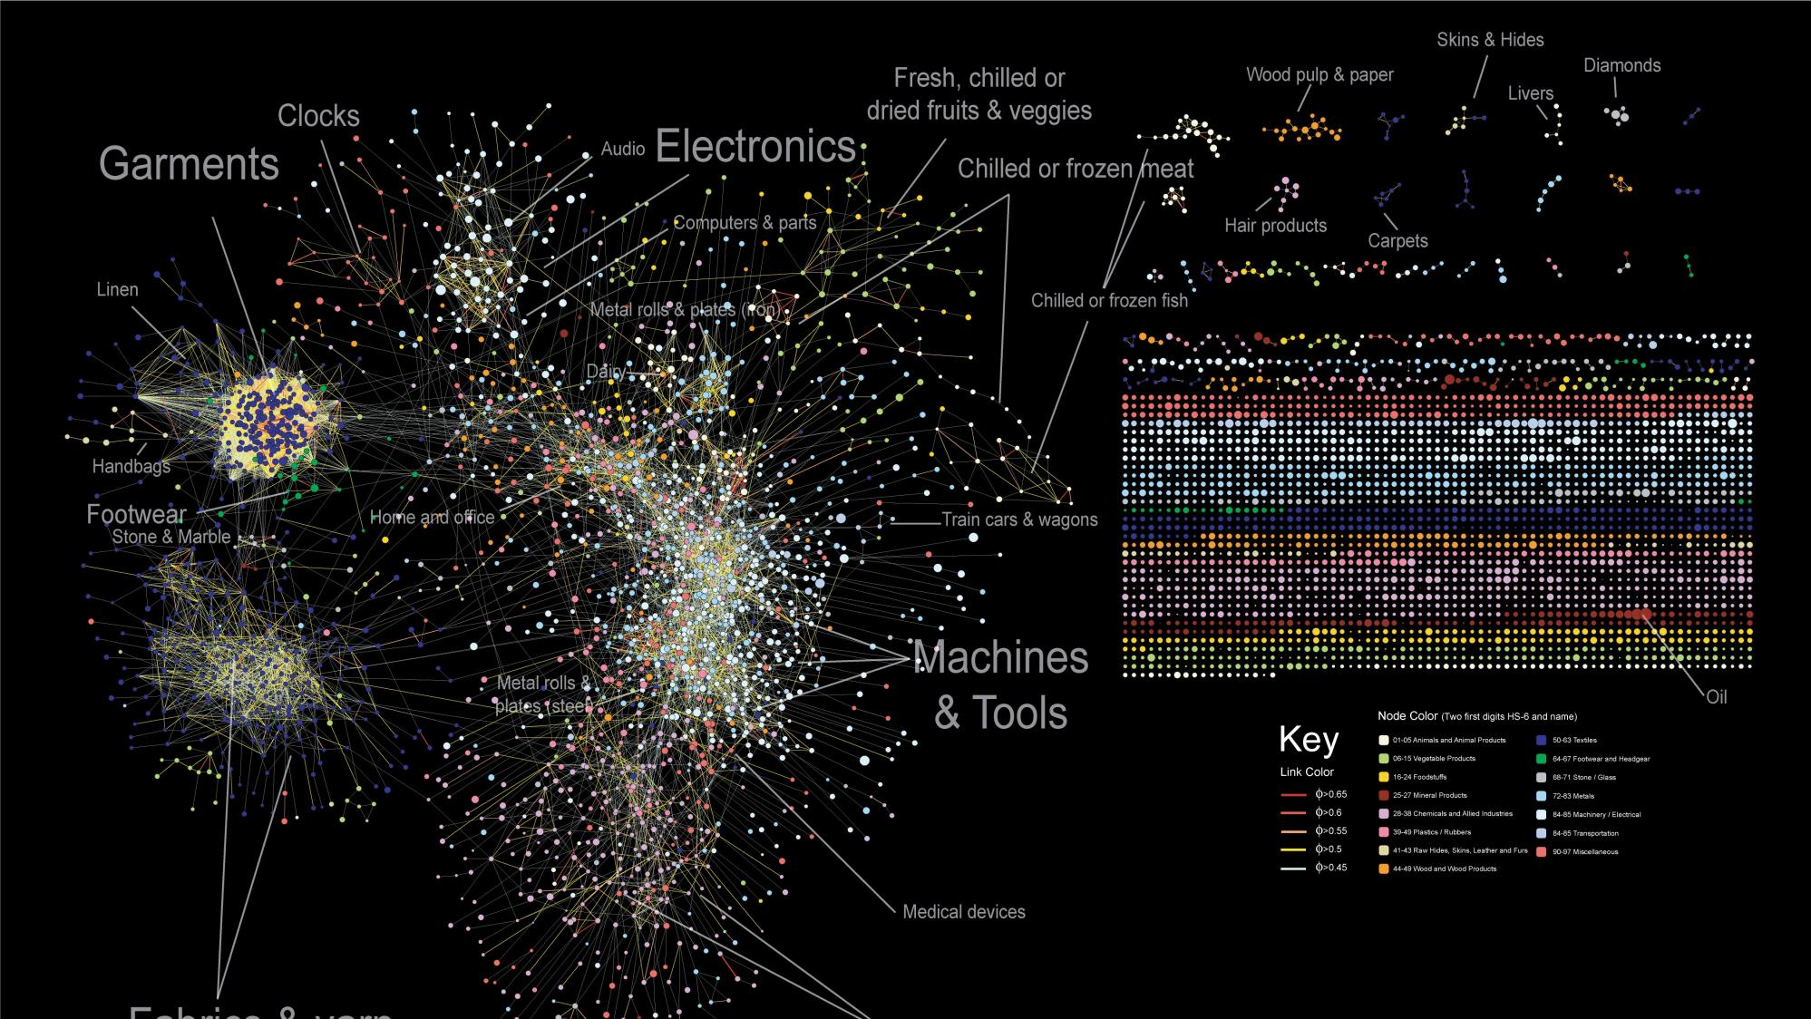

Slide 28
Successful UAT depends on being able to lead without authority #uatisnotajob

Slide 29
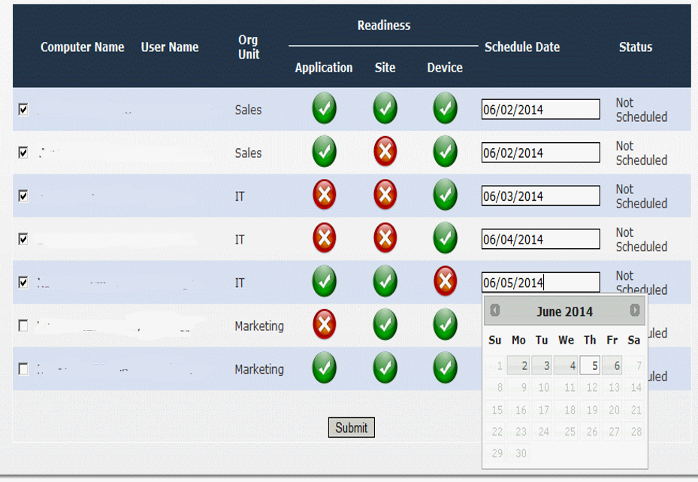

Slide 30
Compatible doesn’t mean supported #support #finalfrontier

Slide 31
Update

Slide 32
“Conservative accountants who assign zero values to many intangible benefits prefer being precisely wrong to being vaguely right.”
Kaplan, R. “Must CIM be justified by faith alone?”, Harvard Business Review, Volume 64, Number 2. 1986

Slide 33
Do you have technical debt to pay? #turnonuac #retiremedv #updateshims

Slide 34
Hunt down and destroy brittleness #hostagenomore

Slide 35
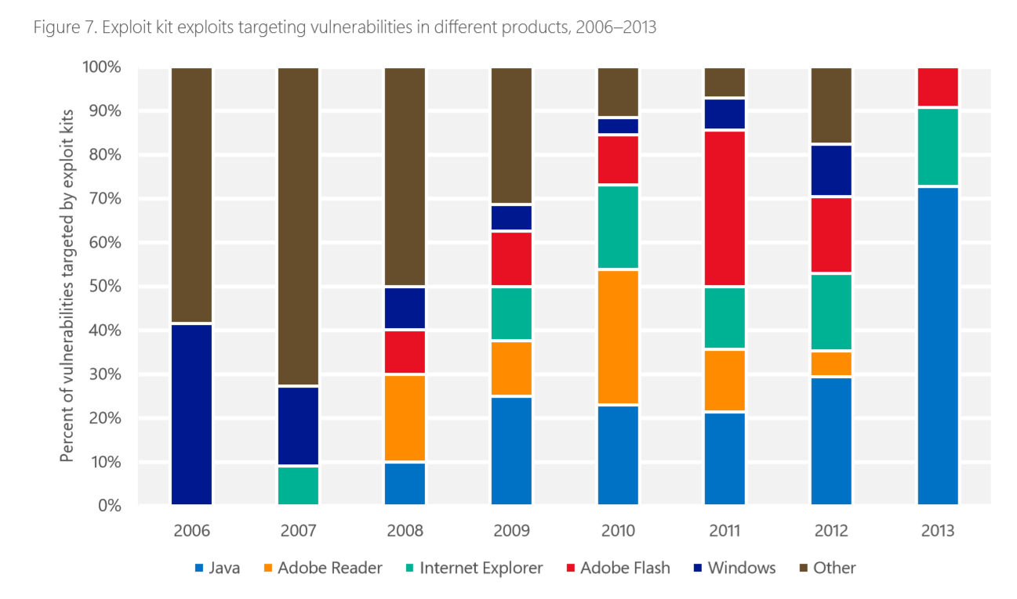

Slide 36
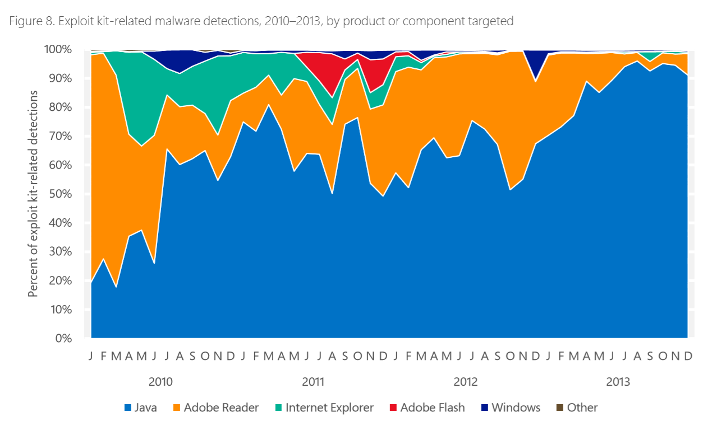

Slide 37
Stop checking for version numbers #youwillalwaysgetitwrong

Slide 40
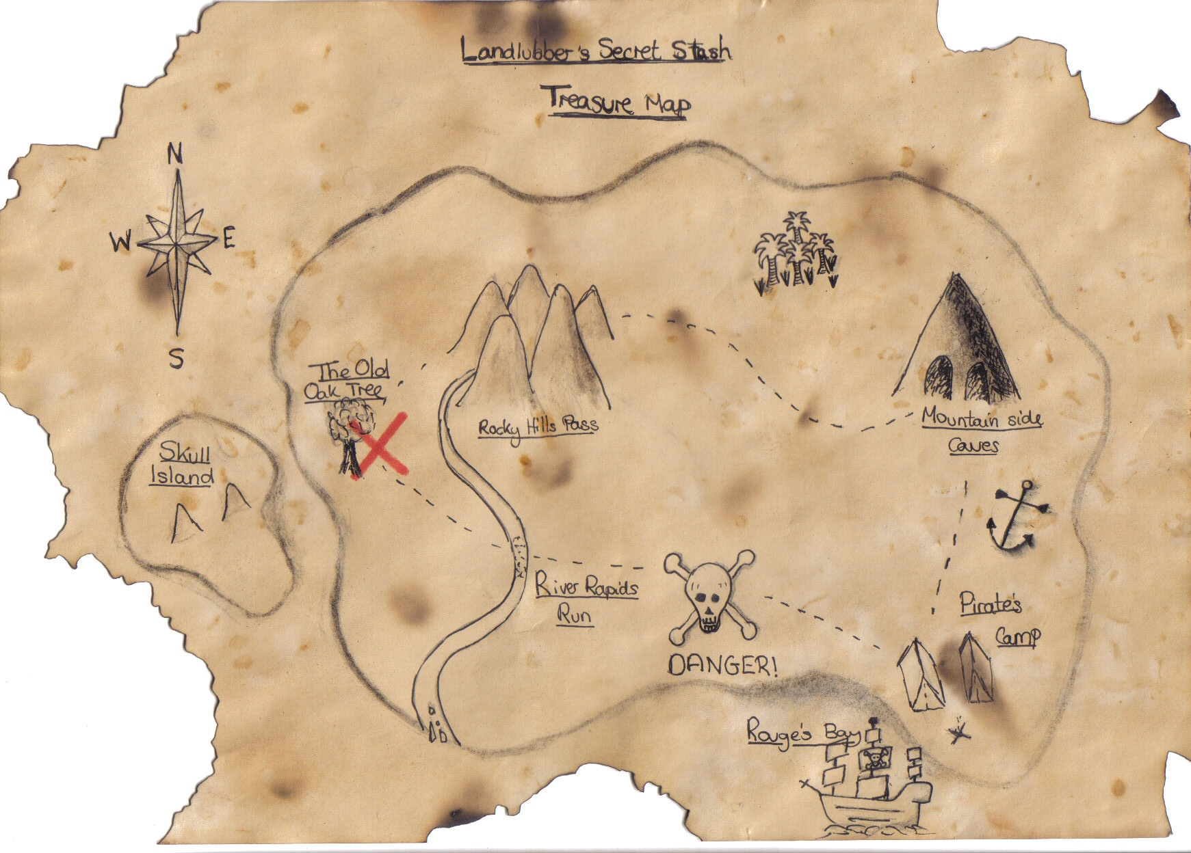

Slide 41
Platform Innovation vs. App Innovation

Slide 42
Faster Fewer 3rd parties have to cooperate New user experiences Cheaper and easier to maintain

Slide 43
HTML5 is terse #bandwidthbill

Slide 44
<!DOCTYPE html PUBLIC "-//W3C//DTD XHTML 1.0 Transitional//EN" "http://www.w3.org/TR/xhtml1/DTD/xhtml1-transitional.dtd">
<html xmlns="http://www.w3.org/1999/xhtml" lang="en" xml:lang="en">
<head>
<meta http-equiv="Content-Type" content="text/html; charset=utf-8" />
<title>Untitled Page</title>
<link rel="stylesheet" type="text/css" href="styles.css" />
</head>
<body>
<p>Hello World!</p>
</body></html>

Slide 45
<!DOCTYPE html>
<html xmlns="http://www.w3.org/1999/xhtml" lang="en" xml:lang="en">
<head>
<meta http-equiv="Content-Type" content="text/html; charset=utf-8" />
<title>Untitled Page</title>
<link rel="stylesheet" type="text/css" href="styles.css" />
</head>
<body>
<p>Hello World!</p>
</body></html>

Slide 46
<!DOCTYPE html>
<html lang="en">
<head>
<meta http-equiv="Content-Type" content="text/html; charset=utf-8" />
<title>Untitled Page</title>
<link rel="stylesheet" type="text/css" href="styles.css" />
</head>
<body>
<p>Hello World!</p>
</body></html>

Slide 47
<!DOCTYPE html>
<html lang="en">
<head>
<meta charset=utf-8 />
<title>Untitled Page</title>
<link rel="stylesheet" type="text/css" href="styles.css" />
</head>
<body>
<p>Hello World!</p>
</body></html>

Slide 48
<!DOCTYPE html>
<html lang="en">
<head>
<meta charset=utf-8 />
<title>Untitled Page</title>
<link rel="stylesheet" href="styles.css" />
</head>
<body>
<p>Hello World!</p>
</body></html>

Slide 49
<!DOCTYPE html>
<html lang="en">
<head>
<meta charset=utf-8 />
<title>Untitled Page</title>
<link rel="stylesheet" href="styles.css" />
</head>
<body>
<p>Hello World!</p>
</body>
</html>

Slide 50
<!DOCTYPE html PUBLIC "-//W3C//DTD XHTML 1.0 Transitional//EN" "http://www.w3.org/TR/xhtml1/DTD/xhtml1-transitional.dtd">
<html xmlns="http://www.w3.org/1999/xhtml" lang="en" xml:lang="en">
<head>
<meta http-equiv="Content-Type" content="text/html; charset=utf-8" />
<title>Untitled Page</title>
<link rel="stylesheet" type="text/css" href="styles.css" />
</head>
<body>
<p>Hello World!</p>
</body></html>

Slide 51
412 characters vs. 188 characters

Slide 52
Defining an ROI #howisitbetter

Slide 53
Enterprise Mode IE Office Telemetry Loopback Exemption #microsoft<3enterprise

Slide 54
We’re modern. We’re durable. We’re just getting started. #justgettingstarted

Slide 55
Windows Track Resources
Windows Enterprise windows.com/enterprise windowsphone.com/business
Windows Springboard microsoft.com/springboard
Microsoft Desktop Optimization Package (MDOP)
microsoft.com/mdop
Windows To Go microsoft.com/windows/wtg
Windows Phone Developer developer.windowsphone.com

Slide 56
Resources
Learning
Sessions on Demand
Microsoft Certification & Training Resources
http://channel9.msdn.com/Events/TechEd
www.microsoft.com/learning
TechNet
msdn
Resources for IT Professionals
Resources for Developers
http://microsoft.com/technet
http://microsoft.com/msdn

Slide 57
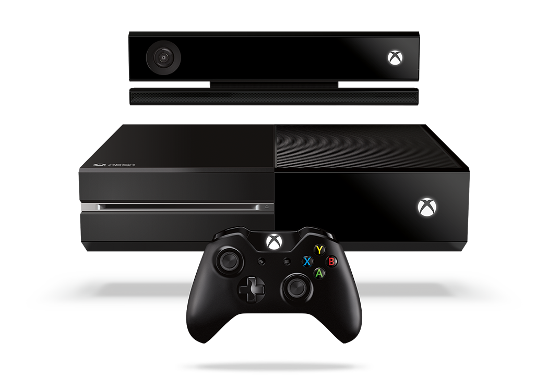
Complete an evaluation and enter to win!

Slide 58
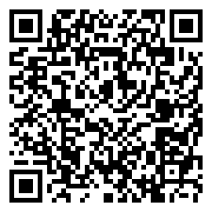
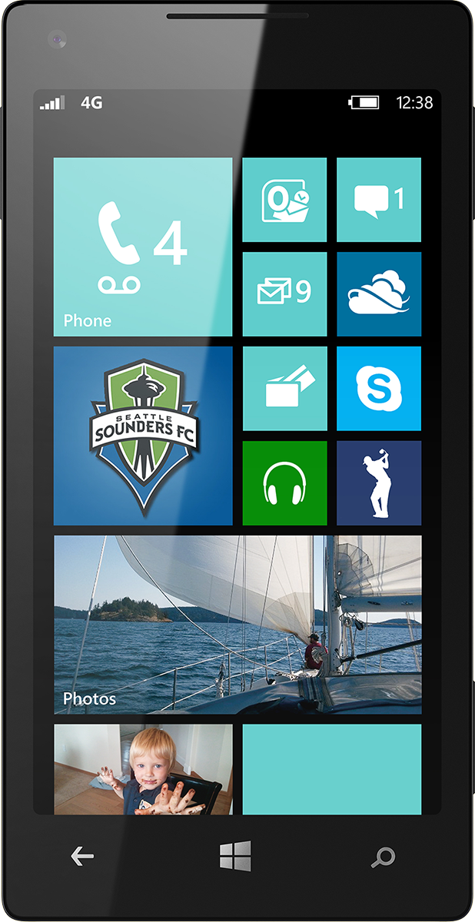
Evaluate this session
Scan this QR code to evaluate this session.

Slide 59
© 2014 Microsoft Corporation. All rights reserved. Microsoft, Windows, and other product names are or may be registered trademarks and/or trademarks in the U.S. and/or other countries.
The information herein is for informational purposes only and represents the current view of Microsoft Corporation as of the date of this presentation. Because Microsoft must respond to changing market conditions, it should not be interpreted to be a commitment on the part of Microsoft, and Microsoft cannot guarantee the accuracy of any information provided after the date of this presentation. MICROSOFT MAKES NO WARRANTIES, EXPRESS, IMPLIED OR STATUTORY, AS TO THE INFORMATION IN THIS PRESENTATION.

