Slide 1


Slide 2

Everything You Need to Know for a Successful Microsoft Office 2013 App-V Deployment
WIN-B330
Briton Zurcher
Senior PM Manager

Slide 3



Objectives & Takeaways
Session Objectives
  Provide an overview of Office 2013 options for enterprise
  Provide a detailed look at Office 2013 with App-V 5.0 SP2
Key Takeaways
  Office 2013 was designed with the enterprise in mind. It’s important to understand the options and match them with your organization’s needs.
  Office 2013 with App-V 5.0 SP2 has a number of unique advantages which make it the right choice for many enterprise deployments.

Slide 4



Agenda
Plan
Enterprise Delivery & Licensing Options
RDS & VDI Considerations
App-V & Office 2013
Deploy
Deployment Options & Prerequisites
Plugins & Connections Groups
Office Coexistence
Manage
Managing Office Updates
Office Package Customizations
Using Deployment Configuration

Slide 5
Planning for Office
Deployment

Slide 6




Office 2013 Delivery Options
Click-To-Run | App-V 5 | MSI-Based
Software-as-a-Service | On-Premise Software “Service” | Traditional Packaged Software
Office 365 Portal, deploy in OS image, stand-alone, or via ESD (SCCM) | Deploy via App-V Server, in OS image, stand-alone, or ESD (SCCM) | Deploy, in OS image, stand-alone or via ESD (SCCM)
“Always Up-to-Date” or Admin Controlled Updates | Admin Controlled Updates | Service Pack and Updates (via MU/WSUS)
Basic Install-Time Controls, GPO | Basic Install-Time Controls, GPO | Granular Install-Time Control (OCT), GPO
Customizations via GP, and add-ins | Customization with App-V deployment configuration, GP, and add-ins | Customizations via OCT, GP, config.xml, and add-ins

Slide 7
Enterprise Licensing Options
 | Volume Licensing | Subscription Licensing
Delivery Support | MSI & App-V 5.0 SP2 | Click-to-Run & App-V 5.0 SP2
Activation Support | Key Management Service (KMS) & Multiple Activation Key (MAK) | Office Licensing Service (OLS) – requires Internet-facing activation every 30 days
Licensing Program | All Volume License programs | Enterprise & Enterprise Subscription Agreements, Microsoft Online Subscription Program
Device/User Licensing & Activation | Licensing & activation per-Device | Licensing per-User (x5 Devices), activation per-Device or per-User
OrgID/MSA | OrgID/MSA not required, optional for Sign-In experience | OrgID/MSA required
Remote Desktop Services Support | Supported (Standard or ProPlus) | Support coming Summer 2014 (Office 365 ProPlus Only)

Slide 8
Office 365 ProPlus Activation Modes
Coming
Summer
2014!
User-Based Subscription Activation
Activation is performed once by a user logging in with Office 365 ProPlus credentials
Office is activated at the machine level and available for all user profiles
Activation will continually rearm to look if the user’s account or service has been de-provisioned
Subscription activation (and any other retail activation) does not work in conjunction
with RDS/VDI
Shared Computer
Activation
Activation is performed per login session using Office 365 ProPlus credentials
Activation state is contained within each user profile on a machine and limited to the user session duration
Each user on a shared machine needs to provide their own valid credentials to activate Office
ADFS can be used to eliminate
ongoing sign-in between sessions

Slide 9



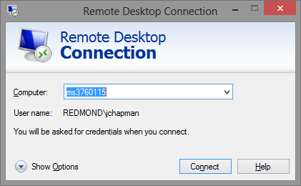

RD Session Host & RemoteApp
Consuming Devices
Connection Broker
RD Session
Host
Single shared server OS with RDS role enabled servicing multiple user profiles
One shared Office install
User Profiles
Key Attributes
Many-to-one relationship with remote computer
Consuming device may see entire desktop or just an application window (RemoteApp)
Enable Shared Content Store mode if using App-V for application deployment

Slide 10
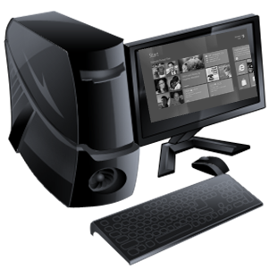
Persistent/Dedicated VDI
Consuming Devices
Connection Broker
Hyper-V
Server
Server operating system with Hyper-V or similar operating system virtualization host
Multiple virtual machines
Each virtual machine has a separate Office install
Virtual Machines
Key Attributes
Users access a dedicated virtual machine (VM) from a consuming device
One-to-one user-to-VM relationship – each VM includes an Office install
User state may be external to VM, but applications are included in VM
Enable Shared Content Store mode if using App-V for application deployment

Slide 11



Volatile/Pooled VDI
Consuming Devices
Connection Broker
Hyper-V
Server
Server OS with Hyper-V or similar OS virtualization host
Virtual machines share common base OS
user State
Virtual Apps
OS Image
Key Attributes
Users access a dynamically-allocated shared base VM (or session) from a consuming device
User state and apps are accessed on storage outside of the VM Pool
Should consider including Office in the base image
Enable Shared Content Store mode if using App-V for application deployment

Slide 12


RDS & VDI Licensing Considerations
Office Volume License
  Windows & Server licenses for RDS/VDI are required
  Office license is required for each device accessing Office in RDS/VDI on-premises
  Software Assurance is required for third-party devices, off-premises access of Office in RDS/VDI
  Depending on your BYOD policies & off-premise access needs, a combination of Windows licenses may be required including Software Assurance, Virtual Desktop Access, and/or Windows Companion License
Office 365 Subscription
  Windows & Server licenses for RDS/VDI are required
  Office 365 includes use of Office in RDS/VDI
  Users may access remote Office deployments from any device, anywhere, supporting BYOD and off-premise access needs.
  Depending on your BYOD policies & off-premise access needs, a combination of Windows licenses may be required including Software Assurance, Virtual Desktop Access, and/or Windows Companion License

Slide 13


App-V: Office 2007 & 2010
Office 2007
  Must perform App-V Sequencing process
  Detailed prescriptive recipe with multiple steps
  OCT .msp must be created for all sequenced packages
  No OS integrations (Windows Search, mailto links, etc.)
Office 2010
  Must perform App-V Sequencing process
  Can use prescriptive recipe method or a Microsoft-supported Package Accelerator
  Must download and use Office Deployment Kit to enable licensing activation
  Must download and use Office 2010 Sequencing Kit to enable OS integrations
  Several OS integrations available (including the ability to deploy without them)

Slide 14


App-V 5.0 SP2 & Office 2013
Zero Sequencing Required
Packages Downloaded Directly
Full OS Integrations
Ready-to-Go in 3 steps:
Download and extract the Office Deployment Tool (ODT)
Download the Office Click-to-Run Packages
Convert Click-to-Run Packages for use with App-v 5.0 SP2
App-V/Office 2013 Deployment Doc:
http://aka.ms/
appvoffice

Slide 15
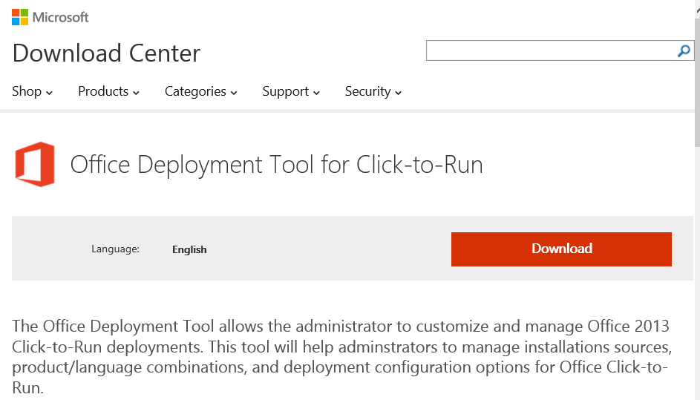
Office Deployment Tool (ODT)
http://aka.ms/msodt
App-V Customization Options:
Product SKU(s)
Version
Bitness
Language(s)
DOWNLOAD
Click-To-Run Media
CUSTOMIZE packages for Click-To-Run & App-V
CONVERT Click-To-Run packages for App-V

Slide 16
Example ODT Configuration
<Configuration>
<Add SourcePath=C:\ODT\ Version="15.1.2.3" OfficeClientEdition="32" >
<Product ID="O365ProPlusRetail">
<Language ID="en-us" />
</Product>
<Product ID="VisioProRetail">
<Language ID="en-us" />
</Product>
</Add>
</Configuration>

Slide 17
Demo: ODT App-V Packager
Briton Zurcher

Slide 18
Deploying Office with App-V

Slide 19
Deployment Prerequisites
Enable Scripts in the App-V Configuration
  Office 2013 relies on package scripts to successfully publish
  Run via PowerShell on target clients:
  Set-AppvClientConfiguration -EnablePackageScripts 1
Publish Globally
  Office 2013 for App-V allows deep integrations and extension points with the OS
  Globally publishing allows for a natively installed Office experience
  For PowerShell install use the global publish switch:
  Publish-AppvClientPackage <Path_to_Package> -global
  For App-V Server, add permissions to a Group of machines rather than a User Group
Only One Package Can be Published
  Each machine can only have one Office 2013 App-V package
  All required Office applications must be included in that single package

Slide 20













Deployment Options
IT
In OS Image (MDT)
App-V Server
SCCM or other ESD
Stand-alone/Scripted
Users
  *For Datacenter Scenarios (RDS and VDI) always enable the Shared Content Store (CSC) Feature. See new performance guidance: http://aka.ms/appvperf

Slide 21
Plugins & Connection Groups
Office 2013 & Plugins
  Because sequencing is no longer required for Office, plugin packages must be created separately
  A Connection Group must be created in order for Office 2013 and the plugin to interoperate
Steps to Deploy a Plugin
  Sequence the plugin(s) using the App-V 5 Sequencer. Use a natively installed version of Office on the sequencing system (C2R or MSI)
  Turn off Virtual Objects and verify Integration Mode in the Deployment Configuration for the plugin package
  Create a Connection Group through the App-V Management Console or manually
  Publish your Office 2013 and plugin package (using the “-global” switch and reference the modified Deployment Configuration if necessary)
  Deploy and enable your Connection Group
*More Detailed Information: App-V/Office 2013 Deployment Doc - http://aka.ms/appvoffice

Slide 22
Office Coexistence
Office Coexistence Scenarios Should be Avoided
  Best practice is to mitigate compatibility issues and avoid coexistence completely
  If beginning with native, deploy the second package as native (MSI or C2R) if possible
  If beginning with App-V, deploy the second package with App-V
  All coexistence solutions should be fully tested and verified before deploying
The Fine Print
  Only one version of App-V Office should be deployed with OS integrations
  Only one version of Outlook should be used, the other should be disabled
  Only one version of Office can own file-type associations (based on last version installed or published)
Coexistence Scenarios Should be Temporary
  Coexistence deployment should facilitate a faster transitions to the latest Office versions
  Long-term coexistence deployment is not recommend and organizations should begin with a plan to fully transition in the immediate future

Slide 23
Office Coexistence Matrix
Beginning Office Install | 2013 Coexistence Option(s)
2010 MSI | 2013 Click-to-Run 2013 App-V 2013 MSI
2010 App-V (isolated)* | 2013 App-V
2007 MSI | 2013 Click-to-Run 2013 App-V 2013 MSI
2007 App-V | 2013 App-V
*Running 2010 App-V integrated with 2013 App-V (which is always integrated) is not recommended. Run at your own risk after fully testing your scenarios.

Slide 24
Demo: Deploying Office with App-V
Briton Zurcher

Slide 25
Managing your App-V Deployment

Slide 26




Managing Updates
Download Update and Create Package
Publish Updated Package
Restart End-Points for Update to be Applied
No need to start with the previous package, a new one will be created
PackageID will remain static, VersionID will change
Remember to always publish Office with the “global” switch
Existing package will be overwritten, only the file deltas will be transferred
Office user state will not be affected by updates
Updates will remain pending until end-points are restarted
Restart at users’ convenience unless an important security update is included

Slide 27
Office App-V Package Customizations
Deployment Configuration can be used to:
  Disable publishing of certain Office Applications
  Disable Office Application Shortcuts
  Disable certain native extensions (file-type associations and URL protocols)
  Many additional advanced customizations (including scripting)
Customizations don’t require repacking or redeployment of the package
  Deploy updated DeploymentConfig.xml
  Republish package referencing the new Deployment Configuration

Slide 28


A Note on Visio & Project 2013
Visio & Project are Globally Published
  Just like the Core Suite, Visio & Project 2013 must also be published globally
  Only one Office 2013 package can be published to each machine
  Visio and/or Project must be include in your Office package via ODT configuration
  Deployment Configuration is not the method for selectively preventing Visio & Project launch for RD Session Host users
Options for Selectively Targeting Visio & Project
  Deploy with Subscription Licensing and enable Shared Computer Activation (Summer ’14). Control entitlement to Visio & Project via the Office 365 Admin Console
  Deploy different Office packages to distinct RD Session Hosts and target groups of users to the corresponding hosts which have the right entitlements to Visio & Project
  Use Microsoft AppLocker to restrict execution of Visio & Project to select users

Slide 29
ODT Summer 2014 Updates
Shared Computer Activation
  Ability for Subscription customers to activate Office entitlements at the user level rather than the machine level
Application Exclusion
  Ability to exclude specific Office applications (within a SKU) when creating a package with the ODT
Custom Office PackageID
  Ability to create an App-V package with a custom PackageID GUID
  This will allow App-V Server customers to manage multiple Office 2013 packages to the Server (however, only one Office package can be published per machine)

Slide 30
DeploymentConfig.XML – Disable Publish
<Applications>
<Application Id="[{AppVPackageRoot}]\office15\MSACCESS.EXE" Enabled="true">
<VisualElements>
<Name>Access 2013</Name>
<Icon />
<Description />
</VisualElements>
</Application>
</Applications>

Slide 31
DeploymentConfig.XML – Disable Shortcut
<Shortcuts Enabled="true">
<Extensions>
<Extension Category="AppV.Shortcut">
<Shortcut>
<File>[{Common Programs}]\Microsoft Office 2013\Access 2013.lnk</File>
<Target>[{AppVPackageRoot}]\office15\MSACCESS.EXE</Target>
<Icon>[{Windows}]\Installer\{90150000-000F-0000-0000-0000000FF1CE}\accicons.exe.0.ico</Icon>
<Arguments />
<WorkingDirectory />
<AppUserModelId>Microsoft.Office.MSACCESS.EXE.15</AppUserModelId>
<AppUserModelExcludeFromShowInNewInstall>true</AppUserModelExcludeFromShowInNewInstall>
<Description>Build a professional app quickly to manage data.</Description>
<ShowCommand>1</ShowCommand>
<ApplicationId>[{AppVPackageRoot}]\office15\MSACCESS.EXE</ApplicationId>
</Shortcut>
</Extension>
</Shortcuts>

Slide 32
Demo: Office Customization
Briton Zurcher

Slide 33
Summary: Key Takeaways
Office 2013 is Designed for Enterprise
App-V Provides Unique Advantages
Flexible Deployment & Licensing
Full Software-as-a-Service Option
Device & User Activation Modes
Native Experience When Virtualized
ODT for easy C2R & App-V Packaging
Admin Control for Updates
Temporary coexistence with
Office 2010 or 2007
Volume and Subscription Licensing Both Supported
Diverse On-Premise Deployment Options
Shared Content Store for RDS/VDI
Office Plugins can be Virtualized
Deployment Configuration Customization Ability
All of Your Applications Can Be Virtualized and Managed Together

Slide 34

Thank You!
briz@microsoft.com
@bzurc
http://www.linkedin.com/in/bzurc
blogs.technet.com/b/appv

Slide 35
Related content
WIN-B362: Project Virtual Reality Check: Microsoft App-V 5 Performance, Tuning, and Optimization (App-V PTO) - Thursday @10:15
WIN-B355: The Circle of Life for an App-V 5.0 Package: From Sequence to Termination – Thursday @13:00
WIN-B215: Deploying Microsoft App-V 5 and Citrix XenDesktop 7 – Thursday @14:45
WIN-B360: Sizing App-V 5: Planning and Designing a Highly Available, Scalable, and Resilient Management and Delivery System – Thursday @14:45
WIN-H309: Implementing App-V 5 in Microsoft System Center 2012 R2 Configuration Manager - HOL

Slide 36
Windows Track Resources
Windows Enterprise windows.com/enterprise windowsphone.com/business
Windows Springboard microsoft.com/springboard
Microsoft Desktop Optimization Package (MDOP)
microsoft.com/mdop
Windows To Go microsoft.com/windows/wtg
Windows Phone Developer developer.windowsphone.com

Slide 37

Resources
Learning
  Sessions on Demand
  Microsoft Certification & Training Resources
http://channel9.msdn.com/Events/TechEd
www.microsoft.com/learning
TechNet
msdn
  Resources for IT Professionals
  Resources for Developers
http://microsoft.com/technet
http://microsoft.com/msdn

Slide 38



Complete an evaluation and enter to win!

Slide 39


Evaluate this session
Scan this
QR code
to evaluate
this session.

Slide 40


© 2014 Microsoft Corporation. All rights reserved. Microsoft, Windows, and other product names are or may be registered trademarks and/or trademarks in the U.S. and/or other countries.
The information herein is for informational purposes only and represents the current view of Microsoft Corporation as of the date of this presentation. Because Microsoft must respond to changing market conditions, it should not be interpreted to be a commitment on the part of Microsoft, and Microsoft cannot guarantee the accuracy of any information provided after the date of this presentation. MICROSOFT MAKES NO WARRANTIES, EXPRESS, IMPLIED OR STATUTORY, AS TO THE INFORMATION IN THIS PRESENTATION.

