Slide 2
Making Sense of the Microsoft Information Protection Stack
WIN-B335
Chris Hallum
Senior Product Manager
Operating Systems Group - Security
Microsoft Corporation

Slide 3
Agenda
Problem Statement
What Success Looks Like to Microsoft
Our Current Solutions
Putting them all together

Slide 4
Problem Statement
Customers see information protection as a significant challenge and a growing business priority.
The explosion of device types and form factors and BYOD is challenging existing policies and practices.
Microsoft has many point solutions spanning across many products
Until recently platforms other than Windows have not been supported by our solutions.

Slide 5
Success Is…
“I know what data is sensitive, what is not. My sensitive data is protected, anywhere it resides, regardless of type. I can control its flow and monitor its use. Access to my data is controlled by me.”
CXO or ITPro
“I am empowered to act responsibly with my organization’s data.”
Information Worker

Slide 6
Industry Approach
Data in Use
Data in Motion
Data at Rest

Slide 7
The Entities to Secure
Data
Apps
Device
Authorize Protect Share
Scenarios

Slide 8
Microsoft Solutions
Active Directory
AppLocker
User Profiles
AD FS
Dynamic Access Control
BitLocker
Web Application Proxy
Work Folders
Encrypting File System
Right Management Services
Windows Azure AD
SharePoint FCI
Exchange DLP
SSL
Windows Azure RMS
IPv6
Windows Azure MFA
BitLocker to Go
Remote Business Data Removal

Slide 9
Data
Authorize
Protect
Share

Slide 10
Challenges
I want to provide a single identity for users to access all corporate resources
I want to be able to ensure that access to data automatically stays up to date with our users roles and responsibilities
I want to be able to wipe data from devices when the relationship with the device or users ends
I want to be able to ensure files are encrypted and only accessible by authorized users
I want to be enable safe sharing of content with internal and external users
I want to prevent users from being able to leak information using email

Slide 11
Authorize
I want to provide a single identity for users to access all corporate resources

Slide 12
Providing Users with a Common Identity
3rd party services
Apps in Azure
Active Directory
IT can use Active Directory Federation Services to connect with Azure Active Directory for a consistent cloud-based identity.
Users get access through accounts in Windows Azure Active Directory to Windows Azure, Office 365, and third-party applications.
Users are more productive and secure when they have single sign-on to all their resources.
Web Apps
Developers can build applications that leverage the common identity model .
IT can provide users with a common identity across on-premises or cloud-based services, leveraging Windows Server Active Directory and Windows Azure Active Directory.
Active Directory
LOB Apps
Files

Slide 13
Windows Azure Active Directory
Choose among hundreds of popular SaaS apps from a pre-populated application gallery.
Non-MS SaaS apps
Sync identity with DirSync or provide SSO with AD FS
Active Directory
Active Directory
Multi-Factor Authentication
Add Azure Multi-Factor Authentication for additional user identity verification
LOB Apps
Web Apps
Comprehensive identity and access management tools provide combined directory services management, identity governance, application access management, etc
Easily add custom cloud-based apps. Facilitate developers with identity management.

Slide 14
Windows Azure Active Directory Options Overview
 | Azure AD Free | Azure AD Premium
Directory as a service | þ | þ
Directory synchronization | þ | þ
Single Sign-On | þ | þ
Security Reports | þ | þ
Self Service Password Reset |  | þ
Self-service group management |  | þ
Advanced security and app usage reports |  | þ
Multi-Factor Authentication |  | þ
Forefront Identity Manger (FIM) |  | þ
Enterprise SLA of 99.9% |  | þ

Slide 15
Authorize
I want to be able to ensure that access to data automatically stays up to date with our users roles and responsibilities

Slide 16
Protect Data with Dynamic Access Control
File Services
Active Directory
Automatically identify and classify data based on content. Classification applies as files are created or modified.
File classification, access policies and automated Rights Management works against client distributed data through Work Folders.
Centrally manage access control and audit polices from Windows Server Active Directory.
Central access and audit policies can be applied across multiple file servers, with near real-time classification and processing of new and modified documents.

Slide 17
Authorize
I need a easy way for users to enroll BYOD devices and access corporate resources

Slide 18
Making Information Available
Users can enroll devices for access to the Company Portal for easy access to corporate applications
IT can publish Desktop Virtualization (VDI) for access to centralized resources
Users can work from anywhere on their device with access to their corporate resources.
RD Gateway
Session host
VDI
IT can publish access to resources with the Web Application Proxy based on device awareness and the users identity
Web Apps
Web Application Proxy
IT can provide seamless corporate access with DirectAccess and automatic VPN connections.
Users can register devices for single sign-on and access to corporate data with Workplace Join
LOB Apps
Remote Access
Active Directory
Files

Slide 19
Authorize
I want to be able to wipe data from devices when the relationship with the device or users ends

Slide 20
IT Control over Corporate Data
Users can enroll BYOD devices with an MDM to access corporate data and apps regardless of device or location
Personal Apps and Data
User Enrollment in MDM
Company Apps and Data
Policies
Management with Intune or 3rd Party MDM

Slide 21
IT Control over Corporate Data
Users can enroll BYOD devices with an MDM to access corporate data and apps regardless of device or location
Personal Apps and Data
Company Apps and Data
MDM provides IT with the ability to control user access to the data and apps.
MDM Initiated Wipe Command
Policies
MDM’s that make use of technologies like Windows 8.1’s Remote Business Data Removal and others can wipe data and apps or make them permanently inaccessible
Management with Intune or 3rd Party MDM

Slide 22
Demo Automatic data protection with Work Folders Automatic application of rights management Wipe via Remote Business Data Removal (RBDR)
Chris Hallum

Slide 23
Protect
Share
I want to be able to ensure files are encrypted and only accessible by authorized users

Slide 24
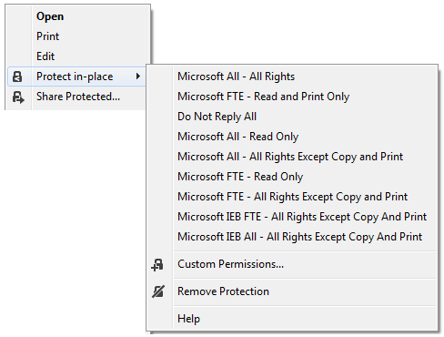
Protect Data with Rights Management
Integration with Office 2010/13
Rights Management Services
File Services
Rights Management
Hybrid options across Windows Server and Windows Azure
Windows Shell Extensions
Automatically identify and classify data based on content with automatic encryption using DAC/FCI, SharePoint, Exchange

Slide 25
Demo Share Protected Content
Chris Hallum

Slide 26
Share
I want to prevent users from being able to leak information using email

Slide 27
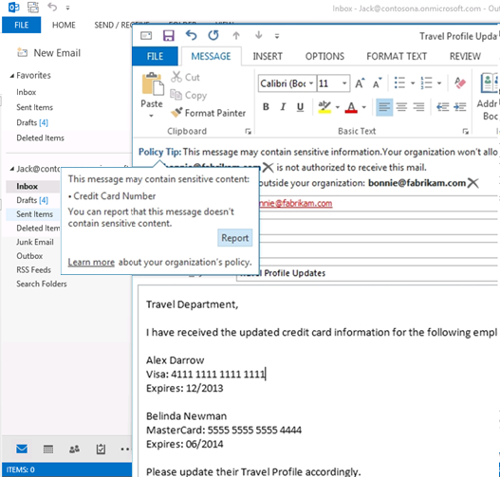
Exchange DLP Sender notified of sensitive data
Drive increased compliance with Exchange DLP which empowers users to manage their compliance with contextual policy education
Outlook provides real-time scanning of an email’s subject, body, and attachments, and it provides policy tips and information
Exchange DLP works even when disconnected, and it enables IT define policy rules, provide custom text and actions for their users, and audit user behavior

Slide 28
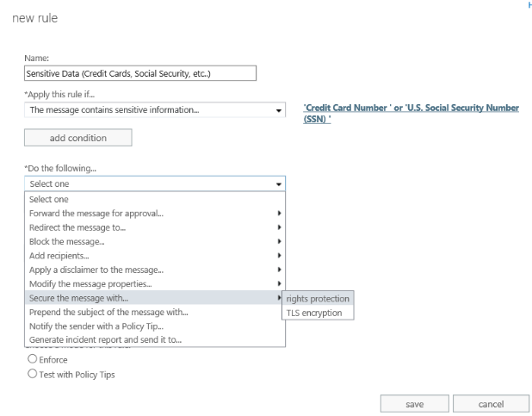
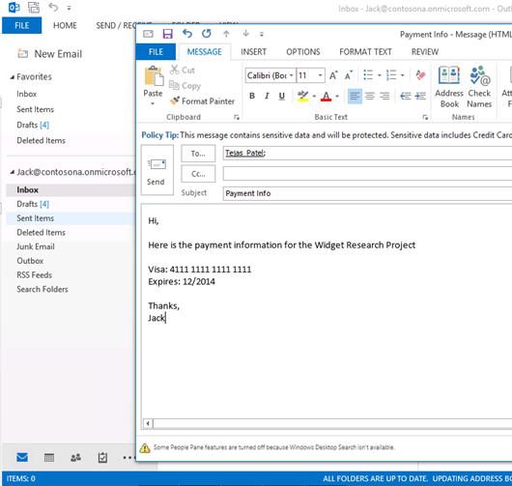
Exchange DLP with RMS Rules based policy can automatically protect sensitive data
Powerful rules based policies from Exchange DLP can enforce the automatic application of right management to email and documents that include sensitive information.
A simple yet powerful rules generation experience with pre-canned templates makes it easy for IT to quickly implement and provision DLP policy that can detect the presence of sensitive information and protect it

Slide 29
Putting it All Together
Authorize
Protect
Share
Common Identity across on-premises and cloud with Windows Server and Windows Azure Active Directory
Windows Rights Management (RMS) and AD Rights Management Services (RMS) protect and enforce access control on data regardless of type. Remote Business Data Removal (RBDR) enables secure wipe of data.
Secure collaboration and sharing both within and outside your company along with the ability to enforce protection is enabled using Exchange DLP

Slide 30
Apps
Authorize
Protect

Slide 31
Challenges
I want to be able to control which applications can be accessed by users and devices with conditional access policies
I need my applications to be able to protect our data such that our users can safely share data

Slide 32
Authorize
I want to be able to control which applications can be accessed by users and devices with conditional access policies

Slide 33
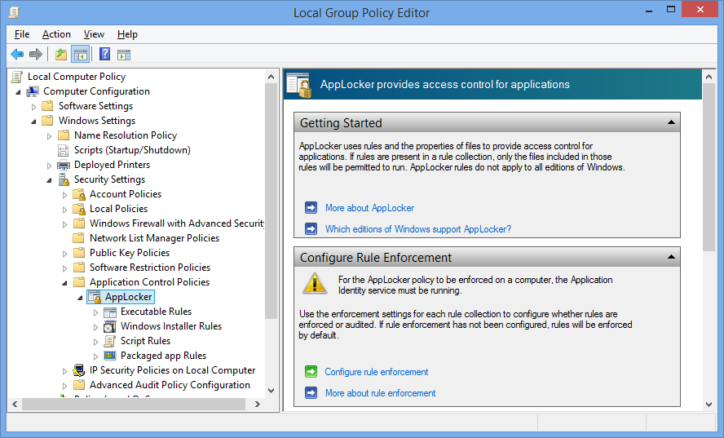
Protecting Data with Application Control
Active Directory
Users with even the best intentions will use applications that put your organization’s data at risk
Well intentioned apps may be used to leak corporate data and malicious apps will harm or steal it
AppLocker can put IT back in control of which application can and can not be used using policy based white and black lists

Slide 34
Demo AppLocker Rules Creation
Chris Hallum

Slide 35
Protect
I need my applications to be able to protect our data such that our users can safely share it

Slide 36
App Integration
Microsoft Rights Management
Applications (e.g.: Adobe, LOB) will use the Microsoft Right Management API to enable read, write, and protecting of data
Rights Management API
Remote Business Data Removal
Server components (e.g.: Exchange; Workfolders) will use the EAS or OMA-DM protocol to communicate policy to the client indicating that the data it sends to the client must be encrypted via RBDR. Once the client acknowledges RBDR capability data transfer can begin.
1
EAS or OMA-DM
2
Applications (e.g.: Mail) will use the RBDR API to encrypt the data as it is received from the server.
RBDR API
Management system (e.g.: Intune/Airwatch) will use EAS or OMA-DM to provision a wipe command to the client when needed.
EAS or OMA-DM

Slide 37
Putting it All Together
Authorize
Protect
AppLocker enables IT to control which applications are authorized for use within their company
Developers can build enlightened applications that leverage Microsoft Rights Management (RMS), AD Rights Management Services (RMS) and Remotes Business Data Removal capabilities to protect company apps and data

Slide 38
Device
Authorize
Protect

Slide 39
Challenges
I want to be able to control which devices can be used for storage
I want to prevent unauthorized access to data when a device is lost or stolen

Slide 40
Authorize
I want to be able to control which devices can be used for storage

Slide 41
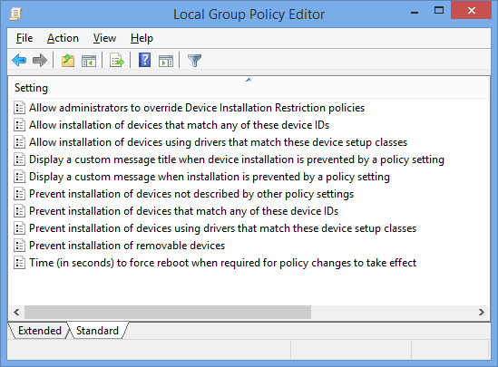
Device Control Policies
Active Directory
Users with even the best intentions will use devices and break policy to get their jobs done.
Controlling which peripherals can and can’t be used on their devices maybe be required to protect organizations and their data
Device Installation Restriction policies can put IT back in control of which peripherals can and can not be used using policy based white and black lists.

Slide 42
Demo Device Restriction Policy Creation
Chris Hallum

Slide 43
Protect
I want to prevent unauthorized access to data when a device is lost or stolen

Slide 44
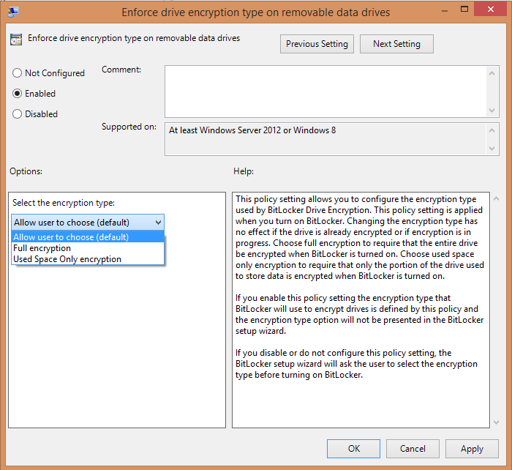
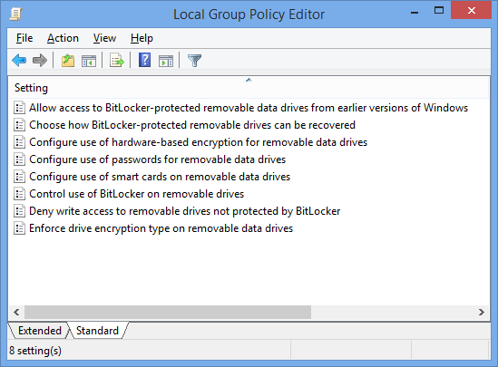
BitLocker and BitLocker to Go
Active Directory
When a device is lost or stolen organizations need a high level of assurance that the data on the device can’t be accessed by an unauthorized user.
BitLocker and BitLocker to Go provide device encryption technology for local and removable storage
Microsoft BitLocker Administration and Monitoring and Group Policy can enforce policy and ensure local and removable storage are secure before making it available for use

Slide 45
Putting it All Together
Authorize
Protect
Device Installation Restriction policies enable IT to control which peripherals are authorized for use within their company
BitLocker and BitLocker to Go provides IT with the ability to enforce encryption on devices and removal storage

Slide 46
Putting it All Together
We have a broad and comprehensive set of solutions across Data, Apps and Devices
We continue to invest in additional capabilities such as identity and persistent data protection
Further integrating the breadth of our products into cohesive solutions is a priority to us for the future

Slide 47
Windows Track Resources
Windows Enterprise windows.com/enterprise windowsphone.com/business
Windows Springboard microsoft.com/springboard
Microsoft Desktop Optimization Package (MDOP)
microsoft.com/mdop
Windows To Go microsoft.com/windows/wtg
Windows Phone Developer developer.windowsphone.com

Slide 48
Related content
Breakout Sessions
The State of Windows 8.1 Security: Malware Resistance - May 12th 4:45PM; Room: 371A
Malware Hunting with Mark Russinovich - May 15th 10:15AM; Room: Grand Ballrm C
Bulletproofing Your Network Security - May 12th 1:15 PM; Grand Ballrm A
Social Engineering: Targeted Attacks, and IT Security - May 13 5:00 PM - 6:15 PM Room: Grand Ballrm A
Instructor Led labs
Implementing Endpoint Protection in SCCM - May 13th 10:15; AM Room: Hall E ILL Room 3
Implementing Endpoint Protection in SCCM - May 15th 8:30; AM Room: Hall E ILL Room 3

Slide 49
Resources
Learning
Sessions on Demand
Microsoft Certification & Training Resources
http://channel9.msdn.com/Events/TechEd
www.microsoft.com/learning
TechNet
msdn
Resources for IT Professionals
Resources for Developers
http://microsoft.com/technet
http://microsoft.com/msdn

Slide 50
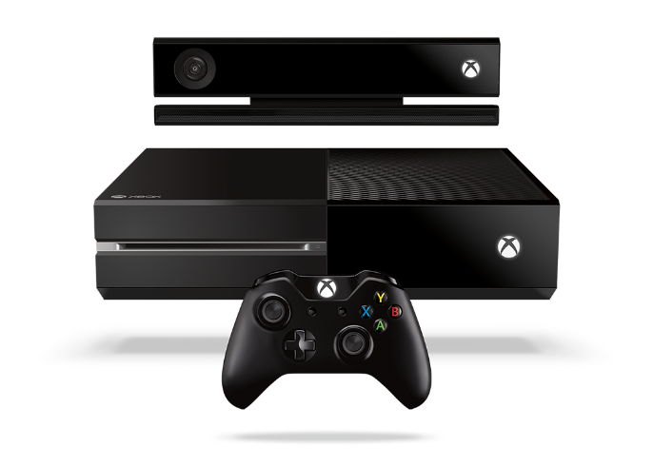
Complete an evaluation and enter to win!

Slide 51
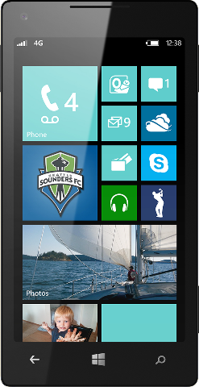
Evaluate this session
Scan this QR code to evaluate this session.

Slide 52
© 2014 Microsoft Corporation. All rights reserved. Microsoft, Windows, and other product names are or may be registered trademarks and/or trademarks in the U.S. and/or other countries.
The information herein is for informational purposes only and represents the current view of Microsoft Corporation as of the date of this presentation. Because Microsoft must respond to changing market conditions, it should not be interpreted to be a commitment on the part of Microsoft, and Microsoft cannot guarantee the accuracy of any information provided after the date of this presentation. MICROSOFT MAKES NO WARRANTIES, EXPRESS, IMPLIED OR STATUTORY, AS TO THE INFORMATION IN THIS PRESENTATION.

