Slide 2
Empower Your Demanding Mobile LOB Apps with SQLite and Offline Data Sync on Windows 8.1
WIN-B337
Rob Tiffany

Slide 3
Why Should you Care About SQLite + Sync?
Enterprise apps have more demanding requirements
They make heavier use of data and must reliably connect to backend systems
They have more stringent authentication and authorization security requirements
Employees must keep working regardless of network conditions
SQLite is the world’s most popular database
An embedded, in-process database engine that read/writes to ordinary disk files
Widely used cross-platform on iOS, Android, Python, Mono, Windows etc…
Small, Fast, Reliable, and Public Domain
All transactions are ACID even if interrupted by system crashes or power failures
Azure Mobile Services to the rescue
New offline data sync feature means apps don’t have to be connected all the time
Uses SQLite as a local data store with built-in change tracking and conflict resolution
Authentication with Azure Active Directory plus cross-platform push notifications

Slide 4
Getting Started

Slide 5
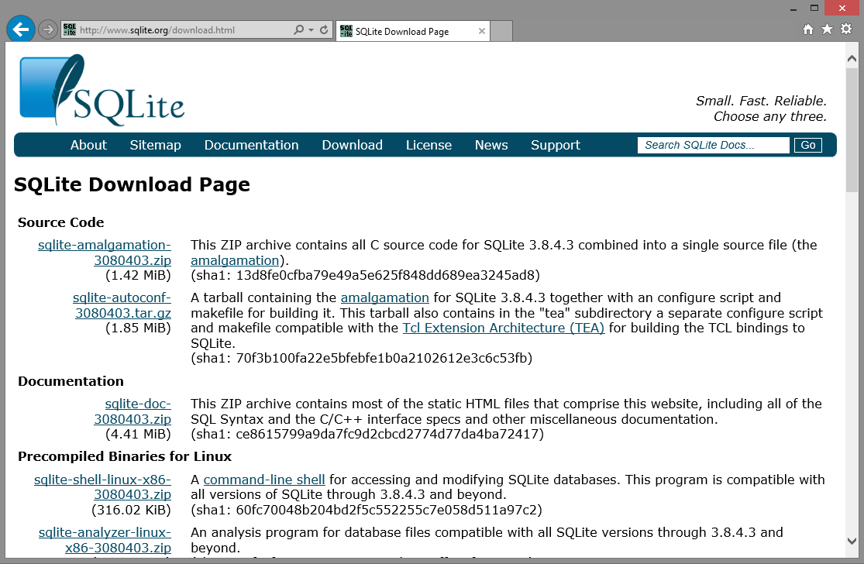
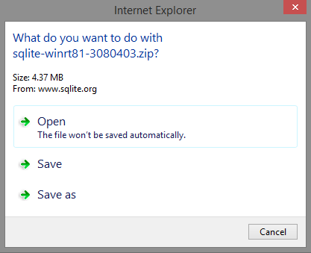
Let’s Get SQLite
Download from SQLite.org
In the Precompiled Binaries for Windows Runtime section of the download page, download the VSIX package to support WinRT 8.1 application development with Visual Studio 2013
Save the file with the .vsix extension instead of .zip

Slide 6
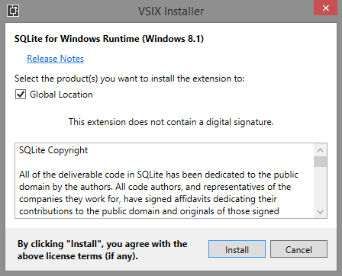
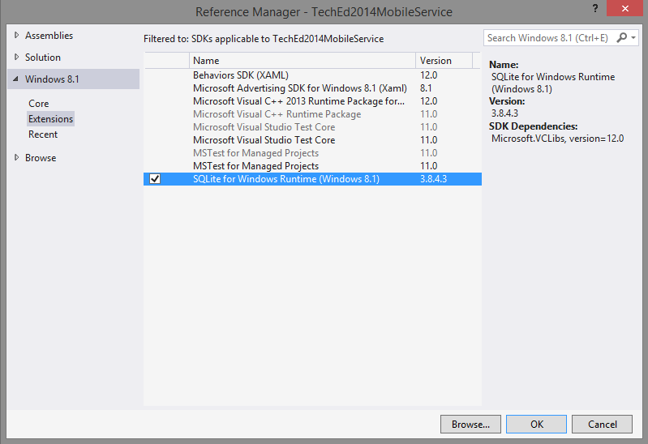
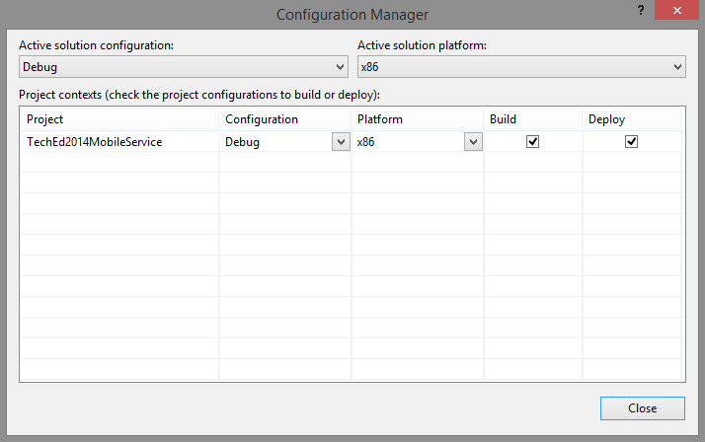
Install SQLite
Install and use SQLite in your app
Double-click on the VSIX file to install in Visual Studio
Add a reference to the extension in your app
Processor Architecture
Any CPU is not supported with SQLite
Launch Configuration Manager and select x86, x64 or ARM

Slide 7
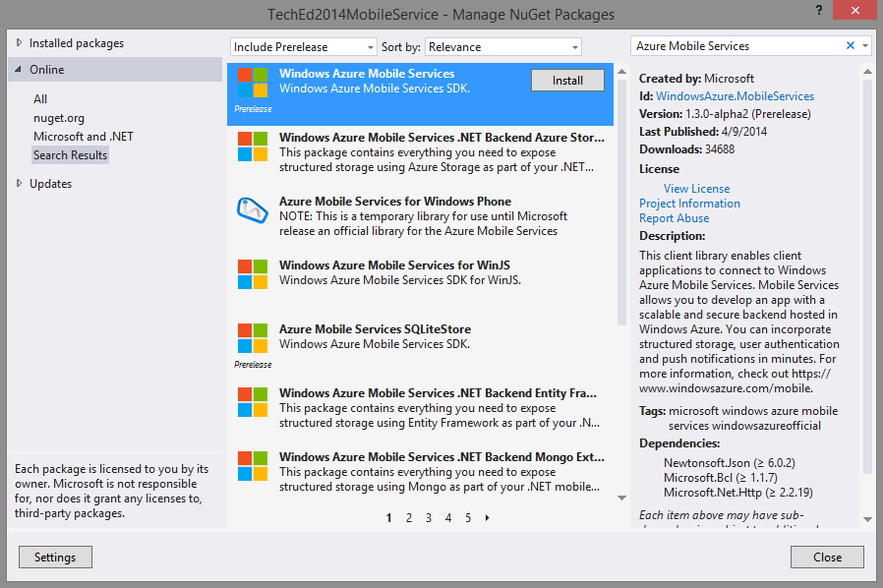
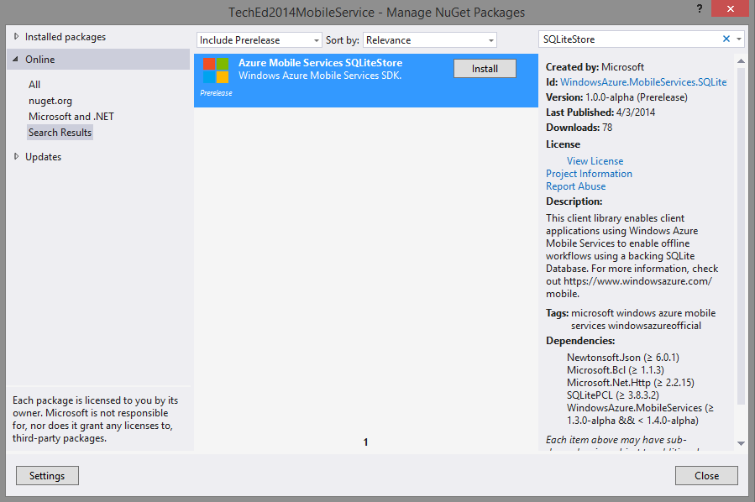
Install Mobile Services
Add the SDK
Manage NuGet Packages from your app
From the Online section, choose Include Prerelease and search for Azure Mobile Services
Install version 1.3.0-alpha2
Add the SQLiteStore
Manage NuGet Packages from your app
From the Online section, choose Include Prerelease and search for SQLiteStore
Install version 1.0.0-alpha
SQLitePCL from Microsoft Open Technologies is included which allows you to interact with SQLite via DDL and DML SQL commands

Slide 8
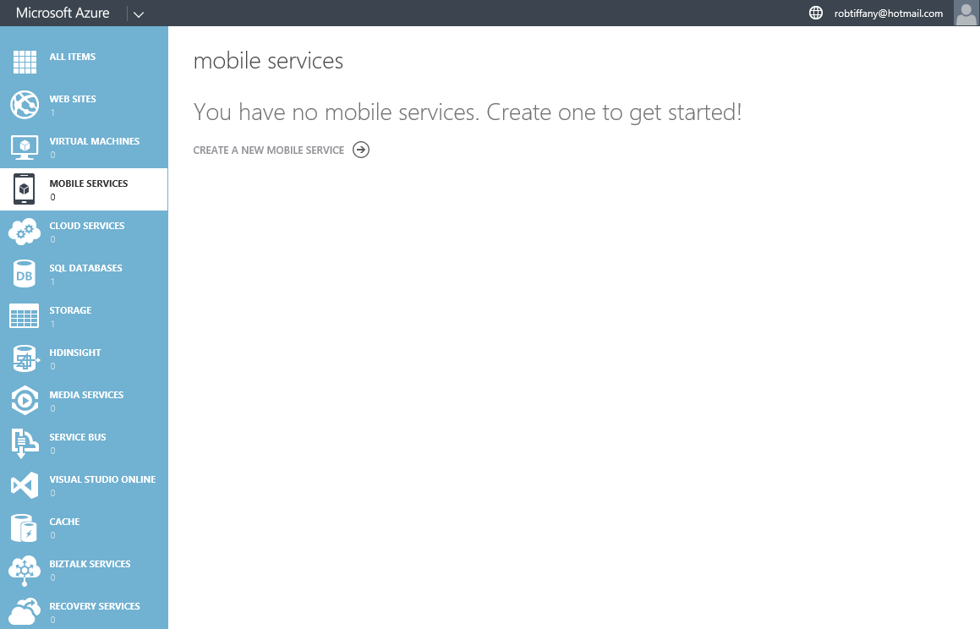
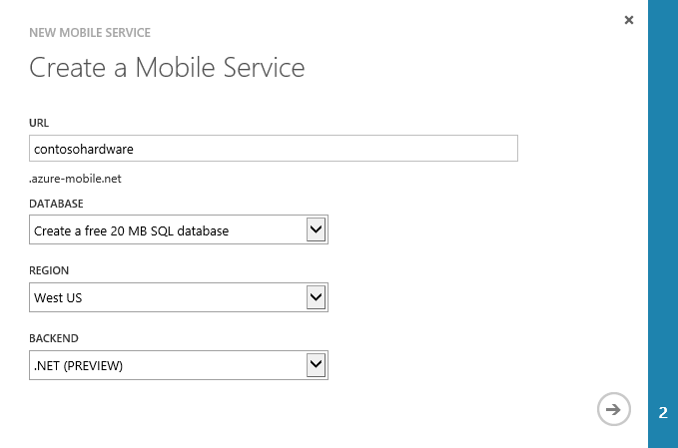
Azure Mobile Services
Login to your Azure Portal
Create a new mobile service
Create a unique URL
Select a new or existing database
Select a region
Choose .NET for your backend

Slide 9
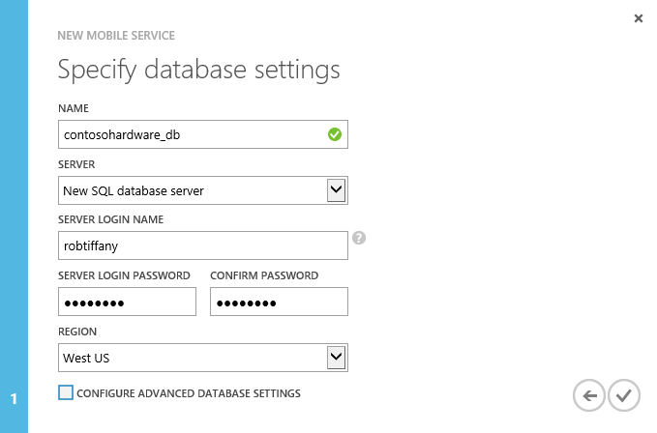
Azure SQL Database
Configure
Unique name based on URL
New or existing SQL Database server
Login name
Complex password > 8 characters
Select a region
Success!

Slide 10
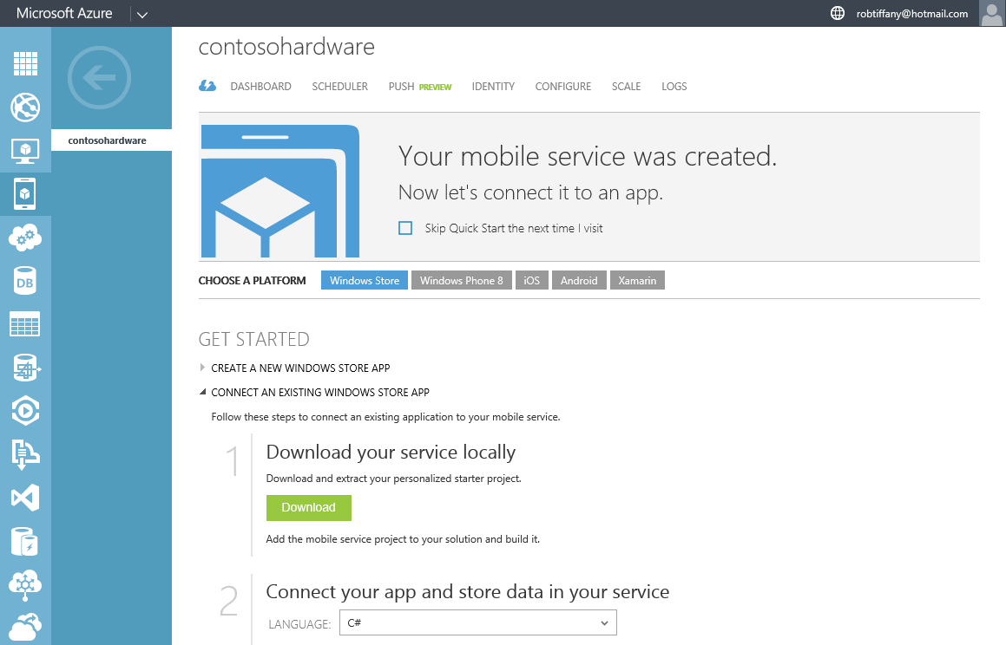
Choose a Mobile Platform
Windows Store
Download project zip file
Keep it safe since it contains sensitive info
Extract zip file and add included folder to your existing Windows Store project folder
Right-click on Solution in Visual Studio and add existing project by navigating to the csproj file

Slide 11
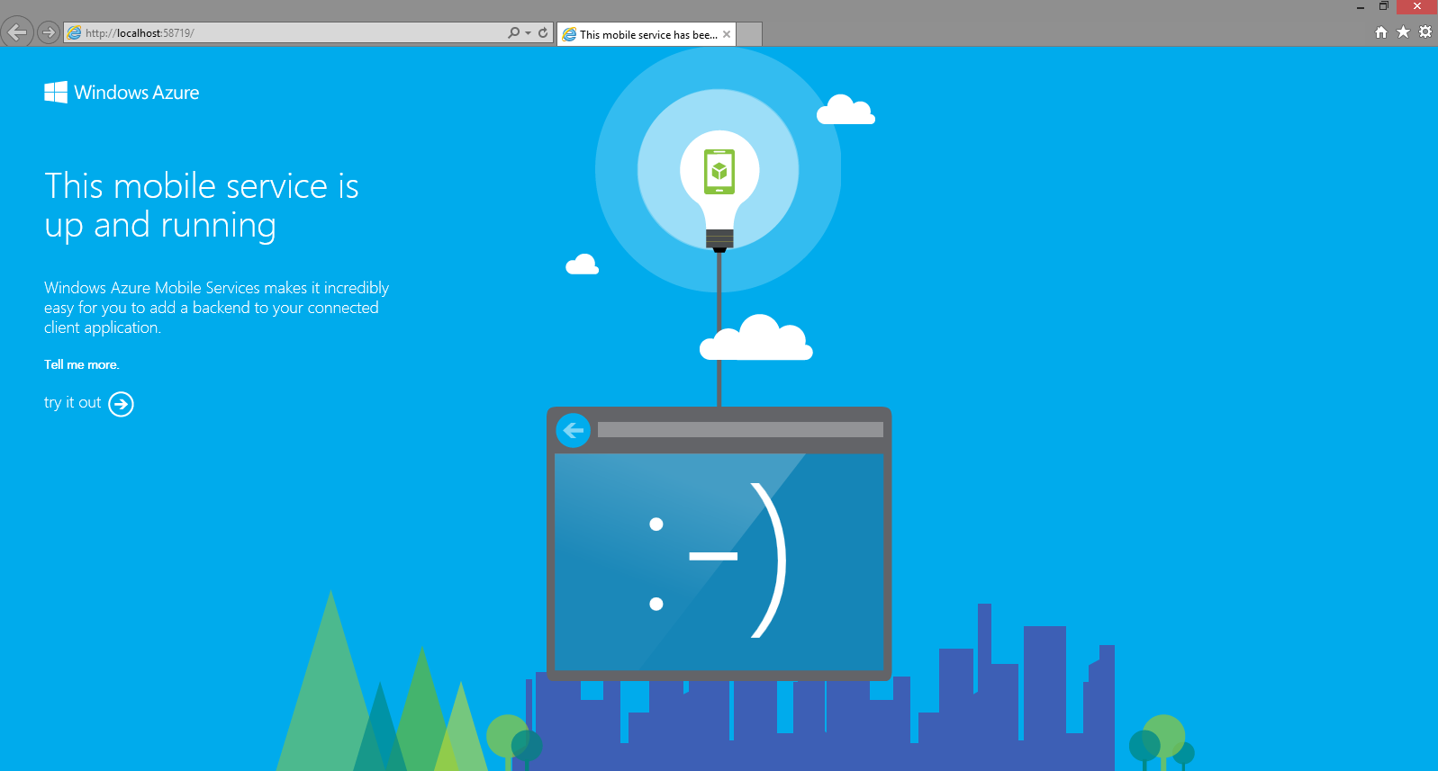
Up and Running
Test Locally
Build combined server + client solution to ensure there are no errors
Right click on the mobile service project and select Start new Instance

Slide 12
CODE TO CONNECT
using Microsoft.WindowsAzure.MobileServices;
public static MobileServiceClient MobileService = new MobileServiceClient("http://localhost:58719");
// Use this constructor instead after publishing to the cloud
// public static MobileServiceClient MobileService = new MobileServiceClient(
// "https://contosohw.azure-mobile.net/",
// "YyEPpgqZIGbqjtlyWqNGdamURJRXeT19"
//);

Slide 13
SQLite Data Definition Language (DDL)

Slide 14
Defining the Database and Tables
Create the Database
Utilize the MobileServiceSQLiteStore wrapper to create database and tables
Create Table Schemas
Classes represent the data your app needs to work with
Standard SQL DDL statements are not required
Data object classes must be created both on the Client side and server side

Slide 15
CREATE TABLE: Client
using Microsoft.WindowsAzure.MobileServices;
using Newtonsoft.Json;
namespace TechEd2014MobileService.DataObjects
{
public class Customer
{
public string Id { get; set; }
[JsonProperty(PropertyName = "FirstName")]
public string FirstName { get; set; }
[JsonProperty(PropertyName = "LastName")]
public string LastName { get; set; }
[Version]
public string Version { get; set; }
}
}

Slide 16
CREATE TABLE: Server
using Microsoft.WindowsAzure.Mobile.Service;
namespace contosohardwareService.DataObjects
{
public class Customer : EntityData
{
public string FirstName { get; set; }
public string LastName { get; set; }
}
}

Slide 17
CREATE DATABASE: Client
if(!client.SyncContext.IsInitialized)
{
//Create SQLite Database
var store = new MobileServiceSQLiteStore("store.db");
//Create Customer Table
store.DefineTable<DataObjects.Customer>();
//Initialize Sync Context
await client.SyncContext.InitializeAsync(store, new SyncHandler(client));
}
public static IMobileServiceSyncTable<DataObjects.Customer> customerTable = client.GetSyncTable<DataObjects.Customer>();

Slide 18
Demo
SQLite DDL Operations

Slide 19
SQLite Data Manipulation Language (DML)

Slide 20
Working with Data
How do enterprise mobile apps utilize data?
Load and display data in the UI elements of your Views
Allow users to enter new data and update existing data
Pass and transform data through various workflows
Perform mathematical calculations
Capture local telemetry data to be used for analysis
How do you do it?
Leverage your LINQ skills to perform CRUD operations against your local database
Standard SQL DML statements are not required

Slide 21
SELECT
try
{
CustomerList.ItemsSource = await (from c in App.customerTable
select c).ToListAsync();
}
catch (Exception ex)
{
//TODO: Handle Error
}

Slide 22
INSERT
try
{
await App.customerTable.InsertAsync(new DataObjects.Customer
{
FirstName = "Andy",
LastName = "Wigley"
});
}
catch(Exception ex)
{
//TODO: Handle Error
}

Slide 23
UPDATE
try
{
var query = from c in App.customerTable
where c.LastName == "Randolph"
select c;
foreach (var customer in (await query.ToEnumerableAsync()))
{
customer.FirstName = "Nicholas";
await App.customerTable.UpdateAsync(customer);
}
}
catch (Exception ex)
{
//TODO: Handle Error
}

Slide 24
DELETE
try
{
var query = from c in App.customerTable
where c.LastName == "Tiffany"
select c;
foreach (var customer in (await query.ToEnumerableAsync()))
{
await App.customerTable.DeleteAsync(customer);
}
}
catch (Exception ex)
{
//TODO: Handle Error
}

Slide 25
Demo
SQLite DML Operations

Slide 26
Sync

Slide 27
Synchronizing Data
Push
A call to PushAsync() sends all locally tracked changes to the Azure SQL Database
Pull
A call to PullAsync() on a local table retrieves data from the corresponding Azure SQL Database table
A LINQ or OData query is passed as a parameter to filter the amount of data downloaded
If there are local items in the pending sync queue, they are pushed before the pull is executed
Purge
A call to PurgeAsync() clears the local table of data the app doesn’t need anymore
Conflicts
Since sync works on the basis of optimistic concurrency, multiple devices or the server could make updates to the same row
A sync handler detects conflicts between local and server versions of the data

Slide 28
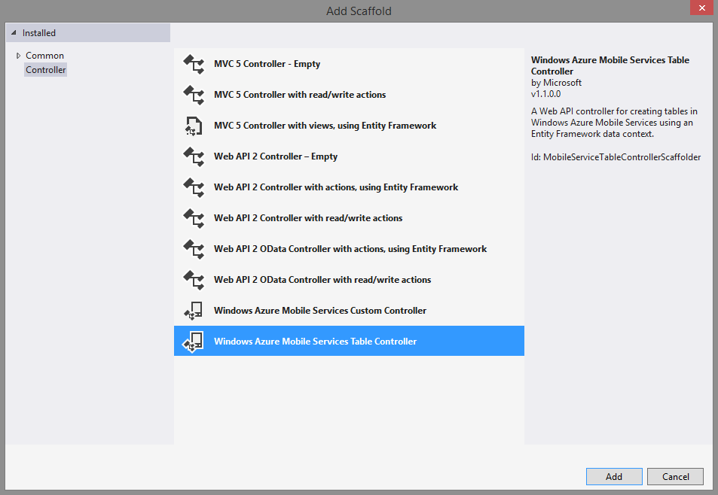
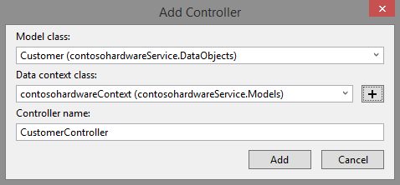
Web API
Create Controller
Right click on the Controllers folder and add a Mobile Services Table Controller
Select a model class
Select existing data context class
Visual Studio will automatically name the controller based on the model class

Slide 29
CONTROLLER
// GET tables/Customer
public IQueryable<Customer> GetAllCustomer()
{
return Query();
}
// GET tables/Customer/48D68C86-6EA6-4C25-AA33-223FC9A27959
public SingleResult<Customer> GetCustomer(string id)
{
return Lookup(id);
}
// PATCH tables/Customer/48D68C86-6EA6-4C25-AA33-223FC9A27959
public Task<Customer> PatchCustomer(string id, Delta<Customer> patch)
{
return UpdateAsync(id, patch);
}
// POST tables/Customer/48D68C86-6EA6-4C25-AA33-223FC9A27959
public async Task<IHttpActionResult> PostCustomer(Customer item)
{
Customer current = await InsertAsync(item);
return CreatedAtRoute("Tables", new { id = current.Id }, current);
}
// DELETE tables/Customer/48D68C86-6EA6-4C25-AA33-223FC9A27959
public Task DeleteCustomer(string id)
{
return DeleteAsync(id);
}

Slide 30
PULL
Exception pullException = null;
try
{
var filter = from c in App.customerTable
select c;
await App.customerTable.PullAsync(filter, new System.Threading.CancellationToken());
}
catch (Exception ex)
{
pullException = ex;
}
if (pullException != null)
{
MessageDialog md = new MessageDialog("Pull failed: " + pullException.Message);
await md.ShowAsync();
}

Slide 31
PUSH
string errorString = string.Empty;
try
{
await App.client.SyncContext.PushAsync(new System.Threading.CancellationToken());
}
catch(MobileServicePushFailedException ex)
{
errorString = "Push failed because of sync errors: " +
ex.PushResult.Errors.Count() + ", message: " + ex.Message;
}
catch(Exception ex)
{
errorString = "Push failed: " + ex.Message;
}
if(errorString != string.Empty)
{
MessageDialog md = new MessageDialog(errorString);
await md.ShowAsync();
}

Slide 32
PURGE
string errorString = string.Empty;
try
{
var query = from c in App.customerTable
select c;
await App.customerTable.PurgeAsync(query, new System.Threading.CancellationToken());
}
catch (Exception ex)
{
errorString = "Purge failed: " + ex.Message;
}
if (errorString != string.Empty)
{
MessageDialog md = new MessageDialog(errorString);
await md.ShowAsync();
}

Slide 33
Demo
Sync

Slide 34
We’re done.

Slide 35
Related content
WIN-B217 Deploying and Managing Enterprise Apps on Windows and Windows Phone
WIN-B214 Windows Phone 8.1 Early Deployment Experience in the Enterprise
WIN-B322 From 4 to 40 inches: Developing Windows Applications across Multiple Form Factors
Find Me Later at the Windows Booth

Slide 36
Windows Track Resources
Windows Enterprise windows.com/enterprise windowsphone.com/business
Windows Springboard microsoft.com/springboard
Microsoft Desktop Optimization Package (MDOP)
microsoft.com/mdop
Windows To Go microsoft.com/windows/wtg
Windows Phone Developer developer.windowsphone.com

Slide 37
Resources
Learning
Sessions on Demand
Microsoft Certification & Training Resources
http://channel9.msdn.com/Events/TechEd
www.microsoft.com/learning
TechNet
msdn
Resources for IT Professionals
Resources for Developers
http://microsoft.com/technet
http://microsoft.com/msdn

Slide 38
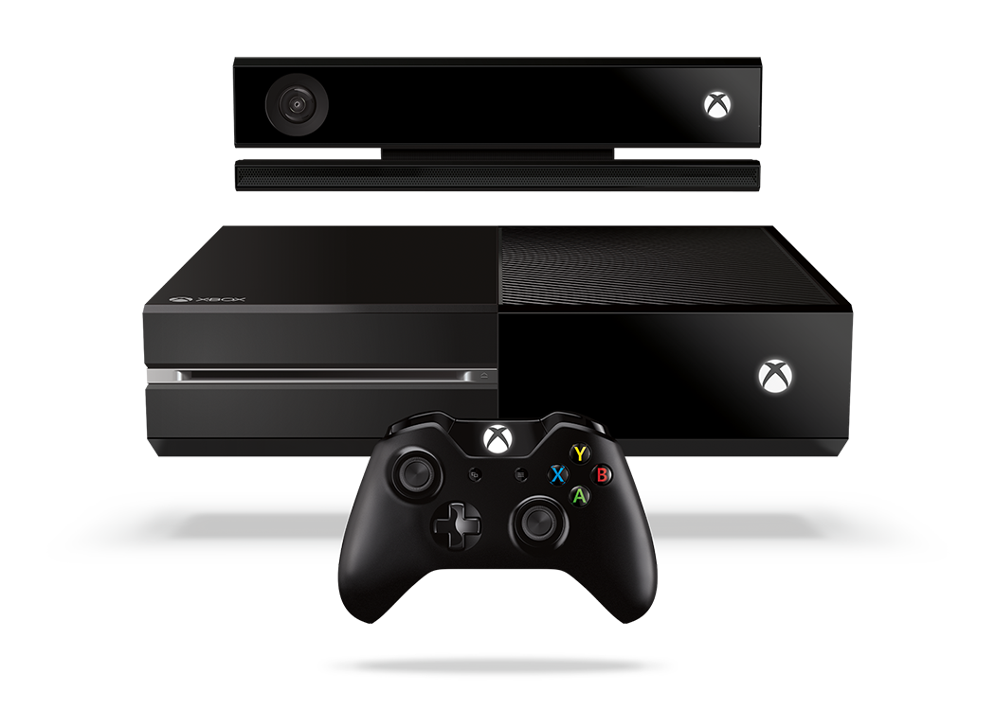
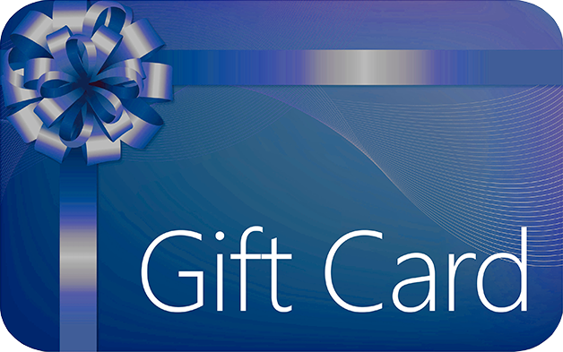
Complete an evaluation and enter to win!

Slide 39
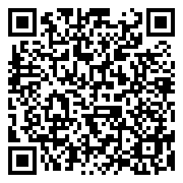
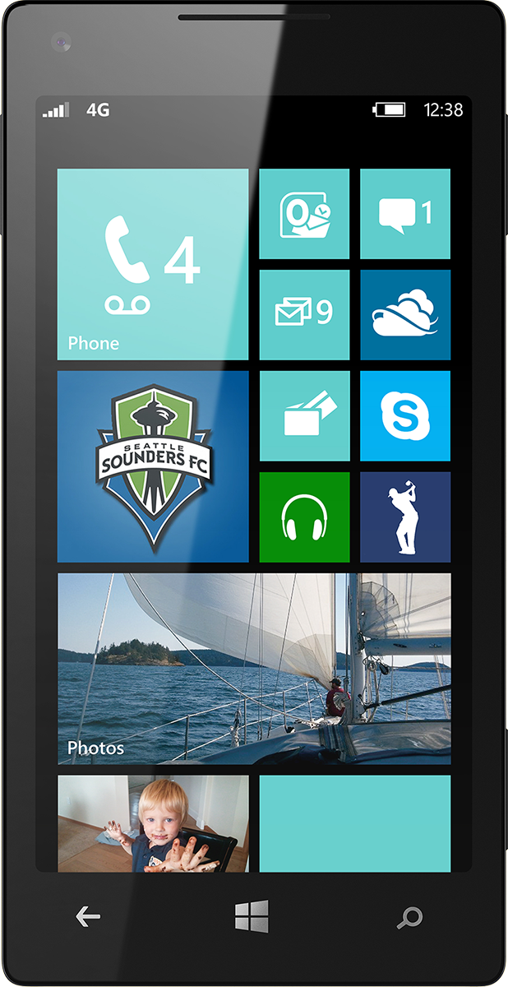
Evaluate this session
Scan this QR code to evaluate this session.

Slide 40
© 2014 Microsoft Corporation. All rights reserved. Microsoft, Windows, and other product names are or may be registered trademarks and/or trademarks in the U.S. and/or other countries.
The information herein is for informational purposes only and represents the current view of Microsoft Corporation as of the date of this presentation. Because Microsoft must respond to changing market conditions, it should not be interpreted to be a commitment on the part of Microsoft, and Microsoft cannot guarantee the accuracy of any information provided after the date of this presentation. MICROSOFT MAKES NO WARRANTIES, EXPRESS, IMPLIED OR STATUTORY, AS TO THE INFORMATION IN THIS PRESENTATION.

