Slide 2
App-V 5 Performance, Tuning, and Optimization
WIN-B362
Ment van der Plas
Ryan Bijkerk

Slide 3
?

Slide 4
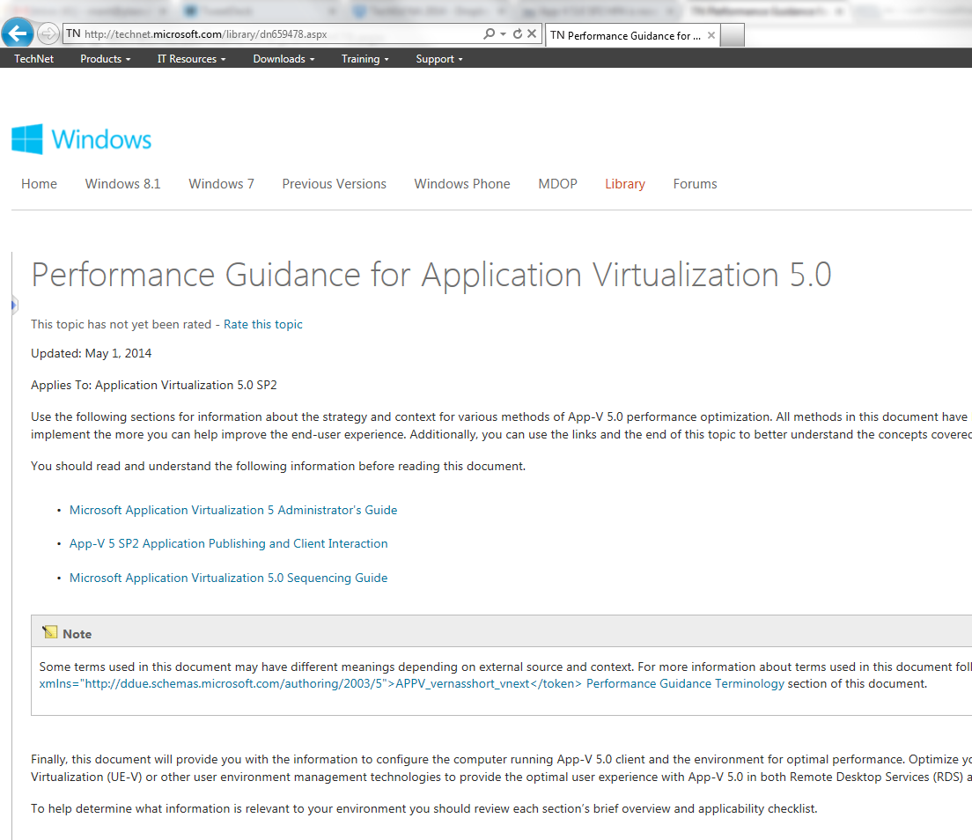
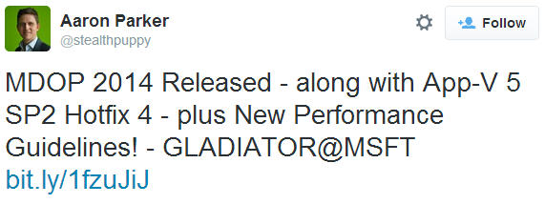
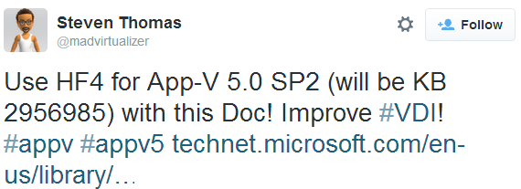
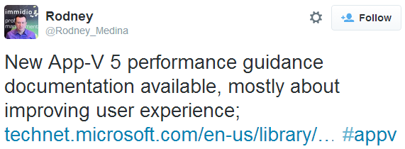
On the performance topic… App-V 5.0 SP2 Hotfix 4 – released!
http://bit.ly/appv5performance

Slide 5
Our goal is to bring you:
Unbiased, independent information on App-V 5 performance and tuning best practices

Slide 6
Agenda
Project VRC
Ryan & Ment
Introduction
Scenarios
Conclusions
Who are we?
Local Cached
Registry
Staging
FB1
Fault
VFS
Migr.
Summary: best practices for Microsoft App-V 5
Shared Content Store
HF4
Q&A
Login VSI
Benchmark tool
Test environment
Performance metrics
Publishing
Streaming

Slide 7
Agenda
Project VRC
Ryan & Ment
All
deployment models
Introduction
Scenarios
Conclusions
Who are we?
Local Cached
Registry
Staging
FB1
Fault
VFS
Migr.
Summary: best practices for Microsoft App-V 5
Shared Content Store
HF4
Q&A
Login VSI
Benchmark tool
Test environment
Performance metrics
Publishing
Streaming
Hosted desktop specific
Publishing & Streaming specific

Slide 8
Who are we?
Ment van der Plas Microsoft App-V MVP since 2009 @mentvanderplas | Ryan Bijkerk Development Manager at LoginVSI @logitblog

Slide 9
Introduction Project VRC
Started 2009
Joint venture PQR and Login Consultants
Independent, unbiased
Best practices, performance analysis
Login VSI is industry standard for benchmarking

Slide 10
The journey since 2009
1 and 2:
3
4
5
6
7
8
SBC
VDI, Windows XP / Windows 7
AppVirt solutions
Anti-Virus
Office in VDI
VDI/SBC, Windows 8.1/Server 2012R2
App-V 5.0
Independent & unbiased performance analysis
Executed more than 2500 tests
Performed by industry leaders
Resulted in 7 free whitepapers with 100s of best practices
www.projectvrc.com

Slide 11
Benchmarking
Capacity Planning
Load / Stress Testing
Change Impact Prediction

Slide 13
Workload applications

Slide 14
Workload applications
Virtual Applications

Slide 15
Why include Office?
May not be the best candidate to virtualize or publish dynamically
Office integrates with many other applications
It has many integration points with the OS (like COM objects) that take time to process
In short: it’s an unique application
But therefore we like it!
Characteristics of the Office product may also exist in your LOB applications
Your business application may behave even worse!

Slide 16
Single Server

Slide 17
Configuration 1

Slide 18
Start the test

Slide 19
Push beyond the limit

Slide 20
Saturation

Slide 21
Configuration 2

Slide 22
Start the test

Slide 23
Push beyond the limit

Slide 24
Saturation

Slide 25
What we get is a capacity indication (%) called ‘VSImax’
Example

Slide 26
We also get performance metrics in this example CPU utilization
Example

Slide 27
Test platform (hardware)
Infra
Test
Server brand/model | 4 x Cisco UCS B200
CPU | Intel 6-core E5649
Memory | 48GB
Server brand/model | 2 x Cisco UCS B230
CPU | Intel 10-core E72860
Memory | 256GB
Storage | 1 x Hitachi Data Systems (HDS)
Model | AMS 2100
Size | 60 x 600GB 15K FC
Storage | 1 x Hitachi Data Systems (HDS)
Model | AMS 2100
Size | 60 x 600GB 15K FC
Focus of performance analysis

Slide 28
App-V environment
Infra
Test
APPV 5
Management
Server
APPV 5
Publishing Server
Streaming Server
VM
VM
VM
VM
VM
VM
VM
VM
VM
VM
VM
VM
VM
VM
VM
VM
VM
VM
VM
VM
VM
Generic components (AD, DHCP, DNS, …)
VM
VM
VM
VM
VM
VM
VM
VM
VM
VM
VM
VM
VM
VM
App-V Servers are running:
Windows Server 2008 R2 (x64 – 4096MB)
Clients are running:
Windows 7 SP1 (x86 – 1024MB 2vCPU)

Slide 29
Infrastructure automation
All our tests are fully automated
All VMs are refreshed to the original state with each test run (e.g. stateless VDI)
Host is rebooted an idles for 30 min before executing a test
Law of large numbers
A single loop doesn’t count: an entire run consists of 10 consecutive test cycles
Each run takes 24 hours and we’ve conducted over 50 runs!
The presented results are averages of these runs
7
1
Reboot all launchers
Disable VMware View Pool
Reboot host
Start refresh of the pool
Reboot host
Idle for 30 min
Login VSI test
8..
6
2
5
3
4

Slide 30
Agenda
Project VRC
Ryan & Ment
Introduction
Scenarios
Conclusions
Who are we?
Local Cached
Registry
Staging
FB1
Fault
VFS
Migr.
Summary: best practices for Microsoft App-V 5
Shared Content Store
HF4
Q&A
Login VSI
Benchmark tool
Test environment
Performance metrics
Publishing
Streaming

Slide 31
Default configuration Unless stated otherwise…
 | Default | Alternative
Publishing | User Publishing | Global Publishing
Publish Optimization | Pre-add | Pre-add & publish
Streaming | Shared Content Store | Stream & Cache
Protocol | HTTP | SMB
Package Optimization | Fault | FB1
Package Root | PVAD | VFS

Slide 32
Agenda
Project VRC
Ryan & Ment
Introduction
Scenarios
Conclusions
Who are we?
Local Cached
Registry
Staging
FB1
Fault
VFS
Migr.
Summary: best practices for Microsoft App-V 5
Shared Content Store
HF4
Q&A
Login VSI
Benchmark tool
Test environment
Performance metrics
Publishing
Streaming

Slide 33
Capacity impact based on VSImax

Slide 34
??

Slide 35
Extraordinary high CPU Utilization

Slide 36
Large offset in Writes

Slide 37
What’s causing the large offset?
Reason: MS .NET Framework Optimization Service
MS .NET Framework 4.0 as a software dependency was introduced with App-V 5.0
NGEN technology makes apps launch much faster and works to optimize your machine
The optimization runs as a background process and wasn’t finished
Recommendation
Force the optimization (mscorsvw.exe) to run at maximum speed in the image
Script: http://bit.ly/dotNetCpu

Slide 38
Large offset in CPU extremely reduced
Unexplained peak remains

Slide 39
Normal disk IO behavior
Unexplained peak remains

Slide 40
Capacity impact based on VSImax

Slide 41
Conclusions
Impact
Application Virtualization has impact on recourses and capacity
App-V 5.0 has more integration points than previous versions and therefore consumes more resources
Unclear results
Unexplainable peak in CPU and I/O in beginning of the test
Occurs in both App-V 4.6 as well as 5.0 tests
It didn’t influence our test results
Recommendation
For best performance optimize the .NET Framework Optimization Service
Specifically in hosted desktop scenarios

Slide 42
Agenda
Project VRC
Ryan & Ment
Introduction
Scenarios
Conclusions
Who are we?
Local Cached
Registry
Staging
FB1
Fault
VFS
Migr.
Summary: best practices for Microsoft App-V 5
Shared Content Store
HF4
Q&A
Login VSI
Benchmark tool
Test environment
Performance metrics
Publishing
Streaming

Slide 43
Registry staging
Extracts the (virtual) registry from the package
Enables the virtual registry, including opacity configuration with the native registry
Part of the overall publishing process
Runs as a background thread
Can produce some significant overhead (CPU) and delay
Can be configured to be on-demand (delayed)
Occurring at application launch and not publishing
Beneficial if many applications are being published
Specifically in pooled (non-persistent) VDI scenarios
Blog post by Steven Thomas (@madvirtualizer): http://bit.ly/AppVRegStaging

Slide 44
Disabling background registry staging has a negative impact on capacity

Slide 45
A small negative impact on CPU

Slide 46
But a positive impact on writes

Slide 47
Conclusions
Impact
Disabling (background) Registry Staging has a small negative impact on CPU and capacity
It has a positive impact on write IO, specifically in a streaming scenario
We could not confirm the performance improvements in our tests
Recommendation
Microsoft recommends to disable Registry Staging in VDI environments for performance reasons
If you disable Registry Staging there’s a small tradeoff in capacity
Performance improvements are likely to be seen in an environment with more applications

Slide 48
Agenda
Project VRC
Ryan & Ment
Introduction
Scenarios
Conclusions
Who are we?
Local Cached
Registry
Staging
FB1
Fault
VFS
Migr.
Summary: best practices for Microsoft App-V 5
Shared Content Store
HF4
Q&A
Login VSI
Benchmark tool
Test environment
Performance metrics
Publishing
Streaming

Slide 49
Capacity impact of streaming alternatives

Slide 50
Small difference in Disk Reads

Slide 51
But a huge offset in Disk Writes

Slide 52
Streaming does have an impact on CPU

Slide 53
Total MB/sec of the streaming server

Slide 54
Conclusions
Impact
Streaming does has a fair amount of impact on CPU and capacity
Default streaming (including caching) has a huge impact on Disk IO (Write)
Shared Content Store (SCS) drastically lowers the number of Write IOs (up to 4-5x)
SCS also reduces the amount of network traffic from the streaming server (1,5-2x)
Recommendation
Microsoft recommends to use SCS in a hosted desktop scenarios for performance reasons
Based on our test results, we strongly encourage this best practice
In persistent VDI scenarios it may be more beneficial in the long run to use streaming with caching

Slide 55
Agenda
Project VRC
Ryan & Ment
Introduction
Scenarios
Conclusions
Who are we?
Local Cached
Registry
Staging
FB1
Fault
VFS
Migr.
Summary: best practices for Microsoft App-V 5
Shared Content Store
HF4
Q&A
Login VSI
Benchmark tool
Test environment
Performance metrics
Publishing
Streaming

Slide 56
How important are publishing times to you?
http://www.logitblog.com/get-app-v-5x-publishing-time-with-powershell/

Slide 57
Publishing time Per individual application
32 seconds
Adobe Flash
Microsoft Office 2010
Freemind
Adobe Reader

Slide 58
Publishing times in % At workload start without user load (lower is better)

Slide 59
Publishing times in seconds At workload start without user load (lower is better)
sec.

Slide 60
Publishing hit primarily on CPU

Slide 61
User publishing is faster than Global …and time increases under user load
seconds
25
50
75
100
125
150 (Users)

Slide 62
It pays to optimize your publishing to control the publishing times under user load
seconds
25
50
75
100
125
150 (Users)

Slide 63
Conclusions
Impact
Impact of publishing is primarily on CPU and not disk
Applications with a lot of integration points have a huge impact on the publishing time
Publishing times will increase heavily when the host is under load
Generally we see that user publishing is faster than global publishing
Recommendation
Microsoft recommends to pre-add applications for best performance
We can’t confirm the performance gain but we can confirm no degradation
Exclude certain integration components (like COM) or move intense applications to the image

Slide 64
Agenda
Project VRC
Ryan & Ment
Introduction
Scenarios
Conclusions
Who are we?
Local Cached
Registry
Staging
FB1
Fault
VFS
Migr.
Summary: best practices for Microsoft App-V 5
Shared Content Store
HF4
Q&A
Login VSI
Benchmark tool
Test environment
Performance metrics
Publishing
Streaming

Slide 65
Capacity impact of streaming protocol

Slide 66
SMB has lower CPU utilization

Slide 67
Disk IO behavior is quite similar

Slide 68
SMB results in faster publishing times
seconds
25
50
75
100
125
150 (Users)

Slide 69
Conclusions
Impact
The streaming protocol has a large impact on capacity and publishing times
SMB as streaming protocol is faster than HTTP
Big difference in CPU between the streaming protocols but no noticeable difference in disk IO
Recommendation
For performance reasons use SMB in streaming scenarios
Other reasons may require HTTP (like security or remote access scenarios)
Important: we’ve not tested with SMB 3.0 on Windows Server 2012 (R2) / Windows 8.1

Slide 70
Agenda
Project VRC
Ryan & Ment
Introduction
Scenarios
Conclusions
Who are we?
Local Cached
Registry
Staging
FB1
Fault
VFS
Migr.
Summary: best practices for Microsoft App-V 5
Shared Content Store
HF4
Q&A
Login VSI
Benchmark tool
Test environment
Performance metrics
Publishing
Streaming

Slide 71
Capacity impact of Package ‘architecture’

Slide 72
No noticeable difference in CPU

Slide 73
Small Write IO offset in Non-VFS package

Slide 74
Fault package has a small Write IO offset

Slide 75
Conclusions
Impact
The package ‘architecture’ has no noticeable difference in capacity, CPU and publishing times
We noticed some small deviations in Write IO
Less integration points will reduce CPU and Write IOs (already confirmed earlier)
Recommendation
For performance reasons Microsoft recommends to use Fault streamed, PVAD installed packages
We can’t confirm the performance gain but we can confirm no degradation in either scenario
For (publishing) performance reasons disable package integration points if not required

Slide 76
Agenda
Project VRC
Ryan & Ment
Introduction
Scenarios
Conclusions
Who are we?
Local Cached
Registry
Staging
FB1
Fault
VFS
Migr.
Summary: best practices for Microsoft App-V 5
Shared Content Store
HF4
Q&A
Login VSI
Benchmark tool
Test environment
Performance metrics
Publishing
Streaming

Slide 77
Focus for HF4 was not on capacity

Slide 78
Focus was on performance (publishing)
seconds
25
50
75
100
125
150 (Users)

Slide 79
Publishing time in %

Slide 80
Conclusion
Impact
App-V 5.0 SP2 Hotfix Package 4 does not have impact on capacity (positive or negative)
Primary focus of this release was on (publishing) performance
We see a big improvement in publishing times
Recommendation
Use App-V 5.0 SP2 Hotfix Package 4 in any publishing scenario

Slide 81
Agenda
Project VRC
Ryan & Ment
Introduction
Scenarios
Conclusions
Who are we?
Local Cached
Registry
Staging
FB1
Fault
VFS
Migr.
Summary: best practices for Microsoft App-V 5
Shared Content Store
HF4
Q&A
Login VSI
Benchmark tool
Test environment
Performance metrics
Publishing
Streaming

Slide 82
Summary: best practices for App-V 5
Regardless of App-V 5: optimize .NET Framework 4 in hosted desktop environments
We strongly encourage to use Shared Content Store to significantly reduce the number Disk IO and network throughput
Applications with integration points (like COM) are CPU heavy to publish; for performance reasons disable them if not required

Slide 83
Summary: best practices for App-V 5
In streaming scenarios SMB is the faster protocol with lower resource impact
We haven’t found proof that the package architecture has any relevant impact on performance or capacity
Use App-V 5.0 SP2 Hotfix Package 4 in any publishing scenario

Slide 84
We recommend to test for yourself to understand the impact in your environment

Slide 86
Q&A

Slide 87
Windows Track Resources
Windows Enterprise windows.com/enterprise windowsphone.com/business
Windows Springboard microsoft.com/springboard
Microsoft Desktop Optimization Package (MDOP)
microsoft.com/mdop
Windows To Go microsoft.com/windows/wtg
Windows Phone Developer developer.windowsphone.com

Slide 88
Resources
Learning
Sessions on Demand
Microsoft Certification & Training Resources
http://channel9.msdn.com/Events/TechEd
www.microsoft.com/learning
TechNet
msdn
Resources for IT Professionals
Resources for Developers
http://microsoft.com/technet
http://microsoft.com/msdn

Slide 89
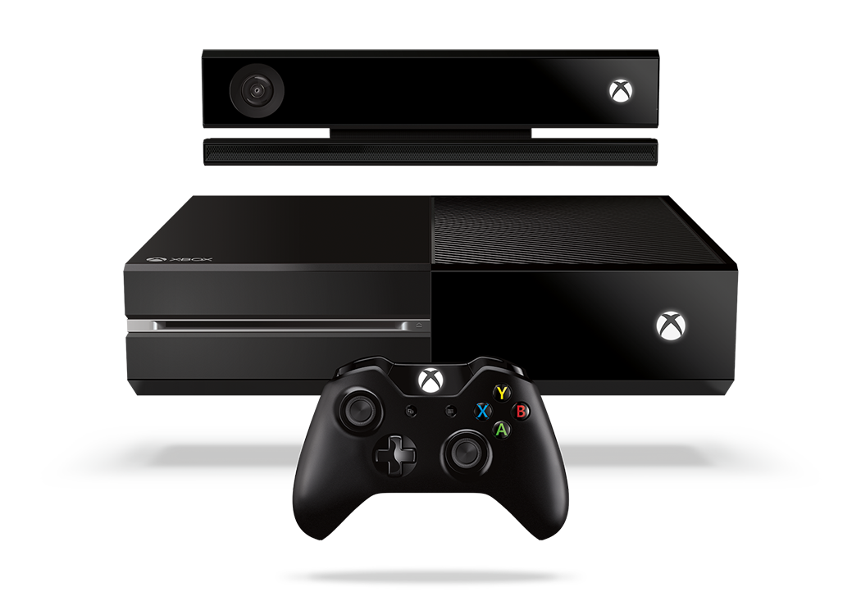
Complete an evaluation and enter to win!

Slide 90
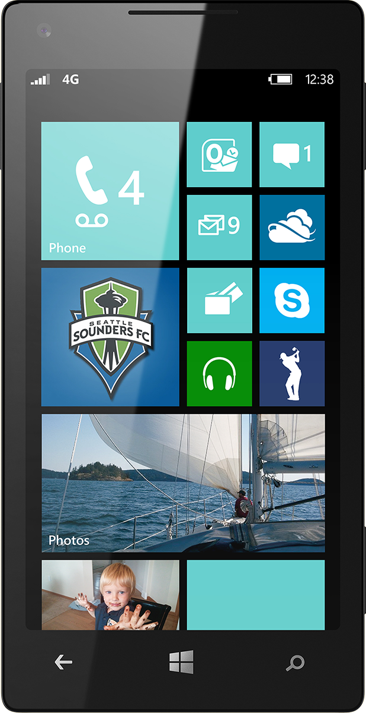
Evaluate this session
Scan this QR code to evaluate this session.

Slide 91
© 2014 Microsoft Corporation. All rights reserved. Microsoft, Windows, and other product names are or may be registered trademarks and/or trademarks in the U.S. and/or other countries.
The information herein is for informational purposes only and represents the current view of Microsoft Corporation as of the date of this presentation. Because Microsoft must respond to changing market conditions, it should not be interpreted to be a commitment on the part of Microsoft, and Microsoft cannot guarantee the accuracy of any information provided after the date of this presentation. MICROSOFT MAKES NO WARRANTIES, EXPRESS, IMPLIED OR STATUTORY, AS TO THE INFORMATION IN THIS PRESENTATION.

