Slide 2
Advanced Microsoft Deployment Toolkit 2013 Customizations Dueling MDT Enhancements
Johan Arwidmark
Knowledge Factory
@jarwidmark #WINB410

Slide 3
Johan Arwidmark
jarwidmark http://deploymentresearch.com johan.arwidmark@knowledgefactory.se

Slide 4
Demo environment
Available for download
DC01
MDT01
CM01
OR01

Slide 5
Why MDT 2013?
Lite Touch
Extends Windows ADK and WDS
Zero Touch
Extends ConfigMgr 2012 R2 OSD

Slide 6
DEMO
Why MDT 2013?

Slide 7
Rules (CustomSettings.ini)
External
Scripts
Function Setname()
Dim re
Set re=new RegExp
SQL
Web Services

Slide 8
DEMO
Bending the rules

Slide 9
Using the MDT database
Full SQL or SQL Express
SQL Server 2012 SP1 recommended
Browser Service
Started, if not running on default instance
Firewall open for SQL Browser service

Slide 10
DEMO
Using the MDT database

Slide 11
Extending the MDT database
Additional tables or views
Stored Procedures

Slide 12
DEMO
Extending the MDT database

Slide 13
Using user exit scripts
Call external vb scripts
Call functions, have them return values

Slide 14
DEMO
Using user exit scripts

Slide 15
Using web services
Code running on the server
WinPE and MDT talks to web services natively

Slide 16
DEMO
Using Web services

Slide 17
Integrating with System Center 2012 R2
Creating Orchestrator runbooks
Calling runbooks from the task sequence

Slide 18
DEMO
Integrating with Orchestrator 2012 R2

Slide 19
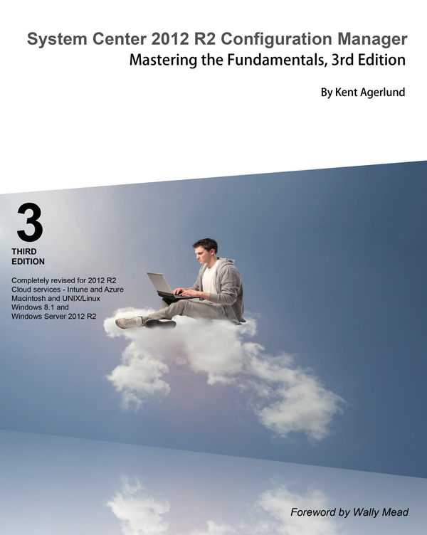
Resources – trainings, videos, books
deploymentartist.com

Slide 20
Related content
PCIT-B410: ConfigMgr 2012 - MVP Experts Panel
WIN-B410: Advanced MDT 2013 Customizations
WIN-IL300: Deploying Windows 8.1 with ConfigMgr 2012 R2
WIN-B358: Real-World Windows 8.1 Deployment
WIN-IL200: Creating a Windows 8.1 Reference Image

Slide 21
Windows Track Resources
Windows Enterprise windows.com/enterprise windowsphone.com/business
Windows Springboard microsoft.com/springboard
Microsoft Desktop Optimization Package (MDOP)
microsoft.com/mdop
Windows To Go microsoft.com/windows/wtg
Windows Phone Developer developer.windowsphone.com

Slide 22
Resources
Learning
Sessions on Demand
Microsoft Certification & Training Resources
http://channel9.msdn.com/Events/TechEd
www.microsoft.com/learning
TechNet
msdn
Resources for IT Professionals
Resources for Developers
http://microsoft.com/technet
http://microsoft.com/msdn

Slide 23
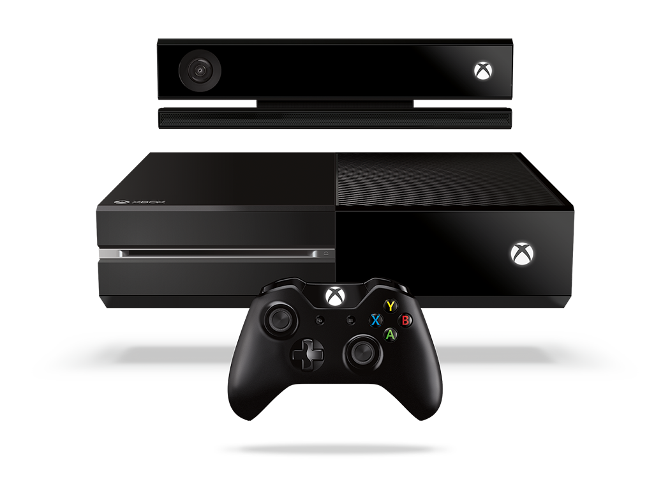
Complete an evaluation and enter to win!

Slide 24
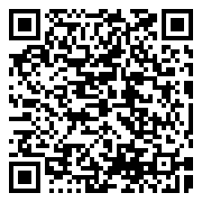
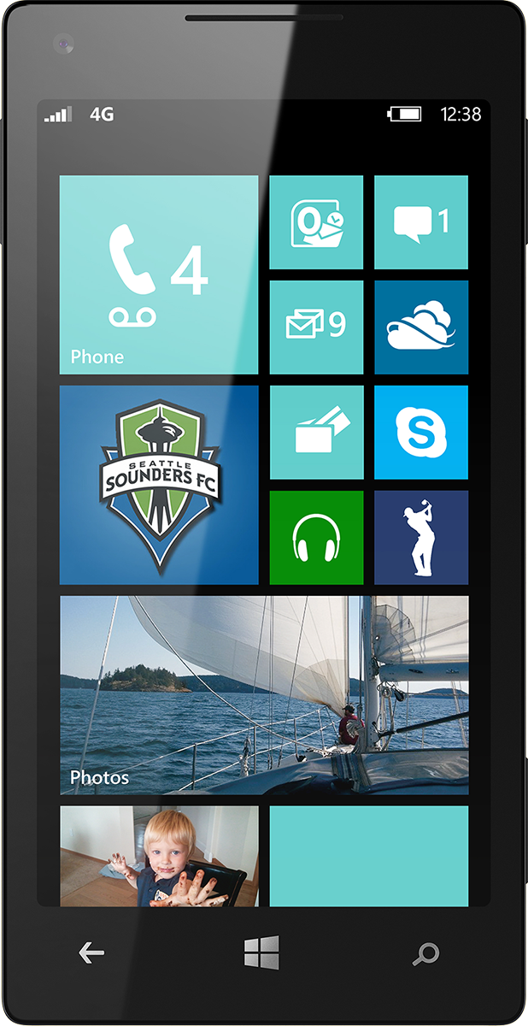
Evaluate this session
Scan this QR code to evaluate this session.

Slide 25
© 2014 Microsoft Corporation. All rights reserved. Microsoft, Windows, and other product names are or may be registered trademarks and/or trademarks in the U.S. and/or other countries.
The information herein is for informational purposes only and represents the current view of Microsoft Corporation as of the date of this presentation. Because Microsoft must respond to changing market conditions, it should not be interpreted to be a commitment on the part of Microsoft, and Microsoft cannot guarantee the accuracy of any information provided after the date of this presentation. MICROSOFT MAKES NO WARRANTIES, EXPRESS, IMPLIED OR STATUTORY, AS TO THE INFORMATION IN THIS PRESENTATION.

