Slide 2
Troubleshooting Windows 8.1 Deployments: In Depth
Win-B411
Keith Garner [MVP]
Principal Consultant
http://DeploymentLive.com

Slide 3
Windows Deployment An introduction
There are many ways to deploy Windows
Leveraging common tools and techniques
Assembled together into a full deployment process
So there are often many moving parts
Lots of moving parts = lots of points for failure
You need to be able to troubleshoot all parts
Different solutions have different parts

Slide 4
Windows Deployment A range of solutions
System Center Configuration Manager 2012
We will spend some time on each of these…
Microsoft Deployment Toolkit
Windows Deployment Services
Core Windows AIK/ADK Tools
Build your own
(or 3rd party)
Simple Scenarios
More features
Complete Control

Slide 5
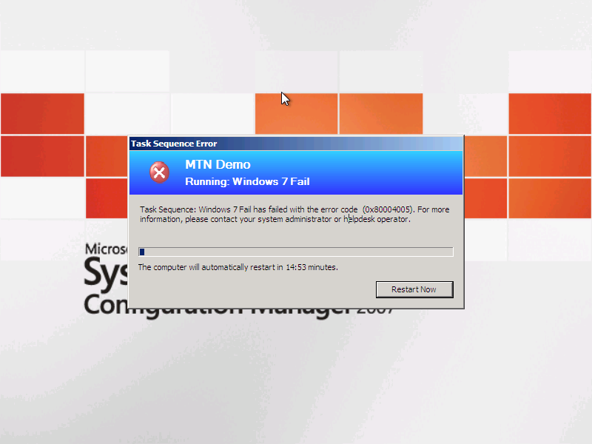
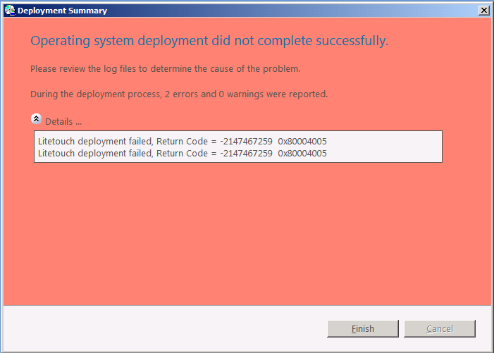
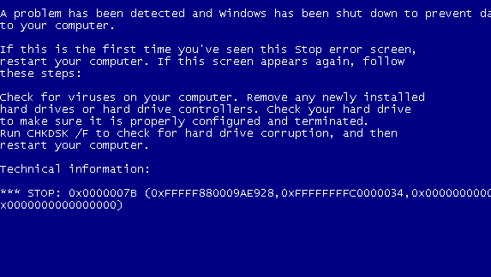
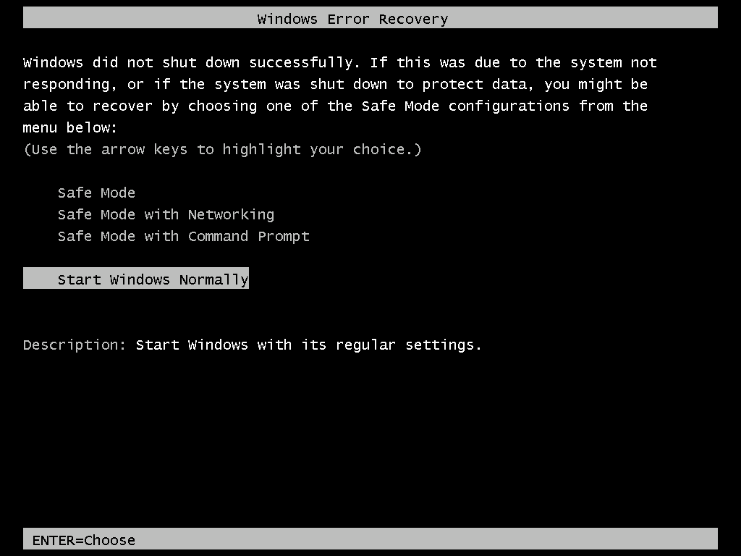
Windows Deployment Typical errors
These are confusing! :(

Slide 6
Windows Deployment Getting to the root cause
Logs, logs, and more logs
For best results:
Understand what a successful deployment looks like
Don’t be distracted by errors and warnings that aren’t really errors or warnings
Pay as much attention to what isn’t in the logs as what is
Know how to get error text from error numbers
Use CMTrace (Trace32) from Configuration Manager Toolkit

Slide 7
Great tool for Log Files: CMTrace.exe
Download CMTrace.exe from Microsoft
It’s FREE!
System Center 2012 R2 Configuration Manager Toolkit http://www.microsoft.com/en-us/download/details.aspx?id=36213
Cool Features:
It can parse Config Mgr style log files
Any changes to log files are updated in the display instantly
It can translate error code numbers to human readable descriptions
Limitations
Use 64-bit version on 64-bit WinPE. Get it from 32-bit version of CMTrace.
CMTrace can not handle log files with <NULL> characters.

Slide 8
Windows Deployment Getting to the root cause
Where do I look?
You can never have too many log files, grab them all
Find the error and work backwards to look for clues
Error messages are often too high level, so you need to dig deeper
Identifying the cause from these messages is a critical skill
Each tool creates its own logs (sometimes more than one)
That’s a lot of logs…
Know which ones to look at for each scenario

Slide 9
Windows Deployment Getting to the root cause
Are you using MDT?
Configure SLShare to point to a common server
Enable Monitoring
As a last resort use SLShareDynamicLogging

Slide 10
Log Files

Slide 11
Operating System Logs Windows 7 and Windows 8.x
Two key logs created by the SETUP process
Setupact.log: Contains information about setup actions during the installation process
Setuperr.log: Contains only the error messages (subset of what is in Setupact.log)
Depending on when the failure occurs, the files can be located in different places:
C:\$WINDOWS.~BT\Sources\Panther, X:\$WINDOWS.~BT\Sources\Panther (Windows PE)
C:\WINDOWS\Panther (specialize)
C:\WINDOWS\Panther\UnattendGC (OOBE)
C:\WINDOWS\System32\Sysprep\Panther (sysprep)
How to find panther logs:
http://support.microsoft.com/kb/927521

Slide 12
Operating System Logs Windows 7 and Windows 8.x
More useful logs:
Cbs.log: Shows results of DISM commands to inject drivers, language packs, security updates, etc. during the OS installation process
Setupapi.dev.log: Resides in %WinDir%\inf; useful when investigating failed driver installations
Netsetup.log: Resides in %WinDir%\Debug; useful when troubleshooting domain join issues
WindowsUpdate.log: Resides in %WINDIR%\; useful for detecting issues installing updates from Windows Update, WSUS, or ConfigMgr (SUP)

Slide 13
Operating System Logs Windows PE
Two main logs:
Wpeinit.log: Resides in X:\WINDOWS\system32 (so grab it before rebooting); useful when investigating start-up issues or slow initialization times
Setupapi.dev.log: Resides in %WinDir%\inf; useful when investigating failed driver installations (just like in the full OS)

Slide 14
Operating System Logs Windows Deployment Services
Logging to a file is disabled by default, so you first need to turn it on
http://support.microsoft.com/kb/936625
Once enabled, there is one main log:
WDSServer.log: Resides in C:\WINDOWS\Tracing useful when confirming if WDS is seeing and processing requests

Slide 15
User State Migration Tools Useful logs
Logs depend on what is being done:
USMTEstimate.log Created when estimating the USMT space requirements (not always created)
USMTCapture.log or Scanstate.log Created by the USMT when capturing data
USMTRestore.log or Loadstate.log Created by the USMT when restoring data
USMTCapture.prg or USMTRestore.prg Created by USMT

Slide 16
Task Sequencer Useful logs
SMSTS.log. This file is created by the Task Sequencer and describes all Task Sequencer transactions.
Depending on the deployment scenario, it may move around:
%TEMP%\SMSTSLog
%WinDir%\System32\ccm\logs or %WINDIR%\Syswow64\ccm\logs
C:\_SmsTaskSequence\Logs
C:\SMSTSLog
X:\SMSTSLog
Task Sequencer Used by Config Mgr (OSD) & MDT

Slide 17
Microsoft Deployment Toolkit Useful logs
Each script creates its own log file in the log path
The log path will change
Based on the type of deployment and phase
X:\MININT\SMSOSD\OSDLOGS
C:\MININT\SMSOSD\OSDLOGS
C:\_SmsTaskSequence\SMSOSD\OSDLOGS
C:\Windows\Temp\Deploymentlogs
BDD.log contains a summarized view
Some pieces might require looking at other files (e.g. ZTIBackup_ImageX.log, USMTCapture.log)

Slide 18
Configuration Manager Useful logs
Other useful logs beyond the SMSTS.LOG include:
DriverCatalog.log: Contains information that may be useful when getting errors while importing drivers
TaskSequenceProvider.log: Useful when getting errors while saving or importing a task sequence
SMSPXE.LOG: Used when troubleshooting PXE boot issues
SMSPROV.LOG: May have more error details while saving or importing a task sequence
More at http://technet.microsoft.com/en-us/library/bb932135.aspx

Slide 19
Getting to the Logs
Magic keystrokes:
With Configuration Manager (OSD), F8 can work while in Windows PE
Check the “Enable command support (testing only)” box.
No reboot until the command prompt exits.
With MDT 2010 Lite Touch, F8 always works while in Windows PE
No reboot until the command prompt exits
While Windows Setup is running, press Shift-F10 to get a command prompt

Slide 20
Demo: CMTrace http://www.microsoft.com/en-us/download/details.aspx?id=36213

Slide 21
ZTIHelloWorld.wsf
<job id="Hello">
<script language="VBScript" src="ZTIUtility.vbs"/>
<script language="VBScript">
oLogging.CreateEntry "Hello World.", LogTypeInfo
</script>
</job>

Slide 22
ZTIHelloWorld.log
<![LOG[Microsoft Deployment Toolkit version: <VERSION>]LOG]!><time="17:36:03.000+000" date="03-19-2011" component="helloworld" context="" type="1" thread="" file="helloworld">
<![LOG[Hello World.]LOG]!><time="17:36:03.000+000" date="03-19-2011" component="helloworld" context="" type="1" thread="" file="helloworld">

Slide 23
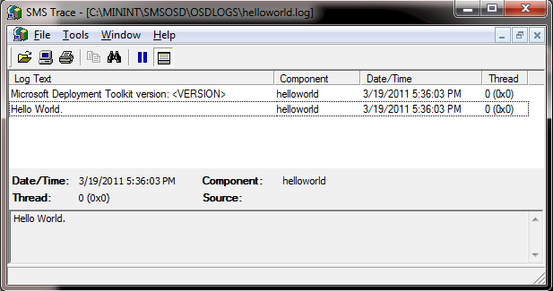
CMTrace Example:

Slide 24
Common Issues: Windows 7 and 8.x

Slide 25
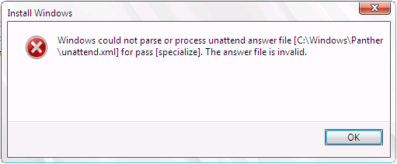
Windows Setup Failures Bad computer name
From setuperr.log:
[windeploy.exe] Setup failed, returning exit code [0x1f]
From BDD.LOG (Lite Touch):
Setup failed applying image <path>, rc = 31
Dig into details in setupact.log:
[setup.exe] SMI data results dump: Source = Name: Microsoft-Windows-Shell-Setup, …, /settings/ComputerName
[setup.exe] SMI data results dump: Description = Value is invalid
Cause:
Computer names can be at most 15 characters long (may be a problem using OSDComputerName=%SerialNumber%)
Key learning: Error 31 means “something is wrong with unattend.xml”
How to shoot yourself in the foot

Slide 26
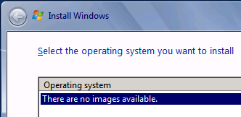
Windows Setup Failures Mismatched product key
From setuperr.log:
CallBack_SelectImageOrShowUi: There are no matching OS images
Dig into details in setupact.log:
CallBack_ProductKey_Validate: EditionID for product key is Professional
CDepImageXMLInfo::GetEditionID:EditionID=Enterprise, Flags=Enterprise : Returning Enterprise
SelectOSImages: Using EditionID as a constraint and couldn’t find any matching image
Cause:
Product key specified didn’t match the image
May also mean no EditionID was captured (Windows 7 with certain patches or old ImageX) or Flags wasn’t specified (Windows Vista)
Key learning:
“No images” might mean “no matching images”

Slide 27
Windows Setup Failures Broken domain join
Simplest scenario:
Create an autounattend.xml with domain join details, prompting for the computer name
Install Windows from media
Issue:
Domain join happens with a random computer name, and the later computer rename breaks the domain trust
Cause:
http://support.microsoft.com/kb/944353, “by design”
Workaround:
Run a command (e.g. NETDOM) or script later to do the join
Build an unattend with all the needed information, then install
Key learning:
That’s why other tools don’t do it this way
IBM, acronym, “broken as design”

Slide 28
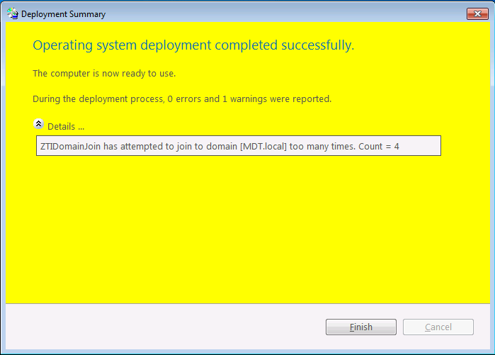
Windows Setup Failure Domain join issues
Issue:
OS deployment is successful, but the computer is still in a workgroup
From SETUPACT.LOG:
[DJOIN.EXE] Unattended Join: NetJoinDomain failed error code is [1355]
From %WINDIR%\Debug\Netsetup.log:
NetpGetComputerObjectDn: Specified path ‘CN=Computers,DC=domain,DC=com’ is not an OU
Causes:
Incorrect join settings
Key learning:
Don’t specify CN=Computers, leave the OU blank instead
“NET HELPMSG 1355” is “invalid domain” – kind of misleading
It’s a quiet “failure”, unless using MDT Lite Touch
Insanity is doing the same thing over and over and expecting a different result.

Slide 29
Windows Setup Failure Domain join issues
Issue:
Computer joins the domain but doesn’t end up in the specified OU
Causes:
“By design”, the existing computer object is updated but it won’t be moved to another OU
Key learning:
It may be necessary to move the computes to another OU manually or using a script
You can use WMI filters to exclude GPOs if necessary
Issue:
Join fails if the computer object already exists but works otherwise
Causes:
Join account needs to update the existing computer object

Slide 30
Windows Setup Failure Crashes
Issue:
You see this screen instead of new OS
Rebooting has the same result
Causes:
Blue screen crash
Bad driver (e.g. x64 injected into x86)
Missing mass storage driver
Key learning:
To get more information, uncheck “Automatically restart” on system failure or set registry key in the OS image:
HKLM\System\CurrentControlSet\Control\CrashControl\AutoReboot=0
http://support.microsoft.com/kb/307973
STOP 0x7B: Mass storage driver issue
http://support.microsoft.com/kb/324103
Status 0xc0000359: Wrong driver platform
http://support.microsoft.com/kb/2008373
Dumps may be required
Blue screen pictures

Slide 31
Demo: Windows Setup Failures

Slide 32
Common Issues: Windows PE

Slide 33
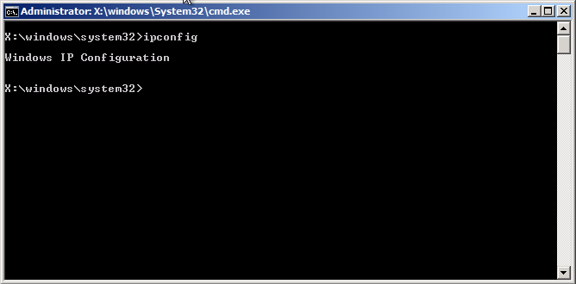
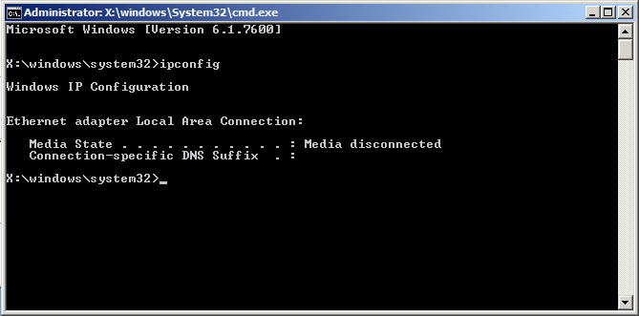
Windows PE Failures Networking issues
Issue:
A connection to the deployment share <share> could not be made.
Failed to find a valid network adapter.
An error occurred while retrieving policy for this computer (0x80072EE7)
Causes:
No DHCP address received (portfast)
No network driver
Name resolution issue
Key learning:
Press F8 to get to a command prompt, IPCONFIG to see networking details, PING/NSLOOKUP to check name resolution

Slide 34
Common Issues: Microsoft Deployment Toolkit

Slide 35
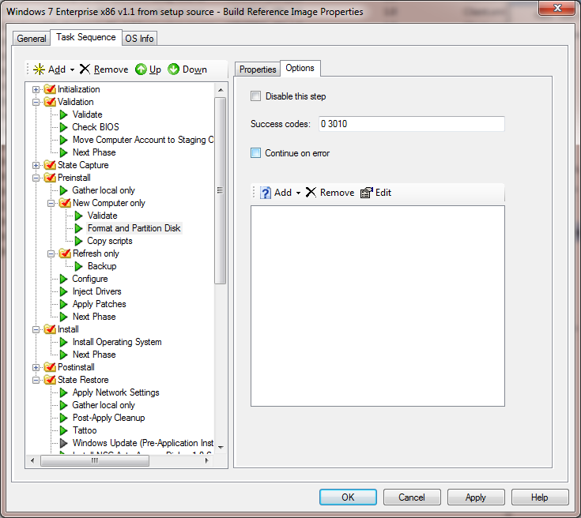
Microsoft Deployment Toolkit Task Sequence Failures
Issue:
Task sequence failure, return code -2147467259 (80004005)
Cause:
A step in the task sequence failed
Could be just about anything
Incorrect command lines
Batch files run without “cmd.exe /c”
Batch files using relative file references (issue when run via a UNC)
MSU files without “wusa.exe /quiet”
Unexpected return codes
Find the SMSTS.LOG to see the real reason
Key learning:
This error does not mean “access denied”
Use TRACE32/CMTrace, or similar tools to look up errors
Use tools to capture the errors
Red herring

Slide 36
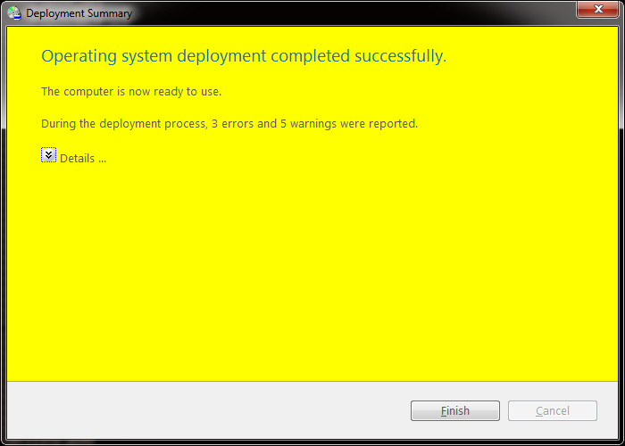
Microsoft Deployment Toolkit Task Sequence Warnings
Issue:
Task sequence warning, Yellow Summary Page
Cause:
Some kind of error in the Task Sequence.
Non-catastrophic.
Could be just about anything
Find the BDD.LOG to see the real reason
Key learning:
Use TRACE32/CMTrace, or similar tools to read logs.

Slide 37
Microsoft Deployment Toolkit Task sequence doesn’t resume in new OS
Issue:
A customer performs a Lite Touch deployment and the OS installs correctly. However, the machine doesn’t automatically log in to resume the task sequence.
When logging in manually, the task sequence still doesn’t continue.
When looking for the C:\Windows\Panther\UnattendGC\setupact.log, they find it is missing or old.
Causes:
The image wasn’t sysprepped – either it failed (look for C:\Windows\system32\sysprep\Panther\setupact.log) or it wasn’t executed at all.
Key learning:
Ask how the customer captured the image. In most cases, this happens when the customer captures the image by hand and misses some steps.
(Yes, sysprep is required, see http://blogs.technet.com/b/deploymentguys/archive/2009/12/03/sysprep-machine-sids-and-other-myths.aspx)

Slide 38
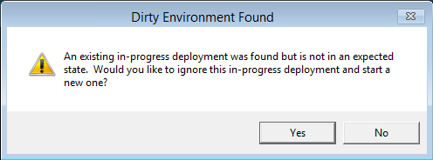
Microsoft Deployment Toolkit Task sequence failure causes issues for the next task sequence
Issue:
A task sequence fails or doesn’t complete, leaving behind files that interfere with the next task sequence that runs on the computer
Causes:
The original failure can happen for a number of reasons:
Wrong boot order, Windows Setup failure, pressing the power button, missing network or mass storage driver, etc.
Suspending a task sequence but not resuming it
Subsequent issues are caused by MININT and/or _SMSTaskSequence folders present from the original failure
Key learning:
Move to MDT 2012 and/or MDT 2013!

Slide 39
Windows Setup Failure Windows is not install on C:\
Issue:
When installing Windows from Configuration Manager 2012+
Windows is installed on Drive D:\ - As it was captured by the Windows Build Lab.
Causes:
Configuration Manager has code to *force* use of whatever was captured.
OSDPReserveDriveLetter can be confusing
True – Use the drive letter as captured by the OS
False – Use the drive letter as assigned by WinPE
Key learning:
Check the Blogs: Search for “OSDPreserveDriveLetter”
Frank Rojas has an *Excellent* article on the subject:
http://blogs.technet.com/b/system_center_configuration_manager_operating_system_deployment_support_blog/archive/2014/04/28/how-to-ensure-that-windows-installs-on-c-during-a-system-center-2012-configuration-manager-osd-task-sequence.aspx

Slide 40
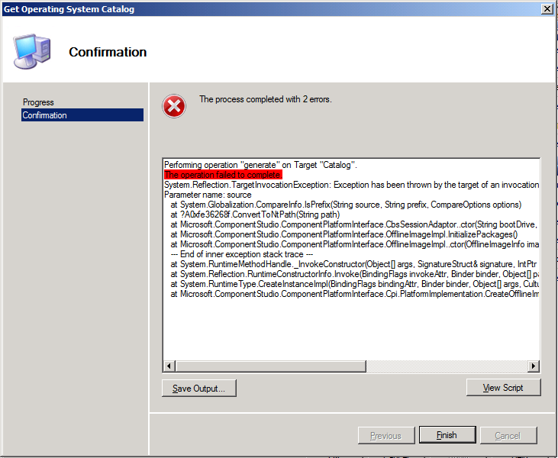
Microsoft Deployment Toolkit Catalog generation error
Issue:
When trying to edit an unattend.xml associated with a custom WIM image, a catalog (CLG) file needs to be generated matching what is in the image
Catalog generation fails
Causes:
Unable to mount the WIM (fails quickly), often a WIMGAPI issue
Issues with antivirus software (fails slowly) when it tries to mount registry hives from the image
Unsupported for an x86 WIM on an x64 OS (fails slowly)
See note at http://technet.microsoft.com/en-us/library/dd744500(WS.10).aspx
Key learning:
You might need to use an x86 OS to generate a catalog for x86 OSes

Slide 41
Common Issues: Config Mgr OS Deployment

Slide 42
ConfigMgr OS Deployment Task Sequence Failures
Issue:
Task sequence failure, return code -2147467259 (80004005)
Cause:
A step in the task sequence failed
Most of the same causes as with Lite Touch
Find the SMSTS.LOG to see the real reason, or check the status messages (they contain the last 1024 characters of output)
Key learning:
This error does not mean “access denied”
Use TRACE32/CMTRACE or similar tools to look up errors
Use tools to capture the errors…

Slide 43
ConfigMgr OS Deployment Windows is running from D:\WINDOWS
Issue:
Using the original INSTALL.WIM as an OS image package, the OS ends up on the D: drive
Cause:
When using an OS image package, ConfigMgr forces the OS to use the same drive letter as where it was captured
Technically this isn’t needed any more for Windows 7…
Windows 7 is originally installed on D:
Done in the Windows build lab before sysprepping and capturing
Key learning:
Install from an OS install package (as SETUP will fix the drive letter)
Create a custom image using an OS install package (captured from C:) and deploy that instead

Slide 44
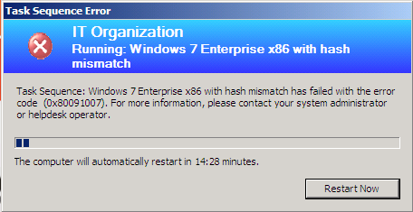
ConfigMgr OS Deployment Hash mismatch
Issue:
Task sequence will fail if the downloaded content hash does not match what was previously calculated
Cause:
Usually unknown, often happens with new packages
Resolution:
Refresh the DPs for the affected package
Key learning:
Test your task sequence to make sure it works before targeting large groups of machines

Slide 45
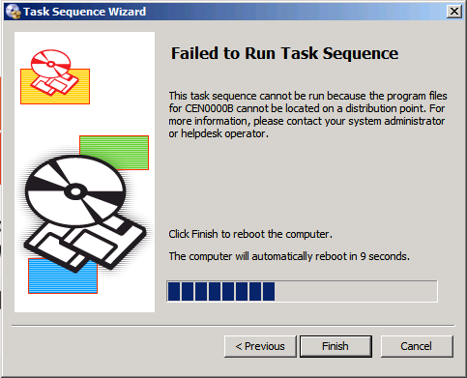
ConfigMgr OS Deployment Packages not available
Issue:
Task sequence won’t run if all packages are not available on DPs
Cause:
Packages never distributed to accessible DPs
Pending package distributions
Out-of-date task sequence policies (clients need to poll again)
Resolution:
Push the required packages, wait for policy update
Scripted…

Slide 46
ConfigMgr OS Deployment PXE boot issues
Issues:
Computers will not PXE boot
Causes:
Networking issues (BOOTP forwarders, PORTFAST configuration)
PXE-E53: No boot filename received
DHCP option configuration
Same vs. different server, options 60/66/67
Unknown computer support not enabled
No task sequence advertisements
“All Systems” doesn’t include “All Unknown Computers” → ABORTPXE
No boot images available for task sequence advertisements
X86 and x64 are needed in order to extract needed files
Cached information on server
Default cache time of 60 minutes (including negative) → ABORTPXE

Slide 47
ConfigMgr OS Deployment PXE boot issues
Resolutions and troubleshooting instructions:
Distribute both boot images (x86, x64)
Check SMSPXE.LOG and WDSSERVER.LOG
Ignore dummy “ping” requests, search for computer’s MAC or UUID
Look at lines after “LookupDevice” and “GetBootAction”
Set the cache expire time http://support.microsoft.com/kb/2019640
Know the meanings of different PXE error codes http://h18013.www1.hp.com/products/servers/management/rdp/knowledgebase/00000138.html
More troubleshooting notes http://blogs.technet.com/smsandmom/archive/2008/09/17/configmgr-2007-troubleshooting-pxe-service-point-issues-and-wds-service-not-starting.aspx
Key learning:
Troubleshooting requires an understanding of what is going on – pay attention to subtle details

Slide 48
Demo: Configuration Manager PXE

Slide 49
Troubleshooting Techniques

Slide 50
Getting More help!
Contact Microsoft Support
Windows, MDT, and Config Mgr are fully supported! Bring your logs!
Use the forums on TechNet
http://social.technet.microsoft.com/Forums/en-US/w7itproinstall
http://social.technet.microsoft.com/Forums/en-US/w8itproinstall
http://social.technet.microsoft.com/Forums/en-US/mdt
http://social.technet.microsoft.com/Forums/en-US/configmgrosd
Post error messages, logs, pictures, be descriptive.
For big Log files upload to public sites like SkyDrive and share the Link.
Join Mailing Distribution Lists
MDTOSD mailing list on http://www.myitforum.com

Slide 51
Windows Track Resources
Windows Enterprise windows.com/enterprise windowsphone.com/business
Windows Springboard microsoft.com/springboard
Microsoft Desktop Optimization Package (MDOP)
microsoft.com/mdop
Windows To Go microsoft.com/windows/wtg
Windows Phone Developer developer.windowsphone.com

Slide 52
Resources
Learning
Sessions on Demand
Microsoft Certification & Training Resources
http://channel9.msdn.com/Events/TechEd
www.microsoft.com/learning
TechNet
msdn
Resources for IT Professionals
Resources for Developers
http://microsoft.com/technet
http://microsoft.com/msdn

Slide 53
Complete an evaluation and enter to win!

Slide 54
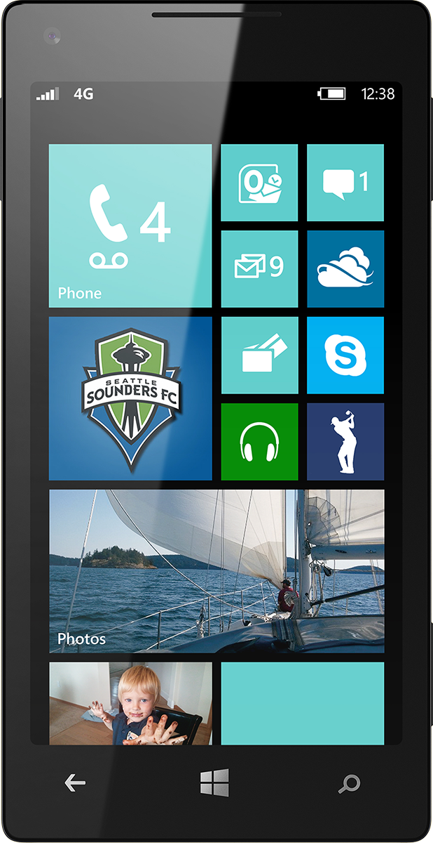
Evaluate this session
Scan this QR code to evaluate this session.

Slide 55
© 2014 Microsoft Corporation. All rights reserved. Microsoft, Windows, and other product names are or may be registered trademarks and/or trademarks in the U.S. and/or other countries.
The information herein is for informational purposes only and represents the current view of Microsoft Corporation as of the date of this presentation. Because Microsoft must respond to changing market conditions, it should not be interpreted to be a commitment on the part of Microsoft, and Microsoft cannot guarantee the accuracy of any information provided after the date of this presentation. MICROSOFT MAKES NO WARRANTIES, EXPRESS, IMPLIED OR STATUTORY, AS TO THE INFORMATION IN THIS PRESENTATION.

