Slide 2
Windows Performance Deep Dive Troubleshooting
WIN-B413
Milad Aslaner Yong Rhee
Premier Field Engineer Sr. Premier Field Engineer
Microsoft Microsoft

Slide 3
Agenda
This is going to be really in-depth… promise!
Windows Performance Lifecycle
Windows Internals
Windows Performance Toolkit
Windows Assessment Services

Slide 4
Windows Performance Lifecycle

Slide 5
Performance Lifecycle
Design for Performance
Deliver consistent Performance
Learning
Planning
Instrumenting
Measuring
Analyzing
Iterate

Slide 6
Performance Fundamentals
How do we define great performance?
Fast
‘Snappy’ user interactions
Getting from Point A to point B in minimal time
Examples: App Launch, Navigating pages, Changing orientation
Fluid
Smooth’ user interactions
Understand budgets and optimize layouts
Examples: Panning a page, animations, eliminating glitches
Efficient
System ‘citizenship’ is important
‘Pay for play’ approach to system utilization
Example: Battery life, memory and disk footprint

Slide 7
Windows Internals

Slide 8
Overview
Subsystem dlls
System Processes
Services
Applications
Environmental Subsystems
User
Mode
Kernel
Mode
NTDLL.dll
Executive
Windowing and Graphics
Device and File System Drivers
Kernel
Hardware Abstraction Layer

Slide 9
How does a Thread get CPU time?
Thread 1
High
Thread 2
Medium
Thread 3
Low
CPU Scheduler
Thread 1
High
Thread 2
Medium
Dispatcher
CPU

Slide 10
Windows Boot: Overview
BIOS
OS Loader
OS Initialization
BIOS
OS Loader
Kernel Initialization
Session Initialization
Winlogon
Initialization
Explorer
Initialization
Post Boot
Activity
ReadyBoot Prefetcher

Slide 11
So many tools… when to go for which?
Analysis | Perfmon | DebugDiag/ Adplus/ ProcDump | Visual Studio | Windows Performance Toolkit
Basic analysis | Y | N | Y | N
Advanced analysis | N | Y |  | Y
Analysis of apps/services | Y | Y | Y | Y
Analysis of drivers | N | N | - | Y
Trace capture & export | Y | Y | N | Y
Reopen shared/post mortem traces | Y | Y | N | Y
Source code linking | N | Y | Y | N

Slide 12
Windows Performance Toolkit

Slide 13
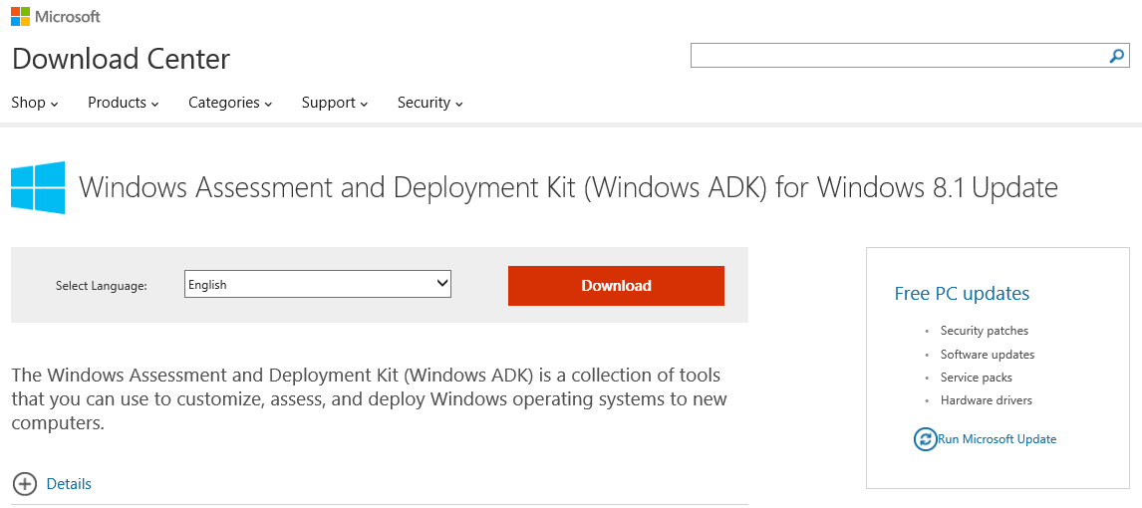
What is WPT and where do I get it?
Windows Performance Recorder (WPR)
  Allows you to capture a trace for the problem you want to investigate
Windows Performance Analyzer (WPA)
  Exposes information about the system and allows you to do performance analysis

Slide 14
Walkthrough WPT Live Action
Yong Rhee

Slide 15
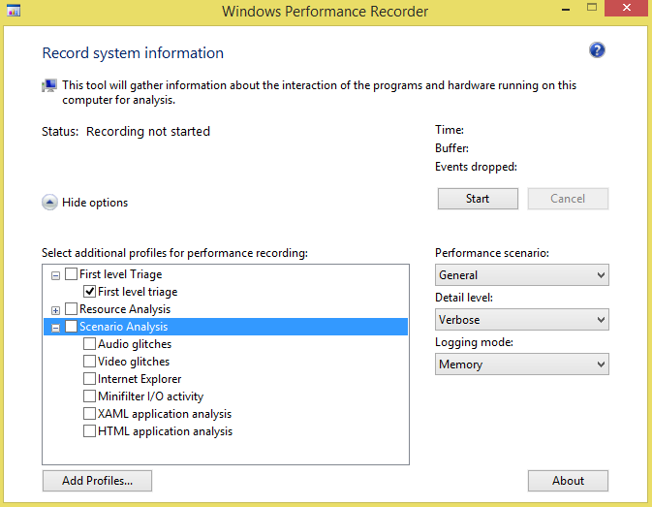
How do I capture a trace?
Windows
  Install WPT (aka.ms/downloadWPT)
  Copy the redistributables for WPR onto your x64/x86/ARM system
Trace just a scenario
  Enable CPU and/or Disk or other Analysis recording profile

Slide 16
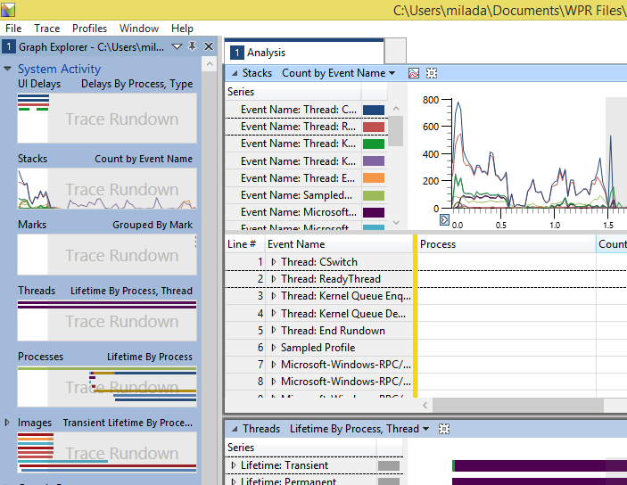
Let’s get started…
Graph Explorer
  Left pane that contains all the views into the data in your trace
Analysis Tabs
  Drag graphs into different tabs to customize your view
Graph and table
  Each view has a visualization and a table that aggregates the data in the view
  Can be in graph only, table only, or graph and table mode

Slide 17
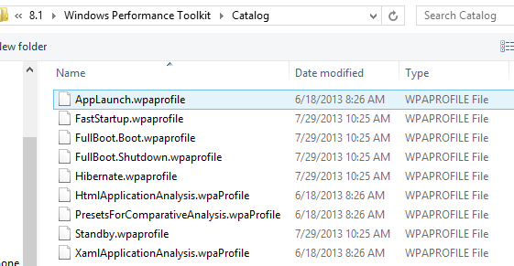
Field Tricks #01: WPA - Profiles
Predefined view of graphs and tables arranged in analysis tabs.
Catalog contains different profiles to jumpstart your analysis
  Go to Profile > Apply > Browse Catalog

Slide 18
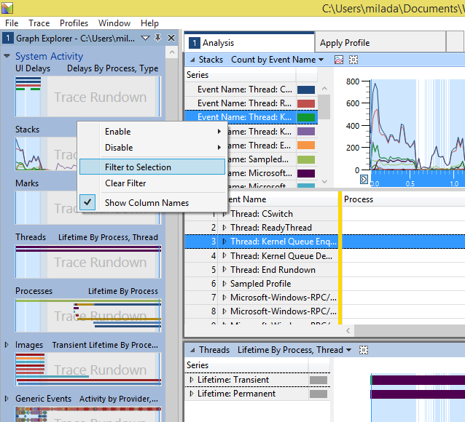
Field Tricks #02: WPA – Common cmdlts.
Zoom
  Trim the timeline you’re looking at
  Click and drag to select, right click and zoom (or press CTRL + .)
Filter to selection
  Trim data you’re looking at in a given table
  Select an item (in table or legend), right click and filter

Slide 19
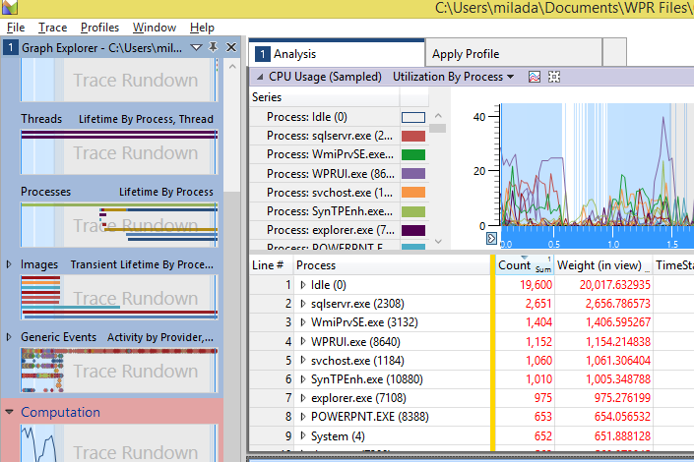
CPU Usage (Sampled)
Description
  Graph provides a 3rd view of CPU usage in your system based on CPU samples.
Key Information
  Summary table is especially useful for understanding what code is running at any given time.
  Zoom into a region that you are interested in and expand the Stack column for your app.

Slide 20
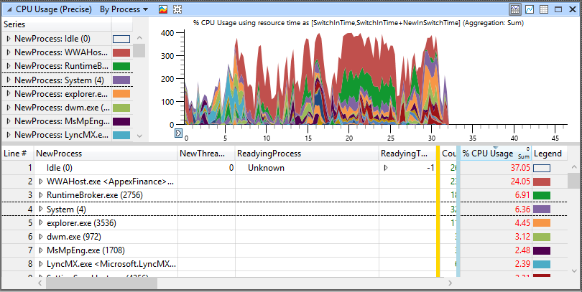
CPU Usage (Precise)
Description
  Summary table shows overall CPU Usage, based on context switch events.
Key Information
  You can use this summary table to understand, at a high level, what processes are running on your system.
  You can also expand each Process to see its component threads.

Slide 21
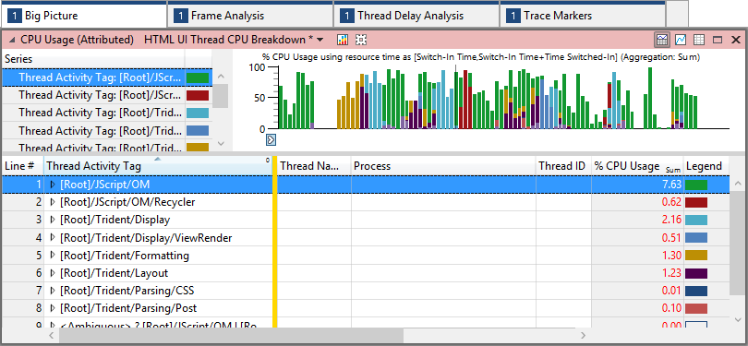
CPU Usage (Attributed)
Description
  Summary table breaks down the CPU costs into several categories that are important for analysis.
Key Information
  Thread Activity Tag column aggregates costs into several defined categories.
  Several preset views available that allow you to filter the data to specific types of threads.
  Typically use the UI Thread preset views for our analysis.

Slide 22
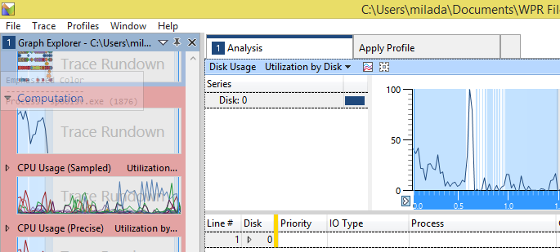
Disk Usage
Description
  Graph shows disk activity on your system.
Key Information
  Typically use this in its graph view, to correlate disk activity with delays in our app.
  There are numerous preset views that help you to dig in to the different types of disk I/O and utilization in your system.

Slide 23
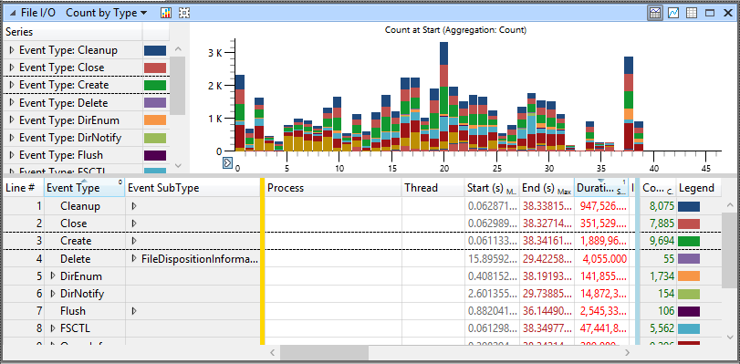
File I/O
Description
  Graph shows disk activity on your system with a per-file granularity.
Key Information
  To populate this graph with data, you must enable the “File I/O activity” profile when you collect your trace.
  Graph allows you to see exactly which files were requested by your app (See the File Name column) and what type of File operation it used.

Slide 24
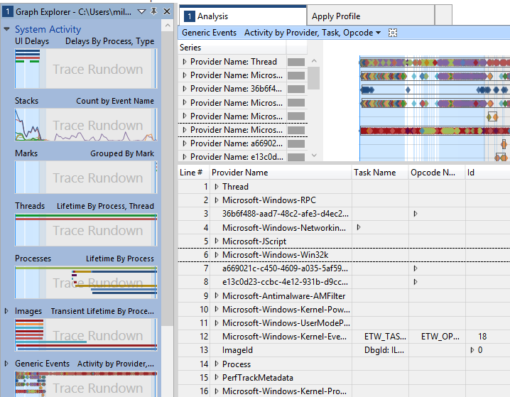
Generic Events
Description
  Summary table presents all events that were collected in your trace.
Key Information
  We have provided several filters to make these events more useful:
    Touch Events – shows marks for each type of touch event
    msWriteProfilerMark – shows markers for each of the events that msWriteProfilerMark logs
    VSync-DWMFrame – marks the VSync events during screen updates with red lines

Slide 25
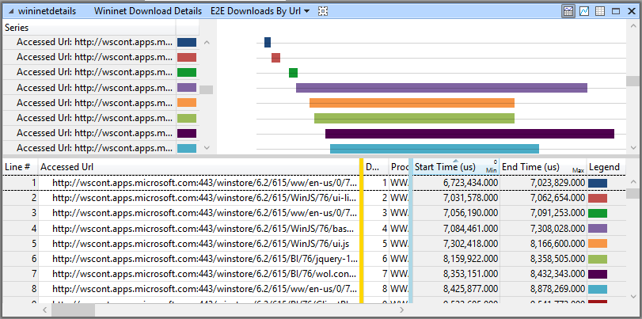
WinInet
Description
  Summary table and graph show what network requests were made on your system.
Key Information
  This graph helps to identify what network requests your app makes or is blocked by.
  If your app’s UI thread CPU usage dips, only to return after a network request completes, it was probably blocked by the network request.

Slide 26
WPT Real World Analysis
Yong Rhee

Slide 27
Windows Assessment Services

Slide 28
What is WAS and where do I get it?
Windows Assessment Services (WAS)
  Test framework that is used to automate quality measurements, such as performance, reliability and functionality, in a lab environment on multiple computers.

Slide 29
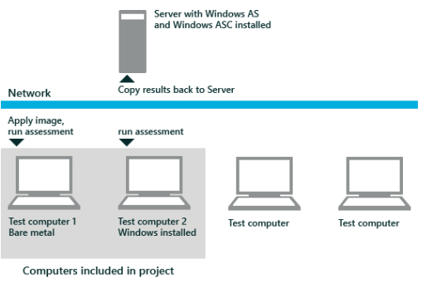
What can I really ‘assess’?
WAS can help with:
  Automates image deployment to test computers by using WDS and a customized Windows PE image
  Automates the running of assessments by using WinRM
  Automates the collection of results from test computers by using WinRM to copy results to the Windows Assessment Services server.

Slide 30
Sounds good… but what do I need?
Verify that you have the following:
  Windows Server® 2012 with the following:
    Recommended: 1 GB NIC
    Recommended: Sizable storage space for trace files, results and images
  One or more test computers that have the following
    USB boot support
    Network (PXE) boot support
    Network Card driver
  Windows 8 image (if you are using bare metal computers)
  All computers must be on the same subnet
  DHCP server to assign IP addresses to test computers

Slide 31
How do I install WAS?
Tip and Tricks:
  install WAS on a server computer, which also installs Windows ASC on the server.
  Alternatively you can also install a stand-alone version of Windows ASC on a client computer.

Slide 32
How do I configure WAS?
Setup/config includes:
  Initializing WAS
  Configuring access to symbols
  Adding NIC Drivers to the Windows PE image (only when the test computers require out-of-box NIC drivers)
  Preparing the Windows PE USB drive for test computer inventory
  Adding Test computers, images and unattended answer files to the inventory
  Adding OOB drivers to the WDS driver store

Slide 33
WAS IN ACTION:
Create, Run and Review

Slide 34
Field 101 for WAS
Let’s be really clear on this:
  WAS assesses one computer at a time
  Can't be installed on a server and isn't designed to assess server computers
  Can't be installed on Windows RT.
    But, you can package a job and run it on Windows RT if the assessment supports ARM-based processors.
So what are common scenarios for WAS?
  WAS fulfill a general industry need for assessing a computer in a unified manner
  WAS is designed for system builders and computer reviewers
  WAS helps you with black box analysis, comparison, clean computers and new hardware/software analysis

Slide 35
Thank You

Slide 36

Related content
Breakout Sessions
Thursday, May 15 at 2:45 PM WIN-B359 2014 Edition: How Many Coffees Can You Drink While Your PC Starts?
Labs
Monday, May 12th 1:15 PM WIN-IL301 Resolving Windows Performance Issues without Opening a Support Case
Tuesday, May 13 at 8:30 AM WIN-IL301-R Resolving Windows Performance Issues without Opening a Support Case
Thursday, May 15 at 10:15 AM WIN-IL301-RR Resolving Windows Performance Issues without Opening a Support Case

Slide 37
Windows Track Resources
Windows Enterprise windows.com/enterprise windowsphone.com/business
Windows Springboard microsoft.com/springboard
Microsoft Desktop Optimization Package (MDOP)
microsoft.com/mdop
Windows To Go microsoft.com/windows/wtg
Windows Phone Developer developer.windowsphone.com

Slide 38

Resources
Learning
  Sessions on Demand
  Microsoft Certification & Training Resources
http://channel9.msdn.com/Events/TechEd
www.microsoft.com/learning
TechNet
msdn
  Resources for IT Professionals
  Resources for Developers
http://microsoft.com/technet
http://microsoft.com/msdn

Slide 39
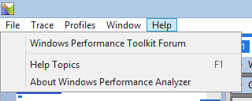
Resources
  Download and install the Windows SDK
  Technical Documents
http://aka.ms/downloadSDK/
http://aka.ms/perftools/
  Loading Symbols
  Event Tracing
http://msdn.microsoft.com/en-us/library/windows/hardware/hh448108.aspx
http://msdn.microsoft.com/en-us/library/windows/desktop/bb968803(v=vs.85).aspx/
  Generic Events
  Creating WPR Recording Profiles
http://msdn.microsoft.com/en-us/library/windows/hardware/hh448242.aspx
http://msdn.microsoft.com/en-us/library/windows/desktop/hh448223.aspx
Let us know your feedback! By going to the WPT forum

Slide 40
Resources continued…
  Getting started with WPA
  Technical Documents
http://msdn.microsoft.com/en-us/library/windows/hardware/hh448170.aspx
http://aka.ms/perftools/
  Introduction to App Analysis Capabilities
  Windows Store Apps Performance fundamentals
http://msdn.microsoft.com/en-us/library/windows/hardware/dn282269.aspx
http://msdn.microsoft.com/en-us/library/windows/apps/hh750312.aspx
  Frame Analysis Tab
http://msdn.microsoft.com/en-us/library/windows/hardware/dn441476.aspx
  Big Picture Tab
http://msdn.microsoft.com/en-us/library/windows/hardware/dn441475.aspx
  XAML and content virtualization
http://msdn.microsoft.com/en-us/library/windows/apps/xaml/hh780657.aspx

Slide 41



Complete an evaluation and enter to win!

Slide 42


Evaluate this session
Scan this
QR code
to evaluate
this session.

Slide 43


© 2014 Microsoft Corporation. All rights reserved. Microsoft, Windows, and other product names are or may be registered trademarks and/or trademarks in the U.S. and/or other countries.
The information herein is for informational purposes only and represents the current view of Microsoft Corporation as of the date of this presentation. Because Microsoft must respond to changing market conditions, it should not be interpreted to be a commitment on the part of Microsoft, and Microsoft cannot guarantee the accuracy of any information provided after the date of this presentation. MICROSOFT MAKES NO WARRANTIES, EXPRESS, IMPLIED OR STATUTORY, AS TO THE INFORMATION IN THIS PRESENTATION.

