Slide 1
What is a “modern” application?
Ulrich (Uli) Homann
Chief Architect, Microsoft Services
Microsoft Corporation

Slide 2




Understanding modern apps
Multiple form factors
Anytime access
Choice
Identity
Social

Slide 3
A modern application – another view
Each Application
  Hardware/Software Install/Configure
  Dedicated resources
  Scaled for worst case
  Always on
  Multiple Environments
The Outcome
  Expensive, Inflexible, Underutilized,
  Brittle, Takes Too Long
Application
Middleware
OS
Hardware

Slide 4












CDN
caching
messaging
database
VMs
business analytics
compute
storage
networking
identity
commerce
Global Physical Infrastructure
servers/network/datacenters
automated
managed resources
elastic
usage based
North Central US, S. Central US, N. Europe, W. Europe, E. Asia, S.E. Asia + 24 Edge CDN Locations

Slide 5
Lifecycle patterns
Predictable bursting
Growing fast
On and off
Unpredictable bursting

Slide 6
Latency Shifts
0
micro-
milli-
second
minute
hour
day
week
month

Slide 7

Latency shifts

Slide 8

Scheduling a service call
2. Service call
1. Schedule service
Fleet scheduling
3. Dynamic dispatch
Event processing Alert Generation
6. Notification
4. GPS Telemetry
Analysis: Near real-time + historic processing
Happy customers
5. Notification

Slide 9
Major external factors
3rd Data discontinuity
Supply and value chains
Apps across platforms
New architecture

Slide 10

Key concepts
Virtualization
Homogenization
Resiliency
Elasticity
Real-time Health
Automation

Slide 11
High scale application archetype
intelligent network load balancer
network activation
stateless web and/or application servers
stateless “worker” process servers
async activation
state: queues, database, object store, files…

Slide 12
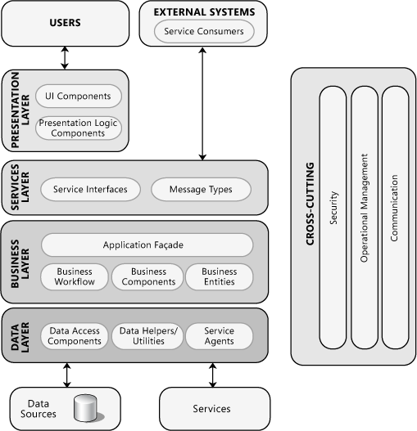
Application models
  Decompose by function
  Decompose functions by roles

Slide 13


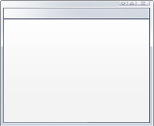



ASAP asynchronicity
  Avoid dependency
  Loosely couple “process” from “process trigger”
  Process “as soon
  as possible”

Slide 14
Start small, grow in growth units
Initial Size
Growth Unit A
Capacity Driver:
# of users
+ 1 App Server
Growth Unit B
Capacity driver: content db size
+1 SQL Server
Max Growth
4 App Servers
2 SQL Servers
Monitoring counters
Trigger growth at 80%
RPS – Initial 99, Growth 80
Content db size – Initial 0.8 TB, growth 0.7 TB

Slide 15


Lead the transition from
software into services

Slide 16
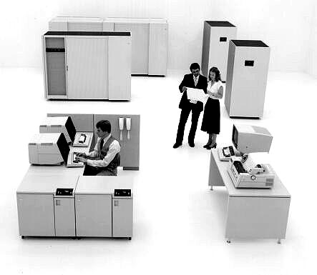
The good old days
Managed operations
Designed
Redbooks
Error Messages
Security
Physical access
Process
Defined processes

Slide 17
Traffic Management
Strategy
Strategy
Strategy
Data Center
Data Center
Data Center
ESP
ESP
ESP
Cloud Fabric
Cloud Fabric
Cloud Fabric
Application
Application
Application
Services
Services
Services
Your Services
Your Services
Your Services
Platform Services
Platform Services
Platform Services
3rd Party
Services
3rd Party
Services
3rd Party
Services

Slide 18
FMEA
Failure point: design element subject to outage
Design elements subject to external change
Common failure points

Slide 19
Failure mode example
public int GetBusinessData(string[] parameters) {
try {
var config = Config.Open(_configPath);
var conn = ConnectToDB(config.ConnectString);
var data = conn.GetData(_sproc, parameters);
return data;
} catch (Exception e) {
WriteEventLogEvent(100, E_ExceptionInDal);
throw;
}
}

Slide 20
Dealing with failure modes
Likelihood of failure, practicality of resiliency
Appropriate action when failure occurs
Use/simulate failures and test thoroughly

Slide 21
Fault and upgrade domains
Fault Domains
Failed component can’t take down service
Isolated infrastructure
Physical hosts, racks
Network equipment
Two by default
Role instances across 2+ fault domains
Upgrade Domains
VM rolling upgrades, no availability impact
Logical grouping of role instances
Five by default
Role instances spread over upgrade domains
Deployment upgraded for all or one at a time

Slide 22
Monitoring health and performance

Slide 23
Modern applications
People ready
Design
Experience

Slide 24

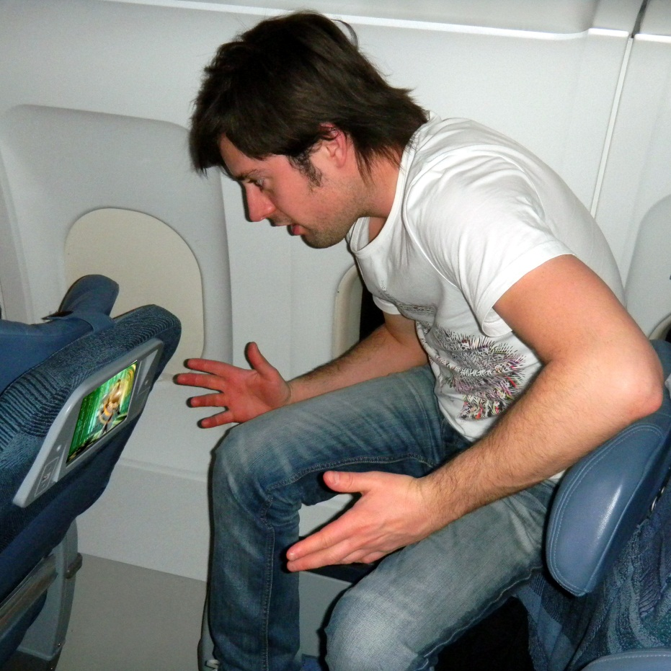

Slide 25
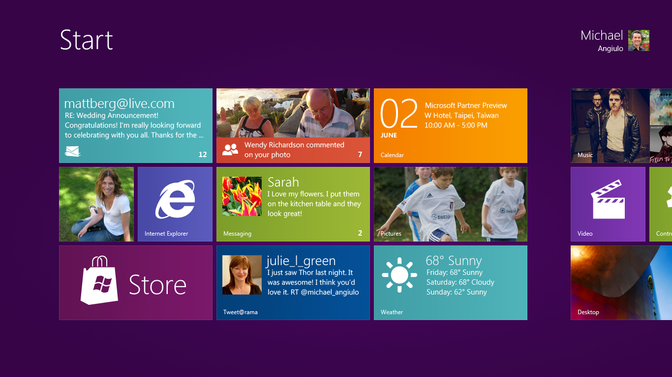

Slide 26
Modern applications
Insightful
Adaptive

Slide 27

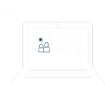

Flexible workstyle solutions
Anywhere connection
Personalized experience
Intelligent infrastructure
Cloud management
Unified management
Personalized devices
On the road
On your device
On your phone
VDI optimized

Slide 28
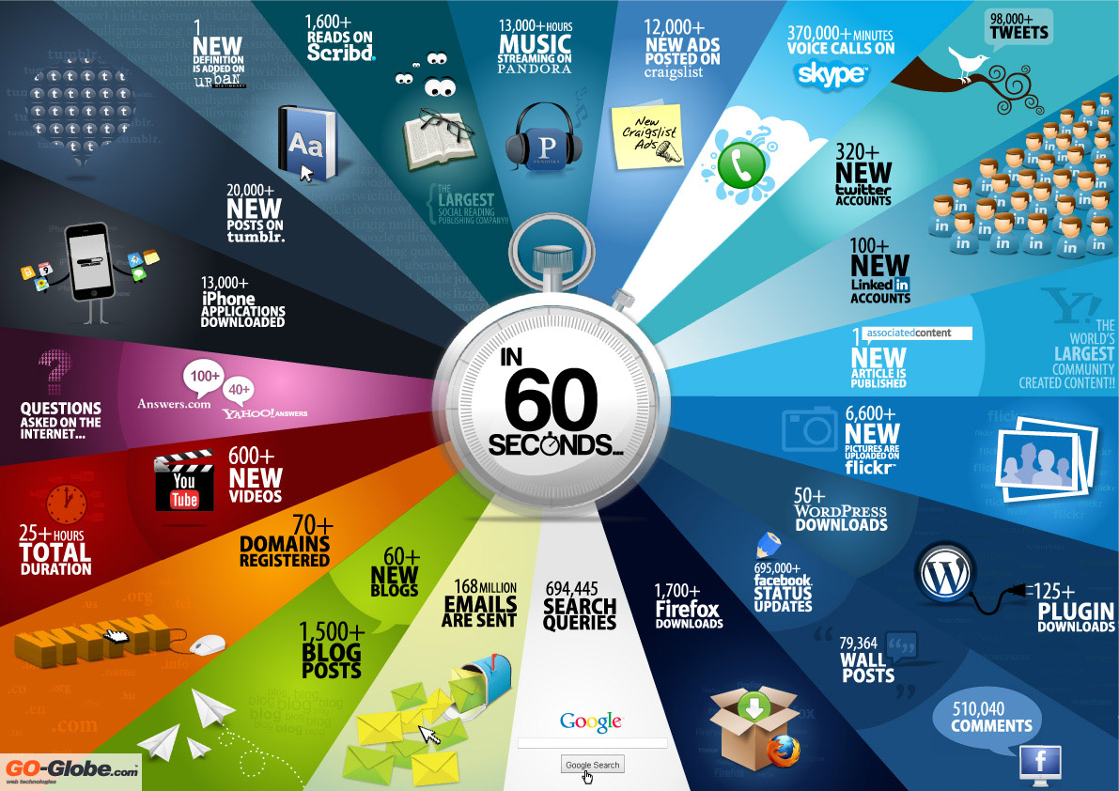
http://www.go-gulf.com/blog/60-seconds

Slide 29
Adaptive insightful experience
Generation <<ME>>
Social group behavior
Right information at the right time
User intent
User preferences
User behavior

Slide 30
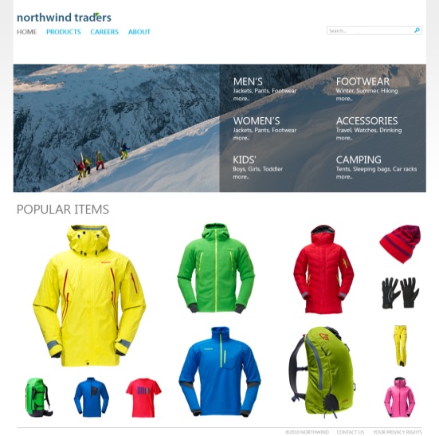
Instrumentation and analysis
Usage counts
Click-through boosting
Item relationships (recs)
Analysis processing
Application instrumentation

Slide 31
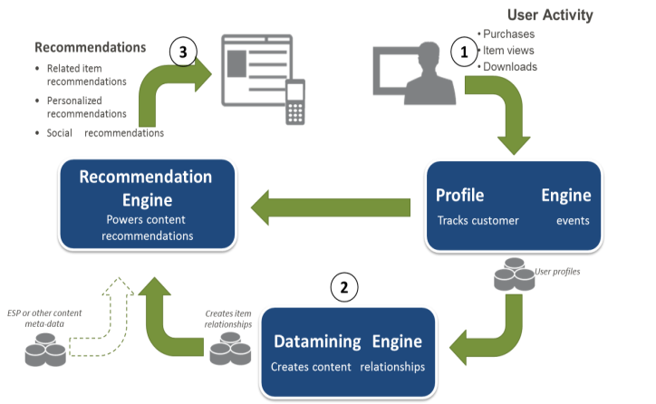

Slide 32
Real-time insight architecture and topology
Targeted content
Collection service
StreamInsight service
Real-time event analysis

Slide 33




Resources
Learning
  Connect. Share. Discuss.
  Microsoft Certification & Training Resources
http://europe.msteched.com
www.microsoft.com/learning
TechNet
  Resources for IT Professionals
  Resources for Developers
http://microsoft.com/technet
http://microsoft.com/msdn

Slide 34
Submit your evals online
Evaluations
http://europe.msteched.com/sessions

Slide 35
© 2012 Microsoft Corporation. All rights reserved. Microsoft, Windows, Windows Vista and other product names are or may be registered trademarks and/or trademarks in the U.S. and/or other countries.
The information herein is for informational purposes only and represents the current view of Microsoft Corporation as of the date of this presentation. Because Microsoft must respond to changing market conditions, it should not be interpreted to be a commitment on the
part of Microsoft, and Microsoft cannot guarantee the accuracy of any information provided after the date of this presentation. MICROSOFT MAKES NO WARRANTIES, EXPRESS, IMPLIED OR STATUTORY, AS TO THE INFORMATION IN THIS PRESENTATION.

