Slide 1
Windows Azure
SQL Reporting
Dany Hoter
Senior Program Manager
Microsoft Corporation
Ola Lavi
Software Development Engineer
Microsoft Corporation

Slide 2
Agenda
SSRS → Windows Azure SQL Reporting
Who can use it?
How to use it?
Architecture
Pricing and SLA
Future directions
And lots of demos…

Slide 3

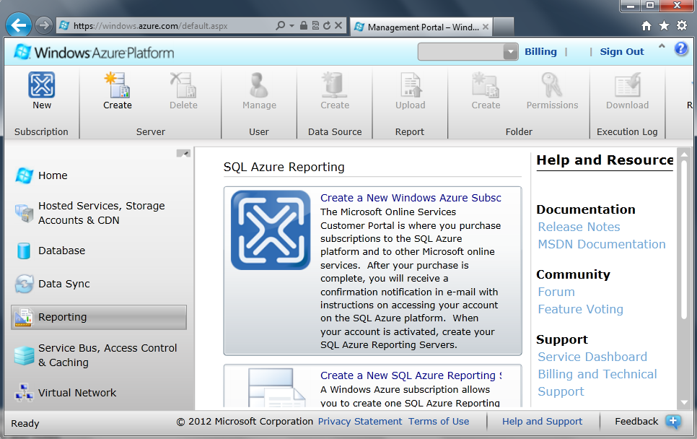
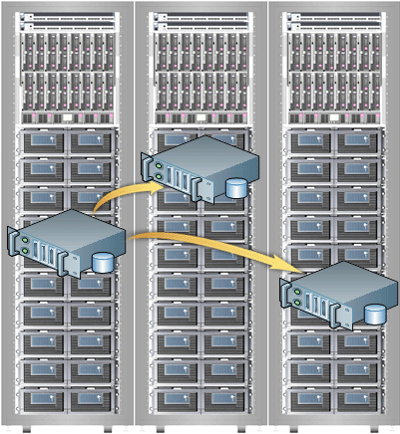


SSRS → Windows Azure SQL Reporting
Reporting Services
Windows Azure SQL Database connectivity
Azure infrastructure
Datacenters worldwide
Windows Azure portal

Slide 4
Let’s see it
demo

Slide 5
Windows Azure SQL Reporting is Globally Available
announcing

Slide 6
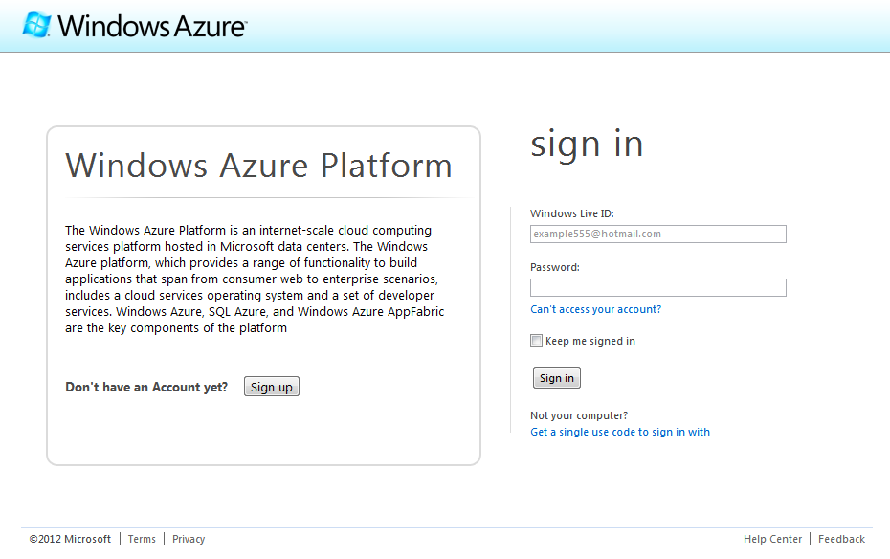
Who can use it?
Anybody with a Windows Azure subscription can create and manage reporting servers.
Trial is available at windowsazure.com

Slide 7
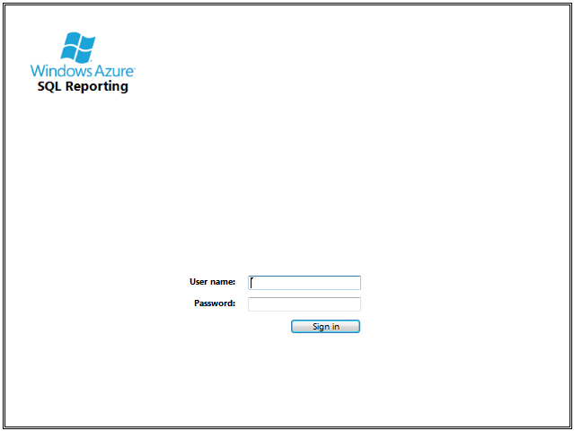
Who can use it?
Any authorized user can view a report

Slide 8
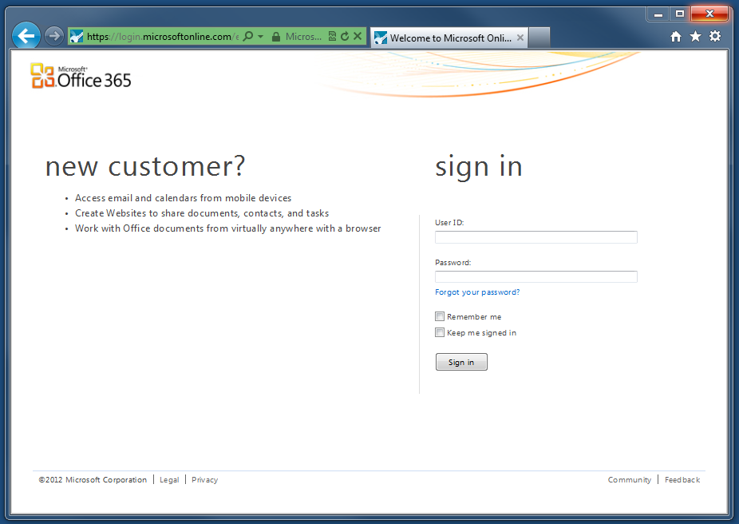
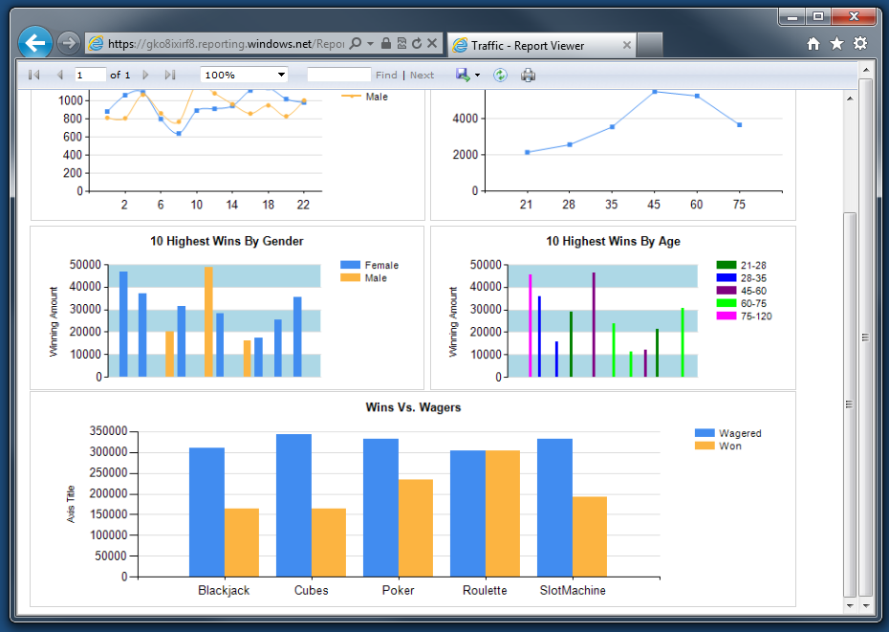
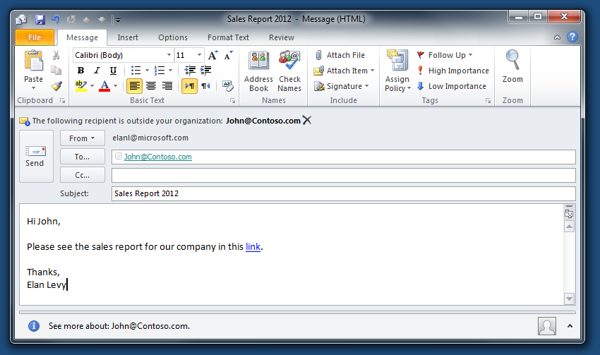
How to use it?
  Direct URL Access
    Send a URL in an email
    Embed in a website
    Embed in SharePoint / SharePoint Online

Slide 9
SharePoint Online
demo

Slide 10
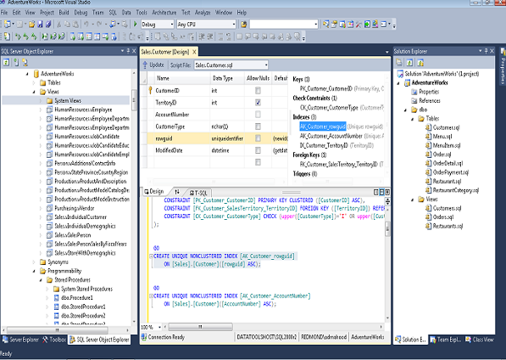
Why Reporting in Windows Azure?
Quick and simple:
  Up and running in no time
  No hardware planning
  Using the tools you already know
    SQL Server Data Tools
    Report Builder V3 and above

Slide 11
Why Reporting in Windows Azure?
  Secure, automatically patched, monitored 24x7
  99.9% SLA tracked externally on distributed geographies
  Scales automatically, grows as needed, no provisioning required
  Easily distributed around the globe
  Automatically backed up in Windows Azure data centers

Slide 12
Windows Azure Portal
demo
Windows Azure SQL Reporting management experience

Slide 13
Programmability Interface
The API from SSRS is available in SQL Reporting.
It allows you to develop your own features to extend SQL Reporting.
  Upload reports
  Export reports
  Set configuration

Slide 14

Render report using SOAP API
rsExecutionContext = new ReportExecutionService();
rsExecutionContext.LoadReport("/Folder/ReportName", null);
//render report to required format
byte[] result = rsExecutionContext.Render(reportFormat,
null,
out extension,
out encoding,
out mimeType,
out warnings,
out streamIDs);

Slide 15
Using SOAP API to execute and schedule reports
demo

Slide 16
It’s in the cloud!
Leverage Windows Azure SQL Reporting in the cloud to address access scenarios:
  Mobile / Tablet
  Report sharing between companies
  Public websites

Slide 17
Windows 8 tablet
demo

Slide 18
Architecture
SLA Monitor
SQL Server Reporting Services
SQL Reporting Infra
SQL Reporting Gateway
SQL Server Management Portal
Data Source
Catalog DB
Temp DB
Worker Roles
Azure Portal
SQL Database
Load Balancer
Windows Azure

Slide 19
How do we track SLA?
Windows Azure SQL Reporting
SLA Monitor
SLA Monitor
99.9% SLA

Slide 20
Pricing
The price is correlated to usage:
  No servers → No Charge
  Servers are charged by the hour
  Every hour a server may render up to 200 reports for $0.88/hour
  SQL Reporting scales automatically: additional instances of 200 reports will cost $0.88/hour

Slide 21
Some Restrictions apply
No support for Custom assemblies, Custom extensions, Custom report items, Code elements
Only one data source – Windows Azure SQL server
Basic security model
Scheduling, subscriptions and alerting are not supported
Limited Report Builder support

Slide 22
Future Directions
Extensibility – code segments
Upgrade reporting engine to SQL Server 2012
Additional data centers
Additional data sources
Identity federation and delegation
Scheduling and Alerting

Slide 23
Recap
Windows Azure SQL Reporting is Globally Available
Management experience:
  Windows Azure portal
  SQL Server Data Tools
Demos
  Report URL access
  SOAP API
  Win 8 tablet

Slide 24

Senior Program Manager
danyh@microsoft.com
Dany
Hoter

Slide 25

Software Development Engineer
olavi@microsoft.com
Ola Lavi

Slide 26


Track Resources
SQL Server 2012 Eval Copy
Hands-On Labs
@sqlserver
@TechEd_NA
#msTechEd
Get Certified!
mva
Microsoft Virtual Academy

Slide 27




Resources
Learning
  Connect. Share. Discuss.
  Microsoft Certification & Training Resources
http://europe.msteched.com
www.microsoft.com/learning
TechNet
  Resources for IT Professionals
  Resources for Developers
http://microsoft.com/technet
http://microsoft.com/msdn

Slide 28
Submit your evals online
Evaluations
http://europe.msteched.com/sessions

Slide 29
© 2012 Microsoft Corporation. All rights reserved. Microsoft, Windows, Windows Vista and other product names are or may be registered trademarks and/or trademarks in the U.S. and/or other countries.
The information herein is for informational purposes only and represents the current view of Microsoft Corporation as of the date of this presentation. Because Microsoft must respond to changing market conditions, it should not be interpreted to be a commitment on the
part of Microsoft, and Microsoft cannot guarantee the accuracy of any information provided after the date of this presentation. MICROSOFT MAKES NO WARRANTIES, EXPRESS, IMPLIED OR STATUTORY, AS TO THE INFORMATION IN THIS PRESENTATION.

