Slide 1
Microsoft System Center 2012 Configuration Manager Overview
MGT309
Mark Florida
Principal Program Manager Lead
Microsoft Corporation
Wally Mead
Senior Program Manager
Microsoft Corporation

Slide 2




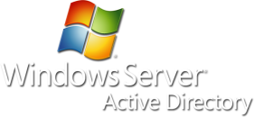


Evolution of Microsoft Client Management
2012
2012
2011
2007
2003
1999
SMS 2.0
1994
SMS 1.0
Client Management Infancy (NT Domain)
Groups Model
Laptops, Servers, Enterprise Scale
Comprehensive Management
Management from the Cloud
Consumerization of IT

Slide 3


Challenges to Enabling Consumerization
Infrastructure Considerations
Infrastructure Considerations
Management of diverse devices
How can IT support and manage all those devices?
I want to use the device I prefer
Devices ←→ User
Corporate ←→ Consumer
Secure, anywhere
access to apps
& data
I want to connect to people and be productive anywhere, anytime
How can IT provide access to apps and data while maintaining security?
Application Experience
Security and Access

Slide 4


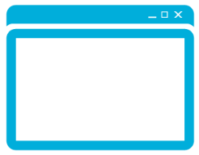

System Center 2012 Configuration Manager
Empower Users
Unify Infrastructure
Simplify Administration
Empower people to be more productive from almost anywhere on almost any device.
Reduce costs by unifying
IT management
infrastructure.
Improve IT effectiveness
and efficiency.

Slide 5






Empower Users
Unify Infrastructure
Simplify Administration
Application Delivery
Mobile Device Management
Empower people to be more productive from anywhere on any device.
Reduce costs by unifying
IT management
infrastructure.
Improve IT effectiveness
and efficiency.
Empower Users
Unify Infrastructure
Simplify Administration
Empower people to be more productive from almost anywhere on almost any device.
Reduce costs by unifying
IT management infrastructure.
Improve IT effectiveness
and efficiency.

Slide 6








User-centric Application Delivery
Administrator
Empower
Deliver best user experience on each device
Define application once
Delivery Evaluation Criteria
User
Device type
Network connection
< >
User/Device Relationships
Primary Devices
MSI
App-V
Non-primary Devices
VDI
Presentation Server
Remote Desktop
Windows
Embedded

Slide 7




User-centric Application Delivery
New Application Model
Empower
General Information
Application “Package”
Administrator Properties
End User Metadata
Keep your apps organized and managed
< >
The “friendly” information for your users (appears in Catalog)
Deployment Type
Detection Method
Install Command
Requirement Rules
Dependencies
Supersedence
App-V
Is app installed?
Windows Script
Command line and options
Windows Installer
Can/cannot install app
CAB
Apps that must be present
Application version control

Slide 8
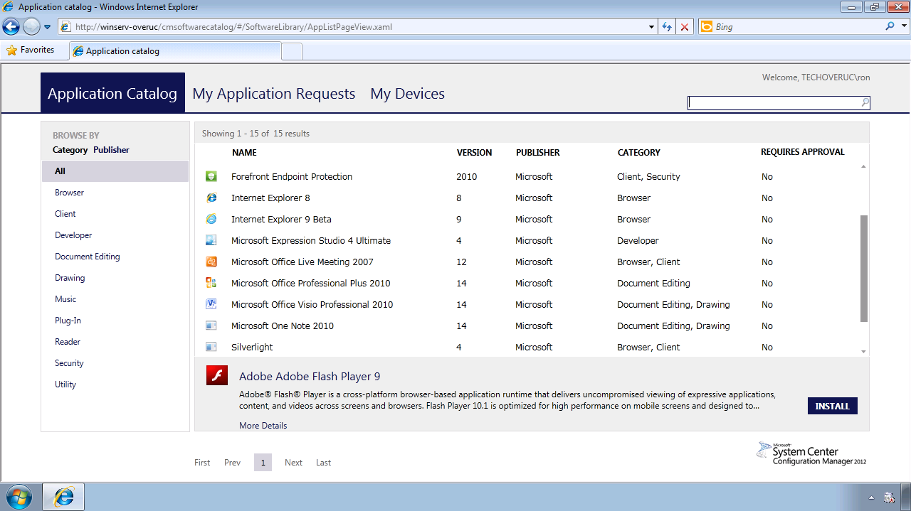
User-centric Application Delivery
End User Self-service
Empower
Administrators publish software titles to catalog, complete with meta data to enable search
Deliver best user experience
on each device
IT
Users can browse, select and install directly from Catalog
Application model determines format and policies for delivery
User

Slide 9
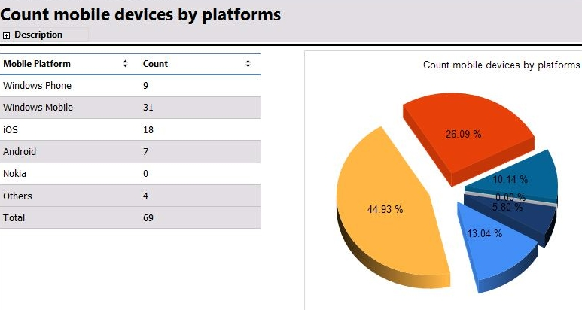


Mobile Device Management
Empower
Management for all Exchange ActiveSync (EAS) connected devices
EAS-based policy delivery
Discovery and inventory
Settings policy
Remote Wipe
7

Slide 10
People-Centric Software Distribution
DEMO

Slide 11
Upcoming Enhancements in SP1
Empower
Platform Support:
  Windows 8
  Windows 8 tablet (Intel SoC) support
  Mac OS X
  Linux and Unix
Operating System Deployment: Windows To Go support
Application Delivery:
  Metro style applications
  Deep link applications
  Network cost support

Slide 12
Metro Style Applications and MAC OS X Software Distribution
DEMO

Slide 13
Unify Infrastructure
Reduced Infrastructure Requirements
Unified Management of Virtual Clients
Endpoint Protection
Compliance & Settings Management
Software Update Management
Reduce costs by unifying
IT management
infrastructure.
Power Management
Internet-based Client Management

Slide 14

Reduced Infrastructure Requirements
Unify
Central Administration Site
Primary Sites
Secondary Sites
Central primary site administration
Reporting
Client management and settings
Delegated administration
Content routing
Distributions points
Central Administration
Site
Primary Site
Primary Site
Secondary Site
Secondary Site
Secondary Site
Secondary Site
Secondary Site
Secondary Site

Slide 15


Unified Management of Virtual Clients
Unify
User-centric application delivery through App-V or Citrix XenApp.
CONNECTION BROKER
Single admin experience for managing physical and virtual desktops. Integrates with RDS and XenDesktop.
Recognizes pooled and personal virtual desktops
Randomizes tasks
APP-V
SEQUENCER
CONFIGMGR
DP/MP
HYPER-V

Slide 16
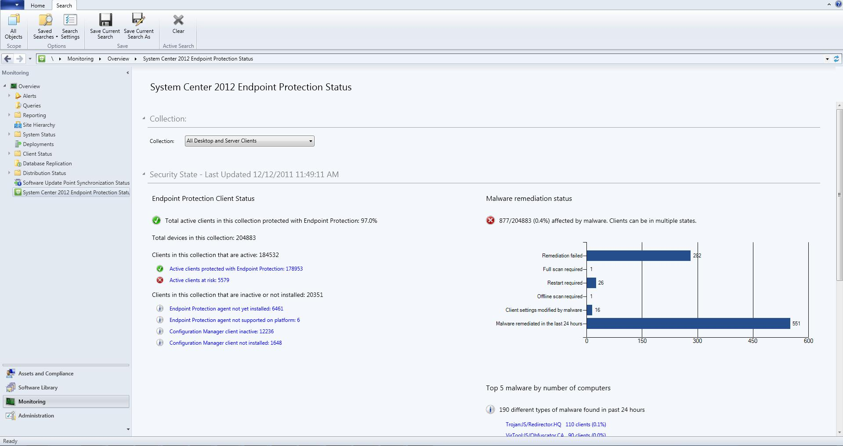
Security and Compliance
Endpoint Protection
Unify
Unified Infrastructure
Simplified server
and client deployment
Streamlined updates
Consolidated reporting
Comprehensive Protection Stack
Behavior monitoring
Antimalware
Dynamic Translation
Windows and Firewall Management

Slide 17
Security and Compliance
Software Update
Unify
Microsoft Update
Auto Deployment
Faster deployment through search
Schedule content download and deployment to avoid reboot during work hours
State-based Updates
Allows individual
or group deployment
Updates added to groups auto deploy to targeted collections
Optimized for New Content Model
Reduce replication and storage
Expired updates and content deleted
Identifies who needs updates and reports on compliance
Downloads updates
CAS
Primary Site
SUP Role/WSUS
Primary Site
DP Role
Primary Site
MP Role
Distributes updates
Assigns policy to scan for update status or to deploy update
Reports
compliance

Slide 18
Security and Compliance
Settings Management
Unify
ConfigMgr MP
Baseline
ConfigMgr Agent
Assignment to collections
Baseline drift
Auto Remediate
OR
Create Alert
(to Service Manager)
!
Baseline Configuration Items
Active
Directory
Script
WMI
XML
SQL
File
Software
Updates
Registry
MSI
IIS
Improved functionality
Copy settings
Trigger console alerts
Richer reporting
Enhanced versioning and audit tracking
Ability to specify versions to be used in baselines
Audit tracking includes who changed what
Pre-built industry standard baseline templates
through IT GRC Solution Accelerator

Slide 19
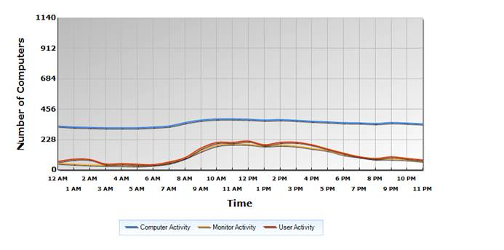
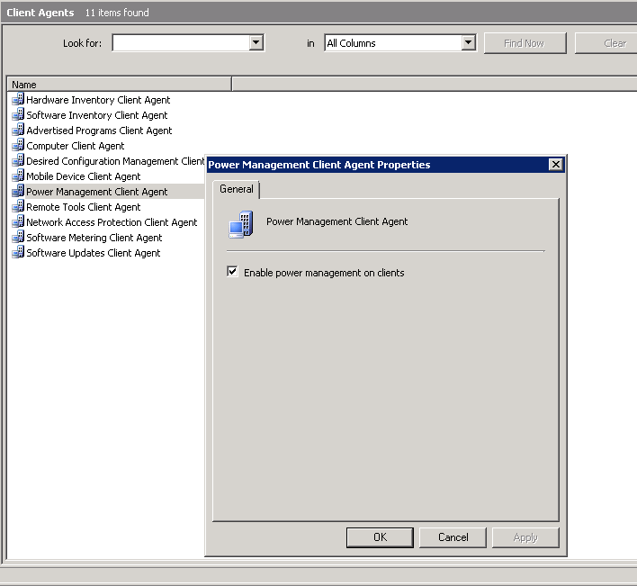
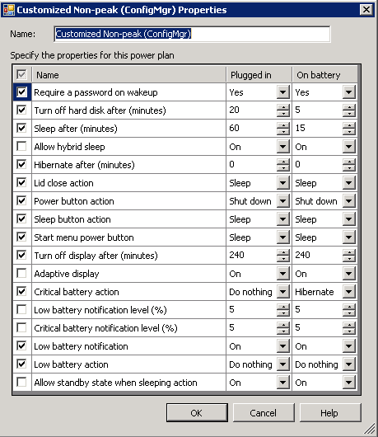
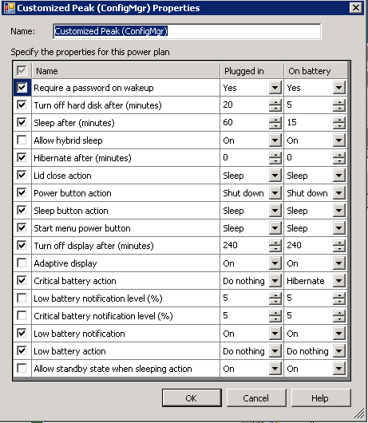
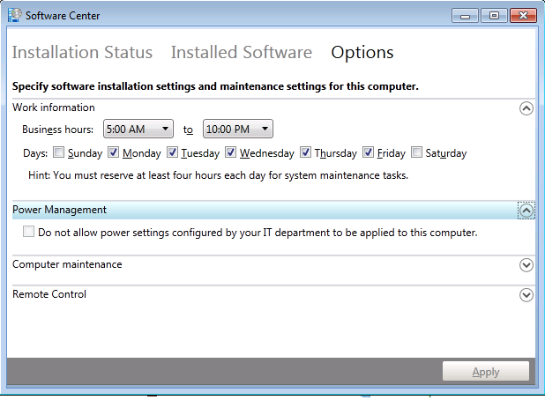
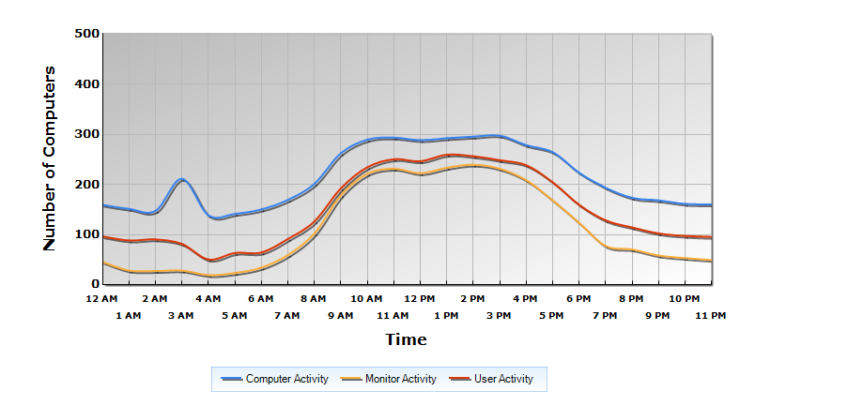
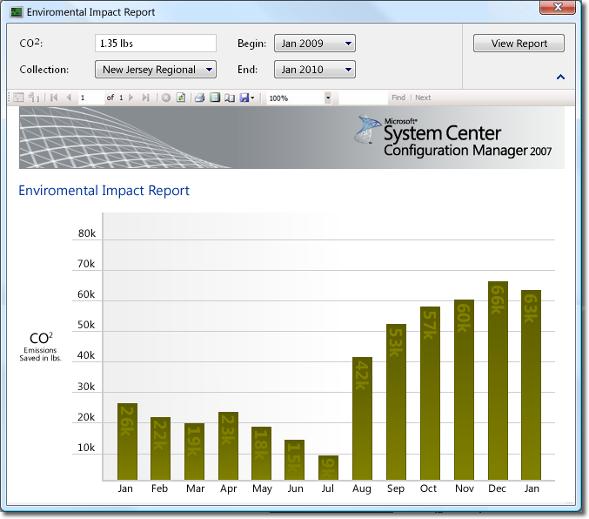
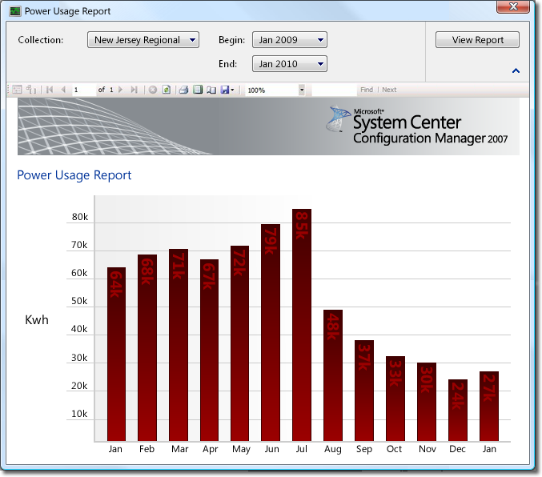
Power Management
Unify
Week 1: Monitor
Enable client management agent
Begin monitoring usage and activity
Week 2: Plan
Continue monitoring on usage and activity
Begin to develop Power Plan
VM awareness (new compared to 2007)
Copy power policies (new compared to 2007)
Mid-Month:
Power Plan has been confirmed
Non-Peak & Peak
Week 3: Apply Power policy
Begin applying Power Plan
End user opt-out (new compared to 2007)
Week 4: Compliance & Analyze
Review before and after usage and activity
Determine savings in Kwh and Co2 saved

Slide 20

Internet-based Client Management
Unify
Reduced Complexity
Single Primary site can manage both Intranet clients (over HTTP) and Internet clients (over HTTPS)
Flexibility
Primary sites can be configured to either support only HTTPS roles or both HTTP and HTTPS site roles
Reliability
Intelligent client behavior enables client to communicate using the most secure option available
Tighter security enforcement by only allowing clients with Enterprise-issued certificates to communicate with the ConfigMgr roles
Intranet
Internet
PR1
MP
MP
DP
DP
Non PKI enabled site system
PKI enabled site system

Slide 21
Settings Management
DEMO

Slide 22
Upcoming Enhancements in SP1
Unify
Flexible hierarchy management:
  Ability to add a new Central Administration Site
  Migration between ConfigMgr 2012 hierarchies
Hierarchy easier to control:
  When: Schedule replication for a given link
  What: SQL Server distributed views
  How much: Compression for SQL Server data
Software Updates Management:
  Fallback to WU/MU for content
  Definition updates 3x/day
Endpoint Protection
  Real-time administrative actions
Setting Management: User Profile and Data Management
  Client Side Caching
  Roaming User Profiles
  Folder Redirection

Slide 23
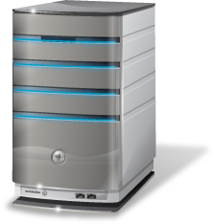

Flexible Hierarchy Management
What’s new in SP1
Scenario 1:
Hierarchy Expansion
Central Administration Site
Must be a new installation
Scenario 2:
Merger
Primary Site
Migration
Primary Site
Houston Primary Site
10,000 Clients
Miami Primary Site
5,000 Clients

Slide 24
Simplify Administration
Modern GUI
Role-based Administration
Operating System Deployment
Client Health
Asset Intelligence
Improve IT effectiveness
and efficiency.
Remote Control

Slide 25
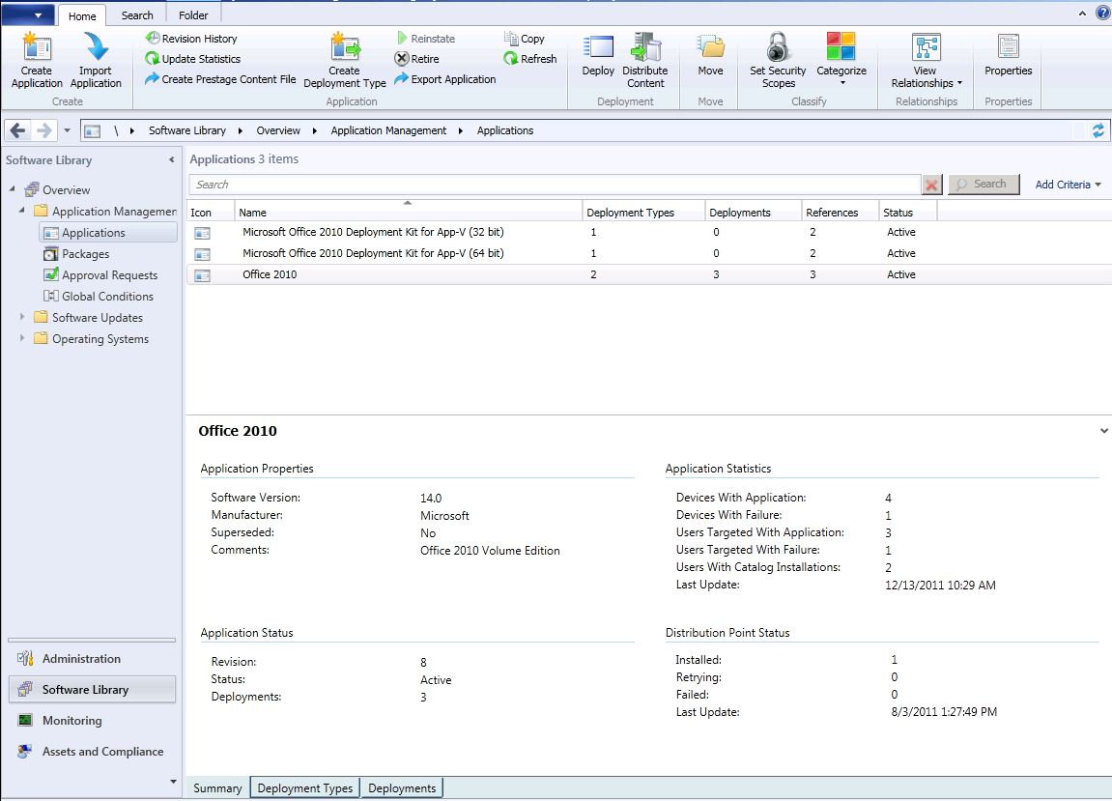
Modern GUI
Simplify
Intuitive ribbon interface
In-console alerts
Global search capability
New collection membership rules
allow better filtering of members

Slide 26

Role Based Administration
Simplify
Map the organizational roles of your administrators
to defined security roles
Security organization role
Geography
Reduces error, defines span of control for the organization
Meg- WW Central System Administrator
Louis-Software Update Manager for France
Bob- US & France Security Admin
Can see & update “France” desktops
Cannot modify security settings on “France” desktops
Cannot see “All Systems” or “U.S.” desktops
Can see & modify security settings on “France” and “U.S.” desktops
Cannot update “France” or “U.S.” desktops
Cannot see “All Systems”
Functionality | ConfigMgr 2007 | ConfigMgr 2012
What types of objects can I see and what can I do to them? | Class rights | Security roles
Which instances can I see and interact with? | Object instance permissions | Security scopes
Which resources can I interact with? | Site specific resource permissions | Collection limiting

Slide 27
Role Based Administration
DEMO

Slide 28
Operating System Deployment
Simplify
Multiple Deployment Method Support
CAS
PXE initiated deployment allows client computers to request deployment over the network
Multi-cast deployment to conserve
network bandwidth
Stand-alone media deployment for no network connectivity or low bandwidth
Pre-staged media deployment allows you to deploy an operating system to a computer that
is not fully provisioned
USMT 4.0 UI integration makes it easier transfer files and user settings from one machine to another
Image
Task Sequence
Report
WDS PXE Server
Primary Site
DP Role
Primary Site
MP Role

Slide 29
Operating System Deployment
What’s new in SP1
BitLocker changes:
  TPM and PIN
  Used Space BitLocker
Prestage media now supports additional content types:
  Before: WIM
  Now: WIM, Applications, Drivers, Package/Programs

Slide 30
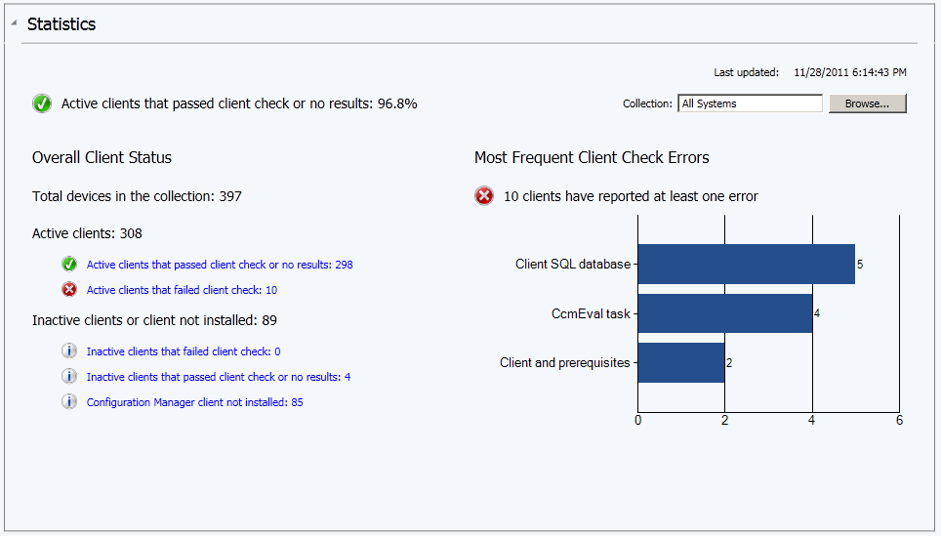
Client Activity and Health
Simplify
In-console view of client health
Threshold-based console alerts
Heartbeat DDRs
HW/SW inventory and status
Remediation (same as Setting Mgmt)

Slide 31




Asset Intelligence, Inventory, and
Software Metering
Simplify
Consolidated/simplified reporting that allows you to
Understand software installation profiles
Plan for hardware upgrades
Identify over or under licensing issues
Track custom apps or groups of titles
Real-time Application
and Hardware Intelligence
Asset Intelligence Service
Software Metering & License Reports
ConfigMgr Inventory
Asset Intelligence Catalog
Notes:
6/26/2012 7:10 PM
31
© 2005 Microsoft Corporation. All rights reserved.
This presentation is for informational purposes only. Microsoft makes no warranties, express or implied, in this summary.

Slide 32

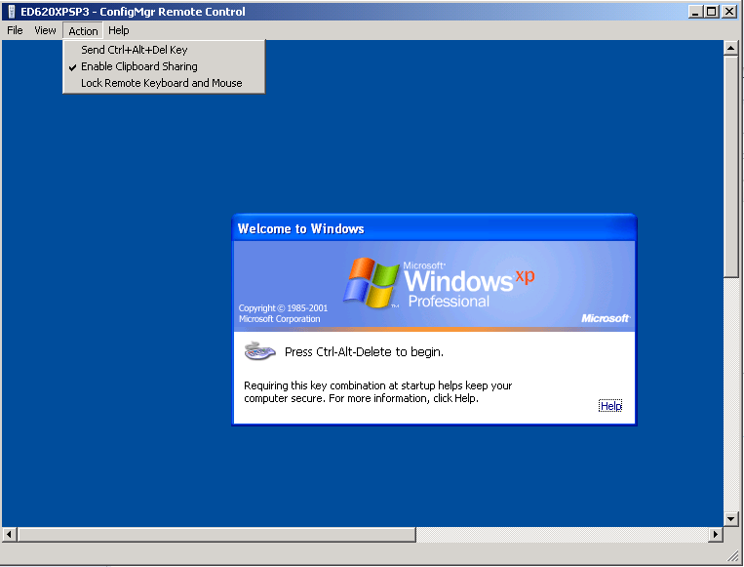
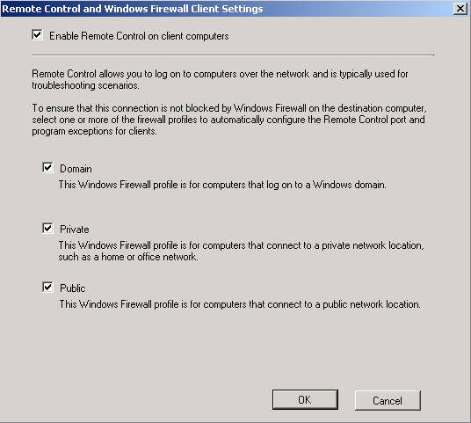
Remote Control
Simplify
What's New in Remote Control
  Ability to send Ctrl-Alt-Del keystroke to host device
  Granular client settings per collection
  Lock keyboard and Mouse
  Ability to create Firewall exception rule
  Ccmeval monitors and
  remediates Remote Control Service

Slide 33
PowerShell
What’s new in SP1
PowerShell Provider
Cmdlets:
  Scope: Tasks exposed in the Administration Console
  How:
    Suitable experience for administrator (not the SDK)
    Align with PowerShell general conventions

Slide 34
Migration From Configmgr 2007 To 2012
Assist with Flattening of Hierarchy
Assist with Migration of Objects
Assist with Migration of Clients
Maximize Re-usability of x64 Server Hardware
Minimize WAN impact

Slide 35
Built-in Migration Feature
Migration Job Types:
  Object Migration (Collections, software distribution packages, boundaries, metering rules etc.)
  Collection based Migration (Select a collection and migrate associated objects)
Content functionality:
  Re-use of existing ConfigMgr 2007 content (Distribution
  Point sharing)
  Distribution Point upgrade
Import of ConfigMgr 2007 inventory MOF files

Slide 36
Prepare For Configuration Manager 2012
Flatten hierarchy where possible
Plan for Windows Server 2008, SQL 2008, and 64-bit
Start implementing BranchCache™ with Configuration Manager 2007 SP2
Move from web reporting to SQL Reporting Services
Avoid mixing user and devices in collection definitions
Use UNC (\\server\myapp\myapp.msi) in package source path instead of local path (d:\myapp)

Slide 37
Summary
Application Delivery
2007 R3
2012
2012 SP1
Empower
Application Delivery
Device Centric
User Centric
Metro style
Mobile Device Management
MDM licensing
Integrated
End user platform support
Windows and EAS
Windows 8,Mac,Linux
Unify
Reduced Infrastructure Requirements
New
Flexible hierarchies
Unified Management of Virtual Clients
Improved
Endpoint Protection
Integrated
Real-time actions
Compliance & Settings Management
Auto Remediation
User Profile and Data
Software Update Management
Improved
Power Management
Internet-based Client Management
Improved
Simplify
Role-based Administration
New
Operating System Deployment
Improved
Asset Intelligence, Client Health, and Inventory

Slide 38


Related Content
Breakout Sessions
  MGT310 | Microsoft System Center 2012 Endpoint Protection Overview
  MGT311 | Microsoft System Center 2012 Configuration Manager Deployment and Infrastructure Technical Overview
  MGT312 | Deep Application Management with Microsoft System Center 2012 Configuration Manager
  MGT313 | Microsoft System Center 2012 Configuration Manager: Plan, Deploy, and Migrate from Configuration Manager 2007 to 2012
  MGT318 | Patch and Settings Management in Microsoft System Center 2012 Configuration Manager
  WCL388 | Client Management Scenarios in the Windows 8 Timeframe

Slide 39

Related Content
Hands-on Labs:
  MGT23-HOL | Deploying Windows 7 to Bare Metal Systems with Microsoft System Center 2012 Configuration Manager
  MGT24-HOL | Implementing Endpoint Protection 2012 in Microsoft System Center 2012 Configuration Manager
  MGT12-HOL | Compliance and Settings Management in Microsoft System Center 2012 Configuration Manager
  MGT25-HOL | Deep Dive: Microsoft System Center 2012 Configuration Manager SQL Replication Labs
  MGT21-HOL | Basic Software Distribution in Microsoft System Center 2012 Configuration Manager
  MGT16-HOL | Migrating from Microsoft System Center Configuration Manager 2007 to System Center 2012 Configuration Manager
  MGT14-HOL | Implementing Role Based Administration in Microsoft System Center 2012 Configuration Manager
  MGT15-HOL | Deploying a Microsoft System Center 2012 Configuration Manager Hierarchy
  MGT11-HOL | Introduction to Microsoft System Center 2012 Configuration Manager

Slide 40


MGT Track Resources
#TEMGT309
Talk to our Experts at the TLC
Hands-On Labs
DOWNLOAD System Center 2012 Evaluation
microsoft.com/systemcenter
DOWNLOAD System Center 2012 SP1 CTP
microsoft.com/systemcenter

Slide 41



Resources
Learning
  Connect. Share. Discuss.
  Microsoft Certification & Training Resources
http://europe.msteched.com
www.microsoft.com/learning
TechNet
  Resources for IT Professionals
  Resources for Developers
http://microsoft.com/technet
http://microsoft.com/msdn

Slide 42
Submit your evals online
Evaluations
http://europe.msteched.com/sessions

Slide 43
© 2012 Microsoft Corporation. All rights reserved. Microsoft, Windows, Windows Vista and other product names are or may be registered trademarks and/or trademarks in the U.S. and/or other countries.
The information herein is for informational purposes only and represents the current view of Microsoft Corporation as of the date of this presentation. Because Microsoft must respond to changing market conditions, it should not be interpreted to be a commitment on the
part of Microsoft, and Microsoft cannot guarantee the accuracy of any information provided after the date of this presentation. MICROSOFT MAKES NO WARRANTIES, EXPRESS, IMPLIED OR STATUTORY, AS TO THE INFORMATION IN THIS PRESENTATION.

