Slide 1
Speeding the Transition to a Responsive, Virtualized Storage Infrastructure
Alexander Best
Director Technical Business Development
DataCore Software

Slide 2
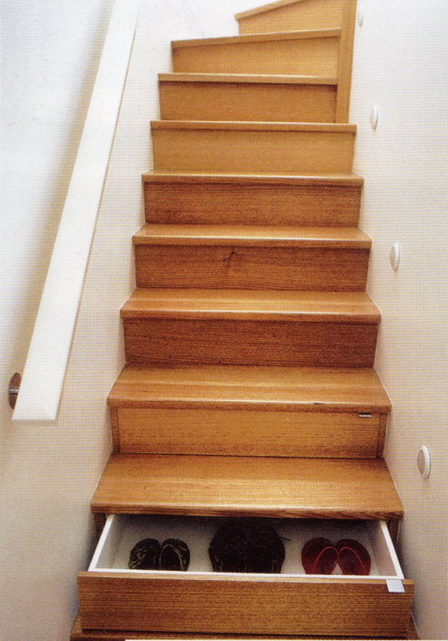
Storage is Growing

Slide 3


Slide 4
Agenda
Storage Considerations for Private Cloud
Why Virtualization Projects Fail
Best Practices in Storage Virtualization

Slide 5
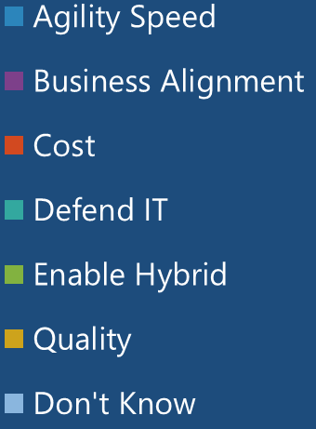

Drivers of the Cloud
=
______%

Slide 6
DRIVERS FOR PRIVATE CLOUD
*According to Gartner

Slide 9
Need More Storage

Slide 10
Need More Storage

Slide 11
Drivers for the Private Cloud
Agile & Speed
Cost
Business Alignment

Slide 12
Need More Storage

Slide 13
NIST CLOUD REFERENCE MODEL
Cloud
Consumer
Cloud Provider
Cloud
Broker
Service Layer
Cloud Service
Management
SaaS
Service
Intermediation
PaaS
Cloud
Auditor
Business Support
IaaS
Service
Aggregation
Security
Privacy
Security
Audit
Resource Abstraction & Control Layer
Provisioning / Configuration
Service
Arbitrage
Privacy Impact
Audit
Physical Resource Layer
Portability / Interoperability
Hardware
Performance Audit
Facility
Cloud Carrier

Slide 14
DATACORE’S ROLE
Cloud
Consumer
Cloud Provider
Cloud
Broker
Service Layer
Cloud Service
Management
IaaS
SaaS
Service
Intermediation
PaaS
Cloud
Auditor
Business Support
Resource Abstraction
& Control Layer
Provisioning / Configuration
IaaS
Service
Aggregation
Security
Privacy
Security
Audit
Provisioning / Configuration
Resource Abstraction & Control Layer
Service
Arbitrage
Privacy Impact
Audit
Physical Resource Layer
Portability / Interoperability
Portability / Interoperability
Hardware
Performance Audit
Facility
Cloud Carrier

Slide 15

Private Cloud- Storage
Resource Pooling
Automation
Self Service

Slide 16

TOO SMALL FOR YOUR OWN
PRIVATE CLOUD?
Principles still apply
Team with others in
related industry
Outsource it

Slide 17
TOO SMALL FOR YOUR OWN
PRIVATE CLOUD?
Principles still apply
Team with others in
related industry
Outsource it

Slide 18

Private Cloud Considerations
Mission Critical
High Availability
Storage
VM Mobility
Networking
Automation

Slide 19
Private Cloud Considerations
Mission Critical
High Availability
Storage
VM Mobility
Networking
Automation

Slide 20
Private Cloud Considerations
Mission Critical
High Availability
Storage
VM Mobility
Networking
Automation

Slide 22



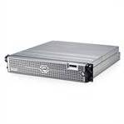

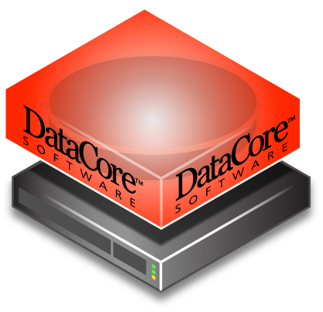

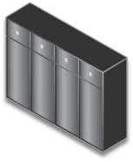
Storage Hypervisor
Cluster
Application Server
Virtual Disks
Shared
Virtual Disks
Storage Hypervisor
Disk Arrays

Slide 23
Benefits of Virtualization of Storage
Pool Disks from Different Vendors
Just in time Fulfillment
Tier Storage of different types
Allocate on demand
Increase performance
Highly Available

Slide 24
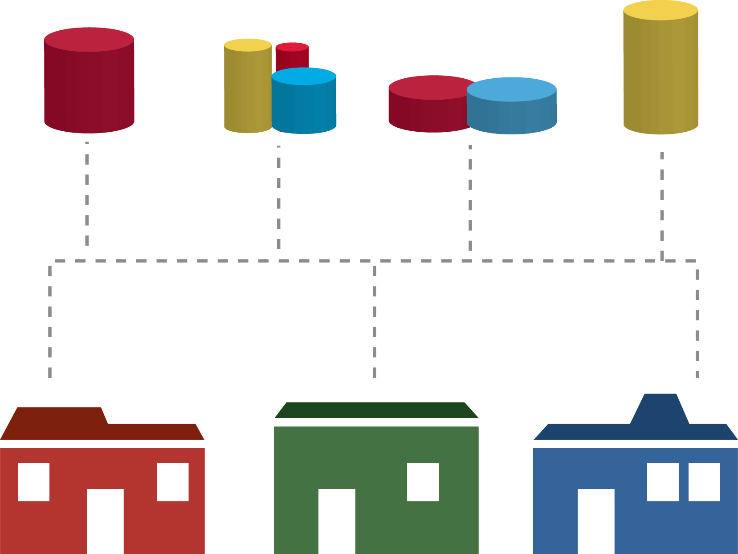
RESOURCE SHARING
Pool assets
Distribute loads
Amortize costs
Load balance
  During peaks

Slide 25
Demo Pooled Storage
Heterogeneous Storage

Slide 26

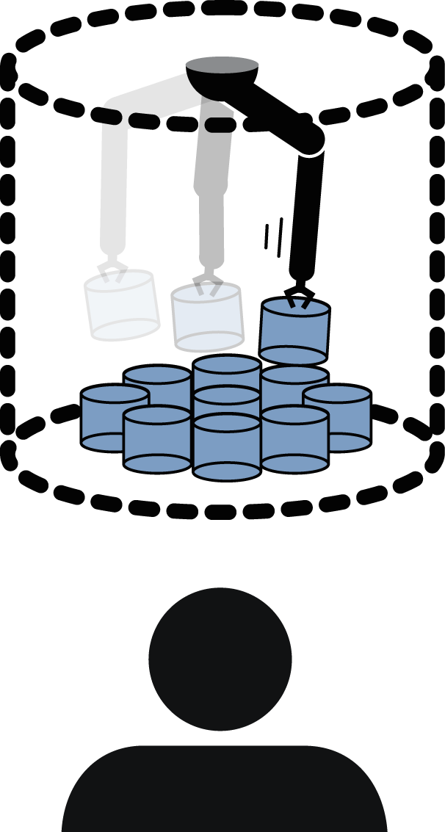
Disk Allocation
How much do you think you need?
  “A lot... and even more next year”
Fulfill in small chunks
  Just-in-time
  “Thin” provisioned
From any disk source

Slide 29
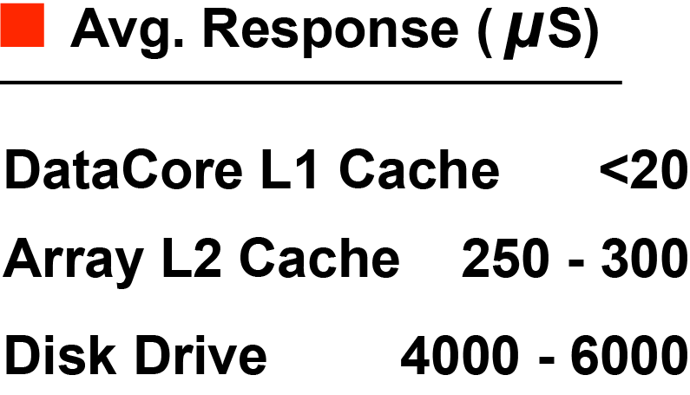

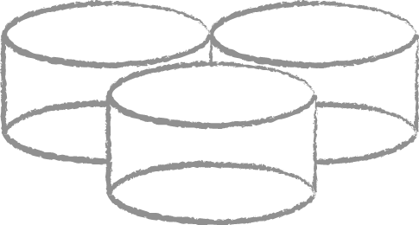



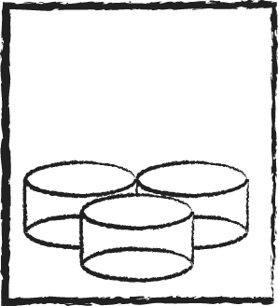
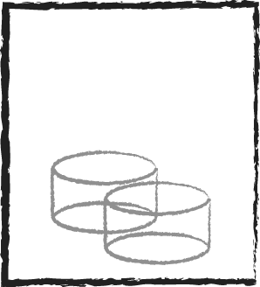
Caching Detailed
Output
from Cache
Poll for
Input
CPU
CPU
High-Speed
Level 1 Caching
Write
Coalesce
Pre-fetch
CPU
CPU
Cached
Array
Cached
Array
Un-cached
Array
Disk
Subsystems

Slide 30
DataCore Cache – An Application View
Hardware Testbed: 1 Database Server connected via
a.) Fibre Channel to a NetApp FAS 2020 equipped with 12x300GB Fibre Channel Drives
b.) Fibre Channel to a DataCore Server accessing an Fujitsu Eternus DX 80 with 12x 300GB SAS Drives
Software Testbed: Informix CRM DB with 8.8 Million Records
Tested Operations:
1.) Select of a customer profile using sequential scan, reading 8.8 Millionen records, no index.
2.) Store result set of 750,000 records in a temporary table on disk.
The test was repeated 3 times for each storage configuration.
The DB was stopped and started before each test.

Slide 31
Results for DB Server attached to
NetApp FAS 2020
Total runtime of the Task = 13min

Slide 32
Results for DB Server attached to
DataCore Solution
Total runtime of the Task = 2min 12sec!
Performance Gain
591%

Slide 33
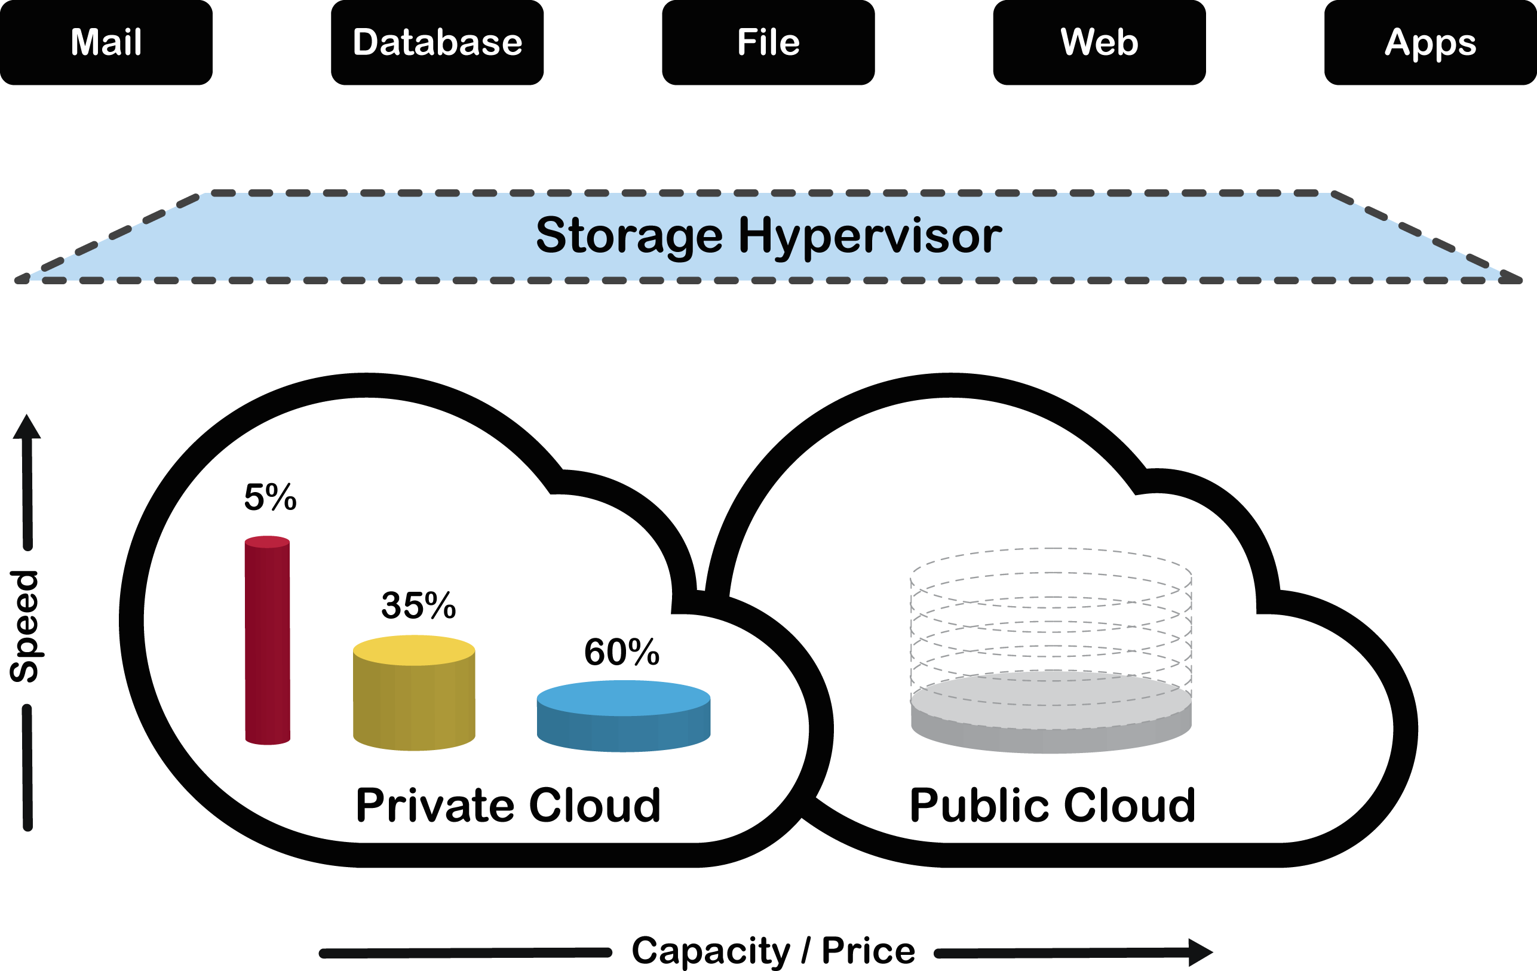
Traditional Tiering

Slide 34
DYNAMIC ASSET OPTIMIZATION

Slide 35




Auto Tiering- Disk Pool
Tier 1
Tier 2
Tier 3
Chunks
Above average moves up a tier
Below average moves down a tier

Slide 36
Auto Tiering- Disk Pool
Tier 1
Tier 2
Tier 3
Chunks
Above average moves up a tier
Below average moves down a tier

Slide 37
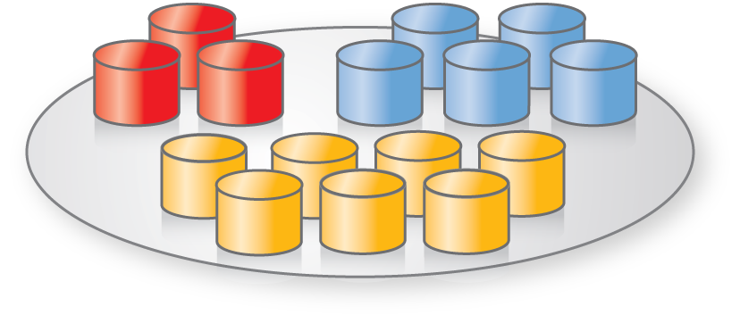

Auto Tiering- Virtual Disk
Frequently
Accessed
DISK POOL
VIRTUAL DISK
Tier 1
Moderately
Accessed
Infrequently
Accessed
Tier 2

Slide 38
Auto Tiering- Virtual Disk
Frequently
Accessed
DISK POOL
VIRTUAL DISK
Tier 1
Moderately
Accessed
Infrequently
Accessed
Tier 2

Slide 39
Demo Automatic Tiering

Slide 41
Management
Independent Management
Standards Based
Automation & Management

Slide 43
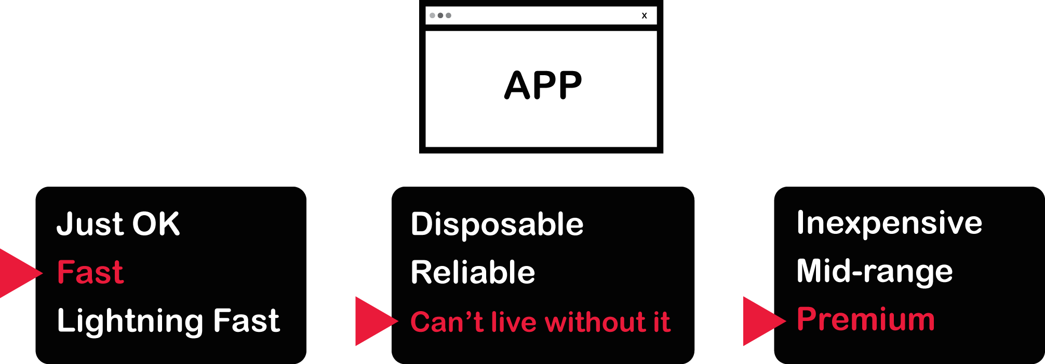

SERVICE LEVELS
Speed
Protection
Cost

Slide 44
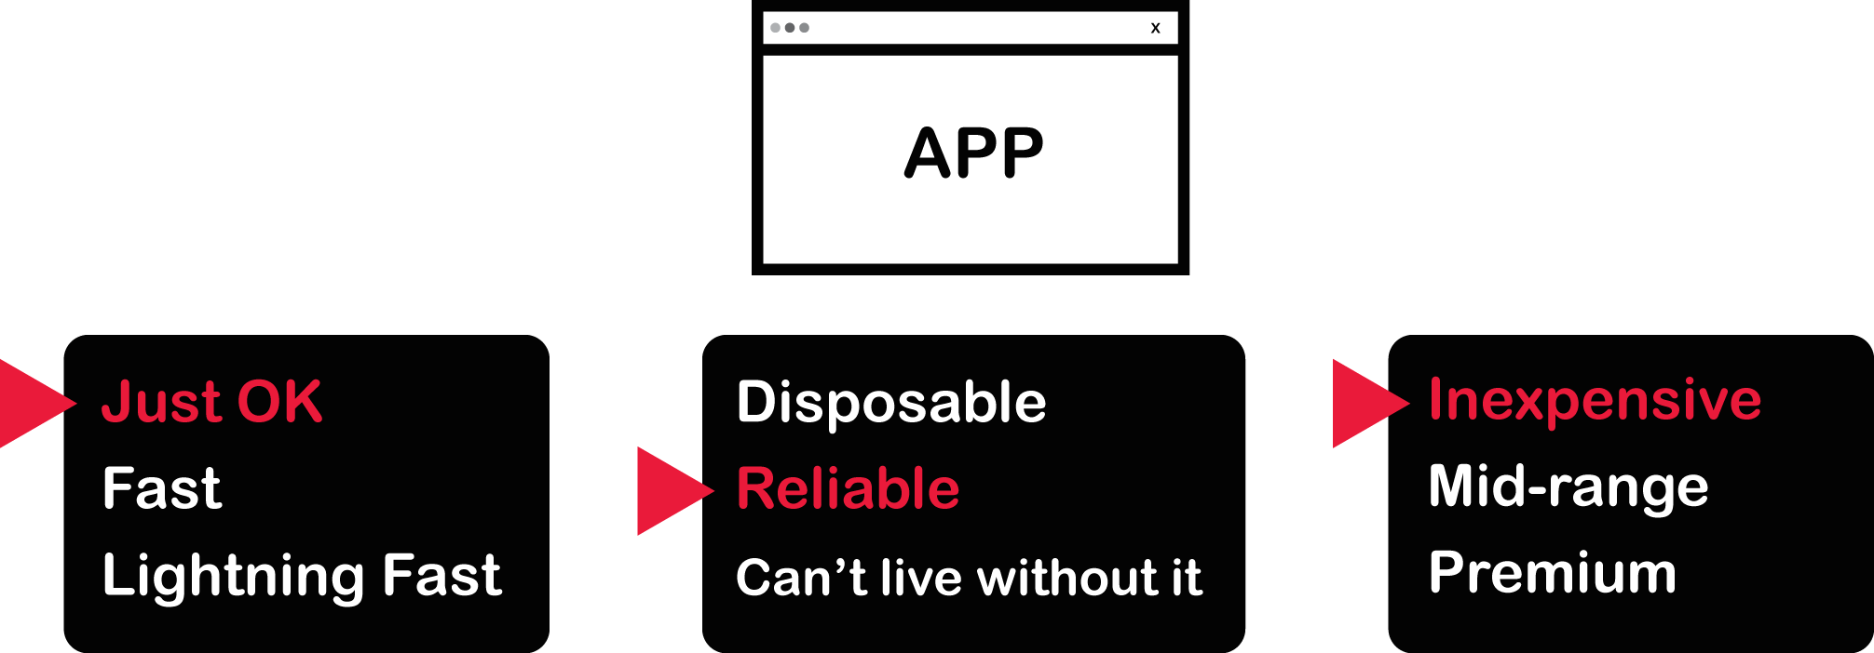
SERVICE LEVELS
Protection
Speed
Cost

Slide 45
Management Industry Tools
Microsoft SCOM
Windows Power Shell
VmWare
Hitachi Analyzer
Etc….

Slide 46
VM Mobility
Expandable
Resilient
VM Mobility

Slide 47


ARCHITECT FOR RESILIENCY

Slide 48
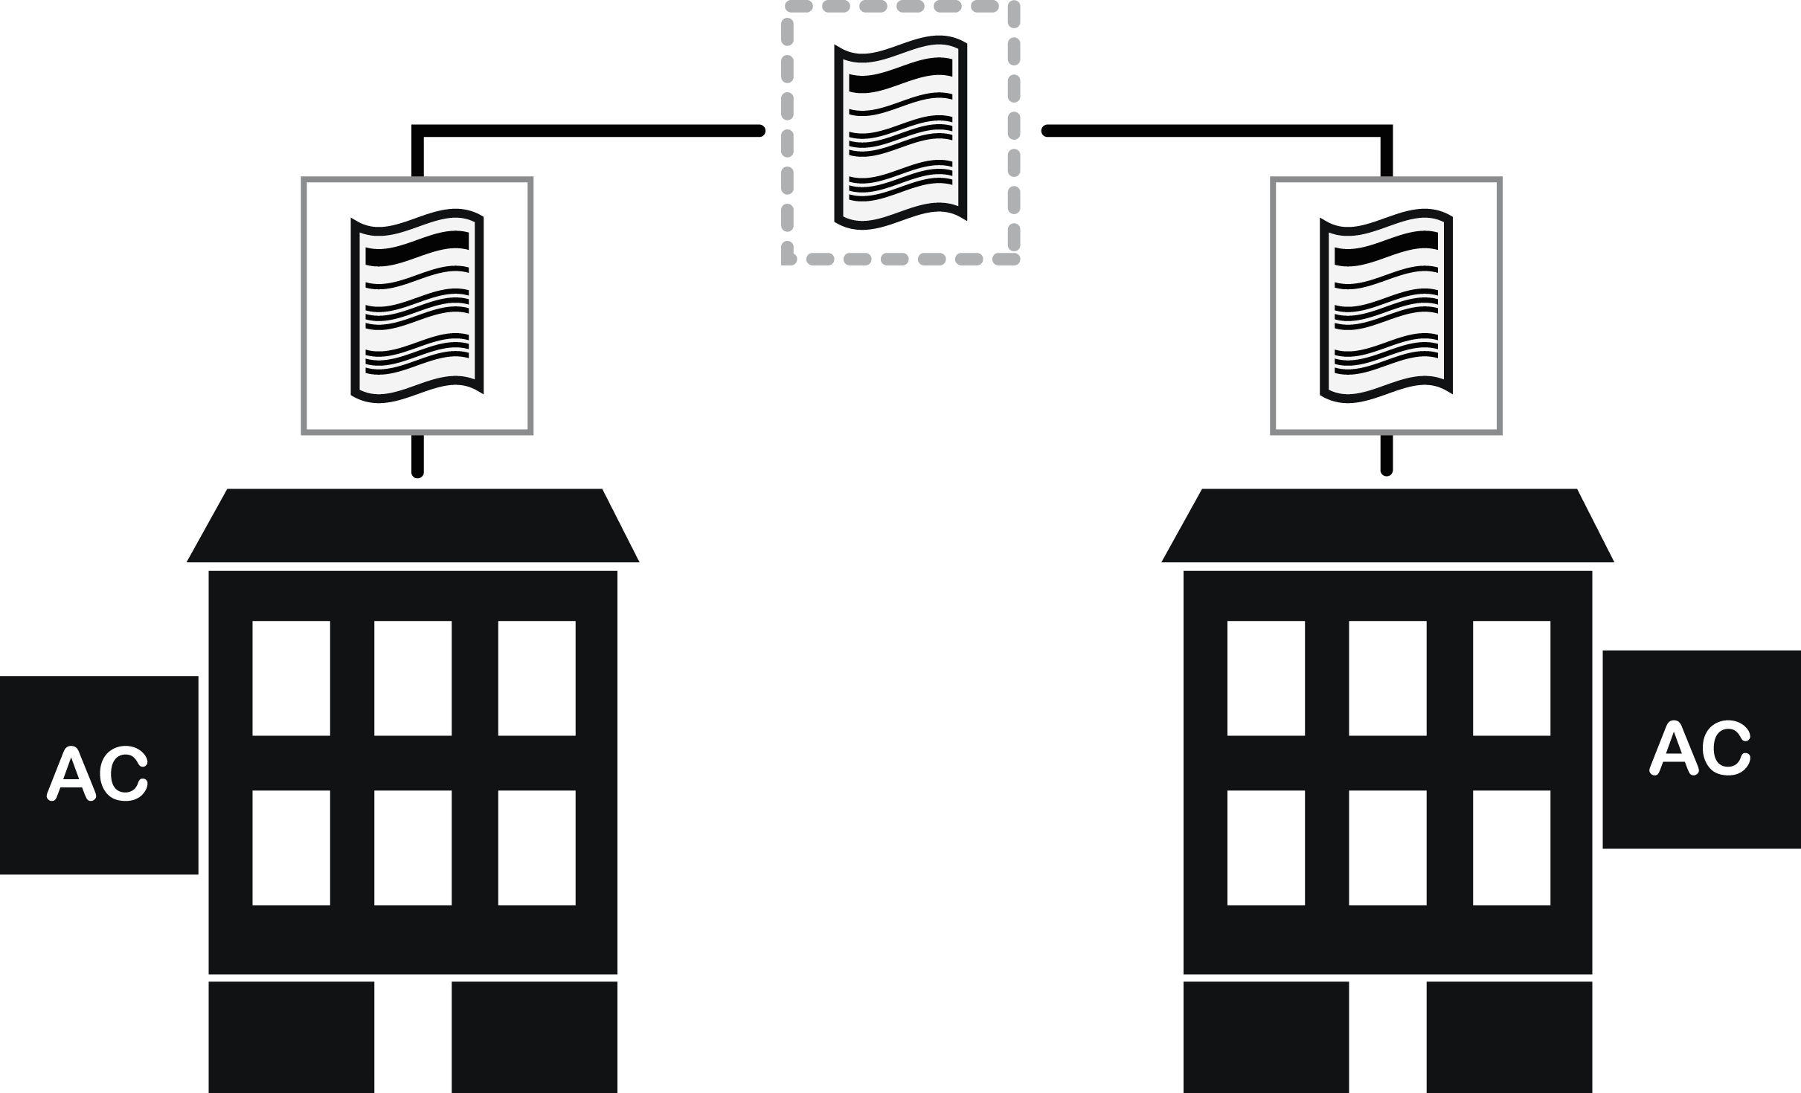



ELIMINATE SINGLE POINTS
OF FAILURE

Slide 49
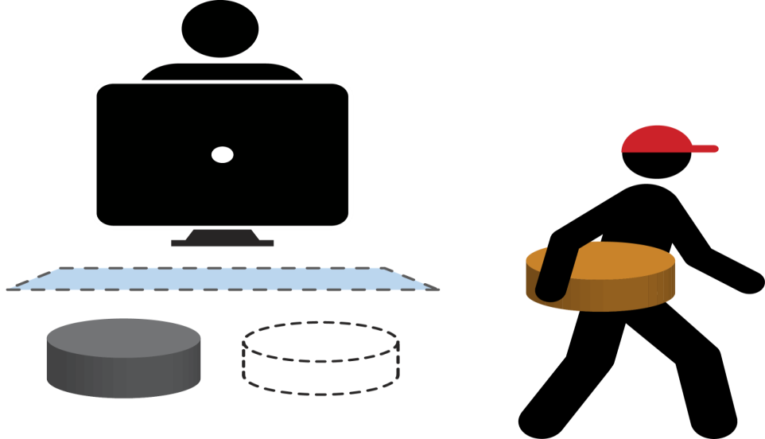
WORRY-FREE CHANGE MANAGEMENT

Slide 50
WORRY-FREE CHANGE MANAGEMENT

Slide 51
Demo High Availibility
Non-Stop Operation

Slide 52






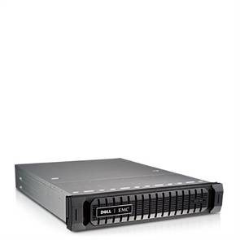


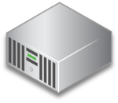
High Availability
Cluster
Shared
Virtual Disks
iSCSI, FCoE,
Fibre Channel SAN
Caching
Caching
Synchronous Mirroring

Slide 53


DISASTER COUNTERMEASURES
Regional Data Centers
DR Site

Slide 54


DISASTER COUNTERMEASURES
Regional Data Centers
DR Site

Slide 55




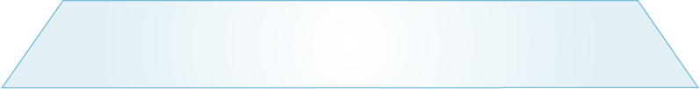




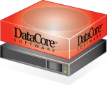
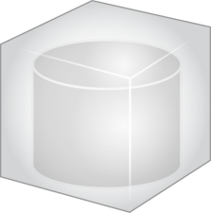
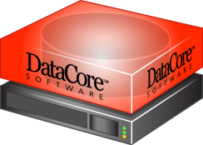
Disaster Site - Async Replication
Building 1
Building 2
Cluster
DR Sites
Asynchronous
Replication
SHARED
VIRTUAL DISKS
Caching
Caching
Active
Active
Centralized
Management
Synchronous Mirroring

Slide 56

THE “UNDO” BUTTON
Malware / user mistakes
Continuous Data
Protection (CDP)

Slide 57

THE “UNDO” BUTTON
Malware / user mistakes
Continuous Data
Protection (CDP)
Rewind to time before problem occurred
Rollback to earlier known-good point in time
  Before user deleted files
  Before virus infection

Slide 59
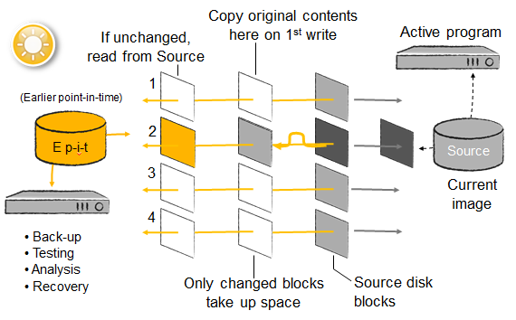
Snapshots

Slide 60
VDI Demonstration

Slide 61

EXPAND AS NEEDED

Slide 62

EXPAND AS NEEDED

Slide 63

EXPAND AS NEEDED

Slide 64
EXPAND AS NEEDED

Slide 66
Conclusion
Storage Virtualization is the next wave of virtualization
This transformation will be innovative, and possibly even disruptive.
Your future architecting decisions should think of storage as Flexible, Elastic even, and in alignment with your other business and infrastructure goals.

Slide 67
Contact Info
Alexander Best
Email @ Alex.Best@DataCore.com

Slide 68


Related Content
Breakout Sessions
Hands-on Labs
Product Demo Stations – Available at Booth P2
Related Certification Exam
Find Me Later At… DataCore Software Booth P2

Slide 69


SIA, WSV, and VIR Track Resources
#TEVIR250
Talk to our Experts at the TLC
Hands-On Labs
DOWNLOAD Windows Server 2012 Release Candidate
microsoft.com/windowsserver
DOWNLOAD Microsoft System Center 2012 Evaluation
microsoft.com/systemcenter

Slide 70



Resources
Learning
  Connect. Share. Discuss.
  Microsoft Certification & Training Resources
http://europe.msteched.com
www.microsoft.com/learning
TechNet
  Resources for IT Professionals
  Resources for Developers
http://microsoft.com/technet
http://microsoft.com/msdn

Slide 71
Submit your evals online
Evaluations
http://europe.msteched.com/sessions

Slide 72
© 2012 Microsoft Corporation. All rights reserved. Microsoft, Windows, Windows Vista and other product names are or may be registered trademarks and/or trademarks in the U.S. and/or other countries.
The information herein is for informational purposes only and represents the current view of Microsoft Corporation as of the date of this presentation. Because Microsoft must respond to changing market conditions, it should not be interpreted to be a commitment on the
part of Microsoft, and Microsoft cannot guarantee the accuracy of any information provided after the date of this presentation. MICROSOFT MAKES NO WARRANTIES, EXPRESS, IMPLIED OR STATUTORY, AS TO THE INFORMATION IN THIS PRESENTATION.

