Slide 1
Messaging and Collaboration Scenarios with Windows Small Business Server 2011 Essentials
WSV204
David Fabritius
Product Marketing Manager
Microsoft Corporation

Slide 2
What is SBS?
Unique capabilities…
PC Backup and Health Monitoring,
Server and Client Management,
Remote Web Access,
Office 365 Integration, Phone App, etc.
Turn WS features into a solution…
Dashboard makes it easy for non-technical customers to manage their server
(e.g. Add user, monitor machine status, …)
Windows Server
Active Directory, File & Print, Networking, Web, …
Same LOB Applications/Inherits Rich Functionality

Slide 3


Windows SBS 2011 Essentials
  Ideal First Server
  Easy-to-use solution
  Office 365 integration
  Helps protect data
  Helps organize information
  Access from virtually anywhere
Simplify your life
Your business with you, virtually anywhere
Get Ready for the future
  Automatic local backup, simple restore of server and client computers
  Easily connect to online services
  Work virtually anywhere, anytime
  Increase business productivity
  Simple, secure, dependable network
  Easy-to-use storage and sharing
Everything Your Business Needs in a Server, Nothing It Doesn’t.

Slide 4
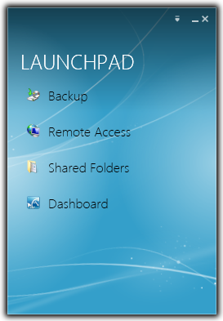
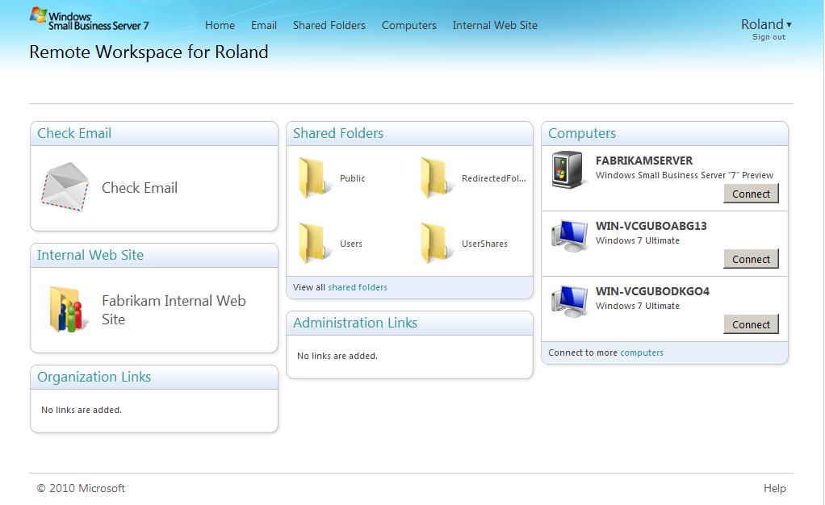
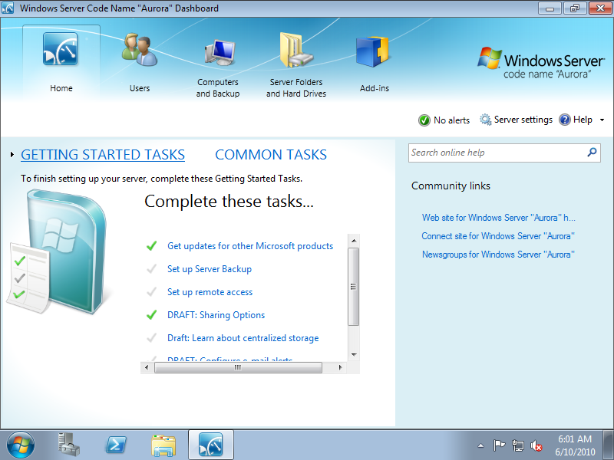
User Experience
Essentials Launchpad
Single “go to” place for users on the network
Remote Web Access
Essentials Dashboard
Quickly launch common tasks
Receive alerts and warnings
Simplified central management for common tasks
Consistent experiences for discovery, navigation, tasks and getting help
Access network resources from home or while on-the-road
All users interfaces are extensible by 3rd parties and support OEM customization

Slide 5
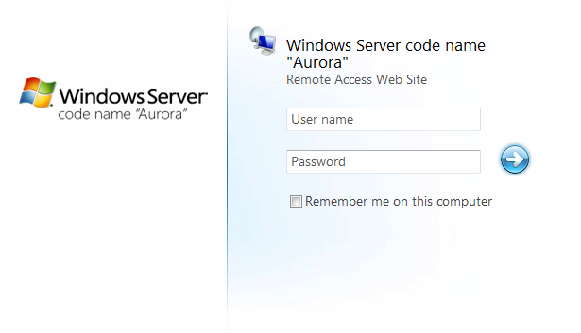
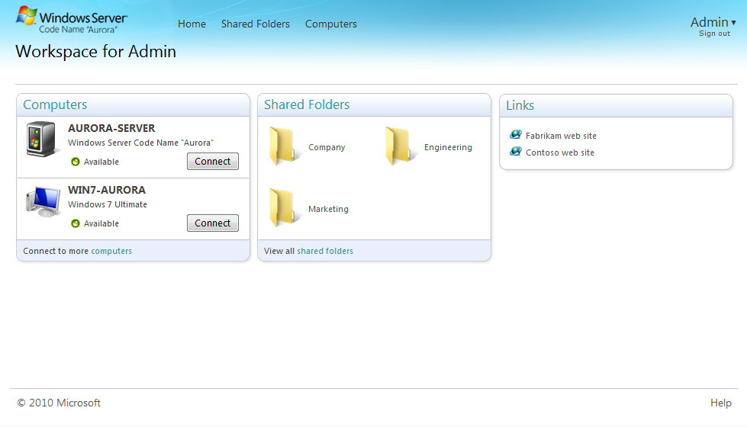
Remote Web Access
Provides secure remote connections to:
  Computers
  Shared Folders
  Links
Extensible with Add-ins
Customizable

Slide 6
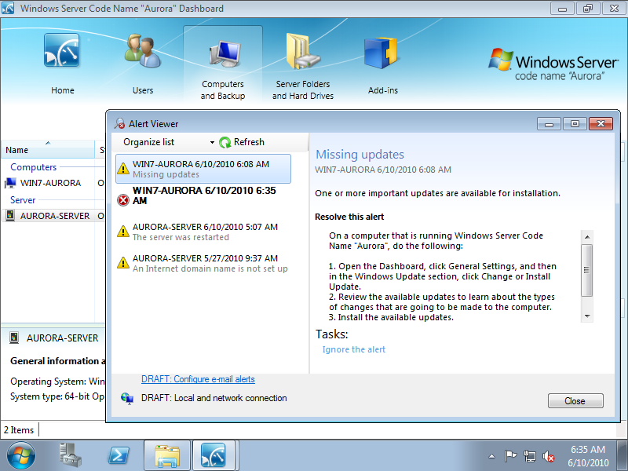
Health Monitoring and Alerts
Helps customers monitor the security status of their network
Extensible:
  Target events to customer and/or VAP
  3 severity levels for the events (informational, warning, critical)
  Provide custom actions for addressing, if appropriate

Slide 7
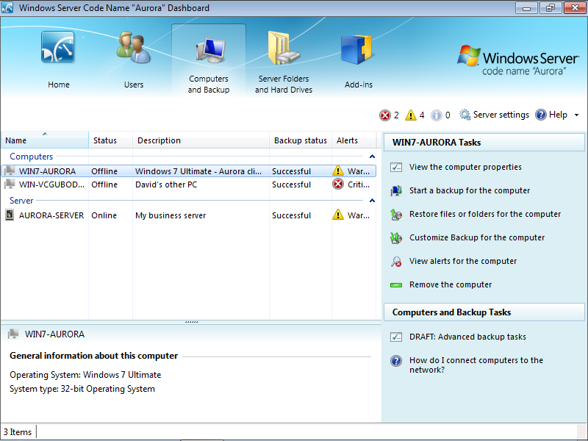
Server Backup
Based on Windows Server backup
Essentials key scenarios:
  Single File Restore
  Folder Restore
  Server Bare Metal Recovery
  Client Backup/Restore
  Factory Reset (for headless)

Slide 8





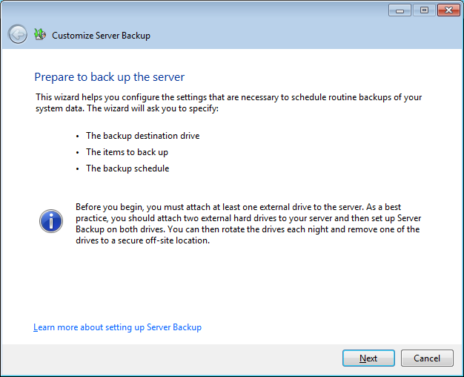
Client Backup
Automatically backup all computers on a nightly basis
File and folder restore wizard
VSS writer for backup and restore of client backup database
Recover full system and data (bare metal restore) of backed up client computers to similar hardware

Slide 9
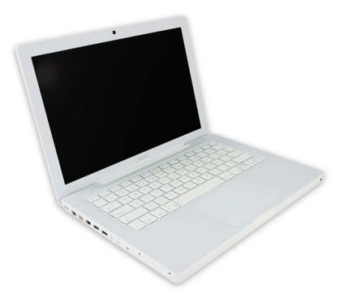
Mac Support
Mac/Apple clients are now supported out-of-the-box
Support for Leopard and above
  Macs Support Initial Configuration, Client Connector, Dashboard, Launchpad (including health alerts), and Remote Web Access
  Dashboard integration - Mac appears in
  Computers list
  Mac access to shared folders
  Mac can use server as Time Machine backup
  destination
  Mac client side support for add-ins
Mac and iPhone support for Remote Web Access

Slide 10
Add-ins
Add-in
Add-in Manager
Functionality that extends the product to add end user features, administrative features, or both.
A centralized location to manage add-ins installed from a share, USB key, 3rd party share, the cloud . . .
Includes add-in deployment infrastructure
OEM Pre-installation during factory imaging
Online and on-premise

Slide 11





Better Together with Windows 7
Windows® 7 Professional and
Windows® Small Business Server 2011 Essentials
Windows Small Business Server 2011 Essentials and Windows 7 Professional together provide small businesses like yours with improved networking capabilities needed in order to help bring your business to the next level. Together, they help you get more done, safeguard your work, gain control of your PCs, while remaining easy to set up and manage especially with limited IT skills and resources.
Gain Control of
Your PCs
Safeguard Your Work
Get More Done
1. Help protect and secure data
2. Help stay safe online
1. Easily find and share data
2. Stay productive virtually anywhere
1. Easily manage users and PCs
2. Control access to files and devices

Slide 12
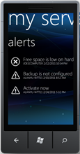
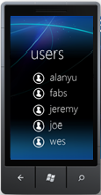
Better Together with Windows Phone 7
With SBS 2011 Essentials and the Windows Server Solutions Phone Connector, you can:
  View alerts and perform actions, including repair action if available
  Pin status to home page
  View storage usage summary
  View status of connected computers and initiate PC backups
  Enable and disable user accounts
  Reset user account passwords
Design theme will be specific to platform

Slide 13






Small Business Customer Needs
Small business owners needs to fit 16 hours of work into an 8-hour day. They want solutions that are powerful, secure, easy-to-use, and will make a real difference in the productivity and effectiveness of their employees.
Customer desires:
Solve customer challenges with the combination of Windows® SBS 2011 Essentials and Microsoft® Office 365 to deliver the power of an on-premise solution server with the convenience of cloud based productivity applications.
Improving personal and organizational productivity
Better safeguarding of information
Getting the most out of IT investments
IT that just works

Slide 14




Meet Customer Needs
SBS 2011 Essentials with Office 365 is a simplified and affordable solution that helps small business customers:
Safeguard
Your Work
Maintain a dependable data environment that helps safeguard important data with built-in security and reliability features.
Get More
Done
Make information and applications easy to access, work on, and share and collaborate with other people.
Enjoy Great
Flexibility
Reduce IT complexity with a seamless combination of on-premise server functionality and cloud-based productivity solutions.

Slide 15
A Complete Solution
Product Features | Functions | SBS Essentials | Office 365 | Better Together
Data Protection and Security | Centrally store and protect critical business data on the server; backup entire client computers to the server.
File and Print Sharing | Share data and resources across the company network.
Control Access to Sensitive Information | Easily leverage the power of Active Directory to create user accounts and control access to resources on the network.
Proactively Detect and Address Issues | Health monitoring and alerts give proscriptive guidance to address server and client computer issues proactively.
Remote Access | Remotely access files and take control of computers in the local office via highly secure, encrypted connections.
LOB Application Support | Provides a platform to host and access both custom and proprietary line-of-business applications.
Advanced Data Base + BI (W/PAO) | Transform data and information into business insight and the basis for making important decisions.
Website Hosting | Host your website to make it accessible on the Internet.
Email with Exchange 2010 | Take advantage of professional-grade electronic mail, calendaring, contacts, tasks and more.
Website + File Share with SharePoint | Easily share data and resources through an easily accessible online platform.
Chat and Online Meetings with Lync | Unite voice communications, IM, audio, video and Web conferencing through a single interface that
Antivirus and Anti-Spam | Protect against damaging computer viruses and spam 24/7.
Editing of Documents with Office Web Apps | Utilize familiar collaboration and productivity tools through the cloud to edit documents.

Slide 16
Office 365 Integration Module technical overview
title

Slide 17
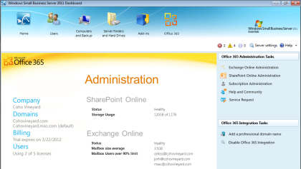
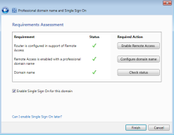
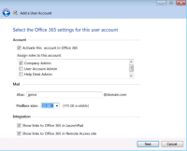
Office 365 Integration Module
  Provides additional value to your combined experience
  At-a-glance view provides subscription, service & usage info
  Extends the Dashboard to provide a unified experience for
  user account creation and management
  Quick access to common Office 365 administration tasks
  Password Synchronization to enable one logon name/password for both the Essentials network and Office 365 service
  Hassle free DNS maintenance

Slide 18
OIM Feature Summary
Simple configuration
Unified identity management
Use the same Windows password to access Office 365
Integrated domain name configuration
At-a-glance view of your Office 365 subscription

Slide 19
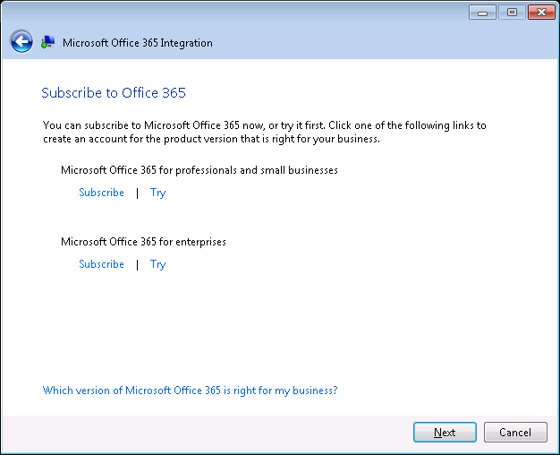
Simple Configuration
Start configuration from the Getting Started task list
Only requirement is your Office 365 ID and password
Configuration wizard supports getting a new Office 365 subscription

Slide 20
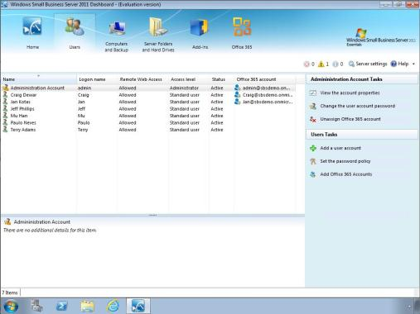
Unified identity management
You can assign either a new or an existing Office 365 account to an SBS user account
You can manage a user’s Office 365 account from the SBS Dashboard throughout the lifecycle

Slide 21


Password Sync
2. New password gets synchronized to Office 365
Office 365
SBS 2011 Essentials
The same credentials are used to access the local network and Office 365
1. User changes Windows password

Slide 22
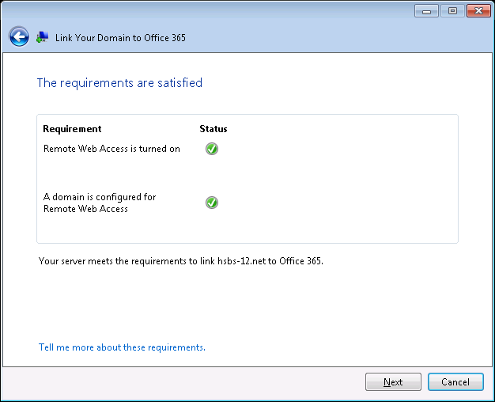
Integrated Domain Name Configuration
Easily configure the same company domain for Office 365 and Remote Web Access
  For example:
  contoso.com as your Office 365 email domain and remote.contoso.com for RWA

Slide 23
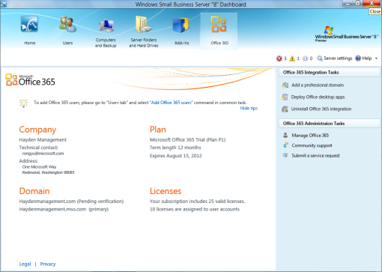
At-a-glance view of Office 365
The Dashboard provides a single administrative interface
Get an at-a-glance view of your Office 365 subscription information
Also manage your users, client computers, shared folders, hard drives, etc.

Slide 24
Office 365 Integration Module
demo

Slide 25

“With Windows Small Business Server 2011 Essentials, we can choose how we store and access our data—on-premises or in the cloud. Now, we’re free to organize the business the way that works best for us.”
Ian Roche, Managing Director, Aurora-Petroleum, 7 employees.

Slide 26


Questions
?
?

Slide 27


SIA, WSV, and VIR Track Resources
#TEWSV204
Talk to our Experts at the TLC
Hands-On Labs
DOWNLOAD Windows Server 2012 Release Candidate
microsoft.com/windowsserver
DOWNLOAD Windows Azure
Windowsazure.com/
teched

Slide 28




Resources
Learning
  Connect. Share. Discuss.
  Microsoft Certification & Training Resources
http://europe.msteched.com
www.microsoft.com/learning
TechNet
  Resources for IT Professionals
  Resources for Developers
http://microsoft.com/technet
http://microsoft.com/msdn

Slide 29
Submit your evals online
Evaluations
http://europe.msteched.com/sessions

Slide 30
© 2012 Microsoft Corporation. All rights reserved. Microsoft, Windows, Windows Vista and other product names are or may be registered trademarks and/or trademarks in the U.S. and/or other countries.
The information herein is for informational purposes only and represents the current view of Microsoft Corporation as of the date of this presentation. Because Microsoft must respond to changing market conditions, it should not be interpreted to be a commitment on the
part of Microsoft, and Microsoft cannot guarantee the accuracy of any information provided after the date of this presentation. MICROSOFT MAKES NO WARRANTIES, EXPRESS, IMPLIED OR STATUTORY, AS TO THE INFORMATION IN THIS PRESENTATION.

