Slide 1
Sustainability in Infrastructure Design
AAP303
Jeff Stokes
Senior Premier Field Engineer
Microsoft Corporation

Slide 2
Introduction
IT Industry for 17 years
Microsoft for 4.5 years
Field Engineer for 3 years

Slide 3

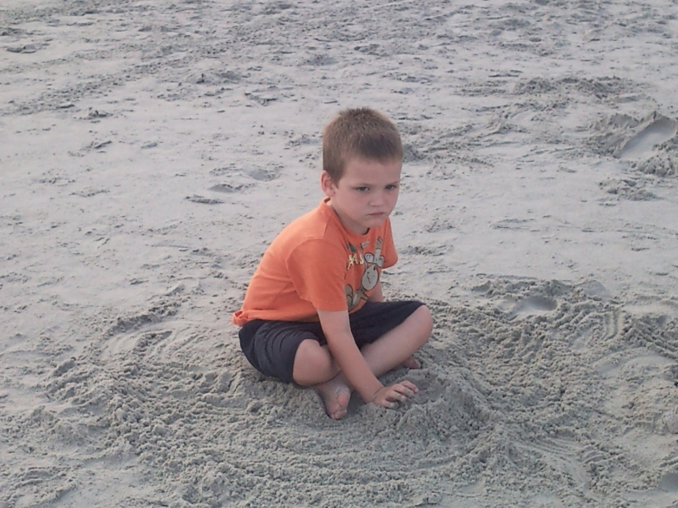

Slide 4
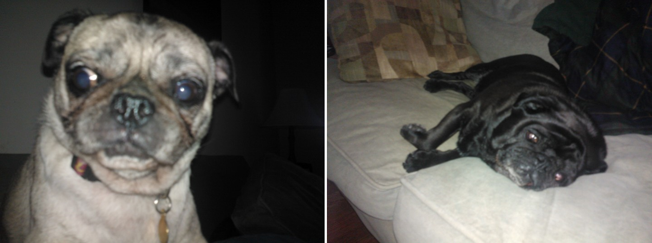

Slide 5
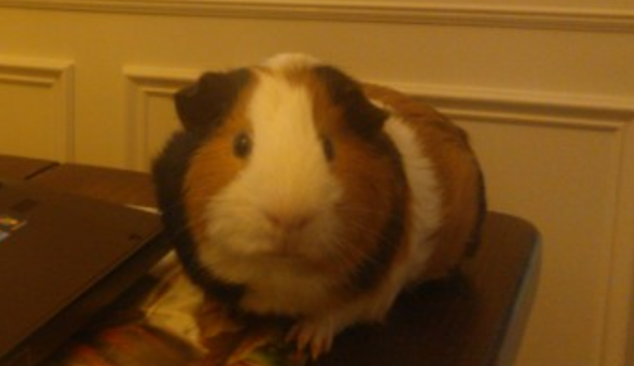

Slide 6
Definitions
PFE – Premier Field Engineer
Sustainability – the ability to be sustained and supported
Supportability – capable of being supported

Slide 7
Three objectives
Proactive Considerations
Reactive Considerations
Synergies and Such

Slide 8
Proactive Considerations
Performance
Support
Design

Slide 9
Performance
Performance isn’t hard, it’s different
  PAL (pal.codeplex.com)
  WPR/WPA (Windows 8 ADK)
  Netsh/Netmon

Slide 10
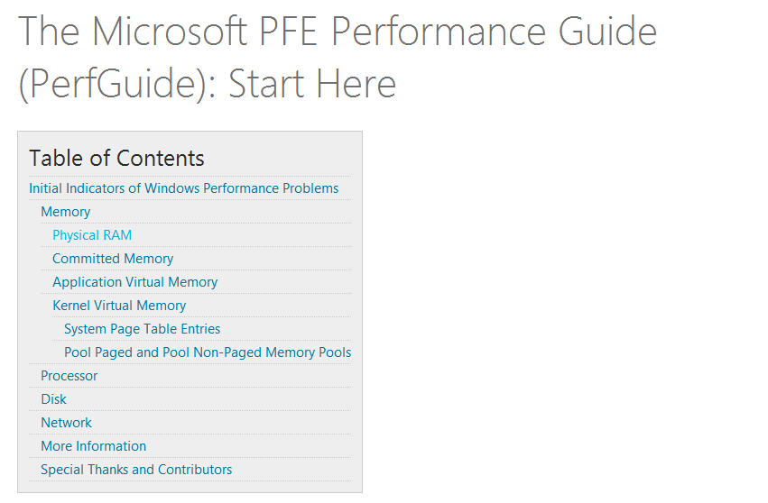

Slide 11
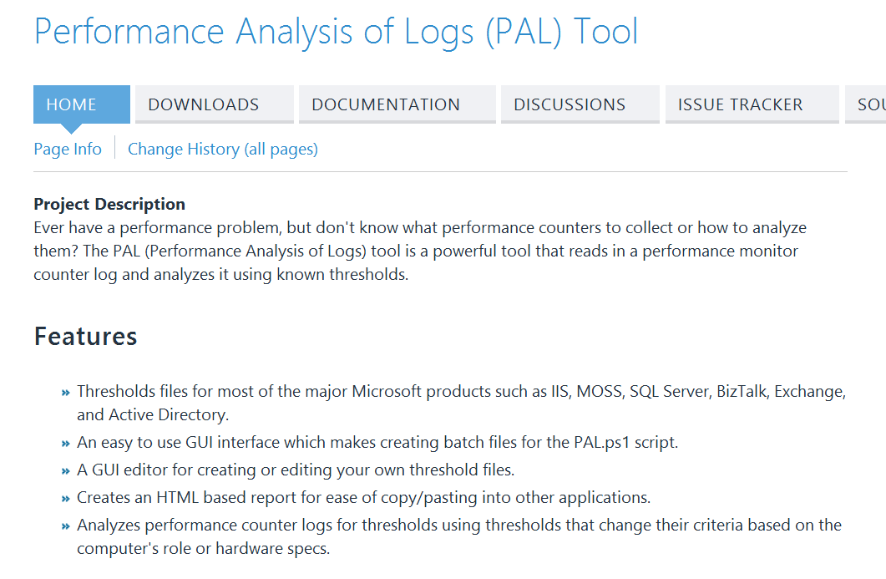

Slide 12
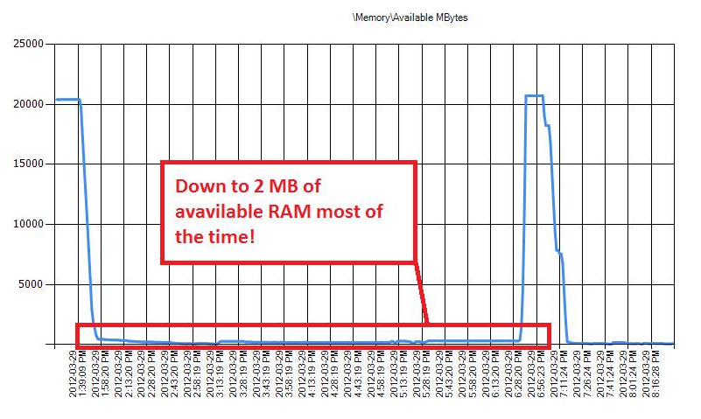

Slide 13
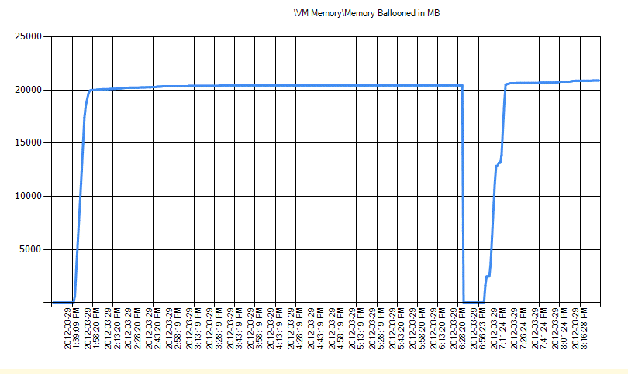

Slide 14
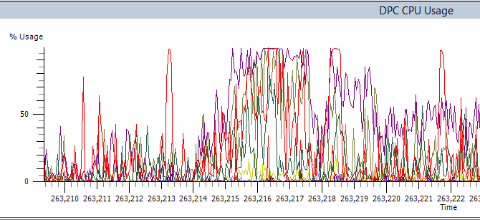

Slide 15
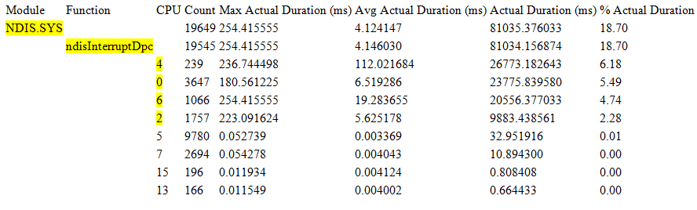

Slide 16
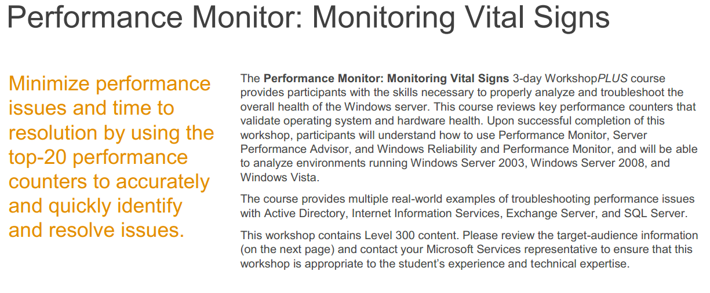

Slide 17
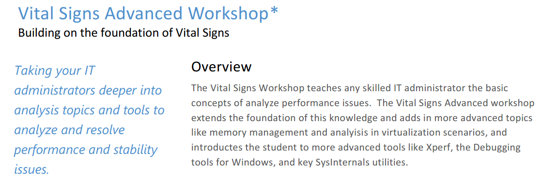

Slide 18
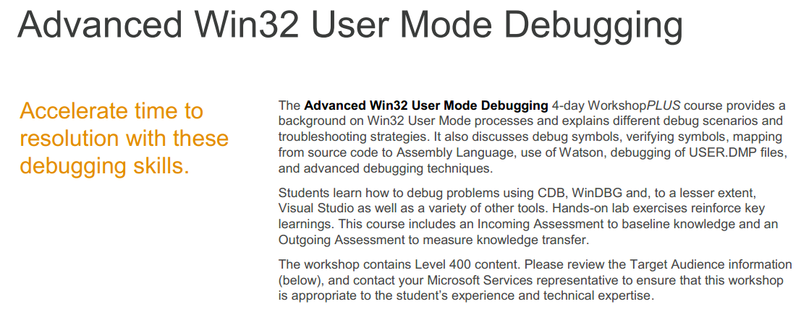

Slide 19
Support
Monitoring
Servicing
Business vs IT vs Best Practices

Slide 20
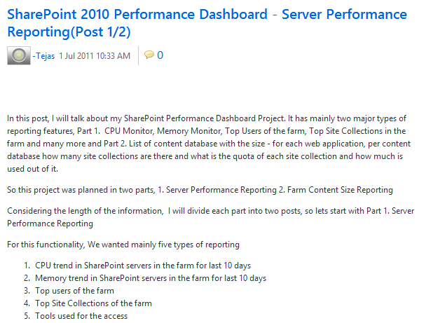

Slide 21
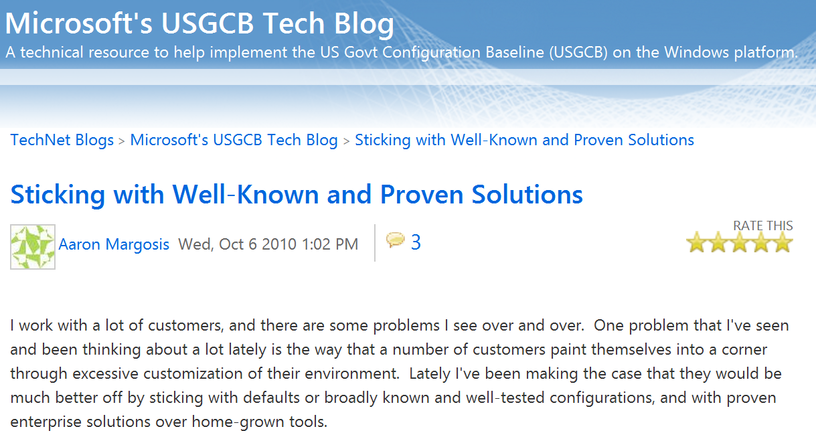

Slide 22
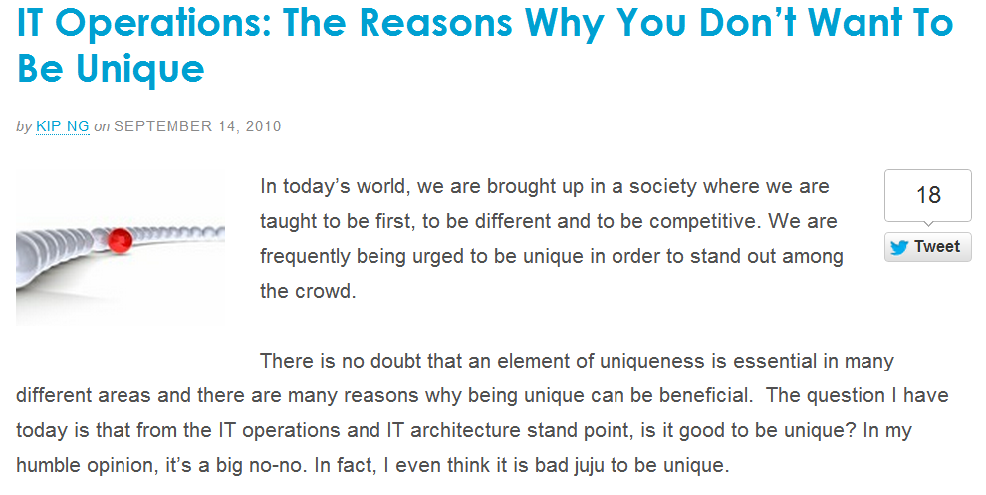

Slide 23
Design
Capacity Limits
Architectural Limits
Cloud will set you free

Slide 24
A tale of an end user…
Big Brother?
Third-Party Firewall
SMB
Anti-Virus

Slide 25
A tale of an end user…
?

Slide 26
A tale of an end user…

Slide 27
A tale of an end user…
Software iSCSI Initiator
Shared 10G-E on the Host
32 Bit Windows 2003 Server

Slide 28



Replication Stagnation!

Slide 29

Load Balancing Act

Slide 30


Disasters Around Every Corner!

Slide 31
Three objectives
Proactive Considerations
Reactive Considerations
Synergies and Such

Slide 32
Reactive Considerations
Disaster²
Root Cause
Agility

Slide 33
Disaster²
The case for too much success
Planning for the unplannable
Does your plan work?

Slide 34
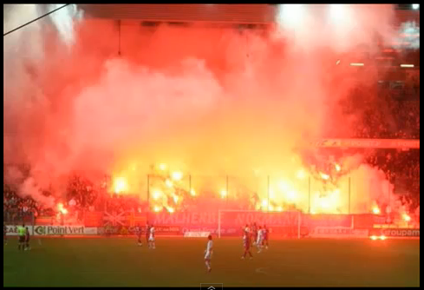

Slide 35
Root Cause
What if the root cause isn’t pretty?
What was the cost of finding root cause?
Do you act on the root cause?

Slide 36



Health Management
Proactive
Reactive
V.S.

Slide 37
Agility
Change Control and Audit
Single Points of Failure
Build Certification

Slide 38
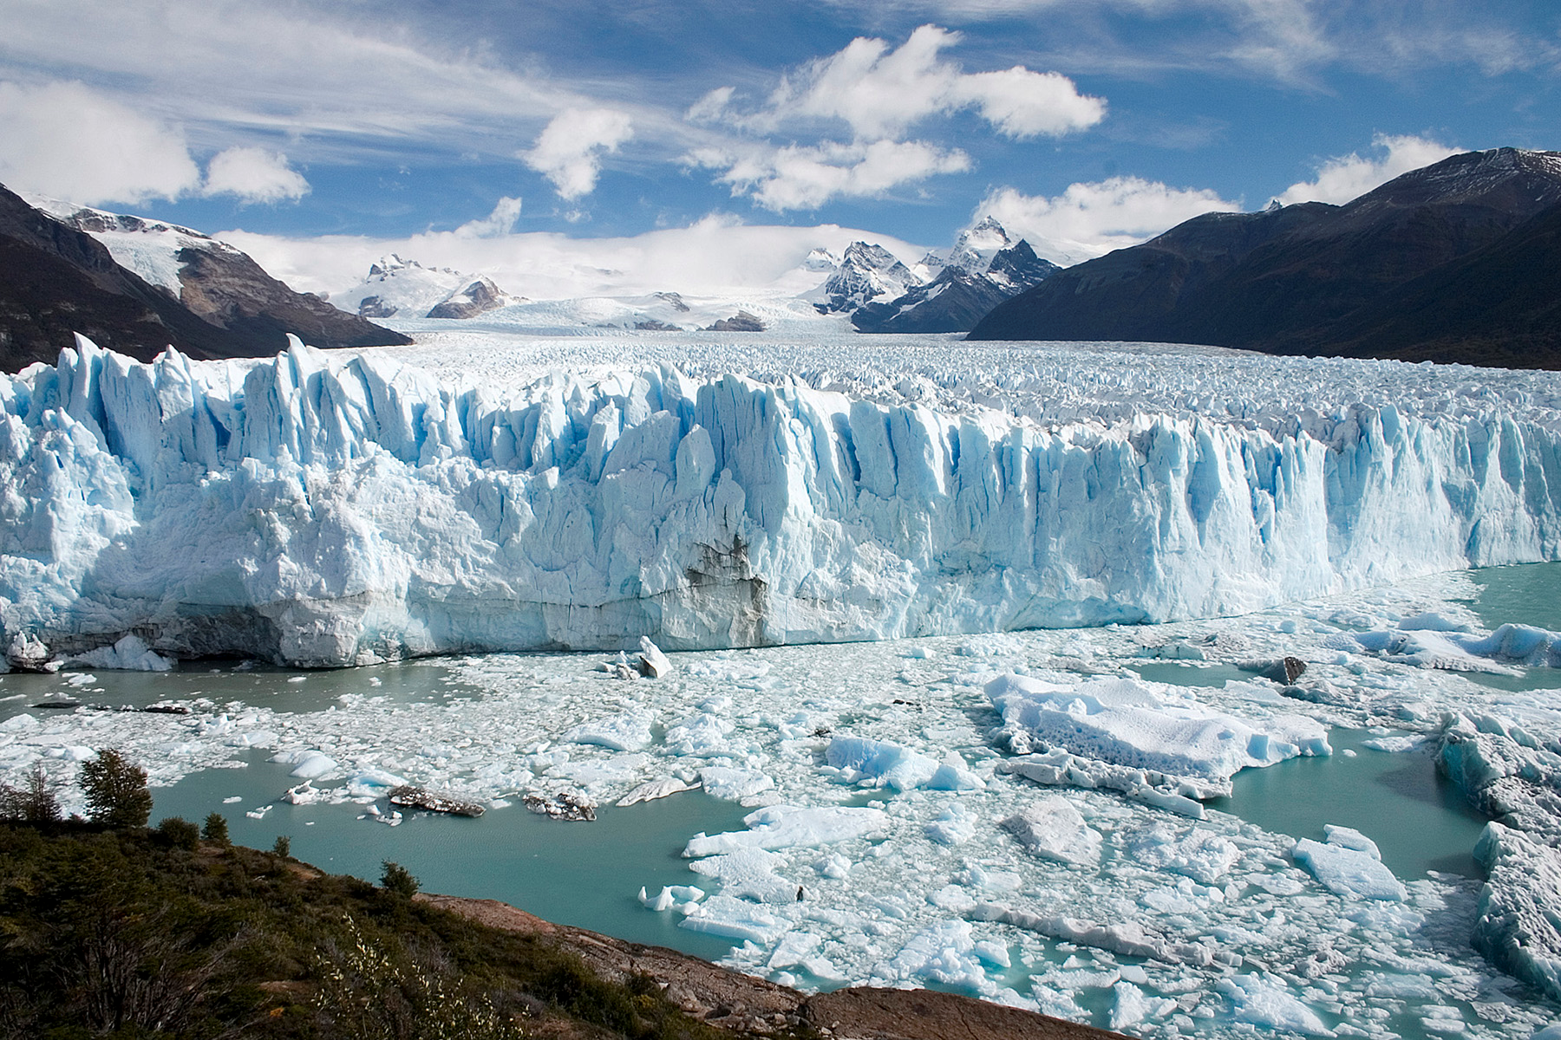

Slide 39
Three objectives
Proactive Considerations
Reactive Considerations
Synergies and Such

Slide 40
Synergies and Such
Overlap in the enterprise
The cost of siloing
The cost of offshoring/outsourcing

Slide 41



Slide 42


Slide 43
‘And during the few moments that we have left, we want to have just an off-the-cuff chat between you and me — us. We want to talk right down to earth in a language that everybody here can easily understand.’ – Malcom X

Slide 44
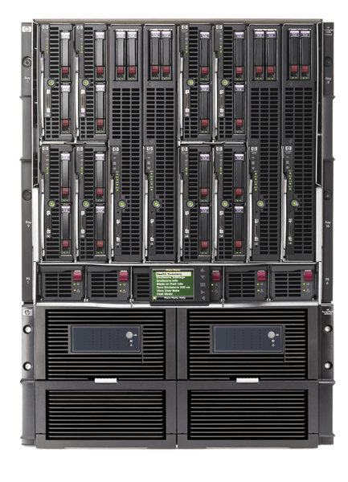
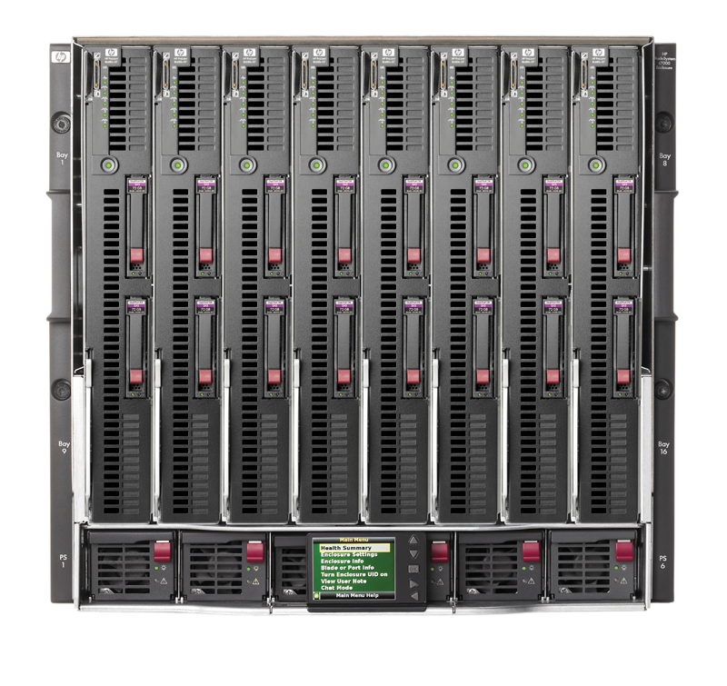
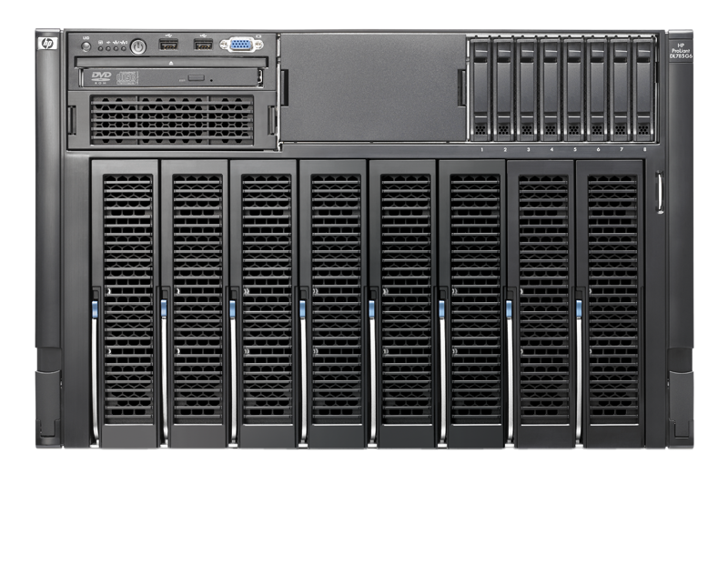
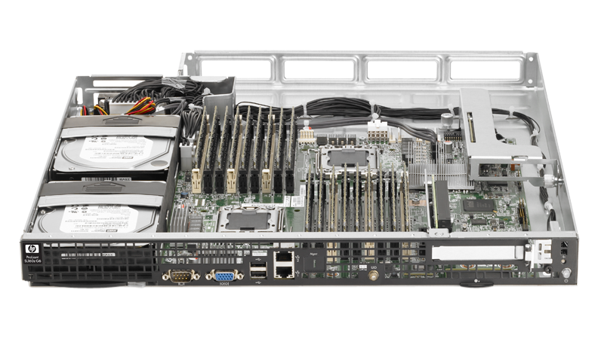
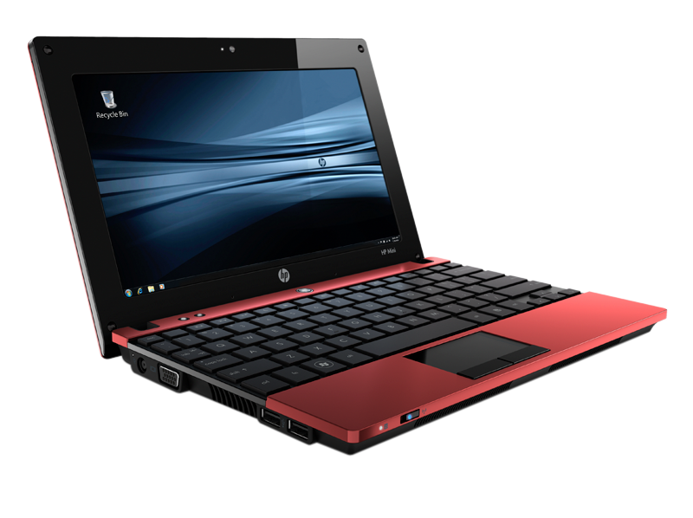
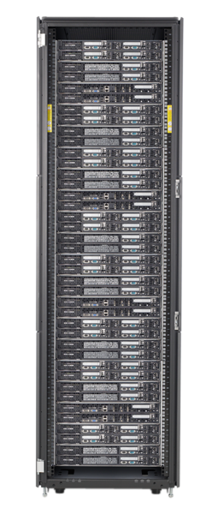
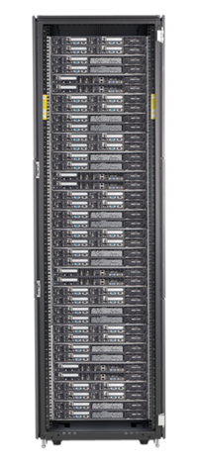

Slide 45
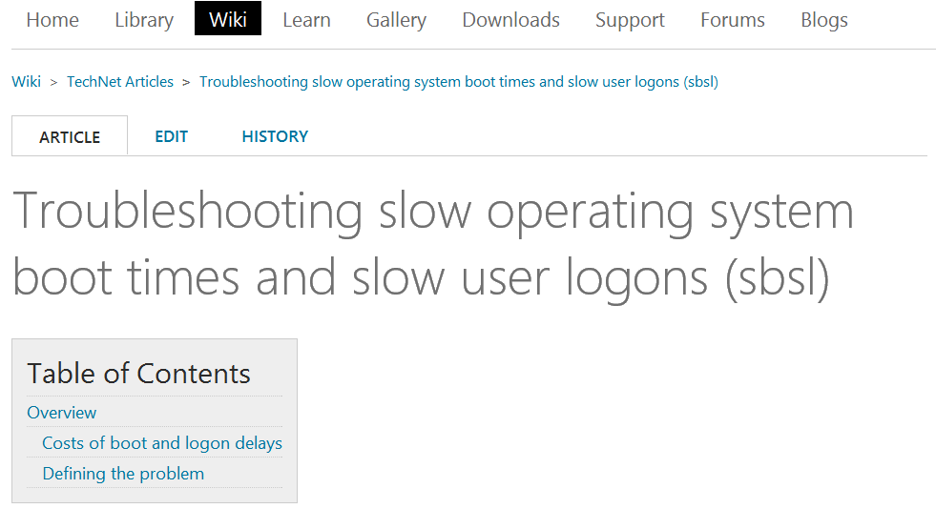

Slide 46
Org Size | Delayed Boot cost | Delayed logon cost | Total Cost
1 | $208 | $250 | $458
5 | $1,041 | $1,250 | $2,291
10 | $2,083 | $2,500 | $4,583
20 | $4,166 | $5,000 | $9,166
50 | $10,416 | $12,500 | $22,916
100 | $20,833 | $25,000 | $45,833
1,000 | $208,333 | $250,000 | $458,333
10,000 | $2,083,333 | $2,500,000 | $4,583,333
100,000 | $20,833,333 | $25,000,000 | $45,833,333

Slide 47
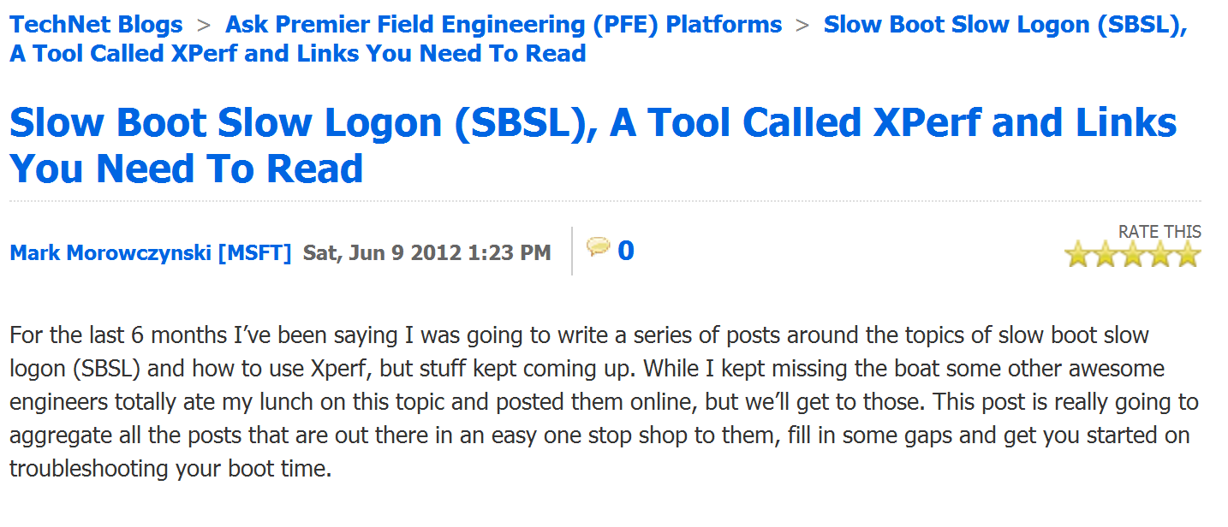

Slide 48
The problem with jokes about UPD is….
You never know if the audience gets them.

Slide 49


Related Content
MGT319 Infrastructure Management: Configure and Deploy
VIR314 Windows Server 2012 VDI/RDS Infrastructure and Management
PRC04 User-Centric Application Delivery Rocks the World: Using Microsoft System Center 2012 Configuration Manager
MGT318 Patch and Settings Management in Microsoft System Center 2012 Configuration Manager
MGT302 Application Monitoring with Microsoft System Center Operations Manager 2012
MGT328 Automating Datacenter Using Microsoft System Center 2012
WCL329 Windows Intune: Cloud Based PC Management (Technical Overview)
FDN04 Modernizing Your Datacenter
WCL328 Windows Intune for the Enterprise
WSV328 The Path to Continuous Availability with Windows Server 2012

Slide 50



Resources
Learning
  Connect. Share. Discuss.
  Microsoft Certification & Training Resources
http://northamerica.msteched.com
www.microsoft.com/learning
TechNet
  Resources for IT Professionals
  Resources for Developers
http://microsoft.com/technet
http://microsoft.com/msdn

Slide 51







Required Slide
Complete an evaluation on CommNet and enter to win!

Slide 52

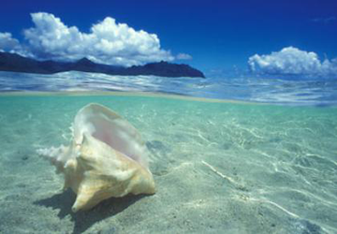



Please Complete an Evaluation
Your feedback is important!
Be eligible
to win great daily prizes and the grand prize of a $5,000 Travel Voucher!
Multiple
ways to Evaluate Sessions
Scan the Tag
to evaluate this
session now
on myTechEd Mobile

Slide 53
© 2012 Microsoft Corporation. All rights reserved. Microsoft, Windows, Windows Vista and other product names are or may be registered trademarks and/or trademarks in the U.S. and/or other countries.
The information herein is for informational purposes only and represents the current view of Microsoft Corporation as of the date of this presentation. Because Microsoft must respond to changing market conditions, it should not be interpreted to be a commitment on the
part of Microsoft, and Microsoft cannot guarantee the accuracy of any information provided after the date of this presentation. MICROSOFT MAKES NO WARRANTIES, EXPRESS, IMPLIED OR STATUTORY, AS TO THE INFORMATION IN THIS PRESENTATION.

