Slide 1
Real World Developer Testing with Visual Studio 2012
AAP401
David Starr
Chief Software Craftsman
Scrum.org
Peter Provost
Program Manager Lead
Microsoft

Slide 2
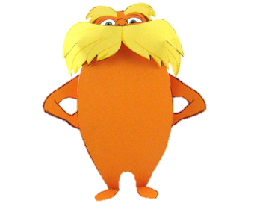
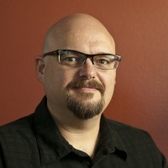

About Us
David Starr
Peter Provost
Chief Software Craftsman, Scrum.org
Visual Studio ALM MVP
ElegantCode.com founder
david@scrum.org
@elegantcoder
The guy who makes cool Agiley stuff in Visual Studio
Peter.Provost@microsoft.com
peterprovost.org
@pprovost

Slide 3

Today’s Discussion
Doubling Down
Testing the Top
Packaging
Inverting Yourself
Parallel and Threads

Slide 4

Developer Testing Haiku
Real world is messy
Response is to isolate
We drive us crazy
Photo by Caitlin Regan

Slide 5





Doubling Down
That’s not what I expected him to do.

Slide 6

Double the Alternatives
Dummies
Fakes
Stubs
Mocks
Spies, etc.

Slide 7
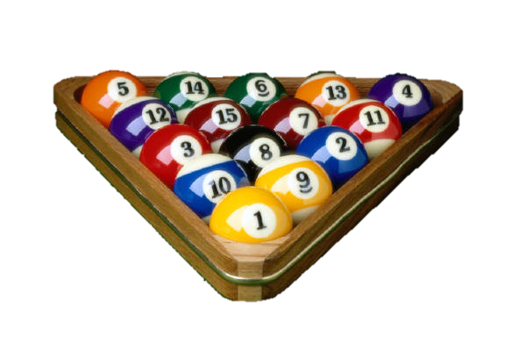
Framework Emulation
It’s like using a test-specific table when creating and testing the balls.

Slide 8

Testing the Top
Only by testing the UI do I know that everything under it works.
Scott Schimanski, Test Manager
A Test

Slide 9

Things found on top
Here
XAML
JavaScript
We combat this with
MVC MVC MVVM

Slide 10
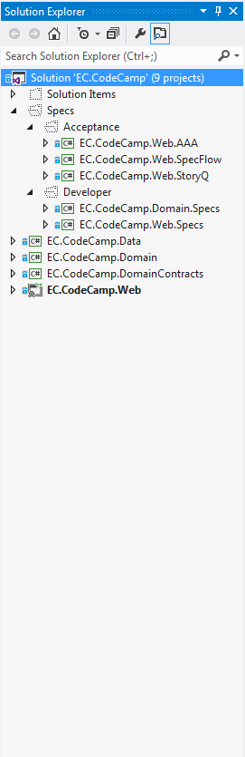
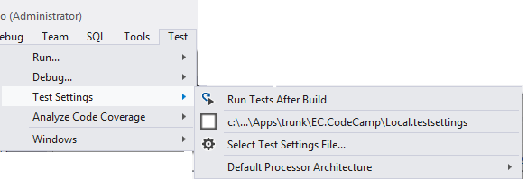

Packaging Patterns
Relationships between projects affect test execution times
Test execution times affect how often developers run tests

Slide 11

Things that grow
Teams
The thing we’re making
Test suites
Integration effort
Build times

Slide 12
The Player
Test
Project
Exe or Site
Assembly A
Assembly B
Assembly C

Slide 13
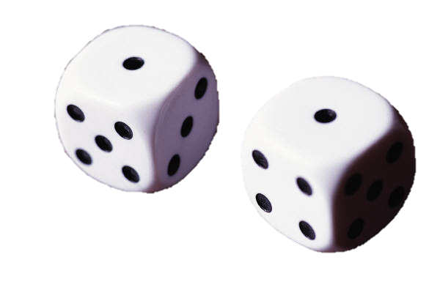
Snake Eyes
Unit Test Project 1
Exe or Site
Integration Test Project 1
Unit Test Proj 2
Assembly A
Integration Test Project 2
Unit Test Proj 3
Assembly B
Integration Test Project 3
Unit Test Project 4
Assembly C
Integration Test Project 4

Slide 14
Monogamy
Quality Specialists
Functional Test Project 1
Performance Test Project 2
Security Test Project 3
Code Specialists
Test Project 1
Exe or Site
Test Project 2
Assembly A
Test Project 3
Assembly B
Test Project 4
Assembly C

Slide 15

Inverting Yourself
Inversion of Control
  A lifestyle choice
  What happens when parents age
  A sweet trick
  A tool for decoupling code which occasionally causes developers to curse after finding the config issue in the test project. Again.

Slide 16
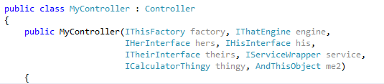
The Dependency Addict

Slide 17

Primitive Obsession

Slide 18
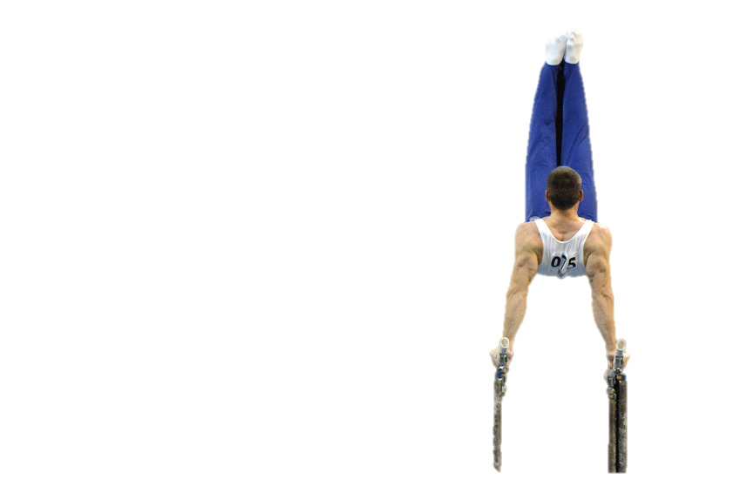
Parallel and Threads
Many patterns exist for multi-threading
Task Parallel Library enables feats of strength
Async and Await bring juice, too

Slide 19
Thank you!
David Starr
david@scrum.org
Blog: elegantcode.com
@elegantcoder
Peter Provost
Peter.Provost@microsoft.com
Blog: peterprovost.org
@pprovost

Slide 20


Related Content
Breakout Sessions
DEV214 Introducing the New Visual Studio 11 Unit Testing Experience
DEV411 Testing Un-testable Code with Fakes in Visual Studio 2012
AAP311 Compile & Execute Requirements in .NET
Hands on Labs
DEV17-HOL Explore the New Unit Testing and Code Clone Capabilities of
Visual Studio 2012
Product Demo Stations
DEV01-TLC Application Lifecycle Management (ALM)

Slide 21



Resources
Learning
  Connect. Share. Discuss.
  Microsoft Certification & Training Resources
http://northamerica.msteched.com
www.microsoft.com/learning
TechNet
  Resources for IT Professionals
  Resources for Developers
http://microsoft.com/technet
http://microsoft.com/msdn

Slide 22







Required Slide
Complete an evaluation on CommNet and enter to win!

Slide 23


MS Tag
Scan the Tag
to evaluate this
session now on
myTechEd Mobile

Slide 24
© 2012 Microsoft Corporation. All rights reserved. Microsoft, Windows, Windows Vista and other product names are or may be registered trademarks and/or trademarks in the U.S. and/or other countries.
The information herein is for informational purposes only and represents the current view of Microsoft Corporation as of the date of this presentation. Because Microsoft must respond to changing market conditions, it should not be interpreted to be a commitment on the
part of Microsoft, and Microsoft cannot guarantee the accuracy of any information provided after the date of this presentation. MICROSOFT MAKES NO WARRANTIES, EXPRESS, IMPLIED OR STATUTORY, AS TO THE INFORMATION IN THIS PRESENTATION.

