Slide 1
Cloud-Ready Data Services
AZR208
Quentin Clark
Corporate Vice President
Microsoft Corporation

Slide 2










cloud data services
big data
database
storage
traffic
caching
messaging
identity
media
CDN
networking

Slide 3

Big Data
new data sources
large data volumes
new technologies
non-traditional data types
new economics
New Questions & New Insights
Notes:
Slide Objectives:
Define and explain the characteristics of “Big Data”
Speaking Points:
Notes:

Slide 4





Microsoft & Big Data
Enterprise ready
with Hadoop on Windows & Azure
Connecting to the world’s data with
Azure Marketplace
Insights for everyone with Microsoft BI
Notes:
There is a lot of discussion about “Big Data” in the world today. So what do people mean? Is it about scale and large volumes? Not exclusively. Is it about processing unstructured data like web logs? No not exclusively. Is it about a specific computational pattern or method that gives you real-time insight? No, not exclusively. These are all things SQL Server supports today.
Often what people are talking about are new specific computational patterns including map reduce, which emerged as a method to process lots of unstructured data in a distributed storage system. Now, this doesn’t have a monopoly on “Volume”, “Variety” or “Velocity” but does provide some unique capabilities.
Microsoft has a unique perspective on Big Data – We are the only major Data Platform vendor who is also in the 100PB club of Cloud providers. We have invested heavily in building and running a big data platform to fuel and drive our business. Microsoft is managing 100’s of Petabytes of data across our online properties. Adding 8 PBs per month, running 20k jobs per day to run the business.
<click>
We are also integrating SQL Server with Big Data and completing the solution by enabling developers to build applications on this data; and connect it through to our end users with our BI tools. So we have a pretty good understanding of how to build and operate one of these infrastructures and connect it thru to developers and end users.
Ultimately what we see here is an opportunity to activate data that has lived outside the traditional data platform. And consistent with our strategy, deliver immersive insights over all data to all users in the tools they are familiar with.
Last fall we announced a Big Data strategy that embraces Hadoop for activating this ambient data being born outside the traditional data platform. Hadoop is the open source implementation of Map Reduce parallel computation engine and environment, and it's used (quite widely now) in the processing of streams of data that go well beyond even the largest enterprise data sets in size. Whether it’s sensor, clickstream, social media, location-based or other data that is generated and collected in large gobs, Hadoop is often on the scene in the service of processing and analyzing it.
<click>Here’s Microsoft’s Big Data strategy:
Enterprise Ready – delivering an enterprise class implementation or distribution of Hadoop for Windows Server and Windows Azure, integrated with SQL Server 2012, Active Directory and System Center makes it dramatically easier, efficient and cost effective for your organization to capitalize on the opportunity Big Data can bring to your business.
And with the Hadoop distribution for Windows Azure, customers can instantly begin taking advantage of the benefits of Big Data without capital infrastructure or operational costs.
Connected with the World’s Data – Microsoft’s Big Data solution enables customers to augment their analysis with publicly available data from social media sites such as Twitter and Facebook, and hundreds of trusted data providers on Windows Azure Marketplace. Azure Marketplace also exposes hundreds of applications and data mining algorithms to help unlock new insights for customers.
Delivering Insights for Everyone with MS BI – Through deep integration with its BI (PowerPivot and Power View) and EDW tools, Microsoft’s Big Data solution offers customers deep insights on all their structured and unstructured data with the tools they use every day.
Now let’s take a look at a demo which highlights the real power of our Big Data solutions.

Slide 5



Azure Data Management
SQL Server in a Virtual Machine
Azure SQL Database
Azure Table Storage
SQL Server in a Virtual Machine
Azure Blob Storage
Notes:
Slide Objectives:
Explain the offerings that Microsoft is providing in Azure for storing, querying, and managing data.
Speaking Points:
Notes:

Slide 6



SQL Server in a Virtual Machine
Full SQL Server capability
Low TCO for existing apps
Flexibility & control
Managed infrastructure
Notes:
Slide Objectives:
Explain the benefits of Virtual Machines + SQL Server
Speaking Points:
Full SQL Server Capability
High Availability of Database with AlwaysOn Availability Groups
Advanced Security (Transparent data encryption & auditing)
Full Business Intelligence Functionality
Low TCO for Existing Apps
No App Changes Required
Familiar Development tools
Library of VM Templates
Flexibility and Control
Full Control of Virtual Machine
Common Identity (Active Directory Integration)
Managed Infrastructure
Fully Managed Infrastructure
99.9% SLA for Virtual Machine
Single Pane of Glass to Manage with System Center 2012
Notes:

Slide 7

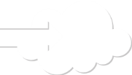


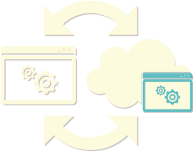

Common Scenarios
Public Cloud
SQL Server in a Windows Azure Virtual Machine
move existing
tier 2 & 3 apps
develop
& test
backup database
to the cloud
extend on-prem
applications
Notes:
Slide Objectives:
Explain the benefits of Virtual Machines + SQL Server
Speaking Points:
Notes:

Slide 8
demo
SQL Server & Windows Azure Virtual Machines
David Robinson
Notes:
Slide Objectives:
Introduce the demoer and setup the first segment of the expense reporting demo.
Demo Flow:
Introduce the expense reporting application scenario
Create a Virtual Machine with SQL Server in the Windows Azure management portal
Connect to the VM using SSMS and import a BACPAC from our on-premises database
Change our app configuration and deploy it to Windows Azure Web Sites
Show our app completely running in Windows Azure with a Web Site and a VM
Speaking Points:
Notes:

Slide 9
Azure Data Management
SQL Server in a Virtual Machine
Azure SQL Database
Azure Table Storage
Azure Blob Storage
Notes:
Slide Objectives:
Transition to talk about the managed service
Speaking Points:
Notes:

Slide 10
Windows Azure SQL Database
Relational database as a service
Fully managed
High availability, scalability, & global reach
Familiar language and framework support
Notes:
Slide Objectives:
Define Windows Azure SQL Database and differentiate the managed service from SQL (or any database) in a VM
Speaking Points:
Notes:
Relational Database Service
Full managed PaaS
Dynamically scale on demand
HA built-in automatically for the database
Designed for the new cloud design point
Common Architecture with SQL Server
Rapid Application Development
Popular languages and frameworks supported
T-SQL, .NET, PHP, Java, OData, Entity Framework, Python

Slide 11
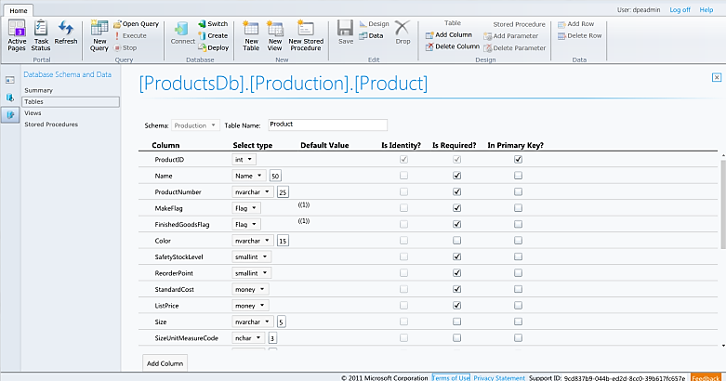
Familiar and Consistent Tools
Visual Studio
SQL Server Management Studio
Manage.WindowsAzure.com
Notes:
Slide Objectives:
Emphasize that there are three familiar tools for developers to use when interacting with Windows Azure SQL Database.
Speaking Points:
Visual Studio
Integrated Database Design Environment
Table Designer, T-SQL Editor, and Debugging
SQL Server Management Studio
Database migration via Data-Tier Applications
Import / Export Service
Manage.WindowsAzure.com
Unified management experience
Cross browser
Notes:
IntelliSense in T-SQL Editor
SQL Server Data Tools
Strive to make it consistent as possible
Intersection with the cloud
Bridging you to the new cloud world
Consistency to the new developer experience
Consistency with the new cloud model

Slide 12
demo
Windows Azure SQL Database
David Robinson
Notes:
Slide Objectives:
Setup the second segment of the expense reporting demo.
Demo Flow:
Create a Windows Azure SQL Database from the new Windows Azure management portal
Speaking Points:
Notes:

Slide 13
Inside Windows Azure SQL Database
1
New Database Request
TDS Gateway
Front-end Node
TDS Session
2
Primary & Replica Databases Created
Backend Node Replica 1
Backend Primary Node
Backend Node Replica 2
SQL DB
SQL DB
SQL DB
Scalability and Availability: Fabric, Failover, Replication, and Load balancing
Notes:
Slide Objectives:
Explain how databases are provisioned and managed by the WA SQL Database service.
Emphasize that we are able to automate several aspects of the database for you including high availability by maintaining three replicas of data
Speaking Points:
Notes:
A request for a new database comes in. The TDS Gateway interrogates the request and looks at the protocol and handles the request accordingly.
The request is then sent to the master cluster which contains information regarding all backend nodes (load, etc.).
[Jeff Currier] We keep a pool of buffered databases around for db create requests. When a user goes to make a request to create a database we simply go to the master cluster (GPM) to find where the current primary replica is for partition containing the list of these buffer databases. We then connect to that partition and take out one of the databases for our use. We then connect directly to that database stamping it with the new database name, server information.

Slide 14
SQL Federation
Scale Out Your Data
Extends T-SQL syntax
Add and remove database nodes seamlessly
Enables greater scalability and performance
Dynamic partitioning with no downtime
Notes:
Slide Objectives:
Introduce SQL Federation and the value it provides, without getting into the specific details of how it works.
Speaking Points:
New T-SQL Federation Syntax
Add and remove database nodes seamlessly
Enables greater scalability and performance
Dynamic partitioning with no downtime
Notes:
Scale by adding and removing nodes in front and middle tiers
Extend the model to the Database Tier

Slide 15
demo
Windows Azure SQL Federation
David Robinson
Notes:
Slide Objectives:
Invite the demoer back to show SQL Federation
Demo Flow:
Load a script in SSMS that shows a partitioned version of the Expense Reporting database
Speaking Points:
Notes:

Slide 16

Windows Azure SQL Database
Smart TV “Call Home” application
Over 4 million Smart TVs supported
5000 web requests / second
Notes:
Slide Objectives:
Introduce SQL Federation and the value it provides, without getting into the specific details of how it works.
Speaking Points:
Over 4 million Smart TVs supported
5000 web requests / second
Scale to numerous Federation members
Notes:
Samsung's Smart TV: Use simple gestures to select apps and signature services. Control your TV functions by talking to our TV.
Samsung can service the apps and firmware for all smart tvs worldwide from a central location. The TV’s report back any issues, and Samsung can troubleshoot and service the TV remotely. The number of requests from over 4 million smart TV's totaling over 5000 web requests / second required massive scale out. They were able to get this type of scale out using SQL Federation.
The goal with using Federation was to use its elasticity to support the world-wide demand that the smart TVs would need. As TVs are turned on, they “ping” home to check for firmware and application updates. Since these TVs are sold world-wide, the need for supporting the peak times is critical. Samsung plans to use SQL Federation with this same architecture for many of their other appliances.

Slide 17
SQL Data Sync
Synchronize Your Data
Database synchronization as a service
Azure SQL Databases
On-premises & Azure SQL Database
Configuration driven
Elastically scales with demand
SQL Server
(On-Premises)
Notes:
Slide Objectives:
Introduce the data sync service as an added capabilities on top of the database
Speaking Points:
Notes:
Leverage the Microsoft Windows Azure platform and Microsoft SQL Azure without the necessity of creating and managing your own synchronization code.
Conflict resolution
Bi-directional
Based on the Sync Framework
NO CODE!

Slide 18
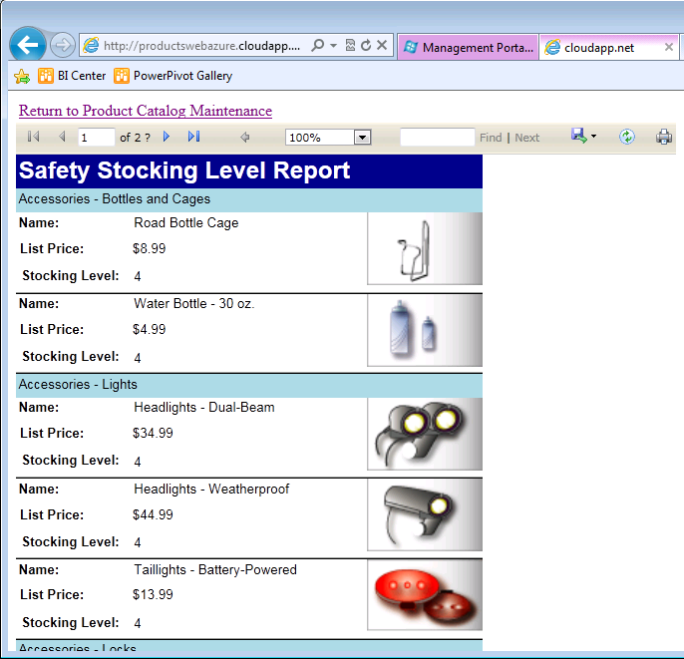
SQL Reporting
Visualize Your Data
Reporting delivered as cloud service
Elastically scales with demand
Familiar tools & programming model
Secure access for viewing & managing reports
Notes:
Slide Objectives:
Define the SQL Reporting service and use it as another example of a managed service we’re providing today for databases, but that will extend more broadly in the future.
Announce the commercial availability of the SQL Reporting service
Speaking Points:
Notes:
SQL Reporting is based on SQL Server Reporting Services offered as a service
Developers can deliver highly visual and interactive reports as an integrated part of a Windows Azure based solution.
No need to install your own reporting services instance or apply updates
Build reports using same familiar tools

Slide 19
Azure Data Management
SQL Server in a Virtual Machine
Azure SQL Database
Azure Table Storage
Azure Blob Storage

Slide 20
Azure Table Storage
NoSQL Data Storage
Fully managed PaaS
Account
Storage Account: MovieData
Key-value
Table Name: Movies
Star Wars
Matrix
Fan Boys
Table
Hierarchical
REST API
Entity
Geo replication
Notes:
Slide Objectives:
Define the table storage and differentiate it from a Windows Azure SQL Database
Since we are not showing a demo of table storage, provide some details on the concepts including tables, entitles, and accounts.
Speaking Points:
Notes:
Tables store entities
Entity schema can vary in the same table
Automatic scalability

Slide 21
Azure Table Storage
var Movie = new Movie
{
PartitionKey = “Comedies”;
RowKey = 1;
Title = “The Three Amigos”;
Rating = 1;
Description = “Three down-on-their luck actors accept an invitation...”;
}
MovieContext.AddObject(“movies”, Movie);
MovieContext.SaveChanges();
Save the Entity
Query the Entity
Var entity = (from item in MovieContext.Movie
where item.PartitionKey == “Comedies”;
&& item.RowKey == 1;
select item).First();
Notes:
Slide Objectives:
Provide a simple code example that shows how to use table storage with the .NET Storage Client library
Speaking Points:
The Microsoft® .NET Client Library for WCF Data Services provides a library of managed code classes that you can use to work with tables and entities in the Table service. The .NET Client Library offers an alternative to using the Table service REST API.
Allows you to write queries using LINQ syntax instead of using the REST protocol.
Notes:

Slide 22
Azure Data Management
SQL Server in a Virtual Machine
Azure SQL Database
Azure Table Storage
Azure Blob Storage

Slide 23
Azure Blob Storage
Unstructured Data Storage
Managed service
Hundreds of gigabytes per blob in size
100TB per storage account
REST API
Geo-replication for disaster recovery
Notes:
Slide Objectives
Define the blob storage service and the benefits of the service
Speaking Points:
Notes:
The Blob service provides storage for entities, such as binary files and text files.
The REST API for the Blob service exposes two resources:
Containers
Blobs.
A container is a set of blobs; every blob must belong to a container.
The Blob service defines two types of blobs:
Block blobs, which are optimized for streaming.
Page blobs, which are optimized for random read/write operations and which provide the ability to write to a range of bytes in a blob.
Blobs can be read by calling the Get Blob operation. A client may read the entire blob, or an arbitrary range of bytes.
Block blobs less than or equal to 64 MB in size can be uploaded by calling the Put Blob operation.
Block blobs larger than 64 MB must be uploaded as a set of blocks, each of which must be less than or equal to 4 MB in size.
Page blobs are created and initialized with a maximum size with a call to Put Blob.
To write content to a page blob, you call the Put Page operation. The maximum size currently supported for a page blob is 1 TB.
Notes
http://msdn.microsoft.com/en-us/library/dd573356.aspx
Using the REST API for the Blob service, developers can create a hierarchical namespace similar to a file system. Blob names may encode a hierarchy by using a configurable path separator. For example, the blob names MyGroup/MyBlob1 and MyGroup/MyBlob2 imply a virtual level of organization for blobs. The enumeration operation for blobs supports traversing the virtual hierarchy in a manner similar to that of a file system, so that you can return a set of blobs that are organized beneath a group. For example, you can enumerate all blobs organized under MyGroup/.

Slide 24
demo
Azure Blob Storage
David Robinson
Notes:
Slide Objectives:
Invite the demoer back to show blob storage
Demo Flow:
Create a storage account in the new Windows Azure management portal
Copy the storage account key
Drop into Visual Studio and install the Storage Client library
Include the storage key in the web.config
Add HTML to the view for uploading the expense report receipts
Add code in the controller for storing the receipt in blob storage
Redeploy the web site to Windows Azure Web Sites
Show how we can upload a receipt
Speaking Points:
Notes:

Slide 25
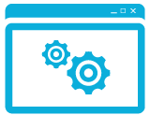
Hadoop On Windows Azure
Managed service
Javascript console simplifies development
Integrate data with Hive ODBC driver
Hadoop Cluster
Excel integration
Azure Blob Storage
Preview: M/R, HDFS, Hive, Pig, Streaming & more
Notes:
Slide Objectives
Explain our implementation of Hadoop on Windows Azure
Speaking Points:
Notes:

Slide 26
demo
Hadoop on Windows Azure
David Robinson
Notes:
Slide Objectives:
Invite the demoer back to show Hadoop
Demo Flow:
Speaking Points:
Notes:

Slide 27
Summary
Cloud services for the new world of data
Managed services
Breadth of data types and programming models
Cloud on your terms
Notes:
Slide Objectives:
Wrap up by summarizing the key themes that we’ve covered
Demo Flow:
Speaking Points:
Notes:

Slide 29




Resources
Learning
  Connect. Share. Discuss.
  Microsoft Certification & Training Resources
http://northamerica.msteched.com
www.microsoft.com/learning
TechNet
  Resources for IT Professionals
  Resources for Developers
http://microsoft.com/technet
http://microsoft.com/msdn

Slide 30







Required Slide
Complete an evaluation on CommNet and enter to win!

Slide 31


MS Tag
Scan the Tag
to evaluate this
session now on
myTechEd Mobile
Notes:
TechEd is working with Microsoft Tag (http://tag.microsoft.com/overview.aspx) to create a unique Tag for every session at the event. Your session Tag will appear on both the room signage and at the end of your presentation. With your session Tag, attendees will be able to scan as they enter the room to retrieve session details, view speaker bios, and engage in discussions; or scan at the end of the presentation to evaluate your session and download materials.

Slide 32
© 2012 Microsoft Corporation. All rights reserved. Microsoft, Windows, Windows Vista and other product names are or may be registered trademarks and/or trademarks in the U.S. and/or other countries.
The information herein is for informational purposes only and represents the current view of Microsoft Corporation as of the date of this presentation. Because Microsoft must respond to changing market conditions, it should not be interpreted to be a commitment on the
part of Microsoft, and Microsoft cannot guarantee the accuracy of any information provided after the date of this presentation. MICROSOFT MAKES NO WARRANTIES, EXPRESS, IMPLIED OR STATUTORY, AS TO THE INFORMATION IN THIS PRESENTATION.

