Slide 1
Windows Azure Insights for the Enterprise IT Pro
AZR301
John Craddock
Infrastructure and Identity Architect
XTSeminars

Slide 2
Agenda
  IT roles and challenges
  Introduction to the Cloud
  Windows Azure fundamentals
  Deploying Windows Azure Virtual Machines
  Connecting on-premise and Cloud systems
  Building and deploying a Windows Azure service
  Managing identity with the Access Control Service

Slide 3
What do IT pros do?
Install server hardware
Configure the network
Install the OS
  Update, update, update……..
Manage storage and backup
Apply security
Manage certificates
Deploy applications
Monitor application/OS health and performance
Match the business requirements by scaling to demand and being agile

Slide 4
Managing demand
Forecast demand
IT capacity
Potential business loss
Compute capacity
Over capacity
Under capacity
Wasted capacity
Entry barrier
Time
Don’t forget you are also paying for unnecessary
software licencing while you are over capacity

Slide 5
Demand burst
CLMs
IT demand
Compute capacity
Ticket sales open
Ticket sales open
Time
Concert ticket web site

Slide 6
Public Cloud computing
On demand compute and storage capacity
Internet based
Pay for what you use
Delivered as a service
  Don’t expect to be able to change what’s delivered
  Read the SLAs
    If they don’t give you what you need, look to another vendor

Slide 7






Windows Azure
Building blocks for distributed services
Access control
Network connectivity
  Connect on-premise and Cloud applications
Caching
Windows Azure Services
Web roles
worker roles
Web sites
Virtual machines
Compute
Storage
SQL Azure
New
Windows Azure management
Blobs, tables, queues
Portal
APIs
On-premise development
On-premise management
Visual Studio, Azure SDK etc
Windows Admin
Server Tools

Slide 8
Setting the boundaries
Windows Azure is an extension of your IT environment
  As IT Pros, you need to monitor, debug, scale, backup
    Doing all the good things you do today
The anomaly is that developers have the potential to access compute and storage without asking you!
  Fine for development but not for production
Take control of your Windows Azure
production environment

Slide 9
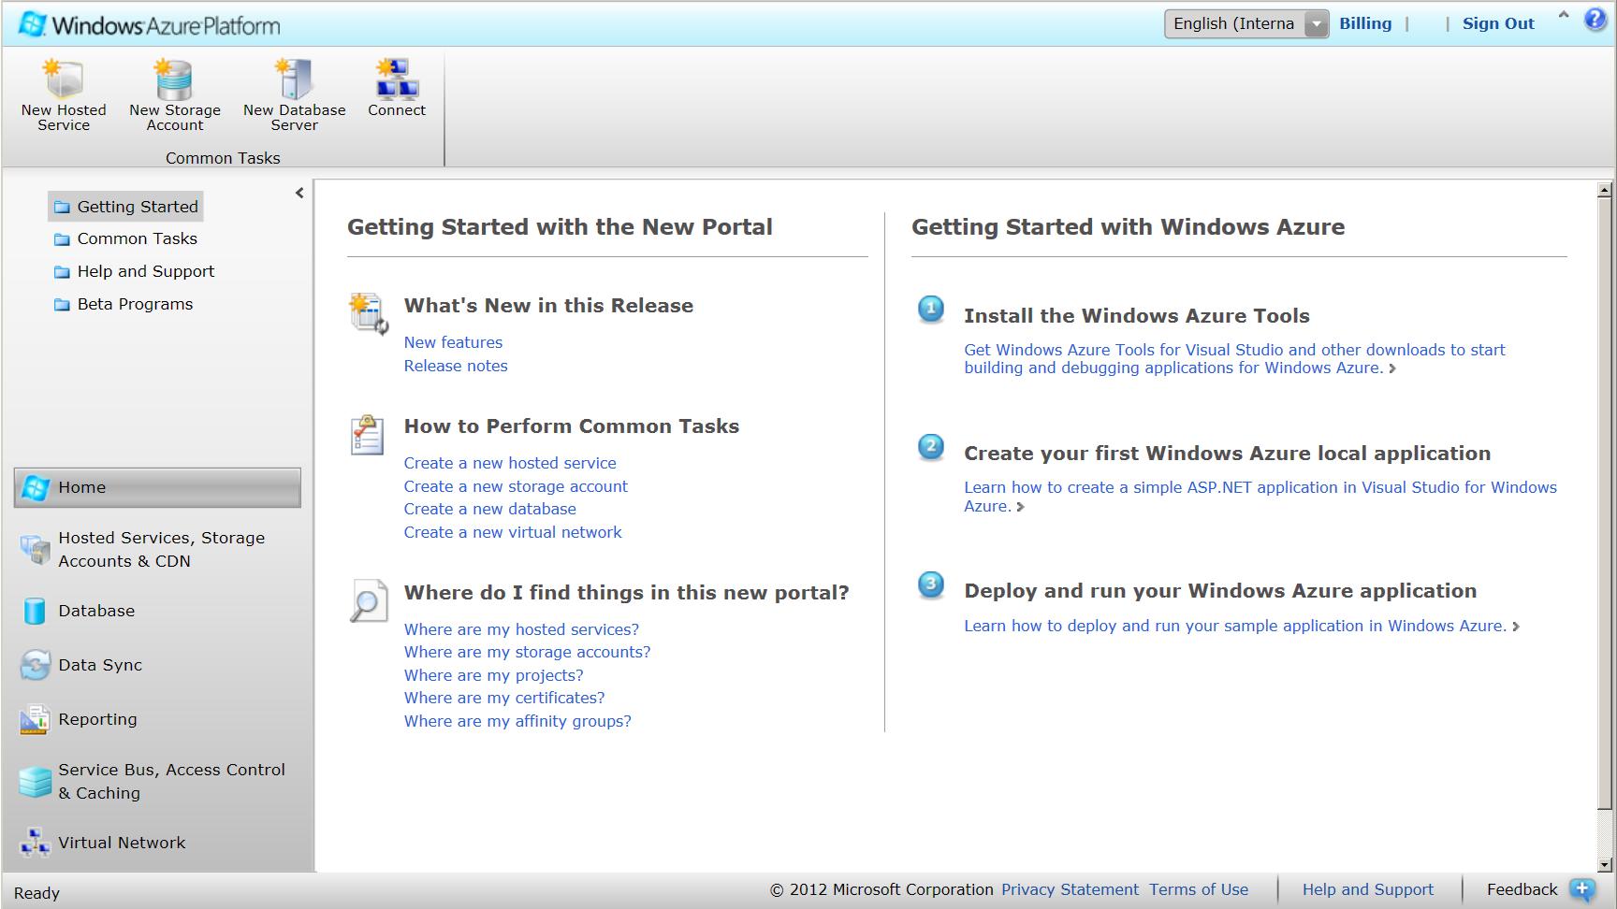
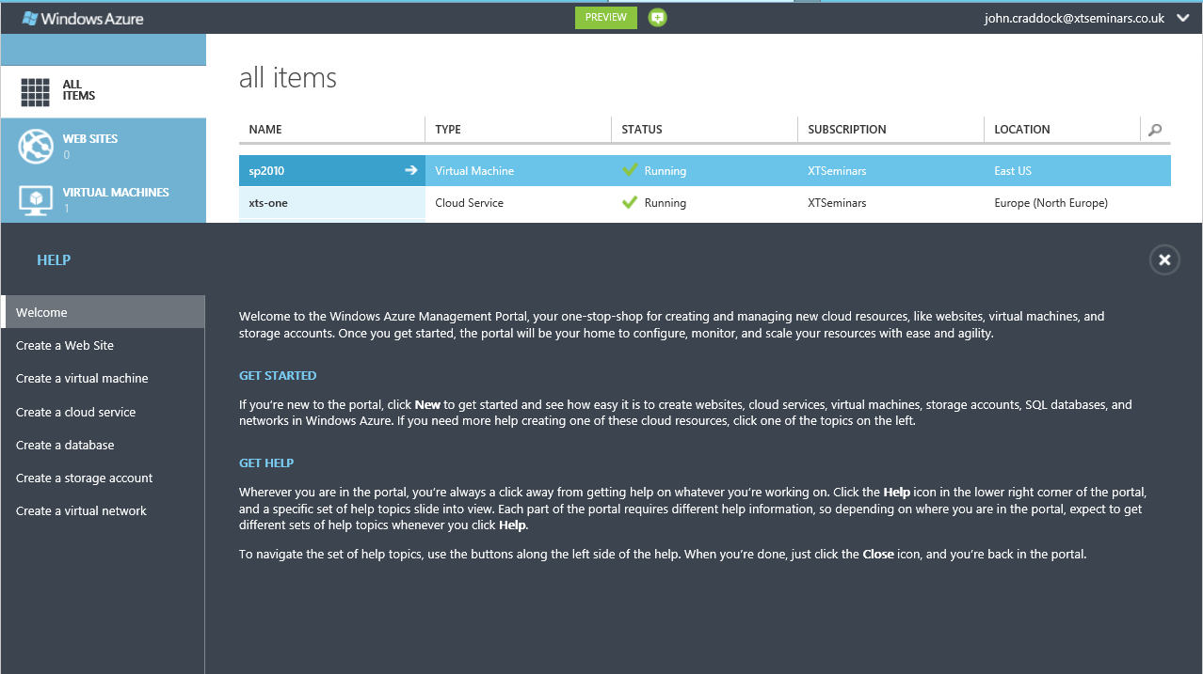
Ready to go…
www.windowsazure.com
Start by creating a subscription
  Check for introductory offers
  MSDN subscriptions include Windows Azure service

Slide 10
The Windows Azure portal tour…..

Slide 11


Web & Worker roles
Web Role 1
instance #3
Worker Role 1
Request
instance #2
instance #3
Database
LB
Browser
Response
instance #1
instance #1
instance #0
instance #0
Scale up
and down
Communications via
Queues and Tables

Slide 12
Web & Worker roles (continued)
Applications are specifically developed for Windows Azure Web roles, Worker roles and storage
Windows Azure applications can be run in a development environment
  You cannot deploy and run them on-premise
Pay per role instance
  Two instances required for 99.95% SLA
Add and remove instances based on demand
  Load balancing is automatically configured

Slide 13
Choose your instance size
Compute Instance Size | CPU | Memory | Instance Storage | I/O Performance
Extra Small | 1.0 GHz | 768 MB | 20 GB | Low
Small | 1.6 GHz | 1.75 GB | 225 GB | Moderate
Medium | 2 x 1.6 GHz | 3.5 GB | 490 GB | High
Large | 4 x 1.6 GHz | 7 GB | 1,000 GB | High
Extra Large | 8 x 1.6 GHz | 14 GB | 2,040 GB | High
Each instance is deployed in its own VM
  You can use RDP to access the VM
Cost is based on deployed instance sizes
  Charged even if the instance is not running
Remember the SLA requires at least two instances per role

Slide 14

Choose where your service is located
You decide which region of the world you deploy in
  You cannot choose a datacentre
  Affinity groups can be created to ensure that a hosted service and storage are in the same datacentre within a region

Slide 15
Storage
Local storage can be allocated on an instance bases
  All Web and Worker roles are stateless so local storage should only be used for caching
Persistent storage is managed through
  BLOBs
    NTFS VHD drive can be stored in blobs and attached to instances
  Tables
  Queues
  SQL Azure

Slide 16
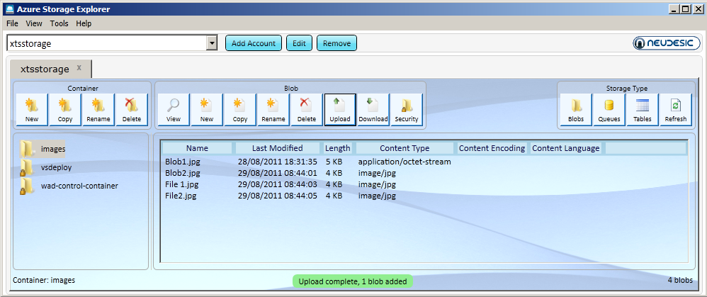
Storage access
Blobs, tables and queues are accessible via URLs
  Accessible via Representational State Transfer (REST) APIs
    Uses HTTP methods : POST, GET, PUT and DELETE
  Requests are signed with the storage key
All Windows Azure storage can be accessed from anywhere

Slide 17
Creating a storage account

Slide 18
Windows Azure Virtual Machines
Persistent VM roles
  Yes, VMs as we know and love them ☺
  Bring your own or use Microsoft provided
    You update and maintain them
Possible to host:
  Active Directory, SharePoint 2010, SQL Server and more…
99.9% SLA on single-instance
Connect to on-premise using
  Windows Azure Virtual Network

Slide 19
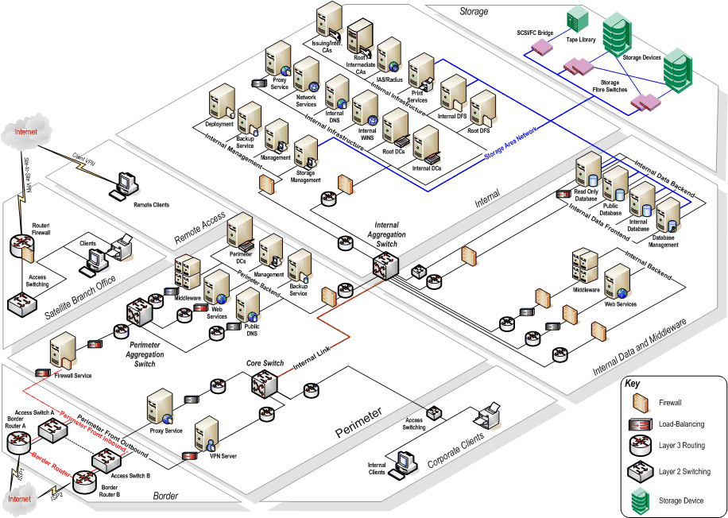
Windows Azure Virtual Network
Windows Azure
Persistent VMs
On-Premise to Windows Azure routable VPN
  Supports IPv4 routing
  Bring your own IP addresses

Slide 20
Creating a virtual machine

Slide 21
Deploying Cloud Services
Web Role 1
instance #3
Worker Role 1
Request
instance #2
instance #3
Database
LB
Browser
Response
instance #1
instance #1
instance #0
instance #0
Scale up
and down
Communications via
Queues and Tables

Slide 22
The developer builds the application
<WorkerRole name="Example1_WorkerRole1" vmsize="Small">
<Imports>
<Import moduleName="Diagnostics" />
<Import moduleName="RemoteAccess" />
<Import moduleName="RemoteForwarder" />
</Imports>
<ConfigurationSettings>
<Setting name="DataConnectionString" />
Binaries
  Web/Worker role code
  VM roles: VHDs
Definition file (.csdef)
  Role names and types
  Instance sizes
  Network endpoints
Configuration file (.cscfg)
  Number of instances for each role
  Configuration settings for modules
  and strings declared in the definition file
  Configuration data can be updated on a live system
<Role name="Example1_WorkerRole1">
<Instances count="2" />
<ConfigurationSettings>
<Setting name="DataConnectionString" value="DefaultEndpointsProtocol=https;AccountName=xtsstorage;AccountKey=LR44MguTHmD1bGpcObJxdr22zZcYrPj8UclhJMBllyFngsHq+Z5OYqdJ8Na6y1+xxxxxxxxxxxxxxxxxxx==" />
<Setting name="Microsoft.WindowsAzure.Plugins.RemoteAccess.Enabled" value="true" />
<Setting name="Microsoft.WindowsAzure.Plugins.RemoteAccess.AccountUsername" value="Tom" />

Slide 23

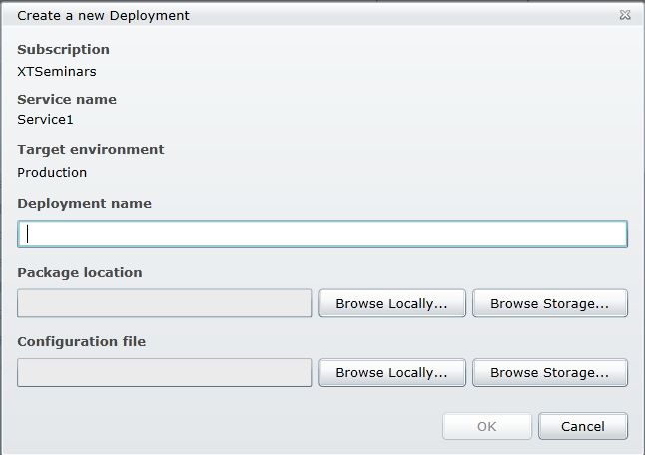
Deploying the service
The binaries and definition (csdef) file are zipped into
service package file
Configuration data values can be updated on the live system

Slide 24
Running the service
Develop and
package service
The Fabric Controller manages
  Resource allocation
  Service provisioning
  Service lifecycle
  Service health
Portal Service
RDFE
Regional datacenter
Fabric Controller
Public IP
Internet
LB
Resources allocated for roles

Slide 25
Update & Fault Domains
Web Role Inst #0
Web Role Inst #1
Worker Role Inst #0
Worker Role Inst #1
Worker Role Inst #2
Update Domain 0
Update Domain 1
Update Domain 2
Windows Azure distributes instances across multiple Update Domains to support in-place upgrades
  One domain is updated at a time
    Supports application and Windows Azure OS updates
  Service remains running with reduced capacity
Similar concept used to support Windows Azure datacentre hardware failures
  Instances are distributed across multiple fault domains
    A single failure will allow service to remain running

Slide 26

Staging and production
http://<name>.cloudapp.net
LB
Production URL
Production
LB
Staging URL
Staging
http://<guid>.cloudapp.net
A service can be deployed to staging, tested and “moved” to production by swapping the VIP
A service upgrade can be deployed to staging and then swapped to the production environment
  During the swap the current production environment is “moved” to staging

Slide 27
Deploying and running applications

Slide 28
Demand burst with Windows Azure
Scale prior to
demand
On-demand compute capacity
and software lisencing
IT Demand
Compute Capacity
Ticket sales open
Ticket sales open
Time
Concert ticket website

Slide 29
Track demand – ensure success
Available
Forecast demand
Required
IT capacity
Time

Slide 30
Managing Identity in the Cloud
Federation joins it all together
User
Name: Fred
Password: *****
Age: 107
Country: Japan
User
  On-premise
  Partner organization
  Somewhere!!!
User’s Identity
  On-premise
  Partner organization
  3rd Party Identity provider
Application
  On-premise
  Partner organization
  Somewhere!!!

Slide 31
Windows Azure Active Directory
Windows Azure AD includes the Access Control Service (ACS)
  Provides a method for applications and services to authenticate and authorize users
ACS brokers authentication with popular identity providers
  Live ID
  Google
  Yahoo
  Facebook
Relying parties can be applications or AD FS

Slide 32

Using ACS
Access Control Service
Relying party
AD FS server
or application
Rules engine
Management services
Azure
Trust
User
STS
Management portal
Authenticate
Identity providers
LiveID
Google
Yahoo
AD FS 2.0
Facebook
OpenID
IdP token
ST
ST
IdP token
Process rules
ACS token
ST
ACS administrator
ST

Slide 33
ACS in action

Slide 34
Monitoring and diagnostics

Slide 35
Gathering data
Role instance
Windows data sources
Event logs
IIS logs
Failed request log
Performance counters
Diagnostic
monitoring
Role
Local storage
Windows Azure Storage
Blobs & Tables
On premise analysis

Slide 36
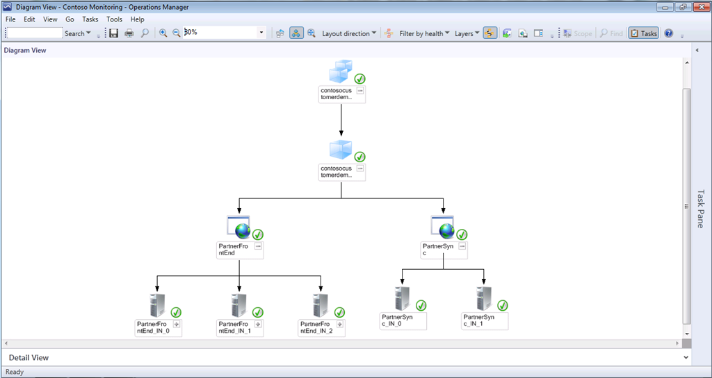
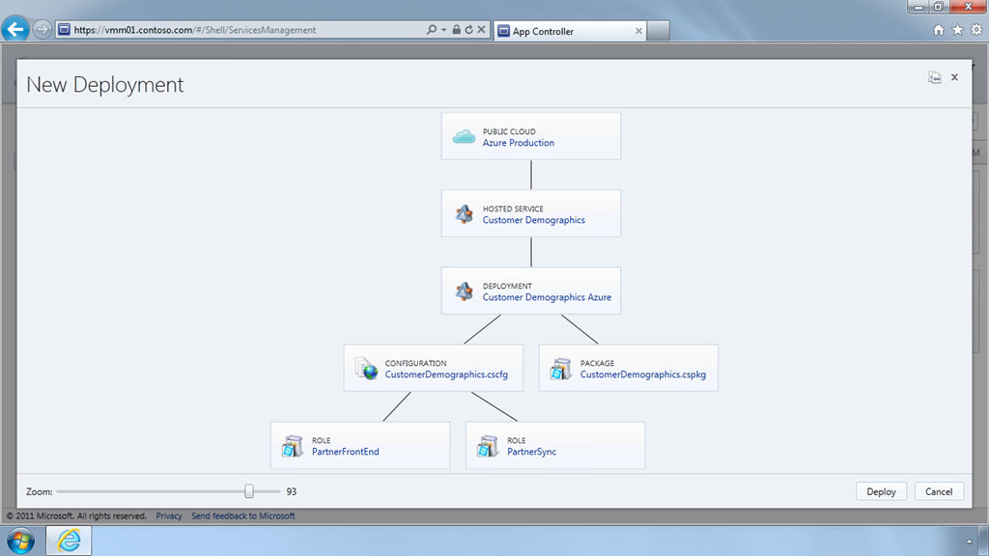
System Center 2012 puts you in the driving seat
App Controller
  Deploy and manage services/roles and instance counts
Operations Manager
  Monitoring health and performance

Slide 37
What do IT pros do with Windows Azure?
- Manage image libraries and deploy
Install server hardware
Configure the network
Install the OS
  Update, update, update……..
Manage storage and backup
Apply security
Manage certificates
Deploy VMs and applications
Monitor application/OS health and performance
Match the business requirements by scaling to demand and being agile
- for cloud / on-premise connectivity
New ways of supporting your enterprise and new opportunities

Slide 38
Azure Cloud offers you the opportunity to be the expert at bringing scalability and agility to your company’s applications and services

Slide 39
A chance to innovate
Test out new ideas with small upfront costs
If you need to scale rapidly, you can

Slide 40


Consulting services on request
John.craddock@xtseminars.co.uk
John has designed and implemented computing systems ranging from high-speed industrial controllers through to distributed IT systems with a focus on security and high-availability. A key player in many IT projects for industry leaders including Microsoft, the UK Government and multi-nationals that require optimized IT systems. Developed technical training courses that have been published worldwide, co-authored a highly successful book on Microsoft Active Directory Internals, presents regularly at major international conferences including TechEd, IT Forum and European summits. John can be engaged as a consultant or booked for speaking engagements through XTSeminars. www.xtseminars.co.uk
John Craddock
Infrastructure and security Architect
XTSeminars Ltd
@john_craddock blog.xtseminars.co.uk

Slide 41


Track Resources
@WindowsAzure
@ms_teched
Hands-On Labs
Meetwindowsazure.com
DOWNLOAD Windows Azure
Windowsazure.com/
teched

Slide 42




Resources
Learning
  Connect. Share. Discuss.
  Microsoft Certification & Training Resources
http://northamerica.msteched.com
www.microsoft.com/learning
TechNet
  Resources for IT Professionals
  Resources for Developers
http://microsoft.com/technet
http://microsoft.com/msdn

Slide 43







Required Slide
Complete an evaluation on CommNet and enter to win!

Slide 44


MS Tag
Scan the Tag
to evaluate this
session now on
myTechEd Mobile

Slide 45
© 2012 Microsoft Corporation. All rights reserved. Microsoft, Windows, Windows Vista and other product names are or may be registered trademarks and/or trademarks in the U.S. and/or other countries.
The information herein is for informational purposes only and represents the current view of Microsoft Corporation as of the date of this presentation. Because Microsoft must respond to changing market conditions, it should not be interpreted to be a commitment on the
part of Microsoft, and Microsoft cannot guarantee the accuracy of any information provided after the date of this presentation. MICROSOFT MAKES NO WARRANTIES, EXPRESS, IMPLIED OR STATUTORY, AS TO THE INFORMATION IN THIS PRESENTATION.

