Slide 1
Service Bus Solution Patterns
AZR317
Clemens Vasters
Principal Technical Lead
Microsoft Corporation
Abhishek Lal
Senior Program Manager
Microsoft Corporation

Slide 2
Agenda
Customer
Use-Cases
  Composite integration patterns
Access Control and Provisioning
→
  Messaging Channel Patterns
Message Routing Patterns
Device Integration
Q&A

Slide 3
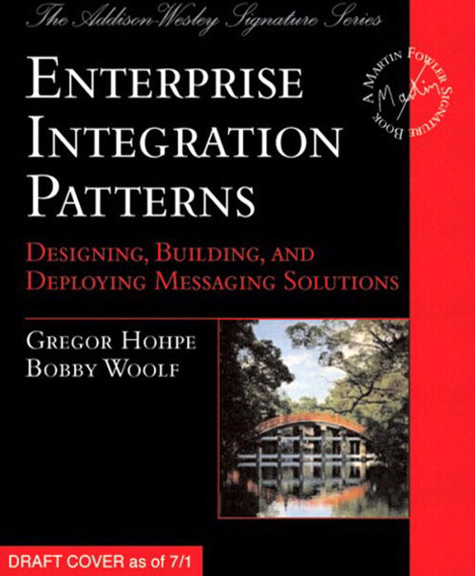
Before we go there ….
Common “Enterprise” Goals (per Gregor)
  Information portals
  Data replication
  Shared business function
  Service oriented architectures
  Distributed business processes
  Business-to-business integration
Future “Enterprise” Goal (per us)
  Large scale reach to consumers via apps and devices
  Meet business needs with higher agility

Slide 4
What is Service Bus?
Household Appliance
Phone, Tablet, PC
Point of Sale Kiosk
SaaS Cloud Service Solution
★
Queues
Topics
Relays
Notifications*
Bridges*
Line of Business Application
Event Aggregator
Team Sharepoint
Site
…

Slide 5
Customer Use cases

Slide 6
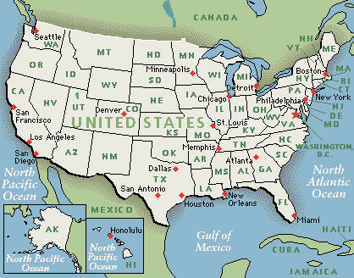

Web Services For Retailers
Windows Azure
Service Instance1
Service
Instance2
Service
InstanceN
Service Instance1
Service
Instance2
Service
InstanceN
or
Multi-Tenant Web Services
Per-Tenant Web Services
Orders Queue
Relay
Catalog Distribution Topic
Retail
Sites
Retailer’s Data Center
LOB Service

Slide 7
Web Services For Retailers
ISV: Solution Provider for Retail Stores
Solution Profile
  Point-of-sale apps send messages to Queues
  On-premises data access for sensitive data
  Event notifications between HQ and retail locations
Service Bus Usage
  Service Bus Queues for asynchronous messaging
  Relay for on-premises information access
  Topics for event-notifications

Slide 8

SaaS with Dynamic Compute Workload
Windows Azure
Processor Service
Controller Service
Processing Role Instance1
Processing Role Instance2
Processing Role InstanceN
Controller Role Instance1
Controller Role Instance2
4
3
5
Job Data
Store (Blob)
Monitoring Topic
Job Queue
1
2

Slide 9
SaaS with Dynamic Compute Workload
ISV: Specialized, Dynamic Compute Capacity Provider
Solution profile
  Users submit jobs through a rich client app
  Jobs are processed as HPC-style workloads on Windows Azure
  Users can monitor progress, and receive notifications on progress
Service Bus Usage
  Queue (with external Blob references) for job submission
  Relay for request-response, low latency messaging between job controller and job processing worker roles to allocate tasks
  Topic for event aggregation and monitoring

Slide 10
“Who has what data about me?” Service
Windows Azure
Consumer Web Site
Web Role Instance1
Web Role Instance2
Web Role InstanceN
Reply
Queues
Distribution
Topic
Session
Request Queue
Controller Service
Data Services
Scheduling
Role Instance3
Scheduling
Role Instance2
Scheduling
Role Instance1
Data Service 1
Data Service 2
Data Service 3

Slide 11
“Who has what data about me?” Service
Customer: Commercial website to track personal data
Solution
  Data gathered from several disparate sources
  Fan-out processing of customer requests from website
  Responses from different systems correlated to present results
Service Bus Usage
  Queues for decoupling of the web layer from middle-tier services
  Enable scaling to thousands of online web site users
  Topic fan-out for communicating with data services
  Request/Response correlation using Sessions

Slide 12
Scaling things out
Devices

Slide 13

Air Conditioners and other Devices
Partition
Event Flow
Control Flow
Topic
Sub
Sub
Sub
Sub
Sub
Sub
Topic
Control
Analytics
Event Store

Slide 14
Scale-Units
Mobile App Service/Site
Ingestion Topic P1
Sub
Sub
Sub
Sub
Sub
Sub
Subscription
Subscription
Sub
Fan-OutTopic Px/1
Web Role (x2)
Storage Reader
Storage Writer
Aggregator
Control System
Px
Event Store P1
Stats Topic

Slide 15
Event Ingestion
Partitions
Custom Gateway
Ingestion Topic P1
Ingestion Topic P2
Ingestion Topic Px
…
Subscription
Subscription
Sub
Subscription
Subscription
Sub
Subscription
Subscription
Subscription
Storage Writer
Aggregator
CS
P1
Storage Writer
Aggregator
CS
P2
Storage Writer
Aggregator
Control System Px
Event Store P1
Event Store P2
Event Store
Px
Stats Topic
Subscription
Subscription
Storage Writer
Real-Time Analytics Dashboard
Analytics Store

Slide 16
Command Fan-Out
Partition
Fan-Out
Sub
Sub
Sub
Sub
Sub
Sub
Sub
Sub
Sub
Topic
Topic
Topic
Control System

Slide 17

Provisioning
1
Factory installed device-id
Per-device id and key
Partition Queue URI
Partition Subscription URI
Registration with factory installed device-id
5
Provisioning
Access Control Service
Device Allow List
Create “Service Id”
Service Id
2
Device Verification
3
Partition Allocator
4
Service Bus
Set “Send” Permission
Set “Listen” Permission
Create Subscription
Queue
Sub
Sub
Sub
Topic

Slide 18
Enterprise Integration Patterns
  http://www.eaipatterns.com/ by Gregor Hohpe

Slide 19
Messaging Channel Patterns

Slide 20
Publish-Subscribe
Scenario
  Sender broadcasts event to all interested receivers
Common use-cases
  Event Notification
R
S
Sub
R
Topic
Sub
Sub
R

Slide 21
Create Topics and Subscriptions
NamespaceManager namespaceManager = NamespaceManager.Create()
namespaceManager.CreateTopic(“topicName");
namespaceManager.CreateSubscription(“topicName", “FirstSubscription");
namespaceManager.CreateSubscription(“topicName", “SecondSubscription");
namespaceManager.CreateSubscription(“topicName", “ThirdSubscription");

Slide 22
Publish Subscribe
demo

Slide 23
Content-Based Router
Scenario
  Route a message to different recipients based on data contained in the message
Common Use-Cases
  Order Processing Systems
R
S
Sub
R
Topic
Sub
Sub
R

Slide 24
Create Subscriptions with Rules (Filters)
TopicDescription mainTopic = namespaceManager.CreateTopic(“topicName");
namespaceManager.CreateSubscription(“topicName", “AuditSubscription");
namespaceManager.CreateSubscription(“topicName", “Category1Subscription",
new SqlFilter(“Category = 1"));
namespaceManager.CreateSubscription(“topicName", “CategoryNot1Subscription",
new SqlFilter(“Category <> 1"));
BrokeredMessage myMessage = new BrokeredMessage();
myMessage.Properties.Add(“Category”, 1);
or
myMessage.Properties.Add(“Category”, 2);
or
myMessage.Properties.Add(“Category”, 3);

Slide 25
Content-Based Router
demo
demo

Slide 26
Recipient List
Scenario
  The sender wants to send the message to a list of recipients
Common use-cases
  Order processing systems – route to specific vendors/departments
R
S
Sub
R
Topic
Sub
Sub
R

Slide 27
Create Rules (with SQL Filters)
TopicDescription mainTopic = namespaceManager.CreateTopic(“topicName");
namespaceManager.CreateSubscription(“topicName", “AuditSubscription");
namespaceManager.CreateSubscription(“topicName", "FirstSubscription",
new SqlFilter("Address LIKE '%First%'"));
namespaceManager.CreateSubscription(“topicName", “SecondSubscription",
new SqlFilter("Address LIKE '%Second%'"));
BrokeredMessage myMessage = new BrokeredMessage();
myMessage.Properties.Add(“Address”, “First”);
or
myMessage.Properties.Add(“Address”, “Second”);
or
myMessage.Properties.Add(“Address”, “First,Second”);

Slide 28
Recipient List
demo
demo

Slide 29
Message Routing Patterns

Slide 30
Splitter
Scenario
  Break down a message into a series of independent messages
Common use-cases
  Need to split a single job to multiple jobs
    Parallel processing
    Process by different services
  Order Processing Systems – process one order which may include many items.
Order Processing
Order2:
Item 11
Item 12
Order 1:
Item1
Item2
Order2
Item12
Order2
Item11
Order 1
Item2
Order 1
Item1
Topic

Slide 31
Aggregator
Scenario
  Collect individual messages, detect completion and publish a single message
  Self starting aggregator – No prior knowledge is required
  Full content aggregator – Need to know how many aggregates (messages) in the session
Common use-cases
  Distributed Query system – Merge replies from multiple providers
  Order Processing Systems – combine the results of individual but related suborders into single order for further processing

Slide 32
Implementing Aggregator with Service Bus
Correlate messages with sessions
Use Session state to monitor the overall progress and determine completeness
Full content aggregator strategies
Order 2: Item11, Item12
S1
Order 1: Item1, Item2
Order2
Item12
Ordered Received Queue
Order 1
Item1
Order2:
READY
Order 1:
READY
Order 1
Item2
Queue
S2
Order2
Item11
Ordered Processing Queue
Queue

Slide 33
Processing Sessions
QueueDescription queueDescription = new QueueDescription(queueName)
{RequiresSession = true };
// Specify Session Id when sending the message
BrokeredMessage message = new BrokeredMessage();
message.SessionId = sessionId;
// Accepting session and reading messages
MessageSession sessionRcv = sessionQueueClient.AcceptMessageSession(TimeSpan.FromSeconds(10));
while ((receivedMessage = sessionRcv.Receive(TimeSpan.FromSeconds(10))) != null)
{
ProcessMessage(receivedMessage);
}
// Close Session after all messages have been processed
sessionRcv.Close();

Slide 34
Using Session State
// Extracting sessions state
Stream stream = messageSession .GetState();
if (stream != null)
{
using (var reader = new StreamReader(stream))
{ state = reader.ReadToEnd(); }
}
// Modify session state
using (var stream = new MemoryStream())
{
using (var writer = new StreamWriter(stream))
{
writer.Write(state);
writer.Flush();
stream.Position = 0;
messageSession.SetState(stream);
}
}
messageSession.Close();

Slide 35
Resequencer
Scenario
  A statefull filter which collects and reorders messages
Common use-cases
  Get a stream of related but out-of-order messages back into the correct order

Slide 36
Implementing Resequencer with Service Bus
Correlate messages with sessions ID. Identify sequence with a sequence ID property
Use session state to store out-of-sequence messages
Defer out-of-sequence messages for a later time
Next: M2
Out-Of-Seq: M3
Next: M3
Out-Of-Seq: M3
Next: M2
M3
S
R
M2
M3
M1
Queue
M3
M2
M1

Slide 37
Deferring messages
if (sessionState.GetNextSequenceId() != messageId)
{
Console.WriteLine("Defering message: Category {0}, Message sequence {1}", session.SessionId, messageId);
// Deferring the message, and setting sessions state.
// Note: Use transaction scope to ensure consistency
message.Defer();
sessionState.AddOutOfSequenceMessage(messageId, message.SequenceNumber);
SetState(session, sessionState);
}
…
while (sessionState.GetNextOutOfSequenceMessage() != -1)
{
//Call back defered messages
Console.WriteLine("Calling back for deferred message: sequence {0}", sessionState.GetNextSequenceId());
receivedMessage = receiver.Receive(sessionState.GetNextOutOfSequenceMessage());
ProcessMessage(receivedMessage, ref sessionState, receiver);
}

Slide 38
Resequencer
demo
demo

Slide 39
Composite integration patterns

Slide 40
Composed Message Processor
Scenario
  Distribute messages to several systems for processing. Aggregate the responses to create a single reply.
  Need to maintain the overall message flow when a message is sent to multiple recipients each send a reply back.
Common use-cases
  Order processing – A large order being fulfilled by deferent departments each providing subset of the items

Slide 41
Composed Message Processor
S1
Order 1:
Item1
Item2
Order Handling
Splitter
Order Processing
Topic
Dept A
Queue
Order2
Item12
DeptA
Order2
Item11
DeptB
Order 1
Item2
DeptB
Order 1
Item1
DeptA
Order2:
Item 11
Item 12
Dept B
Dept C
S2
Order2 <Item 11,Item 12>
Inv1
Order 1<Item1,Item2>
Order2
Item12
DeptA
Order Processing
Order Aggregating
Order 1
Item1
DeptA
Topic
Dept A
Inv2
Order2:
READY
Order 1:
READY
Order2
Item11
DeptB
Dept B
Order 1
Item2
DeptB
Queue
Dept C
Inventory System

Slide 42
Scatter-Gather
Scenario
  Distribute a message to multiple recipients and re-aggregate the responses
  Need to handle a single request by multiple (parallel) processing services before returning single response
Common use-cases
  Distributed Query system– Merge replies from multiple providers

Slide 43
Scatter-Gather
V1
Scattering
Loan Req-1
Loan Req-2
Topic
Vendor A
S1
Loan Req-2
Loan Req-1
V2
Vendor B
Loan Req-1
Vendor C
Loan Req-2
Loan Req-1
V3
Req2 <Quote, Vendor3>
V1
Req1 <Quote, Vendor1>
Gathering
Loan Req-1
V2
Queue
Req2
Req1
Loan Req-1
V3
Loan Req-2

Slide 44
Agenda
Customer
Use-Cases
  Composite integration patterns
Access Control and Provisioning
→
  Messaging Channel Patterns
Message Routing Patterns
Device Integration
Q&A

Slide 45


Track Resources
@WindowsAzure
@ms_teched
Hands-On Labs
Meetwindowsazure.com
DOWNLOAD Windows Azure
Windowsazure.com/
teched

Slide 46




Resources
Learning
  Connect. Share. Discuss.
  Microsoft Certification & Training Resources
http://northamerica.msteched.com
www.microsoft.com/learning
TechNet
  Resources for IT Professionals
  Resources for Developers
http://microsoft.com/technet
http://microsoft.com/msdn

Slide 47



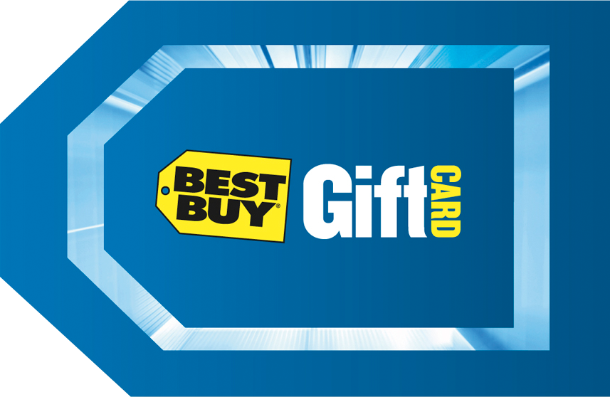



Required Slide
Complete an evaluation on CommNet and enter to win!

Slide 48


MS Tag
Scan the Tag
to evaluate this
session now on
myTechEd Mobile

Slide 49
© 2012 Microsoft Corporation. All rights reserved. Microsoft, Windows, Windows Vista and other product names are or may be registered trademarks and/or trademarks in the U.S. and/or other countries.
The information herein is for informational purposes only and represents the current view of Microsoft Corporation as of the date of this presentation. Because Microsoft must respond to changing market conditions, it should not be interpreted to be a commitment on the
part of Microsoft, and Microsoft cannot guarantee the accuracy of any information provided after the date of this presentation. MICROSOFT MAKES NO WARRANTIES, EXPRESS, IMPLIED OR STATUTORY, AS TO THE INFORMATION IN THIS PRESENTATION.

