Slide 1
Experience the World’s Data with the Data Market on the Windows Azure Marketplace
DBI203
Piotr Puszkiewicz & Roger Mall
Senior Program Managers
Microsoft Corporation

Slide 2

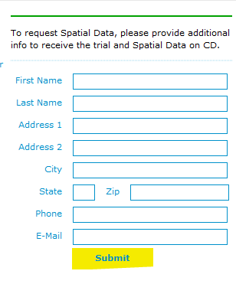

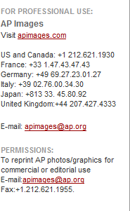
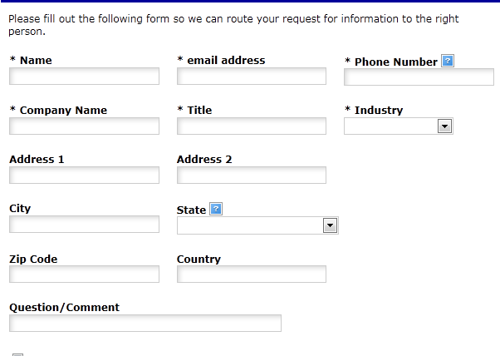
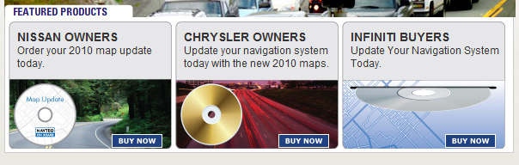
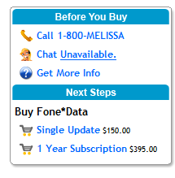
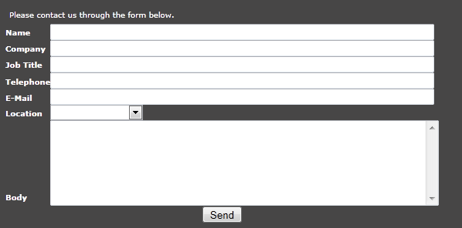
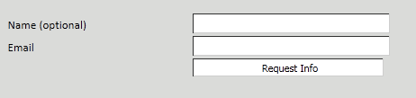

The Hard Path to Content…

Slide 3









The Role of the Marketplace
Data Enterprises
Big Business
Windows Azure Marketplace
Academia
Domain Experts
Historical
Records
Small
Business
Consumer
Government
Easy discovery
Clear pricing
Unified billing
Trusted brand
Connected ecosystem
Powerful infrastructure
Sensors
Developers
Data & App Consumers
Content Providers

Slide 4



Core Marketplace Services
Discovery
Buyers confidently browse, discover, purchase, and use new content. The Marketplace is provided by a trusted brand and provides immediate access to the content consumers demand. No high-pressure sales pitches, no hidden strings, no hassles.
Ecosystem
Marketplace provides integration between content and the apps that depend on it. Office, SQL Server, Visual Studio, and other data apps are easily connected to Marketplace. The Marketplace invests in building out high-quality connections so individual content providers don’t have to.
Monetization
Particularly important for smaller content providers, the Marketplace manages the challenges of selling abroad. Marketplace eliminates the complexity of international business so Content Providers can focus on content.
Infrastructure
Marketplace provides account management, authorization, metering, throttling, localized UI, and a variety of other services backed by Microsoft’s world-class cloud computing resources.

Slide 5



Marketplace Content
Premium Data & Services
The Marketplace offers more than 15 categories of high-quality curated data and data services. Publishers of premium data and Web services enjoy the full breadth of Marketplace services.
Premium Cloud Apps
Cloud Application developers depend on the Marketplace to manage the business of selling access to their applications, focusing instead on giving buyers the best value from their purchases.
Free Data & Services
Premium data and services often add insight on top of publically available knowledge. The Marketplace encourages Content Providers to distribute their free data to give uniform access to our ecosystem.
Catalog Apps
Apps that do not yet take advantage of Marketplace services can become more discoverable by being listed in the Marketplace’s extensive application catalog.

Slide 6

What is Data?
Window Azure SQL DB
Publishing portal Data wizard walks you through connecting to and exposing the dataset.
Web Service or
SQL Server
Marketplace team will work with you to build out the mapping. You will be contacted after submitting the offer.

Slide 7
Publishing to the Marketplace
demo
Roger Mall
Senior Program Manager
Windows Azure Marketplace

Slide 8
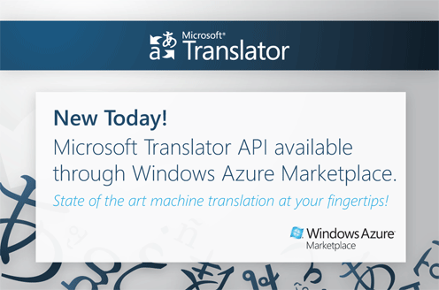

Microsoft Translator API
Reliability: Translator is a cloud-based high performance, highly scalable,
machine translation service from Microsoft
Productivity: Translation, language detection, access to collaborative
TM, speech synthesis
Flexibility: Access to functionality via OData, SOAP, REST, AJAX and a
Web site translation widget

Slide 9
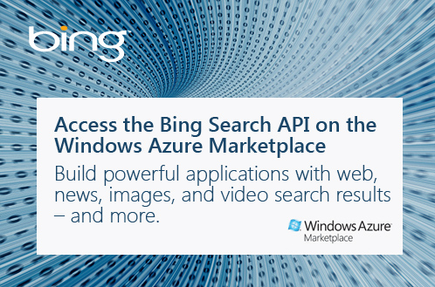
Microsoft Search API
Embed search results in applications using OData
Web, image, news, and video results, plus related searches and spelling
Free Trial: available now

Slide 10
Building a Content Driven Application
demo
Piotr Puszkiewicz
Senior Program Manager
Windows Azure Marketplace

Slide 11

Marketplace Resources
Home Page https://datamarket.azure.com
Publisher Portal https://publish.marketplace.windowsazure.com
Docs: http://msdn.microsoft.com/en-us/library/windowsazure/gg315539

Slide 12


Track Resources
SQL Server 2012 Eval Copy
Hands-On Labs
@sqlserver
@ms_teched
Get Certified!
mva
Microsoft Virtual Academy

Slide 13



Resources
Learning
  Connect. Share. Discuss.
  Microsoft Certification & Training Resources
http://northamerica.msteched.com
www.microsoft.com/learning
TechNet
  Resources for IT Professionals
  Resources for Developers
http://microsoft.com/technet
http://microsoft.com/msdn

Slide 14







Complete an evaluation on CommNet and enter to win!

Slide 15
© 2012 Microsoft Corporation. All rights reserved. Microsoft, Windows, Windows Vista and other product names are or may be registered trademarks and/or trademarks in the U.S. and/or other countries.
The information herein is for informational purposes only and represents the current view of Microsoft Corporation as of the date of this presentation. Because Microsoft must respond to changing market conditions, it should not be interpreted to be a commitment on the
part of Microsoft, and Microsoft cannot guarantee the accuracy of any information provided after the date of this presentation. MICROSOFT MAKES NO WARRANTIES, EXPRESS, IMPLIED OR STATUTORY, AS TO THE INFORMATION IN THIS PRESENTATION.

