Slide 1
Data Mining 2012 with Microsoft Excel 2010 and PowerPivot
DBI204
Mark Tabladillo, Ph.D.
Microsoft MVP, Data Mining Architect
MarkTab Consulting

Slide 2




Welcome
http://marktab.net/TechEd2012
Mark
Tabladillo
@marktabnet

Slide 3
Outline
Fundamentals
Demonstration
Resources

Slide 4
Outline
Fundamentals
Demonstration
Resources

Slide 5
Definitions
Phrase | Goal
“Data Mining” | Inform actionable decisions
“Machine Learning” | Determine best performing algorithm

Slide 6
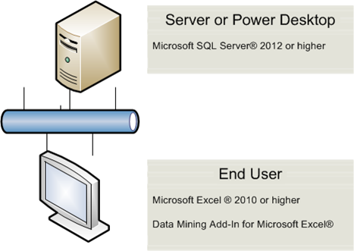
SQL Server Data Mining
Service, not application
SQL Server Analysis Services (SSAS)
Multiple Interfaces:
  Excel
  SQL Server Data Tools (SSDT) – formerly BIDS
  SQL Server Management Studio (SSMS)
  PowerShell

Slide 7
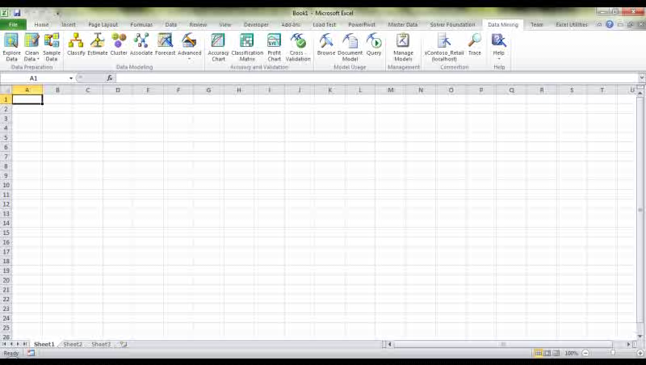
Data Mining Add-In for Excel
Built for Office 2010: 32-Bit or 64-Bit Add-In
Requires Analysis Services
SQL Server 2012 Editions for Data Mining
  Enterprise or
  Business Intelligence or
  Developer

Slide 8
PowerPivot for Excel
Features
  Excel Workbooks
  Leverages Memory: Fast Processing
  Loads Large Datasets (especially 64-Bit)
  Analytics through DAX Language
  Leverages Multi-Core Processors

Slide 9
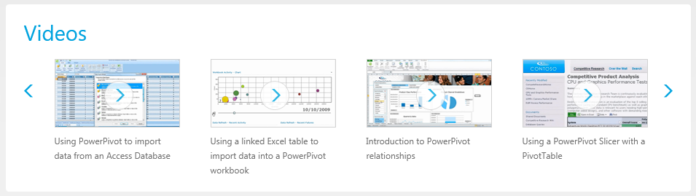
PowerPivot http://www.microsoft.com/en-us/bi/powerpivot.aspx

Slide 10
Demonstration Data
Contoso Retail demo dataset
  http://www.microsoft.com/en-us/download/details.aspx?id=18279
Windows Azure Marketplace
  https://datamarket.azure.com/

Slide 11

Slide for Showing Developer’s Software Code

Slide 12
Analysis Tab
demo
Mark Tabladillo
Microsoft MVP
MarkTab Consulting

Slide 13
Data Mining Tab
demo
Mark Tabladillo
Microsoft MVP
MarkTab Consulting

Slide 14
Outline
Fundamentals
Demonstration
Resources

Slide 15
How to Get Started
Excel Data Mining Add-In (Free)
  http://www.microsoft.com/en-us/download/details.aspx?id=29061
PowerPivot (Free)
  http://www.microsoft.com/en-us/bi/powerpivot.aspx
Windows 7
  http://windows.microsoft.com/en-US/windows/shop/windows-7
SQL Server 2012
  http://www.microsoft.com/sqlserver/en/us/default.aspx
Microsoft Office
  http://office.microsoft.com/en-us/

Slide 16
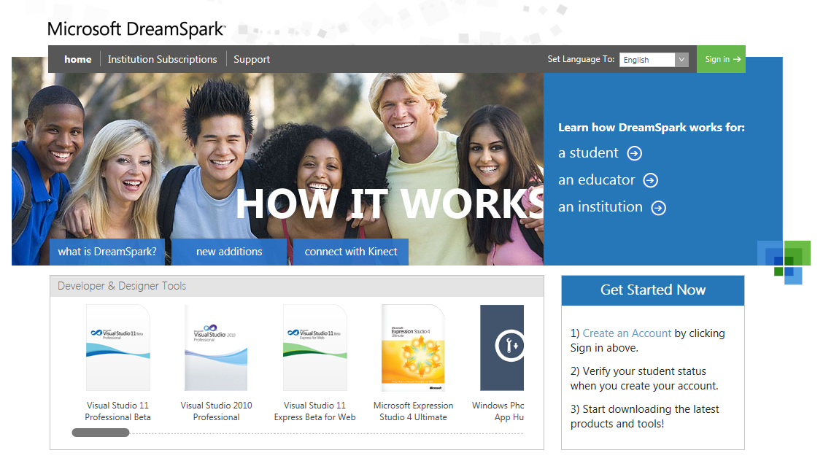
For Students http://www.dreamspark.com

Slide 17
Connect
Landing Webpage http://www.marktab.net/TechEd2012
  Data Mining Blog
  Data Mining Resources
  Twitter
  LinkedIn

Slide 18
Conclusion
SQL Server Analysis Services provides enterprise-level data mining to Excel 2010 with PowerPivot
The Analyze and Data Mining Tabs have user-friendly functions for data mining Excel tables
The landing webpage includes many places to continue to learn

Slide 19


Related Content
Breakout Sessions (DBI320 -- Delivering KPIs with Microsoft SQL Server Analysis Services)
Hands-on Labs (DBI51-HOL -- Creating a PowerPivot Workbook in Microsoft Excel 2010 )
Product Demo Stations (SQL Server Business Intelligence)
Related Certification Exam: MCSE Business Intelligence
Find Me Later At: Managed Self Service BI (Mon morn and night, Tues morn)

Slide 20


Track Resources
SQL Server 2012 Eval Copy
Hands-On Labs
@sqlserver
@ms_teched
Get Certified!
mva
Microsoft Virtual Academy

Slide 21



Resources
Learning
  Connect. Share. Discuss.
  Microsoft Certification & Training Resources
http://northamerica.msteched.com
www.microsoft.com/learning
TechNet
  Resources for IT Professionals
  Resources for Developers
http://microsoft.com/technet
http://microsoft.com/msdn

Slide 22







Required Slide
Complete an evaluation on CommNet and enter to win!

Slide 23


MS Tag
Scan the Tag
to evaluate this
session now on
myTechEd Mobile

Slide 24
© 2012 Microsoft Corporation. All rights reserved. Microsoft, Windows, Windows Vista and other product names are or may be registered trademarks and/or trademarks in the U.S. and/or other countries.
The information herein is for informational purposes only and represents the current view of Microsoft Corporation as of the date of this presentation. Because Microsoft must respond to changing market conditions, it should not be interpreted to be a commitment on the
part of Microsoft, and Microsoft cannot guarantee the accuracy of any information provided after the date of this presentation. MICROSOFT MAKES NO WARRANTIES, EXPRESS, IMPLIED OR STATUTORY, AS TO THE INFORMATION IN THIS PRESENTATION.

