Slide 1
Business Intelligence and Data Visualization: Microsoft SQL Server 2012
DBI206
Jen Stirrup
MVP
Copper Blue Consulting

Slide 2
Agenda
Traditional Business Intelligence versus ‘New’ Business Intelligence #newBI
Self-Service Business Intelligence in SQL Server 2012:
  PowerPivot
Data Visualisation in SQL Server 2012:
  Power View Architecture and demo
  Reporting Services in Sharepoint
Questions?

Slide 3
Agenda
Traditional Business Intelligence versus ‘New’ Business Intelligence #newBI
Self-Service Business Intelligence in SQL Server 2012:
  PowerPivot
Data Visualisation in SQL Server 2012:
  Power View Architecture and demo
  Reporting Services in Sharepoint
Questions?

Slide 4
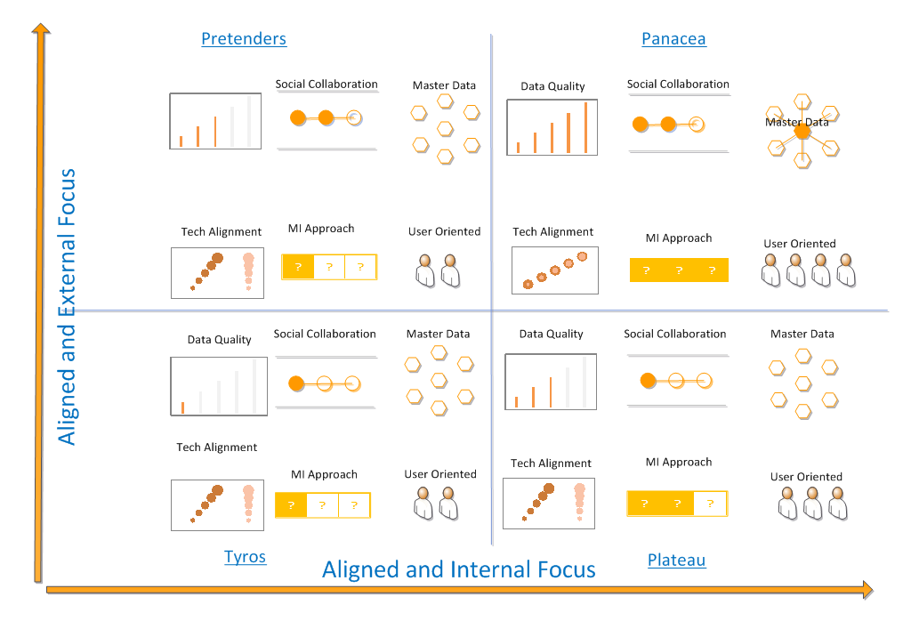
End User BI in SQL Server 2012

Slide 5

Business Intelligence is about people first…

Slide 6

… enabled by technology

Slide 7

… making Businesses Intelligent

Slide 8
What % of organizations considers their Business Intelligence Initiatives a success?
A) 38.1%
B) 52.8%
C) 6.8%
D) 2.3%

Slide 9
What % of organizations considers their Business Intelligence Initiatives a success?
A) 38.1%
B) 52.8%
C) 6.8%
D) 2.3%

Slide 10

‘Traditional’ BI
Upsides

Slide 11

‘Traditional’ BI
Upsides

Slide 12

‘Traditional’ BI
Upsides

Slide 13

‘Traditional’ BI
Upsides

Slide 14

‘Traditional’ BI
Upsides

Slide 15

‘Traditional’ BI
Upsides

Slide 16


‘Traditional’ BI
Upsides
Downsides

Slide 17

End User BI
Upsides

Slide 18

End User BI
Upsides

Slide 19

End User BI
Upsides

Slide 20

End User BI
Upsides

Slide 21

End User BI
Upsides
Downsides

Slide 22

End User BI in SQL Server 2012

Slide 23
End User BI in SQL Server 2012

Slide 24

End User BI in SQL Server 2012
Downsides

Slide 25
Design tools..
SQL Server
SharePoint
Office
Report Builder
Dashboard Designer
Excel
Power View
SharePoint Chart
Access
Power Pivot
Excel Services
Visio
Data Mining for Excel
Visio services
PerformancePoint Services
SQL Server Data Tools
Tabular Model
25

Slide 26
Agenda
Traditional Business Intelligence versus ‘New’ Business Intelligence #newBI
Self-Service Business Intelligence in SQL Server 2012:
  PowerPivot
Data Visualisation in SQL Server 2012:
  Power View Architecture and demo
  Reporting Services in Sharepoint
Questions?

Slide 27







Report Authoring Suite
IT Pros
Power Users
Developers
End Users
Sophisticated
Design Environment
Productive
Authoring
Visual data
representation
Report
Viewer Controls
Re-use
of insights
Highly
Interactive
Rich Design
Capabilities
Flexible
layout
Rich
Presentation
Report Designer / SSRS
Power Pivot
Power View
Embedded Operational Business

Slide 28
Report Authoring Suite
IT Pros
Power Users
Developers
End Users
Sophisticated
Design Environment
Productive
Authoring
Visual data
representation
Report
Viewer Controls
Re-use
of insights
Highly
Interactive
Rich Design
Capabilities
Flexible
layout
Rich
Presentation
Report Designer / SSRS
Power Pivot
Power View
Embedded Operational Business

Slide 29
What is PowerPivot?
PowerPivot gives users the power to create compelling self-service BI solutions using familiar Excel Interface

Slide 30

PowerPivot

Slide 31
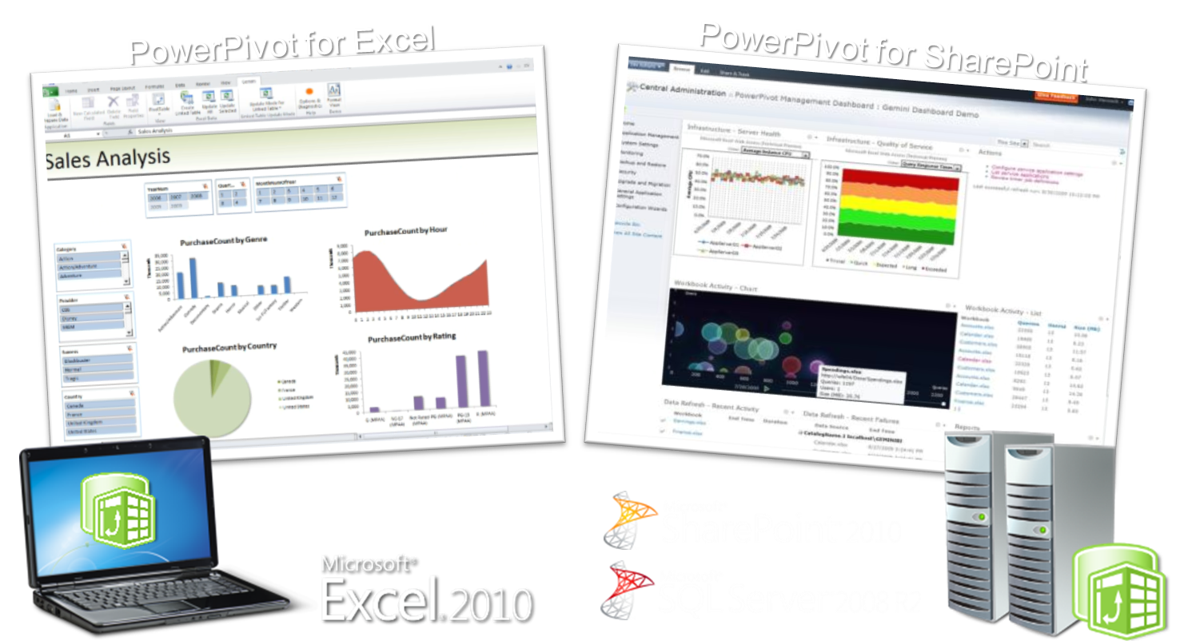
PowerPivot Versions

Slide 32
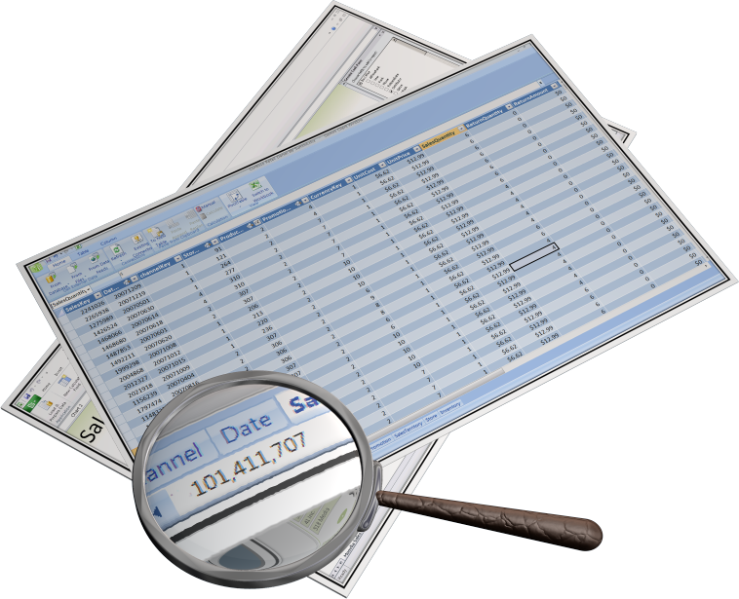
Why PowerPivot?
Mashups
Far better than VLOOKUP
High Performance
Sophisticated Time Intelligence

Slide 33
End User BI in SQL Server 2012

Slide 34
Power Pivot
demo
Name: Jen Stirrup
Title: Business Intelligence and Data Visualisation in SQL Server 2012
Group

Slide 35

What did we learn from the demo?

Slide 36
Report Authoring Suite
IT Pros
Power Users
Developers
End Users
Sophisticated
Design Environment
Productive
Authoring
Visual data
representation
Report
Viewer Controls
Re-use
of insights
Highly
Interactive
Rich Design
Capabilities
Flexible
layout
Rich
Presentation
Report Designer / SSRS
Power Pivot
Power View
Embedded Operational Business

Slide 37
Agenda
Traditional Business Intelligence versus ‘New’ Business Intelligence #newBI
Self-Service Business Intelligence in SQL Server 2012:
  PowerPivot
Data Visualisation in SQL Server 2012:
  Power View Architecture and demo
  Reporting Services in Sharepoint
Questions?

Slide 38

What is Power View
Power View is an interactive data exploration and visual presentation experience.

Slide 39






Architecture
SharePoint Farm
SQL Server BIDS
BISM Model
Web Front End
App Server
SSRS Addin for SharePoint
RS Shared Service
Power View via Browser
AS Server
PowerPivot
System Service
PowerPivot
Web Service
Analysis Services SP Integrated
Excel PowerPivot
Model
Data sources

Slide 40
Data Visualisation is about People
Preattentive Processing
Visual Integration
Cognitive Integration

Slide 41
Pre-attentive Attributes
Attribute | Example | Assumption
Spatial Position | 2D Grouping 2D Position | Sloping to the right = Greater
Form | Length Width Orientation Size | Longer = Greater Higher = Greater
Colour | Hue Intensity | Brighter = Greater Darker = Greater

Slide 42
Pre-attentive Attributes
Attribute | Example | Graph Type
Spatial Position | 2D Grouping 2D Position | Line Graph
Form | Length Width Orientation Size | Bar Chart
Colour | Hue Intensity | Scatter Chart

Slide 43
PowerView
demo
Name: Jen Stirrup
Title: Business Intelligence and Data Visualisation in SQL Server 2012
Group

Slide 44
What did we learn from the demo?

Slide 45
Agenda
Traditional Business Intelligence versus ‘New’ Business Intelligence #newBI
Self-Service Business Intelligence in SQL Server 2012:
  PowerPivot
Data Visualisation in SQL Server 2012:
  Power View Architecture and demo
  Reporting Services in Sharepoint
Questions?

Slide 46
Reporting Services
SQL Server Data Tools
Sharepoint Integrated mode is, well, more integrated!
Rsreportserver.config
Report Server logs now stored in Sharepoint hive
SOAP API is no longer supported

Slide 47
Reporting Services Design Future
White Space – use ConsumeContainerWhitespace
Rendered page by page
Nested Sub Report preserved in Excel

Slide 48
Reporting Services in SSDT
demo
Name: Jen Stirrup
Title: Business Intelligence and Data Visualisation in SQL Server 2012
Group

Slide 49



Summary
Self-Service Business Intelligence
Power Pivot
Power View
Reporting Services in SSDT

Slide 50
Summary
Thank You for attending!
Self-Service Business Intelligence
Power Pivot
Power View
Reporting Services in SSDT

Slide 51

Questions

Slide 52
Thank You

Slide 53


Track Resources
SQL Server 2012 Eval Copy
Hands-On Labs
@sqlserver
@TechEd_NA
#msTechEd
Get Certified!
mva
Microsoft Virtual Academy

Slide 54



Resources
Learning
  Connect. Share. Discuss.
  Microsoft Certification & Training Resources
http://northamerica.msteched.com
www.microsoft.com/learning
TechNet
  Resources for IT Professionals
  Resources for Developers
http://microsoft.com/technet
http://microsoft.com/msdn

Slide 55







Required Slide
Complete an evaluation on CommNet and enter to win!

Slide 56


MS Tag
Scan the Tag
to evaluate this
session now on
myTechEd Mobile

Slide 57
© 2012 Microsoft Corporation. All rights reserved. Microsoft, Windows, Windows Vista and other product names are or may be registered trademarks and/or trademarks in the U.S. and/or other countries.
The information herein is for informational purposes only and represents the current view of Microsoft Corporation as of the date of this presentation. Because Microsoft must respond to changing market conditions, it should not be interpreted to be a commitment on the
part of Microsoft, and Microsoft cannot guarantee the accuracy of any information provided after the date of this presentation. MICROSOFT MAKES NO WARRANTIES, EXPRESS, IMPLIED OR STATUTORY, AS TO THE INFORMATION IN THIS PRESENTATION.

