Slide 1
BI Power Hour
DBI207
Amit Velingkar, Sean Boon, Julie Strauss, Matt Masson, Matthew Roche
Microsoft Corporation

Slide 2
About the Power Hour
Demos
You will not learn anything useful*
Let’s have fun
* We are not responsible for any accidental learning

Slide 3
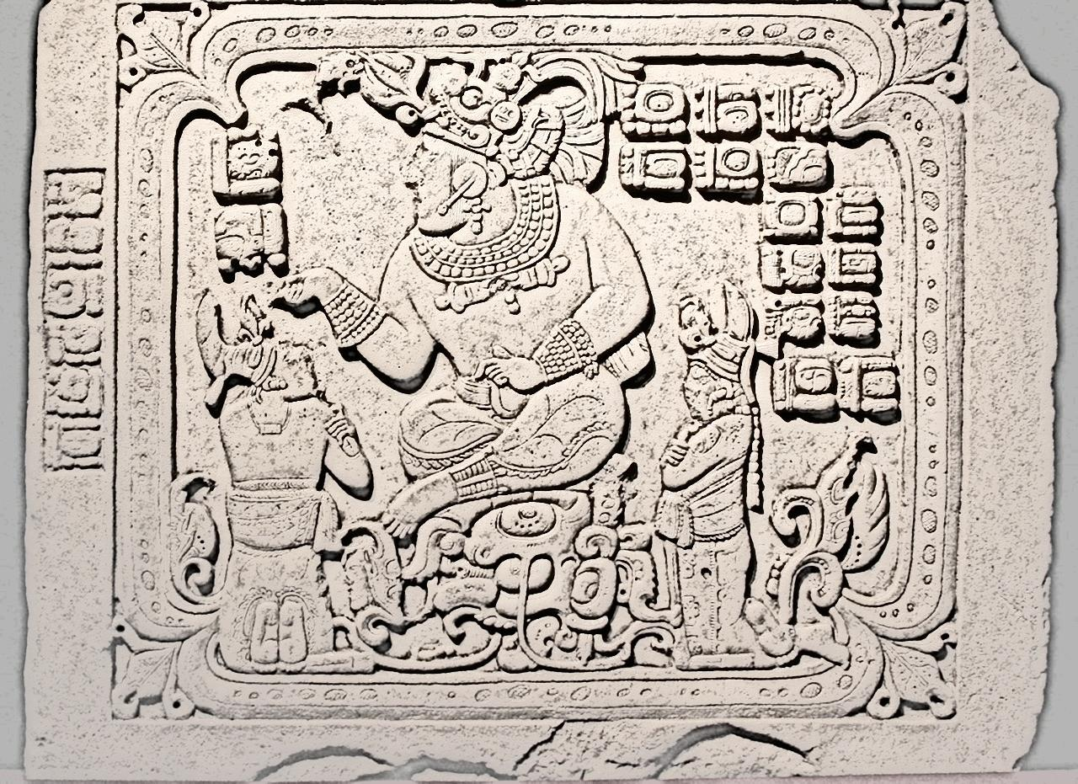
SQL Server 2012 – Mayan Edition
“The last version of SQL Server you will ever need…”

Slide 4


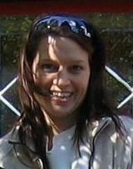


Julie Strauss
Julie have been with Microsoft since 2001 and have been working with Business Intelligence in various positions over the past 10 years covering roles from support engineer to product planning and product management. Prior to taking on her current position in the product team, Julie was the product manager for SQL Server Analysis Services and SQL Server Reporting Services

Slide 5

Sean Boon
Sean didn’t send me a bio slide, so this is what he gets.

Slide 6


Amit Velingkar
Amit Velingkar is a Program Manager on Microsoft Excel team, working on Business Intelligence and Data Visualizations features. He likes to travel, play cricket and often dabbles with web applications.
He is suspicious about the motives of a few of his friends…

Slide 7
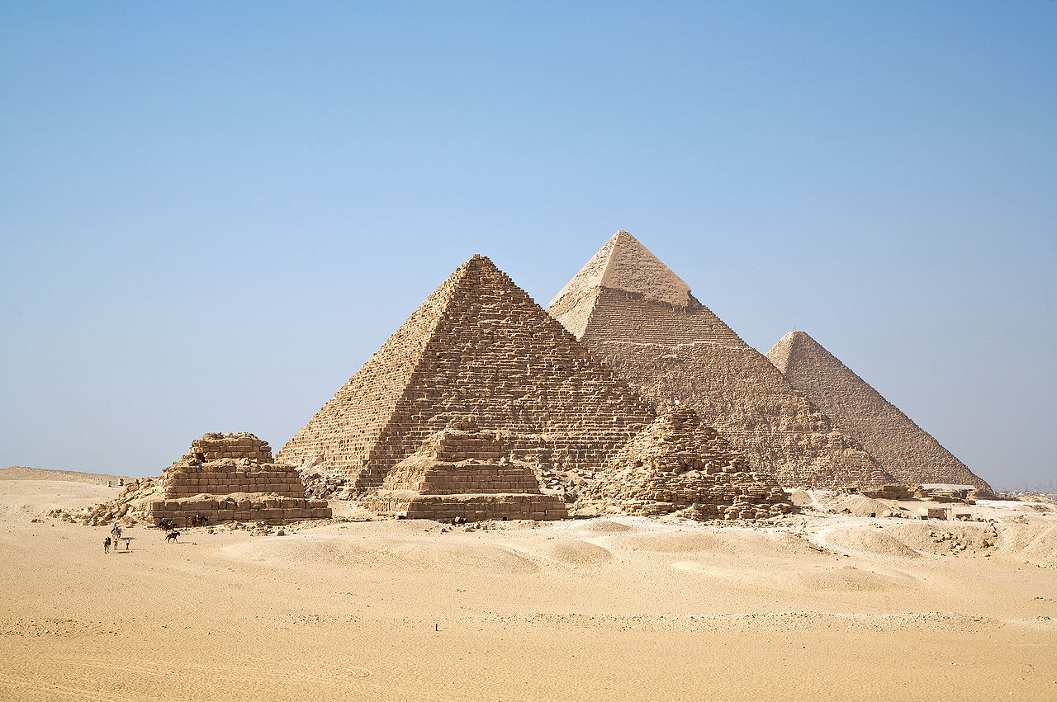
originally posted to Flickr as Mayan Zodiac Circle

Slide 8
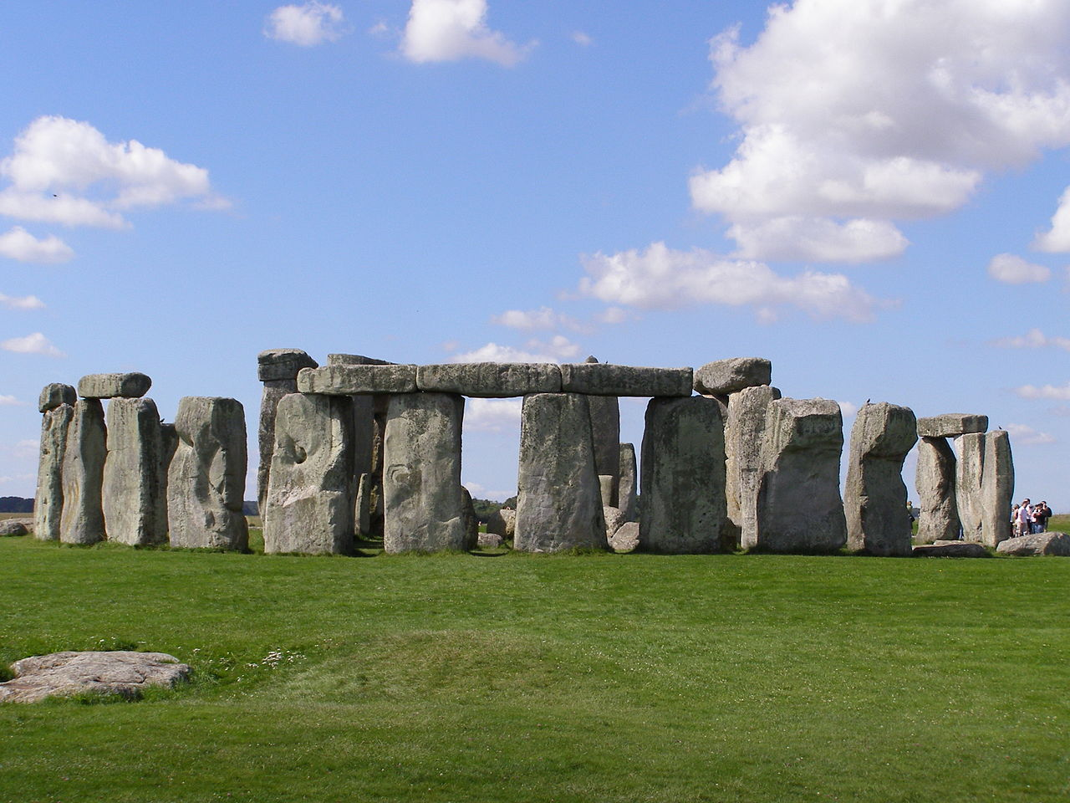
originally posted to Flickr as Mayan Zodiac Circle

Slide 9
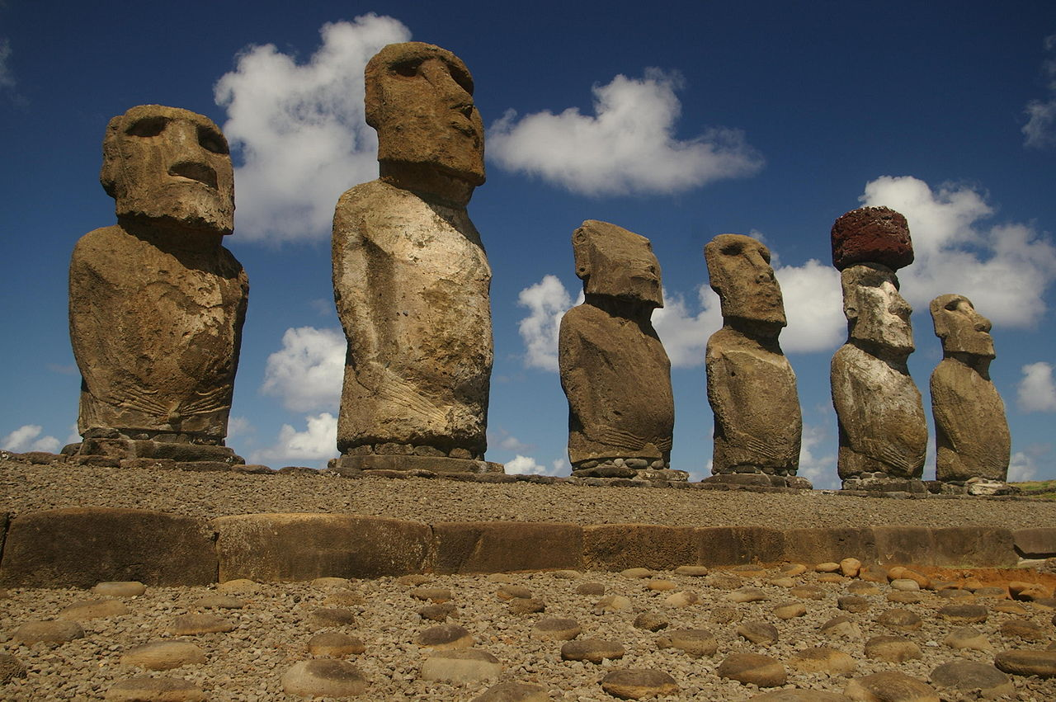
originally posted to Flickr as Mayan Zodiac Circle

Slide 10
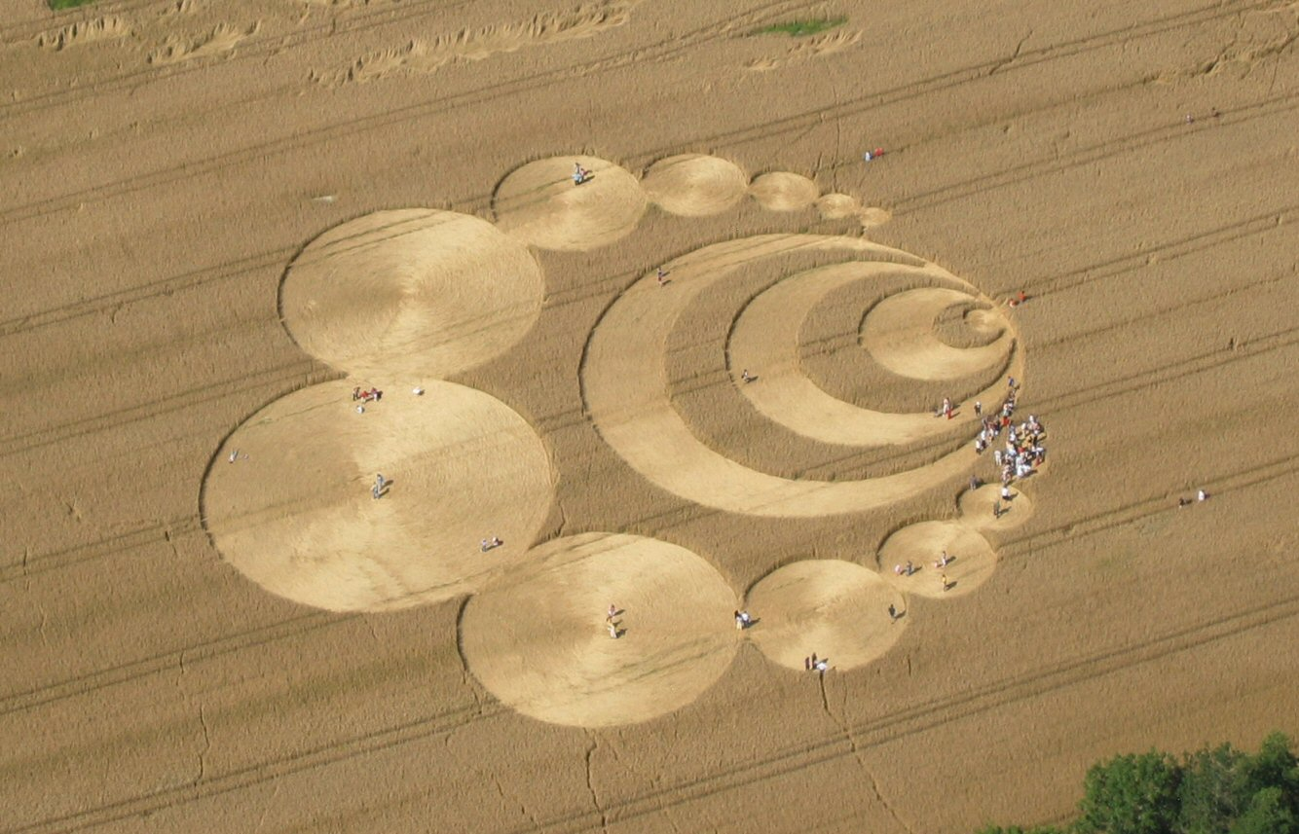
originally posted to Flickr as Mayan Zodiac Circle

Slide 11
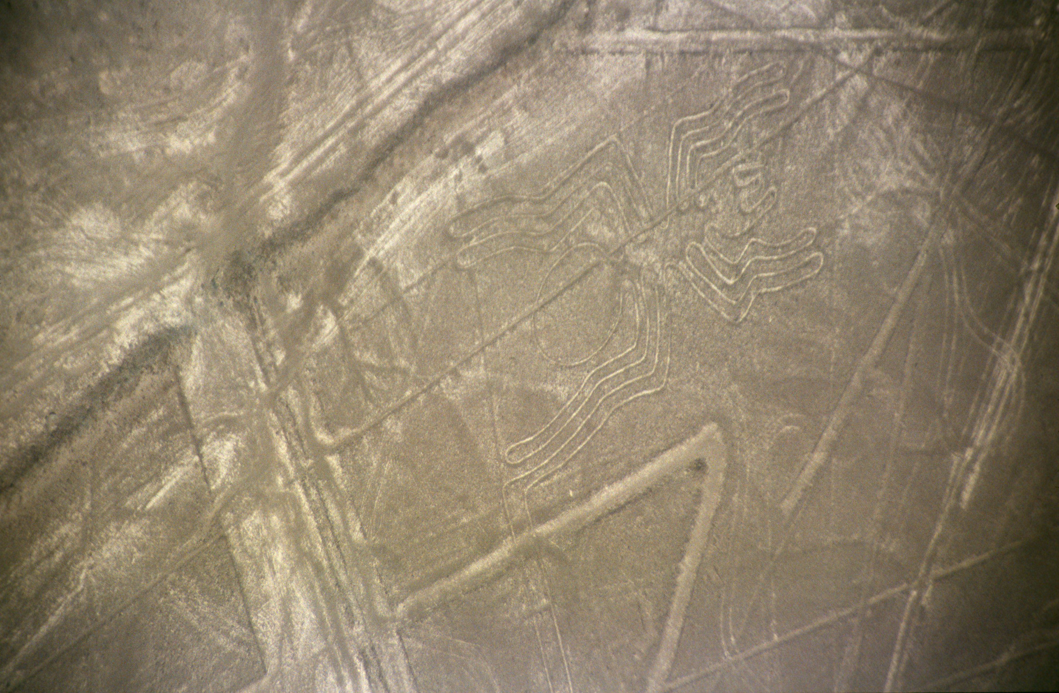
originally posted to Flickr as Mayan Zodiac Circle

Slide 13

originally posted to Flickr as Mayan Zodiac Circle

Slide 14

Worlds largest database?

Slide 15

Key “ET” Drivers
“Birth” Place
Education
Employment

Slide 16

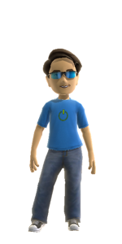
Matt Masson
Matt became an international superstar at the BI Power Hour in 2010, where he proved that you don’t need real friends if you can create them programmatically. Last year, he showed how he uses SQL Server 2012 to manage all aspects of his social life. Recently, he has been trying to find that special someone to settle down with, and has once again turned to SSIS to solve his problems …

Slide 17
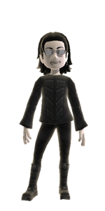
Matthew Roche
Matthew Roche is a Senior Program Manager on the SQL Server product team, working on Data Curation with Data Quality Services and Master Data Services. Matthew can’t manage a decent Scottish accent, and as such is both surprised and delighted when he is mistaken for Donald Farmer at technical conferences.

Slide 18
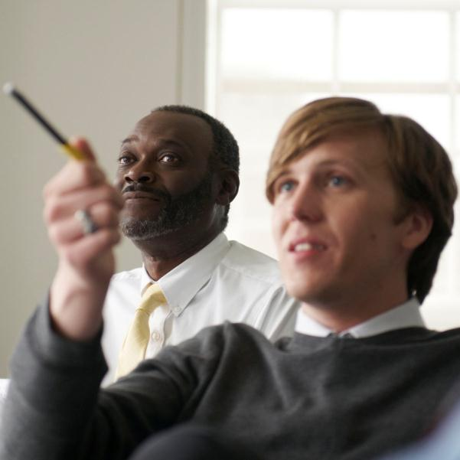

Track Resources
SQL Server 2012 Eval Copy
Hands-On Labs
@sqlserver
@ms_teched
Get Certified!
mva
Microsoft Virtual Academy

Slide 19



Resources
Learning
  Connect. Share. Discuss.
  Microsoft Certification & Training Resources
http://northamerica.msteched.com
www.microsoft.com/learning
TechNet
  Resources for IT Professionals
  Resources for Developers
http://microsoft.com/technet
http://microsoft.com/msdn

Slide 20







Required Slide
Complete an evaluation on CommNet and enter to win!

Slide 21


MS Tag
Scan the Tag
to evaluate this
session now on
myTechEd Mobile

Slide 22
© 2012 Microsoft Corporation. All rights reserved. Microsoft, Windows, Windows Vista and other product names are or may be registered trademarks and/or trademarks in the U.S. and/or other countries.
The information herein is for informational purposes only and represents the current view of Microsoft Corporation as of the date of this presentation. Because Microsoft must respond to changing market conditions, it should not be interpreted to be a commitment on the
part of Microsoft, and Microsoft cannot guarantee the accuracy of any information provided after the date of this presentation. MICROSOFT MAKES NO WARRANTIES, EXPRESS, IMPLIED OR STATUTORY, AS TO THE INFORMATION IN THIS PRESENTATION.

